Slide 1
Image-Processing Application

Slide 2
Learning Outcomes
At the end of this module, you will be able to:
Outline the operation and types of edge detection algorithms.
Describe the operation of grayscaling and mathematical derivation of gradient magnitude.
Compare and contrast the Sobel kernels with other existing kernels including Roberts Cross and Prewitt.

Slide 3
Edge Detection
Edge detection is a basic mathematical operation widely used in image processing and computer vision.
It detects sharp changes in image brightness.
Picture author: JonMcLoone
Notes:
The aim of edge detection is to detect sharp changes in image brightness that eventually characterize the boundaries of objects in a digital image. These boundaries are used in computer vision systems for object recognition, scene interpretation, face identification, and so on.

Slide 4
Edge Detection
Most edge detection algorithms can be broadly grouped into two categories:
Search-based edge detection
Zero-crossing based edge detection
Search-based methods
Detect edges by searching for local directional maxima of edge strength
Usually a first-order derivative expression, such as the gradient magnitude
Zero-crossing based methods
Search for zero crossings in a second-order derivative expression computed from the image
Notes:
There are several methods for edge detection, but there are broadly two categories: the search-based method and the zero-crossing method.
Search-based methods try to detect edges by searching for local directional maxima of edge strength. They are usually gradient methods that look for maximums and minimums in the first derivative of the image. The Sobel method is a common example of gradient methods.
The Zero-crossing-based methods are frequently called Laplacian methods because they search for zero-crossings in the second derivative of the image; that is to say, they look for inflection points in the edge functions.

Slide 5
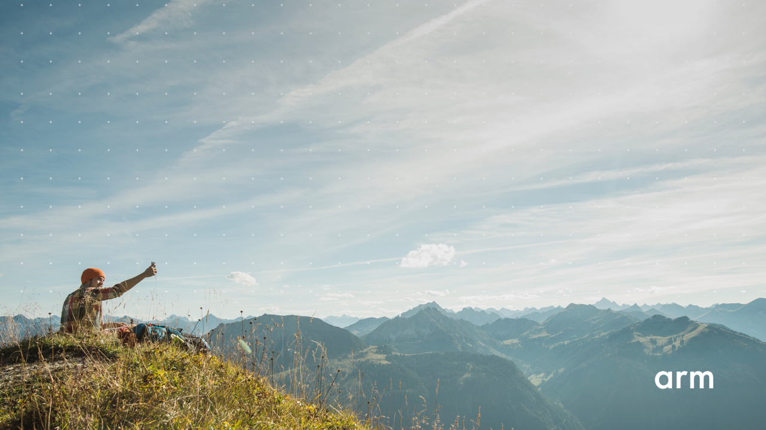
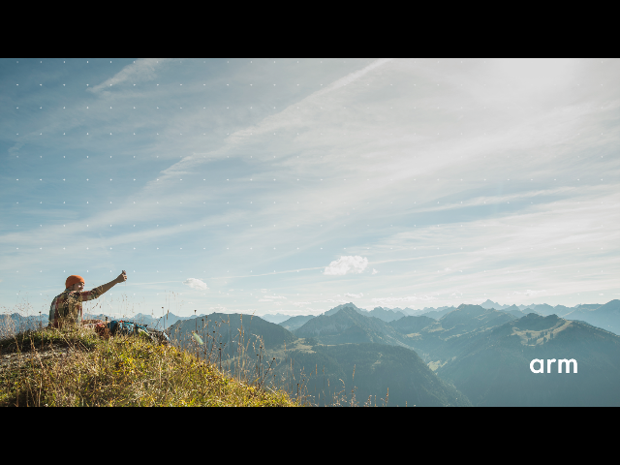
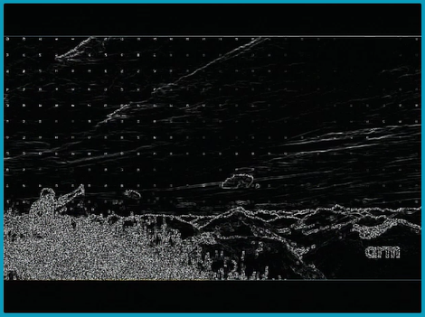
Edge Detection
Image Scaling
HDMI Input
Grayscale
Gradient
HDMI Output
Notes:
This slide shows a procedure for edge detection from an HDMI input to an HDMI output. The procedure involves image scaling, grayscale, and calculating the intensity gradient magnitude, which will be covered in the rest of this video.

Slide 6
Image Scaling
Input image
1,1 | 1,2 | 1,3 | 1,4 | 1,5 | 1,6
2,1 | 2,2 | 2,3 | 2,4 | 2,5 | 2,6
3,1 | 3,2 | 3,3 | 3,4 | 3,5 | 3,6
4,1 | 4,2 | 4,3 | 4,4 | 4,5 | 4,6
5,1 | 5,2 | 5,3 | 5,4 | 5,5 | 5,6
6,1 | 6,2 | 6,3 | 6,4 | 6,5 | 6,6
1,1 | 1,3 | 1,5
3,1 | 3,3 | 3,5
5,1 | 5,3 | 5,5
1280 x 720
640 x 360
Input image
Notes:
Image scaling is one of the basic image processing concepts in digital graphics. In our application, it handles the issue of the different resolution between input video and output video.
There are many different algorithms for image scaling to provide more natural and detailed output. One such algorithm is the nearest-neighbor interpolation, which is one of the simplest algorithms.
In the example shown in this slide, since the input image is exactly 2×2 times of the output image, we need to copy one of the four adjacent pixels to the output pixel.

Slide 7
Grayscale
(R, G, B)
grayscale
Notes:
Each pixel in the input image has three color channels, so a 3-dimensional space need to be considered in image processing. To simplify the algorithm and speed computation, you can convert the colored image to a 1-dimensional scaler before further processing.
The grayscale is a common method to convert multi-dimensional color space to a scaler. It is like black-and-white photography which uses only the magnitude of luminance.

Slide 8
Grayscale
$A=0.299R+0.587G+0.114B$
——PAL/NTSC
$A=0.2126R+0.7152G+0.0722B$
——HDTV/sRGB
$A=\frac{19595}{65536}R+\frac{38470}{65536}G+\frac{7471}{65536}B$
——simplified equation we can use
Notes:
To convert a color image to grayscale, we can implement a linear transformation that adds up the values of the three color channels with different coefficients. The coefficients of each channel depend on which color space is used. And we can see the coefficient of the green channel is usually greater than the other two, and this is because green is the most sensitive color for human eyes.

Slide 9
Intensity Gradient Magnitude
Notes:
Next, we will look at intensity gradient magnitude calculations.

Slide 10
Intensity Gradient Magnitude
The gradient magnitude of an image can be computed as
$\left|G\right|=\sqrt{G_{x}^{2}+G_{y}^{2}}$
where${ G}_{x}$ and $G_{y}$are estimates of first-order image derivatives.
Different gradient operators can be applied to estimate first-order derivatives from the input image or a smoothed version of it. The simplest approach is to use central differences:
$G_{x}\left(x,y\right)=−1/2∙A\left(x−1,y\right)+0∙A\left(x,y\right)+1/2∙A\left(x+1,y\right)$ $G_{y}\left(x,y\right)=−1/2∙A(x,y−1)+0∙A(x,y)+1/2∙A\left(x,y+1\right)$
or write it as a convolution operator: $G_{x}=\left[\begin{matrix}−1/2 & 0 & 1/2\end{matrix}\right]∗A, G_{y}=\left[\begin{matrix}1/2 \\ 0 \\ −1/2\end{matrix}\right]∗A$
which requires intensity values of four pixels around the pixel considered the central (right, left, up, and down).
Notes:
An image gradient is the directional change of intensity in an image. The magnitude of the gradient provides information about the strength of the edge, while the direction of the gradient provides information about the direction of the edge (more precisely, it gives the perpendicular to the direction).
Often, an approximate magnitude of the image gradient (¦G¦) is computed as the sum of the magnitude first-order image derivatives ($\left|G\right|= \left|Gx\right|$+$\left|Gy\right|)$, which is much faster to compute.
The simplest approach to estimate the first-order image derivatives (Gx and Gy) is to use central differences around a pixel that is considered to be central. This means the computation would require the intensity values of four pixels around the central, which are the pixels on the right, left, up, and down.
The equation to calculate the central differences is shown in the slide. In the equation, A is the source image.
The equation can also be expressed using a convolution operator, and thus accomplishing a convolution between a kernel and a source image.

Slide 11
Intensity Gradient Magnitude
Other convolution operators:
Sobel $G_{x}=\left[\begin{matrix}−1 & 0 & +1 \\ −2 & 0 & +2 \\ −1 & 0 & +1\end{matrix}\right]∗A, G_{y}=\left[\begin{matrix}+1 & +2 & +1 \\ 0 & 0 & 0 \\ −1 & −2 & −1\end{matrix}\right]∗A$
These kernels are designed to respond maximally to horizontal and vertical edges (relative to the pixel grid), with one kernel for each of the two perpendicular orientations.
Roberts Cross $G_{x}=\left[\begin{matrix}+1 & 0 \\ 0 & −1\end{matrix}\right]∗A, G_{y}=\left[\begin{matrix}0 & +1 \\ −1 & 0\end{matrix}\right]∗A$
These kernels are designed to respond maximally to edges running at 45º to the pixel grid, with one kernel for each of the two perpendicular orientations.
Prewitt $G_{x}=\left[\begin{matrix}−1 & 0 & +1 \\ −1 & 0 & +1 \\ −1 & 0 & +1\end{matrix}\right]∗A, G_{y}=\left[\begin{matrix}−1 & −1 & −1 \\ 0 & 0 & 0 \\ +1 & +1 & +1\end{matrix}\right]∗A$
NOTE: The differential masks act as high-pass filters that tend to amplify image noise. Pre-smoothing the image is often needed to reduce effects of the noise. Usually smoothing is done with a low-pass filter.
Notes:
There are a few known convolution operators or, more specifically, kernels, that can be used for edge detection, such as Sobel, Roberts Cross, and Prewitt.

Slide 12
Software Programming: Edge Detection Algorithm
Pixels of a frame are stored continuously in DDR memory from the start address.
Compute intensity of each pixel: $A_{i,j}=0.30∙R_{i,j}+0.59∙G_{i,j}+0.11∙B_{i,j}.$
First-order gradient of intensity (Prewitt operator):
$G_{x}=\left[\begin{matrix}−1 & 0 & +1 \\ −1 & 0 & +1 \\ −1 & 0 & +1\end{matrix}\right]∗A,G_{y}=\left[\begin{matrix}−1 & −1 & −1 \\ 0 & 0 & 0 \\ +1 & +1 & +1\end{matrix}\right]∗A$ where * here is the two-dimensional convolution operation.
The final pixel’s value equals: $G=\sqrt{G_{x}^{2}+G_{y}^{2}}.$
B_{1,1} | G_{1,1} | R_{1,1} | B_{1,2} | G_{1,2} | R_{1,2} | … | B_{1,640} | G_{1,640} | R_{1,640} | B_{2,1} | G_{2,1} | R_{2,1} | B_{2,2} | G_{2,2} | R_{2,2} | … | B_{480,640} | G_{480,640} | R_{480,640}
Notes:
The pixels of a frame are stored continuously in DDR memory from the start address as shown in this slide.
A simple edge detection algorithm involves first computing the intensity of each pixel based on their RGB values. Then, the first-order gradient of intensity is calculated using a kernel, such as Sobel, Prewitt, or Roberts Cross convolution operator.
Finally, the intensity gradient magnitude is calculated for each pixel, which is the square root of the sum of squares of the first-order gradients.

