Slide 1
Accelerate Image Processing Using SIMD Engine

Slide 2
Learning Outcomes
At the end of this module, you will be able to:
Explain the purpose of SIMD and give examples of SIMD implementation.
Explain what Arm Neon technology does and how to use it.
Outline the usage of Neon technology in C language.
Give an example on using Neon in C language.
Compare and contrast the benefits and limitations of using Neon for accelerating image processing.

Slide 3
Parallel Image Processing
Pixel 1
Step A
Pixel 1
Step B
Pixel 2
Step A
Pixel 2
Step B
Input
…
…
Output
Pixel 1
Step A
Pixel 1
Step B
SIMD Processor
DSP
GPU
Customized Logic
Pixel 2
Step A
Pixel 2
Step B
Input
Output
…
…
Pixel N
Step A
Pixel N
Step B
Notes:
In the previous chapter, we have completed our SoC design and demonstrated it using an edge detection image processing application. We might also see that there are limitations when implementing image processing in sequential software.
To improve the performance, image data is better to be processed in parallel.
Today most of the image processing job is done by SIMD processor, DSP, GPU, or customized hardware circuits.

Slide 4
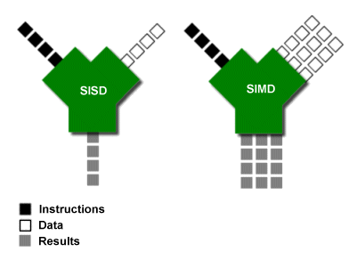
SIMD - Single Instruction, Multiple Data
Processors with SIMD, comparing to SISD (single-instruction-single-data, ordinary CPUs) can perform the same operation on multiple data simultaneously.

Slide 5
SIMD - Single Instruction, Multiple Data
Processors with SIMD, comparing to SISD (single-instruction-single-data, ordinary CPUs) can perform the same operation on multiple data simultaneously.
For example, grayscale computing for every pixel is the same: reading values of three color channels, multiplying by same coefficients, and adding together.
In ordinary CPUs, pixels have to be computed one-by-one.
SIMD processors allow to compute several pixels (multiple data) using the algorithm above (single instruction) simultaneously with less time consumption.

Slide 6
SIMD Implementations
Arm Neon technology
Introduced from Arm Cortex-A8/A9
Intel MMX/SSE and later versions
Widely used in modern x86 based processors
SPE (Signal Processing Engine) for PowerPC
AMD 3DNow!
Beyond those, modern GPUs are often SIMD implementations.

Slide 7
Introduction to Neon technology
Arm Neon technology is an Advanced SIMD (single instruction multiple data) architecture extension for the Arm Cortex-A series and Cortex-R52 processors.
 | Armv7-A/R | Armv8-A/R | Armv8-A
 |  | AArch32 | AArch64
Floating-point | 32-bit | 16-bit*/32-bit | 16-bit*/32-bit/64-bit
Integer | 8-bit/16-bit/32-bit | 8-bit/16-bit/32-bit/ 64-bit | 8-bit/16-bit/32-bit/ 64-bit
*Only in Armv8.2-A

Slide 8
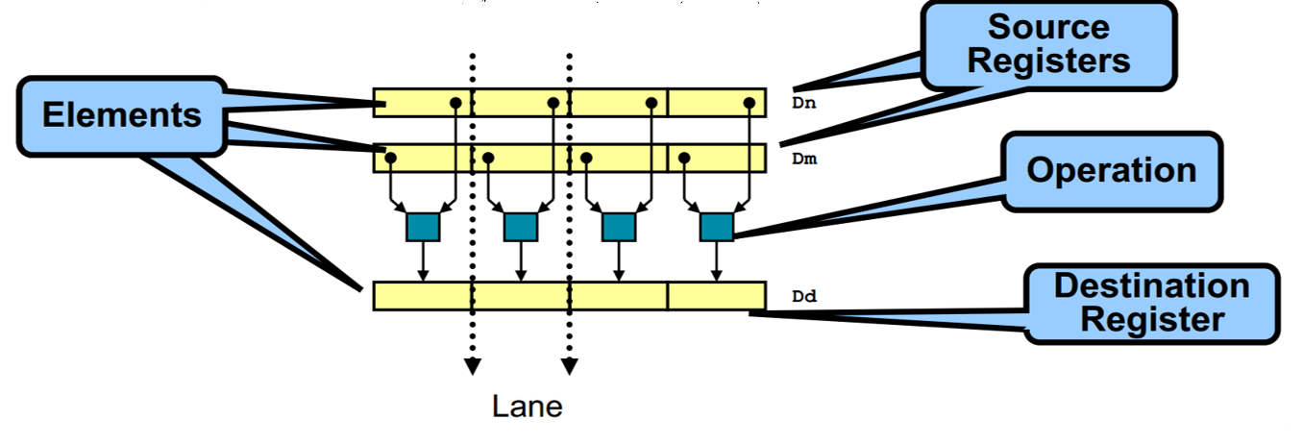
Introduction to Neon technology
Neon is a wide SIMD data processing architecture
Extension of the Arm instruction set
Thirty-two registers, 64-bits wide (dual view as sixteen registers, 128-bits wide)
Neon instructions perform “packed SIMD” processing
Registers are considered vectors of elements of the same data type
Data types can be signed/unsigned 8-bit, 16-bit, 32-bit, 64-bit, single-precision float
Instructions perform the same operation in all lanes
Notes:
Neon technology provides SIMD operations in Arm processors that implement the Advanced SIMD architecture extensions. These operations can significantly accelerate repetitive operations on large data sets.

Slide 9
Introduction to Neon
General purpose SIMD processing useful for many applications
Supports widest range of multimedia codecs used for internet applications
Many soft codec standards; e.g., MPEG-4, H.264, On2 VP6/7/8, Real, AVS
Ideal solution for normal sized “internet streaming” decoding of various formats
Fewer cycles needed
Neon gives a 60-150% performance boost on complex video codecs
Simple DSP algorithms demonstrate a larger performance boost (4x-8x)
Balance of computation and memory access is required
Processor can sleep sooner →overall dynamic power saving
Notes:
Media processors, such as those used in mobile devices, often split each full data register into multiple sub-registers and perform computations on the sub-registers in parallel. If the processing for the data sets are simple and are repeated many times, SIMD can considerably improve performance. This is particularly beneficial for digital signal processing or multimedia algorithms.

Slide 10
How to Use Neon
Neon optimized open-source libraries
OpenMAX DL (development layer): APIs contain a comprehensive set of audio, video, and imaging functions that can be used for a wide range of accelerated codec functionality, such as MPEG-4, H.264, MP3, AAC, and JPEG.
Broad open-source support for Neon
Vectorizing compilers
Exploits Neon SIMD automatically with existing C source code
Neon intrinsics
C function call interface to Neon operations
Supports all data types and operations supported by Neon
Assembler code
For those who want to optimize at the lowest level

Slide 11
Neon Vector Data Types
Neon Support in C defines data types for vectors according to the following pattern: <type><size>x<number of lanes>_t
int8x8_t int16x4_t int32x2_t int64x1_t uint8x8_t uint16x4_t uint32x2_t uint64x1_t float16x4_t float32x2_t poly8x8_t poly16x4_t int8x16_t int16x8_t int32x4_t int64x2_t uint8x16_t uint16x8_t uint32x4_t uint64x2_t float16x8_t float32x4_t poly8x16_t poly16x8_t
For example, int16x4_t is a vector containing four lanes each containing a 16-bit integer.
There are array types defined for array lengths between 2 and 4: struct int16x4x2_t
{
int16x4_t val[2];
};

Slide 12
Neon Intrinsic
The Neon intrinsics Arm provided to generate Neon code for ArmV7 or later processors.
The Neon intrinsics are defined in the header file arm_neon.h.
The intrinsics use a naming scheme that is similar to the Neon assembler syntax:
v<opname><flags>_<type>
An additional q flag is provided to specify that the intrinsic operates on 128-bit vectors.
For Example:
uint16x8_t vmull_u8 (uint8x8_t a, uint8x8_t b)

Slide 13
Neon Intrinsic Example
uint16x8_t vmull_u8 (uint8x8_t a, uint8x8_t b)
It will be compiled to
a → Vn.8B, b → Vm.8B UMULL Vd.8H,Vn.8B,Vm.8B Vd.8H → result
which performs multiplication of two 64-bit vectors containing unsigned 8-bit integers, resulting in a 128-bit vector of unsigned 16-bit integers.
a
• • •
8×8-bit
╳
╳
╳
b
• • •
8×8-bit
result
• • •
8×16-bit

Slide 14
More Intrinsics
There are more than 1000 intrinsics available.
int16x4_t vadd_s16 (int16x4_t a, int16x4_t b); // 64-bit registers
int16x8_t vaddq_s16 (int16x8_t a, int16x8_t b); // 128-bit registers
int32x4_t vaddl_s16 (int16x4_t a, int16x4_t b); // long form
int32x4_t vaddw_s16 (int32x4_t a, int16x4_t b); // wide form
int16x4_t vqadd_s16 (int16x4_t a, int16x4_t b); // saturating form
int16x8_t vqaddq_s16 (int16x8_t a, int16x8_t b);
int8x8_t vaddhn_s16 (int16x8_t a, int16x8_t b); // narrow form
int8x8_t vraddhn_s16 (int16x8_t a, int16x8_t b); // + rounding
int16x4_t vhadd_s16 (int16x4_t a, int16x4_t b); // halving add
int16x8_t vhaddq_s16 (int16x8_t a, int16x8_t b);
int16x4_t vrhadd_s16 (int16x4_t a, int16x4_t b); // + rounding
int16x8_t vrhaddq_s16 (int16x8_t a, int16x8_t b);
int16x4_t vpadd_s16 (int16x4_t a, int16x4_t b); // pairwise
int32x2_t vpaddl_s16 (int16x4_t a); // long pairwise
int32x4_t vpaddlq_s16 (int16x8_t a);

Slide 15
Comparing between Ordinary Processor and Neon
Ordinary Processor
Neon Engine
Loop for 8 times:
for (i = 0; i < 8; i++) { result[i] = a[i] * b[i]; }
Compute in one single instruction:
result = vmull_u8 (a, b);
or:
a → Vn.8B, b → Vm.8B UMULL Vd.8H,Vn.8B,Vm.8B Vd.8H → result

Slide 16
Example: Using Neon Engine for 8-Pixel Grayscale
$A={\left(77R+150G+29B\right)}/{256}$
Step 1: Load data and constants
uint8x8x3_t rgb = vld3_u8 (pixel); uint8x8_t rfac = vdup_n_u8 (77); uint8x8_t gfac = vdup_n_u8 (150); uint8x8_t bfac = vdup_n_u8 (29);
Step 2: Compute grayscale
uint16x8_t temp; temp = vmull_u8 ( rgb.val[0], rfac); temp = vmlal_u8 (temp, rgb.val[1], gfac); temp = vmlal_u8 (temp, rgb.val[2], bfac);
Step 3: Normalize results
result = vshrn_n_u16 (temp, 8);
val[0]
R0
R1
• • •
R7
rgb
val[1]
G0
G1
• • •
G7
val[2]
B0
B1
• • •
B7
rfac
77
77
• • •
77
gfac
150
150
• • •
150
bfac
29
29
• • •
29
temp
77R0
77R1
• • •
77R7
temp
77R0+150G0
77R1+150G1
• • •
77R7+150G7
temp
77R0+150G0+29B0
77R1+150G1+29B1
• • •
77R7+150G7+29B7
result
$$\frac{\text{77}\text{R}\text{0}\text{+}\text{150}\text{G}\text{0}\text{+}\text{29}\text{B}\text{0}}{\text{2}\text{56}}$$
$$\frac{\text{77}\text{R}\text{0}\text{+}\text{150}\text{G}\text{0}\text{+}\text{29}\text{B}\text{0}}{\text{2}\text{56}}$$
• • •
$$\frac{\text{77}\text{R}\text{0}\text{+}\text{150}\text{G}\text{0}\text{+}\text{29}\text{B}\text{0}}{\text{2}\text{56}}$$

Slide 17
Neon Ecosystem
Arm Compute Library
The Compute Library contains a comprehensive collection of software functions, from basic mathematical operator to machine learning support like Convolutional Neural Networks, implemented for the Arm Cortex-A family of CPU processors (and the Arm Mali family of GPUs).
It is a convenient repository of low-level optimized functions that developers can source individually or use as part of complex pipelines in order to accelerate their algorithms and applications.
Partner’s Modules
A wide range of codecs and DSP modules are available from several partners.
Video codecs, audio codecs, computer vision, machine learning, etc..

Slide 18
Neon Engine on Zynq-7000 Platform
Notes:
The Zynq platform provides a Neon engine, which is a SIMD processor that can process data in parallel, and a number of programmable logics, where we can implement the algorithm in hardware to further improve the performance of our application.

Slide 19
Limitations and Tips
Loading Neon registers costs delay.
Make Neon codes together.
Consider prefetch.
Optimize your codes using libraries or assembler.
You may get higher efficiency by writing assembler Neon codes by yourself, or using highly optimized libraries.

