Slide 1
HDMI overview

Slide 2
Learning Outcomes
At the end of this module, you will be able to:
Explain what HDMI is and what it does in comparison with other video connection types.
Identify the HDMI interfaces including the TDMS channels.
Describe the properties of TDMS timing.

Slide 3
What is HDMI?
HDMI (High-Definition Multimedia Interface)
Compact audio/video interface
Transfers uncompressed video data and compressed or uncompressed digital audio data.
A digital replacement for existing analog video standards.
Notes:
HDMI stands for High-Definition Multimedia Interface. This normalized interface was driven by various manufacturers to be the substitute for existing analog video standards.
HDMI provides an interface between any digital video and audio source and compatible audio/video monitors.
Uncompressed video data and compressed or uncompressed audio data can be transferred, so high definition display is enabled.
Data is codified in the TMDS format (Transition Minimized Differential Signaling), a high-speed serial transmission technology that reduces electromagnetic interference problems over conduction cables.
HDMI 1.0 was presented in December 2002 and has a maximum transfer rate of 4.9 Gbit/s. Since September 2013, HDMI 2.0 is available, with a 18Gbit/s maximum transfer rate and two simultaneous video streams.

Slide 4
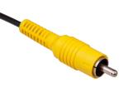
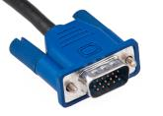
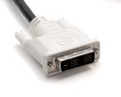
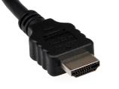
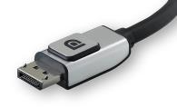
Comparison among Video Connections
 |  | Resolution | Signals
Composite Video |  | 625 lines | Analog 1 + shield
VGA |  | 2048×1536@60Hz (Device-dependent) | Analog 3 + VS/HS
DVI |  | 1920×1200@60Hz (Single link) 2560×1600@60Hz (Dual link) | Digital 6 TMDS
HDMI |  | 1920×1200@60Hz (v1.0) 4096×2160@60Hz (v2.0) | Digital 3 TMDS
DisplayPort |  | 2560×1600@60Hz (v1.1) 7680×4320@60Hz (v1.3) | Digital 4 LVDS
Notes:
This table shows the image resolution achievable by different video standards, together with the type of signal used in the transmission. Notice that the HDMI 2.0 standard obtains a 4096x2160p resolution.
There are four HDMI connector types:
Type A, the most commonly used, is 13.9 mm x 4.45 mm (19 pins, 3 data channels)
Type B is 21.3 mm x 4.45 mm (dual link with 6 data channels)
Type C is 10.42 mm x 2.42 mm (19 pins, 3 data channels). MINI
Type D is 5.9 mm x 2.3 mm (19 pins, 3 data channels). MICRO

Slide 5
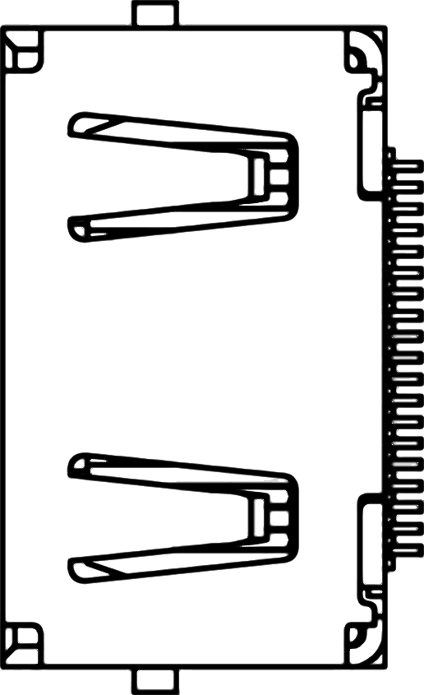
HDMI Interface
HDMI port on some development boards can be configured as either input or output, controlled by a HDMI_OUT_EN signal (for example).
TMDS Channel 0
hdmi_d_p0 / hdmi_d_n0
TMDS Channel 1
hdmi_d_p1 / hdmi_d_n1
TMDS Channel 2
hdmi_d_p2 / hdmi_d_n2
TMDS Clock
hdmi_clk_p / hdmi_clk_n
DDC
hdmi_scl / hdmi_sda
CEC
hdmi_cec
HPD
hdmi_hpd
hdmi_out_en
FPGA
Notes:
Some FPGA development boards have an HDMI port that can be configured as either input or output. Depending on whether it is configured as an input or as an output port, the direction of some signals differ between Source and Sink.
For a ZYBO Zynq development board, these signals are:
HPD (Hot Plug Detect): This signals the presence of a Sink to a Source. It is an input signal when Zynq is a Source and an output signal when it is a Sink.
5V0 (Auxiliary signal for Sink): This is an output signal when Zynq is a Source and an input signal when it is a Sink.
HDMI has three physically separate communication channels: DDC, TMDS and the optional CEC.
The CEC (Consumer Electronics Control) function is bidirectional by definition (it is used for remote control purposes).
When operating as Sink, the DDC (Display Data Chanel) function is required to be implemented so that a connected Source can read out important characteristics of the device. It is a communication channel based on the I2C bus specification.
TMDS (Transition-minimized differential signaling) interleaves video, audio and auxiliary data using three different packet types. It is used to send 10-bit characters that are encoded using 8b/10b encoding. It is supported on Zynq by the I/O buffers on the programmable logic side. 50 ohm external parallel termination resistors are provided on the ZYBO board.

Slide 6
HDMI Signals: TMDS channels
Input streams
HDMI TMDS
Output streams
3 pairs of TMDS and 1 Clock:
3.3V level
8b/10b encoding
10 bits on PHY during I clock period
Transmitting video data, control data, and audio data.
Source
Sink
Encoder/
Serializer
Recovery/
Decoder
Pixel B
D[7:0]
D[7:0]
Pixel B
D[1:0]
Channel 0
D[1:0]
H, VSYNC
H, VSYNC
Aux data
D[3:0]
D[3:0]
Aux data
Encoder/
Serializer
Recovery/
Decoder
Pixel G
D[7:0]
D[7:0]
Pixel G
Channel 1
Ctrl0, Ctrl1
D[1:0]
D[1:0]
Ctrl0, Ctrl1
Aux data
D[3:0]
D[3:0]
Aux data
Encoder/
Serializer
Recovery/
Decoder
Pixel R
D[7:0]
D[7:0]
Pixel R
Ctrl2, Ctrl3
Channel 2
D[1:0]
Ctrl2, Ctrl3
D[1:0]
Aux data
D[3:0]
D[3:0]
Aux data
PLL
PLL
Pixel clock
Clock
Pixel clock
Notes:
TMDS uses four channels for serial data communication: Red, Green, Blue, and Clock.
Physically twisted pairs are used to transmit data in current logic for noise reduction. Wires are DC coupled and terminated to 3.3 V.
8b/10b encoding is used, which means that each 8-bit series is transformed into a 10bit-series (8-bit data plus 2 bits of control). The algorithm creates a special 10-bit sequence that minimizes the 0-to-1 and 1-to-0 transitions. In doing so, the difference between the counts of ones and zeros in a string of at least 20 bits will be no more than two. Also, there will be not more than five ones or zeros in a row. This reduces EMC issues. Active DC-balancing also minimizes voltage swings.
TDMS transmits video data (Blue, Green, Red pixels), control data (VSINC, HSYNC signals, CTLn signals) and auxiliary data (e.g. audio samples and packet headers).

Slide 7
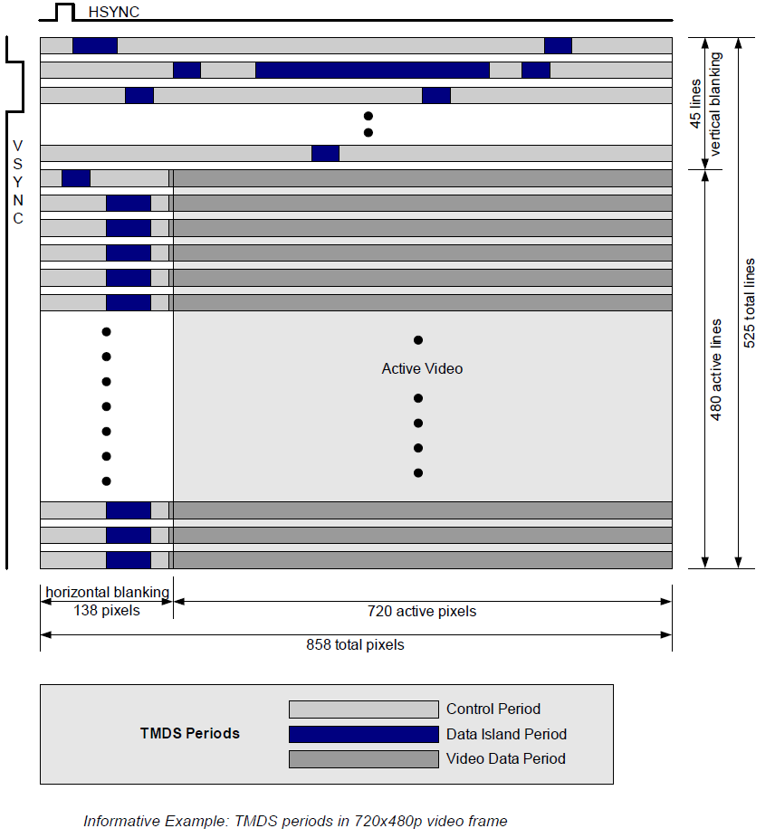
HDMI Signals: TMDS Timing
A video frame contains vertical blanking, horizontal blanking and active video.
Blanking contains Control Period and Data Island Period (e.g. audio).
A Control Period is required between any two periods that are not Control Periods.
The Preamble, contained in each Control Period, indicates the type of the following data period.
Figure source: High-Definition Multimedia Interface Specification Version 1.3a.
Notes:
Each HDMI video frame contains a vertical blanking region, a horizontal blanking region, and an active video region, in which the image is displayed.
Blanking regions contain control data (VSYNC, HSYNC), packed in control periods and additional data, e.g. audio data, packed in Data Island Periods.
Typical HSYNCc values are 25-90 KHz while typical VSYNC values are 24-120 Hz (or frames per second).
A Control Period is required between any two periods that are not Control Periods (Data Island or Video Data).
Immediately preceding each Video Data Period or Data Island Period is the Preamble.
The Preamble comprise a sequence of eight control characters that gives an indication on whether the upcoming data period is a Video Data Period or is a Data Island. The values of CTL0, CTL1, CTL2, and CTL3 indicate the type of data period, while the remaining Control signals, HSYNC and VSYNC, may vary.

Slide 8
HDMI Signals: Display Data Channel (DDC)
Used by the HDMI source device to read the E-EDID data from the HDMI sink device.
Used to learn what audio/video formats it can take.
Based on the I²C bus specification.
Usually implemented by an I²C EEPROM at address 0x50.
Implemented on FPGA in our Lab.
Notes:
HDMI requires the implementation of the Enhanced Display Data Channel (E-DDC). This channel is used by the HDMI source device to read the E-DID data from the HDMI sink device so that it can know what audio/video formats it can accept. It enables, for instance, a modern PC to identify what kinds of monitors are connected to the HDMI port.
The DDC function must comply with the I2C protocol (100kHz max clock rate). It can be implemented by emulating an I2C-capable EEPROM, for instance by using an embedded I2C peripheral or by implementing it on the FPGA programmable logic. The Source shall use I2C commands to read information from a Sink’s E-EDID with a subordinate address.

Slide 9
HDMI Signals: Consumer Electronics Control (CEC)
Allows the command and control of up-to 15 CEC-enabled devices connected through HDMI by using only one of their remote controls.
One-wire bidirectional serial bus
Based on the CENELEC standard AV.link protocol.
Implementation is optional (not used in our Lab).
Notes:
Consumer Electronics Control (CEC) is an HDMI feature designed to allow the user to command and control up to 15 CEC-enabled devices connected through HDMI by using only one of their remote controls.
For example it allows for controlling a television set, a DVD player and a set-top box using only the remote control of the TV.
CEC is a one-wire bidirectional serial bus that is based on the AV.link protocol*. CEC implementation is optional in a product, but CEC writing is mandatory.
(*) AV.link carries control information between audio-visual devices connected via the SCART. It is standardized as CENELC EN 50157-1.

Slide 10
HDMI Signals: Hot Plug Detect (HPD)
Weak pulled-up to a positive voltage on sink devices.
Pulled-down to ground on source devices.
Allow sink devices to detect a plug action of sources.
Notes:
As mentioned previously, the HPD signal is used to communicate the presence of a Sink to a Source. This makes the HDMI hot-pluggable. The HPD is transmitted over pin 19 of the connector.
It is pulled-up to a positive voltage on sink devices, and pulled-down to ground on source devices. However, a source may use a high voltage level HPD signal to initiate the reading of E-EDID data (on the other hand, an HDMI Sink can indicate any change to the contents of the E-EDID by driving a low voltage on the pin). In either case, the HPD pin may be asserted only when the +5V power line from the Source is detected.

Slide 11
Hardware Implementation
In Xilinx AXI Video DMA IP core
TDATA is used as 24-bit RGB data.
TLAST is used to indicate the end of each line.
TUSER is used to indicate the start of each frame.
Control and Status
Registers
AXI4-Lite
DataMover
Line Buffer
AXI4 Memory
AXI4-Stream
READ
WRITE
Notes:
A memory access module will be used in this implementation of a memory access module for interfacing between the video framebuffer (in the DDR memory) and the AXI-Stream bus.
The VDMA (Xilinx Video Direct Memory Access) module is an IP core integrated in Xilinx Vivado. It transfers data to/from the framebuffer, which is stored in the DDR memory. There are two buses between the VDMA core and interconnects in the SoC. One is an AXI-Lite bus used for Cortex-A9 processor to access control registers in the VDMA core; the other is an AXI bus that connected to AXI (e.g. DDR memory) subordinates for video data transmission.
Notes (from AXI Video Direct Memory Access v6.3 LogiCORE IP Product Guide (PG020) (xilinx.com)):
First registers must be programmed through the AXI4-Lite interface.
The Control/Status block then generates commands to the data mover to initiate write and read commands on the AXI4 manager interface.
A configurable asynchronous line buffer is used to temporarily hold the pixel data before writing it out to the AXI4-Memory Map interface or the AXI4-Stream interface.
The AXI-Stream protocol signals will be used as follows:
TDATA is used as 24-bit RGB data.
TLAST is used to indicate the end of each line.
TUSER is used to indicate the start of each frame.

Slide 12
Useful Resources
AMBA® 4 AXI4-Stream Protocol Specification. ARM, 2010.
AXI Video Direct Memory Access v6.2. LogiCORE IP Product Guide. Vivado Design Suite. Xilinx, 2015.

