Slide 1
Arm and Arm Processors

Slide 2
Learning Outcomes
At the end of this module, you will be able to:
Identify the characteristics of Arm processor classes and their corresponding instruction set architecture.
Describe the properties of the Armv7-A architecture, including the AAPCS, operating modes, registers, memory model, and Virtualization Extensions.
Outline the properties of the Arm Cortex-A9 Processor.
Identify what Arm Neon technology is and its usage.

Slide 3
Arm Products
Processors
Cortex-A, R, M, SecurCore
System IP
CoreLink, CoreSight, AMBA Design Tools
Multimedia
Mali graphics, video, display
Physical IP
Artisan Logic IP, Interface IP, Memory IP, DesignStart
Tools
Software tools (Development Studio, Keil MDK), debug adapters, models, boards
Support
Training, documentation, Arm Connected Community
Notes:
We will begin this lecture with an overview of Arm products.
Arm is well known for its processors, which include the Cortex-A, Cortex-R, and Cortex-M processors.
However, Arm is not just a processor company. Arm also offers a portfolio of products that covers data engines, system IPs, multimedia IPs, and physical IPs.
In terms of software tools, Arm offers the Arm Development Studio, also called DS-5, Keil MDK Arm, as well as a suite of software IPs.

Slide 4
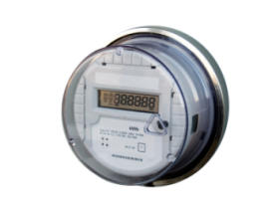
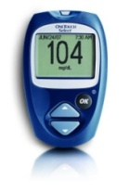
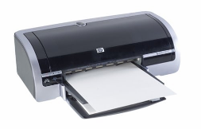
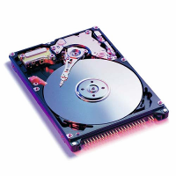
Arm Processors and Applications
M
R
A
Notes:
These processor cores end up in various electronic devices.
For example, the Cortex-M is used in various embedded systems ranging from utility meters to digital thermometers. Recently, they are being widely used in wearable technology and the Internet of Things more broadly.
The Cortex-R is mostly used in automotive devices and wireless controllers.
The Cortex-A is used in high-end devices, such as smartphones, digital TVs, and servers.

Slide 5
Arm Processor Families
Cortex-A series (advanced application)
High-performance processors for open OSs
Applications include smartphones, digital TV, server solutions, and home gateways.
Cortex-R series (real-time)
Exceptional performance for real-time applications
Applications include automotive braking systems and powertrains.
Cortex-M series (microcontroller)
Cost-sensitive solutions for deterministic microcontroller applications
Applications include microcontrollers, mixed signal devices, smart sensors, automotive body electronics, and airbags.
Notes:
Arm’s product portfolio includes a range of processor families with different performance and power characteristics suitable for various SoC applications.
The Cortex-A series includes a number of high-performance processors that can support open Operating Systems. These processors are typically used in advanced embedded applications from smartphones, digital TV, set-top boxes, and rich IoT devices through to enterprise networking, and server solutions. The power efficiency of the Cortex-A processors can provide significant advantages in an increasingly energy-conscious application landscape.
The Cortex-R series includes processors with an exceptional performance for real-time applications where reliability, high availability, fault tolerance, maintainability, and deterministic real-time responses are essential. Application examples include automotive braking systems and powertrains.
The Cortex-M series is a range of scalable and compatible, energy-efficient, easy-to-use processors designed for cost-sensitive applications such as microcontrollers, mixed signal devices, smart sensors, automotive body electronics, and airbags.

Slide 6
Arm Processor Families
SecurCore series
High-security applications such as smartcards and e-government
Neoverse
High performance efficiency for cloud, infrastructure, and AI/ML-accelerated applications
Classic processors
Include Arm7, Arm9, and Arm11 families
Notes:
The SecurCore series provides powerful 32-bit security-enhanced solutions. These processors are used in a wide range of security applications such as e-Government smartcards, Pay TV, and banking.
Classic processors include the Arm7, Arm9, and Arm11 families. These processors have been available for over 15 years.

Slide 7
Arm Cortex-A Series Family
Cortex-A series: Cortex-A5, A7, A8, A9, A12, A15, A17, A53, A57
High-performance application processors
Run rich OSs, multicore technology, 32-bit and 64-bit supports
Applications
Mobile computing Netbook, tablet, eReader
Mobile handset Smartphones, feature phones, wearables
Digital home Set-top box, digital TV, Blu-Ray player, gaming consoles
Automotive Infotainment, navigation
Enterprise industrial printers, routers, wireless base-stations, VOIP phones and equipment
Wireless infrastructure
Notes:
The Cortex-A series can be divided into two categories.
The first category is the high-performance processors, which include A15, A17, and A57 processors.
The other category is the high-efficiency processors, which include A5, A7, and A53 processors.
Cortex-A9 processors sit between the two categories, providing both high performance and restrained power consumption.

Slide 8
Arm Cortex-R Series Family
Cortex-R series: Cortex-R4, R5, R7
Real-time processor
High-performance: Fast processing combined with a high clock frequency
Real-time: Processing meets hard real-time constraints on all occasions.
Safe: Dependable, reliable systems with high error resistance
Cost-effective: Features for optimal performance, power, and area
Applications
Automotive Airbag, braking, stability, dashboard, engine management
Storage Hard disk drive controllers, solid state drive controllers
Mobile handsets 3G, 4G, LTE, WiMax smartphones and baseband modems
Embedded, enterprise, home, cameras
Notes:
The main difference between the R series and the A series is in the memory system architecture. The R series has no virtual memory and no address translation within the processor. Certain sections of memory that are used to store critical sections of code and data are closely coupled to the CPU so they can be quickly accessed.
There are also some additional features to help meet real-time requirements (such as fast peripheral access) and for error detection and correction.

Slide 9
Arm Cortex-M Series Family
Cortex-M series: Cortex-M0, M0+, M1, M3, M4, M7
Low-power processor for embedded microcontrollers
Energy-efficiency
Smaller code
Ease of use
Applications
Internet of Things, connectivity, smart metering, human interface devices, automotive and industrial control systems, domestic household appliances, consumer products, and medical instrumentation
Notes:
The Cortex-M series is designed for cost-effective microcontroller applications such as embedded DSP and embedded control.
These are processors with restrained hardware resources but with very low power consumption and small footprints.

Slide 10
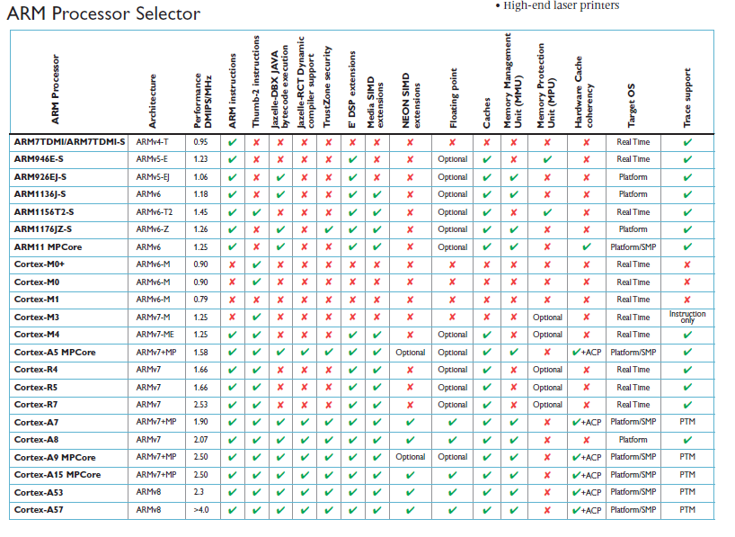
Sample Arm Processors
Processor Class
Arm7
Arm9
Arm11
M
R
A
Notes:
Arm’s main product line includes over 20 processor cores. The current processor offerings are broadly classified into three families: the M, R, and A class.
There are currently five Arm-developed instruction set architectures: the Armv4, Armv5, Armv6, Armv7, and Armv8 architectures.
The release of Armv7 architecture coincided with the introduction of the Cortex product naming convention.
This naming convention is based on the Cortex class, whether it is A, R, or M, followed by a qualitative numeric indicator of performance and functionality, for example, Cortex-A57.

Slide 11
Arm Processors v Arm Architectures
Arm architecture:
Describes the details of instruction set, programmer’s model, Exception model, and memory map
Documented in the Architecture Reference Manual
Arm processor:
Developed using one of the Arm architectures
More implementing details, such as timing information and implementation-related information
Documented in the processor’s Technical Reference Manual
Armv4/V4t Architecture
Armv5/v4E Architecture
Armv6 Architecture
Armv7
Architecture
Armv8 Architecture
Armv7-A
e.g., Cortex-A9
Armv8-A
e.g., Cortex-A75
Cortex-A57
Armv7-R
e.g., Cortex-R4
Armv8-R
e.g., Cortex-R52
Arm v6-M
e.g., Cortex-M0, M1
Armv7-M
e.g., Cortex-M3
Armv8-M
e.g., Cortex-M33
e.g., Arm7TDMI
e.g., Arm9926EJ-S
e.g., Arm1136
Notes:
Each Arm processor is developed using one of the Arm architectures.
Arm architectures evolved from the original Arm architecture, and the introduction of the Thumb instruction set with the Armv4T architecture, to the very last Armv8 with a 64-bit instruction set.

Slide 12
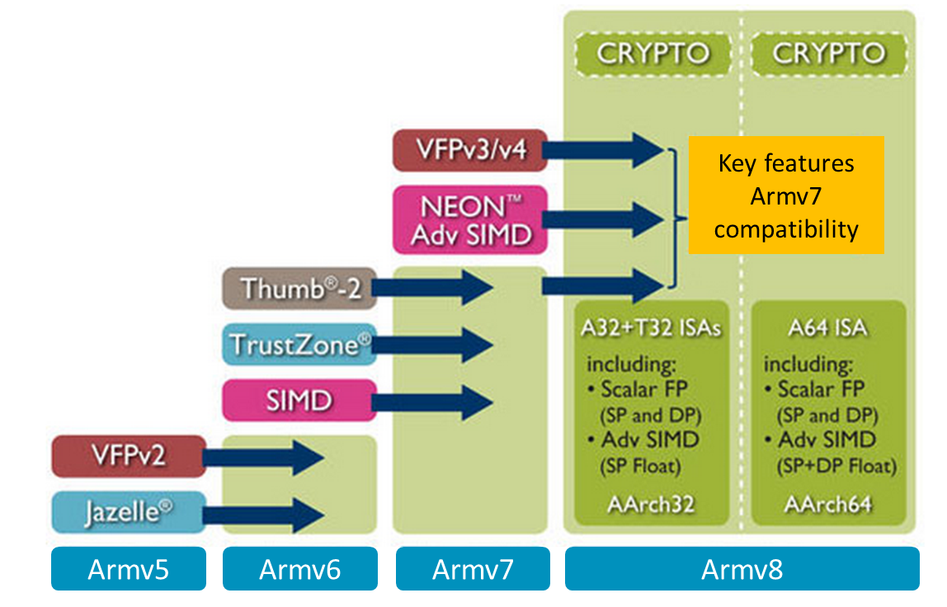
Arm Architectures
Notes:
Each new architecture has been the consequence of recognizing the needs of new markets and application areas of electronic devices, integrating the resources required to fulfill developers’ expectations:
This diagram shows the evolvement of the Arm architectures from having DSP-focussed additional instructions and Jazelle-DBX for Java bytecode interpretation in the Armv5 architecture, right up to data-level parallelism for multimedia applications through SIMD and NEON.

Slide 13
Which Architecture Is My Processor?
Processor core Architecture
Arm7TDMI family v4T
Arm9TDMI family v4T
Arm9E family v5TE, v5TEJ
Arm10E family v5TE, v5TEJ
Arm11 family v6
Arm1136J(F)-S v6
Arm1156T2(F)-S v6T2
Arm1176JZ(F)-S v6Z
Arm11 MPCore v6k
Cortex family
Arm Cortex-A57 v8-A (64-bit, highest performance)
Arm Cortex-A53 v8-A (64-bit)
Arm Cortex-A15 v7-A (with security and virtualization extensions)
Arm Cortex-A9 v7-A (with security extensions)
Arm Cortex-A8 v7-A (with security extensions)
Arm Cortex-A7 v7-A (with security and virtualization extensions)
Arm Cortex-A5 v7-A (with security extensions)
Arm Cortex-R5 v7-R
Arm Cortex-R4 v7-R
Arm Cortex-M4 v7-M
Arm Cortex-M3 v7-M
Arm Cortex-M1 v6-M (16-bit Thumb, except for system instructions)
Arm Cortex-M0 v6-M (16-bit Thumb, except for system instructions)
Notes:
The list on this slide covers the most common configurations of processor core and architecture.
There are a couple of Arm architecture oddities that should only rarely appear in real-world designs. For example, a version of Armv6 called v6K deals with enhanced kernel support and some multicore issues.

Slide 14
Arm and Thumb Instruction Sets
Early Arm processors
32-bit instruction set, called the Arm instruction set
Powerful and good performance
Larger program memory compared to 8-bit and 16-bit processors
Larger power consumption
Thumb-1 instruction set
16-bit instruction set, first used in the Arm7TDMI processor in 1995
Provides a subset of the Arm instructions, giving better code density compared to 32-bit RISC architecture
Code size is reduced by ~30%, but performance is also reduced by ~20%.
Can be used together with Arm instructions using a multiplexer
Incoming
Instructions
0
Arm
Instruction
Decoder
Instructions
Executing
Thumb Remap
to Arm
1
T bit, 0: select Arm,
1: select Thumb
Notes:
The Thumb-1 instruction set consists of 16-bit instructions that were created as a subset of the original 32-bit Arm instructions for improving code density and power consumption.
On execution, the 16-bit Thumb-1 instructions are decompressed to full 32-bit instructions, thus producing the same effect on the processor’s model. It is possible to switch from Arm code to Thumb code and vice versa, so designers can emphasize performance at the subroutine level.

Slide 15
Arm and Thumb Instruction Sets
Thumb-2 instruction set
Consists of both 32-bit Thumb and original 16-bit Thumb-1 instruction sets
Compared to the 32-bit Arm instruction set, code size is reduced by ~26%, while maintaining similar performance
Thumb Execution Environment (ThumbEE) instruction set
Based on Thumb
With some changes and additions to make it a better target for dynamically generated code, i.e., code compiled on the device either shortly before or during execution
Armv7-A architecture
Based on Thumb-2 and ThumbEE
Notes:
Thumb-2 is a superset of the Thumb-1 instruction set. It introduces 32-bit instructions that are intermixed with the 16-bit instructions.
The main difference from the Arm Instruction Set Architecture (ISA) is that Thumb-2 instructions are unconditional, although a new conditional execution instruction called IT is introduced. The performance is close to the Arm ISA, while keeping the original density of the Thumb-1 ISA.
Arm-v7 defines the ThumbEE instruction set, which introduces some changes and additions to make it a better target for dynamically generated code.
C and C++ code will normally be compiled to Thumb, since it gives the best density/performance mix for most code.

Slide 16
The Arm Register Set
r0
r1
r2
Sixteen general-purpose registers
Some of the registers have special significance.
R15: Program Counter (pc)
R14: Link register (lr)
R13: Stack pointer (sp)
There are also two status registers.
Current Program Status Register (CPSR)
Saved Program Status Register (SPSR)
Only present in exception modes
Only accessible by some instructions
r3
r4
r5
General-purpose registers
r6
r7
r8
r9
r10
r11
r12
r13 (sp)
R13: stack pointer
R14: link registers
R15: Program Counter
r14 (lr)
r15 (pc)
cpsr
Program Status Registers
spsr
Notes:
Now let’s explore the Armv7-A architecture.
To begin with, let us look at the register organization in Arm state.
The Arm register set consists of a sixteen general-purpose registers, where registers r13 to r15 have special significance:
r15 holds the Program Counter.
r14 holds the link register. This register receives the return address when a branch with link instruction is executed. At all other times, it can be used as a general-purpose register.
r13 holds the stack pointer.
There are also two Program Status Registers:
Current Program Status Register (CPSR),
and the
Saved Program Status Register (SPSR).
The CPSR stores the flags, processor mode, processor state, endianness, interrupt, and abort disable bits.
The SPSR is only present in exception modes and saves the preexception value of the CPSR.

Slide 17
Assembler Syntax
Data processing instructions
<operation><condition> Rd, Rm, <op2>
ADDEQ r4, r5, r6
SUB r5, r7, #4
MOV r4, #7
Memory access instructions
<operation><size> Rd, [<address>]
LDR r0, [r6, #4]
STRB r4, [r7], #8
<operation><addressing mode> <Rn>!, <registers list>
LDMIA r0, {r1, r2, r7}
STMFD sp!, {r4-r11, lr}
Program flow instructions
<branch> <label>
BL foo
B bar
Notes:
Unified Assembler Language, or UAL, provides a canonical form of the assembly language syntax for all Arm and Thumb instructions. Most earlier Arm mnemonics are still supported as synonyms, but most Thumb mnemonics are not.
There are, of course,
-Data processing instructions for arithmetic and logic operations
-Status register access instructions
-Load/store instructions for memory access
-Branch instructions for program flow
There are also exceptions generating and managing instructions, coprocessor instructions, Advanced SIMD instructions, and floating point data processing instructions.

Slide 18
AAPCS
Arguments into function
Result(s) from function
otherwise corruptible
(Additional parameters
passed on stack)
r0 (a1)
The compiler has a set of rules known as a Procedure Call Standard that determines how to pass parameters to a function (see AAPCS).
CPSR flags may be corrupted by function call.
Assembler code that links with compiled code must follow the AAPCS at external interfaces.
The AAPCS is part of the ABI for the Arm architecture.
r9 is used as the static base if the RWPI option selected.
r1 (a2)
r2 (a3)
r3 (a4)
r4 (v1)
r5 (v2)
r6 (v3)
Register variables
Must be preserved
r7 (v4)
r8 (v5)
r9 (v6/SB)
r10 (v7)
r11 (v8)
Scratch register
(corruptible)
r12
Stack Pointer Link Register
Program Counter
r13 (sp)
r14 (lr)
r15 (pc)
- sp should always be 8-byte (2 words) aligned.
- r14 can be used as a temporary register once value stacked.
Notes:
The Arm Architecture Procedure Call Standard (AAPCS) defines how subroutines can be separately written, compiled, and assembled to work together.
It describes a contract between a calling routine and a called routine that defines:
-Obligations on the caller to create a program state in which the called routine may start to execute
-Obligations on the called routine to preserve the program state of the caller across the call
-The rights of the called routine to alter the program state of its caller
This standard specifies the base for a family of PCS variants generated by choices that reflect alternative priorities among code size, performance, and functionality, such as ease of debugging, runtime checking, and support for shared libraries.

Slide 19
Processor Modes
The Arm processor has seven basic operating modes:
Each mode has access to its own stack space and a different subset of registers.
Some operations can only be carried out in a privileged mode.
Mode | Description | Privilege level
Supervisor | Entered on reset and when a supervisor call instruction (SVC) is executed | PL1 | Privileged modes
FIQ | Entered when a high-priority (fast) interrupt is raised | PL1
IRQ | Entered when a normal-priority interrupt is raised | PL1
Abort | Used to handle memory access violations | PL1
Undef | Used to handle undefined instructions | PL1
System | Privileged mode using the same registers as user mode | PL1
User | Mode under which most applications/OS tasks run | PL0 | Unprivileged mode
Exception modes
Notes:
The programmers’ model can be split into two elements: the processor modes and the processor registers. Firstly, we will look at the processor modes. Note that this slide does not apply to the Cortex-M3 or M1 processors.
A typical application will run in an unprivileged mode known as “user” mode. The various exception types will be dealt within one of the following privileged modes: supervisor mode, fast interrupt mode, normal interrupt mode, abort mode, and UNDEFINED mode. We will look later on at what causes each of the exceptions.
What is the difference between the privileged and unprivileged modes?
The Arm core has an output signal that indicates whether the current mode is privileged or unprivileged, and this can be used, for instance, by a memory controller to allow IO access only in a privileged mode.
In addition, some operations are only permitted in a privileged mode, such as directly changing the mode and enabling interrupts.
All current Arm cores implement a system mode, which was introduced in the Arm v4 architecture. This is simply a privileged version of user mode. It is important for reentrant exceptions because no exceptions can cause a system mode to be entered.
Note that a system mode is used for reentrant interrupts.
There are also two other modes, Hypervisor (PL2) and Monitor (PL1). These modes are implemented with virtualization and with Security Extensions, respectively.

Slide 20
Banking of Registers
User mode
IRQ
FIQ
Undef
Abort
SVC
r0
General-purpose registers are 32 bits long. A subset of these registers is accessible in each mode.
Note: System mode uses the user mode register set.
r1
r2
r3
r4
r5
r6
r7
r8
r8
r9
r9
r10
r10
r11
r11
r12
r12
r13 (sp)
r13 (sp)
r13 (sp)
r13 (sp)
r13 (sp)
r13 (sp)
r14 (lr)
r14 (lr)
r14 (lr)
r14 (lr)
r14 (lr)
r14 (lr)
r15 (pc)
cpsr
spsr
spsr
spsr
spsr
spsr
Current mode
Banked out registers
Notes:
Only certain registers are visible in particular modes. This animated slide shows the way that the banking of registers works:
On the left, the currently visible set of registers is shown for a particular mode.
On the right are the registers that are banked out while in that particular mode.
The animation shows the banking of registers during mode switching that follows an example sequence of User -> IRQ -> User -> FIQ -> User modes.
When an exception occurs:
The processor first copies CPSR into SPSR of the exception mode.
Then, the processor sets the appropriate CPSR bits. For example, the bits are updated to
-Change to predefined state (Arm or Thumb)
-Change to predefined endianness
-Change to exception mode, or
-Disable interrupts
Next, the processor stores the return address in the Link Register of the exception mode
Finally, the processor sets the Program Counter to the vector address
To return from the exception mode, the exception handler needs to:
Restore CPSR from SPSR of the exception mode
and then
Restore the Program Counter from the Link Register of the exception mode
Exceptions can be handled in the Arm or Thumb state in Armv7 processors. For processors that do NOT include Thumb-2 Technology, such as the Arm1136JF-S processor, the exception must be handled in Arm state.
Note that this slide does not apply to the Cortex-M3 or M1 processors.

Slide 21
Exceptions
When an exception occurs:
It causes entry into a processor mode that executes software at PL1 or PL2.
It causes the execution of a software handler for the exception.
Exception includes:
Resets
Interrupts
Memory system aborts
Undefined instructions
SVCs, secure monitor calls (SMCs), and hypervisor calls (HVCs)
Processor execution is forced to the exception vector (an address) corresponding to that type of exception.
Vector table:
A set of eight consecutive vectors
World aligned memory addresses starting at an exception base address
Notes:
An exception causes the processor to suspend program execution to handle an event, such as an externally generated interrupt or an attempt to execute an undefined instruction. Exceptions can be generated by internal and external sources.
Normally, when an exception occurs, the processor state is preserved immediately, before handling the exception. This means that when the event has been handled, the original state can be restored, and program execution resumed, from the point where the exception occurred.
More than one exception might be generated at the same time, and a new exception can be generated while the processor is handling an exception.
Most details of exception handling are not visible to application-level software.
What is an exception vector and vector table?
When an exception occurs, the processor execution is forced to an address that corresponds to the type of exception.
This address is called the exception vector for that exception.
A set of exception vectors comprises eight consecutive word-aligned memory addresses, starting at an exception base address. These eight vectors form a vector table.
The number of possible exception base addresses and therefore the number of vector tables depend on the implemented architecture profile and extensions.
Note that for the IRQ and FIQ exceptions only, when the exceptions are taken to IRQ mode and FIQ mode, software can change the exception vectors from the vector table values by setting the VE bit in the SCTLR register to 1.

Slide 22
Vector Table
A vector table has one entry per exception type.
Table entries contain instructions, not addresses.
1 × Arm instruction
2 × 16-bit Thumb instructions
1 × 32-bit Thumb instruction
Arm/Thumb controlled by SCTLR.TE bit
The vector table address is configurable.
0x0 or 0xFFFF0000
SCTLR.V bit / VINITHI signal
The security extensions add support for other addresses.
Vector base address registers
0x1C
FIQ
0x18
IRQ
0x14
(Reserved)
0x10
Data Abort
0x0C
Prefetch Abort
0x08
SVC
0x04
UNDEFINED instruction
0x00
Reset
Vector Table
At reset, the vector table can be at 0x0 or 0xFFFF0000.
Notes:
In summary, what does a vector table do?
Exception handling on the core is controlled through the use of the vector table that sits in an area of memory. The vector table is a table of instructions that the Arm core jumps to when an exception is raised. These instructions are located in a specific place in memory. The default vector base address is 0x00000000, but most Arm cores permit the vector base address to be moved to 0xFFFF0000.
Note that the vector at offset 0x14 in the vector table is used for exceptions that cause entry to Hypervisor mode, when implemented with virtualization.
At reset, any implemented vectored interrupt mechanism is disabled, and the IRQ and FIQ exception vectors are at fixed offsets from the exception base address that is being used. With this configuration, an FIQ or IRQ handler typically starts with an instruction sequence that determines the cause of the interrupt and then branches to an appropriate routine to handle it.
If an implementation supports vectored interrupts, enabling this feature means an interrupt controller can prioritize interrupts and provide the address of the required interrupt handler directly to the processor for use as the interrupt vector.

Slide 23
Memory Model
Memory Map
Uncached
Peripherals
OS
User Access
Application Space
Cached, read-only
Vectors
A system includes different memories and peripherals.
The processor needs to be told how it should access different devices.
For each address region:
Access permissions
Read/write permissions for user/privileged modes
Memory types
Caching/buffering and access ordering rules for memory accesses
Notes:
Which features are typically used and required by applications and Operating Systems?
We would logically group functional pieces of code and data together in the memory map and would like to have separate control of attributes for each of these areas. The processor needs to be told how it should access different devices through different memory areas.

Slide 24
Memory Types
In Armv6/Armv7, address locations must be described in terms of a type.
The type tells the processor how it can access that location:
Memory access ordering rules
Caching and buffering behavior
Speculation
There are three mutually exclusive memory type attributes:
Normal: Data and instructions
Device: Devices/peripherals
Strongly ordered: Device/peripherals, or data used by legacy code
Normal and device memory allow additional attributes for specifying the cache policy and whether the region is shared.
For example, normal memory can be cached or non-cached.
Notes:
Memory access ordering rules are rules that control the order in a sequence of load/store instructions.
Normal and device memory regions have additional attributes for specifying the cache policy and whether the region is shared.
Usually, memory used for programs and for data storage is suitable for access using the normal memory attribute. Examples of memory technologies for where the normal memory attribute is appropriate are programmed Flash ROM, ROM, SRAM, DRAM, and DDR memory.

Slide 25
Example: Cached Arm Macrocell
For memory management, an Arm core can include either an MMU or MPU.
Memory Management Unit (MMU)
Implements Virtual Memory System Architecture (VMSA)
Memory Protection Unit (MPU)
Implements physical memory system architecture (PMSA)
Instruction cache
MMU/MPU
Arm core
AMBA Interconnect
CP15
Bus Interface Unit
L2 Cache
WB
Data cache
Notes:
To allow memory management and memory protection, some Arm processors can include either a Memory Management Unit (MMU), or a Memory Protection Unit (MPU).
An MMU implements a Virtual Memory System Architecture. On the other hand, the MPU implements a physical memory system architecture. MPUs are usually implemented in low-power processors that only require memory protection and does not require any virtual memory management.
The diagram in this slide shows an example of a cached Arm Macrocell.
In this example, the write buffer and L1 data and instruction caches have close proximity to the core. The access to the L1 cache is fast. The writes to the write buffer are also fast.
The L2 sits further out from the core. Access to L2 is slower than L1.
The reads from external memory are slower. Every uncached access is slower.

Slide 26
Data Alignment
Armv6/v7 data alignment:
Data accesses can be unaligned.
Only a subset of load/store instructions support unaligned accesses.
Unaligned accesses are only allowed to addresses marked as normal.
The load/store unit will access memory with aligned memory accesses and make the data available to the CPU.
Instructions are aligned as follows:
Arm instructions are word aligned.
Thumb and ThumbEE instructions are halfword-aligned.
Java bytecodes are byte-aligned.
Arm processors are little-endian.
But can be configured to access big-endian memory systems
Notes:
Arm is designed to efficiently access memory using a single memory access cycle. So word accesses must be on a word address boundary and halfword accesses must be on a halfword address boundary. This includes instruction fetches.
The Arm architecture has been designed to interface to a fast but simple 32-bit-wide memory system. Only a single memory cycle is performed on each access, so it is not possible to have an access that is split across a 4-byte boundary. Hence, all unaligned word and unaligned halfword accesses are not allowed.
Detecting incorrectly aligned data accesses is important to ensure program correctness.
Note that instruction fetches may appear to be unaligned due to the fact that bits 1 and 0 of the Program Counter are not driven with valid addresses for instruction fetches. Memory systems must ignore these bits for instruction fetches and not raise alignment errors as a result.
Prior to Armv6 architecture, all hardware data accesses had to be size aligned, for example, words on word boundaries. Unaligned accesses could be caught by hardware too.
Unaligned data in software was accessed by a series of aligned memory accesses. In the Armv7 architecture, some load and store instructions support unaligned data accesses.

Slide 27
Endianness
Endianness determines how contents of registers relate to the contents of memory.
Arm registers are word (4 bytes) width.
Arm addresses memory as a sequence of bytes.
Arm processors are little-endian.
But can be configured to access big-endian memory systems.
Arm supports three models of endianness.
LE little-endian
BE-32 word-invariant big-endian (dropped in architecture v7)
BE-8 byte-invariant big-endian (introduced in architecture v6)
Little-endian memory system
Least significant byte is at lowest address.
Big-endian memory system
Most significant byte is at lowest address.
Notes:
Alignment does not specify completely the mappings between words, halfwords, and bytes. Different models of endianness show how memory contents may map to register contents and vice versa.
A memory system uses either a little-endian scheme or a big-endian scheme.
In a little-endian memory system, the least significant byte, halfword, or word is stored at the lowest address.
In a big-endian memory system, the most significant byte, halfword, or word is stored at the lowest address.
Arm supports little-endian, byte-invariant big-endian, and word-invariant big-endian models.

Slide 28
PMU
Armv6 & Armv7-A/R processors include a Performance Monitoring Unit (PMU).
The PMU provides a non-intrusive method of collecting execution information from the core.
Enabling the PMU does not change the timing of the core.
PMU accessed through
CP15 (mandatory)
A memory-mapped interface (optional)
An external debug interface (optional)
The PMU provides:
Cycle counter: counts execution cycles (optional 1/64 divider)
Programmable event counters
The number of counters and available events vary between cores.
The PMU can be configured to generate interrupts if a counter overflows.
Interrupt signals are an output from the core.
Need to be connected to the system’s interrupt controller.
Notes:
The Performance Monitoring Unit or PMU is a way of getting low-level information about the performance of the core, while being relatively non-invasive.
The number of counters provided by the PMU, and what they can count, varies between cores. The way they are programmed also varies.
In the Armv7 architecture, the Performance Monitors Extension is an optional feature of an implementation, but Arm strongly recommends that Armv7-A and Armv7-R architecture implementations include the Performance Monitors Extension.
The basic form of the PMU is a cycle counter, event counters, and controls for the counters, or enable interrupts and flagging.
The cycle counter has the ability to count every cycle or every sixty-fourth cycle
The event counted by each counter is programmable.
Note that the Armv7 architecture provides space for up to thirty-one counters. The actual number of counters is IMPLEMENTATION DEFINED, and the specification includes an identification mechanism.
An OS running on the processor can use the CP15 interface to access the counters. This supports a number of uses, including dynamic compilation technique and energy management.
Also, if required, the OS can enable application software to access the counters. This enables an application to monitor its own performance with fine-grained control without requiring OS support. For example, an application might implement per-function performance monitoring.

Slide 29
Coprocessors
On earlier Arm processors, additional coprocessors could be added to expand the Arm instruction set.
Newer processors do not allow user-defined coprocessors:
Usually better for system designers to use memory-mapped peripherals
Easier to implement, since coprocessors have to be tied in to the core pipeline
Arm uses coprocessors for internal functions so as not to enforce a particular memory map:
System control coprocessor: cp15
Used for processor configuration: System ID, caches, MMU, TCMs, etc.
Debug coprocessor: cp14
Can be used to access debug control registers
VFP and Neon: cp10 and cp11
Notes:
A part of the Arm instruction set is defined as being implemented by the external hardware known as a coprocessor. There is an instruction space for up to sixteen coprocessors though zero is defined as never present, so the maximum is actually fifteen. These allow the Arm instruction set to be expanded in a system-dependent way.
There are several coprocessors that are reserved by Arm for specific purposes.
Coprocessor 15, also known as CP15, provides system control functionality. This includes architecture and feature identification, as well as control, status information, and configuration support. CP15 also provides performance monitor registers.
Coprocessor 14, also known as CP14, supports debug, the ThumbEE, and direct Java bytecode execution.
Coprocessors 10 and 11, also known as CP10 and CP11, both support floating-point and vector operations, and the control and configuration of the Advanced SIMD and floating-point architecture extensions.
Coprocessors 8, 9, 12, and 13 are reserved for future use by Arm. Any coprocessor access instruction attempting to access one of these coprocessors is UNDEFINED.
As the Arm core fetches each instruction, each coprocessor in the system will also read that instruction into its pipeline follower. As the coprocessor instruction space is defined, each coprocessor can determine if an instruction is the coprocessor one, and as each coprocessor has a unique number, the coprocessor will know whether a particular instruction is the one it is meant to execute.
When a coprocessor instruction reaches the execute stage of the Arm pipeline, the Arm core will indicate to the system coprocessors via some handshaking signals that it wants a coprocessor to deal with the instruction. If the appropriate coprocessor exists, then it can get on with executing the instruction while the Arm core continues executing the following instructions. Otherwise, an undefined instruction exception is taken, which means that it is possible to emulate coprocessors in software.

Slide 30
Architecture Extensions
Architecture extensions to meet the changing needs of applications in new markets
Security
The TrustZone
Additional operating mode, Monitor (Mon) mode, with associated banked registers and an additional secure operating state
40-bit physical addressing (LPAE)
Extension to the VMSAv7 virtual memory architecture
Enables the generation of 40-bit physical addresses from 32-bit virtual addresses
Virtualization
Extra mode: Hypervisor mode, with associated banked registers
New Hyp exception to trap software accesses to hardware and configuration registers
Advanced SIMD and floating-point: Both floating point (VFP) support and Advanced SIMD (Neon)
Can be implemented together, in which case they share a common register bank and some common instructions
Notes:
There are several architecture extensions that Arm developed to meet the demands of the market.
TrustZone was introduced in the v6K architecture and is an optional extension to the Armv7-A profile. TrustZone introduces an additional operating mode, Monitor mode, with associated banked registers and an additional secure operating state.
A 40-bit physical addressing Large Physical Address Extension or LPAE is an optional extension to the Armv7-A profile. This extension to the VMSAv7 virtual memory architecture enables the generation of 40-bit physical addresses from 32-bit virtual addresses. LPAE is supported by the Cortex-A7, Cortex-A12, Cortex-A15, and Cortex-A17 processors.
Both floating point support and Advanced SIMD or NEON are optional extensions to the Armv7-A profile. They can be implemented together, in which case they share a common register bank and some common instructions. Almost all Neon implementations also include floating point support.
The Virtualization Extension is supported by the Cortex-A7, Cortex-A12, Cortex-A15, and Cortex-A17 processors.

Slide 31
TrustZone
Processor provides two worlds: secure and normal.
Each world has its own vector table and page tables.
“Monitor” mode acts as a gatekeeper for moving between worlds.
Two physical address spaces, controlled by NS attribute
Secure (S) and Non-secure (NS)
S:0x8000 treated as different physical location from NS:0x8000
Debug for Secure world code and data can be restricted.
Application(s)
Trusted Service(s)
OS
Trusted OS
Secure Monitor
Notes:
Let us take a further look into TrustZone.
A secure system is one that protects assets from a range of plausible attacks to prevent them from being copied or damaged or made unavailable.
The Arm TrustZone technology is a Security Extension that provides system-wide hardware isolation for trusted software. The TrustZone hardware architecture aims to provide resources that enable a system designer to build secure systems.
In essence, system security is achieved by dividing all of the device’s hardware and software resources so that they exist in either the Secure world for the security subsystem or the Normal world for everything else. System hardware ensures that no Secure world resources can be accessed from the Normal world. A secure design places all sensitive resources in the Secure world and has robust software running that can protect assets against a wide range of possible attacks.

Slide 32
Virtual Memory System Architecture (VMSA)
Provides virtual address to physical address translation system
Up to 40 bits fine grain translation
Arm Memory Management Unit (MMU) implements VMSA
Translation tables
Descriptor
Notes:
Before we look at Large Physical Address Extensions, or LPAE, let us be clear on what VMSA and descriptors are.
Virtual Memory System Architecture, or VMSA, provides a virtual to physical address translation system.
It supports physical addresses of up to 40 bits at a fine grain of translation.
The Arm Memory Management Unit or MMU implements VMSA. The MMU translates addresses from virtual view of memory to the physical addresses in the real system. In the MMU, the address translation is done using translation tables. A translation table is a data structure created by software in memory that the MMU hardware uses to do virtual address translation. Each entry in the translation table follows a descriptor format. This contains all information required to translate a page in virtual memory to a page in physical memory and access permissions and memory attributes necessary for that page.

Slide 33
Large Physical Address Extensions
Long-descriptor format for page tables added
32-bit virtual address mapped onto 40-bit physical address space
New translation table format using 64-bit translation table descriptors
1TB of memory space accessible
32-bit short-descriptor format still supported
Configurable in the translation table base control register EAE bit (bit 31)
Can use 16MB memory supersections to map onto 40-bit address space
Notes:
So what is Large Physical Address Extensions, or LPAE?
LPAE is an extension to the VMSA of the Armv7 architecture. This allows for accessing a 1TB memory space. The LPAE requires implementation of the multiprocessing extensions.
With LPAE, a long-descriptor translation table format is implemented. LPAE supports the assignment of memory attributes to memory pages, at a granularity of 4KB, across the complete input address range. LPAE also supports the assignment of memory attributes to blocks of memory, where a block can be 2MB or 1GB.
The short-descriptor translation table format is still supported.
The short-descriptor format supports a memory map based on memory pages, sections, or even supersections.
-A small page consists of 4KB blocks of memory, while a large page consists of 64KB blocks of memory.
-Sections consist of 1MB blocks of memory.
-Supersections, on the other hand, consist of 16MB blocks of memory. Support for supersections is optional, although an implementation that includes the LPAE and supports more than 32 bits of physical address must also support supersections to provide access to the entire physical address space.

Slide 34
Virtualization
Support for running multiple guest OSs in the normal world
Hypervisor mode to control switching between guest OSs
Two-stage address translation: OS and hypervisor levels
Hypervisor mode can trap exceptions and choose which guest to direct them to.
Normal world
Secure world
Application(s)
Application(s)
Trusted Service(s)
Guest OS
Guest OS
Trusted OS
Hypervisor
Secure Monitor
Notes:
Virtualization is the concept where more than one Operating System is enabled to co-exist and operate on a same system.
The Arm Virtualization Extensions make it possible to operate multiple Operating Systems on the same system, while offering each such Operating System an illusion of sole ownership of the system by virtue of introduction of new architectural features.
One of the features is the Hypervisor mode. The Hypervisor mode is an addition to the existing privileged modes that we have covered in the previous slides, such as IRQ mode, IFQ mode, Abort mode, and so on. Hypervisor mode is expected to be occupied by Hypervisor software managing multiple guest operating systems. Hypervisor mode only exists in the Normal or Non-secure world and can also trap exceptions and choose which guest OS to direct them to.
The other new feature as a part of the Virtualization Extension is an additional memory translation, also known as the Stage 2 translation. This includes the introduction of Intermediate Physical Address or IPA in order to get the final Physical Address corresponding to the Virtual Address. Why is IPA needed in virtualization? When there are multiple guest OSs running, each OS sets its own translation tables independently of each other. There may be situations where the OSs independently translate the virtual address to the same physical address resulting in address overlaps. By having an IPA, the hypervisor sorts out any potential overlaps so that each guest OS can access different physical address.

Slide 35
Arm Cortex-A Series Processors
Cortex-A57
Cortex-A53
Cortex-A15
Cortex-A9
Cortex-A8
Cortex-A7
Cortex-A5
Armv8
64-bit
Armv8 architecture: 64-bit
Cortex-A57
Cortex-A53
Armv7 architecture: 32-bit
Cortex-A15
Cortex-A9
Cortex-A8
Cortex-A7
Cortex-A5
Armv7-A
32-bit
Notes:
The Cortex-A series processors include those based on the 32-bit Armv7 architecture and those based on the newest 64-bit Armv8 architecture.

Slide 36
Arm Cortex-A Series Overview
High-performance
Used in applications that have high-compute requirements
Run rich OSs and deliver interactive media and graphics on the latest must-have devices.
Multicore technology
Single to quad-core implementation for performance orientated applications
Supports symmetric and asymmetric OS implementations
Arm big.LITTLE compatible
Advanced extensions
Thumb-2 for optimal code size and performance
TrustZone Security Extensions for trusted computing
Jazelle technology for accelerating execution environments such as Java, .Net, MSIL, Python, and Perl
Ideal for mobile Internet
Native support for technologies like Adobe Flash
High-performance Neon engine for broad support of media codecs
Notes:
As introduced earlier, the Cortex-A series includes high-performance multicore technology processors endowed with advanced extensions such as the Thumb-2 instruction set, the TrustZone Security Extensions, the Jazelle technology for bytecode execution acceleration, and the Neon engine for parallelized data processing. These features make the A series ideal for mobile internet.

Slide 37
Arm Cortex-A Series Processors
Processor | Performance | Typical Frequency | Architecture | Year | Comments
Cortex-A5 | 1.57 DMIPS/MHz /core | 400-800 MHz | Armv7-A | 2009 | Cost-effective processor core
Cortex-A7 | 1.9 DMIPS/MHz /core | 800 MHz-1.2 GHz | Armv7-A | 2011 | High-energy and area-efficient core
Cortex-A8 | 2.0 DMIPS/MHz/core | 600 MHz-1 GHz | Armv7-A | 2005 | First one supporting Armv7-A architecture
Cortex-A9 | 2.5 DMIPS/MHz /core | 800 MHz-2 GHz | Armv7-A | 2007 | Widely deployed Armv7-A-based processor
Cortex-A12 | 3.0 DMIPS/MHz /core |  | Armv7-A | 2013
Cortex-A15 | >3.5 DMIPS/MHz /core | Up to 2.5GHz | Armv7-A | 2010 | High-performance core
Cortex-A17 |  | Up to 2.5GHz | Armv7-A | 2014 | The most efficient Armv7-A-based processor
Cortex-A53 | 2.3 DMIPS/MHz |  | Armv8-A | 2013 | Most efficient 32/64-bit processor
Cortex-A57 | >4.1 DMIPS/MHz |  | Armv8-A | 2013 | Proven high-performance 32/64-bit core for mobile and enterprise computing
Cortex-A72 |  | Up to 2.5GHz | Armv8-A | 2015 | Arm’s highest-performance processor
Notes:
The Cortex-A series processors scale efficiently across a range of the highest performing consumer, embedded, and enterprise devices. These include a spectrum of smartphones, mobile computing platforms, digital TVs, set-top boxes, and rich IoT devices, as well as enterprise networking and server solutions. In an increasingly energy-conscious business landscape, the power efficiency of Cortex-A processors can provide significant advantages.

Slide 38
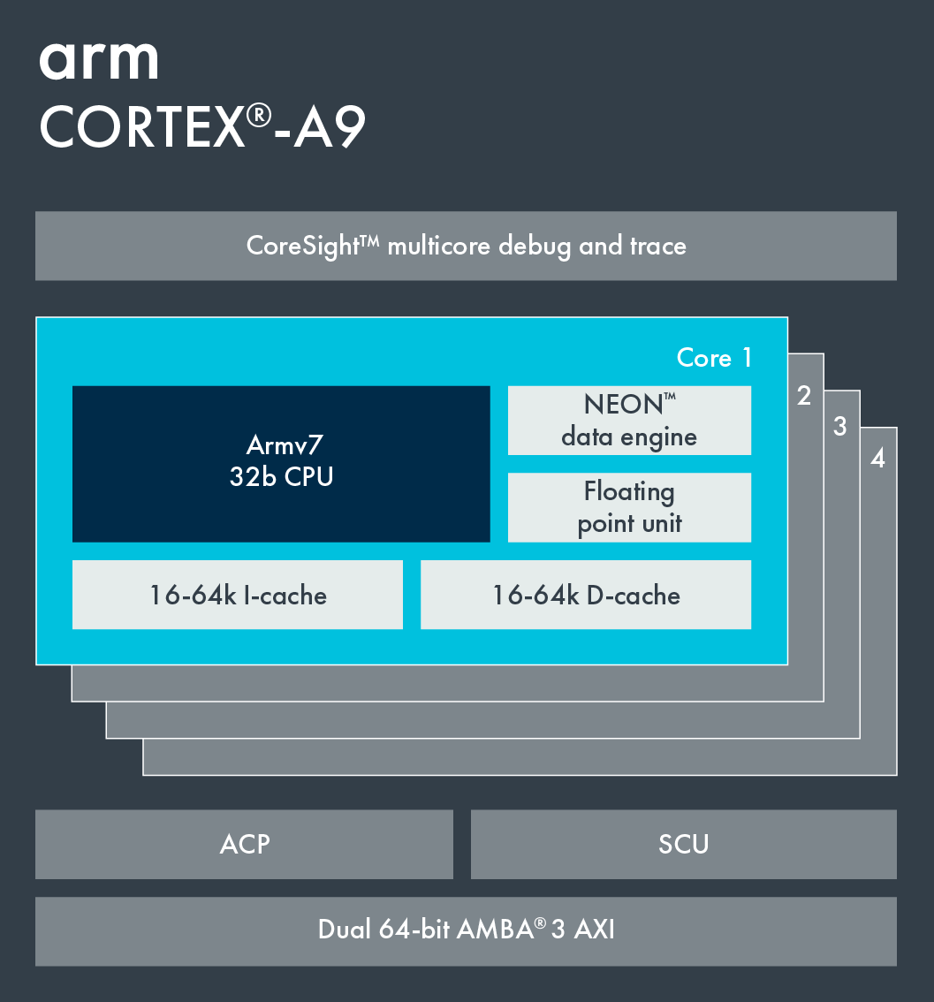
Arm Cortex-A9 Processor
Arm Cortex-A9 features
Armv7 architecture: Thumb-2, ThumbEE
0.8GHz to 2GHz
2.5 DMIPS/MHz/core
Single core or 4x MPCore solution
Up to 20k DMIPS (2GHz, quad-core)
Power-efficient and high-performance processor
Dynamic length pipeline (8–11 stages)
Up to 64KB L1 I/D cache
Up to 8MB of L2 cache
Optional Neon media and/or floating point processing engine
Notes:
The Arm Cortex-A9 processor is a popular general-purpose choice for low-power or thermally constrained, cost-sensitive devices. Introduced in 2008, it is used in smartphones, digital TV, and both consumer and enterprise applications enabling the Internet of Things. As a single processor solution, the Cortex-A9 processor offers an overall performance enhancement of well above 50% compared to Arm Cortex-A8 solutions.
This slide summarizes the main characteristics of the Cortex-A9 processor.
Note that all Xilinx Zynq-7000 devices incorporate a dual-core Cortex-A9 processor.

Slide 39
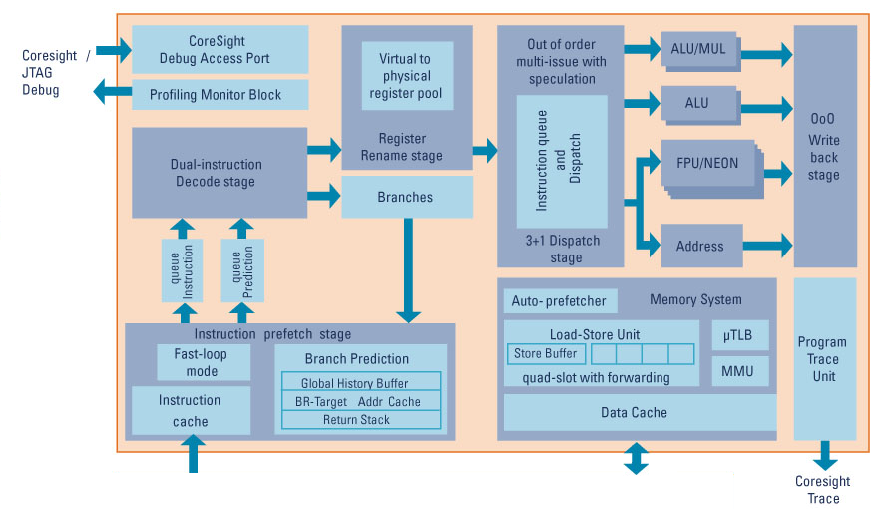
Cortex-A9 Diagram
Notes:
This diagram shows a block diagram of the Cortex-A9 processor.
In the instruction queue, small loop mode provides low-power operation while executing small instruction loops. In brief, it allows the core to stop prefetching instructions while executing a loop small enough to fit inside the instruction queue buffer, thereby removing cache latencies and conserving power.
The Cortex-A9 processor implements the ARMv7-A architecture and runs 32-bit Arm instructions, 16-bit and 32-bit Thumb® instructions, and 8-bit Java bytecodes in Jazelle® state.
Jazelle DBX technology is a combined hardware and software solution from Arm, giving platform developers the freedom to run Java applications alongside established OS, middleware, and application code on a single Arm processor. Jazelle technology software is a multi-tasking Java virtual machine, optimized to take advantage of Jazelle technology architecture extensions available in many Arm processor cores.
The Cortex-A9 also has a Program Trace Macrocell or PTM interface. PTM is a real-time trace module providing instruction tracing of a processor. A PTM is an integral part of an Arm RealView debug solution.

Slide 40
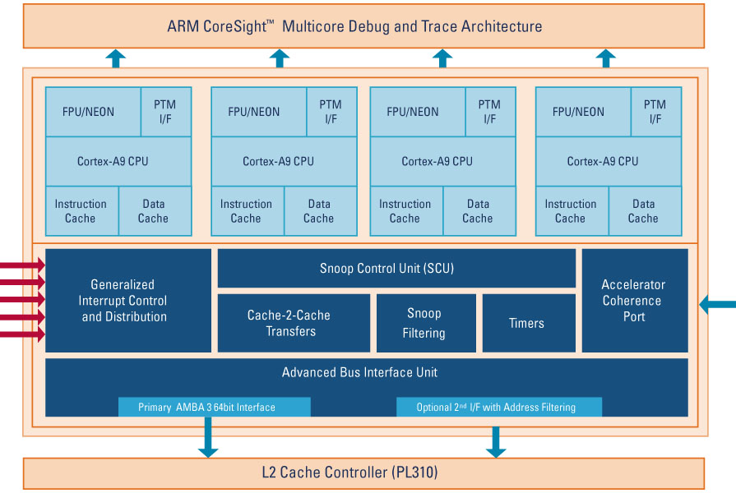
Cortex-A9 MPCore
Contains up to four Cortex-A9 processors
SCU
Maintains L1 data cache coherency between processors
Arbitrates accesses to the L2 memory system, through one or two external 64-bit AXI Manager interfaces
Optional ACP for maintaining coherency with DMA controller, graphics processor, or similar
Integrated interrupt controller
Same programmer’s model as Arm Generic Interrupt Controller (GIC): the PL390 PrimeCell
Notes:
The Cortex-A9 MPCore has one up to four Cortex-A9 cores in a cluster. Each Cortex-A9 core is identical to standard single core processors described in the previous slide. Each core has a private timer and watchdog unit.
The SCU connects the Cortex-A9 cores to the memory system through the AXI interfaces. Its functions are to:
-Maintain data cache coherency between the Cortex-A9 cores
-Initiate L2 AXI memory accesses
-Arbitrate between Cortex-A9 cores requesting L2 accesses
-Manage ACP accesses

Slide 41
Cortex-A9 Pipeline
ISS
Ex1
Ex2
WB
Main (P0)
Fe1
Fe2
Fe3
IQ
De
Re
M1
M2
Mac (M)
BM
Prefetch Unit
Ex1
Ex2
WB
Dual (P1)
Decode and issue stages
AGU
LSU
WB
Load/store (LS)
CE
WB
Compute Engine (CE)
Five backend execution pipelines
Pipelines are clustered into three different issue groups.
Main, or multiply accumulate (Mac)
Dual execution (also known as secondary)
Load/store, or compute engine (Neon or floating point)
Core can issue up to 3 instructions per cycle.
Notes:
This diagram shows an overview of the Cortex-A9 processor pipeline.
Let us first look at the Prefetch Unit.
In the Prefetch Unit, the instructions are fetched, indicated by FE in this diagram. However, these instructions are not really instructions unless they reach the Instruction Queue labeled as IQ in this diagram. Before they reach the Instruction Queue, they are just 64 bits of data that are simply forwarded along between stages. In the Instruction Queue, they become instructions, and only two of them can move on to decode per cycle, even if they are both 16 bits.
Next, let us look at the decode stage of the pipeline.
Instruction decode is indicated as DE in the diagram. The decode stage can decode up to two Armv7 or two Thumb-2 instructions per cycle. It is connected to the IQ using two 32-bit buses. This core makes use of micro-ops in some cases, thereby splitting instructions up into smaller pieces by taking extra cycles.
Register renaming, which is indicated as RE in the diagram, facilitates out-of-order execution.
The branch monitor, which is indicated as BM in the diagram, provides feedback to the branch predictor in the instruction prefetch stage, based on issued branches.
Next, let us look at the issue and execution stages of the pipeline.
The issue stage is indicated as ISS in the diagram.
The pipelines are clustered into three different issue groups:
The main or multiple accumulate execution pipeline, indicated as P0 and M, respectively, in the diagram.
The dual execution pipeline, indicated as P1 in the diagram.
Finally, the Load/Store or Compute Engine execution pipeline, indicated as LS or CE, respectively, in the diagram. The Address Generation Unit (AGU) generates addresses with offsets for the Load/Store Unit without using any of the ALU pipelines. The Load/Store Unit is indicated as LSU in the diagram.
Due to these three different issue groups, the processor can therefore issue up to three instructions per cycle.
Executed pipelines can complete out of order, thanks to register renaming, unless actual interdependency exists. In certain situations, instructions can be issued out of order into ALU pipelines but never into the others.
Finally, The write-back stage, indicated by WB in the diagram, happens after the execution stage in the pipeline. In a write-back cache, data is only written to main memory when it is forced out of the cache on line replacement following a cache miss. Otherwise, writes by the processor only update the cache. This is also known as copyback.

Slide 42
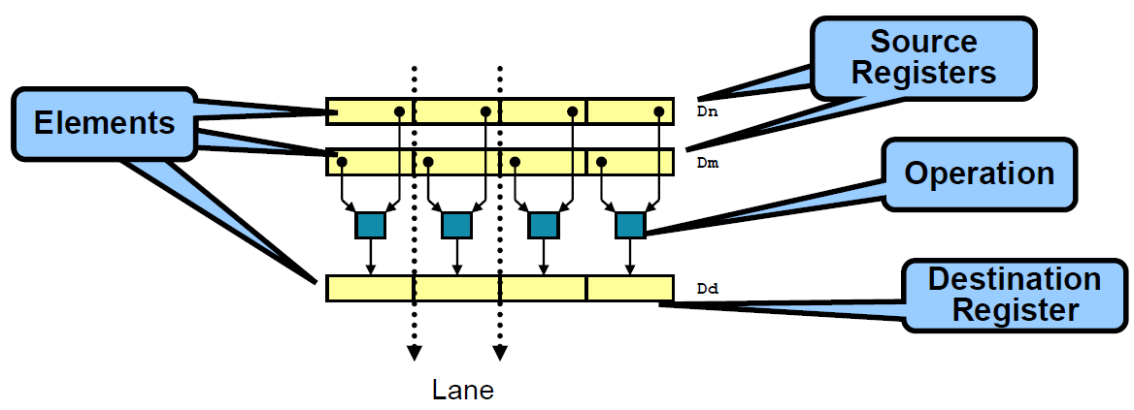
What Is Neon?
Neon is a wide SIMD data processing architecture.
Extension of the Arm instruction set
Thirty-two registers, 64 bits wide (dual view as sixteen registers, 128 bits wide)
Neon instructions perform packed SIMD processing.
Registers are considered vectors of elements of the same data type.
Data types can be signed/unsigned 8-bit, 16-bit, 32-bit, 64-bit, single precision, and float.
Instructions perform the same operation in all lanes.
Notes:
The Armv7 architecture introduced the Advanced Single Instruction Multiple Data or SIMD extension as an optional extension to the Armv7-A and Armv7-R architecture profiles. It extends the SIMD concept by defining groups of instructions operating on vectors stored in 64-bit doubleword registers and 128-bit quadword vector registers. The doubleword registers are named as D registers, and the quadword vector registers are named as Q registers.
The implementation of the Advanced SIMD extension used in Arm processors is called Neon, and this is the common terminology used outside architecture specifications. Neon technology is implemented on all current Arm Cortex-A series processors.
Neon instructions are executed as a part of the Arm or Thumb instruction stream. This simplifies software development, debugging, and integration compared to using an external accelerator. Traditional Arm or Thumb instructions manage all program flow and synchronization. The Neon instructions perform memory accesses, data copying between Neon and general-purpose registers, data type conversion and data processing.

Slide 43
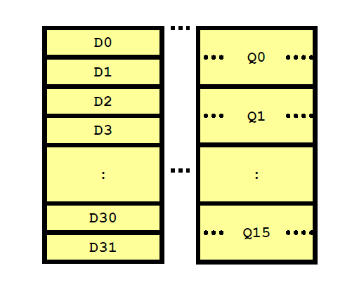
Neon Registers
Neon provides a 256-byte register file.
Distinct from the core registers
Extension to the VFPv2 register file (VFPv3)
Two explicitly aliased views
32 × 64-bit registers (D0–D31)
16 × 128-bit registers (Q0–Q15)
Enables register trade-off
Vector length
Available registers
Notes:
The NEON register bank consists of thirty-two 64-bit registers. If both Advanced SIMD and Vector Floating-Point Architecture, or VFP, version 3 are implemented, they share this register bank.
In this case, VFPv3 is implemented in the VFPv3-D32 form that supports thirty-two double-precision floating-point registers. This integration simplifies implementation of context switching support because the same routines that save and restore VFP context also save and restore NEON context.
The NEON unit can view the same register bank as:
sixteen 128-bit quadword registers, Q0–Q15
or
thirty-two 64-bit doubleword registers, D0–D31

Slide 44
Neon: Enhancing User Experiences
Notes:
Neon technology enhances user experiences with multimedia applications.
Media codecs and graphics accelerators operate on large amounts of data that are less than word-sized. 16-bit data is common in audio applications, and 8-bit data is common in graphics and video. This means that, when performing these operations on a 32-bit microprocessor, parts of the computation units are unused but continue to consume power. To make better use of the available resources, Neon technology uses a single instruction to perform the same operation in parallel on multiple data elements of the same type and size. This way, the hardware that normally adds two 32-bit values instead performs four parallel additions of 8-bit values in the same amount of time.

