Slide 1
AMBA AXI4 Bus Architecture

Slide 2
Learning Outcomes
At the end of this module, you will be able to:
Describe the purpose and operation of a bus and communication protocol in an SoC.
Identify the characteristics of various Arm AMBA System Buses including AMBA 3 and AMBA 4, AXI4-Lite, and AXI4-stream.
Outline the functionality and characteristics of the Arm AMBA AXI4-Lite and AXI4-stream.
Describe the transaction channels read and write operations for the AMBA AXI protocol.
Explain the channel timing mechanism for AXI, including the clock, reset, and VALID and READY handshake mechanism.

Slide 3
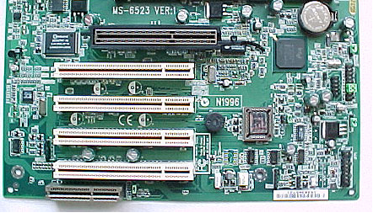
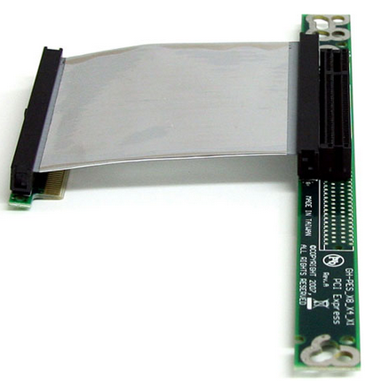
What Is a Bus?
Traditionally, a bus is a communication system that allows data to be transferred between different components in a computer.
The infrastructures is defined in both hardware and software:
Hardware infrastructure includes the physical implementation, such as cables or wires. For example, the PCI uses the PCI cable to connect components inside a desktop.
Software infrastructure includes the bus protocol, e.g., PCI bus protocol.
PCI socket on a mother board
PCI bus cable
Notes:
What is a bus?
A bus is a communication system that allows data to be transferred between different components in a computer.
An important aspect of an SoC is not only which components or blocks it houses, but also how they interconnect. A bus is a very important part of SoC design as it allows the processor to communicate with other parts of the system such as memory blocks, peripherals, application-specific logic, and so on. A basic building block of most on-chip communication architectures in SoC designs is the single shared bus. The simplest bus design consists of a set of shared, parallel wires to which various components are connected. Only one component on the bus can have control of the shared wires at any given time to perform data transfers. This simple bus design limits the parallelism and achievable performance in the system, which makes it unsuitable for most SoC applications. Therefore, more advanced solutions are usually employed in such systems. One of these is the AMBA bus, which we will discuss in this video.
The bus design specification includes both hardware and software infrastructures. The hardware infrastructure includes the physical implementation, such as cables or wires. For example, the PCI uses the PCI cable to connect components inside a desktop. Software infrastructure includes the bus protocol, for example, PCI bus protocol.

Slide 4
Bus Types
External bus
Used to connect external devices, such as a printer, to a computer
Internal bus
Used to connect internal components inside a computer, such as a CPU to memory
Also known as system bus
Less overhead, e.g., no need for electrical characteristics handling and configuration detection
Thus, typically runs faster than the external bus
In an SoC design, the internal bus is integrated onto a single chip; thus, it can also be referred to as an on-chip system bus.
Notes:
Generally speaking, there are two main types of buses: external bus and internal bus.
External buses are also called expansion buses. They are used to connect external devices, such as a printer, to a computer.
Internal buses are also called system buses. They are used to connect internal components in a computer board. They typically run faster than external buses since there is no need for electrical characteristics handling and configuration detection.
In an SoC design, however, internal buses are not wires or signal metal traces printed on a board, but metal paths integrated into the chip itself. These are also referred to as on-chip system buses.

Slide 5
Bus Terminology
Manager
Subordinate 1
Address
Decoder
Subordinate 2
Multiplexor
Select
Subordinate 3
Subordinate
Multiplexor
Notes:
In this diagram, we can see an example of a bus design. It is important to be familiar with the terms that are typically used in the specifications of on-chip buses.
Manager refers to IP components that initiate a read or write data transfer, for example, a processor or a DSP.
Subordinate refers to IP components that do not initiate transfers and only respond to incoming transfer requests, for example, a memory block.
Decoder refers to a logic block that decodes the destination address of a data transfer initiated by a Manager and selects the appropriate Subordinate to receive the data.
A multiplexor is used to multiplex the read data bus and response signals from the Subordinates to the Manager. The decoder provides control for the multiplexor.

Slide 6
Bus Operation in General
A bus typically consists of three types of signal lines:
Data bus is used to exchange data information
Address bus is used to select one of the peripherals (or one register of a peripheral)
Control signals are used to synchronize and identify transactions, such as ready, write/read, transfer mode signals
System on Chip
Manager
(Microprocessor)
Control Signals
32-bit Address Bus
32-bit Data Bus
Subordinate 1
Subordinate 2
Subordinate 3
Subordinate 4
Subordinate 5
Subordinate 6
Notes:
A bus typically consists of three types of signal lines: the data bus, the address bus, and the control signals.
The data bus is for data exchange.
The address bus is used to select peripheral, or one register or a peripheral.
The control signals are used to synchronize and identify transactions. Examples are the ready signal, read/write signal, and transfer mode signal.

Slide 7
A Typical Bus Operation Example
Processor
Peripheral
A typical operation to access a peripheral mainly consists of the following:
The Manager (e.g., a processor) selects one peripheral (or one register) by giving the address to the address bus. At the same time, it sets control signals, such as read or write, transfer size, and so forth.
Address bus
Select a peripheral
Control bus
Read operation, transfer size at the same time
Notes:
Let us now look at an example of a typical bus operation.
The Manager, in this case, a processor, selects one peripheral by giving the address to the address bus.
At the same time, it sets the control signals, such as the read or write signals, transfer size, etc.

Slide 8
A Typical Bus Operation Example
Processor
Peripheral
A typical operation to access a peripheral mainly consists of the following:
The Manager (e.g., a processor) selects one peripheral (or one register) by giving the address to the address bus. At the same time, it sets control signals, such as read or write, transfer size, and so forth.
The Manager waits for the Subordinate (e.g., peripheral) to respond.
Address bus
Select a peripheral
Control bus
Read operation, transfer size at the same time
Notes:
The Manager now waits for the Subordinate (in this case, the peripheral) to respond.

Slide 9
A Typical Bus Operation Example
Processor
Peripheral
A typical operation to access a peripheral mainly consists of the following:
The Manager (e.g., a processor) selects one peripheral (or one register) by giving the address to the address bus. At the same time, it sets control signals, such as read or write, transfer size, and so forth.
The Manager waits for the Subordinate (e.g., peripheral) to respond.
Once the Subordinate is ready, it sends back the requested data to the processor. At the same time, it sets the ready signal on the control bus.
Address bus
Select a peripheral
Control bus
Read operation, transfer size at the same time
Data bus
Send data back to processor
Control bus
Set ready signal at the same time
Notes:
The Subordinate sends back the requested data to the Manager and sets the ready signal on the control bus.

Slide 10
A Typical Bus Operation Example
Processor
Peripheral
A typical operation to access a peripheral mainly consists of the following:
The Manager (e.g., a processor) selects one peripheral (or one register) by giving the address to the address bus. At the same time, it sets control signals, such as read or write, transfer size, and so forth.
The Manager waits for the Subordinate (e.g., peripheral) to respond.
Once the Subordinate is ready, it sends back the requested data to the processor. At the same time, it sets the ready signal on the control bus.
Finally, the Manager reads the transmitted data and starts another communication cycle.
Address bus
Select a peripheral
Control bus
Read operation, transfer size at the same time
Data bus
Send data back to processor
Control bus
Set ready signal at the same time
Processor reads the data and starts the next operation
Address bus
Select a peripheral
Notes:
Finally, the Manager reads the data and starts another communication cycle.

Slide 11
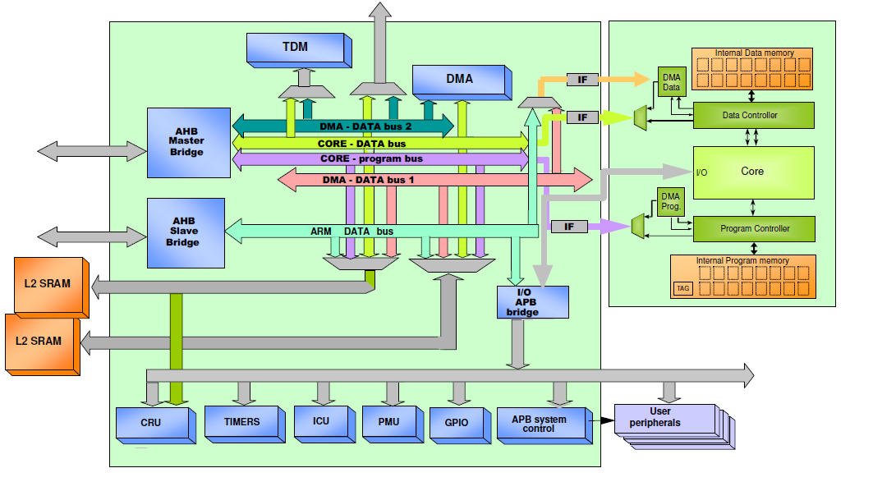
Communication Architecture Standards
Why do we need communication standards?
Modular design approach
Allows design reuse
Facilitates IPs integration into an SoC design
Picture source: http://www.ecs.soton.ac.uk/ (SoC Advance design Technique)
Notes:
Why do we need communication standards?
Modern SoCs need to handle incompatible IP interfaces, and assembling heterogeneous IPs for SoC design can take months. Interface and communication standards define a specific data transfer protocol and decide the number and functionality of pins at IP interfaces. This makes it easy to connect diverse IPs quickly. In summary, communication standards can encourage modular system design and IP reuse, make the design of IP cores independent of the system design, and facilitate the integration of IP cores from different vendors.

Slide 12
Arm AMBA System Bus
AMBA: Advanced Microcontroller Bus Architecture
AMBA protocol is an open standard (except AMBA 5), on-chip interconnect specification.
Used as the on-chip bus in Arm-based SoC designs
Provides the interface standard that enables IP reuse
Facilitates right-first-time development of multi-processor designs with large numbers of controllers and peripherals
Widely used in modern portable mobile devices, such as tablets and smartphones
Notes:
What is AMBA?
AMBA stands for Advanced Microcontroller Bus Architecture.
The Arm AMBA protocols are an open standard, on-chip interconnect specification for the connection, and management of functional blocks in a SoC. It facilitates right-first-time development of multi-processor designs with large numbers of controllers and peripherals.
AMBA provides the interface standard that enables IP reuse. It is widely used in modern devices, such as tablets and smartphones.

Slide 13
Arm AMBA Bus Families
AMBA Family | Bus Protocol | Processor
AMBA 5 | CHI | Cortex-A57, A53
AMBA 4 | ACE, ACE-Lite | Cortex-A7, A15
 | AXI4, AXI4-Lite, AXI4-Stream
AMBA 3 | AXI | Cortex-A9, A8, R4, R5
 | AHB (AHB-Lite) | Cortex-M0, M3, M4
 | APB | Cortex-M0, M3, M4
 | ATB
AMBA 2 | AHB, APB | Arm7, Arm9
AMBA 1 | ASB, APB
Notes:
This table shows the different AMBA family versions and its corresponding bus protocol.
AMBA 1 defines two buses: the Advanced System Bus (ASB) and Advanced Peripheral Bus (APB).
AMBA 2 introduced the AHB (Advanced High-performance Bus) and the APB (Advanced Peripheral Bus). The AHB was intended to be the main system bus in microcontroller usage, and the APB is developed for peripherals connection and designed to take up a minimal area.
AMBA 3 defines four buses (AXI, AHB-Lite, APB, and ATB). AMBA 3 AHB and APB specifications have the same usage as in the previous version. AMBA 3 AXI is developed to support high data throughput. AMBA 3 ATB facilitates moving trace data around the chip.
The AMBA 4 specification adds another five bus protocols as shown in the table. AXI4 is an update for AXI3, to enhance the performance and utilization of the interconnect when used by multiple Managers. ACE, which stands for AXI Coherency Extensions, is widely used on the latest Arm Cortex-A processors, including Cortex-A7 and Cortex-A15.
AMBA 5 is the latest version, and it uses the Coherent Hub Interfaces (CHI) bus protocol. The AMBA 5 CHI architecture specification defines the interfaces for connection of fully coherent processors, such as the Cortex-A57 and Cortex-A53, and dynamic memory controllers, such as the CoreLink DMC-520, to high performance, non-blocking interconnects, such as the CoreLink CCN-504.

Slide 14
AMBA 3 Specifications
AXI: Advanced eXtensible Interface
The most widely used AMBA interface
Connectivity with up to hundreds of Managers and Subordinates in complex SoCs
AMBA 3 defines a set of four interface protocols:
AMBA 3 AXI Interface
AMBA 3 AHB Interface
AMBA 3 APB Interface
AMBA 3 ATB Interface
Between these, they cover the on-chip data traffic requirements from data intensive processing components requiring:
High data throughput
Low-bandwidth communication requiring low gate count and power
On-chip test and debug access
Notes:
AXI, which stands for Advanced eXtensible Interface, is the most widely used AMBA interface. It can provide connectivity for up to hundreds of Managers and Subordinates in complex SoCs. This protocol supports high-performance, high-frequency system designs.

Slide 15
AMBA 3 AXI Interface
The AMBA 3 AXI interface specification has the characteristics to support highly effective data traffic throughput.
The five unidirectional channels with flexible relative timing between them and multiple outstanding transactions with out-of-order data capability enable:
Pipelined interconnect for high-speed operations
Efficient bridging between frequencies for power management
Simultaneous read and write transactions
Efficient support of high initial latency peripherals
Notes:
The AMBA 3 AXI protocol supports highly effective data traffic throughput.
The AXI features has five unilateral channels, supports multiple outstanding addresses and out-of-order transaction completion. These features enable pipelined interconnect for high-speed operations and efficiency for power management. It also can do simultaneous read and write transactions, with support of high initial latency peripherals.
There are five unilateral channels, and they are for write address, write data, write response, read address, and read data. These channels have flexible relative timing between them.
The AMBA 3 AXI protocol:
is suitable for high-bandwidth and low-latency designs
provides high-frequency operation without using complex bridges
meets the interface requirements of a wide range of components
is suitable for memory controllers with high initial access latency
provides flexibility in the implementation of interconnect architectures
is backward-compatible with existing AHB and APB interfaces
The key features of the AXI protocol are:
separate address/control and data phases
support for unaligned data transfers using byte strobes
burst-based transactions with only the start address issued
separate read and write data channels that can provide low-cost direct memory access (DMA)
support for issuing multiple outstanding addresses
support for out-of-order transaction completion
easy addition of register stages to provide timing closure
The AXI protocol includes the optional extensions that cover signaling for low-power operation.

Slide 16
AMBA 4 Specifications
The AMBA 4 specifications add another five interface protocols to the AMBA 3 specifications:
ACE
ACE-Lite
AXI4
AXI4-Lite
AXI4-Stream
The AXI and ACE protocol specifications Issue E, released February 2013, adds new optional properties for AXI ordering, ACE cache behavior, and Armv8 DVM messaging.
Notes:
AMBA 4.0, released in 2010, adds another five interface protocols to the AMBA 3 specifications, which are ACE, ACE-Lite, AXI4, AXI4-Lite, and AXI4-Stream. The protocol specifications Issue E, released February 2013, adds new optional properties for AXI ordering, ACE cache behavior, and Armv8 Distributed Virtual Memory (DVM) messaging.
The AXI4 protocol supports an ordering model based on the use of the AXI ID transaction identifier. For transactions with the same ID:
Transactions to any single peripheral device must arrive at the peripheral in the order in which they are issued, regardless of the addresses of the transactions
Memory transactions that use the same, or overlapping, addresses must arrive at the memory in the order in which they are issued
In an AXI system with multiple Managers, the AXI IDs used for the ordering model include the infrastructure IDs that identify each Manager uniquely. This means that the ordering model applies independently to each Manager in the system. The AXI4 also specifies additional signaling in the protocol to support quality of service (QoS). This addresses the challenges imposed by bandwidth and latency requirements of various IPs in an SoC. ACE, defined as a part of the AMBA 4 specification, extends AXI with additional signaling introducing system-wide coherency. This coherency allows multiple processors to share memory and enables technology like Arm’s big LITTLE processing. The ACE-Lite protocol enables one-way aka I/O coherency, such as a network interface that can read from the caches of a fully coherent ACE processor.

Slide 17
AMBA 4 Specifications
AXI4
Update for AXI3 to enhance the performance and utilization of the interconnect when used by multiple Managers
Support for burst lengths up to 256 beats
Quality of service signaling
Support for multiple region interfaces
AXI4-Lite
Subset of the AXI4 protocol intended for communication with simpler, smaller control register-style interfaces in components
All transactions are a burst length of one
All data accesses are the same size as the width of the data bus
Exclusive accesses are not supported
Does not support AXI IDs
Notes:
AXI4 is a high-performance interface suited for memory-mapped communication, allowing bursts of up to 256 data transfer cycles per address phase and quality-of-service signaling.
AXI4-Lite is light-weight variant of the interface, used for memory-mapped single transactions. This variant has the benefit of a smaller logic footprint with a simplified interface. This variation does not support burst data and so only provides a single data transfer per transaction. AXI4-Lite does not support AXI IDs. This means all transactions must be in order, and all accesses use a single fixed ID value.
Exclusive accesses are not supported. Exclusive access instructions are special memory access instructions for implementing semaphores or mutual exclusive operations. They are normally used when a resource has been shared between multiple application tasks or even between multiple processors. Special hardware resources inside the processor and in the system bus interconnect are needed to monitor exclusive access.

Slide 18
AMBA 4 Specifications
AXI4-stream
Designed for unidirectional data transfers from Manager to Subordinate with greatly reduced signal routing
Supports single and multiple data streams using the same set of shared wires
Support for multiple data widths within the same interconnect
Ideal for implementation in FPGA
Notes:
The AXI4-stream is designed for unidirectional data transfers from Manager to Subordinate with greatly reduced signal routing. It supports single and multiple data streams using the same set of shared wires. There is also support for multiple data widths within the same interconnect.
The AXI4-stream is not memory mapped, and it allows for an unlimited data burst size. A single channel is defined for the transmission of streaming data but allows bursts of an unlimited amount of data. The connection is from Manager to Subordinate only, so if bidirectional transfers are required, both peripherals must be of type Manager/Subordinate.
The AXI4-stream interface has many similarities to an AXI4 write data channel. However, there are some key differences:
The AXI4 write data channel does not permit interleaving.
The AXI4-stream interface does not have a defined or maximum burst or packet length, allows the data width to be any integer number of data bytes, includes TID and TDEST signals to indicate the source and destination, respectively, defines more precisely the manipulation of the TUSER sideband signals, and includes TKEEP signals to allow the insertion and removal of null bytes.

Slide 19
AXI Components and Topology
Manager component
A component that initiates transactions
Subordinate component
A component that receives transactions and responds to them
Subordinate components include memory Subordinate components and peripheral Subordinate components
Interconnect component
A component with more than one AMBA interface that connects one or more Manager components to one or more Subordinate components
An interconnect component can be used to group together either:
a set of Managers so that they appear as a single Manager interface
a set of Subordinates so that they appear as a single Subordinate interface
Notes:
We shall now focus on the AXI protocol.
Before we begin, let us first go through an overview of the AXI components.
A component is a distinct functional unit that has at least one AMBA interface. A component can be used as a general term for Manager, Subordinate, peripheral, and interconnect components.
A Manager is a component that initiates transactions.
A Subordinate is a component that receives transactions and responds to them.
An interconnect component is a component with more than one AMBA interface that connects one or more Manager components to one or more Subordinate components. The interconnect components can be grouped together as a single interface. For example, a set of Managers can appear as a single Manager interface, and a set of Subordinates can appear as a single Subordinate interface.
It is possible that a single component can act as both a Manager component and as a Subordinate component. For example, a Direct Memory Access (DMA) component can be a Manager component when it is initiating transactions to move data and a Subordinate component when it is being programmed.

Slide 20
AXI Components and Topology
Most systems use one of three topologies:
shared address and data buses
shared address buses and multiple data buses
multilayer, with multiple address and data buses
Manager 1
Manager 2
Manager 3
Subordinate 1
Subordinate 2
Subordinate 3
Subordinate 4
Notes:
As this slide shows, a typical system consists of a number of Manager and Subordinate devices connected together through some form of interconnect. The AXI protocol provides a single interface definition for the interfaces:
between a Manager and the interconnect,
between a Subordinate and the interconnect, and
between a Manager and a Subordinate.
This interface definition supports a variety of different interconnect implementations. Most systems use one of three interconnect topologies. The three topologies are:
shared address and data buses,
shared address buses and multiple data buses, and
multilayer, with multiple address and data buses.
In most systems, the address channel bandwidth requirement is significantly less than the data channel bandwidth requirement. Such systems can achieve a good balance between system performance and interconnect complexity by using a shared address bus with multiple data buses to enable parallel data transfers.
For a particular AXI transaction, upstream and downstream refer to the relative positions of AXI components within the AXI topology.

Slide 21
Transaction Channels
When an AXI Manager initiates an AXI operation targeting an AXI Subordinate,
the complete set of required operations on the AXI bus form the AXI transaction
any required payload data is transferred as an AXI burst
a burst can comprise multiple data transfers, or AXI beats
The AXI protocol is burst-based and defines the following independent transaction channels:
read address (AR)
read data (R)
write address (AW)
write data (W)
write response (B)
Notes:
Let us now look at the transaction channels in AXI.
An AXI Manager initiates an AXI transaction to communicate with an AXI Subordinate. Typically, the transaction requires information to be exchanged between the Manager and Subordinate on multiple channels. The complete set of required information exchanges form the AXI transaction.
In an AXI transaction, the payload data is transferred in a single burst that can comprise multiple beats or individual data transfers.
A beat is basically an individual data transfer within an AXI burst.
The AXI protocol is burst-based and has five transaction channels as shown in the slide.
The read and write transactions each have their own address channel. The appropriate address channel carries all of the required address and control information for a transaction. The read data channel carries both the read data and the read response information from the Subordinate to the Manager. The write data channel carries the write data from the Manager to the Subordinate. A Subordinate uses the write response channel to respond to write transactions. All write transactions require completion signaling on the write response channel.
The AXI protocol:
permits address information to be issued ahead of the actual data transfer
supports multiple outstanding transactions
supports out-of-order completion of transactions.
Each AXI channel transfers information in only one direction, and the architecture does not require any fixed relationship between the channels. This means a register slice can be inserted at almost any point in any channel at the cost of an additional cycle of latency.

Slide 22
Channel Architecture of Reads
Manager
Subordinate
Notes:
This diagram shows how a read transaction uses the read address and read data channels. The read data channel carries both the read data and the read response information from the Subordinate to the Manager and includes the data bus and a read response signal.
The data bus can be 8, 16, 32, 64, 128, 256, 512, or 1024 bits wide.
The read response signal indicates the completion status of the read transaction.

Slide 23
Channel Architecture of Writes
Manager
Subordinate
Notes:
This diagram shows how a write transaction uses the write address, write data, and write response channels. The write data channel carries the write data from the Manager to the Subordinate and includes the data bus and a byte lane write strobe signal.
The data bus can be 8, 16, 32, 64, 128, 256, 512, or 1024 bits wide.
The write strobe signal enables sparse data transfer on the write data bus. Each write strobe signal corresponds to a byte of the write data bus. When asserted, a write strobe indicates that the corresponding byte lane of the data contains valid information to be updated in the memory.

Slide 24
Basic Signals
Signals | Read Address | Read Data | Write Address | Write Data | Write Response
HANDSHAKE | ARVALID ARREADY | RVALID RREADY | AWVALID AWREADY | WVALID WREADY | BVALID BREADY
INFORMATION | ARADDR | RDATA RLAST | AWADDR | WDATA WLAST | BRESP
GLOBAL | ACLK, ARESETn
A VALID signal is asserted when valid information is driven by the information transmitter.
A READY signal is asserted when the information receiver is ready to receive.
A LAST signal is to indicate the transfer of the final data item in a transaction (data channels).
Notes:
Each of the independent channels consists of a set of information signals and VALID and READY signals that provide a two-way handshake mechanism.
The information source uses the VALID signal to show when valid address, data, or control information is available on the channel.
The destination uses the READY signal to show when it can accept the information.
Both the read data channel and the write data channel also include a LAST signal to indicate the transfer of the final data item in a transaction.

Slide 25
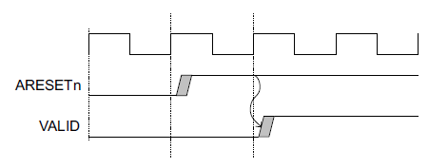
Clock and Reset
Clock
Each AXI component uses a single clock signal, ACLK.
All input signals are sampled on the rising edge of ACLK.
All output signal changes must occur after the rising edge of ACLK.
Reset
A single active-LOW reset signal, ARESETn
Can be asserted asynchronously, but de-assertion must be synchronous with a rising edge of ACLK
ACLK
Notes:
Clock and Reset are the two global signals of the AXI protocol. Input signals are sampled on the rising edge and output signals changes must occur after the rising edge. On Manager and Subordinate interfaces, there must be no combinatorial paths between input and output signals.
The AXI protocol uses a single active-LOW reset signal CALLED ARESETn. The reset signal can be asserted asynchronously, but de-assertion must be synchronous with a rising edge of ACLK.
During reset:
A Manager interface must drive ARVALID, AWVALID, and WVALID LOW.
A Subordinate interface must drive RVALID and BVALID LOW.
All other signals can be driven to any value.
A Manager interface must begin driving ARVALID, AWVALID, or WVALID HIGH only at a rising ACLK edge after ARESETn is HIGH as shown in the diagram in this slide.

Slide 26
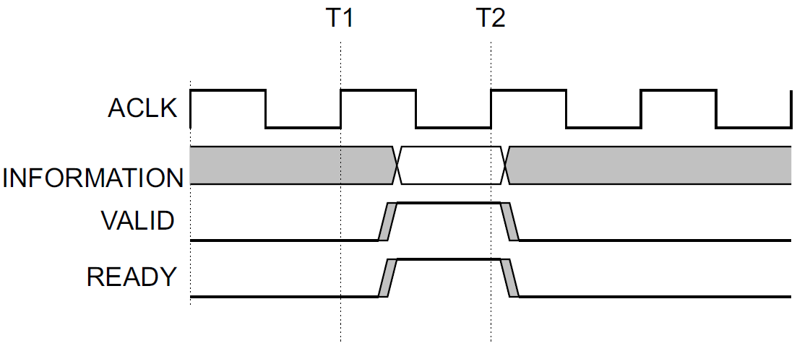
Channel Timing Example: VALID with READY Handshake
After T1, both the source and destination indicate a data transfer.
The transfer occurs at the rising clock edge (after both VALID and READY signals are asserted).
The transfer occurs at T2.
Notes:
All five transaction channels use the same VALID/READY handshake process to transfer address, data, and control information. This two-way flow control mechanism means that both the Manager and Subordinate can control the rate at which the information moves between Manager and Subordinate. The source generates the VALID signal to indicate when the address, data, or control information is available. The destination generates the READY signal to indicate that it can accept the information. Transfer occurs only when both the VALID and READY signals are HIGH.
As shown in this example, both the source and destination happen to indicate, after T1, that they can transfer the address, data, or control information. In this case, the transfer occurs at the rising clock edge when the assertion of both VALID and READY can be recognized. This means the transfer occurs at T2.

Slide 27
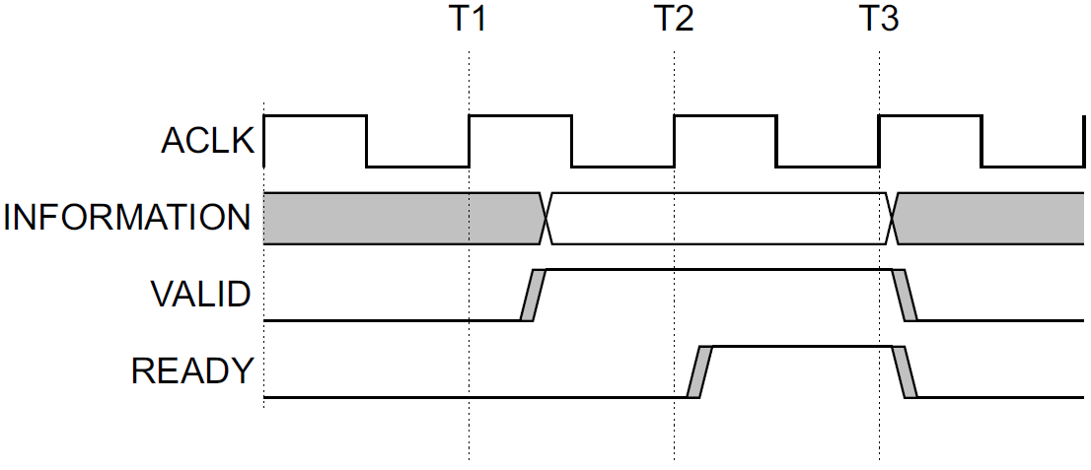
Channel Timing Example: VALID before READY Handshake
After T1, the source presents the address, data, or control information and asserts the VALID signal.
The destination asserts the READY signal after T2.
The source has to keep its information stable until the transfer occurs at T3.
Notes:
What happens if the VALID signal is asserted before the READY signal?
A source is not permitted to wait until READY is asserted before asserting VALID.
Once VALID is asserted, it must remain asserted until the handshake occurs at a rising clock edge at which VALID and READY are both asserted.
In this example, after T1, the source presents the address, data, and control information and asserts the VALID signal. The destination asserts the READY signal after T2. The source has to keep its information stable until the transfer occurs at T3.

Slide 28
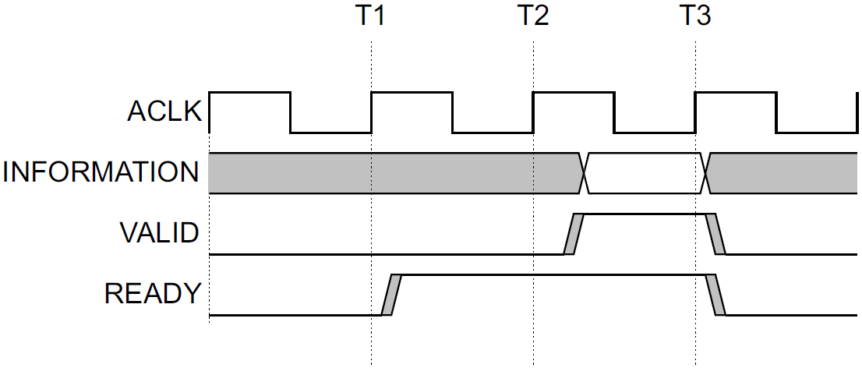
Channel Timing Example: READY before VALID Handshake
After T1, the destination asserts the READY signal (before the address, data, or control information is valid) to indicate that it can accept the information.
After T2, the source presents the information and asserts VALID.
The transfer occurs at T3 (when this assertion is recognized).
Notes:
What if the VALID signal is asserted after the READY signal?
In this case, the transfer occurs in a single cycle.
Note that a destination is permitted to wait for VALID to be asserted before asserting the corresponding READY. If READY is asserted, it is permitted to deassert READY before VALID is asserted.
In this example, the transfer occurs at T3, since this is the rising clock edge that occurs when the assertion of both VALID and READY can be recognized.

Slide 29
Relationships Between the Channels
The AXI protocol requires the following relationships to be maintained:
A write response must always follow the last write transfer in the write transaction of which it is a part.
Read data must always follow the address to which the data relates.
Channel handshakes must conform to the dependencies defined for the handshake signals.
Dependencies are shown in the next slide.
Notes:
The relationship between address, read, write, and write response channels is flexible. This means, for example, that the write data can appear at an interface before the write address for the transaction. This can occur if the write address channel contains more register stages than the write data channel. Similarly, the write data might appear in the same cycle as the address.
However, there are certain relationships that must be maintained:
A write response must always follow the last write transfer in the write transaction to which the write response relates to.
Read data must always follow the address to which the data relates.
Channel handshakes must conform to the dependencies defined for the handshake signals.

Slide 30
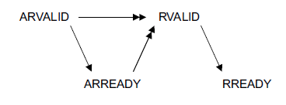
Relationships Between the Channels
Dependency rules between the handshake signals that must be observed:
The VALID signal of the AXI interface sending information must not depend on the READY signal of the AXI interface receiving that information.
An AXI interface that is receiving information can wait until it detects a VALID signal before it asserts its corresponding READY signal.
Read transaction
Write transaction
Notes:
What are the dependencies for the handshake signals?
To prevent a deadlock situation, you must observe the dependencies that exist between the handshake signals.
In any transaction:
The VALID signal of one AXI component must not be dependent on the READY signal of the other component in the transaction.
The READY signal can wait for assertion of the VALID signal.
In the diagrams in this slide, the single-headed arrows point to signals that can be asserted before or after the previous signal is asserted. Double-headed arrows point to signals that must be asserted only after assertion of the previous signal.
The diagram on the left shows that, in a read transaction, the Subordinate can wait for ARVALID to be asserted before it asserts ARREADY. The Subordinate must wait for both ARVALID and ARREADY to be asserted before it starts to return read data by asserting RVALID.
The diagram on the right shows that, in a write transaction, the Manager must not wait for the Subordinate to assert AWREADY or WREADY before asserting AWVALID or WVALID. The Subordinate can wait for AWVALID or WVALID, or both, before asserting AWREADY. The Subordinate must wait for both WVALID and WREADY to be asserted before asserting BVALID (VALID write response signal).

