Slide 1
Interrupts and Low-Power Features

Slide 2
Learning Objectives
At the end of this lecture, you should be able to:
Outline the different types of interrupts and their function.
Describe the steps taken by the processor in handling interrupts and exceptions.
Outline the differences between interrupts and exceptions.
Describe the functions of the Nested Vectored Interrupt Controller (NVIC).

Slide 3
Module syllabus
Interrupts
  What are interrupts?
  Why use interrupts?
Interrupts
  Entering an exception handler
  Exiting an exception handler
Microcontroller interrupts
Timing analysis
Program design with interrupts
Sharing data safely between ISRS and other threads
Notes:
This module starts with a general introduction into interrupts and their handling within the controller and the Arm architecture.
After explaining external and internal interrupts, the general program design is discussed.

Slide 4
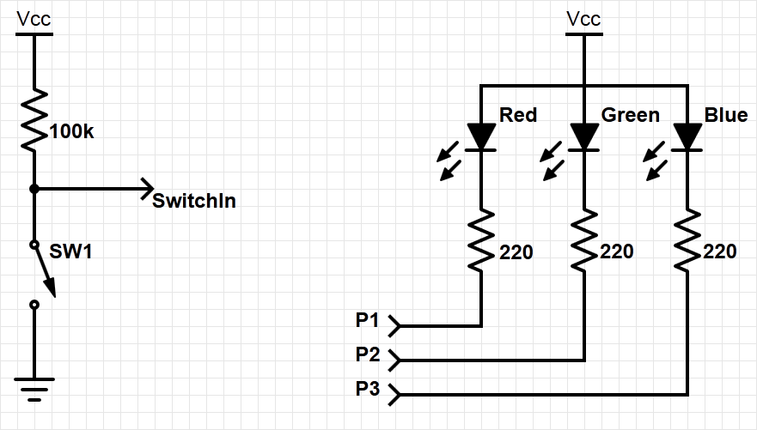
Example system with interrupt
Goal: to change the color of the RGB LED when the switch is pressed
Need to add an external switch
  (resistor is internal – a pull-up resistor)
Notes:
Let’s consider the following example:
Using a switch, we want to change the color of an RGB LED when it is pressed. To do this, we apply an external switch to a GPIO pin on the controller. In order to prevent the GPIO pin from being “open”, we will use a pull-up resistor as shown in the slide.
In the following slides, you will see how to implement interrupts by using this example system.

Slide 5
How can we detect when a switch is pressed?
One option is polling; e.g. using software to check it regularly. However, polling is:
  Slow – user needs to check to see if switch is pressed
  Wasteful of CPU time – the faster the response needed, the more often user needs to check
  Not scalable – It’s difficult to build a multi-activity system that can respond quickly. The system’s response time depends on all other processing it has to do.
A better option is an interrupt; e.g., using special hardware in the MCU to detect and run ISR in response. An interrupt is:
  Efficient – the code runs only when necessary
  Fast – it’s a hardware mechanism
  Scalable:
          ISR response time doesn’t depend on most other processing
          Code modules can be developed independently
Notes:
There are two ways to detect when a switch is pressed or not: polling and use of interrupts.
Polling is the method in which the microcontroller is continuously checking the status of a flag. It is slow, inefficient and is poorly scalable: The more GPIO or other events have to be polled, the more time is needed. So there is a natural limit to the number of supervised GPIOs possible at a given processor speed.
However, an interrupt-based routine only runs the code when it is called/initiated by the internet-service routine. This routine directly executes addressed code, sometimes without any CPU interaction. Therefore it is fully scalable, because it is independent from the number of monitored events, so the supervision doesn’t consume CPU time.

Slide 6
Interrupt or Exception Processing Sequence
Main code is running.
When the interrupt trigger occurs:
  The processor does some hardwired processing
  The processor executes the ISR, including return-from-interrupt instruction at the end
Then the processor resumes running main code
Hardwired CPU response activities
Interrupt routine
Main code
Time
Notes:
The term “interrupt” is self-explanatory: according to its priority, it interrupts (nearly) everything in order to execute its own code. While each interrupt’s configuration determines what is actually interrupted, if the interrupt is active, then regular program code will be stopped.
After stopping the main code, some hardwired routines such as saving registers are performed, before the interrupt routine is started.
All steps will be reversed after the interrupt routine is finished, and the regular program execution continues.

Slide 7
Interrupts
Hardware-triggered asynchronous software routine
  Triggered by hardware signal from peripheral or external device
  Asynchronous – can happen anywhere in the program (unless interrupt is disabled)
  Software routine – Interrupt Service Routine runs in response to interrupt
Fundamental mechanism of microcontrollers
  Provides efficient event-based processing rather than polling
  Provides quick response to events regardless of program state, complexity, location
  Allows many multithreaded embedded systems to be responsive without an operating system (specifically task scheduler)
Notes:
Interrupts are classified as asynchronous. Asynchronous stands for non-predictable, event-driven, and needs a dedicated trigger.
Therefore, asynchronous controller internal events need to be generated, and these are normally hardware-based pre-processed. In the next step, linked by an internal jump to a dedicated memory area, this code may directly be executed within any significant involvement of the CPU.
This is fundamental for microcontroller programming, because it allows for minimalism, special task design, energy, and runtime sensitivity. So the controller must be prevented from doing unnecessary tasks by operating in a passive mode as long as possible, responding mostly to events and triggers only. Based on this principle, multithreading can be emulated by hardware interrupts without the need for an operating system: The basic operation runs in a main task. Whenever something important happens, this task can be interrupted for a prioritized one.

Slide 8
Example program requirements and design
MAIN
RGB LED
SW
ISR
count
(does initialization, then updates LED based on count)
Global Variable
ISR
MAIN
When switch SW is pressed, ISR will increment count variable.
Main code will light LEDs according to count value in binary sequence (Blue: 4, Green: 2, Red: 1).
Main code will toggle its debug line each time it executes.
ISR will raise its debug line (and lower main’s debug line) whenever it is executing.
Notes:
Going back to our example, the program can be divided into three segments: the main code, the ISR and a global variable.
As shown in the slide, the main code does the initialization, lights the RGB LED according to the global variable value, and toggles the debug line for every loop iteration.
The ISR is triggered only when the switched is pressed and is incrementing the global variable value. The ISR also sets the debug line whenever it is executing.

Slide 9
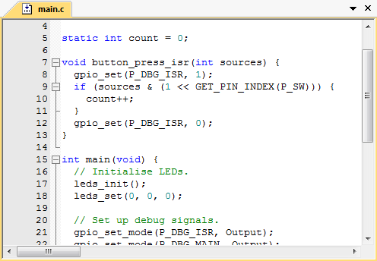
Example exception handler
Now we will examine the processor’s response to exception in detail:
Notes:
In this slide, the exception handling is shown in the source code. An exception is any condition that needs to halt normal execution of the instructions, such as core resets, failures, interrupts.
(Note that the colors refer to the colors as used in the previous slide.)
The functional code of incrementing the counter (yellow: definition and initialization line) is located in the interrupt service routine (red): It is activated by an interrupt on the pin to which the switch is connected. Here, a counter is incremented and controlling the RGB LED.
In the main routine (brown) only the initialization and the connection of the ports to the ISR are made.

Slide 10
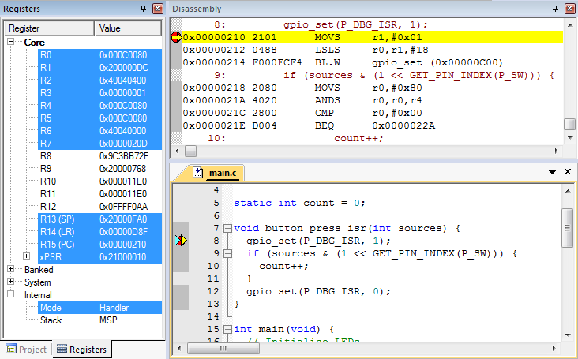
Use debugger for detailed processor view
Can see registers, stack, source code, disassembly (object code)
Note: compiler may generate code for function entry
Place breakpoint on the handler function declaration line in source code, not at the first line of code
Notes:
We can use the debugger to observe the exception handling steps in detail. It is an advantage to follow the next steps within an extended IDE, with assembly and a register section, so that every step of the exception handling can be observed inside the register. To see all the steps, you must set a breakpoint in the first line of the exception handler (here: line 8).

Slide 11
Entering exception handler: CPU hardwired exception processing
Finish current instruction
  Except for lengthy instructions
Push context (registers) onto current stack (MSP or PSP)
  xPSR, Return Address, LR(R14), R12, R3, R2, R1, R0
Switch to handler/privileged mode, use MSP
Load PC with address of interrupt handler
Load LR with EXC_RETURN code
Load IPSR with exception number
Start executing code of interrupt handler
Usually 16 cycles from exception request to execution of first instruction in handler
Notes:
After the exception is triggered, the current instruction (unless it is a lengthy instruction) of the operating code finishes before the interrupt execution process starts. From here within 16 cycles (also called “interrupt latency”), first the current architectural state is saved onto the stack, and then the interrupt routine is prepared (load PC). Afterwards, the return address stored in the LR and the IPSR is loaded with the correct exception number to be executed. Now the interrupt code is started.
Steps are explained in the following slides.

Slide 12
1. Finish current instruction
Most instructions are short and finish quickly.
Some instructions may take many cycles to execute.
  Load Multiple (LDM), Store Multiple (STM), Push, Pop, MULS (32 cycles for some CPU core implementations)
This will delay interrupt response significantly.
If one of these is executing when the interrupt is requested, the processor:
  abandons the instruction
  responds to the interrupt
  executes the ISR
  returns from interrupt
  restarts the abandoned instruction
Notes:
Exception entry occurs when there is a pending exception with sufficient priority, and either the processor is in Thread mode, or the new exception is of higher priority than the exception being handled, in which case the new exception preempts the original exception. If the current executing instruction takes many cycles to execute, then the instruction is abandoned and is restarted after the ISR execution.

Slide 13
2. Push context onto current stack
 |  | <previous> | SP points here before interrupt
 | SP + 0x1C | xPSR
 | SP + 0x18 | PC
Decreasing | SP + 0x14 | LR
memory | SP + 0x10 | R12
address | SP + 0x0C | R3
 | SP + 0x08 | R2
 | SP + 0x04 | R1
 | SP + 0x00 | R0 | SP points here upon entering ISR
Two SPs: Main (MSP), process (PSP)
Which is active depends on operating mode, CONTROL register bit 1
Stack grows toward smaller addresses
Notes:
Alike calling a subroutine, the processor pushes information onto the current stack (PC, xPSR, LR, and registers) before beginning to execute the exception code. The operation of pushing content to the stack is called stacking, whereas the structure of the eight words is called a stack frame.
After the termination of the routine it will be restored and continued from this point.

Slide 14
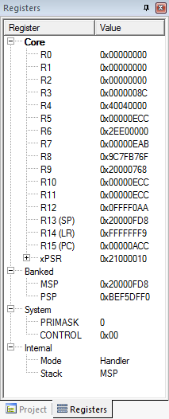
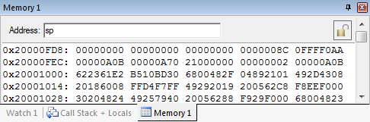
Context saved on stack
SP value is reduced since registers have been pushed onto stack
Saved R0
Saved R1
Saved R2
Saved R3
Saved R12
Saved LR
Saved PC
Saved xPSR
Notes:
The memory snapshot shows the saved registers on the stack. Each word in the stack now holds the value of each one of the registers that are pushed in the stack (stack frame).

Slide 15
3. Switch to handler/privileged mode
Handler mode always uses Main SP
Reset
Thread
Mode.
MSP or PSP.
Exception
Processing
Completed
Starting
Exception
Processing
Handler Mode
MSP
Notes:
After saving the registers and before executing the ISR-code, the execution of the exception needs to be prepared. To do this, the code execution must be switched into privileged mode, so the processor has more access to the core functions, such as full access to the MSR, the MRS instructions, the CPS instructions, and access the system timer, NVIC, or system control block.
This needs to be reversed again after finishing the exception code and returning to normal operation.

Slide 16
Handler and privileged mode
Mode changed to Handler. Was already using MSP
Notes:
In this slide, you can see that the exception handler is triggered and the execution mode is changed from Thread to Handler. Code in Handler mode is always executed as Privileged, therefore the core will automatically switch to Privileged mode when exceptions occur.

Slide 17
Update IPSR with exception number
Exception number 0x10
(interrupt number + 0x10)
Notes:
Another change that took place after the exception handler triggering is the value of IPSR (Interrupt Program Status Register) which is in [8:0] bit position on the xPSR register. According to IPSR bit assignments, 0x10 stands for the interrupt exception handler type.

Slide 18
4. Load PC with address of exception handler
Memory Address | Value
0x0000_0000 | Initial Stack Pointer
0x0000_0004 | Reset
0x0000_0008 | NMI_IRQHandler
…
 | IRQ0_Handler
 | IRQ1_Handler
…
Reset:
…
NMI_IRQHandler:
…
IRQ0_Handler:
…
IRQ1_Handler:
Which Program Counter is selected from the vector table depends on which exception is used
Notes:
When an exception is triggered, the Program Counter is loaded with the corresponding exception handler code according to the exception handler type, which can be found on the vector table.

Slide 19
Examine vector table with debugger
Exception number | IRQ number | Vector | Offset
 |  | Initial SP | 0x00
1 |  | Reset | 0x04
2 | -14 | NMI | 0x08
3 | -13 | HardFault | 0x0C
4 |  | Reserved | 0x10
5
6
7
8
9
10
11 | -5 | SVCall | 0x2C
12 |  | Reserved
13
14 | -2 | PendSV | 0x38
15 | -1 | SysTick | 0x3C
16 | 0 | IRQ0 | 0x40
17 | 1 | IRQ1 | 0x44
18 | 2 | IRQ2 | 0x48
. |  | .
16+n | n | IRQn | 0x40+4n
Why is the vector odd?
LSB of address indicates that handler uses Thumb code
Notes:
The vector table contains the reset value of the stack pointer, and the start addresses, also called exception vectors, for all exception handlers. The least significant bit of each vector must be 1, indicating that the exception handler is Thumb code.

Slide 20
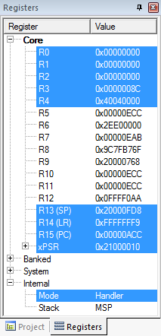

Upon entry to handler
PC has been loaded with start address of handler
Notes:
Here the Program Counter is loaded with the address of the first instruction of the exception handler code.

Slide 21
5. Load LR with EXC_RETURN code
EXC_RETURN value generated by CPU to provide information on how to return
  Which SP to restore registers from? MSP (0) or PSP (1)
          Previous value of SPSEL
  Which mode to return to? Handler (0) or Thread (1)
          Another exception handler may have been running when this exception was requested
EXC_RETURN | Return Mode | Return Stack | Description
0xFFFF_FFF1 | 0 (Handler) | 0 (MSP) | Return to exception handler
0xFFFF_FFF9 | 1 (Thread) | 0 (MSP) | Return to thread with MSP
0xFFFF_FFFD | 1 (Thread) | 1 (PSP) | Return to thread with PSP
Notes:
When stacking is complete, the processor starts executing the exception handler. At the same time, the processor writes an EXC_RETURN value to the LR. This indicates which stack pointer corresponds to the stack frame, and what operation mode the processor was in before the entry occurred.

Slide 22
Updated LR with EXC_RETURN code
Notes:
In this example, the LR has been loaded with 0xFFFF_FFF9 EXC_RETURN code. This code reveals that it will return to normal MSP thread mode after ISR execution.

Slide 23
6. Start executing exception handler
Exception handler starts running, unless preempted by a higher-priority exception
Exception handler may save additional registers on stack
  E.g. if handler may call a subroutine, LR and R4 must be saved
Notes:
Now the exception code has started executing. If nested interrupts are allowed, this can be stopped by another, higher priority interrupt. Otherwise, nested interrupts may also be prohibited. In that case, only high priority exceptions, such as a reset or watchdog event, may interrupt this code.

Slide 24
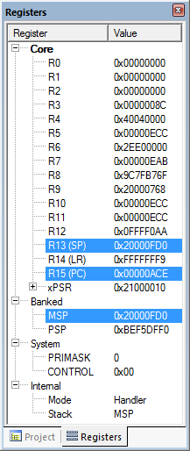
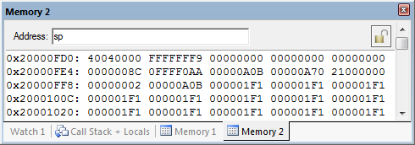
After handler has saved more context
Saved R4
Saved LR
Saved R0
Saved R1
Saved R2
SP value reduced since registers have been pushed onto stack
Saved R3
Saved R12
Saved LR
Saved PC
Saved xPSR
Notes:
Now additional code has been executed, and registers values have been pushed to the stack.

Slide 25
Exiting an exception handler
Execute instruction triggering exception return processing
Select return stack, restore context from that stack
Resume execution of code at restored address
Notes:
Exception return occurs when the processor is in Handler mode and loads the EXC_RETURN value into the PC, in order to restore context and resume execution of the main code.

Slide 26

1. Execute instruction for exception return
No “return from interrupt” instruction
Use regular instruction instead
  BX LR - Branch to address in LR by loading PC with LR contents
  POP …, PC - Pop address from stack into PC
… with a special value EXC_RETURN loaded into the PC to trigger exception handling processing
  BX LR used if EXC_RETURN is still in LR
  If EXC_RETURN has been saved on stack, then use POP
Notes:
There is no special instruction for returning from interrupt. The interrupt routine is terminated like a regular branch.
Depending on where the return address has been stored, either BX LR is used if the return address is still in LR, or the return address has been stored on the stack and is recalled with POP.

Slide 27
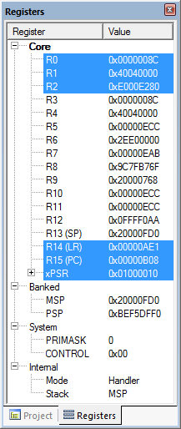
What will be popped from stack?
R4: 0x4040_0000
PC: 0xFFFF_FFF9
Saved R4
Saved LR
Saved R0
Saved R1
Saved R2
Saved R3
Saved R12
Saved LR
Saved PC
Saved xPSR
Notes:
Initially, R4 and PC will be popped from the stack. PC will be loaded with the EXC_RETURN code.

Slide 28
2. Select stack, restore context
Check EXC_RETURN (bit 2) to determine from which SP to pop the context
Pop the registers from that stack
EXC_RETURN | Return Stack | Description
0xFFFF_FFF1 | 0 (MSP) | Return to exception handler with MSP
0xFFFF_FFF9 | 0 (MSP) | Return to thread with MSP
0xFFFF_FFFD | 1 (PSP) | Return to thread with PSP
 |  | <previous> | SP points here after handler
 | SP + 0x1C | xPSR
 | SP + 0x18 | PC
Decreasing | SP + 0x14 | LR
memory | SP + 0x10 | R12
address | SP + 0x0C | R3
 | SP + 0x08 | R2
 | SP + 0x04 | R1
 | SP + 0x00 | R0 | SP points here during handler
Notes:
If the return mode is set to “handler”, the controller may execute another interrupt, otherwise it returns to the normal program execution.
Returning into the normal thread mode, the next step is to determine from which stack (MSP or PSP) the data should be restored. This decision is mainly made to prevent the main program from running out of stack space. As seen on previous slides, the stack is defined by the second bit of the EXC_RETURN: if 0 then the information is in the MSP, if 1 then it is in the PSP.

Slide 29
Example
PC=0xFFFF_FFF9, so return to thread mode with main stack pointer
Pop exception stack frame from stack back into registers
Saved R0
Saved R1
Saved R2
Saved R3
Saved R12
Saved LR
Saved PC
Saved xPSR
Notes:
In this example, according to the EXC_RETURN code, we are going to return to thread mode with the main stack pointer and pop stack frame back to registers.

Slide 30
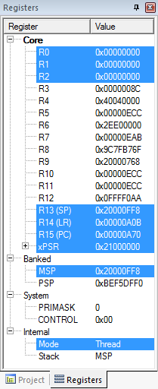
Resume executing previous main thread code
Exception handling registers have been restored: R0, R1, R2, R3, R12, LR, PC, xPSR
SP is back to previous value
Back in thread mode
Next instruction to execute is at 0x0000_0A70
Notes:
Finally, all exception handling registers have been restored (R0, R1, R2, R3, R12, LR, PC, xPSR), and the stack point (SP) points to the value before the interrupt execution. The thread mode is active again, and the PC points to the next regular code instruction at 0x0000_0a70.
The system is in the same Execution state as before the interrupt.

Slide 31
Microcontroller interrupts
Types of interrupts:
  Hardware interrupts
          Asynchronous: not related to what code the processor is currently executing
          Examples: interrupt is asserted, character is received on serial port, or ADC converter finishes conversion
  Exceptions, faults, software interrupts
          Synchronous: are the result of specific instructions executing
          Examples: undefined instructions, overflow occurs for a given instruction
  We can enable and disable (mask) most interrupts as needed (maskable), others are non-maskable
Interrupt service routine (ISR)
  Subroutine which processor is forced to execute to respond to a specific event
  After ISR completes, MCU goes back to previously executing code
Notes:
There are different types of interrupts: primarily “regular” and “exceptional” interrupts.
Regular interrupts are based on asynchronous external events; for example, they are created by ADC conversions, or data received at serial ports. Exceptions usually occur synchronously, which means they are the result of undesirable behavior of executed instructions. Because they happen at the same time as the code, they are called “synchronous”.
Most interrupts can be masked; that is, they can be disabled. The term “masked” comes from the bit mask which is defined to filter unneeded or unwanted interrupts. But not all interrupts are maskable; for example, the watchdog interrupt is not maskable. In this case, they are called non-maskable interrupt (NMI).
The code being forced to be executed by an interrupt is called interrupt service routine (ISR).

Slide 32
Nested vectored interrupt controller
NVIC manages and prioritizes external interrupts
Interrupts are types of exceptions
  Exceptions 16 through 16+N
Modes
  Thread Mode: entered on reset
  Handler Mode: entered on executing an exception
Privilege level
Stack pointers
  Main Stack Pointer, MSP
  Process Stack Pointer, PSP
Exception states: Inactive, Pending, Active, A&P
Port Module
Arm Cortex
Core
Next Module
NVIC
Another Module
Notes:
The Nested Vectored Interrupt Controller (NVIC) provides configurable interrupt handling abilities to the processor. It facilitates low-latency exception and interrupt handling, and controls power management.
The NVIC offers very fast interrupt handling, and provides the vector table as a set of real vectors (addresses).
In addition, the NVIC saves, and automatically restores, a set of the CPU registers (R0-R3, R12, PC, PSR, and LR), does a quick entry to the next pending interrupt without a complete pop/push sequence, and serves a complete set of 255 (240 external) interrupts.

Slide 33
NVIC registers and state
Enable - allows interrupt to be recognized
  Accessed through two registers (set bits for interrupts)
          Set enable with NVIC_ISER, clear enable with NVIC_ICER
  CMSIS Interface: NVIC_EnableIRQ(IRQnum), NVIC_DisableIRQ(IRQnum)
Pending - interrupt has been requested but is not yet serviced
  CMSIS: NVIC_SetPendingIRQ(IRQnum), NVIC_ClearPendingIRQ(IRQnum)
Notes:
The external interrupts are managed and prioritized by the nested vector interrupt controller (NVIC). A “nested interrupt” is an interrupt routine call within another active interrupt. This second interrupt is called “nested”.
There are two possible states: the “enable state”, which means that interrupts are recognized, and the “pending state”, which means that an interrupt has been requested and detected but is not serviced yet.
CMSIS is the Cortex Microcontroller Software Interface Standard, a vendor-independent interface for debugging that also provides commands for controlling the NVIC.

Slide 34
Core exception mask register
Similar to “Global interrupt disable” bit in other MCUs
PRIMASK - Exception mask register (CPU core)
  Bit 0: PM Flag
          Set to 1 to prevent activation of all exceptions with configurable priority
          Clear to 0 to allow activation of all exception
  Access using CPS, MSR and MRS instructions
  Use to prevent data race conditions with code needing atomicity
CMSIS-CORE API
  void __enable_irq() - clears PM flag
  void __disable_irq() - sets PM flag
  uint32_t __get_PRIMASK() - returns value of PRIMASK
  void __set_PRIMASK(uint32_t x) - sets PRIMASK to x
Notes:
Priority Mask Register: The PRIMASK register prevents activation of all exceptions with configurable priority. When the PRIMASK register bit is set, it prevents the activation of all exceptions with configurable priority.
This eliminates the problem of so-called data races. A data race occurs when two independent threats may access the same data. If one threat is manipulating data, another one also needs the, in this case unknown, order of operations. To prevent such a situation the PM flag is set.
The CMSIS-Core API provides dedicated commands to manipulate the PRIMASK and the PM flag.

Slide 35
Prioritization
Exceptions are prioritized to order the response simultaneous requests (smaller number = higher priority)
Priorities of some exceptions are fixed
  Reset: -3, highest priority
  NMI: -2
  Hard Fault: -1
Priorities of other (peripheral) exceptions are adjustable
  Value is stored in the interrupt priority register (IPR0-7)
  0x00
  0x40
  0x80
  0xC0
Notes:
The priority of nearly simultaneous interrupts is important. Here, a priority can be defined. The reset has the highest priority (-3) and the external exceptions are adjustable to higher priorities. The values are stored in the interrupt priority register.

Slide 36
Special cases of prioritization
Simultaneous exception requests?
  Lowest exception type number is serviced first
New exception requested while a handler is executing?
  New priority higher than current priority?
          New exception handler preempts current exception handler
  New priority lower than or equal to current priority?
          New exception held in pending state
          Current handler continues and completes execution
          Previous priority level restored
          New exception handled if priority level allows
Notes:
When multiple exceptions are valid at the same time (i.e. more than one exception occurs during execution of an instruction), they are handled by the core (after completing the execution of the current instruction), according to their priority.

Slide 37
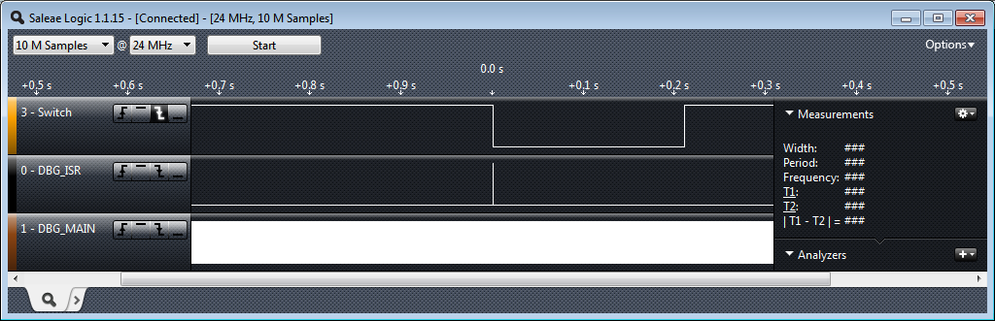
Timing analysis: big picture timing behavior
Switch was pressed for about 0.21 s
ISR runs in response to switch signal’s falling edge
Main seems to be running continuously (signal toggles between 1 and 0)
  Does it really? You will investigate this in the lab exercise.
Notes:
In this and the following slides, we are going to explore the timing behavior of the example that we are using in this module (the switched LED).
The timing analysis is made with the help of a logic analyzer. In our experiment, we learned that the switch is pressed for 0.21s, and the ISR is triggered in response to the falling edge of the signal switch. The DBG_MAIN signal is the debug signal that toggles on every loop iteration of our main code. Here, the interrupts seem not to be working, because the DMG_MAIN signal is running continuously.
Isn’t it? The answer will be investigated in the lab exercise.

Slide 38
Interrupt response latency
Latency = time delay
Why do we care?
  This is overhead which wastes time, and increases as the interrupt rate rises.
  This delays our response to external events, which may or may not be acceptable for the application, such as sampling an analog waveform.
How long does it take?
  Finish executing the current instruction or abandon it
  Push various registers on to the stack, fetch vector
          C_{IntResponseOvhd}: Overhead for responding to each interrupt
  If we have external memory with wait states, this takes longer
Notes:
A very important aspect of interrupts is “latency”.
Latency is defined as the time delay between when the interrupts are triggered, and when the interrupt service routine begins to execute. In some applications, latency is critical; for example, when an analog waveform is sampled.
There are several side-effects that can affect latency, which has to be taken into consideration. For example, latency is affected if the current executing instruction is finished or abandoned.

Slide 39
Maximum interrupt rate
We can only handle so many interrupts per second
  F_{Max_Int}: maximum interrupt frequency
  F_{CPU}: CPU clock frequency
  C_{ISR}: Number of cycles ISR takes to execute
  C_{Overhead}: Number of cycles of overhead for saving state, vectoring, restoring state, etc.
  F_{Max_Int} = F_{CPU}/(C_{ISR}+ C_{Overhead})
  Note that model applies only when there is one interrupt in the system
When processor is responding to interrupts, it isn’t executing our other code
  U_{Int}: Utilization (fraction of processor time) consumed by interrupt processing
  U_{Int} = 100%*F_{Int}* (C_{ISR}+C_{Overhead})/ F_{CPU}
  CPU looks like it’s running the other code with CPU clock speed of (1-U_{Int})*F_{CPU}
Notes:
The maximum interrupt frequency equals the CPU clock frequency, divided by the sum of the interrupt service routine, plus the interrupt overhead cycles.
Note that the higher the interrupt frequency, the less the less time there is for the CPU to execute other code.

Slide 40
Program design with interrupts
How much work to do in ISR?
  Trade-off: faster response for ISR code will delay completion of other code
  In system with multiple ISRs with short deadlines, perform critical work in ISR and buffer partial results for later processing
Should ISRs re-enable interrupts?
How to communicate between ISR and other threads?
  Data buffering
  Data integrity and race conditions
          Volatile data – can be updated outside of the program’s immediate control
          Non-atomic shared data – can be interrupted partway through read or write, is vulnerable to race conditions
Notes:
We have to take several design-time decisions, related to the interrupt implementation, when we are we are designing a program with interrupts.
First, we must consider the amount of work that will be assigned to an interrupt. We have to deal with the time that is going to be spent in between ISR and other code. If we have multiple ISRs, it is better to assign them to perform only critical work, and to buffer the rest for later processing.
Another important question is whether ISRs should be in charge to re-enable interrupts? Because we do not want to have an ISR running for long with all interrupts disabled, it might be preferable for a long-running ISR to re-enable interrupts. On the other hand, if an ISR is fast and efficient, then there is no need for such action.
One way to communicate between ISR and other code is software data buffering, which is generally used as a communication interface. We must always keep data integrity and race conditions in mind.

Slide 41
Volatile data
Compilers assume that variables in memory don’t change spontaneously, and optimize based on that belief
  Don’t reload a variable from memory if current function hasn’t changed it
  Read variable from memory into register (faster access)
  Write back to memory at the end of the procedure, or before a procedure call, or when compiler runs out of free registers
This optimization can fail
  Example: reading from input port, polling for key press
          While (SW_0) ; will read from SW_0 once and reuse that value
          Will generate an infinite loop triggered by SW_0 being true
Variables for which it fails
  Memory-mapped peripheral register – register changes on its own
  Global variables modified by an ISR – ISR changes the variable
  Global variables in a multithreaded application – another thread or ISR changes the variable
Notes:
To optimize code generation and improve runtime, the compiler makes some assumptions about code behavior. One key assumption is that all data behave in an atomic manner, whether it does or not. Because changes from outside are not expected, some variables may be loaded into registers (performance improvements), and write back register values back to memory at the end of the procedure, or when there is a need.
This optimization can fail, however.
For example, the application is reading from input port, polling for key press, and the switch state is represented by the variable SW_0.
If SW_0 is changed by an interrupt routine, this change will not be recognized, as this variable will not update within the while loop.
Other situations that might prompt failure are indicated in the slide.

Slide 42
The volatile directive
We need to tell compiler which variables may change outside of its control
  Use volatile keyword to force compiler to reload these vars from memory for each use
  volatile unsigned int num_ints;
  Pointer to a volatile int
  volatile int * var; // or
  int volatile * var;
  Now each C source read of a variable (e.g. status register) will result in an assembly language LDR instruction
  See explanation in Nigel Jones’ “Volatile,” Embedded Systems Programming July 2001
Notes:
The indicator for potential external changes is the compiler keyword “volatile”.
Volatile data is data which may be changed in other parts of the software.
If a variable is declared using volatile, e.g., volatile int a; then a compiler will reload the variable before every use. However, be careful with the use of this declaration, because volatile may slow down your code – especially very efficient, atomic code – significantly.

Slide 43
Non-atomic shared data
void GetDateTime(DateTimeType * DT){
DT->day = current_time.day;
DT->hour = current_time.hour;
DT->minute = current_time.minute;
DT->second = current_time.second;
}
We want to keep track of current time and date
Use 1 Hz interrupt from timer
System:
  current_time structure tracks time and days since some reference event
  current_time’s fields are updated by periodic 1Hz timer ISR
void DateTimeISR(void){
current_time.second++;
if (current_time.second > 59){
current_time.second = 0;
current_time.minute++;
if (current_time.minute > 59) {
current_time.minute = 0;
current_time.hour++;
if (current_time.hour > 23) {
current_time.hour = 0;
current_time.day++;
… etc.
}
Notes:
A good example is a clock application:
It is called at 1Hz by an interrupt, increasing the seconds-counter by 1. The timer interrupt not only performs the atomic operation of increasing the counter, but also check the correct assignment to minutes, hours and days. Additionally, a routine defines GetDateTime, copying the data to a DateTimeType pointer.
Now, if there is poor timing between interrupt and function call, an inconsistent situation may occur, as indicated in the next slide. This situation is called “data race condition”.

Slide 44
Example: checking the time
Problem: An interrupt at the wrong time will lead to half-updated data in DT
Failure Case
  current_time is {10, 23, 59, 59} (10th day, 23:59:59)
  Task code calls GetDateTime(), which copies the current_time fields to DT: day = 10, hour = 23
  A timer interrupt occurs, which updates current_time to {11, 0, 0, 0}
  GetDateTime() resumes executing, copying the remaining current_time fields to DT: minute = 0, second = 0
  DT now has a time stamp of {10, 23, 0, 0}.
  The system thinks time just jumped backwards one hour!
Fundamental problem: “race condition”
  Preemption enables ISR to interrupt other code and possibly overwrite data
  Must ensure atomic (indivisible) access to the object
          Native atomic object size depends on processor’s instruction set and word size
          32 bits for Arm
Notes:
The problem arises when an interrupt is triggered during the execution of the GetDateTime function, while it is updating DT. The interrupt service routine changed the current time, which has as a result to update the rest of the DT members with the new values. Consequently, the DT beginning of data is older than the end, and therefore they are inconsistent. This faulty update of DT variable is called “race condition”.
Race condition: Anomalous behavior due to unexpected critical dependence on the relative timing of events. The result of example code depends on the relative timing of the read and write operations.
This problem is not simple to solve. Usually, it is a good idea to turn off the interrupts at the beginning of GetDateTime (), using the PRIMASK PM-flag, and turn it on again later. However, this may lead to missing an interrupt event and a 1-second-count, and the consequence is an incorrect time.

Slide 45
Examining the problem more closely
Protect any data object which both:
  Requires multiple instructions to read or write (non-atomic access), and
  Is potentially written by an ISR
How many tasks/ISRs can write to the data object?
  If one, then we have one-way communication
          Must ensure the data isn’t overwritten partway through being read
              Writer and reader don’t interrupt each other
  If more than one, we
          Must ensure the data isn’t overwritten partway through being read
            Writer and reader don’t interrupt each other
          Must ensure the data isn’t overwritten partway through being written
            Writers don’t interrupt each other
Notes:
The data that have to be protected are those which are potentially changed by an ISR, and require multiple instructions to read or write (non-atomic access).
There are many boundary conditions to be met. For instance, if only ISR/task writes to a data object, then we must ensure that data is not overwritten partway through being read. Consequently, writer and reader should not interrupt each other. Additionally, in the case of multiple ISRs that can write to data object, then we have to ensure that writers don’t interrupt each other as well.

Slide 46
Definitions
Race condition: Anomalous behavior due to unexpected critical dependence on the relative timing of events. Result of example code depends on the relative timing of the read and write operations.
Critical section: A section of code which creates a possible race condition. The code section can only be executed by one process at a time. Some synchronization mechanism is required at the entry and exit of the critical section to ensure exclusive use.

Slide 47
Solution: briefly disable preemption
void GetDateTime(DateTimeType * DT){
uint32_t m;
m = __get_PRIMASK();
__disable_irq();
DT->day = current_time.day;
DT->hour = current_time.hour;
DT->minute = current_time.minute;
DT->second = current_time.second;
__set_PRIMASK(m);
}
Prevent preemption within critical section
If an ISR can write to the shared data object,
need to disable interrupts
  save current interrupt masking state in m
  disable interrupts
Restore previous state afterwards (interrupts
may have already been disabled for another
reason)
Use CMSIS-CORE to save, control and
restore interrupt masking state
Avoid disabling interrupts. Disabling delays response to all other processing requests
Use as few instructions as possible, to make the time as short as possible
Notes:
One solution is to briefly disable preemption. To prevent any interruption during critical section execution. If we know that an ISR (or more) can write to the shared data object, we need then to disable interrupts. This can be achieved with the help of CMSIS-CORE. by saving the current PRIMASK state into a temporary variable, disabling interrupts, executing the critical code section and, finally, restoring the PRIMASK register status.
In general, you should avoid disabling interrupts since it may affect other processing requests. If you need to disable interrupts, try to do it for as few instructions as possible, in order to make the time of the interrupt as short as possible.

