Slide 1
General Purpose I/O

Slide 2
Learning Objectives
At the end of this lecture, you should be able to:
Explain the concept of GPIO alternative functions and outline its advantages.
Explain the functions and relevance of pull-up and pull-down resistors used in IO pins.
Describe a simple input synchronisation circuitry consisting of two D-flipflops and explain its importance.
Describe the GPIO code structure and outline its layers.
Write C program to set the GPIO mode and turn on the on-board LED.

Slide 3
Overview
How do we make a program light up LEDs in response to a switch?
GPIO
  Basic Concepts
  Port Circuitry
  Alternate Functions
  Peripheral Access In C
Circuit Interfacing
  Inputs
  Outputs
Additional Port Configuration

Slide 4
Basic Concepts
Goal: light either LED1 or LED2 based on switch SW1 position
GPIO = General-purpose input and output (digital)
  Input: program can determine if input signal is a 1 or a 0
  Output: program can set output to 1 or 0
Can use this to interface with external devices
  Input: switch
  Output: LEDs

Slide 5
GPIO Alternative Functions
Pins may have different features
To enable an alternative function, set up the appropriate register
May also have analogue paths for ADC / DAC etc.
Advantages:
  Saves space on the package
  Improves flexibility
Memory Mapped I/O
Alternate Function 1
Alternate Function 2
Pin
…
Alternate Function n
Function Select
Notes:
There is quite a bit of circuitry associated with a GPIO port bit. The connection between package and the external circuit is a pin or a pad, and is shown on the far right. We will examine this circuit in more detail in the next few slides. Various properties can be configured using the control registers, and data can either be written out or read in.

Slide 6
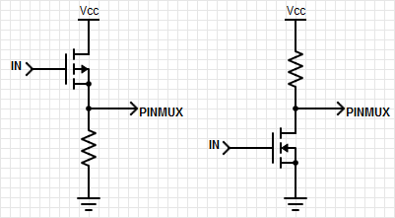
Pull-Up & Pull-Down Resistors
Ensure a known value on the output if a pin is left floating
In our example, we want the switch SW1 to pull the pin to ground, so we enable the pull-up
The pin value is:
  High when SW1 is not pressed
  Low when SW1 is pressed
Pull-down
Pull-up

Slide 7
Input Synchronization
External signals are asynchronous to internal clock
If an external signal changes at the same time as the clock, a flip-flop can enter a metastable state indefinitely
Solution – synchronize the input signals with the clock
This is done for us by hardware, no need to worry!
Pin
D
Q
D
Q
Input
CLK

Slide 8
Code Structure
Main code talks to the drivers, producing easy to read and understand code
  gpio_set_mode(P2_5, Output)
Drivers utilize CMSIS library and group relevant actions
  port_struct->direction_reg = output
CMSIS transforms memory mapped registers into C structs
  #define PORT0 ((struct PORT*)0x2000030)
Registers directly control hardware
Hardware drives I/O pins physically
main.c
High Level
drivers
CMSIS
Registers
Low Level
Input
Pin
Hardware
Output
direction_reg

Slide 9
Drivers Layer: How It Works
void gpio_set(Pin pin, int value)
1) mask = 1 << pin index
2) tmp = port_struct->data_reg & ~mask
3) tmp |= value << pin index
4) port_struct->data_reg = tmp
e.g. gpio_set(P2_5, 1) with PORT_DATA_REGISTER = 0b01010101
  Create a mask for the bit we want to set (0b00100000)
  Invert the mask (0b11011111) to select all the other bits in the port data register, and save the status of the other bits (tmp = 0b01010101)
  Move the new value of the bit into position, and or it with the new register value (tmp = 0b01110101)
  Write the new data register value out to the port (PORT_DATA_REGISTER = 0b01110101)

Slide 10
Drivers Layer: How It Works
int gpio_get(Pin pin)
1) mask = 1 << pin index
2) tmp = port_struct->data_reg & mask
3) tmp >>= pin index
4) return tmp
e.g. gpio_get(P2_5) with PORT_DATA_REGISTER = 0b01110101
  Create a mask for the bit we want to get (0b00100000)
  Select the bit in the port data register based on the mask (tmp = 0b00100000)
  Bitshift the value to produce a one or zero (tmp = 0b00000001)
  Return the value of the pin back to the user

Slide 11
C Interface: GPIO Configuration
/*! This enum describes the directional setup of a GPIO pin. */
typedef enum {
Reset, //!< Resets the pin-mode to the default value.
Input, //!< Sets the pin as an input with no pull-up or pull-down.
Output, //!< Sets the pin as a low impedance output.
PullUp, //!< Enables the internal pull-up resistor and sets as input.
PullDown //!< Enables the internal pull-down resistor and sets as input.
} PinMode;
/*! \brief Configures the output mode of a GPIO pin.
* Used to set the GPIO as an input, output, and configure the
* possible pull-up or pull-down resistors.
* \param pin Pin to set.
* \param mode New output mode of the pin.
*/
void gpio_set_mode(Pin pin, PinMode mode);

Slide 12
C Interface: Reading and Writing
/*! \brief Sets a pin to the specified logic level.
* \param pin Pin to set.
* \param value New logic level of the pin (0 is low, otherwise high).
*/
void gpio_set(Pin pin, int value);
/*! \brief Get the current logic level of a GPIO pin.
* \param pin Pin to read.
* \return The logic level of the GPIO pin (0 if low, 1 if high).
*/
int gpio_get(Pin pin);

Slide 13
Pseudocode for Program
Make LED1 and LED2 outputs
Make switch an input with a pull-up resistor
do forever {
if switch is not pressed {
Turn off LED1
Turn on LED2
} else {
Turn off LED2
Turn on LED1
}
}
Notes:
Let’s look at a simple program which reads a switch and then lights one of two LEDs, depending on whether the switch is pressed or not. Here is the pseudocode.

Slide 14
C Code
gpio_set_mode(P_LED1, Output); // Set LED pins to outputs
gpio_set_mode(P_LED2, Output);
gpio_set_mode(P_SW, Pullup); // Switch pin to resistive pull-up
while (1) {
if (gpio_get(P_SW)) {
// Switch is not pressed (active-LOW), turn LED1 off and LED2 on.
gpio_set(P_LED1, 0);
gpio_set(P_LED2, 1);
} else {
// Switch is pressed, turn off LED2 and LED1 on.
gpio_set(P_LED2, 0);
gpio_set(P_LED1, 1);
}
}
Notes:
Here is the C code based on the pseudocode. Note how it uses the drivers constructs described previously.

Slide 15
Interfacing
Inputs and Outputs, Ones and Zeros, Voltages and Currents

Slide 16
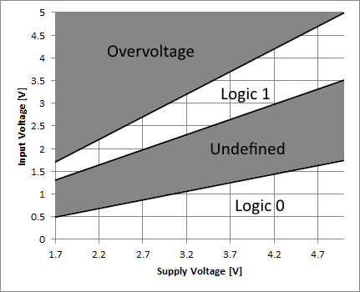
Inputs: What’s a One? A Zero?
Input signal’s value is determined by voltage
Input threshold voltages depend on supply voltage VDD
Exceeding VDD or GND may damage chip

Slide 17
Outputs: What’s a One? A Zero?
Nominal output voltages
  1: VDD-0.5 V to VDD
  0: 0 V to 0.5 V
Note: Output voltage depends on current drawn by load on pin
  Need to consider source-to-drain resistance in the transistor
  Above values only specified when current < 5mA (18 mA for high-drive pads) and VDD > 2.7 V
Logic 1 out
V_{out}
Logic 0 out
I_{out}

Slide 18
Output Example: Driving LEDs
Need to limit current to a value which is safe for
both LED and MCU port driver
Use current-limiting resistor
  R = (VDD – VLED)/ILED
Set ILED = 4mA
VLED depends on type of LED (mainly color)
  Red: ~1.8V
  Blue: ~2.7V
Solve for R given VDD = ~3.0V
  Red: 300W
  Blue: 75W
Demonstration code in Basic Light Switching Example

Slide 19
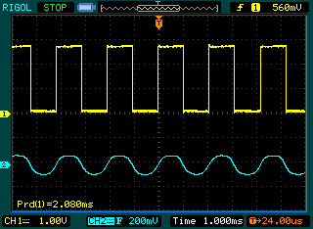
Output Example: Driving a Speaker
Create a square wave with a GPIO output
Use capacitor to block DC value
Use resistor to reduce volume if needed
void beep(void) {
unsigned int period = 20;
while (1) {
gpio_toggle(P_SPEAKER);
delay_ms(period/2);
}
}

