Slide 1
Analog Interfacing

Slide 2
Learning Objectives
At the end of this lecture, you should be able to:
Describe the theory of analog signal to digital signal conversion and vice versa.
Describe the two common types of analog-to-digital converters (ADCs).
Explain the properties of analog-to-digital conversion including range, resolution, quantization and sampling.
Explain Nyquist criterion and its application in sampling frequency of the ADC.
Explain the function of a sample and hold device in ADCs.
Describe the mode of operations of the ADC flash and ADC successive approximation converters.
Describe the functions of the digital-to-analog converter.
Describe the application of ADC in power failure detection and in battery monitoring.

Slide 3
Module syllabus
Converting Between Analog and Digital Values
Analog to Digital Conversion Concepts
Analog Interfacing Peripherals
Digital to Analog Converter
Analog Comparator
Analog to Digital Converter

Slide 4
Why It’s Needed
Embedded systems often need to measure values of physical parameters
These parameters are usually continuous (analog) and not in a digital form which computers (which operate on discrete data values) can process
Temperature
Thermometer (do you have a fever?)
Thermostat for building, fridge, freezer
Car engine controller
Chemical reaction monitor
Safety (e.g. microprocessor processor thermal management)
Light (or infrared or ultraviolet) intensity
Digital camera
IR remote control receiver
Tanning bed
UV monitor
Rotary position
Wind gauge
Knobs
Pressure
Blood pressure monitor
Altimeter
Car engine controller
Scuba dive computer
Tsunami detector
Acceleration
Air bag controller
Vehicle stability
Video game remote
Mechanical strain
Other
Touch screen controller
EKG, EEG
Breathalyzer
Notes:
The ‘natural world’ is entirely analog in nature, so the measurements of physical parameters are likely to produce continuous, analog results. A processor can only handle discrete digital values, so in order to process real-world information, we need to convert between analog and digital. The same is true of outputs: initially they will be digital, but to be useful we often need them in an analog format before they can be used in control systems or to produce information that humans can relate to, e.g. mp3 files are converted to analog before being played through a speaker or headset.
The slide shows a range of systems where some form of conversion is required.

Slide 5
Converting Between Analog and Digital Values

Slide 6
Example Analog Sensor - Depth Gauge
V_ref
// Your software
ADC_Code = adc_read();
V_sensor = ADC_code * V_ref / ADC_MASK;
Pressure_kPa = 250 * (V_sensor / V_supply + 0.04);
Depth_ft = 33 * (Pressure_kPa – Atmos_Press_kPa) / 101.3;
Pressure Sensor
Analog to Digital Converter
Water
Pressure
Voltages
ADC Output Codes
V_sensor
ADC_Code
V_ref
111..111
111..110
111..101
111..100
V_sensor
ADC_Code
Ground
000..001
000..000
Sensor detects pressure and generates a proportional output voltage V_sensor
ADC generates a proportional digital integer (code) based on V_sensor and V_ref
Code can convert that integer to a something more useful
first a float representing the voltage,
then another float representing pressure,
finally another float representing depth
Notes:
Let’s take a look at how an electronic depth gauge on a scuba diver or submarine works using an analog to digital converter. The sensor will produce an analog signal related to the pressure around it. This voltage needs to be converted into digital format before the processor can use it, so we need an analog to digital converter to perform this operation. Many modern microcontrollers have an internal converter, meaning that all is required is to configure and then read the analog input port. If there is no converter, or the internal converter is not fast enough or accurate enough, an external converter can be used and then interfaced via the GPIO.
A single line of code, ADC_code = adc_read(); is all that is needed to read the value produced by the converter. It may then be necessary to scale it in order to convert it to a voltage. Further scaling and linearization may be required in order to convert the value to, in this case, a depth in feet.

Slide 7
Getting From Analog to Digital
A Comparator tells us “Is Vin > Vref?”
Compares an analog input voltage with an analog reference voltage and determines which is larger, returning a 1-bit number
E.g. Indicate if depth > 100ft
Set Vref to voltage pressure sensor returns with 100 ft depth.
An Analog to Digital converter [AD or ADC] tells us how large Vin is as a fraction of Vref.
Reads an analog input signal (usually a voltage) and produces a corresponding multi-bit number at the output.
E.g. calculate the depth
Comparator
Vin
0
Vref
A/D Converter
Vref
0
1
0
1
Vin
Clock
Notes:
There are two common devices used to convert from analog to digital. The comparator gives a simple Higher/Lower answer (effectively a single bit), while the ADC gives a proportional multibit digital value. Both types of device are available on selected Arm Cortex processors, but check data sheets first to ensure they have appropriate speed and accuracy.

Slide 8
Waveform Sampling and Quantization
Digital value
time
A waveform is sampled at a constant rate – every ∆t
Each such sample represents the instantaneous amplitude at the instant of sampling
“At 37 ms, the input is 1.91341914513451451234311… V”
Sampling converts a continuous time signal to a discrete time signal
The sample can now be quantized (converted) into a digital value
Quantization represents a continuous (analog) value with the closest discrete (digital) value
“The sampled input voltage of 1.91341914513451451234311… V is best represented by the code 0x018, since it is in the range of 1.901 V to 1.9980 V which corresponds to code 0x018.”
Notes:
There are two issues of concern with the A to D process:
The digital value is only updated at certain intervals of time; the value we read is actually historical (although it may only be 1μs old). The result is referred to as a ‘discrete time signal’, so we only know the value of the input at certain times. Because of this, it is possible to ‘miss’ short events which occur between samples. We have to ensure that our sample time delta-t is short enough to track sudden changes in the analog input signal (more on this later). However short delta-t is, the resultant digital waveform will be composed of ‘steps’.
The digital output can only take ‘discrete’ binary values – there is no concept of a decimal point (although we can apply scaling in order to represent quantities less than 1). Sometimes, a very small change in analog input will not result in a change of digital output. The slide indicates that an input in the range 1.901 V to 1.998 V will convert to the same digital value of 0x018.

Slide 9
Forward Transfer Function Equations
What code n will the ADC use to represent voltage V_{in}?
General Equation
n = converted code
Vin = sampled input voltage
V+ref = upper voltage reference
V-ref = lower voltage reference
N = number of bits of resolution in ADC
Simplification with V_{-ref} = 0 V
$$n=\left\lfloor \frac{V_{in}}{V_{+ref}}2^{N}+1/2\right\rfloor$$
$$n=\left\lfloor \frac{3.3V}{5V}2^{10}+1/2\right\rfloor =388$$
$$n=\left\lfloor \frac{V_{in}−V_{−ref}}{V_{+ref}−V_{−ref}}2^{N}+1/2\right\rfloor$$
floor(X) nearest integer I such that I <= X
floor(x+0.5) rounds x to the nearest integer
$$\left\lfloor X\right\rfloor =\operatorname{floor}\left(X\right)$$
Notes:
An A to D converter implements a ‘forward’ transfer function, where it produces a code, n, derived from a measurement of an input voltage, Vin. n is always an integer.
In the general case, we will have an upper and lower reference voltage, and the measured voltage must lie between the two. In many cases, the lower reference voltage (V-ref) will be zero (ground) – this simplifies the equation, as indicated on the right of the slide.
The conversion to an integer value requires careful thought. Taking the previous slide as our example, the digital code 0x018 covers the range 1.901 V to 1.998 V. What this actually means is that the code 0x018 represents a voltage of 1.901, and it is not until the voltage exceeds 1.998 that the code will change to 0x019. The process is referred to as ‘floor’, i.e. the value of n represents the lowest voltage in the range 1.901 V to 1.998 V. In order to have 0x018 represent the mid point of the range we need to add the extra ½ in the equations above, and then convert to an integer. This is usually done electronically, within the converter.

Slide 10
Digital to Analog Conversion
May need to generate an analog voltage or current as an output signal
E.g. audio signal, video signal brightness
DAC: “Generate the analog voltage which is this fraction of Vref”
Digital to Analog Converter equation
n = input code
N = number of bits of resolution of converter
Vref = reference voltage
Vout = output voltage. Either
Vout = Vref * n/(2N) or
Vout = Vref * (n+1)/(2N)
The offset +1 term depends on the internal tap configuration of the DAC – check the datasheet to be sure
D/A Converter
0
1
0
1
Vout
Vref
Notes:
At the output of an embedded system, it will be necessary to convert internal digital values back into meaningful analog signals or quantities. The device which performs this operation is usually referred to as a ‘DAC’, a Digital to Analog Converter. Note that a DAC cannot produce a continuous output because the input is discrete. The accuracy of the DAC, i.e. the closeness by which the analog output tracks the digital value, depends on the number of bits (the ‘resolution’ of the DAC) – the more bits, the smaller the ‘step’ size. 12 bits is common on a Cortex M microcontroller, 16 bits are required for HiFi audio.
The analog output of the DAC depends on the digital input, the reference voltage, and the number of bits used on the DAC. It can be calculated as shown on the slide.
Note the importance of having a stable reference voltage.

Slide 11
Inverse Transfer Function
What range of voltages V_{in_min} to V_{in_max} does code n represent?
General Equation
n = converted code
Vin_min = minimum input voltage for code n
Vin_max = maximum input voltage for code n
V+ref = upper voltage reference
V-ref = lower voltage reference
N = number of bits of resolution in ADC
Simplification with V_{-ref} = 0 V
$$V_{in_min}=\frac{n−\frac{1}{2}}{2^{N}}\left(V_{+ref}\right)$$
$$V_{in_max}=\frac{n+\frac{1}{2}}{2^{N}}\left(V_{+ref}\right)$$
$$V_{in_min}=\frac{n−\frac{1}{2}}{2^{N}}\left(V_{+ref}−V_{−ref}\right)+V_{−ref}$$
$$V_{in_max}=\frac{n+\frac{1}{2}}{2^{N}}\left(V_{+ref}−V_{−ref}\right)+V_{−ref}$$
Notes:
A DAC produces the inverse transfer function, i.e. it converts a value n into a discrete output voltage. One value of n will represent a range of equivalent inputs between (n-1/2) and (n+1/2), but because n is an discrete integer, we will output a step waveform composed of discrete converted values.
The converted value of n thus represents a small range of voltages from Vin_min to Vin_max, which cannot be resolved by the DAC. These values can be calculated as indicated on the slide; again, the simple case is when the lower reference voltage (V-ref) will is zero (ground) .
The difference between Vin_max and Vin_min is the step size of the converter.

Slide 12
What if the Reference Voltage is not known?
Example - running off an unregulated battery (to save power)
Measure a known voltage and an unknown voltage
Many MCUs include an internal fixed voltage source which ADC can measure for this purpose
Can also solve for Vref
$$V_{unknown}=V_{known}\frac{n_{unknown}}{n_{known}}$$
$$V_{ref}=V_{known}\frac{2^{N}}{n}$$
“My ADC tells me that channel 27 returns a code of 0x6543, so I can calculate that V_{REFSH} = 1.0V * 2¹⁶/0x6543 = …
Notes:
The accuracy of the voltage reference has a huge influence on the accuracy of the DAC. If we suspect it is drifting in value, we can still use the converter, but it needs to be recalibrated against the value of n for a precisely known voltage. This is OK, but if the reference is still drifting, the converter will need to be calibrated often.
We can use a similar method to check the current value of the reference voltage as shown in the slide.
In Cortex microcontrollers, converters are usually provided with an accurate internal reference, or use the supply rail as a reference. Alternatively, they will have some form of reference input pin.

Slide 13
Analog to Digital conversion concepts
Notes:
We now take a look at the underlying concepts related to the implementation of ADCs and DACs.

Slide 14
A/D – Flash Conversion
A multi-level voltage divider is used to set voltage levels over the complete range of conversion.
A comparator is used at each level to determine whether the voltage is lower or higher than the level.
The series of comparator outputs are encoded to a binary number in digital logic (a priority encoder)
Components used
2^{N} resistors
2^{N} -1 comparators
Note
This particular resistor divider generates voltages which are not offset by ½ bit, so maximum error is 1 bit
We could change this offset voltage by using resistors of values R, 2R, 2R ... 2R, 3R (starting at bottom)
1V
Comparators
7/8 V
R
+
1
R
6/8 V
-
R
+
1
5/8 V
-
R
+
1
4/8 V
-
R
+
Encoder
3
0
3/8 V
-
R
+
0
2/8 V
-
R
+
0
1/8 V
-
R
+
0
-
V
in
Notes:
To complete an A to D conversion, from a signal voltage to a number, normally takes a finite amount of time, and this conversion time impacts on the sample time delta-t, which should be as small as possible.
One approach to this problem is the ‘flash converter’, which has a very low ‘conversion time’. The slide shows a simple 3 bit converter. The converter divides the interval between the reference voltage (1V in this case) and 0V into 8 ranges. A bank of comparators then determines which range the input voltage lies in, and uses an encoder to convert this to a 3-bit digital value. The output is available within fractions of a microsecond, but the hardware requirements are significant – for a 12 bit converter you would need 4095 comparators.
The problem of choosing the nearest value of ‘n’ remains. This can be fixed by making the lowest resistor in the chain half size, and making the upper resistor 50% larger.
Flash converters are often very expensive.

Slide 15
ADC - Successive Approximation Conversion
111111
Successively approximate input voltage by using a binary search and a DAC
SA Register holds current approximation of result
Set all DAC input bits to 0
Start with DAC’s most significant bit
Repeat
Set next input bit for DAC to 1
Wait for DAC and comparator to stabilize
If the DAC output (test voltage) is smaller than the input then set the current bit to 1, else clear the current bit to 0
Test voltage (DAC output)
Analog Input
100110
Voltage
100100
100000
know xxxxxx, try 100000
know 10011x, try 100111
know 1001xx, try 100110
know 100xxx, try 100100
know 10xxxx, try 101000
know 1xxxxx, try 110000
know 100110. Done.
T
T
T
T
T
T
000000
1
2
3
4
5
6
Start of
Conversion
Time
Notes:
The hardware for the successive approximation ADC uses a comparator to compare the input voltage against a test voltage generated by an internal D/A converter, which is driven by the successive approximation (SA) register according to a binary search sequence. Effectively we test each bit in turn to see if it should be set or not. The operation takes one cycle per bit, so the more bits there are, the longer the conversion takes.
This is often the type implemented on a microcontroller. In operation, we initiate the conversion process by signaling the converter, and then wait for the converter to tell us that the conversion is complete (often using an interrupt). This compromises the minimum delta-t, and can seriously limit the sample rate.

Slide 16
ADC Performance Metrics
Number of bits determines overall accuracy.
Linearity measures how well the transition voltages lie on a straight line.
Differential linearity measure the equality of the step size.
Conversion time: between start of conversion and generation of result.
Conversion rate = inverse of conversion time.
Notes:
The fundamental metric for an A to D converter is the number of bits, which limits overall accuracy – the more bits, the smaller the step size.
There are always limitations and inaccuracies present in the conversion from Analog to Digital.
The step increments are not always exactly the same size, and this can lead to incorrect operation where an increase in input voltage causes a decrease in output code, n. This is referred to as a non-monotonic converter.
The linearity and gain of the converter may not be precise, and there may be a constant offset applied to converted values. As a general rule, these errors are designed to be less than one step size.
The conversion time limits the sample rate, which in turn limits the kind of signal we can faithfully capture (see below for Nyquist Rate).

Slide 17
Sampling Problems
When sampling varying signals there is an upper limit on the bandwidth of the converter which is set by the ‘Nyquist criterion’
Nyquist criterion
Fsample >= 2 * Fmax frequency component
Frequency components above ½ Fsample are aliased, distorting the measured signal
Nyquist and the real world
This theorem assumes we have a perfect filter with “brick wall” roll-off
Real world filters have more gentle roll-off
Inexpensive filters are even worse (e.g. first order filter is 20 dB/decade, aka 6 dB/octave)
So we have to choose a sampling frequency high enough that our filter attenuates aliasing components adequately
Notes:
The bandwidth limit of a converter is set by the Nyquist criterion, which says that each cycle of the waveform must be sampled a minimum of twice, i.e. Fsample >= 2 * Fmax
If the criterion is not met, the sampled signal will contain errors (high frequencies will be transformed into lower frequencies – this is called aliasing).
An associated problem is that of ensuring that no frequencies greater than Fsample/2 are present at the input. A filter can reduce high frequency components but it is very difficult to reduce them to a suitably low level without filtering out part of the valid signal we wish to convert.

Slide 18
Inputs
Differential
Use two channels, and compute difference between them
Very good noise immunity
Some sensors offer differential outputs (e.g. Wheatstone Bridge)
Multiplexing
Typically share a single ADC among multiple inputs
Need to select an input, allow time to settle before sampling
Signal Conditioning
Amplify and filter input signal
Protect against out-of-range inputs with clamping diodes
Notes:
There are a number of things we can do to improve the effectiveness of an A to D converter. We can use a differential input – this means that any noise on the signal would affect each channel equally, and when we subtract to find the difference, the noise will get canceled out.
It may be that we do not use the converter continuously, so we can use one converter shared between multiplexed channels. Many modern microcontrollers implement this feature.
We can ensure that the signal we are converting is large enough to use the dynamic range of the converter, and we can filter out unwanted artifacts.
We can protect against overvoltage using diodes which prevent the input from taking values outside the voltage supply range.

Slide 19
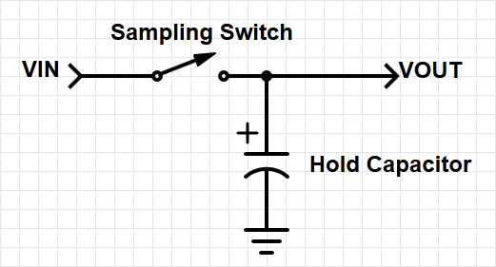
Sample and Hold Devices
Some A/D converters require the input analog signal to be held constant during conversion, (e.g. successive approximation devices)
In other cases, peak capture or sampling at a specific point in time necessitates a sampling device.
This function is accomplished by a sample and hold device as shown to the right.
These devices are incorporated into some A/D converters.
Notes:
Successive approximation converters require the signal to be stable while the conversion is being carried out. An (electronic) switch and capacitor arrangement can ensure that the signal does not change while the conversion is in progress. Such a circuit is referred to as a ‘sample and hold’ circuit.
A sampling switch can also be used to ensure that the signal is sampled at a precise instant. The capacitor will ‘hold’ the input voltage until a conversion has been completed, so an immediate conversion is not necessary.
Because of their usefulness, sample and hold circuits are often implemented on the converter itself.

Slide 20
Analog Interfacing Peripherals

Slide 21
GPIO Alternative Functions
Pins may have different features
To enable an alternative function, set up the appropriate register
May also have analog paths for ADC / DAC etc.
Advantages:
Saves space on the package
Improves flexibility
Memory Mapped I/O
Alternate Function 1
Alternate Function 2
Pin
…
Alternate Function n
Function Select
Find appropriate analog functionality
Notes:
Recall that the general name of an I/O pin is ‘GPIO’. The GP (general purpose) relates to the default single bit digital I/O function. In addition to this, many GPIO pins have ‘alternate functions’. The programmer has to configure a GPIO pin as an alternate function in order to access the more specific functionality.
In order to use a pin for an analog input or output we need to configure the pin control multiplexer to connect to an analog peripheral rather than the GPIO port circuitry. Not all Cortex M processors have full analog I/O features, so check the data sheet to see what is available for your specific microcontroller. The other thing to be aware of is that specific functionality is only available on certain pins – check the data sheet.
The advantages of this approach is that it reduces the pin count, and that I/O pin allocation is more flexible. The functionality of pins is configured in software, meaning it is relatively easy to reconfigure if necessary.

Slide 22
Digital to Analog Converter

Slide 23
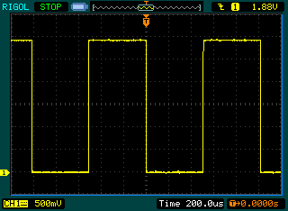
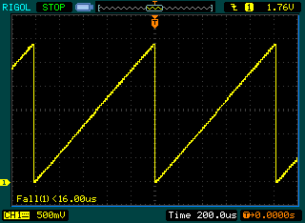
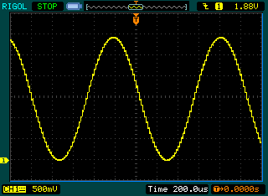
Example: Waveform Generation
DAC can be used to generate arbitrary waveforms
Pre-generate lookup table
Update DAC output value
Delay
Repeat
Notes:
The availability of a DAC means that the microcontroller can be used to synthesize waveforms.
The oscilloscope displays show three commonly used waveforms that have been generated from software.
The process is straightforward – prepare a table of output samples for one complete cycle, and then clock them out to the DAC at regular intervals.
If you look closely at the sine wave, you can see that it is actually composed of small step changes (at the clock rate).

Slide 24
C Code – Initialization
void tone_init(void) {
dac_init();
sinewave_init();
}
void sinewave_init(void) {
int n;
for (n = 0; n < NUM_STEPS; n++) {
sine_table[n] = MAX_DAC_CODE * (1 + sin(n*2*PI/NUM_STEPS)) / 2;
}
}
Notes:
The code shows how this could be done in C.
The initialization function dac_init() prepares the peripheral (alternate pin configuration, etc.)
The sinewave_init() function mathematically generates the table of output samples for the sine wave output (this is slightly more complex than the other two).
The constant MAX_DAC_CODE = (2N – 1) where n is number of bits that the converter implements.
NUM_STEPS determines how many samples there are per period.

Slide 25
C Code – Playback
void tone_play(int period_us, int num_cycles, wavetype wave) {
int sample, step;
while(num_cycles-- > 0) {
for (step = 0; step < NUM_STEPS; step++) {
switch(wave) {
case SINE: sample = sine_table[step]; break;
case SQUARE: sample = step < NUM_STEPS / 2 ? 0 : MAX_DAC_CODE;
break;
case RAMP: sample = (step * MAX_DAC_CODE) / NUM_STEPS; break;
}
dac_set(sample);
delay_us(period_us);
}
}
}
Notes:
This code implements the actual playback of the samples. The input parameters are waveform period, number of cycles to output, and the type of waveform (sine, square or ramp in our case).
The selection of waveform type is handled in a case statement. Samples for the sine wave have already been calculated, whereas the sample values for square and ramp are calculated ‘on the fly’.
It is worth considering how the time to calculate the next sample will affect the rate at which samples are clocked out – in the code we have, there will be very small differences in sample generation time because of this.
As an alternative, we might set a timer running and generate an interrupt at precise intervals when the next sample should be output. So long as we have enough time to calculate the next sample value during the timer period, this will be more accurate.

Slide 26
Analog Comparator
Notes:
An Analog Comparator can be thought of as a single-bit A to D converter. The output depends on the result of a comparison between the analog input and some reference value.

Slide 27
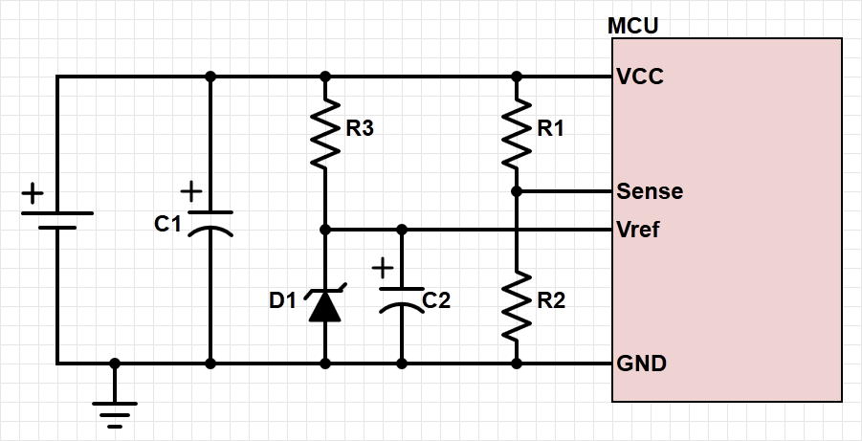
Example: Power Failure Detection
Need warning of when power has failed
Very limited amount of time before capacitor C1 discharges
Save critical information
Turn off output devices
Put system into safe mode
Can use a comparator to compare Vcc against a fixed reference voltage Vref
Notes:
One application of an analog comparator is to detect a system power failure. The comparator (shown as part of the MCU in the diagram) has two input, Vref and Sense.
The Vref input is a stable reference voltage (provided by the zener, D1) and the Sense input is a scaled down version of the power supply voltage.

Slide 28
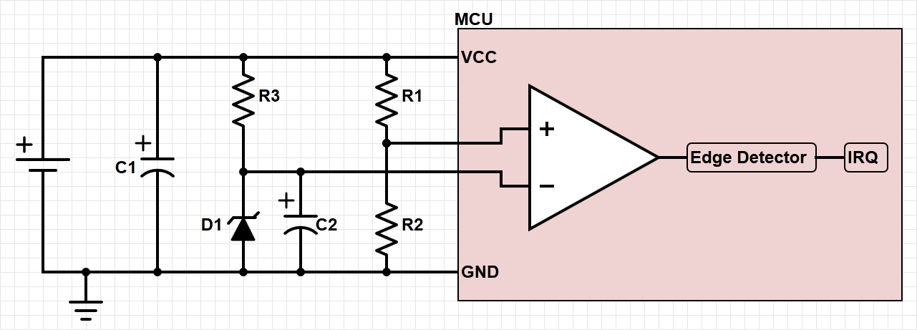
Comparator Overview
Comparator compares Sense and Vref
Comparator output indicates if Sense > Vref (1) or Sense < Vref (0)
Can generate an interrupt request (+, -, or +- edges)
If the Sense input drops below Vref, fire an interrupt
Notes:
In normal operation, when the power supply is functioning normally, Sense>Vref and the comparator will output a logic 1.
If the power supply voltage begins to fall, the sense input will fall below Vref, and the comparator output will fall to zero, which signifies that power supply is going down.
The warning will trigger a falling edge detect interrupt, which will then divert program execution to implement a safe shutdown, or transition to low-power ‘sleep’ mode.
It would be possible to implement a rising edge detection interrupt that could safely bring the system back up again once the power supply is restored.

Slide 29
C Code – Comparator
void comparator_isr(int state) {
if (state) {
// Sense > Vref, turn off LEDs.
leds_set(0, 0, 0);
} else {
// Sense < Vref, turn on red LED.
leds_set(1, 0, 0);
}
}
int main(void) {
comparator_init();
comparator_set_trigger(CompBoth); // ISR on both rising and falling edges.
comparator_set_callback(comparator_isr);
…
}
Notes:
The code implements an interrupt comparator_isr(), which is called when an edge triggered interrupt (rising or falling) is received.
The interrupt service routine handles both situations by controlling one of three system LEDs in order to indicate that the power supply problem is present or not.
The main function handles the configuration of the comparator and interrupt callback.

Slide 30
Analog to Digital Converter
Notes:
A full A to D converter enables a quantitative measurement to be made by converting an analogue input voltage into a proportional digital value (which could be scaled to read volts).

Slide 31
Example: Battery Monitoring
Operates similarly to comparator based system
Measures battery voltage, better indication of battery life than comparator
Can provide information about battery discharge rate
Notes:
The battery monitoring external circuit is the same as for the comparator, but now we can monitor the actual battery voltage (via Sense), and take regular readings of battery state.
This data may then be analyzed on an ongoing basis to estimate battery condition, or warn of deterioration in battery performance before it becomes a significant issue.

Slide 32
Battery Discharge
As the battery discharges, the voltage decreases
Measure with respect to Vref (fixed voltage reference)
Convert to capacity with look-up table and interpolation
Notes:
The graph shows a typical discharge curve for a battery. Regular measurements of the Sense voltage can help establish which part of the curve the battery is operating at, and preempt catastrophic failure.
This is much more useful than the original ‘comparator’ arrangement, but the only additional cost has been the software. Indeed, it may be possible to upgrade the old comparator system in the field by remotely downloading updated software.

