Slide 1
Timer Peripherals

Slide 2
Learning Objectives
At the end of this lecture, you should be able to:
Describe the mode of operation and function of the interrupt timer.
Explain the three modes of operation of the standard timer including ‘compare mode’, capture mode’ and pulse width modulation mode.

Slide 3
Outline
Types of Timer Peripherals
Interrupt Timer
PWM Module
Low-Power Timer
Real-Time Clock
SYSTICK

Slide 4
Types of Timer Peripherals
Interrupt Timer
Can generate periodically generate interrupts or trigger DMA (direct memory access) transfers
PWM Module
Connected to I/O pins, has input capture and output compare support
Can generate PWM signals
Can generate interrupt requests
Low-Power Timer
Can operate as timer or counter in all power modes
Can wake up system with interrupt
Can trigger hardware
Real-Time Clock
Powered by external 32.768 kHz crystal
Tracks elapsed time (seconds) in register
Can set alarm
Can generate 1Hz output signal and/or interrupt
Can wake up system with interrupt
SysTick
Part of CPU core’s peripherals
Can generate periodic interrupt

Slide 5
Timer/Counter Peripheral Introduction
Events
Reload Value
Reload
or
Presettable Binary Counter
PWM
Clock
Interrupt
Current Count
Common peripheral for microcontrollers
Based on presettable binary counter, enhanced with configurability
Count value can be read and written by MCU
Count direction can often be set to up or down
Counter’s clock source can be selected
Counter mode: count pulses which indicate events (e.g. odometer pulses)
Timer mode: clock source is periodic, so counter value is proportional to elapsed time (e.g. stopwatch)
Counter’s overflow/underflow action can be selected
Generate interrupt
Reload counter with special value and continue counting
Toggle hardware output signal

Slide 6
Interrupt Timer

Slide 7
Interrupt Timer
Interrupt
Write 1000 to timer
max
Enabling timer loads counter with 1000, starts counting
Timer counts down to 0
Interrupt generated, counter reloads with 1000, starts counting
Interrupt generated, counter reloads with 700, starts counting
Interrupt generated, counter reloads with 700, starts counting
Interrupt generated, counter reloads with 700, starts counting
Write 700 to timer
max
Load start value from register
Counter counts down with each clock pulse
When timer value reaches zero
Generates interrupt
Reloads timer with start value
Read/write timer start value
Start Value
Reload
Clock
Presettable Binary Counter
Interrupt
Read current timer value

Slide 8
Calculating Max Value
Goal: generate an interrupt every T seconds
Max value = round(T * Freq)
Round since register is an integer, not a real number
Rounding provides closest integer to desired value, resulting in minimum timing error
Example: Interrupt every 137.41ms, assuming clock frequency 24MHz
137.41ms * 24MHz = 3297840
Example: Interrupt with a frequency of 91Hz with a 12MHz clock
(1/91 Hz) * 12MHz = round (131868.1318) = 131868
Use macros, interrupt 1000 times per second:
CLK_FREQ / 1000

Slide 9
Configuring the Interrupt Timer
Setup timer, set to tick at 10Hz
timer_init(CLK_FREQ / 10);
Set interrupt
timer_set_callback(timer_isr);
Enable module
timer_enable();
Disable module
timer_disable();

Slide 10
Example: Stopwatch
Measure time with 100 us resolution
Display elapsed time, updating screen every 10ms
Controls
S1: toggle start/stop
Use interrupt timer
Counter increment every 100 us
Set to timer to expire every 100 us
Calculate max value, e.g. at 24 MHz = round (100 us * 24MHz -1) = 2399
LCD Update every 10 ms
Update LCD every nth ISR
n = 10 ms/100us = 100
Don’t update LCD in ISR! Too slow.
Instead set flag in ISR, poll it in main loop

Slide 11
Timer / PWM Module

Slide 12
Timer / PWM Module
Core Counter
Clock options - external or internal
Prescaler to divide clock
Can reload with set value, or overflow and wrap around
N channels
3 modes
Capture Mode: Capture timer’s value when input signal changes
Output Compare: Change an output signal when timer reaches certain value
PWM: Generate pulse-width-modulated signal. Width of pulse is proportional to specified value.
Possible triggering of interrupt, hardware trigger on overflow
One I/O pin per channel

Slide 13
Major Channel Modes
Input Capture Mode
Capture timer’s value when input signal changes
Rising edge, falling edge, both
How long after I started the timer did the input change?
Measure time delay
Output Compare Mode
Modify output signal when timer reaches specified value
Set, clear, pulse, toggle (invert)
Make a pulse of specified width
Make a pulse after specified delay
Pulse Width Modulation
Make a series of pulses of specified width and frequency

Slide 14
Input Capture Mode
Event on external signal
External Signal
Internal Counter
Value
Enable the module
Fire interrupt with value saved
Fire interrupt with value saved
I/O pin operates as input on edge
When valid edge is detected on pin…
Current value of counter is stored
Interrupt is called

Slide 15
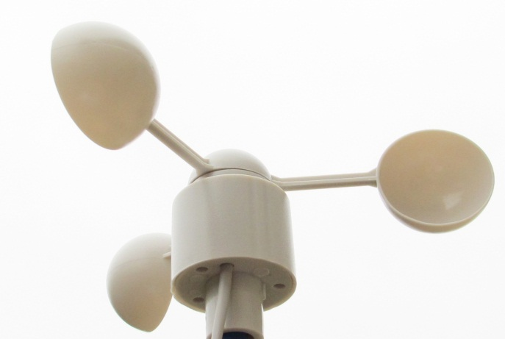
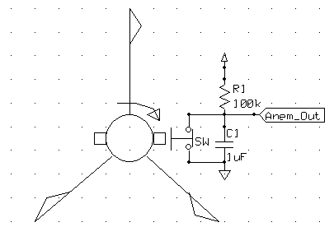
Wind Speed Indicator (Anemometer)
Rotational speed (and pulse frequency) is proportional to wind velocity
Two measurement options:
Frequency (best for high speeds)
Width (best for low speeds)
Can solve for wind velocity v
How can we use the timer for this?
Use Input Capture Mode to measure period of input signal
$$v_{wind}= \frac{K∗f_{clk}}{T_{anemometer}}$$

Slide 16
TPM Capture Mode for Anemometer
Configuration
Set up module to count at given speed from internal clock
Set up channel for input capture on rising edge
Operation: Repeat
First interrupt - on rising edge
Reconfigure channel for input capture on falling edge
Clear counter, start it counting
Second interrupt - on falling edge
Read capture value, save for later use in wind speed calculation
Reconfigure channel for input capture on rising edge
Clear counter, start it counting

Slide 17
Output Compare Mode
Compare Value
Timer
Value
Enable timer
Overflow
Overflow
Toggle
Output
Pin
Value
Clear
Set
Action on match
Toggle
Clear
Set
When counter matches value …
Output signal is generated
Interrupt is called (if enabled)

Slide 18
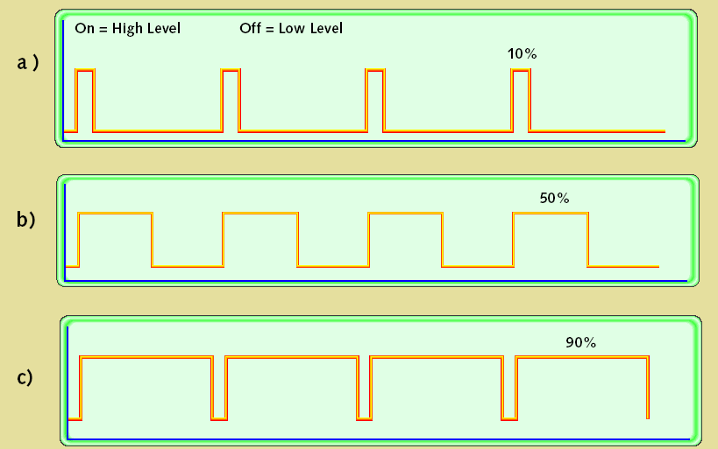
Pulse-Width Modulation
Uses of PWM
Digital power amplifiers are more efficient and less expensive than analog power amplifiers
Applications: motor speed control, light dimmer, switch-mode power conversion
Load (motor, light, etc.) responds slowly, averages PWM signal
Digital communication is less sensitive to noise than analog methods
PWM provides a digital encoding of an analog value
Much less vulnerable to noise
PWM signal characteristics
Modulation frequency – how many pulses occur per second (fixed)
Period – 1/(modulation frequency)
On-time – amount of time that each pulse is on (asserted)
Duty-cycle – on-time/period
Adjust on-time (hence duty cycle) to represent the analog value

Slide 19
PWM Mode
Compare Value
Timer
Value
Enable timer
Overflow
Overflow
Output
Pin
PWM duty cycle proportional to compare value
Period = max timer value
Pulse width = compare value
$$Duty Cycle=\frac{Compare Value}{Max Value}∙100\%$$

Slide 20
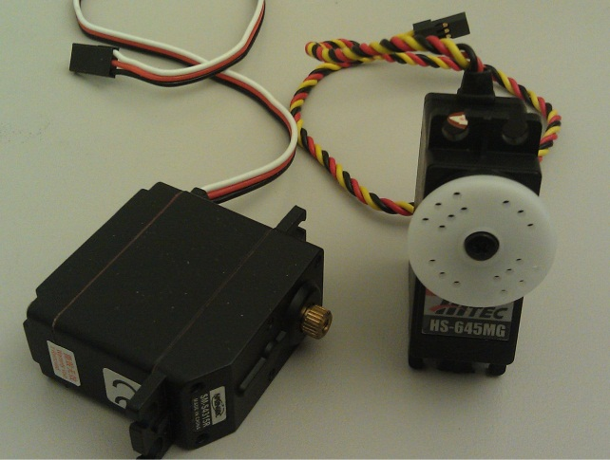
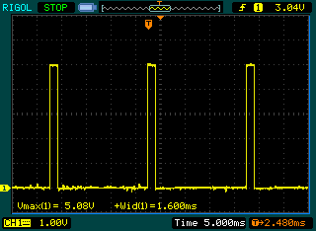
PWM to Drive Servo Motor
Servo PWM signal
20 ms period
1 to 2 ms pulse width

Slide 21
Low Power Timer

Slide 22
Low Power Timer Overview
Current
Average
Current
Interrupt routine
Processor Always On
Sleeping mode
Time
With Low-Power Timer
Features
Count time or external pulses
Generate interrupt when counter matches compare value
Interrupt wakes MCU from any low power mode
Current draw can be reduced to microamps or even nanoamps!
Use the WFI instruction (Wait For Instruction)
Puts CPU in low power mode until interrupt request

