Slide 1
Serial Communications

Slide 2
Learning Objectives
At the end of this lecture, you should be able to:
Outline the concepts of both serial and parallel communication and give examples of their applications.
Explain the difference between synchronous and asynchronous serial communication.
Compare serial and parallel communication including their advantages and disadvantages.
Outline the difference between synchronous half-duplex and full-duplex serial buses
Describe UART and its communication protocol.
Describe SPI communication protocol.
Describe I2C communication protocol.

Slide 3
Overview
Serial communications
Concepts
Tools
Software: polling, interrupts, and buffering
Protocols:
UART
SPI
I2C

Slide 4
Why Communicate Serially?
Native word size is multi-bit (8, 16, 32, etc.)
Often it’s not feasible to support sending all the word’s bits at the same time
Cost and weight: more wires needed, larger connectors needed
Mechanical reliability: more wires => more connector contacts to fail
Timing Complexity: some bits may arrive later than others due to variations in capacitance and resistance across conductors
Circuit complexity and power: may not want to have 16 different radio transmitters + receivers in the system

Slide 5
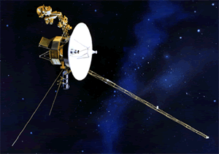
Example System: Voyager Spacecraft
???
Launched in 1977
Constraints: Reliability, power, size, weight, reliability, reliability, etc.
“Uplink communications are via S-band (16-bits/sec command rate) while an X-band transmitter provides downlink telemetry at 160 bits/sec normally and 1.4kbps for playback of high-rate plasma wave data. All data are transmitted from and received at the spacecraft via the 3.7 meters high-gain antenna (HGA).” http://voyager.jpl.nasa.gov/spacecraft/index.html
Uplink – to spacecraft
Downlink – from spacecraft

Slide 6
Example System
Dedicated point-to-point connections
Parallel data lines, read and write lines between MCU and each peripheral
Fast, allows simultaneous transfers
Requires many connections, PCB area, scales badly

Slide 7
Parallel Buses
All devices use buses to share data, read, and write signals
MCU uses individual select lines to address each peripheral
MCU requires fewer pins for data, but still one per data bit
MCU can communicate with only one peripheral at a time

Slide 8
Synchronous Serial Data Transmission
Transmitting Device
Receiving Device
Clock
Serial Data
Data Sampling Time at Receiver
Use shift registers and a clock signal to convert between serial and parallel formats
Synchronous: an explicit clock signal is along with the data signal

Slide 9
Synchronous Full-Duplex Serial Data Bus
Now can use two serial data lines - one for reading, one for writing.
Allows simultaneous send and receive full-duplex communication

Slide 10
Synchronous Half-Duplex Serial Data Bus
Share the serial data line
Doesn’t allow simultaneous send and receive - is half-duplex communication

Slide 11
Asynchronous Serial Communication
Data bits
Start bit
Stop bit
Data Sampling Time at Receiver
Time Zero
T_{bit}*1.5
T_{bit}*2.5
T_{bit}*3.5
T_{bit}*4.5
T_{bit}*5.5
T_{bit}*6.5
T_{bit}*7.5
T_{bit}*8.5
T_{bit}*9.5
Eliminate the clock line!
Transmitter and receiver must generate clock locally
Transmitter must add start bit (always same value) to indicate start of each data frame
Receiver detects leading edge of start bit, then uses it as a timing reference for sampling data line to extract each data bit N at time Tbit*(N+1.5)
Stop bit is also used to detect some timing errors

Slide 12
Serial Communication Specifics
Start bit
Data bits
Stop bit
Data frame fields
Start bit (one bit)
Data (LSB first or MSB, and size – 7, 8, 9 bits)
Optional parity bit is used to make total number of ones in data even or odd
Stop bit (one or two bits)
All devices must use the same communications parameters
E.g. communication speed (300 baud, 600, 1200, 2400, 9600, 14400, 19200, etc.)
Sophisticated network protocols have more information in each data frame
Medium access control – when multiple nodes are on bus, they must arbitrate for permission to transmit
Addressing information – for which node is this message intended?
Larger data payload
Stronger error detection or error correction information
Request for immediate response (“in-frame”)
Message

Slide 13
Error Detection
Can send additional information to verify data was received correctly
Need to specify which parity to expect: even, odd or none.
Parity bit is set so that total number of “1” bits in data and parity is even (for even parity) or odd (for odd parity)
01110111 has 6 “1” bits, so parity bit will be 1 for odd parity, 0 for even parity
01100111 has 5 “1” bits, so parity bit will be 0 for odd parity, 1 for even parity
Single parity bit detects if 1, 3, 5, 7 or 9 bits are corrupted, but doesn’t detect an even number of corrupted bits
Stronger error detection codes (e.g. Cyclic Redundancy Check) exist and use multiple bits (e.g. 8, 16), and can detect many more corruptions.
Used for CAN, USB, Ethernet, Bluetooth, etc.

Slide 14
Tools for Serial Communications Development
Tedious and slow to debug serial protocols with just an oscilloscope
Instead use a logic analyzer to decode bus traffic
Worth its weight in gold!
Saelae 8-Channel Logic Analyzer
$150 (www.saelae.com)
Plugs into PC’s USB port
Decodes SPI, asynchronous serial, I2C, 1-Wire, CAN, etc.
Build your own: with Logic Sniffer or related open-source project

Slide 15
Software Structure – Handling asynchronous Communication

Slide 16
Software Structure
Communication is asynchronous to program
Don’t know what code the program will be executing …
when the next item arrives
when current outgoing item completes transmission
when an error occurs
Need to synchronize between program and serial communication interface somehow
Options
Polling
Wait until data is available
Simple but inefficient of processor time
Interrupt
CPU interrupts program when data is available
Efficient, but more complex

Slide 17
Serial Communications and Interrupts
Main Program or other threads
Want to provide multiple threads of control in the program
Main program (and subroutines it calls)
Transmit ISR – executes when serial interface is ready to send another character
Receive ISR – executes when serial interface receives a character
Error ISR(s) – execute if an error occurs
Need a way of buffering information between threads
Solution: circular queue with head and tail pointers
One for tx, one for rx
get_string
send_string
rx_isr
tx_isr
Serial Interface

Slide 18
Code to Implement Queues
older data
newer data
Enqueue at tail: tail is the index of the next free entry
Dequeue from head: head is the index of the item to remove
Queue size is initialized and stored in size
One queue per direction
tx ISR unloads tx_q
rx ISR loads rx_q
Other threads (e.g. main) load tx_q and unload rx_q
Need to wrap pointer at end of buffer to make it circular,
Use % (modulus, remainder) operator if queue size is not power of two
Use & (bitwise and) if queue size is a power of two
Queue is empty if tail == head
Queue is full if (tail + 1) % size == head
read data from head
write data to tail
get_string
send_string
rx_isr
tx_isr
Serial
Interface

Slide 19
Defining the Queues
typedef struct {
uint8_t *data; //!< Array of data, stored on the heap.
uint32_t head; //!< Index in the array of the oldest element.
uint32_t tail; //!< Index in the array of the youngest element.
uint32_t size; //!< Size of the data array.
} Queue;

Slide 20
Initialization and Status Inquiries
int queue_init(Queue *queue, uint32_t size) {
queue->data = (uint8_t*)malloc(sizeof(uint8_t) * size);
queue->head = 0;
queue->tail = 0;
queue->size = size;
// If malloc returns NULL (0) the allocation has failed.
return queue->data != 0;
}
int queue_is_full(Queue *queue) {
return ((queue->tail + 1) % queue->size) == queue->head;
}
int queue_is_empty(Queue *queue) {
return queue->tail == queue->head;
}

Slide 21
Enqueue and Dequeue
int queue_enqueue(Queue *queue, uint8_t item) {
if (!queue_is_full(queue)) {
queue->data[queue->tail++] = item;
queue->tail %= queue->size;
return 1;
} else {
return 0;
}
}
int queue_dequeue(Queue *queue, uint8_t *item) {
if (!queue_is_empty(queue)) {
*item = queue->data[queue->head++];
queue->head %= queue->size;
return 1;
} else {
return 0;
}
}

Slide 22
Using the Queues
Sending data:
queue_enqueue(…, c)
Receiving data:
queue_dequeue(…, &c)

Slide 23
Software Structure – Parsing Messages

Slide 24
Decoding Messages
Two types of messages
Actual binary data sent
First identify message type
Second, based on this message type, copy binary data from message fields into variables
May need to use pointers and casting to get code to translate formats correctly and safely
ASCII text characters representing data sent
First identify message type
Second, based on this message type, translate (parse) the data from the ASCII message format into a binary format
Third, copy the binary data into variables

Slide 25
Example Binary Serial Data: TSIP
switch (id) {
case 0x84:
lat = *((double *)(&msg[0]));
lon = *((double *)(&msg[8]));
alt = *((double *)(&msg[16]));
clb = *((double *)(&msg[24]));
tof = *((float *)(&msg[32]));
break;
case 0x4A: …
default:
break;
}
Report Packet (0x84) Data Structure
Type | sizeof(Type) | Item | Units
Double | 8 | Latitude | Radians; + for north, - for south
Double | 8 | Lonitude | Radians; + for east, - for west
Double | 8 | Altitude | Meters
Double | 8 | Clock Bias | Meters
Single | 4 | Time-of-fix | Seconds

Slide 26
Example ASCII Serial Data: NMEA-0183
$IDMSG,D1,D2,D3,D4,…,Dn*CS\r\n
$ denotes the start of a message
ID is a two letter mnemonic to describe the source of data, e.g. GP signifies GPS
MSG is a three letter mnemonic to describe the message content.
Commas are used to delaminate the data fields.
Dn represents each of the data fields.
* is used to separate the data from the checksum.
CS contains two ASCII characters representing the hex value of the checksum.
\r\n is the carriage return character followed by the new line character to denote the end of a message.

Slide 27
State Machine for Parsing NMEA-0183
Start
Any char. except *, \r or \n
Append char to buf. Inc. counter
$ Append char to buf.
Talker + Sentence Type
*, \r or \n, non-text, or counter>6
buf==$SDDBT, $VWVHW, or $YXXDR
Enqueue all chars. from buf
/r or /n
Sentence Body
Any char. except *
Enqueue char
*
Enqueue char
Checksum 1
Any char.
Save as checksum1
Checksum 2
Any char.
Save as checksum2

Slide 28
Parsing
switch (parser_state) {
case TALKER_SENTENCE_TYPE:
switch (msg[i]) {
‘*’:
‘\r’:
‘\n’:
parser_state = START;
break;
default:
if (Is_Not_Character(msg[i]) || n>6) {
parser_state = START;
} else {
buf[n++] = msg[i];
}
break;
}
if ((n==6) & … ){
parser_state = SENTENCE_BODY;
}
break;
case SENTENCE_BODY:
break;

Slide 29
Asynchronous serial (UART) Communications

Slide 30
Transmitter Basics
Data
bits
Data Sampling Time at Receiver
T_{bit}
T_{bit}
T_{bit}
T_{bit}
T_{bit}
T_{bit}
T_{bit}
T_{bit}
T_{bit}
T_{bit}
T_{bit}
Time Zero
If no data to send, keep sending 1 (stop bit) – idle line
When there is a data word to send
Send a 0 (start bit) to indicate the start of a word
Send each data bit in the word (use a shift register for the transmit buffer)
Send a 1 (stop bit) to indicate the end of the word

Slide 31
Receiver Basics
Data
bits
Data Sampling Time at Receiver
Time Zero
T_{bit}*1.5
T_{bit}*2.5
T_{bit}*3.5
T_{bit}*4.5
T_{bit}*5.5
T_{bit}*6.5
T_{bit}*7.5
T_{bit}*8.5
T_{bit}*9.5
T_{bit}*10.5
Wait for a falling edge (beginning of a Start bit)
Then wait ½ bit time
Do the following for as many data bits in the word
Wait 1 bit time
Read the data bit and shift it into a receive buffer (shift register)
Wait 1 bit time
Read the bit
if 1 (Stop bit), then OK
if 0, there’s a problem!

Slide 32
For this to work…
Transmitter and receiver must agree on several things (protocol)
Order of data bits
Number of data bits
What a start bit is (1 or 0)
What a stop bit is (1 or 0)
How long a bit lasts
Transmitter and receiver clocks must be reasonably close, since the only timing reference is the start of the start bit

Slide 33
Input Data Oversampling
When receiving, UART oversamples incoming data line
Extra samples allow voting, improving noise immunity
Better synchronization to incoming data, improving noise immunity
Configurable oversampling from 8x to 32x
Put desired oversampling factor minus one into SCB_CTRL, SCB_OVS bits.

Slide 34
Baud Rate
Need to divide high frequency clock down to desired baud rate * oversampling factor
Example
24MHz -> 4800 baud with 16x oversampling
Division factor = 24E6/(4800*16) = 312.5. Must round to closest integer value ( 312 or 313), will have a slight frequency error.

Slide 35
Using the UART
When can we transmit?
Transmit peripheral must be ready for data
Can poll the status register
Or we can use an interrupt, in which case we will need to queue up data
When can we receive a byte?
Receive peripheral must have data
Can poll the status register
Or we can use an interrupt, and again we will need to queue the data

Slide 36
Software for Polled Serial Comm.
void test_polled() {
uart_init(9600);
uart_enable();
while(1) {
uart_tx(uart_rx()); // echoes the received character back
}
}

Slide 37
Example Receiver: Display Data on LCD
line = col = 0;
while (1) {
c = uart_rx();
lcd_set_cursor(col, line);
lcd_put_char(c);
col++;
if (col > 7) {
col = 0;
line++;
if (line > 1) {
line = 0;
}
}
}

Slide 38
Software for Interrupt-Driven Serial Comm.
Use interrupts
First, initialize peripheral to generate interrupts
Second, create single ISR with for the receive callback
Third, enable the peripheral

Slide 39
Interrupt Handler
Queue rx_queue;
void uart_rx_isr(uint8_t rx) {
// Store the received character
queue_enqueue(&rx_queue, rx);
}
int main() {
queue_init(&rx_queue, 128);
uart_init(9600);
uart_set_rx_callback(uart_rx_isr);
uart_enable();
…
}

Slide 40
USB to UART Interface
PCs haven’t had external asynchronous serial interfaces for a while, so how do we communicate with a UART?
USB to UART interface
USB connection to PC
Logic level (0-3.3V) to microcontroller’s UART (not RS232 voltage levels)
USB
UART
TX
RX
PC
D+ / D-
USB to UART bridge
MCU
RX
TX
USB01A USB to serial adapter
http://www.pololu.com/catalog/product/391
Can also supply 5V, 3.3V from USB

Slide 41
Building on Asynchronous Comm.
Problem #1
Logic-level signals (0 to 1.65V, 1.65V to 3.3V) are sensitive to noise and signal degradation
Problem #2
Point-to-point topology does not support a large number of nodes well
Need a dedicated wire to send information from one device to another
Need a UART channel for each device the MCU needs to talk to
Single transmitter, single receiver per data wire

Slide 42
Solution to Noise: Higher Voltages
Use higher voltages to improve noise margin: +3 V to +15 V, -3 V to -15 V
Example IC (Maxim MAX3232) uses charge pumps to generate higher voltages from 3.3V supply rail

Slide 43
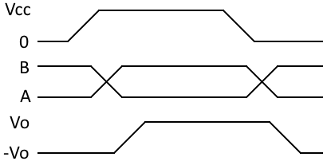
Solution to Noise: Differential Signaling
Data into transmitter
Data out of transmitter, on bus
Data out of receiver
Use differential signaling
Send two signals: Buffered data (A), buffered complement of data (B)
Receiver compares the two signals to determine if data is a one (A > B) or a zero (B > A)

Slide 44
Solutions to Poor Scaling
Approaches
Allow one transmitter to drive multiple receivers (multi-drop)
Connect all transmitters and all receivers to same data line (multi-point network). Need to add a medium access control technique so all nodes can share the wire
Example Protocols
RS-232: higher voltages, point-to-point
RS-422: higher voltages, differential data transmission, multi-drop
RS-485: higher voltages, multi-point

Slide 45
SPI Communications

Slide 46
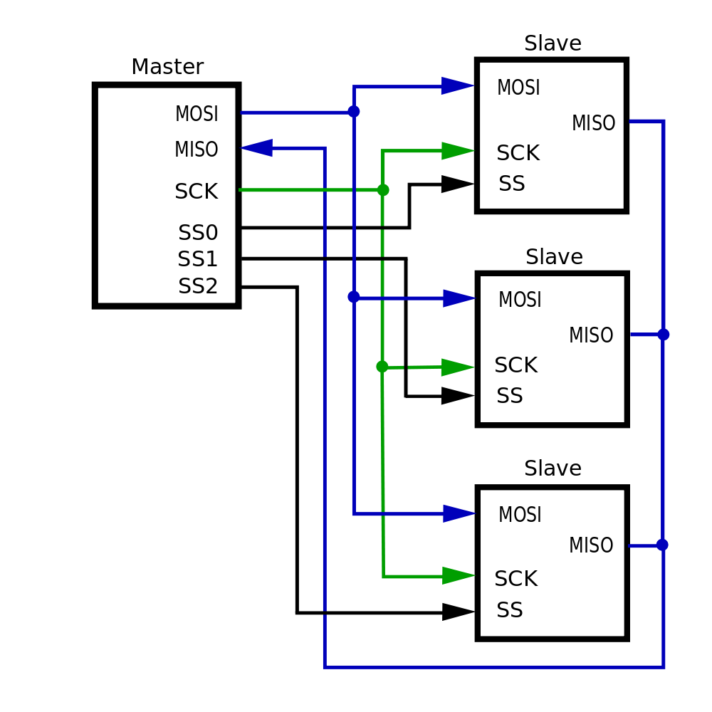
Hardware Architecture
All chips share bus signals
Clock SCK
Data lines MOSI (master out, slave in) and MISO (master in, slave out)
Each peripheral has its own chip select line (CS)
Master (MCU) asserts the CS line of only the peripheral it’s communicating with

Slide 47
Serial Data Transmission
Transmitting Device
Receiving Device
Use shift registers and a clock signal to convert between serial and parallel formats
Synchronous: an explicit clock signal is along with the data signal

Slide 48
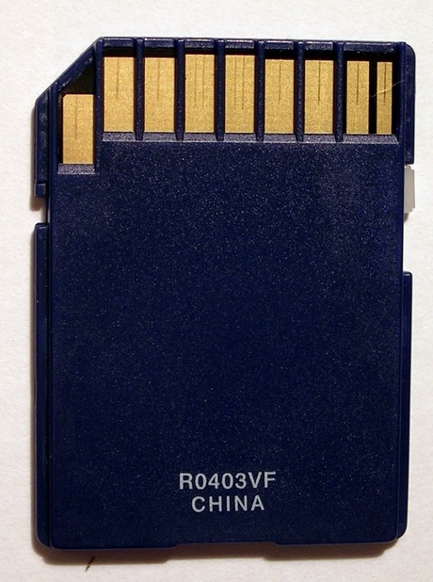
SPI Example: Secure Digital Card Access
SD cards have two communication modes
Native 4-bit
Legacy SPI 1-bit
VDD from 2.7 V to 3.6 V
CS: Chip Select (active-LOW)
Host sends a six-byte command packet to card
Index, argument, CRC
Host reads bytes from card until card signals it is ready
Card returns
0xff while busy
0x00 when ready without errors
0x01-0x7f when error has occurred
CMD /
DI
GND
CLK /
SCLK
VDD
GND
DAT3 /
CS
DAT0/
DO
DAT2 /
X
DAT1/
X

Slide 49
I2C Communications

Slide 50
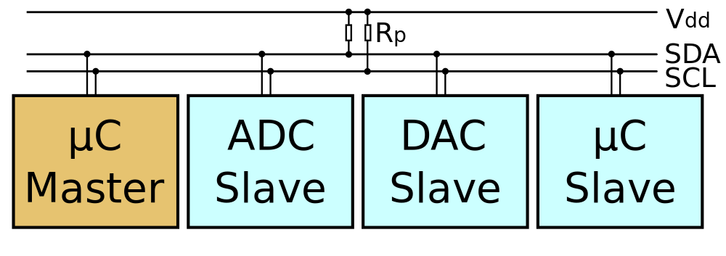
I2C Bus Overview
“Inter-Integrated Circuit” bus
Multiple devices connected by a shared serial bus
Bus is typically controlled by master device, subordinates respond when addressed
I2C bus has two signal lines
SCL: Serial clock
SDA: Serial data
Full details available in “The I2C-bus Specification”
Author: Colin M.L. Burnett, Source: Wikimedia

Slide 51
I2C Bus Connections
Author: Colin M.L. Burnett, Source: Wikimedia
Resistors pull up lines to VDD
Open-drain transistors pull lines down to ground
Master generates SCL clock signal
Can range up to 400 kHz, 1MHz, or more

Slide 52
Master Writing Data to Subordinate
Start
ACK
Write
ACK
Address
Data
Repeated Start

Slide 53
Master Reading Data from Subordinate
SDA
SCL
Start
Stop
ACK
Read
ACK
NACK
Address
Data
Data

Slide 54
I2C Addressing
Each device (IC) has seven-bit address
Different types of device have different default addresses
Sometimes can select a secondary default address by tying a device pin to a different logic level
What if we treat the first byte of data as a register address?
Can specify registers within a given device: 8 bits

Slide 55
Enabling i2c
void temperature_init(void) {
i2c_init();
i2c_enable();
}
void temperature_enable(void) {
// Start conversion.
i2c_start();
i2c_tx(subordinate_ADDRESS | WRITE);
i2c_tx(START_CONVERT_T);
i2c_stop();
}

Slide 56
Reading 12 bits from a temperature sensor
float temperature_read(void) {
short temp;
i2c_start();
i2c_tx(subordinate_ADDRESS | WRITE);
i2c_tx(READ_TEMPERATURE);
i2c_start();
i2c_tx(subordinate_ADDRESS | READ);
temp = i2c_rx() << 8;
i2c_ack();
temp |= i2c_rx();
i2c_nack();
i2c_stop();
// Sign extend from 16-bit to 12-bit.
temp >>= 4;
// Convert from fixed-point to floating point.
return temp / (float)16;
}

Slide 57
Protocol Comparison

Slide 58
Factors to Consider
How fast can the data get through?
Depends on raw bit rate, protocol overhead in packet
How many hardware signals do we need?
May need clock line, chip select lines, etc.
How do we connect multiple devices (topology)?
Dedicated link and hardware per device - point-to-point
One bus for manager transmit/subordinate receive, one bus for subordinate transmit/manager receive
All transmitters and receivers connected to same bus – multi-point
How do we address a target device?
Discrete hardware signal (chip select line)
Address embedded in packet, decoded internally by receiver
How do these factors change as we add more devices?

Slide 59
Protocol Trade-Offs
Protocol | Speed | Signals Req. for Bidirectional Communication with N devices | Device Addressing | Topology
UART (Point to Point) | Fast – Tens of Mbit/s | 2*N (TxD, RxD) | None | Point-to-point full duplex
UART (Multi-drop) | Fast – Tens of Mbit/s | 2 (TxD, RxD) | Added by user in software | Multi-drop
SPI | Fast – Tens of Mbit/s | 3+N for SCLK, MOSI, MISO, and one SS per device | Hardware chip select signal per device | Multi-point full-duplex, multi-drop half-duplex buses
I²C | Moderate – 100kbit/s, 400 kbit/s, 1Mbit/s, 3.4Mbit/s. Packet overhead. | 2 (SCL, SDA) | In packet | Multi-point half-duplex bus

