Slide 1
System Debugging

Slide 2
Learning Outcomes
At the end of this module, you will be able to:
Describe the purpose of a debugging system, including the Arm CoreSight debugging system.
Outline the components and their function in an Arm CoreSight debugging and trace system.
Identify the main steps to build an Arm debugging system.
Arm Cortex-A9 debug interface and Debug registers and CMSIS-DAP.

Slide 3
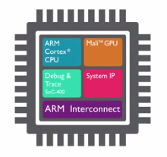
Arm CoreSight Debugging System
Arm CoreSight
Arm debug and trace technology.
Most complete on-chip debug and real-time trace solution for the entire System on Chip (SoC).
Making Arm processor-based SoCs the easiest to debug and optimize.
Notes:
Debugging can generally be performed in two ways:
Invasive debug (often called Debug): These are all debug features that permit modification of processor state. This can be implemented as external debugging (e.g. traditional JTAG debug), or by “self-hosted” debugging (e.g. using a debug monitor that resides in memory). Debug frequently involves halting execution once a failure has been observed, and collecting state information retrospectively to investigate the problem.
Non-invasive debug (often called (data/instruction) Trace): These are all debug features that permit data and program flow observation, but that do not permit modification of the main processor state. It allows for continuous collection of system information for later off-line analysis. Non-invasive debug includes also Sample-based profiling and Performance Monitoring.
CoreSight, the Arm Debug, and Trace technology, are the most complete on-chip debug and real-time trace solution for the entire System on Chip (SoC), making Arm processor-based SoCs the easiest to debug and optimize. With so much money and effort dedicated to this part of SoC design, it is necessary for it to be as efficient as possible when debugging. CoreSight technology addresses the requirement for a multiprocessor debug and trace solution, with high bandwidth for entire systems beyond the processor, despite ever increasing SoC complexity and clock speeds.
CoreSight provides:
A library of modular components and interconnects.
Architected discovery and identification methods to allow for flexible system design and easy inclusion of differentiated debug/trace functions.
A standard implementation of the Arm Debug Interface for debug tools to work with.

Slide 4
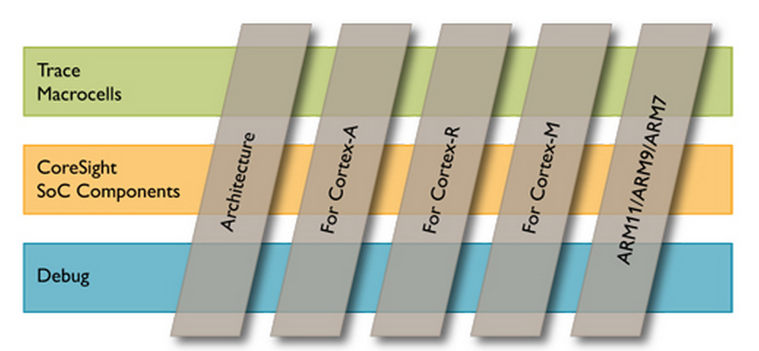
Arm CoreSight Debugging System
Arm CoreSight architecture
Arm processors real-time trace macrocells (ETM & PTM) architecture.
Arm CoreSight SoC component architecture .
Arm Debug Interface (ADI) architecture.
Notes:
A complete Debug and Trace system based on CoreSight requires some additional resources that Arm processors provide as an optional architectural extension. Let us describe the whole picture:
To enable applications to be debugged, an embedded microprocessor might provide facilities that can:
Modify the state of the processor - An external host must be able to modify the contents of the internal registers and the memory system.
Determine the state of the processor - An external host must be able to read the values of the internal registers, and read from the memory system.
Program debug events - An external host must be able to configure the debug logic so that when a special event occurs, such as the program flow reaching a certain instruction in the code, the core enters a special execution mode in which its state can be examined and modified by an external system (Debug state).
Force the processor to enter or exit Debug state from an external system.
Determine when the core enters or leaves Debug state.
Trace program flow around programmable events.
These facilities comprise Embedded Debug Functionality. Two examples of technologies that provide these facilities are:
The ARMv7 Debug Architecture (see the Arm Architecture Reference Manual, ARMv7-A and ARMv7-R edition).
The Embedded Trace Macrocell, (see the ETM Architecture Specification).
However, debug extends beyond the boundaries of an embedded microprocessor core. Engineers must be able to debug components within an embedded SoC and the interconnection fabric of the system. This is called System Debug Functionality. Examples of debug facilities that might be provided at the system level, outside the embedded microprocessor core, include:
Facilities to:
— Examine the state of the system, including state that might not be visible to the embedded microprocessor core.
— Trace accesses on the interconnection fabric. These might be accesses by the microprocessor core, or accesses by other devices such as Direct Memory Access (DMA) engines.
Mechanisms for low-intrusion diagnostic messaging between software and a debugger.
Cross-triggering mechanisms that enable debug components to signal each other.
A fabric for the efficient streaming and collection of diagnostic information, such as program trace.
Examples of technologies that provide these facilities are:
• The ADIv5 Debug Access Port (DAP).
• The CoreSight debug architecture.
• The CoreSight SoC components.
CoreSight on-chip debug and trace includes:
Architecture specifications for the CoreSight Architecture, the Program Flow Trace Macrocell (PTM) and Embedded Trace Macrocell (ETM), the High Speed Serial Trace Port, and the Arm Debug Interface (ADI).
CoreSight components, including the Debug Access Port (DAP), AMBA Trace Bus (ATB) bridge and replicator, the Trace Funnel, the Trace Port Interface Unit (TPIU), the Embedded Trace Buffer (ETB), and the Instrumentation Trace Macrocell (ITM).
Trace macrocells for Arm processors, including the CoreSight PTM-A9.
The AMBA AHB Trace Macrocell (HTM).
The TPIU-Lite and DAP-Lite to provide debug solutions for simple systems.

Slide 5
Arm CoreSight Debugging System
Arm Debug Interface (ADI) Architecture
ADI defines a standard debug interface for debug components in an embedded System on Chip (SoC)
Includes Debug Access Ports (DAP), which contain Access Ports (AP) and Debug Ports (DP).
Trace Macrocell Architecture
Embedded Trace Macrocell (ETM) is a real-time trace module providing instruction and data tracing of a processor. ETM is an integral part of an Arm CoreSight debug and real-time trace solution.
Program Trace Macrocell (PTM) for Program Flow Trace of Cortex-A9
Instrumentation Trace Macrocell (ITM) for high level software view.
AHB Trace Macrocell (HTM) for performance and functional debug.
Figure source: Arm Debug Interface Architecture
Specifications ADIv5 to ADIv5.2
Notes:
The CoreSight architecture introduces a number of key concepts, which together enable complex systems to be designed. Standardized programming models and feature discovery registers allow debug tools to be largely generic with minimal dependence on the feature set of an individual SoC.
CoreSight is not designed as a fixed logic block. It provides many different components that can be used to construct a customized debug&trace architecture that responds to various functionalities and requirements.
These components and their use are described in the Architecture Specification documents provided by Arm. These are:
Arm System Trace Macrocell Programmers’ Model Architecture Specification.
CoreSight Program Flow Trace Architecture Specification.
Embedded Trace Macrocell (ETM) Architecture Specification.
Debug Interface Architecture (ADI) Specification.
High Speed Serial Trace Port Architecture Specification.
Arm Debug Interface (ADI) Architecture
ADI defines a standard debug interface for debug components in an embedded System on Chip (SoC). This includes Debug Access Ports (DAP), which contain Access Ports (AP) and Debug Ports (DP), and which provide an optimized implementation of the ADI architecture for Arm based SoC.
Logically, the Arm Debug Interface (ADI) consists of:
A number of registers that are private to the interface. These are referred to as the Debug Access Port (DAP) registers.
A means to access the DAP registers.
A means to access the debug registers of the debug components to which the DAP is connected.
Trace Macrocell Architecture
The CoreSight technology offers an exhaustive range of trace macrocells, including:
Embedded Trace Macrocell (ETM): a real-time trace module providing instruction and data tracing of a processor. ETM is an integral part of an Arm CoreSight debug and real-time trace solution.
Program Trace Macrocell (PTM) for Program Flow Trace of Cortex-A9.
Instrumentation Trace Macrocell (ITM) for high level software view.
AHB Trace Macrocell (HTM) for performance and functional debug.
Partners can integrate their own trace macrocells to the CoreSight infrastructure by complying with the Arm CoreSight architecture.

Slide 6
Notes:
The CoreSight™ Infrastructure, in conjunction with the CoreSight Trace Macrocells, provides all the infrastructure required to debug, monitor, and optimize the performance of a complete System on Chip (SoC) design.
The CoreSight Infrastructure provides the following capabilities for system-wide trace:
Debug and trace visibility of whole systems.
Cross triggering support between SoC subsystems.
Multi-source trace in a single stream.
Standard programmer's models for standard tools support.
Open interfaces for third party cores.
Low pin count.
Low silicon overhead.
This enables:
Higher visibility of complete system operation through fewer pins.
Standard solution across all silicon vendors for widest tools support.
Re-usable for single Arm processor, multi-core processor and DSP systems.
Faster time-to-market for more reliable and higher performance products.
Support of highest frequency processor.
The figure on the slide shows a complete debug&trace architecture for a complex SoC including two multicore Cortex-A processor and a Mali graphic processor. A combination of ETMs, Debug Access Ports and other architectural components like CTIs, CTMs and STMs are used to implement the debug and trace system. However, more simple implementations are possible depending on the debugging/tracing requirements. The next three slides give some basic typical CoreSight system architectures.

Slide 7
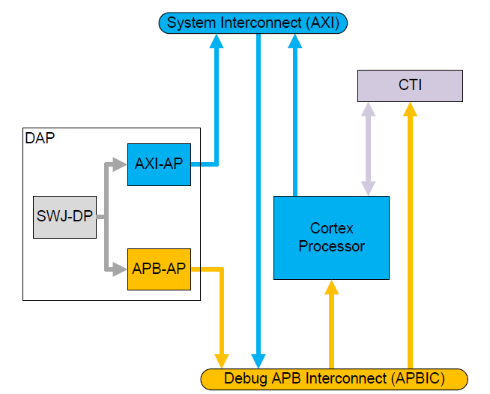
Example1: Single Processor Debug
Figure source: CoreSight Technical Introduction. A quick start for designers. White Paper, Arm
Notes:
This figure shows CoreSight debug in a single processor system.
This configuration provides no trace capabilities. The DAP shown here is configured with a combined Serial Wire and JTAG external interface, and APB internal debug access. The Debug APB connects using an APB-Interconnect to configure the CTI and access the processor. The CTI supports triggering of the processor from a designated resource, and enables connection to additional triggering resources if integrated into a larger system.

Slide 8
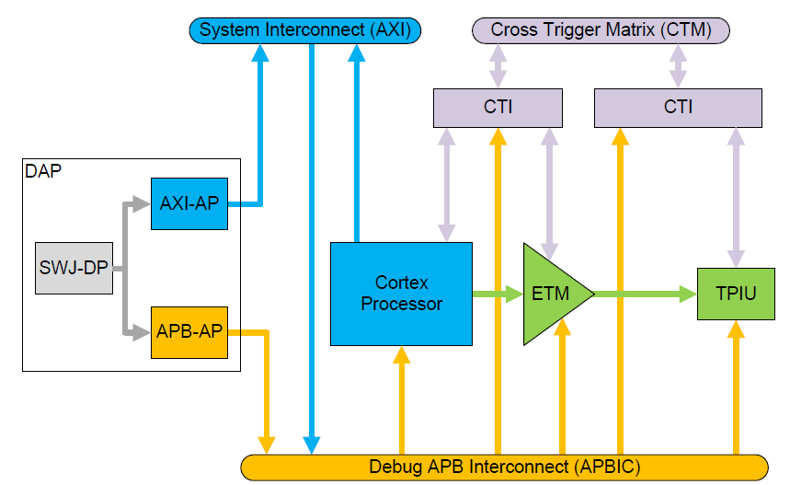
Example 2: Single Processor Trace
Figure source: CoreSight Technical Introduction. A quick start for designers. White Paper, Arm
Notes:
This figure shows a single processor trace using the CoreSight infrastructure.
The CoreSight-compliant ETM trace unit outputs trace directly to a TPIU (Trace Port Interface) for direct output of trace off-chip. You can extend this system to add a CoreSight ETB and replicator to provide on-chip storage of trace data.

Slide 9
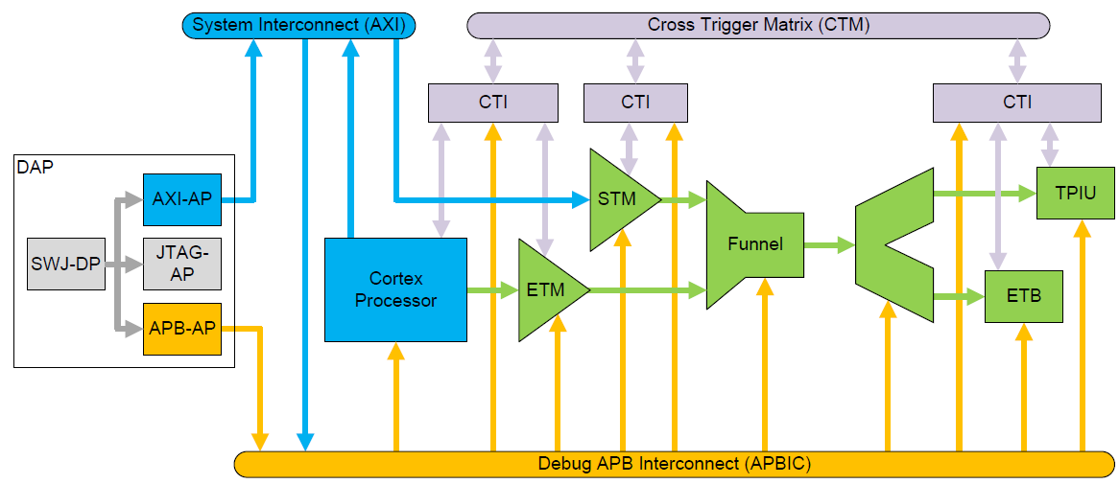
Example 3: Multi Source Trace
Figure source: CoreSight Technical Introduction. A quick start for designers. White Paper, Arm
Notes:
This figure shows full trace capabilities in a single processor system.
The ETM trace unit provides processor instruction and data tracing, and the STM provides instrumentation trace. The trace funnel combines trace from all sources into a single trace stream. This is then either:
Replicated to provide on-chip storage using the CoreSight ETB (limited capacity)
Output off chip using the TPIU (limited bandwidth)
You can program components using the DAP and operate cross-triggering using the CTM and CTIs.
When multiple trace sources are active in the system, each source must be configured with a unique trace source ID, and every trace sink must have trace formatting enabled. One function of the trace formatter is to embed the trace IDs in the final data stream. When only one trace source is active, the trace sink can be used in bypass mode. This can be more efficient in some scenarios.

Slide 10
Arm CoreSight Debugging System
CoreSight SoC Components Architecture
CoreSight™ SoC components in conjunction with the CoreSight Trace macrocells provide all the infrastructure required to debug, monitor, and optimize the performance of a complete System on Chip (SoC) design.
CoreSight SoC-400 provides fully configurable versions of all of the CoreSight components together with AMBA Designer support for the entire range of CoreSight debug & trace logic
Notes:
CoreSight SoC-400 provides configurable versions of all of the CoreSight SoC components, with AMBA Designer support for graphical system design and automated IP stitching.
It includes:
A library of configurable CoreSight components, written in Verilog. Scripts to render configured instances of the CoreSight components are based on your parameter choices.
An optional flow to graphically configure, integrate, and stitch the supplied components and Arm processors using AMBA Designer and supplied IP-XACT component views.
Support for the System Trace Macrocell (STM) and Trace Memory Controller (TMC) (licensed separately).

Slide 11
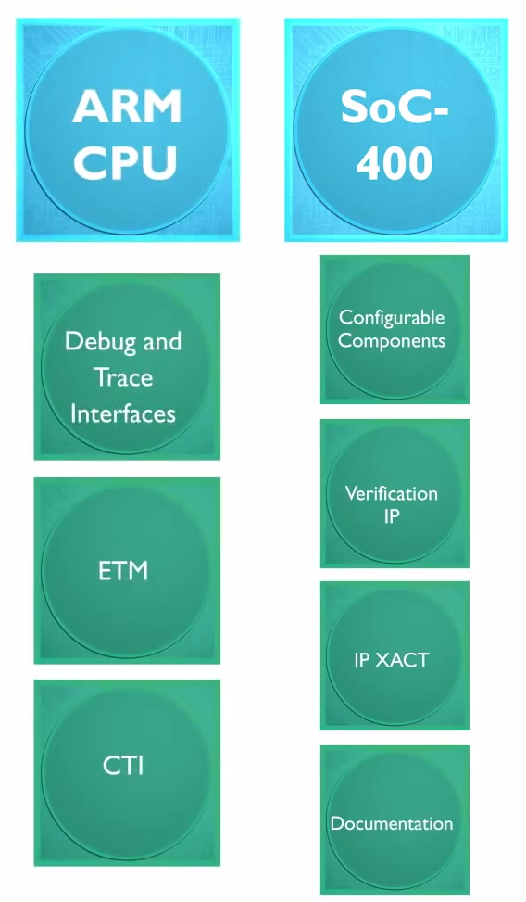
CoreSight SoC-400
Notes:
CoreSight SoC-400 is a kit of parts that enables software developers and SoC designers to develop high-performance systems while decreasing development time and risks.
SoC-400 makes the development process easier, because it includes a library of configurable components, with IP-XACT descriptions, and scripts to implement functionality to meet design requirements.
SoC-400 configurable components are compatible with all Arm CPUs, and Arm CPUs come with their own debug and trace interfaces and hardware blocks that can be connected to your SoC-400 based design.

Slide 12
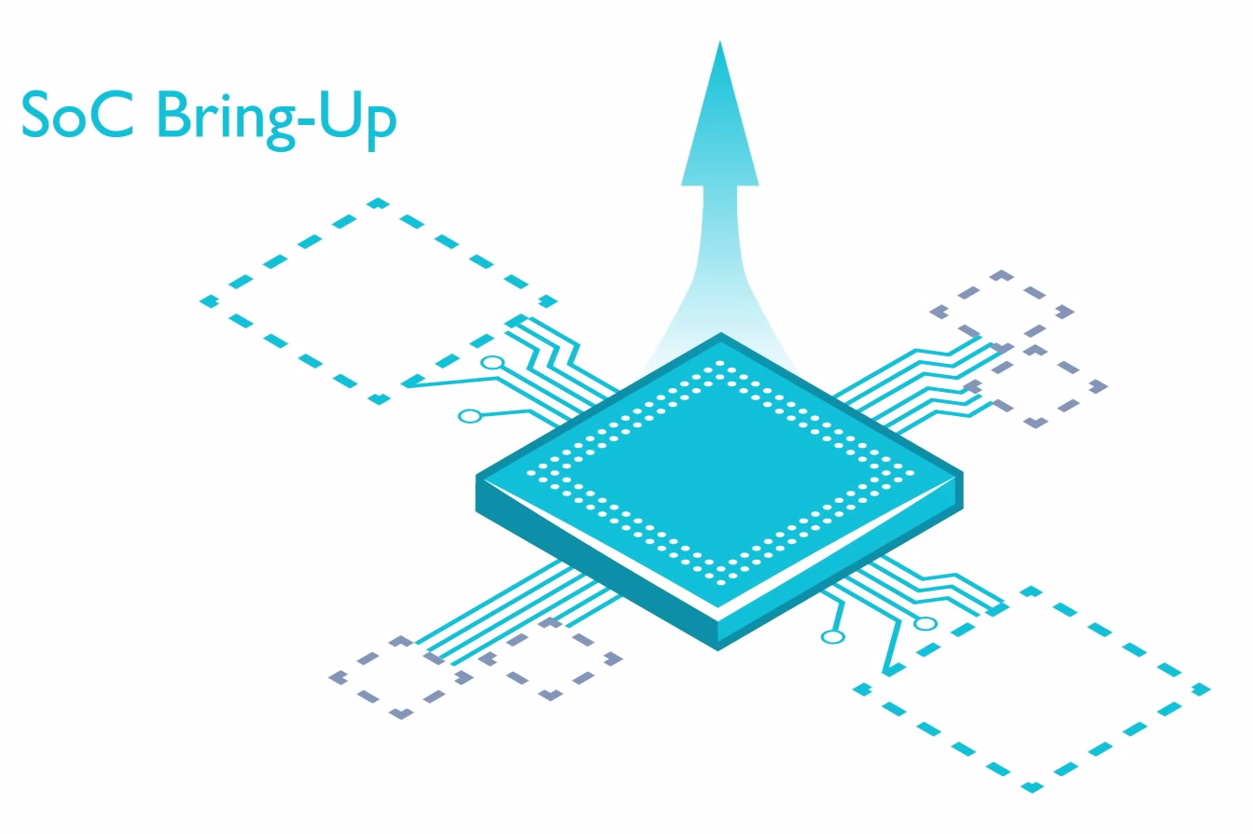
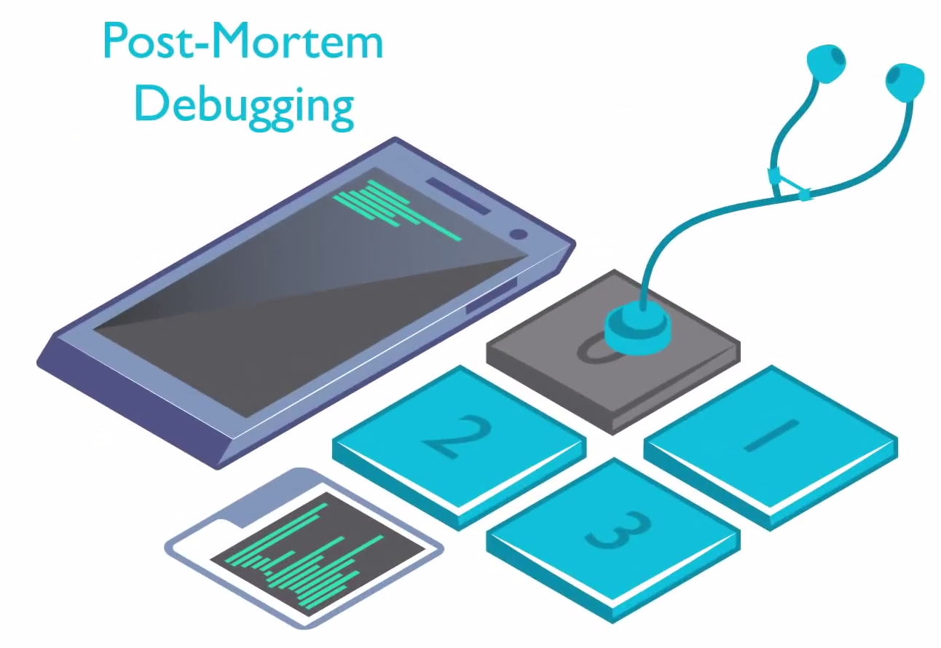
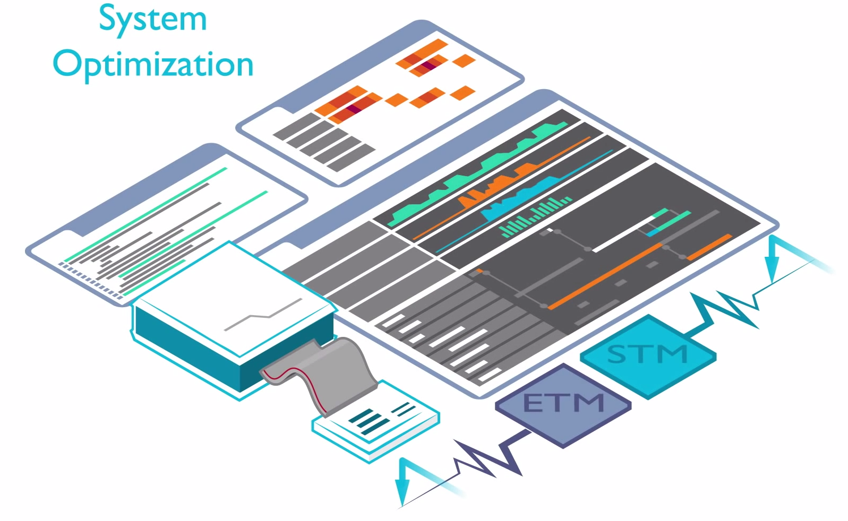
CoreSight SoC-400
SoC Bring-up
Fast bring-up SoC design, reduce time to market.
Software Debugging
Help improve the reliability of your product.
Post-mortem Debugging
Find bugs earlier in the product lifecycle.
System Optimization
For both hardware and software help create best Arm solutions.
Notes:
SOC-400 IP supports four key use cases for a debug and trace solution, as shown above.

Slide 13
Steps to build an Arm debugging subsystem
Start with an Arm CPU.
Use SoC-400 product and configurable components to build the infrastructure for debug trace sub-system.
Use Processor Integration Layer (PILs) to ease integration of Arm processors in SoC-400 debugging subsystem.
Use Trace Memory Controller (TMC) and System Trace Macrocell (STM) to build debug trace solution.
Notes:
To build an Arm debugging system, you typically start with an RM CPU.
You then use the SoC-400 product and its configurable components to build the infrastructure for debug trace sub-system, followed by a library of PILs (Processor Integration Layer). A PIL is a wrapper to ease the integration of Arm processors in a SoC-400-based debug and trace subsystem. PIL deliverables include verification code intended for use in a SoC-400 framework.
You can also use advanced CoreSight components such as a Trace Memory Controller and System Trace Macrocell to build and innovated Debug & Trace solutions to meet your specific requirements for area, power, and debug visibility.

Slide 14
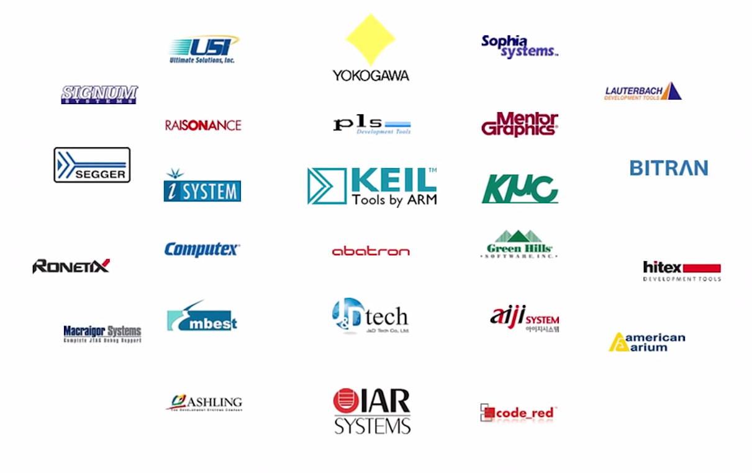
Supported tools
Supported by over 25 industry-leading software and hardware debug tools companies, across all markets and regions
Debug of symmetric multi-processing and asymmetric multicore systems.
Powerful interactive debugging with real-time visibility.
Performance optimization.
Line and path code coverage of assembler and C/C++.
High-level system views with OS and RTOS context.
Real-time data monitoring, common to MCU and automotive applications.
Notes:
CoreSight IP is licensed by all major silicon providers, and is able to address everything from multicore Cortex-A class to low cost Cortex-M platforms.
The CoreSight debug and trace technology is supported by over 25 industry-leading software and hardware debug tools companies, across all markets and regions, and is able to address everything from multicore Cortex-A class to low cost Cortex-M platforms.
Many efficient debug & trace solutions can be delivered such as:
Debug of symmetric multi-processing and asymmetric multicore systems.
Powerful interactive debugging with real-time visibility.
Performance optimization.
Line and path code coverage of assembler and C/C++.
High-level system views with OS and RTOS context.
Real-time data monitoring, common to MCU and automotive applications.

Slide 15
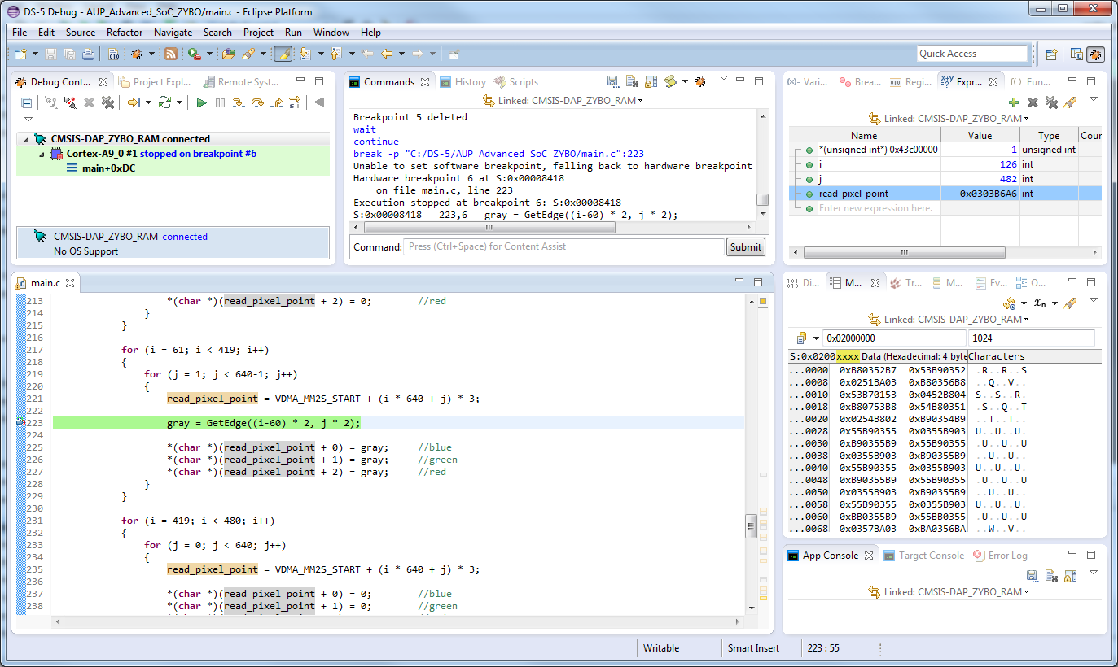
Debug using Arm Development Studio
Debug control
Variables watching
Framebuffer in “Memory”
Breakpoints
Notes:
Arm’s own debug tool, DS-5 development studio, is specially crafted to enable you to develop highly optimized products based on Arm processors by allowing you to make the most of the CoresSight hardware.
We already described DS-5 trace capabilities in Module 03. Many of these capabilities are debug & trace capabilities provided by CoreSight devices. Direct interaction between DS-5 and CoreSight is enabled by CoreSight on-target access library. The library offers a flexible programming interface allowing a variety of use cases and experimentation.

Slide 16
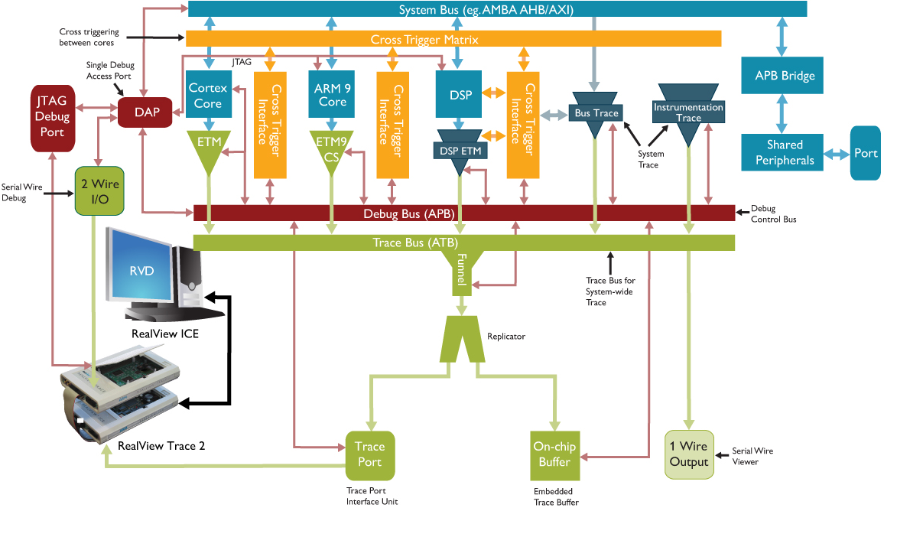
Debugging Cotex-A9 processor using CoreSight
CoreSight™ for Arm Cortex-A series processors
Provides embedded software and application developers with all the on-chip debug.
Real-time trace resources .
Optimization and debug of Cortex-A application processor platforms.
Notes:
In the following slides, we will briefly examine how CoreSight technology can be applied to debugging SoCs based on Cortex-A9 processors. As mentioned, CoreSight components are compatible with all Arm processors and, in particular, with the Cortex-A9 processors.
This figure shows a complete debug & trace solution based on CoreSight. A system like this provides:
Embedded software and application developers with all the on-chip debug.
Real-time trace resources.
Optimization and debug of Cortex-A application processor platforms.
The following slides describe the functionality of each components in this debug & trace architecture.

Slide 17
Debugging Cotex-A9 processor using CoreSight
Component | Overview
Debug Access Port | Provide debugger access to the cores and buses in a SoC, across multiple power and clock islands, enabling exceptionally high download speeds direct to memory.
Embedded Cross Trigger | Synchronize debug and trace across multiple cores.
Program Trace Macrocells (Cortex-A9) | Noninvasively generate cycle-accurate, instruction trace of Arm processors running at full speed.
Embedded Trace Macrocells (Cortex-A5,Cortex-A8) | Noninvasively generate cycle-accurate, instruction and data trace of Arm processors running at full speed.
Trace Funnel | Combine multiple trace sources together.

Slide 18
Debugging Cotex-A9 processor using CoreSight
Component | Overview
Embedded Trace Buffer | Store trace data on-chip at high rates at 32-bit data width, eliminating the need for dedicated trace port pins or an external trace collection unit.
Trace Port Interface Unit | Transmit trace data off-chip via 2-34 pins at frequencies asynchronous to the core. Instrumentation Trace Macrocell for high level, low bandwidth, software generated trace.
Serial Wire Debug | High performance 2-pin debug port that replaces the 5/6-pin JTAG interface with multi-drop support.
Serial Wire Viewer | Single pin output for Instrumentation Trace.
Integration Kit | Contain RTL testbench, test vectors and full documentation for easy validation of a designer's own CoreSight subsystem

Slide 19
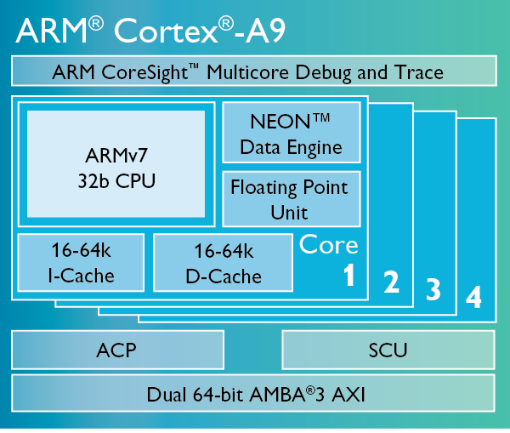
Arm Cortex-A9 debug interface
Debug interface
The Cortex-A9 processor implements the ARMv7 debug architecture.
Debugging modes:
Halt mode debugging in Secure user mode.
Monitor mode debugging in Secure user mode.
Breakpoints and watchpoints
Six breakpoints.
Four watchpoints.
Asynchronous aborts
Notes:
Arm Cortex-A9 CPUs come with their own debug and trace interfaces, and hardware blocks that can be connected to a SoC-400 based design. In particular, the Arm Cortex-A9 debug interface is part of the Armv7 architecture.
Arm processors implement two types of debug support:
Invasive debug: The invasive debug component of the Debug architecture is intended primarily for run-control debugging.
Non-invasive debug
Regarding Invasive Debug (or simply “Debug”):
Software can use the programmers’ model to manage and control debug events. Watchpoints and breakpoints are two examples of debug events. A debugger programs the Debug Status and Control Register, DBGDSCR, to configure which debug-mode is used:
Monitor debug: A debug event causes a debug exception to occur:
a debug exception that relates to instruction execution generates a Prefetch Abort exception
a debug exception that relates to a data access generates a Data Abort exception.
Halting debug: A debug event causes the processor to enter Debug state. In Debug state, the processor stops executing instructions from the location indicated by the Program Counter, but is instead controlled through the external debug interface, in particular using the Instruction Transfer Register, DBGITR. This enables an external agent, such as a debugger, to interrogate processor context, and control all subsequent instruction execution. Because the processor is stopped, it ignores the system and cannot service interrupts.
A debug solution can use a mixture of the two methods, for example to support an OS or RTOS with both:
Running System Debug (RSD) using Monitor debug.
Halting debug support available as a fallback for system failure and boot time debug.
The architecture supports the ability to switch between these two debug-modes.
The Debug architecture provides a software interface that includes:
A Debug Identification Register, DBGDIDR.
Status and control registers, including the Debug Status and Control Register, DBGDSCR.
Hardware breakpoint and watchpoint support.
The DCC.
Features to support the debug of reset, powerdown and the operating system.
Regarding Non-invasive Debug:
The Debug architecture defines the following areas of non-invasive debug:
Instruction trace and, in some implementations, data trace. Trace support is typically implemented using a trace macrocell.
Sample-based profiling.
Performance monitors.
Trace support is an architecture extension (trace macrocell). A trace macrocell constructs a real-time trace stream corresponding to the operation of the processor. How the trace stream is handled is IMPLEMENTATION DEFINED. Typically, use of a trace macrocell is non-invasive. Development tools can connect to the trace macrocell, configure it, capture trace and download the trace without affecting the operation of the processor in any way. A trace macrocell provides an enhanced level of runtime system observation and debug granularity.
Sample-based profiling is an OPTIONAL non-invasive component of the Debug architecture, that enables debug software to profile a program
Performance monitors: The Armv7 architecture defines an OPTIONAL Performance Monitors Extension. The basic form of this is:
A cycle counter, with the ability to count every cycle or every sixty-fourth cycle.
A number of event counters. Software can program the event counted by each counter:
Controls for
— enabling and resetting counters
— indicating overflows
— enabling interrupts on overflow.

Slide 20
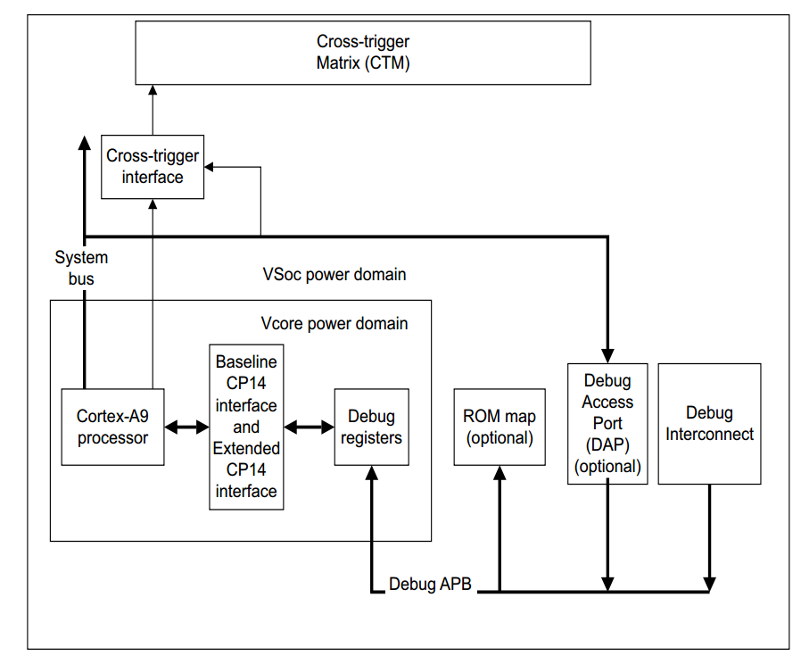
Arm Cortex-A9 Debug Interface
The debug interface consists of:
A Baseline CP14 interface
An Extended CP14 interface
An external debug interface connected to the external debugger through a Debug Access Port (DAP).
Notes:
v7 Debug and v7.1 Debug architectures define Debug register interfaces. The most important distinction is between:
The processor interface, that describes how an ARMv7 processor can access its own debug resources.
The external debug interface, that defines how an external debugger can access the debug resources.
Arm strongly recommends an external debug interface based on the Arm Debug Interface v5 Architecture Specification (ADIv5). This interface supports external debug over powerdown of the processor. ADIv5 supports both a JTAG wire interface and a low pin-count Serial Wire Debug (SWD) interface. The Arm debug tools support either wire interface. An ADIv5 interface enables a debug object, such as an Arm processor, to abstract a set of resources as a memory-mapped peripheral. Accesses to debug resources are made as 32-bit read or write transfers.
The debug architecture requires that some Debug registers are accessible to software executing on the processor, so that the debug architecture can be used by a self-hosted debug monitor. To meet this requirement:
v7.1 Debug requires these Debug registers to be accessible using CP14 register accesses.
v7 Debug requires a subset of these Debug registers to be accessible using CP14 accesses, and the remainder of these registers to be accessible from one or both of the following:
the CP14 interface
a memory-mapped Debug register interface.
If an implementation includes an optional trace macrocell, the appropriate trace architecture specification defines the interface to the trace macrocell registers. The Arm trace macrocell architectures, define optional CP14 and memory-mapped interfaces to the registers.
In particular, the Cortex-A9 debug interface consists of (see the figure on the slide):
a Baseline CP14 interface
an Extended CP14 interface
an external debug interface connected to the external debugger through a Debug Access Port (DAP).

Slide 21
Debug Register Descriptions
Debug State Cache Control Register (DBGDSCCR)
Controls cache behavior while the processor is in Debug state.
Cortex-A9 processor does not implement any of the features of the DBGDSCCR, and it reads as zero.
Breakpoint Value Registers (BVRs)
Registers 64-68, at offsets 0x100-0x114.
Each BVR is associated with a Breakpoint Control Register (BCR)
Breakpoint Control Registers (BCRs)
Read and write registers that contain the necessary control bits for setting:
breakpoints
linked breakpoints
Notes:
The DBGDSCCR is a memory system controls cache behavior for memory operations issued by a debugger when the processor is in Debug state. A debugger can use these to request the minimum amount of intrusion to the processor caches that the implementation permits. The Cortex-A9 processor does not implement any of the features of the Debug State Cache Control Register. The Debug State Cache Control Register reads as zero.
The Breakpoint Value Registers (BVRs) are registers 64-68, at offsets 0x100-0x114. Each BVR is associated with a Breakpoint Control Register (BCR), for example:
BVR0 with BCR0.
BVR1 with BCR1.
This pattern continues up to BVR5 with BCR5. A pair of breakpoint registers, BVRn and BCRn, is called a Breakpoint Register Pair (BRPn).
A Breakpoint Control Register (BCR) is a read/write register that contains the necessary control bits for setting:
Breakpoints.
Linked breakpoints.
Figure on slide shows the BCRs bit assignments.

Slide 22
Debug Register Descriptions
Watchpoint Value Registers (WVRs)
Registers 96-99, at offsets 0x180-0x18C.
Each WVR is associated with a Watchpoint Control Register (WCR).
Watchpoint Control Registers (WCRs)
Contain the necessary control bits for setting:
watchpoints
linked watchpoints
Debug management registers
Define the standardized set of registers that is implemented by all CoreSight components.
Notes:
The Watchpoint Value Registers (WVRs) are registers 96-99, at offsets 0x180-0x18C. Each WVR is associated with a Watchpoint Control Register (WCR), for example:
WVR0 with WCR0
WVR1 with WCR1.
This pattern continues up to WVR3 with WCR3. A pair of watchpoint registers, WVRn and WCRn, is called a Watchpoint Register Pair (WRPn).
The Watchpoint Control Registers (WCRs) contain the necessary control bits for setting:
Watchpoints.
Linked watchpoints.
Figure on slide shows the WCRs bit assignments.
The Debug management registers define the standardized set of registers that is implemented by all CoreSight components. You can access these registers:
• Through the internal CP14 interface.
• Through the APB using the relevant offset.

Slide 23
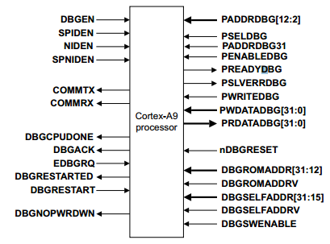
Debug Register Descriptions
Processor ID Registers
Read-only registers that return the same values as the corresponding CP15 ID Code Register and Feature ID Register
CoreSight Identification Registers (Debug Management Registers)
Read-only registers that consist of the Peripheral Identification Registers and the Component Identification Registers.
External debug interface
The system can access memory-mapped debug registers through the Cortex-A9 APB Completer port.
This APB Completer interface supports 32-bits wide data, stalls, completer-generated aborts, and eleven address bits [12:2] mapping 2x4KB of memory.
More information on Cortex-A9 Technical Reference Manual
Notes:
The Processor ID Registers are read-only Debug Management Registers that return the values stored in the Main ID and feature registers of the processor. The processor identification registers are:
Debug registers 832-895, at offsets 0xD00-0xDFC.
Except for register 838, aliases of the CP15 processor identification registers.
The Debug management registers define the standardized set of registers that is implemented by all CoreSight components. These are:
The Peripheral Identification Registers are read-only registers that provide standard information required by all components that conform to the Arm Debug Interface v5 specification. The Peripheral Identification Registers are accessible from the Debug APB bus.
The Component Identification Registers are read-only registers that provide standard information required by all components that conform to the Arm Debug Interface v5 specification. The Component Identification Registers are accessible from the Debug APB bus.
Leaving aside the processor debug interface registers and turning to the external debug interface, we will simply mention that the system can access memory-mapped Debug registers through the Cortex-A9 APB Completer port. This APB Completer interface supports 32-bits wide data, stalls, completer-generated aborts, and 11 address bits [12:2] mapping 2x4KB of memory. bit [12] of PADDRDBG[12:0] selects which of the components is accessed:
Use PADDRDBG[12] = 0 to access the debug area of the Cortex-A9 processor.
Use PADDRDBG[12] = 1 to access the PMU area of the Cortex-A9 processor.
More detailed information can be found in the Cortex-A9 Technical Reference Manual.

Slide 24
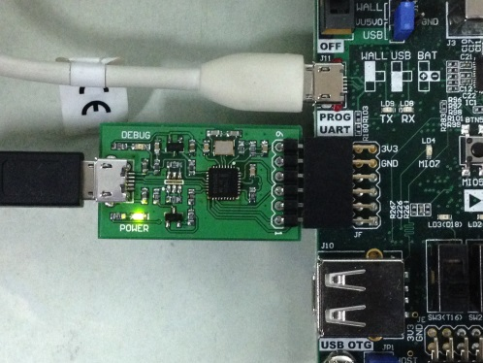
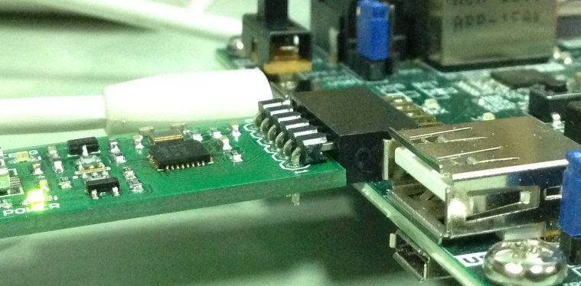
CMSIS-DAP Debugger Probe
CMSIS-DAP Debugger Probe
Provides a standardized way to access the CoreSight Debug Access Port (DAP) of an Arm Cortex microcontroller via USB.
USB connection uses HID (Human Interface Device) driver class.
Based on NXP LPC11U35 MCU.
Low-cost and open-source.
Notes:
Arm standardized the CMSIS-DAP debugging which consists of an abstraction of the Cortex Debug Access Port (DAP) command set over a driver-less USB HID connection. This provides a USB connection to the DAP that major tool vendors have started to support. It even provides the flexibility for users to write their own debugger, or debug script using the USB bindings.
CMSIS-DAP provides a standardized way to access the CoreSight Debug Access Port (DAP) of an Arm Cortex microcontroller via USB. CMSIS-DAP is generally implemented as an on-board interface chip, providing direct USB connection from a development board to a debugger running on a host computer on one side, and over JTAG (Joint Test Action Group) or SWD (Serial Wire Debug) to the target device to access the CoreSight DAP on the other.
Arm has developed this tiny, low-cost CMSIS-DAP debugger probe based on the NXP LPC11U35 MCU (Cortex-M0) which can be easily plugged in a 1x6 JTAF header (see pictures on the slide).

Slide 25
CMSIS-DAP Debugger Probe
3.3V
5V
GND
DM
USB_DM
PIO 0.7
TCK
DP
USB_DP
PIO 0.9
TDO
GND
PIO 0.17
TDI
PIO 0.8
TMS
USB Connector
LPC11U35/501
Notes:
The figure describes the I/O interconnections between the USB connector, the debug probe, and the JTAG connector.

Slide 26
Bibliography
Cortex-A9 Technical Reference Manual, Arm, 2012.
Arm® Architecture Reference Manual. Armv7-A and Armv7-R edition, Arm, 2012.
Arm CoreSight Architecture Specification, Arm, 2013.
Arm CoreSight SoC-400 Technical Reference Manual, Arm, 2015.
Arm Debug Interface Architecture Specification. ADIv5.0 to ADIv5.2. ARM, 2013.
CoreSight technical introduction. A Quick Start for Designers. White Paper, ARM-EPM-039795, Arm, 2013.
Notes:
Bibliography
Cortex-A9 Technical Reference Manual, Arm, 2012.
Arm® Architecture Reference Manual. Armv7-A and Armv7-R edition, Arm, 2012.
Arm CoreSight Architecture Specification, Arm, 2013.
Arm CoreSight SoC-400 Technical Reference Manual, Arm, 2015.
Arm Debug Interface Architecture Specification. ADIv5.0 to ADIv5.2. ARM, 2013.
CoreSight technical introduction. A Quick Start for Designers. White Paper, ARM-EPM-039795, Arm, 2013.

