Slide 1
Discrete-Time Random Processes
Notes:
In this module we will consider specifically discrete-time random signals and their interaction with (discrete-time) linear time-invariant (LTI) systems.
We’ll look at how random signals are described and what happens to them when they are processed.

Slide 2

Deterministic and Random Discrete-Time Signals
Deterministic signals may be described by algebraic expressions. The $n$th value of a deterministic discrete-time signal $x(n)$ might be defined, for example, by the expression $x\left(n\right)=sin⁡(\hat{ω}n)$
Random (stochastic) signals or processes are described in terms of their statistical properties. The $n$th value of a random signal $x(n)$ is not defined.
Notes:
In the first module it was stated that signals may be classified as being either deterministic or random.
If signal $x(n)$ is deterministic it’s described (typically) by an algebraic (or analytic) expression such that for a particular value of $n$ we can determine the value of $x(n)$.
Unlike those of a deterministic signal, the individual values of a random signal are not defined. We cannot say what the $n$th value of a random signal $x(n)$ will be.
Instead, random signals are described in terms of their statistical properties.
In the context of discrete-time signal processing, or at least in the context of this course, we will use the nouns process, signal, and sequence (somewhat) interchangeably. As we go on we’ll see that a number of different terms, notations, and symbols are commonly used to represent the same statistical properties.
Three highly recommended texts on the subject of random signals in digital signal processing, consulted when preparing these slides, are
Paul A Lynn, Digital Signals, Processors and Noise, Macmillan, 1992
Alan V Oppenheim and Ronald W Schafer, Discrete-Time Signal Processing, Pearson, 2014
Peyton Z Peebles, Probability, Random Variables, and Random Signal Principles, McGraw-Hill, 2000
In the context of discrete-time systems, $\hat{ω}=ωT$ , as shown in the example expression for $x(n)$ on this slide, represents normalised frequency, measured in radians, where $T$ is the sampling period in seconds of the discrete-time system.

Slide 3
Discrete-Time Random Signals
Describing discrete-time random signals
Processing discrete-time random signals
Notes:
In this module we’ll first look at how discrete-time random signals are described and then look at how the characteristics of those random signals are altered when they are processed by linear time-invariant (LTI) systems. We’ll concentrate very much on discrete-time signals.

Slide 4
Describing Random Signals – Amplitude Distribution
An amplitude distribution describes the likelihood or probability of a random variable having a particular value (or of lying within a range of values).
A probability density function (pdf) is appropriate for continuous random variables.
A probability mass function (pmf) is appropriate for discrete random variables.
Notes:
So what are the statistical properties used to describe random signals?
A good starting point is a signal’s amplitude distribution.
It was stated earlier that we cannot say what the $n$th value of a random signal $x(n)$ will be.
However, it doesn’t follow that $x(n)$ could take on just any value, outcome, or amplitude.
$x(n)$ may have different probabilities of taking on different amplitudes, including zero probability of taking on some amplitudes.
Amplitude distributions tell us what those different probabilities are.
In this course, the $n$th value of a random signal $x(n)$ will be treated as a random variable $X$. And so in the next slides we may use $X$ and $x(n)$ interchangeably.
From amplitude distributions we can compute the statistical properties mean, mean square and variance.
At this point it may be useful to clarify the distinction between continuous random variables and discrete random variables. Their amplitude distributions are described and treated slightly differently. The amplitude distribution of a continuous random variable is described by a probability density function (pdf) and that of a discrete random variable is described by a probability mass function (pmf).
It’s also useful to point out that two different senses of the word discrete have been used here. Discrete in the context of a discrete random variable is not the same as discrete in the context of discrete-time. Hence the random variable $X$ representing a discrete-time signal $x(n)$ may be either a continuous random variable or a discrete random variable.

Slide 5










Probability Density Function (pdf)
A probability density function (pdf) $p_{X}(x)$ describes the amplitude distribution of a continuous random variable $X$.
Example: uniform pdf
$$\int_{−∞}^{∞}{p_{X}\left(x\right)dx=1}$$
$$p_{X}(x)$$
$$\frac{1}{2A}$$
$$P\left[a<X≤b\right]=\int_{a}^{b}{p_{X}\left(x\right)dx}$$
$$−A$$
$$0$$
$$a$$
$$b$$
$$A$$
x
Notes:
So the amplitude distribution of a continuous random variable is described by its probability density function.
The probability that the value of continuous random variable $X$lies between $a$ and $b$ is equal to the area under the pdf between $x=a$ and $x=b$, that is the integral of the pdf $p_{X}(x)$ with respect to $x$ between $a$ and $b$.
The total area under any pdf (the probability that value of $X$ lies between plus and minus infinity) is equal to one.
The uniform pdf shown here is an example of a situation in which a random variable can’t take on just any value. In this case the magnitude of $X$ cannot be greater than $A$.

Slide 6
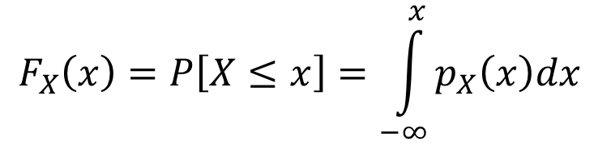






Cumulative Distribution Function (cdf)
A cumulative distribution function (cdf) $F_{X}(x)$ describes the area under the probability density function (pdf) of a continuous random variable $X$ from $−∞$ to $x$.
Example: uniform pdf
$$F_{X}(x)$$
$$1$$
$$F_{X}\left(x\right)=P\left[X≤x\right]=\int_{−∞}^{x}{p_{X}\left(x\right)dx}$$
$$−A$$
$$0$$
$$A$$
x
Notes:
The cumulative distribution function (cdf) $F_{X}\left(x\right)$ gives the area under a probability density function from $−∞$ to $x$.
This slide shows the cumulative distribution function corresponding to the uniform pdf shown in the previous slide.
From left to right, that is as $x$ increases, any cdf rises in a non-decreasing fashion from 0 to 1.

Slide 7
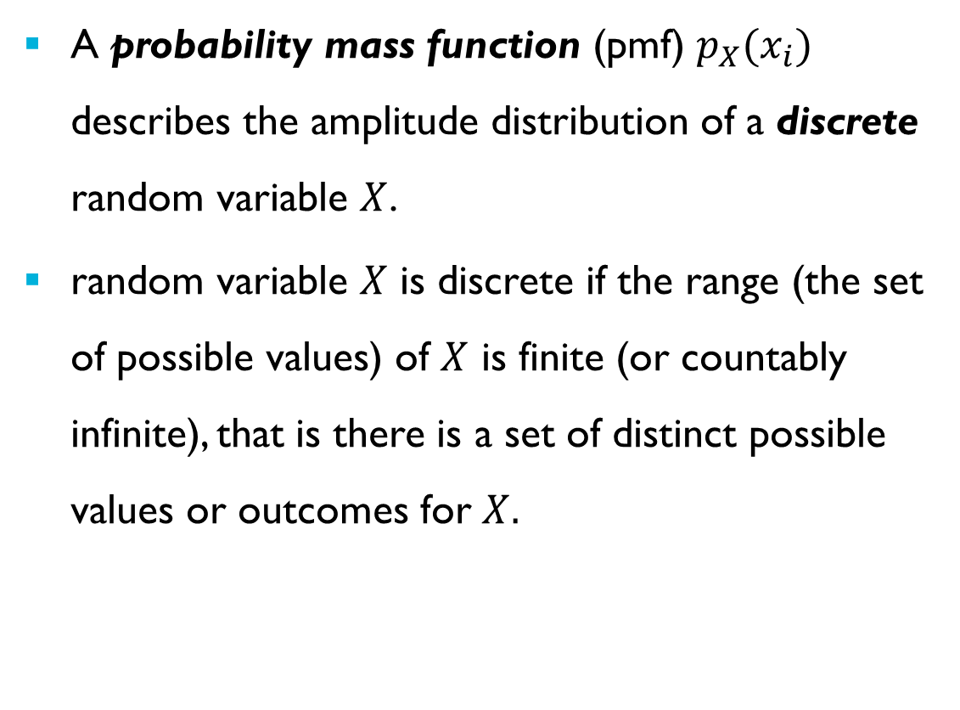

Probability Mass Function (pmf)
A probability mass function (pmf) $p_{X}(x_{i})$ describes the amplitude distribution of a discrete random variable $X$.
random variable $X$ is discrete if the range (the set of possible values) of $X$ is finite (or countably infinite), that is there is a set of distinct possible values or outcomes for $X.$
$$p_{X}\left(x_{i}\right)=P\left[X=x_{i}\right]$$
Notes:
The probability mass function (pmf) is the equivalent of the probability density function for a discrete random variable, that is one for which there is a finite set of distinct possible values or outcomes.
Discrete random variable $X$ can take on any one of that finite (or countably infinite) number of different values $x_{i}$, where$x_{i}$ is the $i$th possible value or outcome of $X$.
The probability mass function describes the probability that the value of discrete random variable $X$ is equal to the $i$th possible (or allowable) value $x_{i}$. The sum of ${p_{X}(x}_{i})$ over all $i$ is therefore equal to 1.

Slide 8

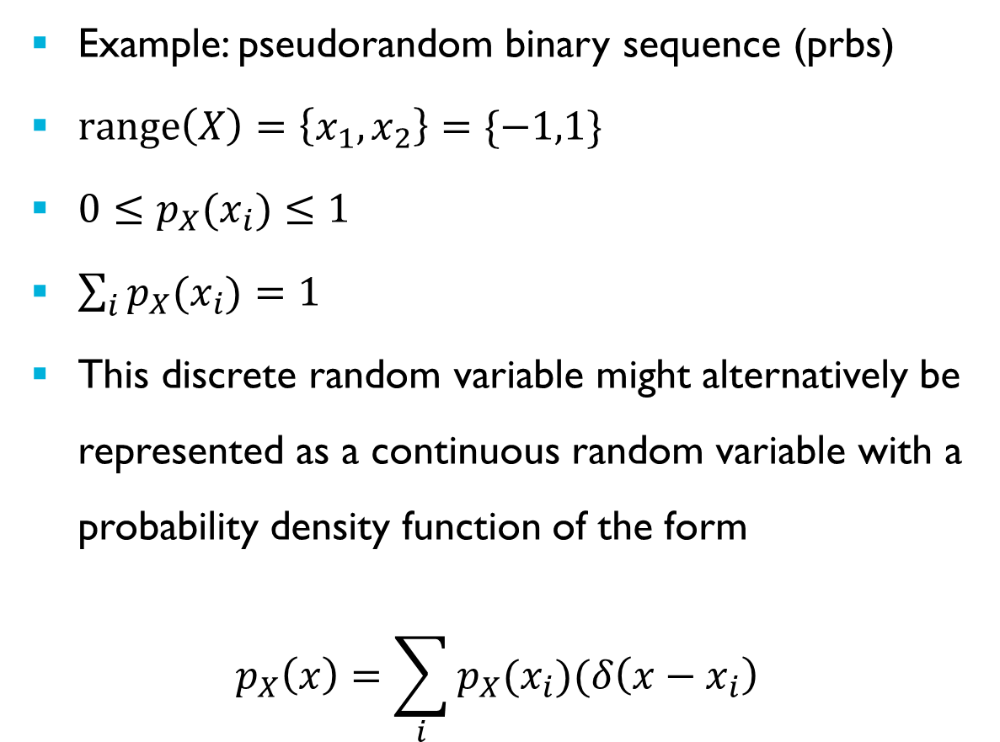



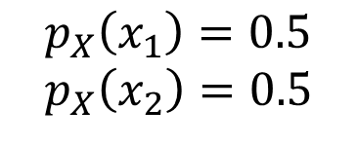


Probability Mass Function (pmf)
Example: pseudorandom binary sequence (prbs)
$\text{range}\left(X\right)=\left\{x_{1},x_{2}\right\}=\{−1,1\}$
${0≤p}_{X}(x_{i})≤1$
$\sum_{i}{p_{X}(x_{i})}=1$
This discrete random variable might alternatively be represented as a continuous random variable with a probability density function of the form
$$p_{X}\left(x\right)=\sum_{i}{p_{X}(x_{i})(δ\left(x−x_{i}\right)}$$
$$p_{x}(x_{i})$$
$$0.5$$
$$−1$$
$$0$$
$$1$$
$$x_{i}$$
$$p_{X}\left(x_{1}\right)=0.5 \\ p_{X}\left(x_{2}\right)=0.5$$
Notes:
An example of a discrete random variable is a pseudorandom binary sequence (PRBS). The value of $x(n)$ is either plus or minus one, each possible outcome in this example having equal probability.
We can represent the probability mass function of a PRBS graphically as shown here.
The range of a discrete random variable is the (ordered) set of possible values or outcomes for $X$.
Each possible value or outcome has an index $i$. The values of $i$ are arbitrary but it’s conventional to index the ordered values in the range as shown here, that is starting at $i=1$ for the most negative possible value or outcome of $X$.
The sum over all $i$ of the probabilities $p_{X}(x_{i})$ is equal to one
Arguably, a pmf might alternatively be represented as a continuous pdf comprising a sum of weighted and shifted impulses.

Slide 9




Probability Distribution Function (pdf)
Example: pseudorandom binary sequence (prbs)
$$F_{X}\left(x\right)=P\left(X≤x\right)=\sum_{x_{i}≤x}{p_{X}(x_{i})}$$
$$F_{X}(x)$$
$$1$$
$$−1$$
$$0$$
$$1$$
$$x_{i}$$
Notes:
Closely related to the pmf is the (cumulative) probability distribution function (pdf) which is discontinuous as it rises in discrete steps from 0 to 1.
Shown here is the probability distribution function corresponding to the probability mass function for the PRBS shown on the previous slide.

Slide 10

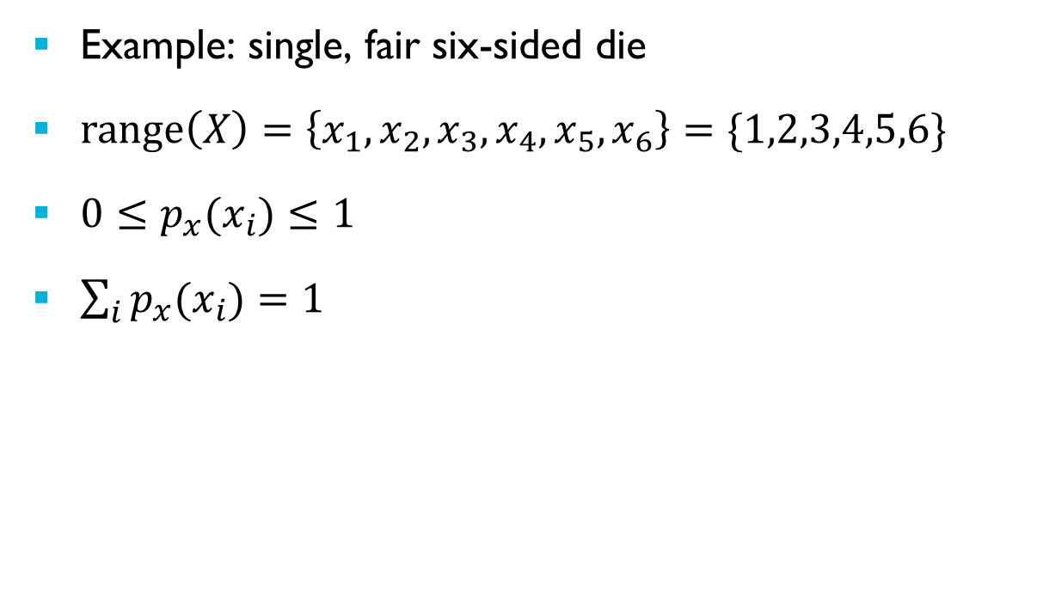








Probability Mass Function (pmf)
Example: single, fair six-sided die
$\text{range}\left(X\right)=\left\{x_{1},x_{2},x_{3},x_{4},x_{5},x_{6}\right\}=\{1,2,3,4,5,6\}$
${0≤p}_{x}(x_{i})≤1$
$\sum_{i}{p_{x}(x_{i})}=1$
$$p_{x}(x_{i})$$
$$0.167$$
$$1$$
$$2$$
$$3$$
$$4$$
$$5$$
$$6$$
$$x_{i}$$
Notes:
The number returned by rolling a fair six-sided die is another example of a discrete random variable.
It can return one of only six distinct (discrete) values. Its range is {1,2,3,4,5,6}
We can represent its probability mass function graphically as shown here.
The probability mass function is applicable to relatively simple random processes and is useful in describing the amplitude distributions of sequences such as a PRBS or integer values read from an analogue to digital converter. Strictly speaking any random (sample) value represented in digital hardware is a discrete random variable.
Think about the prbs() and prand() functions used in some of the laboratory exercises. Function prbs() returns one of only two possible values. It is intuitive to view it as a discrete random variable. Function prand() used in the laboratory exercises returns a uniformly distributed 32-bit integer value. Strictly speaking a discrete random variable with 2^32 different possible outcomes, but it may be practical to think of it as a continuous random variable with a uniform pdf.

Slide 11
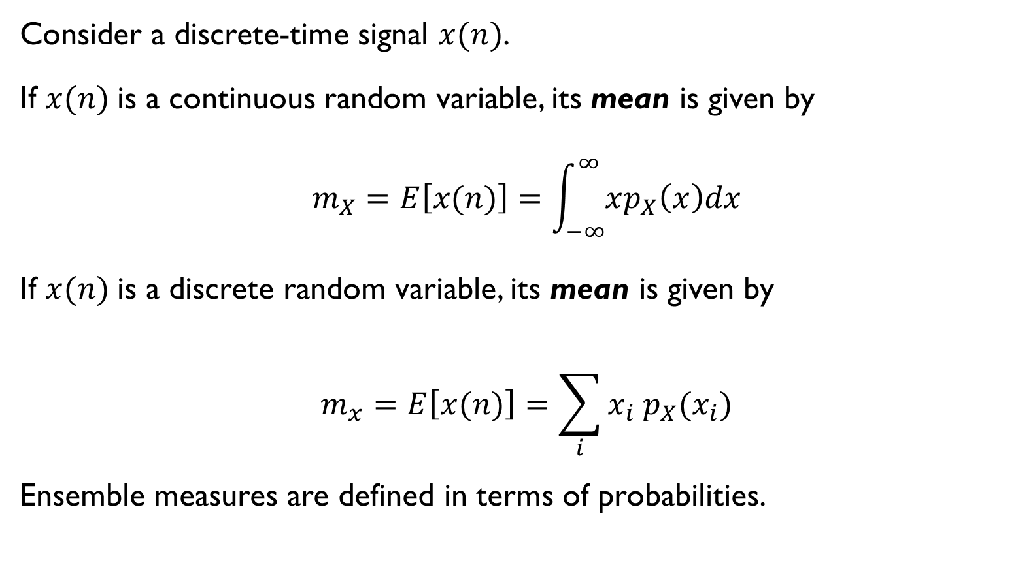
Ensemble Averages - Mean
Consider a discrete-time signal $x(n)$.
If $x(n)$is a continuous random variable, its mean is given by
$$m_{X}=E\left[x(n)\right]=\int_{−∞}^{∞}{xp_{X}\left(x\right)dx}$$
If $x(n)$is a discrete random variable, its mean is given by
$$m_{x}=E\left[x(n)\right]=\sum_{i}{x_{i} p_{X}(x_{i})}$$
Ensemble measures are defined in terms of probabilities.
Notes:
Let’s look at some of the statistical properties or measures used to describe random variables. Let’s look at ensemble averages.
We can express the ensemble mean in terms of the expectation operator $E$ or in terms of a pdf or pmf.
What is an ensemble?
Essentially it is a way of referring to a random process hypothetically and in its entirety, as opposed, specifically, to a finite example of its output.
The set of all sequences which could be generated by a random process is known as an infinite ensemble.

Slide 12
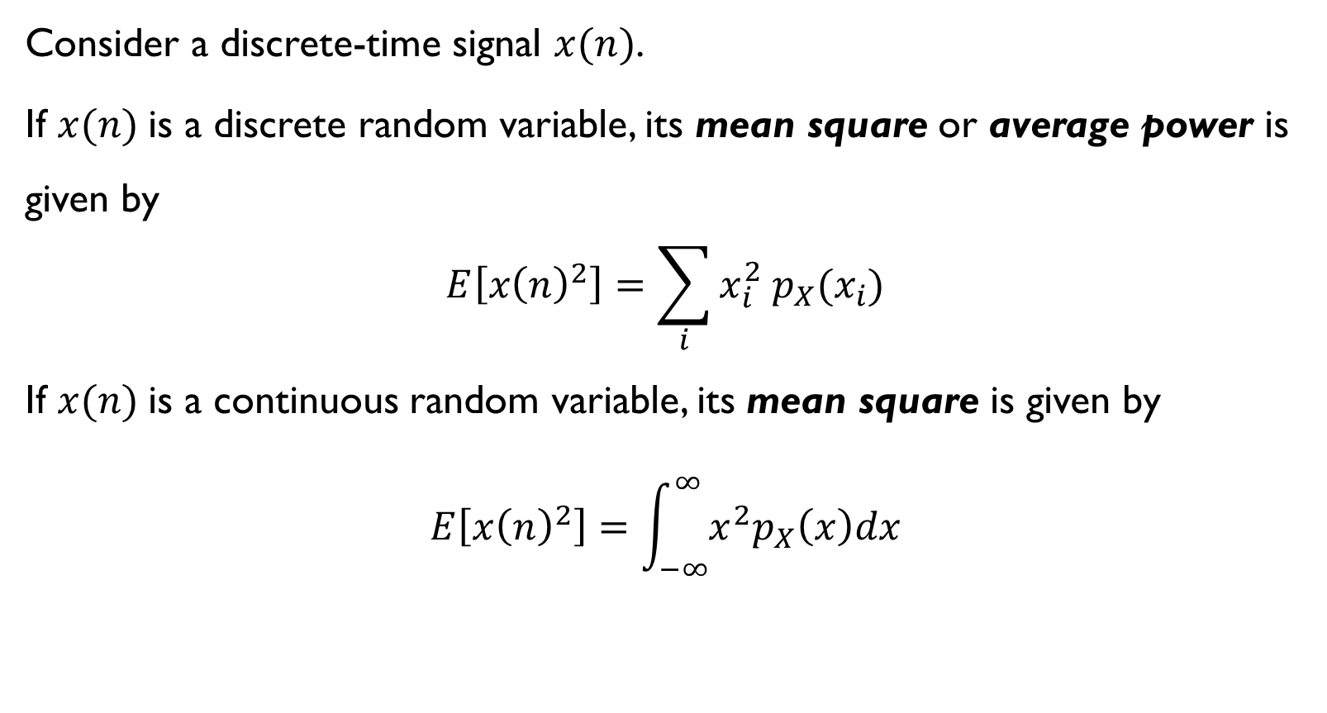
Ensemble Averages – Mean Square
Consider a discrete-time signal $x(n)$.
If $x(n)$is a discrete random variable, its mean square or average power is given by
$$E\left[{x\left(n\right)}^{2}\right]=\sum_{i}{x_{i}^{2} p_{X}(x_{i})}$$
If $x(n)$is a continuous random variable, its mean square is given by
$$E\left[{x\left(n\right)}^{2}\right]=\int_{−∞}^{∞}{x^{2}p_{X}\left(x\right)dx}$$
Notes:
The mean square value of $x(n)$, whether it’s a continuous or a discrete random variable, is equal to its average power.

Slide 13
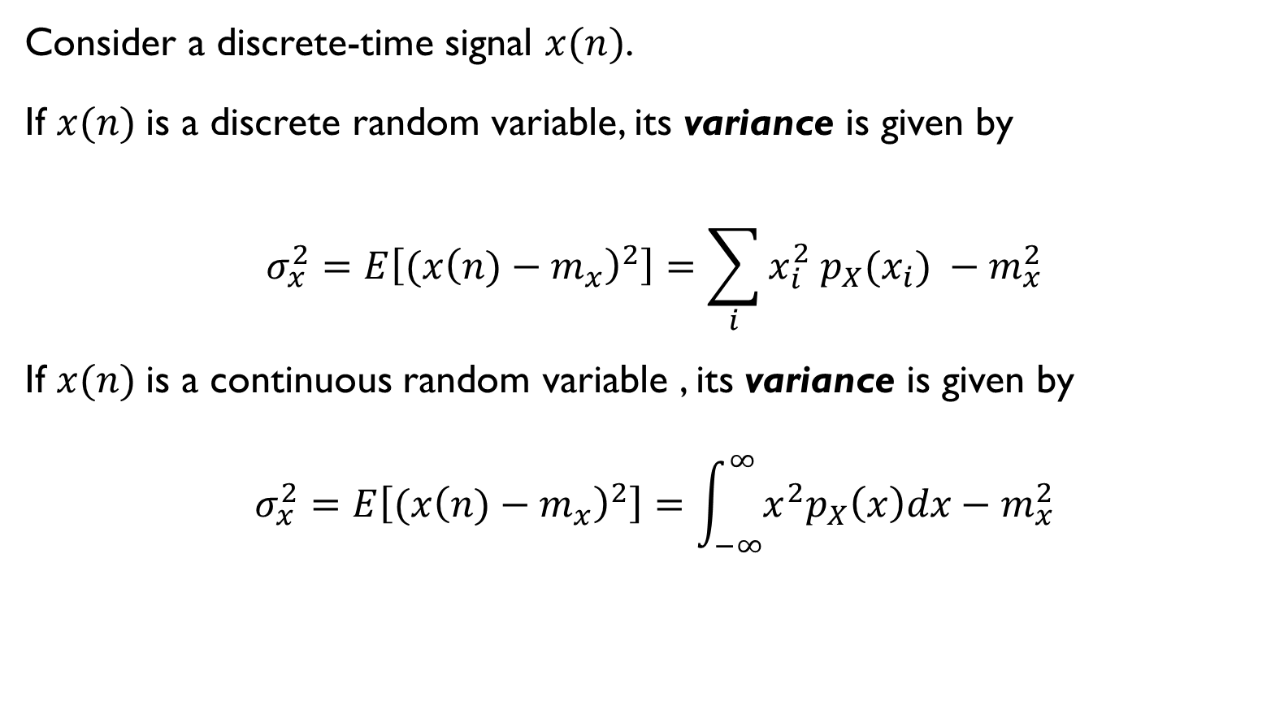
Ensemble Averages – Variance
Consider a discrete-time signal $x(n)$.
If $x(n)$is a discrete random variable, its variance is given by
$$σ_{x}^{2}=E\left[{(x\left(n)−m_{x}\right)}^{2}\right]=\sum_{i}{x_{i}^{2} p_{X}(x_{i})} −m_{x}^{2}$$
If $x(n)$is a continuous random variable , its variance is given by
$$σ_{x}^{2}=E\left[{(x\left(n)−m_{x}\right)}^{2}\right]=\int_{−∞}^{∞}{x^{2}p_{X}\left(x\right)dx}−m_{x}^{2}$$
Notes:
Variance concerns fluctuation about the mean value. It’s equal to the mean square of a signal with the mean removed. For a zero-mean signal it’s equal to the mean square.

Slide 14
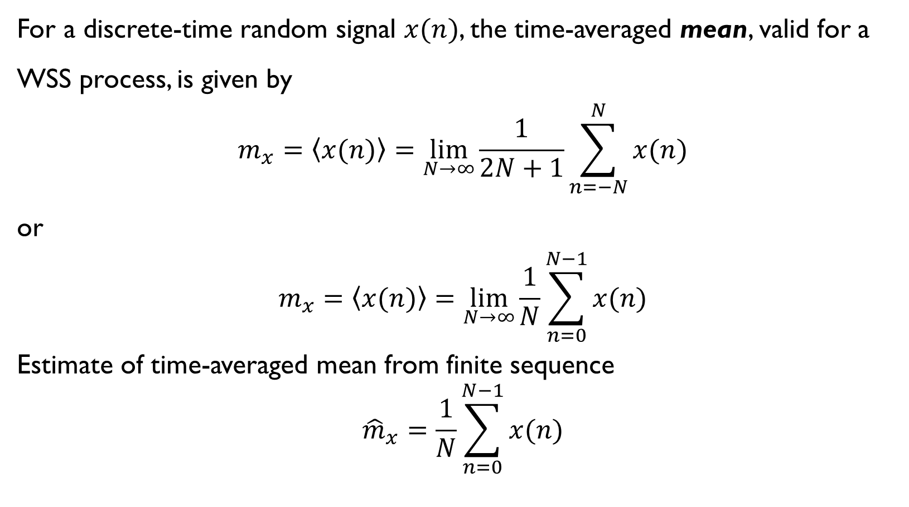
Time-Averaged Mean
For a discrete-time random signal $x(n)$, the time-averaged mean, valid for a WSS process, is given by
$$m_{x}=\left\langle x(n)\right\rangle =\lim_{N→∞}{\frac{1}{2N+1}}\sum_{n=−N}^{N}{x(n)}$$
or
$$m_{x}=\left\langle x(n)\right\rangle =\lim_{N→∞}{\frac{1}{N}}\sum_{n=0}^{N−1}{x(n)}$$
Estimate of time-averaged mean from finite sequence
$${\hat{m}}_{x}=\frac{1}{N}\sum_{n=0}^{N−1}{x(n)}$$
Notes:
Oppenheim states “In a signal processing context, the notion of an ensemble of signals is a convenient mathematical concept that allows us to use the theory of probability to represent the signals. However, in a practical situation, we always have available at most a finite number of finite-length sequences rather than an infinite ensemble of sequences. We might want to infer certain averages from measurements on a single member of the ensemble. If the probability distributions are independent of time, it seems intuitively that the amplitude distribution of a long segment of an individual sequence of samples should be approximately equal to the single probability density that describes the random variable.”
When dealing with individual sequences rather than with ensembles, we can use time-averaged measures defined in terms of the sample values $x(n)$ rather than ensemble measures defined in terms of probabilities.
In certain circumstances time-averaged measures can take the place of ensemble measures. These circumstances are that the signal is stationary and ergodic. In fact the definition of an ergodic signal is that its ensemble and time-averaged means are the same.
Another way of stating this is that time-averaged values are valid for wide sense stationary (WSS) processes (processes for which mean and correlation functions are independent of time origin).
The time–averaged mean definition suggests the possibility of estimating the time-averaged mean (of a random signal) from a finite length sequence (of the random signal). Then we have to consider the quality of such an estimate. It’s conventional to describe this in terms of bias and variance (of the estimate) An unbiased estimate is one that is equal to the actual statistical property of the signal. But on this course we’re not going to get into this rather complicated subject,
Notice the notation, that is the triangular brackets, used to indicate a time-averaged quantity. This is used in some of the literature.
Notice too that we can define a time-averaged mean in two very slightly different ways.

Slide 15

Time-Averaged Variance
For a discrete-time random signal $x\left(n\right),$the time-averaged variance, valid for a WSS process, is given by
$$σ_{x}^{2}=\left\langle {(x\left(n)−m_{x}\right)}^{2}\right\rangle =\lim_{N→∞}{\frac{1}{2N+1}\sum_{n=−N}^{N}{{(x\left(n)−m_{x}\right)}^{2}}}$$
Notes:
Similar observations and arguments as were just made of the time-averaged mean may be made of the time-averaged variance of $x(n)$.

Slide 16
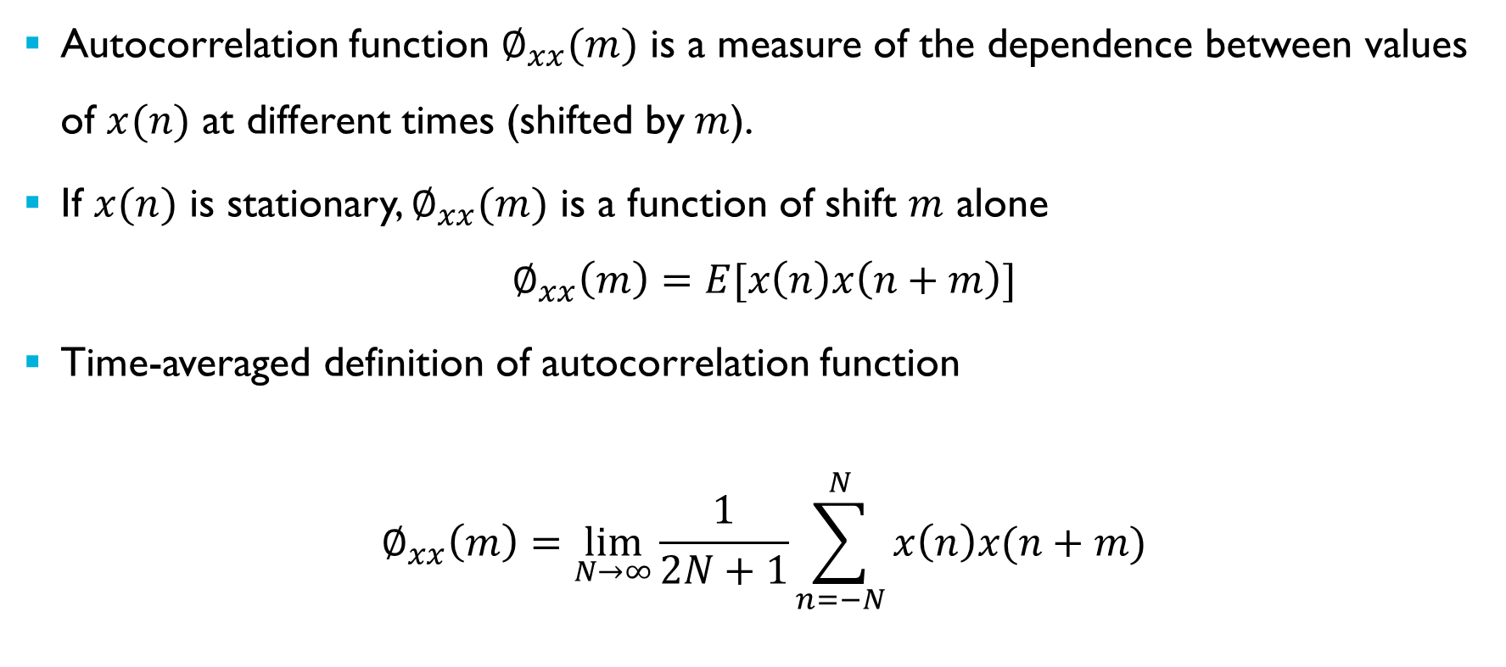
Autocorrelation Function
Autocorrelation function $∅_{xx}(m)$ is a measure of the dependence between values of $x(n)$ at different times (shifted by$m$).
If $x(n)$ is stationary, $∅_{xx}(m)$ is a function of shift $m$ alone
$$∅_{xx}\left(m\right)=E[x\left(n\right)x\left(n+m\right)]$$
Time-averaged definition of autocorrelation function
$$∅_{xx}\left(m\right)=\lim_{N→∞}{\frac{1}{2N+1}\sum_{n=−N}^{N}{x\left(n\right)x(n+m)}}$$
Notes:
The statistical properties of a random signal that we’ve described so far are first order statistics. They tell us nothing about the dependence of one value in the sequence $x(n)$ on another.
Autocorrelation is a second order statistic that gives us a measure of that dependence.
It is the average, or expected value of the product of the sequence $x(n)$ and a (time) shifted version of itself.
We saw that first order random signal statistics, namely mean, mean square, and variance are defined as ensemble averages in terms of probabilities but that, assuming stationarity and ergodicity, we could replace these definitions with time-averages taken from single sequences. The same approach is possible with correlation functions (second order statistics) and so we’ll define the autocorrelation function in time-averaged form.

Slide 17

Autocorrelation Function
Alternative notation
$$R_{xx}\left(m\right)=\lim_{N→∞}{\frac{1}{N}\sum_{n=0}^{N−1}{x\left(n\right)x(n+m)}}$$
Notes:
Autocorrelation is sometimes represented by the symbol $R_{xx}$ rather than $∅_{xx}$ and, as with other time-averaged measures, it may be defined in more than one slightly different way. You may encounter this notation in the literature, that is using symbol $R_{xx}$ to represent the autocorrelation function and using $N$ rather than $\left(2N+1\right).$

Slide 18
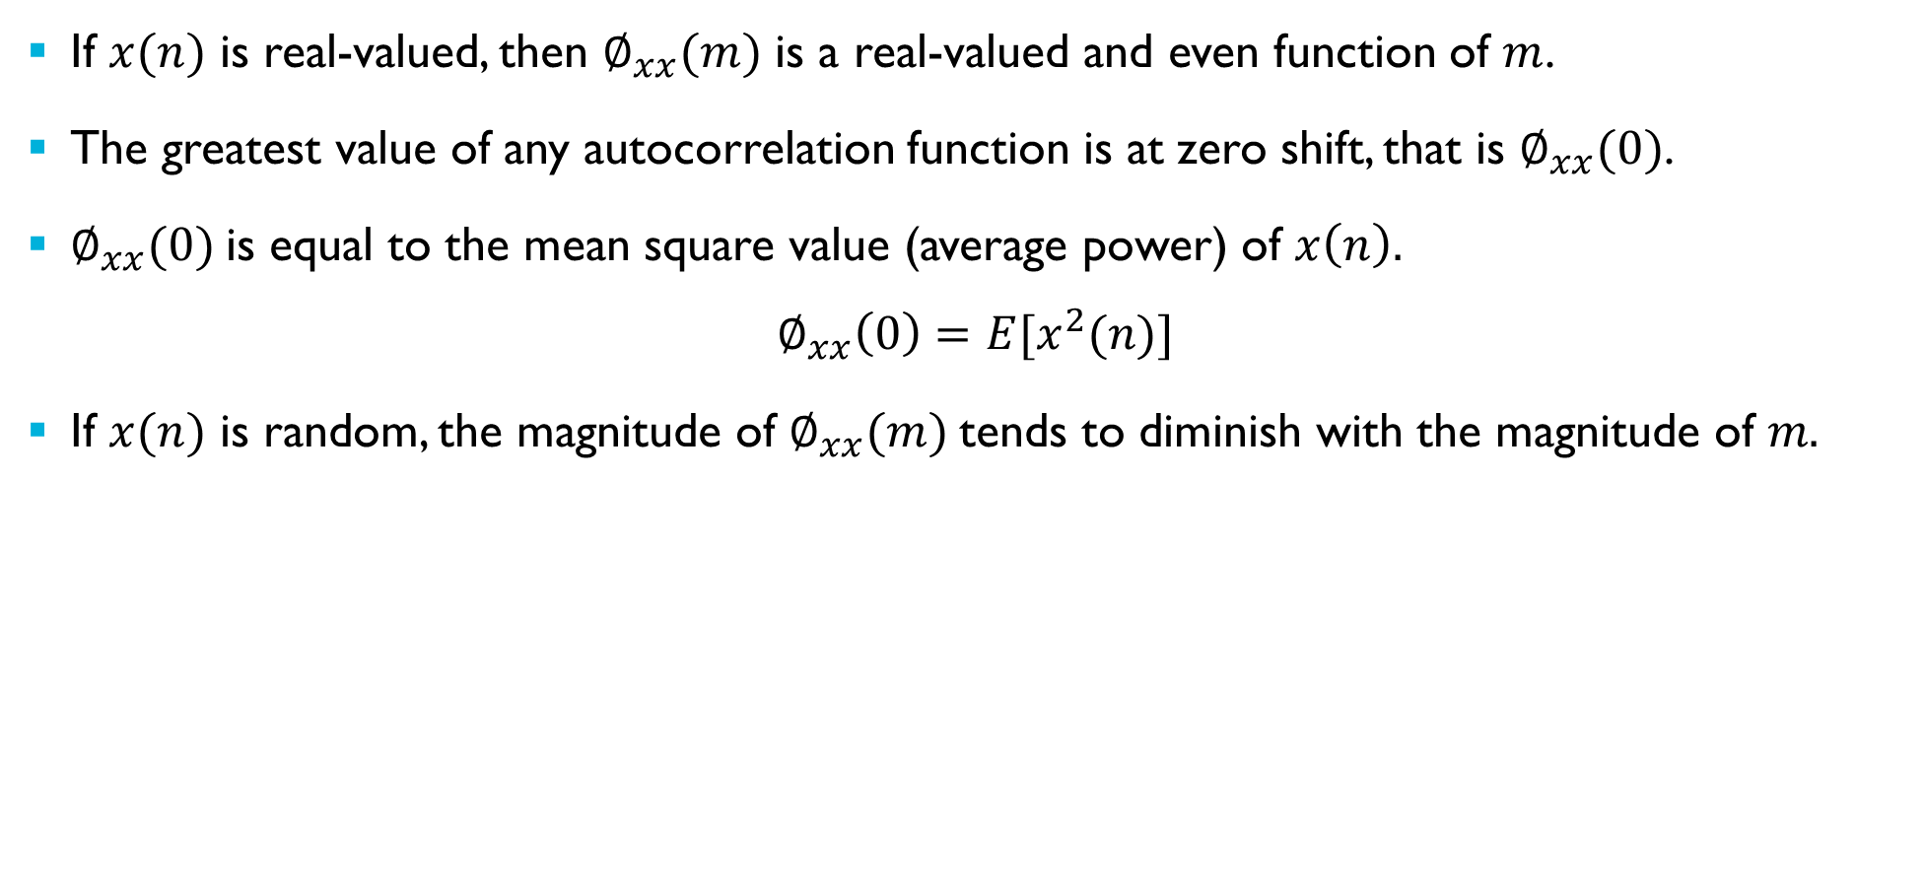
Properties of the Autocorrelation Function
If $x(n)$ is real-valued, then $∅_{xx}(m)$ is a real-valued and even function of $m$.
The greatest value of any autocorrelation function is at zero shift, that is $∅_{xx}(0)$.
$∅_{xx}(0)$is equal to the mean square value (average power) of $x\left(n\right).$
$$∅_{xx}\left(0\right)=E[x^{2}(n)]$$
If $x(n)$ is random, the magnitude of $∅_{xx}(m)$tends to diminish with the magnitude of $m.$
Notes:
If $x(n)$ is real-valued, then its autocorrelation function $∅_{xx}(m)$ is a real-valued and even function of $m$.
Its greatest value is at zero shift.
The central value of the autocorrelation function $∅_{xx}(0)$ is equal to the mean square value or average power of the sequence $x(n)$.
In most cases the autocorrelation function of a random sequence decays with the magnitude of the (time) shift $m$. More distant values in such a random sequence are less dependent on eachother.

Slide 19
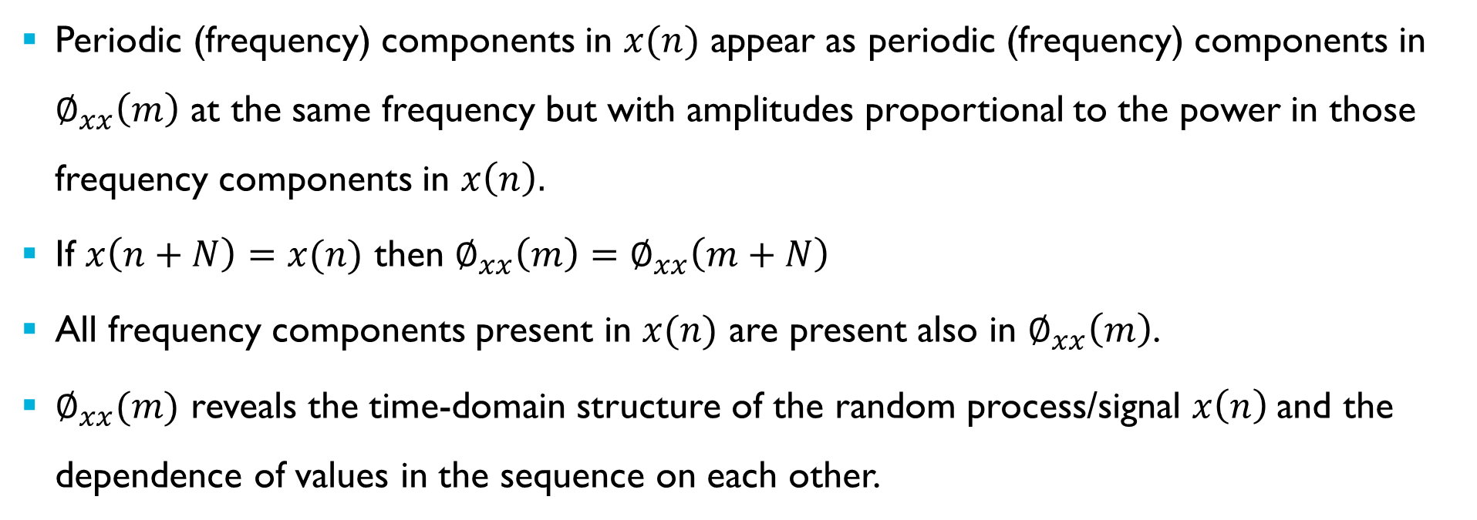
Properties of the Autocorrelation Function
Periodic (frequency) components in $x(n)$ appear as periodic (frequency) components in $∅_{xx}\left(m\right)$ at the same frequency but with amplitudes proportional to the power in those frequency components in $x\left(n\right).$
If $x\left(n+N\right)=x(n)$ then $∅_{xx}\left(m\right)=$ $∅_{xx}\left(m+N\right)$
All frequency components present in $x(n)$ are present also in $∅_{xx}\left(m\right)$.
$∅_{xx}(m)$ reveals the time-domain structure of the random process/signal $x\left(n\right)$and the dependence of values in the sequence on each other.
Notes:
The autocorrelation function $∅_{xx}\left(m\right)$ contains all of the frequency components present in the sequence $x(n)$.
Each frequency component in $∅_{xx}\left(m\right)$ has an amplitude proportional to the square the amplitude of that frequency component in $x(n)$, an amplitude that represents that frequency component’s average power.
Overall, the autocorrelation function $∅_{xx}(m)$ reveals the time-domain structure of the random process/signal $x\left(n\right)$and the dependence of values in the sequence on each other.

Slide 20

Properties of the Autocorrelation Function - Autocovariance
Closely related to autocorrelation is autocovariance
$$γ_{xx}\left(m\right)=\left\langle \left(x\left(n\right)−m_{x}\right)\left(x\left(n+m\right)−m_{x}\right)\right\rangle \\ =\lim_{N→∞}{\frac{1}{2N+1}\sum_{n=−N}^{N}{\left(x\left(n\right)−m_{x}\right)\left(x\left(n+m\right)−m_{x}\right)}}$$
$$γ_{xx}\left(m\right)=∅_{xx}\left(m\right)−m_{x}^{2}$$
Notes:
For completeness, here is the definition of autocovariance.
For a zero-mean random signal autocovariance is equal to autocorrelation.

Slide 21
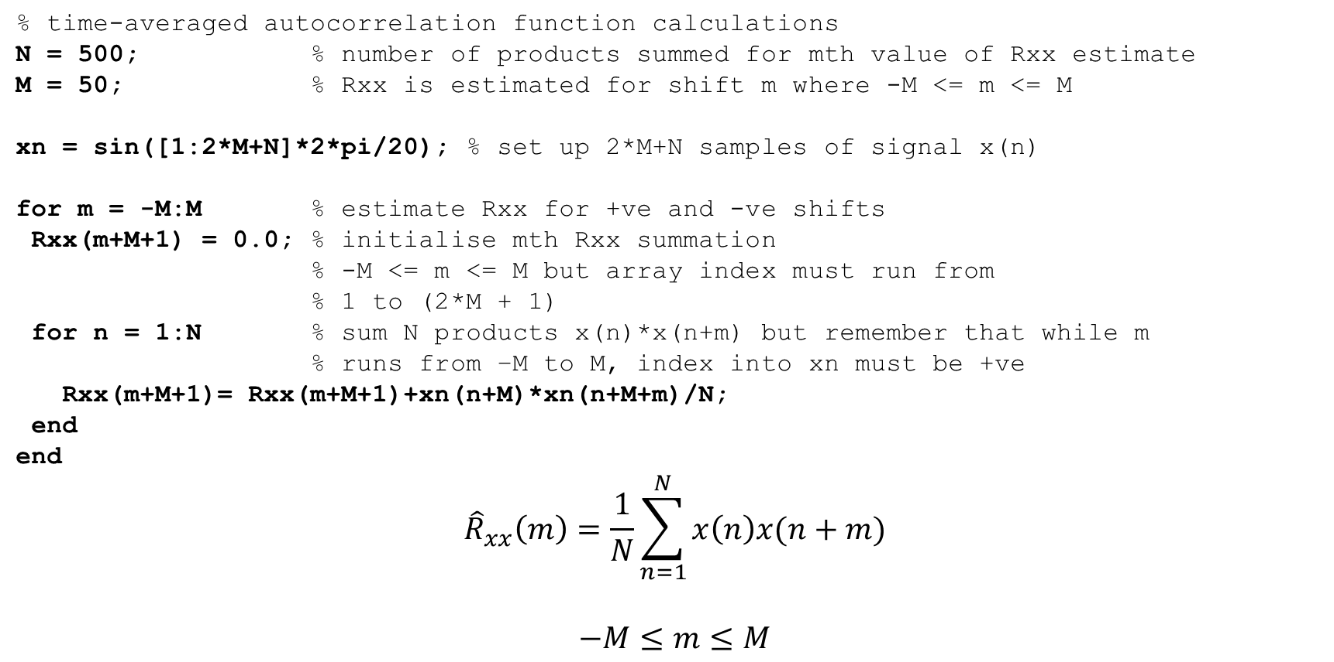
Properties of the Autocorrelation Function
% time-averaged autocorrelation function calculations
N = 500; % number of products summed for mth value of Rxx estimate
M = 50; % Rxx is estimated for shift m where -M <= m <= M
xn = sin([1:2*M+N]*2*pi/20); % set up 2*M+N samples of signal x(n)
for m = -M:M % estimate Rxx for +ve and -ve shifts
Rxx(m+M+1) = 0.0; % initialise mth Rxx summation
% -M <= m <= M but array index must run from
% 1 to (2*M + 1)
for n = 1:N % sum N products x(n)*x(n+m) but remember that while m
% runs from –M to M, index into xn must be +ve
Rxx(m+M+1)= Rxx(m+M+1)+xn(n+M)*xn(n+M+m)/N;
end
end
$${\hat{R}}_{xx}\left(m\right)=\frac{1}{N}\sum_{n=1}^{N}{x\left(n\right)x(n+m)}$$
$$−M≤m≤M$$
Notes:
In the following examples the time-averaged autocorrelation function $R_{xx}(m)$ (or $∅_{xx}(m))$ of sequence $x(n)$ is estimated using a short MATLAB script that evaluates the expression shown at the bottom of the slide.
The range of sample shifts for which $R_{xx}(m)$ is estimated is controlled by the parameter $M$ and the finite number of samples of the sequence $x(n)$ used to form each estimate is controlled by the parameter $N$. Typically, $N$ should be at least ten times greater than $M$.
A total of $(2M+N)$ samples of $x(n)$ are required by this MATLAB script in order to estimate $R_{xx}(m)$.
Autocorrelation is commonly used to describe random signals but the sequence $x(n)$ needn’t be random for us to be able to estimate its autocorrelation function. In fact by considering the autocorrelation function of a sinusoidal signal we can gain useful insights into its properties.
The discrete values in the following figures have deliberately been plotted as bars in order to emphasise that we are looking at discrete-time data in the case of $x(n)$ and discrete data values in the case of $R_{xx}(m)$.

Slide 22
Properties of the Autocorrelation Function
Notes:
Sinusoidal sequence $x(n)$ has a sinusoidal autocorrelation function $R_{xx}(m)$ with the same frequency. In this example, $M=50$ and $N=500$. The autocorrelation function is an even function of shift $m$. Its greatest value, equal to the average power of the sequence $x(n)$ occurs at $m=0$. $x(n)$ and $R_{xx}(m)$ are shown on the same x-axis scale here in order to emphasise that they share the same frequency but while all 101 $(2M+1)$ values of $R_{xx}(m)$ computed by the MATLAB script are shown, only 101 of the 600 $(2M+N)$ samples of $x(n)$ used in the calculations are shown.
To re-iterate, any frequency component in the signal $x(n)$ is present also in its autocorrelation function $R_{xx}(m)$.
Here xn = sin([1:2*M+N]*2*pi/20);

Slide 23
Properties of the Autocorrelation Function
Notes:
Here the frequency of the signal $x(n)$ has been changed. The same single frequency component present in $x(n)$ is present in $R_{xx}\left(m\right)$ but its amplitude, as well as its central maximum value, reflects the average power of the sequence $x(n)$ (in this case 0.5). It’s easier to see at this frequency that the autocorrelation function is an even function of shift $m$.
Here xn = sin([1:2*M+N]*2*pi/60);

Slide 24
Properties of the Autocorrelation Function
Notes:
This and the previous slide illustrate that changing the phase of the signal $x(n)$ has no effect on the autocorrelation function $R_{xx}(m)$. Put another way, $R_{xx}(m)$ doesn’t contain phase information about the frequency components in $x(n)$. As stated previously, it reflects the power in the signal.
There’s a very small change in $R_{xx}(m)$ between this and the previous slide due to the finite number of sample values used to estimate it. In this case $N=500$.
Here xn = sin([1:2*M+N]*2*pi/60 + 1.5);

Slide 25
Properties of the Autocorrelation Function
Notes:
DC levels (zero frequency components) in $x(n)$ appear in $R_{xx}(m)$ too. Effectively we’ve got two different frequency components here in $x(n)$ and both of these appear in $R_{xx}(m)$. You can do the arithmetic to check the value of $R_{xx}(0)$.
Here xn = sin([1:20]*2*pi/20) + 0.5;

Slide 26
Properties of the Autocorrelation Function
Notes:
This slide and the next illustrate the effect of doubling the amplitude of the values in the sequence $x(n)$ from 1 to 2. The amplitude of the autocorrelation function $R_{xx}(m)$ increases by a factor of four from 0.5 to 2. That is, from this slide to the next.
As ever, the central value $R_{xx}(0)$ of the autocorrelation function represents the mean square value of the sequence $x(n)$ and is always the largest value in the autocorrelation function.

Slide 27
Properties of the Autocorrelation Function

Slide 28
Properties of the Autocorrelation Function
Notes:
white noise is the term used to describe a random signal in which there is absolutely no correlation or dependence between successive sample values.
The autocorrelation function of white noise therefore is an impulse.
The definition of white noise says nothing about the amplitude distribution of that random signal.
In this example a random variable $x(n)$ that is zero-mean with uniform pdf and variance 0.33 has (in theory) an autocorrelation function that is an impulse of amplitude 0.33. In other words only $R_{xx}(0)≠0$.
The autocorrelation function shown here has been estimated using $N=500$ and plotted for $M=50$.
Here xn=rand(2*M+N,1)*2-1;

Slide 29
Properties of the Autocorrelation Function
Notes:
Changing $N$ from 500 to 5000 reduces the magnitudes of the values of $R_{xx}(m)$ for $m≠0 and$makes this estimate of $R_{xx}(m)$ more accurate.

Slide 30
Properties of the Autocorrelation Function
Notes:
A pseudorandom binary sequence (PRBS) is another form of white noise. $x(n)$ is rather different from the random signal shown in the previous two slides but its autocorrelation function is an impulse. The mean square (and variance) of this zero-mean random signal is equal to 1 and this is reflected in the central value of the autocorrelation function.
Here xn=prbs(11,2*M+N)*2-1;

Slide 31
Properties of the Autocorrelation Function
Notes:
In this example, the sequence $x(n)$ was formed by passing zero-mean Gaussian white noise through a bandpass filter. Consequently $x(n)$ is not white noise but it is zero-mean and it’s random.
That $x(n)$is not white noise is readily apparent from its autocorrelation function. It’s not an impulse. $x(n)$ and $R_{xx}(m)$ look somewhat similar. This is to be expected since they contain the same band-limited range of frequency components. But, of course, they are not the same. They represent quite different things. Close inspection confirms that $R_{xx}(m)$ is an even function of $m$, that its largest value occurs at $m=0$, and that broadly speaking it decays with the magnitude of $m$.

Slide 32
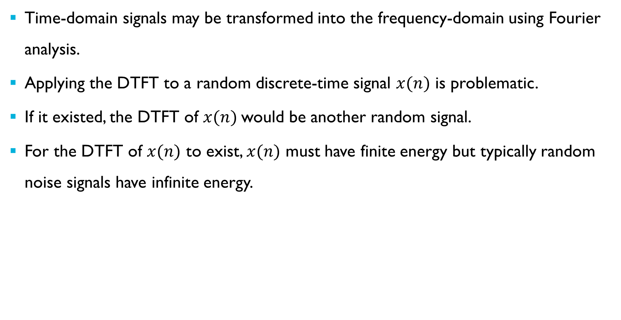
Power Spectral Density (psd)
Time-domain signals may be transformed into the frequency-domain using Fourier analysis.
Applying the DTFT to a random discrete-time signal $x(n)$ is problematic.
If it existed, the DTFT of $x(n)$would be another random signal.
For the DTFT of $x(n)$ to exist, $x(n)$ must have finite energy but typically random noise signals have infinite energy.
Notes:
How is the frequency content of a random signal characterised?
Any time-domain signal has a corresponding frequency-domain representation (found by Fourier analysis)
But Fourier analysis of random signal $x(n)$ is problematic. If it was possible, it would result in another random signal but we are interested in deterministic values rather than the statistics of a frequency-domain representation.
Furthermore, for the DTFT of discrete-time signal $x(n)$ to exist/converge, that signal must have finite energy but random noise signals typically continue indefinitely and have infinite energy. They are power signals.

Slide 33
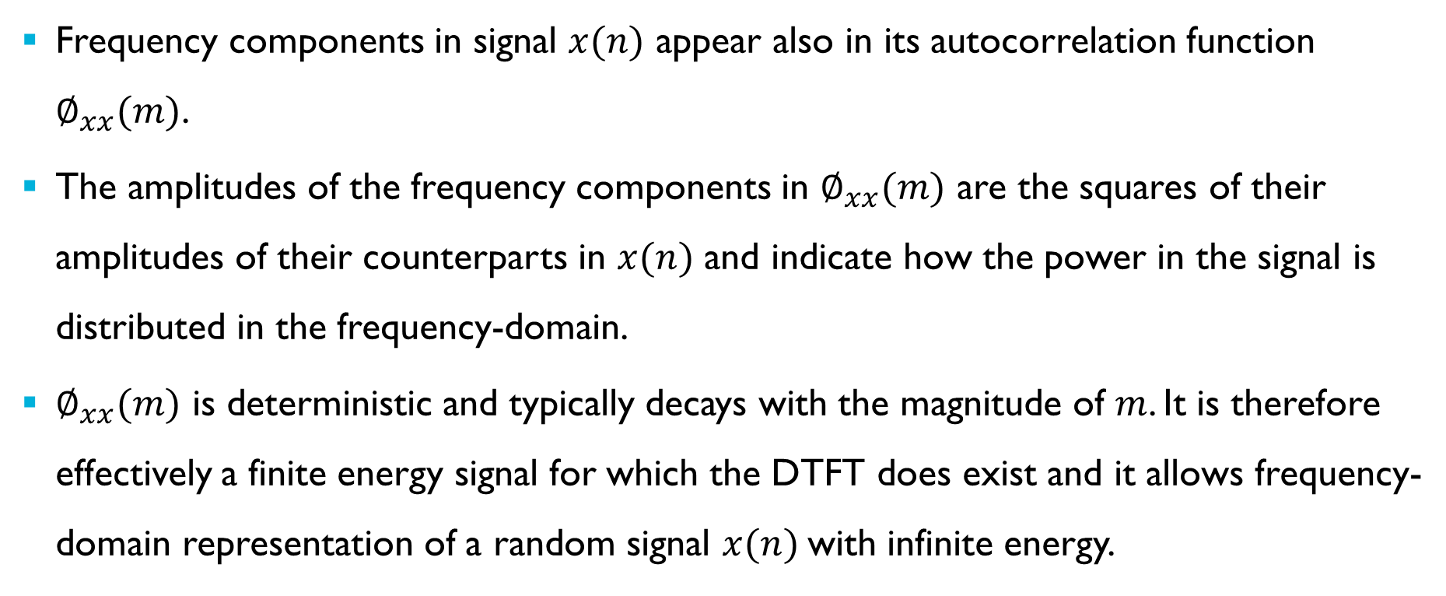
Power Spectral Density (psd)
Frequency components in signal $x(n)$ appear also in its autocorrelation function $∅_{xx}(m)$.
The amplitudes of the frequency components in $∅_{xx}(m)$ are the squares of their amplitudes of their counterparts in $x(n)$ and indicate how the power in the signal is distributed in the frequency-domain.
$∅_{xx}(m)$ is deterministic and typically decays with the magnitude of $m$. It is therefore effectively a finite energy signal for which the DTFT does exist and it allows frequency-domain representation of a random signal $x(n)$with infinite energy.
Notes:
However, we have just seen that the frequency components present in $x\left(n\right)$ are present also in $∅_{xx}(m)$ (with squared amplitudes) and that the magnitude of $∅_{xx}(m)$ for a random signal typically decays with $m$. It may be viewed as a finite energy signal for which the DTFT exists. This allows for the frequency-domain representation of a random signal.
Fourier analysis of the autocorrelation function gives a deterministic result.

Slide 34

Power Spectral Density – Indirect Estimation
The discrete time Fourier transform of the autocorrelation function yields the power spectral density (psd) or power spectrum of the signal $x(n)$.
This is referred to as the indirect method of power spectrum estimation and an estimate of $S_{xx}\left(\hat{ω}\right)$ is referred to as a correlogram.
Notes:
Intuitively since the autocorrelation function contains the same frequency components as $x(n)$ but with squared amplitudes, the DTFT of the autocorrelation function $S_{xx}\left(\hat{ω}\right)$ is a power spectrum.
Indeed, the frequency-domain representation of the autocorrelation function is called the power spectrum or power spectral density function. It indicates how the power in the signal or sequence is distributed between different frequency components.
An estimate of the power spectrum of a random signal made by taking the DTFT of its (estimated) autocorrelation function is called a correlogram.

Slide 35
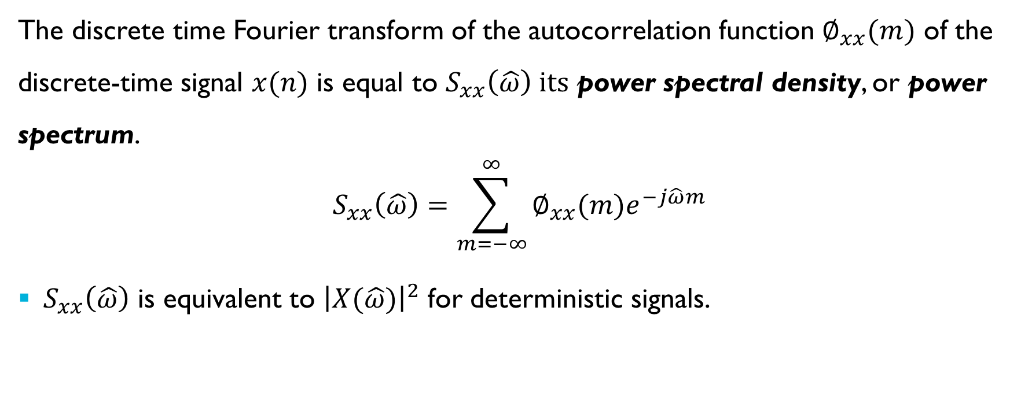
Wiener-Khinchin Theorem
The discrete time Fourier transform of the autocorrelation function $∅_{xx}(m)$ of the discrete-time signal $x(n)$ is equal to $S_{xx}\left(\hat{ω}\right) its$ power spectral density, or power spectrum.
$$S_{xx}\left(\hat{ω}\right)=\sum_{m=−∞}^{∞}{∅_{xx}(m)e^{−j\hat{ω}m}}$$
$S_{xx}\left(\hat{ω}\right)$ is equivalent to ${\left|X(\hat{ω})\right|}^{2}$ for deterministic signals.
Notes:
The Wiener-Khinchin theorem is a formal statement of what we have just talked about.
The power spectral density of a random signal is equivalent to the magnitude squared of the frequency-domain representation of a deterministic signal. That is the magnitude squared of its DTFT.

Slide 36
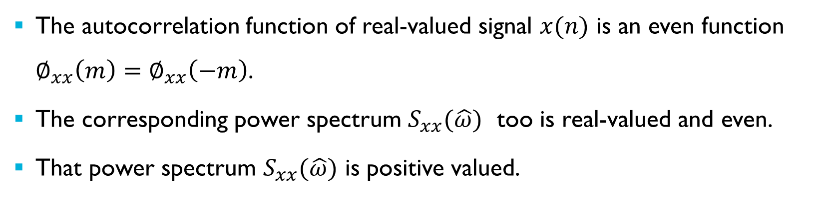
Properties of the Power Spectral Density (psd)
The autocorrelation function of real-valued signal $x(n)$ is an even function $∅_{xx}\left(m\right)=$ $∅_{xx}\left(−m\right)$.
The corresponding power spectrum $S_{xx}(\hat{ω})$ too is real-valued and even.
That power spectrum $S_{xx}(\hat{ω})$ is positive valued.
Notes:
If a random signal is real-valued then its autocorrelation function is an even function (of shift $m$).
The power spectrum of an even autocorrelation function is real-valued and even.
Since it represents power, $S_{xx}(\hat{ω})$ is positive.

Slide 37
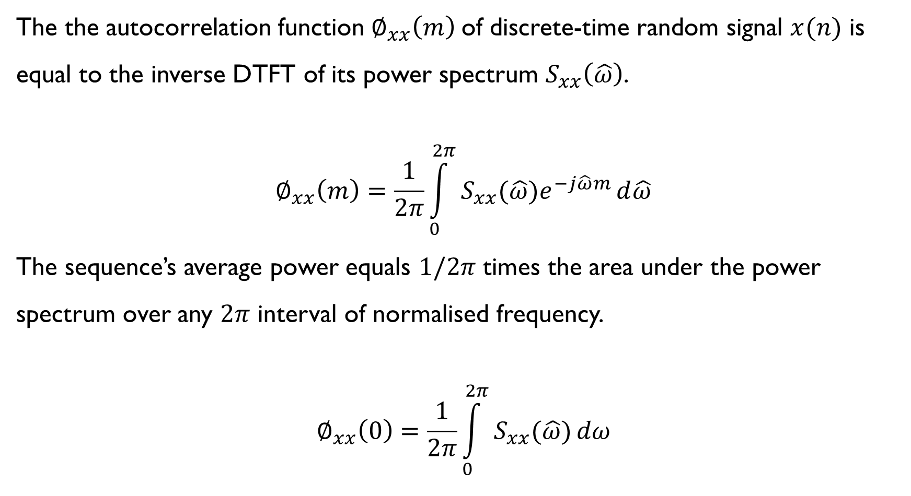
Properties of the Power Spectral Density (psd)
The the autocorrelation function $∅_{xx}\left(m\right)$of discrete-time random signal $x(n)$ is equal to the inverse DTFT of its power spectrum $S_{xx}\left(\hat{ω}\right)$.
$$∅_{xx}\left(m\right)=\frac{1}{2π}\int_{0}^{2π}{S_{xx}(\hat{ω})e^{−j\hat{ω}m}}d\hat{ω}$$
The sequence’s average power equals $1/2π$ times the area under the power spectrum over any $2π$ interval of normalised frequency.
$$∅_{xx}\left(0\right)=\frac{1}{2π}\int_{0}^{2π}{S_{xx}(\hat{ω})}dω$$
Notes:
Since the DTFT of its autocorrelation function is the power spectrum of sequence $x(n)$, the inverse DTFT of the power spectrum is equal to the autocorrelation function of sequence $x\left(n\right).$
A property of the autocorrelation function is that its central, maximum value $∅_{xx}\left(0\right)$ is equal to the average power of the sequence $x\left(n\right)$.
That value may be derived by evaluating the inverse DTFT of the power spectrum for $m=0$ and the resulting expression may be interpreted as showing that the average power of the sequence $x\left(n\right)$ is equal to $1/{2π}$ times the integral of the power spectrum over a $2π$ range of normalised frequency $\hat{ω}$.
This result implies that the units of $S_{xx}(\hat{ω})$ must be watts per radian and hence it is appropriate to refer to it as power spectral density.

Slide 38
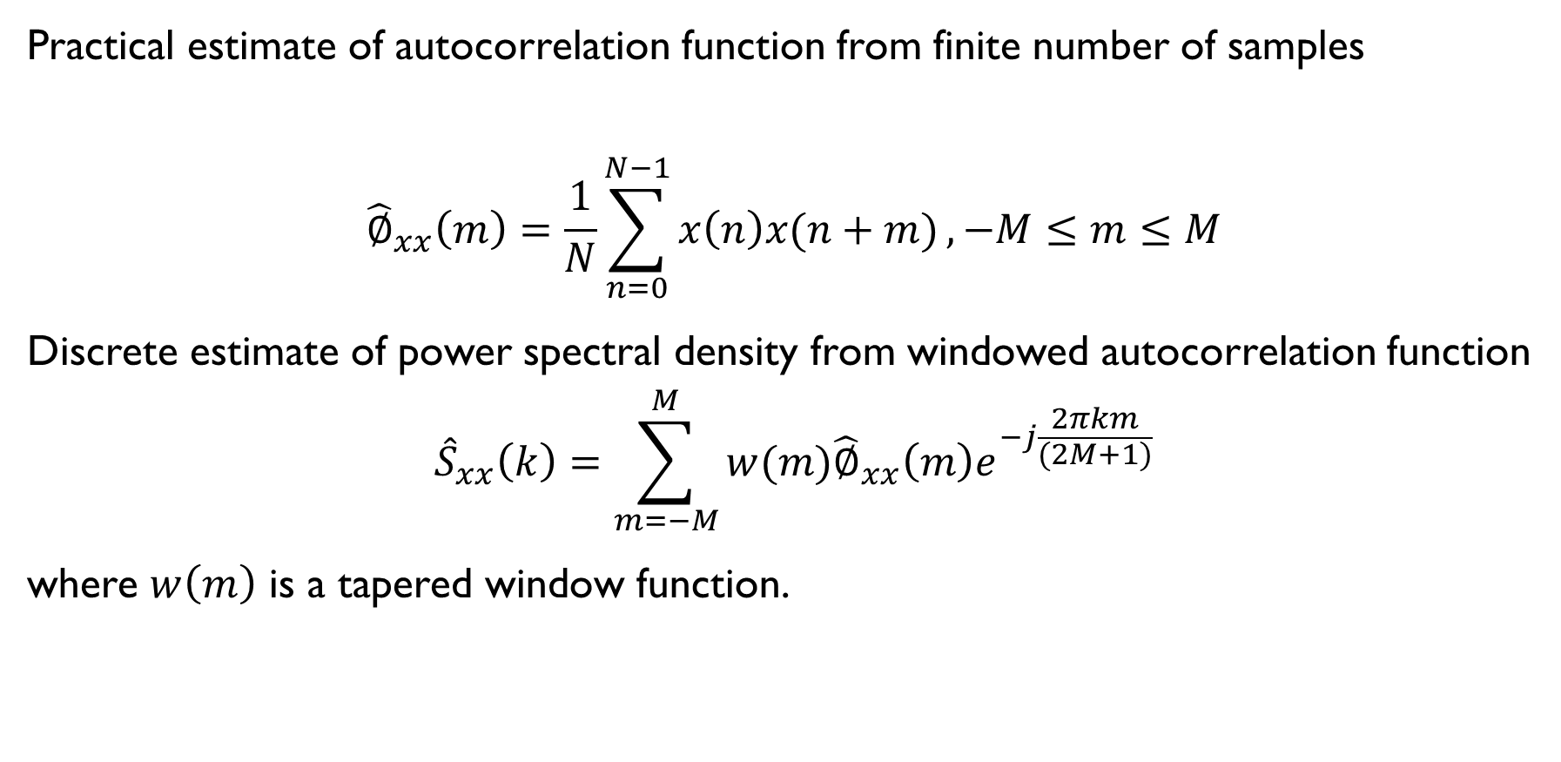
Power Spectral Density – Indirect Estimation
Practical estimate of autocorrelation function from finite number of samples
$${\hat{∅}}_{xx}\left(m\right)=\frac{1}{N}\sum_{n=0}^{N−1}{x\left(n\right)x(n+m)}, −M≤m≤M$$
Discrete estimate of power spectral density from windowed autocorrelation function
$${\hat{S}}_{xx}\left(k\right)=\sum_{m=−M}^{M}{w(m){\hat{∅}}_{xx}\left(m\right)e^{−j\frac{2πkm}{(2M+1)}}}$$
where $w\left(m\right)$ is a tapered window function.
Notes:
The expression for the power spectrum estimate ${\hat{S}}_{xx}\left(\hat{ω}\right)$ computed using the DTFT may be evaluated for any value of normalised frequency $\hat{ω}$.
However, it’s conventional to evaluate the power spectrum estimate at a finite number of regularly spaced frequencies. That may be achieved by applying the DFT rather than the DTFT to the $(2M+1)$ values of the autocorrelation function estimate. This results in a discrete power spectrum estimate ${\hat{S}}_{xx}\left(k\right)$.
It’s conventional also to truncate the autocorrelation function using a triangular, or other tapered, window before computing its DTFT. Given that the autocorrelation function $∅_{xx}(m)$ of a random signal tends to diminish with the magnitude of $m$ the effect of windowing may be quite minimal.
Finally, it’s conventional also to zero pad the $(2M+1)$ values of the autocorrelation function estimate to an even number of values suitable for FFT computation.

Slide 39
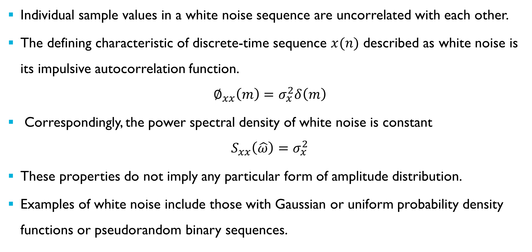
White Noise
Individual sample values in a white noise sequence are uncorrelated with each other.
The defining characteristic of discrete-time sequence $x(n)$ described as white noise is its impulsive autocorrelation function.
$$∅_{xx}\left(m\right)=σ_{x}^{2}δ\left(m\right)$$
Correspondingly, the power spectral density of white noise is constant
$$S_{xx}\left(\hat{ω}\right)=σ_{x}^{2}$$
These properties do not imply any particular form of amplitude distribution.
Examples of white noise include those with Gaussian or uniform probability density functions or pseudorandom binary sequences.
Notes:
Before presenting an illustrative example of indirect spectral estimation let’s say a bit more about white noise.
Any random signal in which adjacent samples are completely uncorrelated may be described as white.
Individual sample values in a white noise sequence are independent of each other. This property corresponds to an autocorrelation function that is an impulse and a constant, or flat, power spectral density but it doesn’t imply any particular amplitude distribution.

Slide 40
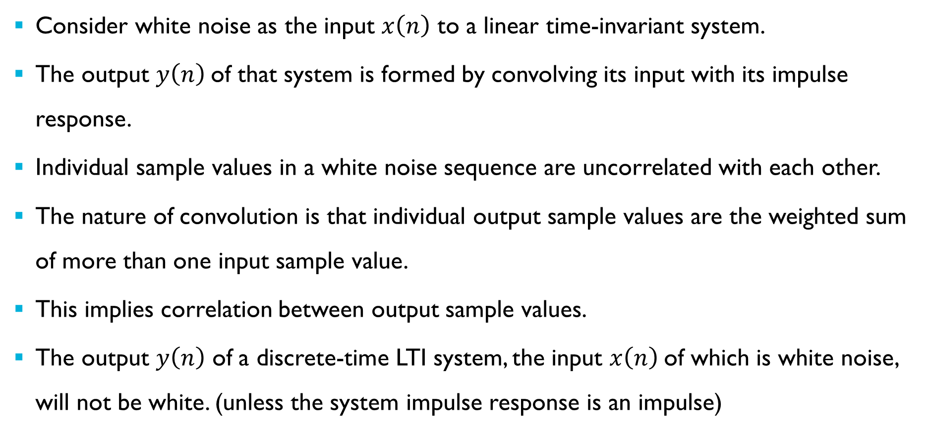
White Noise Processed by LTI system
Consider white noise as the input $x\left(n\right)$ to a linear time-invariant system.
The output $y\left(n\right)$of that system is formed by convolving its input with its impulse response.
Individual sample values in a white noise sequence are uncorrelated with each other.
The nature of convolution is that individual output sample values are the weighted sum of more than one input sample value.
This implies correlation between output sample values.
The output $y\left(n\right)$ of a discrete-time LTI system, the input $x\left(n\right)$of which is white noise, will not be white. (unless the system impulse response is an impulse)
Notes:
What happens if we process white noise using a linear time-invariant system?
The action of a linear time-invariant system may be represented by convolution of its input signal with its impulse response.
Unless the system impulse response is an impulse then each output sample value is contributed to by more than one input sample value.
This implies that there is dependence or correlation between adjacent samples in the output signal.
In other words, the output signal is not white noise.

Slide 41
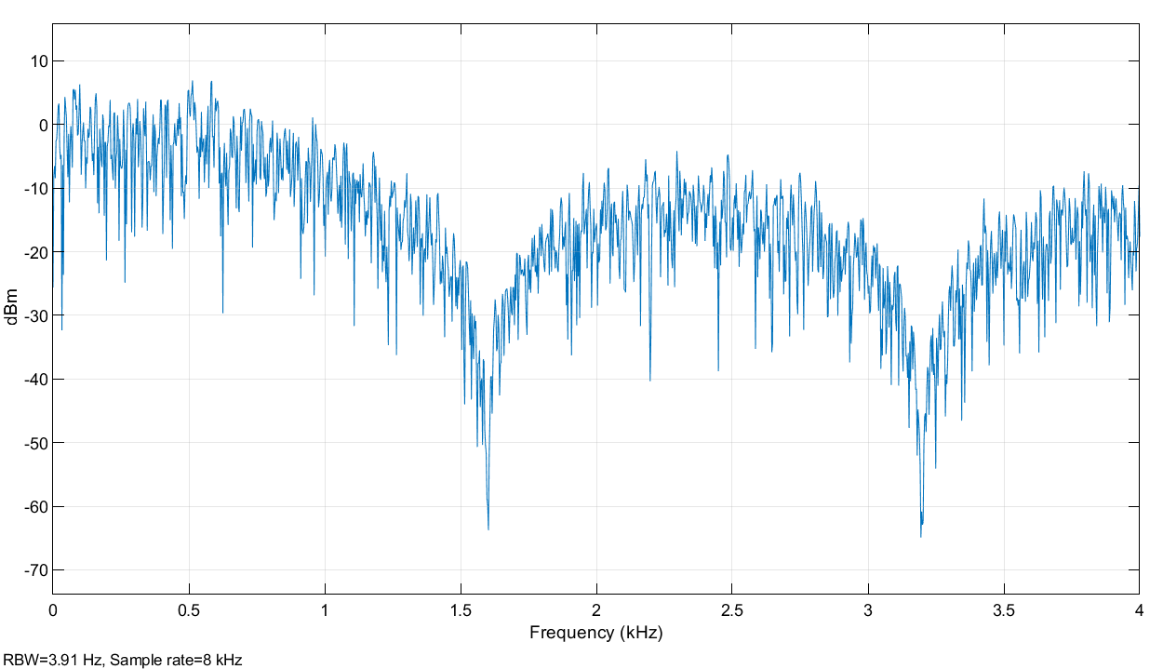
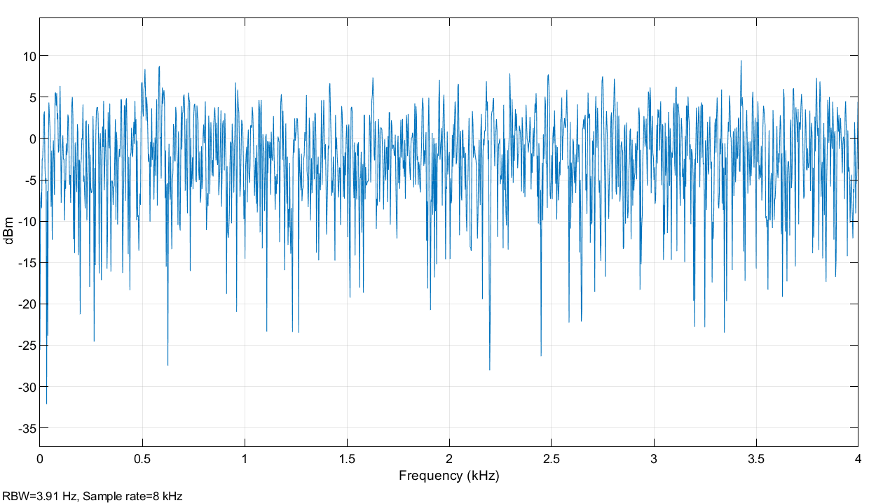
Power Spectral Density - Indirect Estimation
Notes:
As an Illustrative example of indirect spectral analysis, that is estimation of power spectral density using autocorrelation, a Simulink model was used to generate a signal to be processed by the MATLAB script shown in an earlier slide.
The Simulink spectrum analyzers give graphical indications of the power spectra of the unfiltered $x(n)$ and filtered $y(n)$ noise signals. The power spectrum of the input signal is flat but the power spectrum of the output signal is not. In fact the power spectrum of the output signal is proportional to the power response of the LTI system.
In this example, the discrete-time LTI system was a five-point moving average filter with coefficients, and hence impulse response, $[0.2 0.2 0.2 0.2 0.2]$.
We will look in more detail at the effect of an LTI system on the statistical properties of a random signal later. For now simply observe that, unlike the input signal, the output signal doesn’t have a flat spectrum.

Slide 42
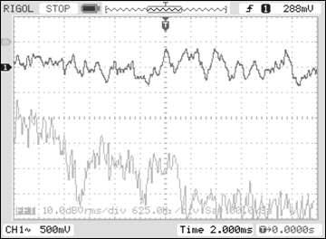
Power Spectral Density - Indirect Estimation
Cypress FM4 Starter Kit
PRBS filtered by 5-point moving average filter
(and by WM8731 DAC reconstruction filter)
program fm4_average_prbs_intr.c
Notes:
The Simulink model presented in the last slide is functionally similar to this lab exercise.

Slide 43
Power Spectral Density - Indirect Estimation
Notes:
The autocorrelation function of the random output signal $y(n)$ in the preceding Simulink simulation was calculated using $N=5000$ sample values for $−50≤m≤50$.
That autocorrelation function was then multiplied by a triangular (Bartlett) window prior to taking its 101-point DFT to obtain the power spectral density estimate shown in the next slide. The triangular Bartlett window applied to the autocorrelation function extended across 101 points $−50≤m≤50$. It’s entirely coincidental that the autocorrelation function in this example has a (far narrower) triangular shape.

Slide 44
Power Spectral Density - Indirect Estimation
Notes:
Here is the power spectral density estimate formed by taking the DFT of the windowed autocorrelation function shown in the previous slide.
This reflects the power spectrum or power response of the LTI system used to process white noise.
The next slide shows the theoretical power response of that filter computed by taking the DFT of the theoretical autocorrelation sequence of the filter, that is the autocorrelation function of the filter’s impulse response.

Slide 45
Power Spectral Density - Indirect Estimation
Notes:
Here is the power response of the filter formed by taking the 101-point DFT of the zero-padded autocorrelation function of its impulse response.
That is the filter impulse response is $h\left(n\right)=[0.2 0.2 0.2 0.2 0.2]$. The autocorrelation sequence of the filter is
$∅_{hh}\left(m\right)=[0.04 0.08 0.12 0.16 0.20 0.16 0.12 0.08 0.04]$.

Slide 46
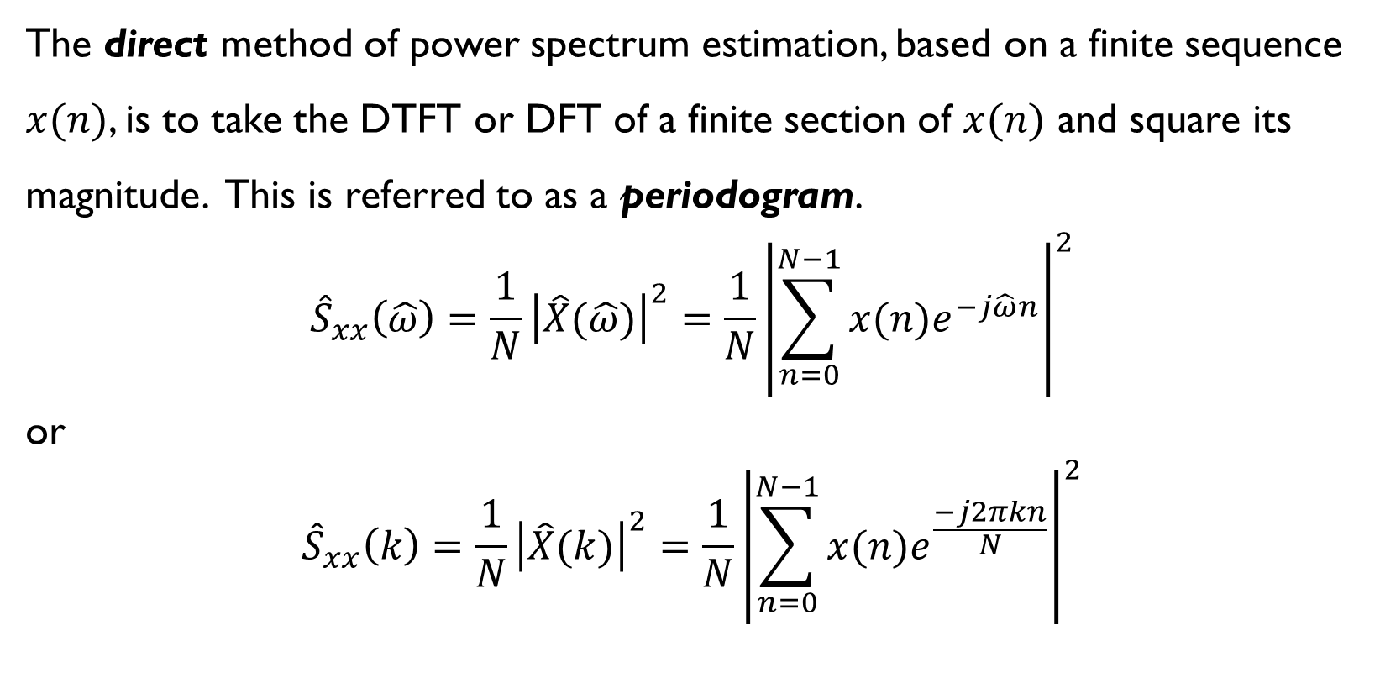
Power Spectral Density - Direct Estimation
The direct method of power spectrum estimation, based on a finite sequence $x(n)$, is to take the DTFT or DFT of a finite section of $x(n)$ and square its magnitude. This is referred to as a periodogram.
$${\hat{S}}_{xx}\left(\hat{ω}\right)=\frac{1}{N}{\left|\hat{X}(\hat{ω})\right|}^{2}=\frac{1}{N}{\left|\sum_{n=0}^{N−1}{x(n)e^{−j\hat{ω}n}}\right|}^{2}$$
or
$${\hat{S}}_{xx}\left(k\right)=\frac{1}{N}{\left|\hat{X}(k)\right|}^{2}=\frac{1}{N}{\left|\sum_{n=0}^{N−1}{x(n)e^{\frac{−j2πkn}{N}}}\right|}^{2}$$
Notes:
The previous few slides concern the indirect method of power spectrum estimation. The discrete Fourier transform of the estimated autocorrelation function of a signal is referred to as a correlogram.
Alternatively we can apply the direct method of spectrum analysis to a finite sequence ($N$ consecutive sample values from $x(n)$). The square of the magnitude of the discrete Fourier transform of the sequence is referred to as a periodogram.

Slide 47
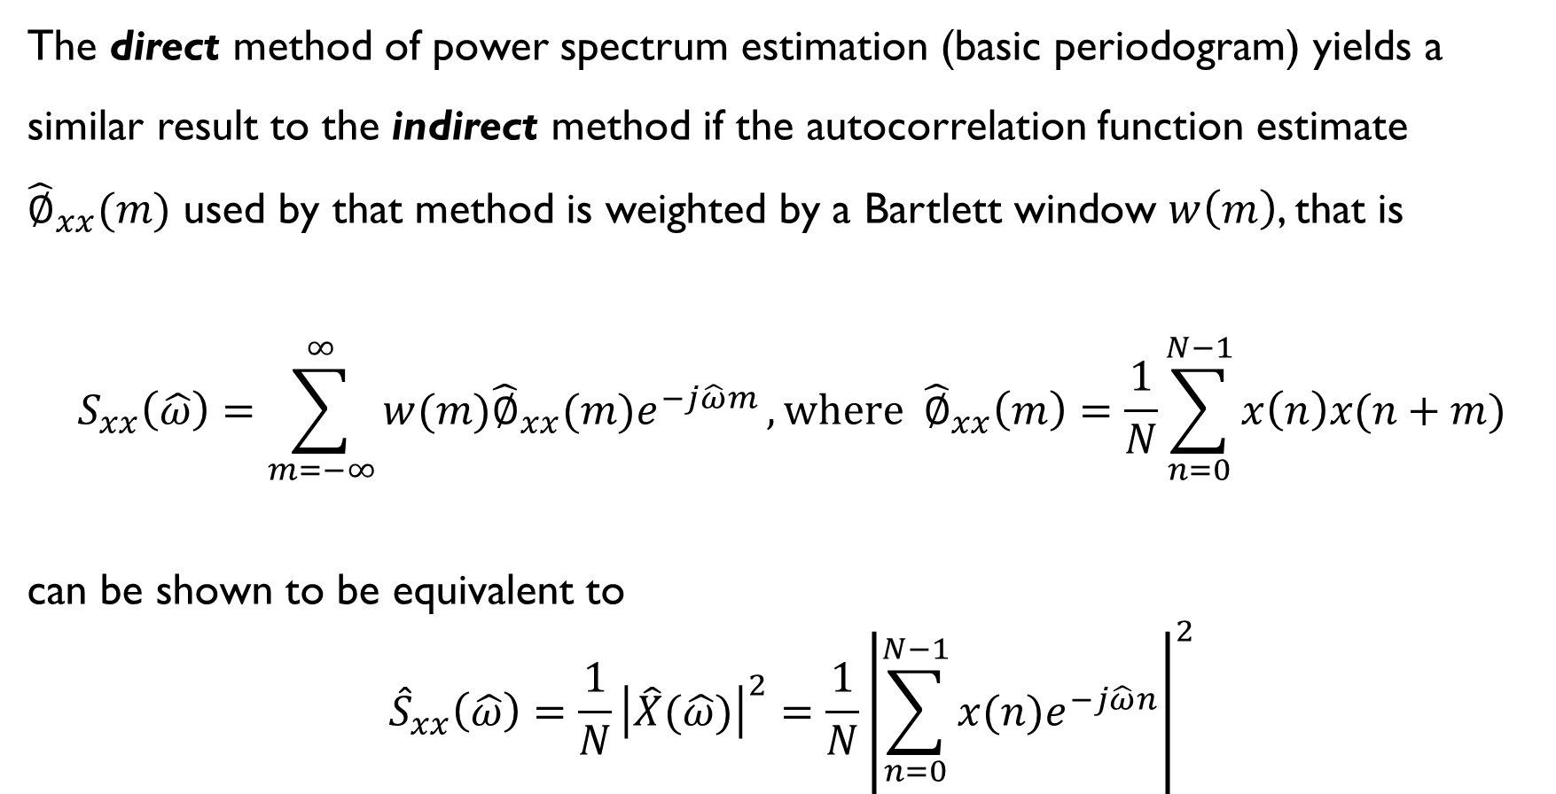
Direct and Indirect spectrum analysis
The direct method of power spectrum estimation (basic periodogram) yields a similar result to the indirect method if the autocorrelation function estimate ${\hat{∅}}_{xx}(m)$ used by that method is weighted by a Bartlett window $w\left(m\right)$, that is
$$S_{xx}\left(\hat{ω}\right)=\sum_{m=−∞}^{∞}{w(m){\hat{∅}}_{xx}(m)e^{−j\hat{ω}m}}, \text{where} {\hat{∅}}_{xx}\left(m\right)=\frac{1}{N}\sum_{n=0}^{N−1}{x\left(n\right)x(n+m)}$$
can be shown to be equivalent to
$${\hat{S}}_{xx}\left(\hat{ω}\right)=\frac{1}{N}{\left|\hat{X}(\hat{ω})\right|}^{2}=\frac{1}{N}{\left|\sum_{n=0}^{N−1}{x(n)e^{−j\hat{ω}n}}\right|}^{2}$$
Notes:
Direct (periodogram) and indirect (correlogram) methods of power spectrum estimation can be shown to be equivalent.
In practice both methods can be noisy and it’s conventional to average several periodograms or correlograms computed from different, and possibly overlapping, sections of the signal $x(n)$ in order to reduce that noise.

Slide 48
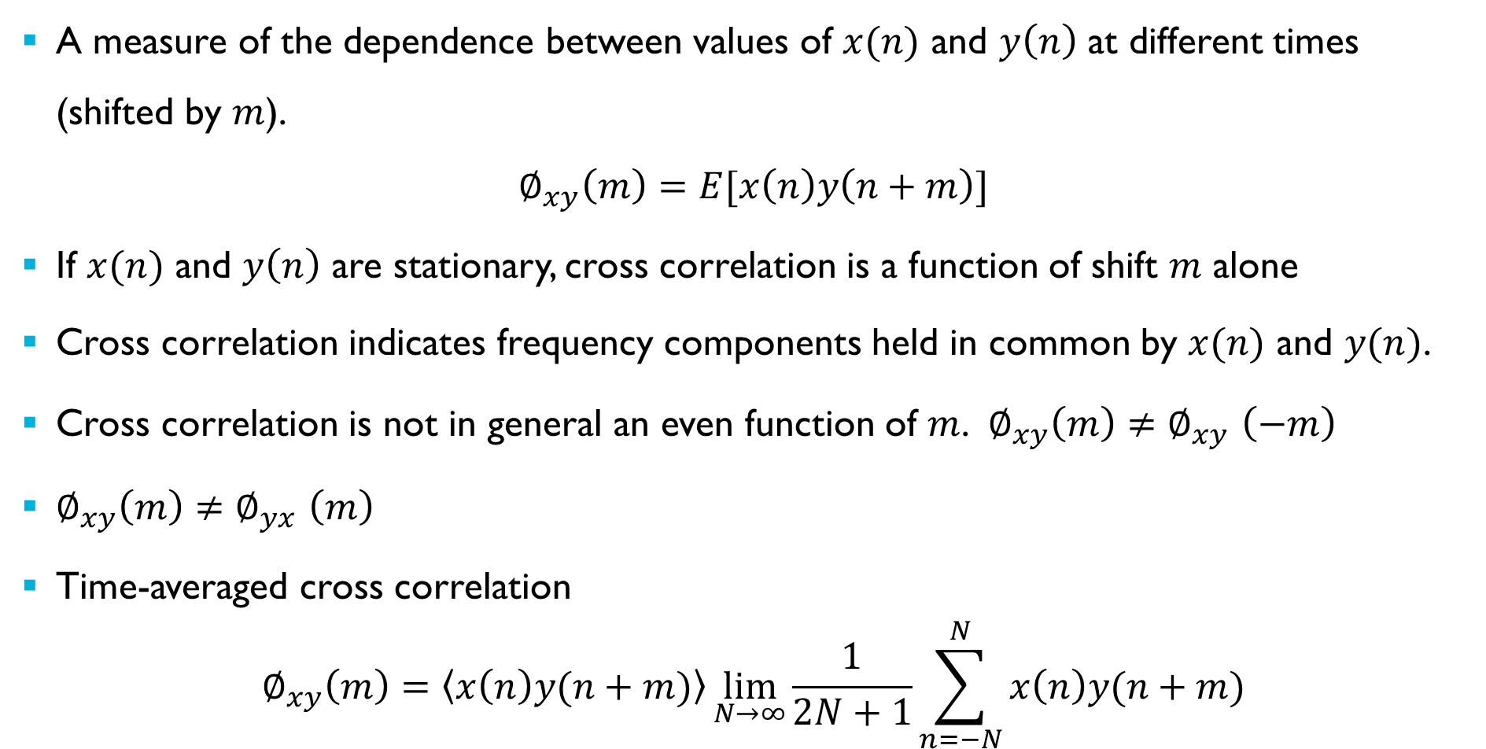
Cross Correlation Function
A measure of the dependence between values of $x(n)$ and $y\left(n\right)$ at different times (shifted by $m$).
$$∅_{xy}\left(m\right)=E[x\left(n\right)y\left(n+m\right)]$$
If $x(n)$ and $y\left(n\right)$ are stationary, cross correlation is a function of shift $m$ alone
Cross correlation indicates frequency components held in common by $x(n)$ and $y(n)$.
Cross correlation is not in general an even function of $m$. $∅_{xy}\left(m\right){≠∅}_{xy}\left(−m\right)$
$∅_{xy}\left(m\right){≠∅}_{yx}\left(m\right)$
Time-averaged cross correlation
$$∅_{xy}\left(m\right)=\left\langle x\left(n\right)y(n+m)\right\rangle \lim_{N→∞}{\frac{1}{2N+1}\sum_{n=−N}^{N}{x\left(n\right)y(n+m)}}$$
Notes:
So we’ve talked about autocorrelation, now let’s talk about cross correlation.
Whereas the autocorrelation function indicates the frequency components present in sequence $x\left(n\right),$the cross correlation function indicates frequency components held in common between sequences $x(n)$ and y$(n)$.
The cross correlation function is not generally an even function of $m$ and for WSS signals the cross correlation function is a function of $m$ alone.
The definition of cross correlation is the expected value of the product of the sequence $x(n)$ and a (time) shifted sequence $y(n)$. The expected value is an ensemble statistic.
Assuming stationarity and ergodicity for sequences $x(n)$ and $y\left(n\right)$, we can replace that definition with a time-averaged form based on single sequences.

Slide 49
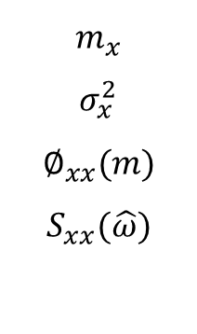

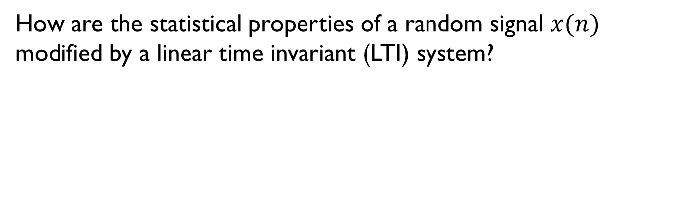

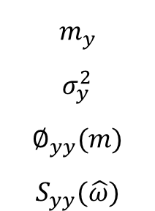
Random Signal Processed by Linear Time-Invariant System
How are the statistical properties of a random signal $x(n)$ modified by a linear time invariant (LTI) system?
$$m_{x}$$
$$σ_{x}^{2}$$
$$∅_{xx}(m)$$
$$S_{xx}(\hat{ω})$$
x(n)
discrete-time
LTI system
y(n)
$$m_{y}$$
$$σ_{y}^{2}$$
$$∅_{yy}(m)$$
$$S_{yy}(\hat{ω})$$
random
input signal
random
output signal
$$h\left(n\right)$$
$$H(\hat{ω})$$
$$y\left(n\right)=h\left(n\right)∗x\left(n\right)$$
$$Y\left(\hat{ω}\right)=H\left(\hat{ω}\right)X(\hat{ω})$$
Notes:
Now let’s consider what happens when random signals are processed by LTI systems.
We’ve seen that random signals are described by their statistical properties. And we saw in an earlier example that the power spectral density of white noise passed through a linear time-invariant system was altered. But how exactly are the statistical properties of a random signal altered?
As indicated in this slide, while the random input and output signals $x(n)$ and $y(n)$ are described in terms of their statistical properties, the linear time-invariant system is characterised by its impulse response $h(n)$ (from which its frequency response $H(\hat{ω})$ and z-transfer function $H(z)$ may be derived) and its action is described by convolution in the time-domain and multiplication in the frequency-domain.

Slide 50
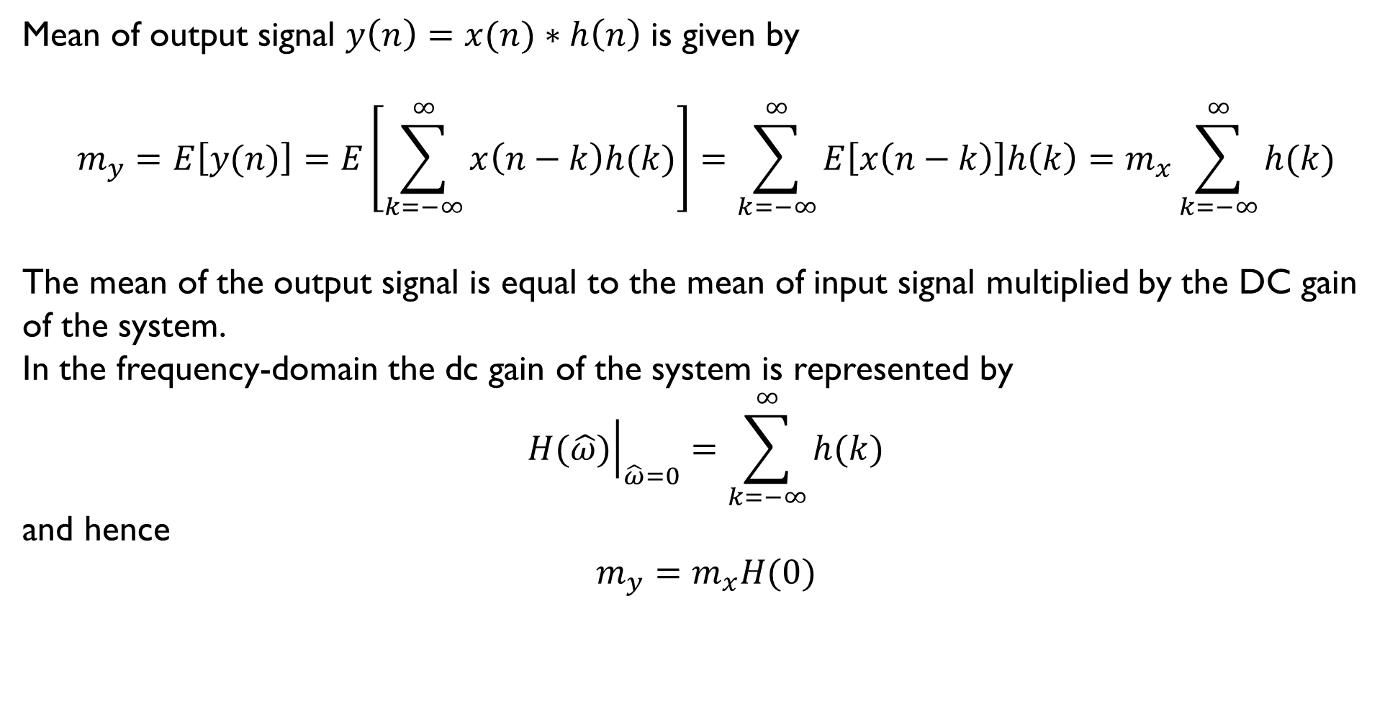
Random Signal Processed by Linear Time-Invariant System
Mean of output signal $y\left(n\right)=x(n)∗h\left(n\right)$ is given by
$$m_{y}=E\left[y(n)\right]=E\left[\sum_{k=−∞}^{∞}{x\left(n−k\right)h(k)}\right]=\sum_{k=−∞}^{∞}{E\left[x\left(n−k\right)\right]h\left(k\right)=m_{x}\sum_{k=−∞}^{∞}{h(k)}}$$
The mean of the output signal is equal to the mean of input signal multiplied by the DC gain
of the system.
In the frequency-domain the dc gain of the system is represented by
$${\left.H(\hat{ω})\right|}_{\hat{ω}=0}=\sum_{k=−∞}^{∞}{h(k)}$$
and hence
$$m_{y}=m_{x}H(0)$$
Notes:
How is the mean of a random signal affected when it’s processed by a linear time-invariant system?
If $x(n)$ is WSS then its expected value is independent of time origin, that is $E\left[x\left(n−k\right)\right]=E\left[x\left(n\right)\right]=m_{x}$.
The expectation of a sum equals the sum of expectations, in this case the expectations or expected values of $x(n−k)$ and of $h(k)$.
And so the mean of the output signal is equal to the mean of input signal multiplied by the DC gain of the system.

Slide 51

Random Signal Processed by Linear Time-Invariant System
Autocorrelation function of output signal $y\left(n\right)=x(n)∗h\left(n\right)$ is given by
$$∅_{yy}\left(m\right)=E\left[y\left(n\right)y\left(n+m\right)\right]=E\left[\sum_{k=−∞}^{∞}{h(k)x\left(n−k\right)}\sum_{l=−∞}^{∞}{x\left(n+m−l\right)h\left(l\right)}\right]$$
$$=\sum_{k=−∞}^{∞}{h(k)}\sum_{l=−∞}^{∞}{E\left[x\left(n−k\right)x\left(n+m−l\right)\right]h\left(l\right)}$$
$$=\sum_{k=−∞}^{∞}{h(k)}\sum_{l=−∞}^{∞}{∅_{xx}(m+k−l)h\left(l\right)}$$
$$=\sum_{k=−∞}^{∞}{h(k)}\sum_{l=−∞}^{∞}{∅_{xx}(m−q)h\left(k+q\right)}$$
where
$$q=(l−k)$$
Notes:
How is the autocorrelation function of a random signal affected?
Again we substitute the convolution sum for $y(n)$ …

Slide 52

Random Signal Processed by Linear Time-Invariant System
$$∅_{yy}\left(m\right)=\sum_{k=−∞}^{∞}{h(k)}\sum_{q=−∞}^{∞}{∅_{xx}(m−q)h\left(k+q\right)} \\ = \sum_{q=−∞}^{∞}{∅_{xx}(m−q)}\sum_{k=−∞}^{∞}{h\left(k\right)h(k+q)} \\ =\sum_{q=−∞}^{∞}{∅_{xx}(m−q)}∅_{hh}(q)$$
Where $∅_{hh}(m)$ is the autocorrelation function of the filter’s impulse response $h(n)$.
$$∅_{yy}(m) =∅_{xx}(m)∗∅_{hh}(m)$$
$∅_{hh}\left(m\right)$ is sometimes referred to as the filter’s autocorrelation sequence
The autocorrelation function of the output signal $y(n)$ equals the convolution of the autocorrelation function
of the input signal x$\left(n\right)$ with the filter’s autocorrelation sequence.
Notes:
… and we find that the autocorrelation function of the output signal $y(n)$ equals the convolution of the autocorrelation function
of the input signal x$\left(n\right)$ with the filter’s autocorrelation sequence.
If $x(n)$ is white noise the expressions shown here can be simplified. The autocorrelation function of $x(n)$ is an impulse and, since convolution with an impulse is equivalent simply to multiplication by the amplitude of that impulse, the autocorrelation function of the output signal $y\left(n\right)$ is proportional to the system’s autocorrelation sequence.

Slide 53

Random Signal Processed by Linear Time-Invariant System
$$∅_{yy}(m) =∅_{xx}(m)∗∅_{hh}(m)$$
Take the DTFT of the expression above, noting that convolution in the time-domain
corresponds to multiplication in the frequency-domain.
$$S_{yy}\left(\hat{ω}\right)=S_{xx}\left(\hat{ω}\right)S_{hh}\left(\hat{ω}\right)$$
Another way of expressing the power spectrum of the LTI system $S_{hh}\left(\hat{ω}\right)$is ${\left|H(\hat{ω})\right|}^{2}$
Sometimes referred to as the power response of the system.
If $x(n)$ is white noise, then $S_{xx}\left(\hat{ω}\right)=σ_{x}^{2}$ and hence $S_{yy}\left(\hat{ω}\right)=$ $σ_{x}^{2}{\left|H(\hat{ω})\right|}^{2}$
that is the power spectrum of the output signal is proportional to the power response
of the LTI system.
Notes:
How is the power spectral density of a random signal affected by processing?
We’ve just seen that the autocorrelation function of the output signal $y(n)$ is equal to the autocorrelation function of the input signal convolved with the autocorrelation sequence of the filter. That is $∅_{yy}(m) =∅_{xx}(m)∗∅_{hh}(m)$.
Taking the DTFT of that expression, noting that convolution in the time-domain corresponds to multiplication in the frequency-domain we see that the power spectrum of the output signal is equal to that of the input signal multiplied by the power response of the system. That is $S_{yy}\left(\hat{ω}\right)=S_{xx}\left(\hat{ω}\right)S_{hh}\left(\hat{ω}\right)$.
If $x(n)$ is white noise, then $S_{xx}\left(\hat{ω}\right)=σ_{x}^{2}$ and hence $S_{yy}\left(\hat{ω}\right)=$ $σ_{x}^{2}{\left|H(\hat{ω})\right|}^{2}$
that is the power spectrum of the output signal is simply proportional to the power response
of the LTI system.

Slide 54

Random Signal Processed by Linear Time-Invariant System
$$∅_{yy}(m) =∅_{xx}(m)∗∅_{hh}(m)$$
Take the z-transform of the expression above, noting that convolution in the time-domain
corresponds to multiplication in the z-domain.
$$S_{yy}\left(z\right)=S_{xx}\left(z\right)S_{hh}\left(z\right)$$
Another way of expressing $S_{hh}\left(z\right)$is ${\left|H(z)\right|}^{2}$.
Note that ${\left|H(z)\right|}^{2}=H\left(z\right)H\left(z^{−1}\right)$ and ${\left|H(\hat{ω})\right|}^{2}=H(\hat{ω})H^{∗}(\hat{ω})$
Notes:
Closely related to the DTFT is the z-transform. We can take the z-transform of the expression for the autocorrelation function of the output signal and express the relationship between the power spectral densities of the random input and output signals thus.

Slide 55




Random Signal Processed by Linear Time-Invariant System
Summary of effect of processing on statistical properties of random signal .
$$m_{x}$$
$$σ_{x}^{2}$$
$$∅_{xx}\left(m\right)$$
$$S_{xx}\left(\hat{ω}\right)$$
x(n)
y(n)
$m_{y}=$ $m_{x}H(0)$
$σ_{y}^{2}=$ $σ_{x}^{2}∅_{hh}\left(0\right)$
$$∅_{yy}\left(m\right)={∅_{xx}\left(m\right)∗∅}_{hh}\left(m\right)$$
$$S_{yy}\left(\hat{ω}\right)=S_{xx}\left(\hat{ω}\right){\left|H(\hat{ω})\right|}^{2}$$
discrete-time
LTI system
$$h\left(n\right)$$
$$H(\hat{ω})$$
mean multiplied by $H\left(0\right).$
variance multiplied by $∅_{hh}\left(0\right).$
autocorrelation function convolved with $∅_{hh}\left(m\right)$.
power spectral density multiplied by ${\left|H(\hat{ω})\right|}^{2}$.
Notes:
This slide summarises the effect of processing by a linear time-invariant system on the statistical properties of a random signal $x(n)$.
Its mean is multiplied by the system’s dc gain $H\left(0\right).$
Its variance is multiplied by the central value of the system’s autocorrelation sequence $∅_{hh}\left(0\right).$
Its autocorrelation function is convolved with the system’s autocorrelation sequence $∅_{hh}\left(m\right)$.
Its power spectral density is multiplied by the system’s power response ${\left|H(\hat{ω})\right|}^{2}$.

Slide 56




Random Signal Processed by Linear Time-Invariant System
Summary of effect of processing zero-mean white noise.
$$m_{x}=0$$
$$σ_{x}^{2}$$
$$∅_{xx}\left(m\right)=σ_{x}^{2}δ(m)$$
$$S_{xx}\left(\hat{ω}\right)=σ_{x}^{2}$$
$$m_{y}=0$$
$σ_{y}^{2}=$ $σ_{x}^{2}∅_{hh}\left(0\right)$
$$∅_{yy}\left(m\right)={σ_{x}^{2} ∅}_{hh}\left(m\right)$$
$$S_{yy}\left(\hat{ω}\right)={σ_{x}^{2} \left|H(\hat{ω})\right|}^{2}$$
x(n)
y(n)
discrete-time
LTI system
$$h\left(n\right)$$
$$H(\hat{ω})$$
zero mean white noise.
variance $σ_{x}^{2}$
zero mean coloured noise.
variance $σ_{x}^{2}$ multiplied by $∅_{hh}\left(0\right).$
autocorrelation function equal to
autocorrelation sequence $∅_{hh}\left(m\right)$
multiplied by variance $σ_{x}^{2}$.
power spectral density equal to ${\left|H(\hat{ω})\right|}^{2}$
multiplied by variance $σ_{x}^{2}$.
Notes:
If the input signal $x(n)$ is zero-mean white noise then the statistical properties of the output signal $y(n)$ are particularly simply related to the deterministic properties of the linear time-invariant system.
The mean of the output signal is zero.
The variance of the output signal is equal to the variance of the input signal $σ_{x}^{2}$ multiplied by $∅_{hh}\left(0\right).$
The autocorrelation function of the output signal is equal to the system’s autocorrelation sequence $∅_{hh}\left(m\right)$multiplied by the variance of the input signal $σ_{x}^{2}$.
The power spectral density of the output signal is equal to the system’s power response ${\left|H(\hat{ω})\right|}^{2}$multiplied by the variance of the input signal $σ_{x}^{2}$.

Slide 57

System Identification by Cross Correlation
The cross correlation function is defined as
$$∅_{xy}\left(m\right)=E[x\left(n\right)y\left(n+m\right)]$$
If $y\left(n\right)$ is the output of a LTI system having impulse response $h(n)$ then it is related to the input $x(n)$ by the correlation sum
$$y\left(n\right)=x\left(n\right)∗h\left(n\right)=\sum_{k=−∞}^{∞}{x(n−k)h\left(k\right)}$$
and hence
$$y\left(n+m\right)=x(n+m)∗h(n)=\sum_{k=−∞}^{∞}{x(n+m−k)h\left(k\right)}$$
Notes:
Arguably, applying white noise as the input to a linear time-invariant system and estimating the autocorrelation function and power spectral density of the output signal (from a finite number of samples) is a form of system identification $S_{yy}\left(\hat{ω}\right)∝{ \left|H\left(\hat{ω}\right)\right|}^{2}$ as we saw in an earlier slide.
A more rigorous method of identifying the system impulse response $h(n)$ uses cross correlation of input and output signals.
The impulse response of a linear time-invariant system characterises it fully whereas a power spectrum doesn’t contain phase information.
White noise is the most appropriate input signal for system identification using cross correlation. It is often more practical and less disruptive to apply white noise to a system rather than an impulse or step function and white noise will excite the system across all frequencies.

Slide 58

System Identification by Cross Correlation
Substituting for $y\left(n+m\right)$ in the definition for cross correlation
$$∅_{xy}\left(m\right)=E\left[x\left(n\right)\sum_{k=−∞}^{∞}{h\left(k\right)x(n+m−k)}\right]$$
and since the autocorrelation function of the input signal is
$$∅_{xx}\left(m−k\right)=E\left[x(n)x(n+m−k)\right]$$
we can write
$$∅_{xy}\left(m\right)=\sum_{k=−∞}^{∞}{∅_{xx}\left(m−k\right)h(k) }$$
The cross correlation of input and output signals is equal to the autocorrelation function $∅_{xx}\left(m\right)$ of the input signal $x(n)$ convolved with the impulse response $h\left(n\right)$ of the LTI system.
Notes:
The cross correlation of input and output signals is equal to the autocorrelation function $∅_{xx}\left(m\right)$ of the input signal $x(n)$ convolved with the impulse response $h\left(n\right)$ of the LTI system.

Slide 59

System Identification by Cross Correlation
Expressed another way
$$∅_{xy}\left(m\right)=∅_{xx}\left(m\right)∗h\left(k\right)$$
If the input signal $x(n)$ is zero-mean white noise with variance $σ_{x}^{2}$ then
$$∅_{xx}\left(m\right)=σ_{x}^{2}δ\left(m\right)$$
and hence
$$∅_{xy}\left(m\right)=σ_{x}^{2}\sum_{k=−∞}^{∞}{δ\left(m−k\right)h\left(k\right)}=σ_{x}^{2}h(m)$$
The cross correlation function is equal to the system impulse response scaled by the variance of the white noise input.
Notes:
And if the input signal is zero-mean white noise then the autocorrelation function of the input signal is a weighted impulse and convolution of this with the system impulse response is trivial.
We saw earlier that if white noise was applied to a linear time-invariant system the autocorrelation function of the output signal is proportional to the autocorrelation sequence of the system.
Now we see that the cross correlation function of the input and output signals is proportional to the impulse response of the system.
In both cases the correlation result identifies a characteristic of the LTI system. The impulse response $h(n)$ identified by the cross correlation operation contains more information about the LTI system than the squared power spectrum ${\left|H(\hat{ω})\right|}^{2}$ identified by the autocorrelation operation.

Slide 60

System Identification by Cross Correlation
In practice, using estimates of the time-averaged forms of the cross correlation function and variance, derived from finite sequences $x(n)$ and $y\left(n\right)$
$${\hat{∅}}_{xy}\left(m\right)=\frac{1}{N}\sum_{n=0}^{N−1}{x\left(n\right)y\left(n+m\right)}$$
$${\hat{σ}}_{x}^{2}=\frac{1}{N}\sum_{n=0}^{N−1}{x^{2}\left(n\right)}$$
$$\hat{h}\left(m\right)=\frac{{\hat{∅}}_{xy}\left(m\right)}{{\hat{σ}}_{x}^{2}}$$
Notes:
A practical system identification procedure may be based on estimates of the time-averaged forms of the cross correlation function and variance, derived from finite sequences $x(n)$ and $y\left(n\right)$.

Slide 61
System Identification by Cross Correlation
Notes:
As an illustrative example of system identification by cross correlation, finite sequences $x(n)$ and y$(n)$ were generated using this Simulink model. The two sequences were exported to the MATLAB workspace where they were processed using a short MATLAB script.
In this example, the discrete-time LTI system was a five-point moving average filter with coefficients, and hence impulse response, $[0.2 0.2 0.2 0.2 0.2]$.
The spectrum analyzer in the Simulink simulation served to indicate that the simulation was working.

Slide 62
System Identification by Cross Correlation
Notes:
Here is an example of the results. Sections of the sequences $x(n)$ and $y(n)$ are shown in the top two graphs. The bottom graph shows their cross correlation function evaluated for$−50≤m≤50$. This may be interpreted as the impulse response $h(n)$ of the system being identified. $N=5000$ values of $x(n)$ and $y(n)$ were used in the calculations. The white noise input signal $x(n)$ had unit variance.

