Slide 1
Predictive Analytics
Manikandan V

Slide 2
Analytics
Analytikos – involving analysis (end of 16th Century)
The analysis of data, typically large sets of data, by the use of mathematics, statistics and computer software.
Analytics is the science of using data to build models that lead to better decisions that in turn add value to individuals, companies and institutions.

Slide 3
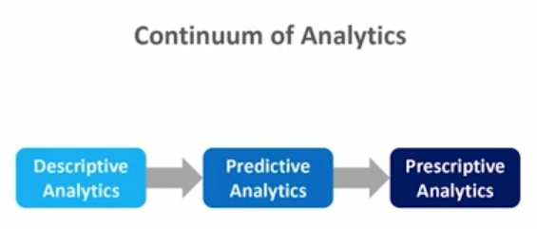
Continuum of Analytics
Descriptive
Diagnostic (Predict-ish)
Predictive
Prescriptive analytics

Slide 4
Descriptive analytics
They're the easiest to calculate and they're based on past data.
They're used to describe what has already happened in the past. So in other words, it's a snapshot of the past.
It's based on prior data or past data that you've already collected that are likely part of your HR information system already.
Example:
  HR metrics like your turnover rate, yield ratio, cost per higher
  WHO statistics on COVID-19, No. of births, No. of death

Slide 5
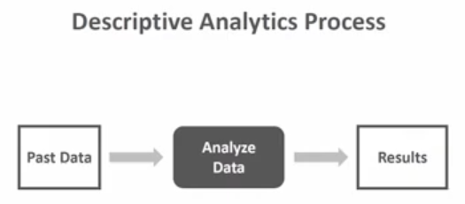
Descriptive analytics

Slide 6
More Examples:
Imagine a company where Unit X showed a 34% turnover rate last year.
Now imagine another company where they're doing an employee survey and they find that 20% of survey respondents indicated that they were strongly considering leaving the company in the next six months.
How about a company where based on a five point rating scale, subject matter experts or SMEs showed a lack of agreement on task criticality as part of a job analysis
Descriptive analytics

Slide 7
we are trying to make inferences based on the data.
we are taking the steps to make inferences about what happened in the past to try to make those predictions in the first place.
Example:
Employees who participate in a new onboarding program, and maybe we find that they're significantly more likely to stay in the company through their first 12 months if they did participate versus if they did not participate in that new onboarding program.
Diagnostic analytics

Slide 8
Predict what will happen in the future based on available data, and then verifying how accurate those predictions are going to be based on a future data or new data that we might collect or new data that arrive to us.
We can high hypothesize what might happen in the future and then look to see, well, what would happen if maybe 10 years from now if the current state of affairs plays out as we have modeled it, what is likely to happen?
Predictive analytics

Slide 9
It's really a two phase process.
First we start with past data, then we build some type of model, statistical model, mathematical model, computational model, and then we look at the results of that model based on those data.
In phase two, we collect new data or multiple sets of new data, and we apply that model that we developed from phase one to those new data, and then we make predictions. And importantly, we then look and see, well, how accurate were our predictions that we made based on that model built during phase one? We applied it to the new data from phase two, and in this way we can see did it really generalize and help us predict into the future?
Predictive analytics

Slide 10
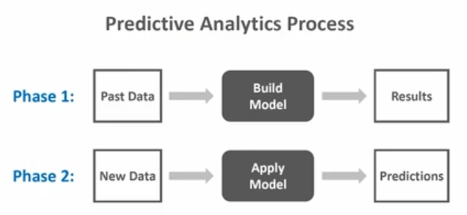
Predictive analytics

Slide 11
Examples:
Imagine you use something called a logistic regression model, and you show that engagement and performance are significant predictors of who will quit in the subsequent six months. And then we take that model that we developed there, and we use it with new data, a new group of employees to see if we can use it to predict who's likely to turn over in the future within the next six months.
And then we can evaluate based on the predictions we had from original model with the new data we actually have where we do find out who actually ended up quitting in the first six months. And we might find something like we find that the predictions are 85% accurate, or we find a level of 85% accuracy based on our model and how when it was applied to the new set of data or future data.
Predictive analytics

Slide 12
Examples:
Another example would be a multiple linear regression model where we show that structured interview and work sample scores significantly predict job performance. Now, we could then do some cross validation with new data where we take the model we developed in phase one, where we find that structured interview and work samples significantly predict job performance and then apply that say regression model to a new data set.
And then we can see, well, how well do those two factors or those two selection tools of the structured interview and work samples scores actually do with the new data in terms of predicting job performance?
Predictive analytics

Slide 13
As the name implies, we're really prescribing action based on analytics.
We use data to predict what will happen in the future based on those available data. And then we verify how accurate those predictions are based on new or future data.
We've just done predictive analytics and then we take an extra step and we prescribe action based on those predictions.
Prescriptive analytics

Slide 14
We have three phases.
Now. First phase, you have your past data, you build your mathematical, computational or statistical model, then you have your preliminary results based on those data.
And then you take that model you built from phase one and you apply it to new data from phase two. And then you see how accurate your predictions actually were based on that model from phase one.
And then you have a third phase where you move on and you take those predictions and you come up with some kind of action.
Prescriptive analytics

Slide 15
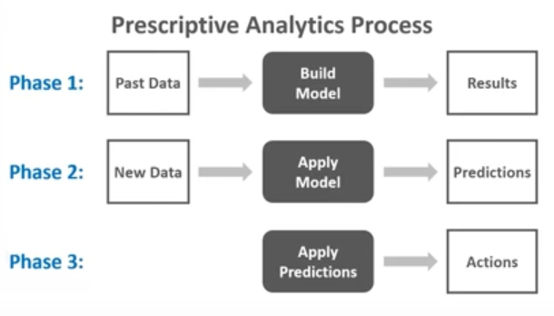
Prescriptive analytics

Slide 16
We can now take prescriptive action by deciding, how are we actually going to take those findings and do something actionable to actually affect engagement and performance as we've determined that those are actually key drivers of who's going to stay and who's going to leave.
Well, first with regard to engagement, we'd redesign the jobs to improve engagement.
And then we could also with regard to increasing performance So those are just a couple steps we could take to actually prescribe action or turn those predictive analytics into something that's actionable.
Prescriptive analytics

Slide 17
Predictive analysis is used in various fields
Online Retail
Healthcare
Education
Fraud Detection
Improvised market campaigning
Weather forecasting
Social Media Analysis
Cyber security
Recommendation and search engines
Government Sector etc.

Slide 18
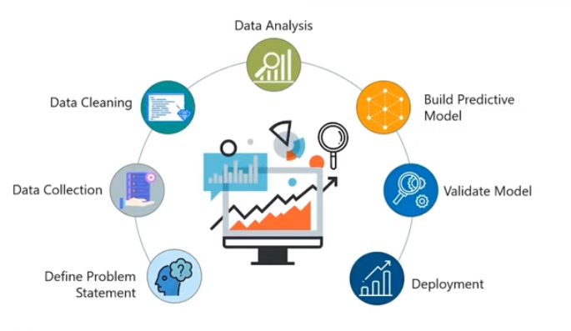
Stages of Predictive Analytics

Slide 19
Define Problem statement
Data collection
Data cleaning
Data analysis
Build predictive model
Validate model
Deployment
Stages of Predictive Analytics

Slide 20
Seven steps
Define your problem statement.
  Before you even start on a project, it is very important that you understand the problem you're trying to solve.
  Identify all the objectives of your project by identifying the variables that you need to predict.
Data collection
  Start gathering all the data. At this stage, some of the questions that you can consider is, what data do I need for my project? Where does it live? How can I obtain it? And what is the most efficient way to store and access all of the data?
Stages of Predictive Analytics

Slide 21
Data cleaning
  Transform your data into the desired format so that you can read the data.
  Missing values or a lot of redundant values in the data set.
Data Analysis
  It is a process of transforming, inspecting, and modeling the data to discover useful information.
  Evaluate all the variables that are available to you or all the data that is available.
  Understand all the patterns that are hidden in your data
  Retrieve all the useful insights from your data.
Stages of Predictive Analytics

Slide 22
Building a predictive model
  Involves mapping your data into a machine learning algorithm.
  Machine learning algorithms can be used to solve a series of problems, such as a classification problem, regression problem, or a clustering problem.
  The first step to building the model is to split the input data randomly for modeling into training data set and into testing data set. After that, you will build the model by using the training data set.
Validating the model
  Test the accuracy of the model,
  Test how efficiently the model is predicting your outcome
  Use the testing data set on your model and you can evaluate whether the predictions are accurate or not.
Stages of Predictive Analytics

Slide 23
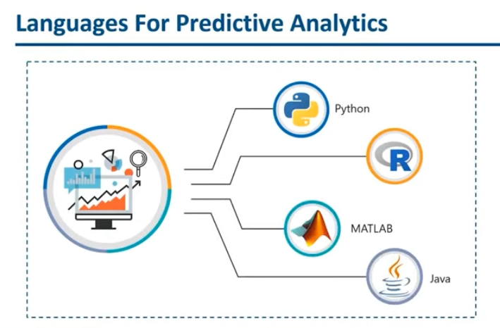
Languages used for Predictive analytics

Slide 24
Features of
R programming language

Slide 25
Data
Data is defined as the qualities(numbers), characters, or symbols on which operations are performed by a computer, which may be stored and transmitted in the form of electrical signals and recorded on magnetic optical or mechanical recording media.
Data are raw facts that have not been processed to express their intended meaning.
In simple words, we can say that all the facts and figures, which can be stored in digital format can be termed as data. All the text numbers, images, audios, videos stored in our phones and computers are some examples of data.
They are all digitally stored and comprised of zeros and ones.
data is a plural term. The singular term for data is datum.

Slide 26

Big Data
Big data refers to copious amounts of data, which are too large to be processed and analyzed by traditional tools. Since the amount of big data increases exponentially, (more than 500 terabytes of data are uploaded to Facebook's database alone in a single day), it represents a real problem in terms of analysis.
Examples:
  Netflix collects user behavior data from its more than 100 million customers. This data helps Netflix in understanding what every individual customer wants to see. Based on the analysis, it recommends movies and TV shows, which the viewer will love to watch.
  Customer is happy - he is getting what he likes without even searching for it,
  Netflix is happy - it has delighted its customers, which will result in higher customer retention.

Slide 27
Big Data
Credit card companies collect and store the real-time data of when and where the credit cards are being swiped. This data helps them in thwarting fraud detection.
  Suppose a credit card is used at location A for the first time. Then after two hours, the same card is being used at location B, which is 5,000 kilometers away from location A. Now, it is practically impossible for a person to travel 5,000 kilometers in two hours, and hence, it becomes clear that someone is trying to fool the system.
These were just two examples. Big data has hundreds of different applications in hundreds of different fields, be it banking, communication, healthcare, media, advertising, manufacturing, transportation, and retail.

Slide 28
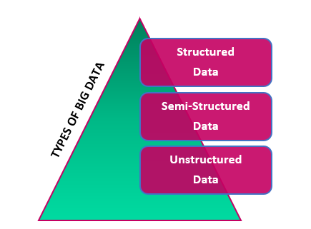
Data and its types
In our everyday life, we see data in so many different forms, Audio and video files, images, lists, text data, like messages, reviews, and so much more.
The data is stored in the database and the database management system manages the data that is it stores and updates the data in the database, and it retrieves the data from the database to provide answers to the users.
As the type of data changes, the way of handling it also changes.
The three different types of data.
  Structured data
  Semi-structured data and
  Unstructured data.

Slide 29
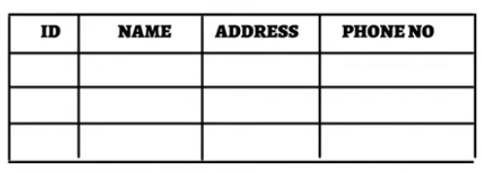
Structured data
Structured data is the kind of data that is stored in a tabular format. That means in the form of Rows and columns. We cannot have just random data in the structured data. The rows and the columns have to be related to one another.
Structured data is used to refer to the data, which is already stored in databases in an ordered manner.
Structured data is very clearly defined and it is stored in a predefined data model.
It accounts for about 20% of the total existing data
Example:
    Excel files
    S Q L databases

Slide 30
Structured data
There are two sources of structured data, machines and humans.
  All the data received from sensors, web logs and financial systems are classified under machine generated data.
  These include medical devices, G P S data, date of usage, statistics captured by servers and applications, and the huge amount of data that usually move through trading platforms
  Human generated structured data mainly includes all the data that humans input into computers, such as names and other personal details. When a person clicks a link on the internet or even makes a move in a game, data is created. This can be used by companies to figure out their customer's behavior and make the appropriate business decisions.

Slide 31
Structured data
Examples:
Suppose when we visit a website of IRCTC. The data is available in a proper tabular format. Like what is the place of departure? What is the time of departure, how much time it is going to take? That means what is the time span of the journey and what time are we going to reach at our destination so we get a proper view and understanding of the data whenever the data is.
Think of a sales database where the customer, product and cost information is stored. Each row containing one unique purchase. It has a fixed format and is generally stored in a database. It can be easily analyzed using a S Q L. That is structured query language where we write queries to analyze the data.

Slide 32
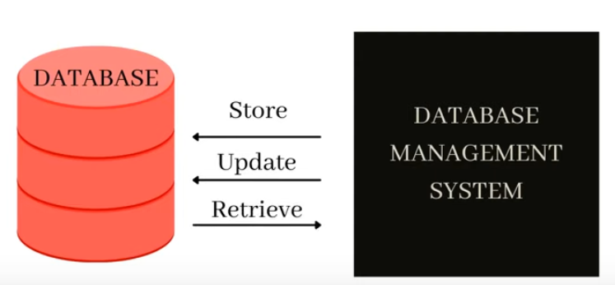
Structured data
So we need to store the data in a structured format, and the data has to be related to one another.
For this kind of data storage, we need a database management system that can manage the data and store update and retrieve it in the related format. To manage this format we need related data in a structured format, we need R D B M S. That is relational database management system.
So structured data is stored in relational databases because they manage the relationship between the data. And hence relational database management system is used to manage relational databases.

Slide 33
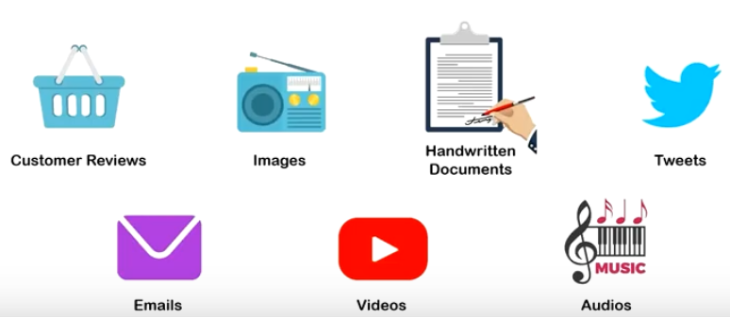
Un-Structured data
Unstructured data has no predefined structure, or it is not available in any forms of predefined data model.
They have no clear format in storage.
80% of the total account for unstructured big data.
Most of the data a person encounters belong to this category
Unstructured data is irregular and ambiguous, irregular because it does not have a predefined format or structure and ambiguous because, it is uncertain in nature.
Common examples are text, data, audio, video, social media, real time streaming data from iot, smart devices, customer reviews, and many more. Where insights go beyond numbers to feelings, opinions, and ideas.

Slide 34
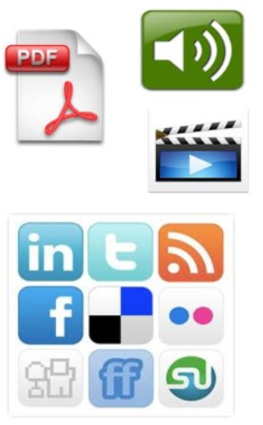
Un-Structured data
Unstructured data is also classified based on its source machine generated or human generated,
  Machine generated data accounts for all the satellite images, the scientific data from various experiments and radar data captured by various facets of technology.
  Human generated unstructured data is found in abundance across the internet since it includes social media data, mobile data, and website content. This means that the pictures we upload to Facebook or Instagram handle the videos we watch on YouTube and even the text messages we send, text documents, PDFs, images and videos.

Slide 35
Un-Structured data
Consider an example of customer review.
  Text reviews cannot be stored in a tabular format. Also, your data can be a mix of text, audio, and visuals. These irregularities and ambiguities make it difficult to store data in a fixed format, but the thing is this unstructured data holds tremendous insights, and if not utilized, businesses will lose out on many opportunities.
Example:
  it can be text numbers, audio, video, images, messages, social media posts.
  Facebook, Instagram, YouTube, Google, they all are made up of unstructured data.
  survey forms are also unstructured data.

Slide 36
Un-Structured data
previously only structured data was used extensively because it was very easy to extract information from that kind of data to analyze that kind of data.
But now with the help of artificial intelligence, unstructured data has also come into the picture.
And thus, unstructured data has become the most useful kind of data these days, and it provides a lot of information.

Slide 37
semi-Structured data
Semi-structured data falls between structured and unstructured data.
It is a combination of both partly structured data and partly unstructured data.
Example:
  Emails. Now, we have all seen a basic format of email. Part of the information in the email is structured and part of it is unstructured. For example, the name of the sender or the email ID and the sender date and time. There is a proper way of mentioning these basic information. However, the content of the email can be images, that can be texts, that can be numbers, that can be PDFs. That portion of the email is unstructured data.

Slide 38
semi-Structured data
Another example of semi-structured data the worldwide web, like on the worldwide web, we have all kinds of data. Some of it is structured, some of it is unstructured. That means it is a combination of both, and it is a semi-structured data.
Big data analysis processing can help a company achieve cost reductions and dynamic growth

Slide 39
Data Mining
Gold, you'll know that it takes a lot of time and effort to find even a small nugget.
It's estimated that to extract enough gold to make a single golden ring, you'd need to sort through around 26 tons of rock and other stuff.
The same is true when mining data, except the
  gold is replaced with insights and
  the panning is replaced with algorithms.
Data mining is the process of extracting valuable information from large data sets, and it's used in a variety of industries from marketing through to healthcare, and it can help businesses to make more informed decisions.

Slide 40
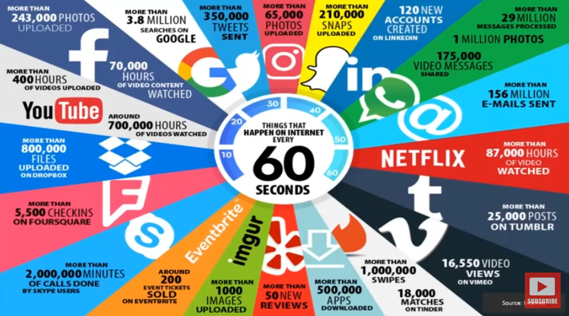

Slide 41

Data Mining
Now, fundamentally, data mining is about processing data and identifying patterns and trends in that information.
And when we think about the evolution of things like data warehouses, and when we think about things like just the the sheer volume of data, big data
We need to process so much of this data and turn it into useful knowledge.

Slide 42
One of the main advantages of data mining is that it can help you to make predictions about future trends. By analyzing past data, you can build up a picture of how things might develop in the future.
Data mining can also help you to identify relationships between different pieces of data that you might not have been able to see before.
So for example, you might see that there is a correlation between the amount of time somebody spends on your website and the likelihood of them making a purchase.
Data Mining

Slide 43
STEPS in Data mining
Setting objectives
    Data scientists and business stakeholders work together to define a business problem that data mining will be applied to. The problem is defined and the scope is defined
Data preparation
    Identifies which set of data will help answer those pertinent questions to the business that we set in step one. Now there's more here than just identifying the data. We also need to clean it, removing any noise such as duplicates, missing values, and outliers.
.

Slide 44
STEPS in Data mining
Applying the data
Applying it specifically through data mining algorithms. We're looking here for interesting data relationships and applying deep learning techniques
Evaluating results
Interpreting results that are valid, novel, useful, and understandable.
.

Slide 45
Data mining technique
/ technology
Data mining works by using various algorithms and techniques to turn large volumes of data into useful information.
Association
Association is rule-based and it's a method for finding relationships between variables. In a given dataset, you make a simple correlation between two or more items, often of the same type to identify patterns.
Example:
when tracking people's buying habits, you might identify that a customer always buys cream and then they tend to buy strawberries, and therefore you could suggest that the next time they buy strawberries, they might also want to purchase cream.

Slide 46
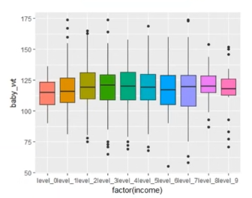
Data mining technique
/ technology
Anomaly Detection
Identification of unusual patterns, outliers which helps us in understanding the variation in data
Example:
Movie theater – the visitors average salary is 30000.
One day, Tata Sons visit the theater. The salary is very high. Its an anomaly that has to be removed while data collection

Slide 47
Data mining technique
Classification
Builds up the idea of the type of customer or the type of item or the type of object by describing multiple attributes to identify a particular class.
Example:
You could easily classify cars into different types like sedan four by four convertible, and you could do that by identifying different attributes like the number of seats or the shape of the car. Then given a new car, you can apply it into a particular class by comparing the attributes with our known definition.
.

Slide 48
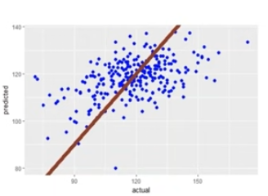
Data mining technique
Regression
Determines the extent of relationship among the variables.
Helps in understanding how the dependent variable varies with changes in independent variable.
Types:
Linear regression
Logistic regression
Poisson regression

Slide 49
Data mining technique
Clustering
Clustering enables you to group individual pieces of data together to form a structure, correlating the data instances with other examples, so you can see where the similarities and the ranges agree.
Example:
  Segregate the observations, on the basis of similarities. Within cluster, similarity is more.
  Account in KVB, etc.
One of the most important things to remember is that data mining techniques are not a one size fits all solution with different techniques being more or less effective. Depending upon your data, your business questions and what you are trying to achieve, it's often a case of trial and error to identify which method will work best for you.
.

Slide 50
Data mining
How should be the mined information ?
New
    The extracted data should give new patterns, relationships among the data entities.
    Ex: smoking causes cancer. This we already know. We should be able to find the longevity of a person smoking. It’s a new data
Correct
    All that glitters is not gold. Similarly we need to validate the correctness of the data before using it.
Potentially useful
The data extracted must be useful for our analysis

Slide 51
data mining processes
There are several data mining processes, that can be applied to modern Data Science projects. The most common of them are CRISP-DM, SEMMA, KDD.

Slide 52
KDD- knowledge discovery in database
The KDD process, is the process of using DM methods to extract what is deemed knowledge, according to the specification of measures, using a database along with any required preprocessing, sub sampling, and transformation of the database. There are considered five stages

Slide 53
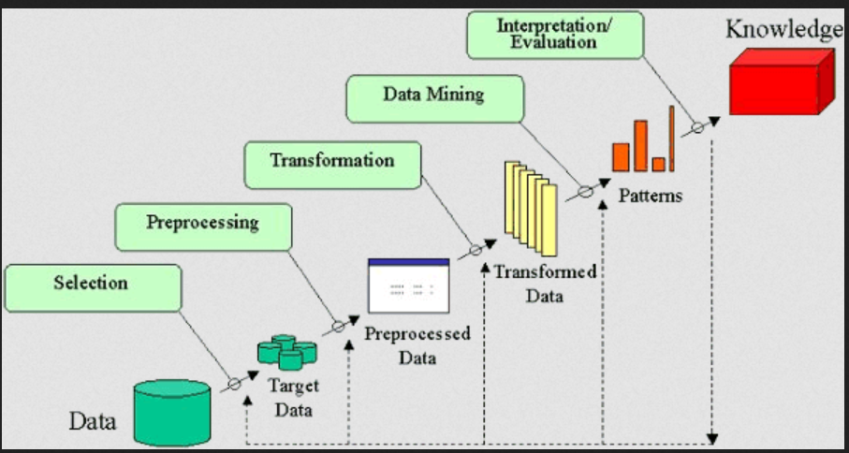

Slide 54
KDD steps
Selection –
    This stage consists on creating a target data set, or focusing on a subset of variables or data samples, on which discovery is to be performed.
Pre processing –
    This stage consists on the target data cleaning and pre processing in order to obtain consistent data.
Transformation –
    This stage consists on the transformation of the data using dimensionality reduction or transformation methods.

Slide 55
KDD steps
Data Mining –
    This stage consists on the searching for patterns of interest in a particular representational form, depending on the data mining objective (usually, prediction)
Interpretation/Evaluation –
    This stage consists on the interpretation and evaluation of the mined patterns

Slide 56
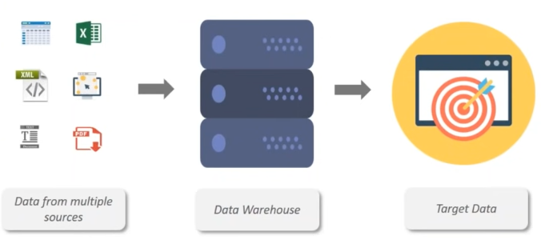
KDD
Step 1
Data Selection

Slide 57

KDD
Step 2
Data Pre-processing
Summarization, aggregation, normalization can be done to transform the data to be suitable for data mining

Slide 58
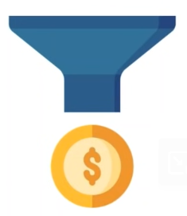
KDD step 3
Data Mining
Applying intelligent operations like clustering, regression, classification to extract useful patterns

Slide 59
KDD step 3
Data Mining
Applying intelligent operations like clustering, regression, classification to extract useful patterns

Slide 60
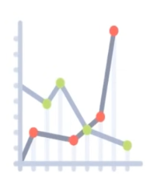
KDD step 4
Data Evaluation
Evaluated for accuracy and validity, to check whether the data is correct, useful and new.
Knowledge representation
KDD
step 5
Need to represent the information thro. Valid tables or graphs

Slide 61
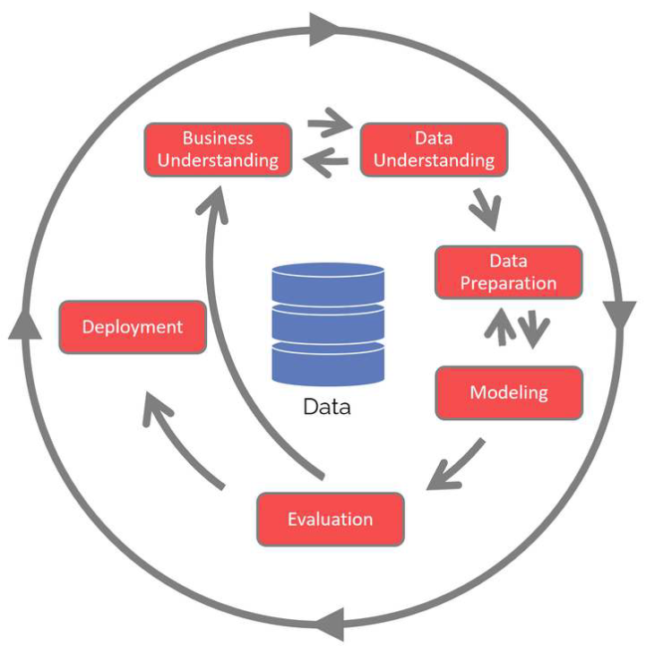
CRISP-DM
CRoss Industry
Standard Process for Data Mining

Slide 62
Six Phases
Business understanding
What does the business need?
Data understanding
What data do we have / need? Is it clean?
Data preparation
How do we organize the data for modeling?
Modeling
What modeling techniques should we apply?
Evaluation
What best meets the business objectives?
Deployment
How do stakeholders access the results?
CRISP-DM

Slide 63
I. Business Understanding
The Business Understanding phase focuses on understanding the objectives and requirements of the project.
While many teams hurry through this phase, establishing a strong business understanding is like building the foundation of a house – absolutely essential.
CRISP-DM
Step 1

Slide 64
Determine business objectives:
    understand what the customer / client is trying to
    achieve, including the business success criteria.
Assess situation:
    Determine resources availability, project requirements, assess risks and contingencies, and conduct a cost-benefit analysis.
Determine project goals:
    In addition to defining the business objectives, you should also define what success looks like from a technical data mining perspective.
Produce project plan:
  Select technologies and tools and define detailed plans for each project phase.
CRISP-DM
Step 1

Slide 65
Reasons for Business Understanding
Get the clear understanding of the business objectives
    To reduce churn rates
    To acquire valuable customers
    To cross-sell/up-sell
    To prevent fraud
Agree success criteria
    To reduce out annual churn rate from 5% to 3%
Assess the situation
Translate to analytical objectives if possible
Evaluate the cost benefits
Clearly understand how action can be taken based on the likely outcomes
    How to deploy
Document relevant resources, constraints and systems

Slide 66
Example Business objectives
A water company wants to reduce pollution
An online gaming company want to identify fraudulent bets
A charity wants to increase supporter lifetime value
A multi-channel subscription-based magazine want to improve renewal rates
Local government planners want to know how likely a ward is to sustain next year
A shipping company wants to identify containers that are likely to contain smuggled items
A coffee retailer wants to understand what effect price changes will have on demand
A hospital wants to know how many staff to deploy in each shift
An online retailer wants to increase their repurchase rates

Slide 67
Business understanding- worked example
A retailer wants to
  Increase the revenue and profit
  By increasing average/total customer lifetime value
  They believe they are below the competitive set
Part of the strategy to achieve this is to increase repurchasing
  They believe they have an issue with repurchase rates for digital customers
Success criteria
  They have a cost constraint – when looking to incentivize repurchase
  The need to identify atleast 40% of customers most likely to repurchase within 20% of all customers
Analytically speaking, they want to:
  Score each first purchase customer with a propensity to repurchase
  Identify the possibilities of repurchase

Slide 68
Business understanding – Hypotheses
The retailer- Business and Analysis teams- develop a set of hypothesized drivers of repurchase. These include:
    Channel experience
    Products bought (in first purchase)
    Value of first purchase
    Whether the first purchase was a promotion
    Whether subsequent promotions were made
      And when(timing)
    Customer life stage
    Timing of first purchase, month, day of week, time of day
    Delivery method
      Reserve and collect, COD, etc.

Slide 69
II. Data Understanding
  the Data Understanding phase focuses on identifying, collecting, and analyzing data sets that can help the project. This phase also has four tasks
CRISP-DM
Step 2

Slide 70
Collect initial data:
    Acquire the necessary data and (if necessary) load it into your analysis tool.
Describe data:
    Examine the data and document its surface properties like data format, number of records, or field identities.
Explore data:
    Dig deeper into the data. Query it, visualize it, and identify relationships among the data.
Verify data quality:
    How clean/dirty is the data? Document any quality issues
CRISP-DM
Step 2

Slide 71
II. Data Preparation
  This phase, which is often referred to as “data munging”, prepares the final data set(s) for modeling. 50% to 80% of the project effort is in the data preparation phase. This phase has five tasks.
Select data:
    Determine which data sets will be used and document reasons for inclusion/exclusion.
Clean data:
    Often this is the lengthiest task. A common practice during this task is to correct, impute, or remove erroneous values.
CRISP-DM
Step 3

Slide 72
Construct data:
    Derive new attributes that will be helpful.
Integrate data:
    Create new data sets by combining data from multiple sources.
Format data:
    Re-format data as necessary. For example, you might convert string values that store numbers to numeric values so that you can perform mathematical operations
CRISP-DM
Step 3

Slide 73
IV. Modeling
  Modeling is often regarded as data science’s most exciting work. In this phase, the team builds and assesses various models based, often using several different modeling techniques. Although the CRISP-DM guide suggests to “iterate model building and assessment until you strongly believe that you have found the best model(s)”, in practice teams might iterating until they have a “good enough” model. This phase has four tasks
CRISP-DM
Step 4

Slide 74
Select modeling techniques:
    Determine which algorithms to try (e.g. regression, neural net).
Generate test design:
    Pending your modeling approach, you might need to split the data into training, test, and validation sets.
Build model:
Build a model using algorithms
Assess model:
    Generally, multiple models are competing against each other, and the data scientist needs to interpret the model results based on domain knowledge, the pre-defined success criteria, and the test design.
CRISP-DM
Step 4

Slide 75
V. Evaluation
    Whereas the Assess Model task of the Modeling phase focuses on technical model assessment, the Evaluation phase looks more broadly at which model best meets the business and what to do next. This phase has three tasks
CRISP-DM
Step 5

Slide 76
Evaluate results:
    Do the models meet the business success criteria?
    Which one(s) should we approve for the business?
Review process:
    Review the work accomplished. Was anything
    overlooked? Were all steps properly executed?
    Summarize findings and correct anything if needed.
Determine next steps:
    Based on the previous three tasks, determine whether to proceed to deployment, iterate further, or initiate new project
CRISP-DM
Step 5

Slide 77
VI. Deployment
    A model is not particularly useful unless the customer can access its results. So, deployment should be thought of in terms of what does it take to actually use the results of the project. Depending on the project, this can be as simple as sharing a report or as complex as implementing a live real-time predictive model. This final phase has four tasks.
CRISP-DM
Step 6
Its important to distinguish between a model in the modelling and deployment phases
Typically,
  In the modelling phase, many different models and modelling options are built and evaluated.
  In deployment phase, the winning model is fixed.

Slide 78
Plan deployment:
Develop and document a plan for deploying the model.
Plan monitoring and maintenance:
    Develop a thorough monitoring and maintenance plan to avoid issues during the operational phase (or post-project phase) of a model.
Produce final report:
    The project team documents a summary of the project which might include a final presentation of data mining results.
Review project:
    Conduct a project retrospective about what went well, what could have been better, and how to improve in the future
CRISP-DM
Step 6

Slide 79
Key Strengths:
    Common Sense-Apply
    Cyclical
    Adopt-able –to various fields
    Right Start – data understanding
    Flexible – can iterate
CRISP-DM
Key Weaknesses:
    Not a Team Coordination Framework
    Can ignore stakeholders
    Outdated
    Documentation Heavy
    Slow starts

Slide 80
Semma
The acronym SEMMA stands for Sample,
Explore, Modify, Model, Assess, and refers to the process of conducting a data mining project. It is a cycle with 5 stages for the process:

Slide 81
Sample –
    This stage consists of sampling the data by extracting a portion of a large data set big enough to contain the significant information, yet small enough to manipulate quickly.
Explore –
    This stage consists of the exploration of the data by searching for unanticipated trends and anomalies in order to gain understanding and ideas.
Modify –
    The modification of the data by creating, selecting, and transforming the variables to focus the model selection process.
Semma

Slide 82
Semma
Model –
modeling the data by allowing the software to search automatically for a combination of data that reliably predicts a desired outcome.
Assess –
    Assessing the data by evaluating the usefulness and reliability of the findings from the data mining process and estimate how well it performs.

Slide 83
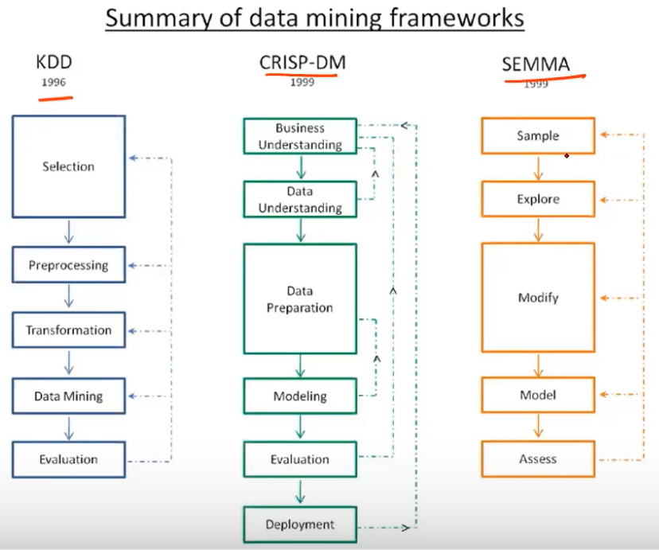
summary

Slide 84
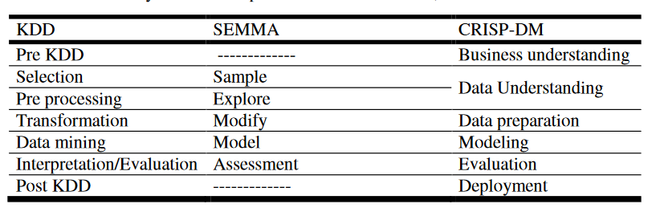
Comparison

Slide 85
Financial Data Analysis
Retail Industry
Telecommunication Industry
Biological Data Analysis
Other Scientific Applications
Intrusion Detection
Criminal Investigation
Counter-Terrorism
Healthcare
Insurance
Market Basket analysis
Data mining applications

Slide 86
Financial Data Analysis
Banks have detailed information about their customers, their transactions and loans. Understanding this bulk of data allows banks to classify customers and customise services like loans, credit card spending limits, rewards and provide discounts on purchases. Identifying unusual activity in a transaction helps track fraudulent activities and security breaches.
Data mining applications

Slide 87
Financial/Banking Sector:
A credit card company can leverage its vast warehouse of customer transaction data to identify customers most likely to be interested in a new credit product.
Credit card fraud detection.
Identify ‘Loyal’ customers.
Extraction of information related to customers.
Determine credit card spending by customer groups.
Data mining applications

Slide 88
Education: For analyzing the education sector, data mining uses Educational Data Mining (EDM) method. This method generates patterns that can be used both by learners and educators. By using data mining EDM we can perform some educational task:
Predicting students admission in higher education
Predicting students profiling
Predicting student performance
Teachers teaching performance
Curriculum development
Predicting student placement opportunities
Data mining applications

Slide 89
Scientific Analysis: Scientific simulations are generating bulks of data every day. This includes data collected from nuclear laboratories, data about human psychology, etc. Data mining techniques are capable of the analysis of these data. Now we can capture and store more new data faster than we can analyze the old data already accumulated. Example of scientific analysis:
Sequence analysis in bioinformatics
Classification of astronomical objects
Medical decision support.
Data mining applications

Slide 90
Healthcare
Data mining helps improve the quality of health care systems. Predictive analysis helps recommend medicines and evaluate the treatment progress. Similarly, identifying unusual patterns in medical claims, medicine purchases or incoherent prescriptions help track fraudulent practices.
Data mining applications

Slide 91
Insurance
Data mining helps insurance companies understand customer purchase behaviour and predict the insurance policy they are likely to purchase in the future. They track fraudulent claim practices and strengthen their systems to avoid them. Insurance companies can trace policies that get claimed together and bundle them to provide better services.
Data mining applications

Slide 92
Transportation:
A diversified transportation company with a large direct sales force can apply data mining to identify the best prospects for its services. A large consumer merchandise organization can apply information mining to improve its business cycle to retailers.
Determine the distribution schedules among outlets.
Analyze loading patterns.
Data mining applications

Slide 93
Market Basket Analysis: Market Basket Analysis is a technique that gives the careful study of purchases done by a customer in a supermarket. This concept identifies the pattern of frequent purchase items by customers. This analysis can help to promote deals, offers, sale by the companies and data mining techniques helps to achieve this analysis task. Example:
Data mining concepts are in use for Sales and marketing to provide better customer service, to improve cross-selling opportunities, to increase direct mail response rates.
Customer Retention in the form of pattern identification and prediction of likely defections is possible by Data mining.
Risk Assessment and Fraud area also use the data-mining concept for identifying inappropriate or unusual behavior etc.
Data mining applications

Slide 94
Data Mining Challenges
    Complex Data
    Distributed Data
    Data Visualisation
    Domain Knowledge
    Incomplete Data
    Higher Costs
    Privacy and Security
    User Interface
    Methodologies for Mining Data
    Data Mining Algorithms
    Performance Issues
    Background Knowledge Incorporation
    Data Disclosure
Data mining challenges
Explanation

Slide 95
Thank
You
Manikandan
manikandan.v@klu.ac.in

Slide 96
Links to Know…
Install R and R studio
https://posit.co/download/rstudio-desktop/
R Programming Tutorial
https://www.w3schools.com/r/r_if_else_andor.asp
Using R
http://www2.hawaii.edu/~georgeha/Handouts/meas/_book/
Predictive Analytics using R
https://www.youtube.com/watch?v=Kd0C-8q0HkI&t=126s
Predictive Analytics Software
https://www.predictiveanalyticstoday.com/top-predictive-analytics-software/

Slide 97
Links to Know…
Data mining using R
https://www.youtube.com/watch?v=BB2O4VCu5j8
Using R Tool (R studio)
https://support.posit.co/hc/en-us/articles/200484448-Editing-and-Executing-Code-in-the-RStudio-IDE

Slide 98
Local examples
Airtel subscriber prediction (300 rupees recharge –full talktime- because customers moving to jio
Amazon ad- making u to buy-tempting to buy
Phone number – gives u aadhar number, pan card info, bank account info- using phonepe
Swiggy order buy- suggestions showing earlier bought items
Window shopping – algorithms predict and make u to buy
Phone number- given to different shops- clustering into groups
Buffey system- so much of food- so much of data

Slide 99
Local examples
Amazon, Google pay giving cashback of 50, 100 for adding new persons, sending money to new persons, etc. – Data Collection
Train ticket sales – crisp-dm

Slide 100
Supporting links
https://www.youtube.com/watch?v=lxCaYg1G9fE&t=261s
https://www.youtube.com/watch?v=7rs0i-9nOjo
https://www.youtube.com/watch?v=-xxCY6WHfRY
https://www.youtube.com/watch?v=dK4aGzeBPkk
https://rpubs.com/Argaadya/crispr_dm

