Slide 1
Cortex-M4 NVIC, EXTI and RCC
Lecture 2
EN3544 Embedded System
By: Ghalib Janjua

Slide 2
Contents
Cortex-M4 – STM32L476VG
Interconnect Matrix
Reset and Clock Controller (RCC)
  Reference
Nested Vectored Interrupt Controller - NVIC
  Reference
External Interrupt and Event Controller – EXTI
  Reference
Q&A

Slide 3
Cortex-M4
FPU
Single precision
Ease of use
Better Efficiency
Easier support for meta language
MCU
Ease of use C programming
Interrupt handling
Low power
Cortex M4
DSP
Harvard Architecture
Single cycle MAC
Barrel shifter
Notes:
MAC = Multiply accumulate

Slide 4
Interconnect Matrix
Cortex-M4
Provide direction connections between
peripherals
Application
  Timer predictable operations
  Power saving
  Reduced GPIO usage
Source
Timer
Analog peripherals
Oscillator
Interrupt
USB
System Error
DFSDM
Destination
Timer
Analog peripherals
DMA
DFSDM

Slide 5
Reset and Clock Controller (RCC)
RCC manages system and peripherals clocks
  3 internal oscillator
  2 external oscillator
    Crystal
    Resonator
  3 Phase lock loops (PLLs)
  Many peripherals independent clocks
RCC manages various system peripherals reset
  System reset
  Power reset
  Backup domain reset
Notes:
High flexibility in the choices of clock sources allows system designer to meet power consumption and accuracy requirements.

Slide 6
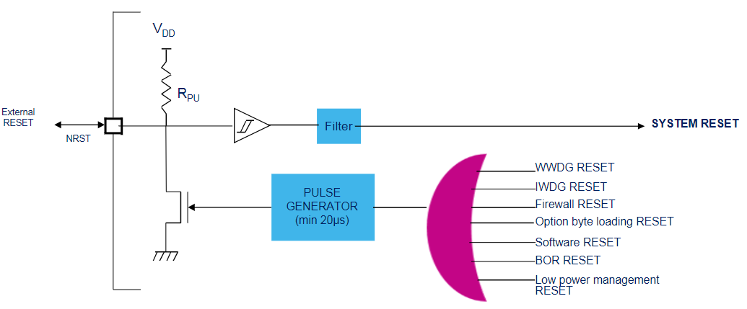
Reset Sources
System Reset
  Resets all registers except RCC register, PWR register and backup domain

Slide 7
Reset Sources
Power Reset
  Brown-out reset (BOR) reset all register except the backup registers
  Exit from standby and reset all register in VCORE
    Except RTC, WKUP, IWDG, standby and shutdown mode control register
  Exit from shutdown generate BOR reset
Backup Domain reset
  Reset backup domain RTC register, Backup register, and the RCC BDCR register
  Sources
    BDRST bit in RCC BDCR register
    VDD or VBAT power on

Slide 8
Clock sources
Three internal clock sources
  High-seed internal 16 MHz RC oscillator (HSI16)
  Multi-speed internal RC oscillator (MSI)
  Low-speed internal 32 kHz RC oscillator (LSI)
Two external oscillator with clock security system
  High-sped external 4 to 48 MHz oscillator (HSE)
  Low-speed external 32.768 kHz oscillator (LSE)
Three PLLs, each with three independent outputs

Slide 9
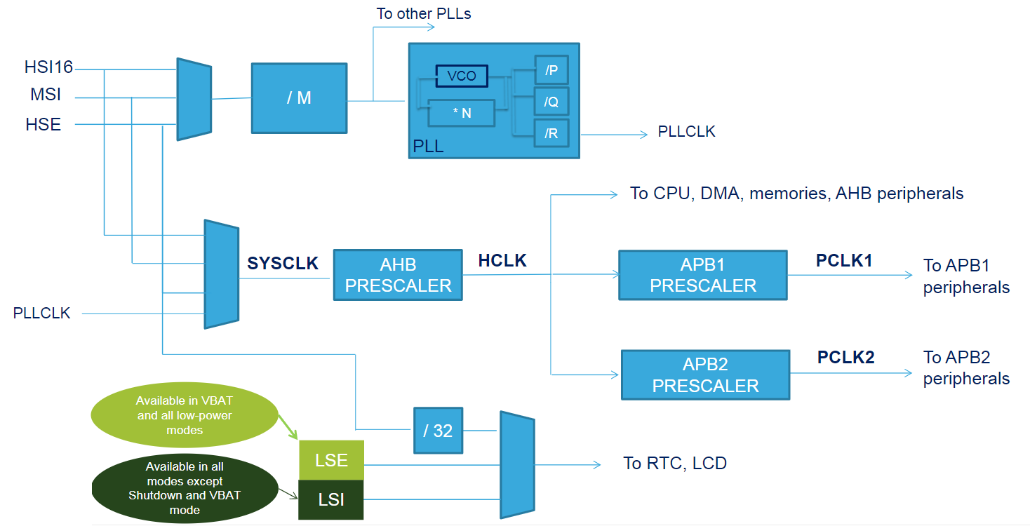
Simplified Clock Tree
Notes:
Advanced Peripheral Bus (APB)
AMBA High-performance Bus (AHB)

Slide 10
MSI Clock
12 Programmable frequencies
  100 kHz
  200 kHz
  400 kHz
  800 kHz
  1 MHz (Standby)
  2 MHz (Standby)
  4 MHz (Standby) (Reset)
  8 MHz (Standby)
  16 MHz
  24 MHz
  32 MHz
  48 MHz
Notes:
MSIRANGE control bits
MSIRGSEL set

Slide 11
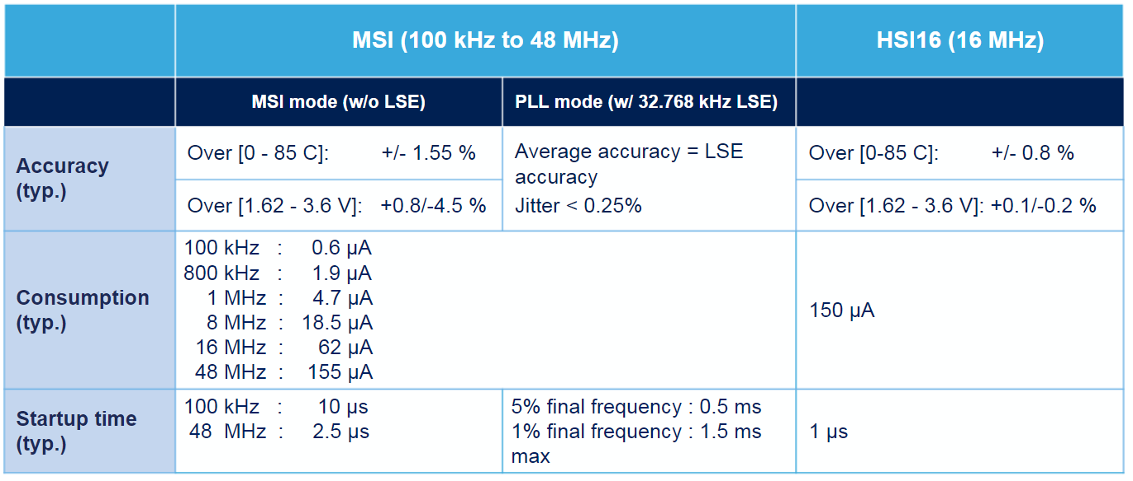

Slide 12
HSE Clock
HSE 4-48MHz
  External source (Bypass mode) up to 48MHz
  External ceramic crystal/resonator (4-48MHz)
Clock security system
  Automatic detection of HSE failure
  NMI generation
  Break input to TIM1/TIM8/TIM15/TIM16/TIM1/
    Example: motor control safe state
  Backup clock HSI16 or MSI
Notes:
Application software does not stop in case of crystal failure

Slide 13
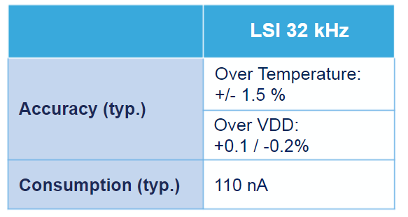
LSI Clock
Available in all mode except Shutdown and VBAT modes
ULP 32 kHz oscillator

Slide 14
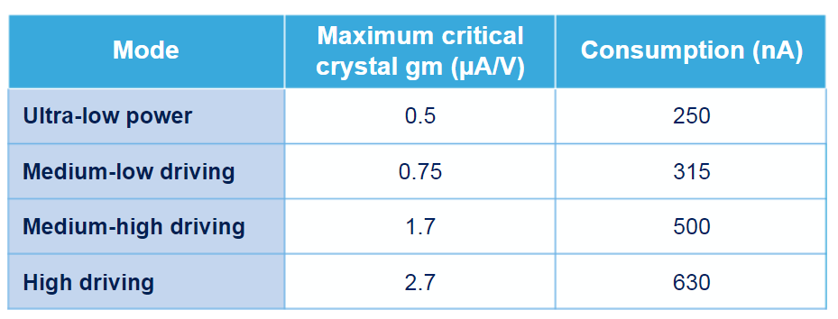
LSE Clock
Available in all power mode and in VBAT mode
32.768 kHz configuration in all low power and high-drive
Clock security system available except VBAT and shutdown

Slide 15
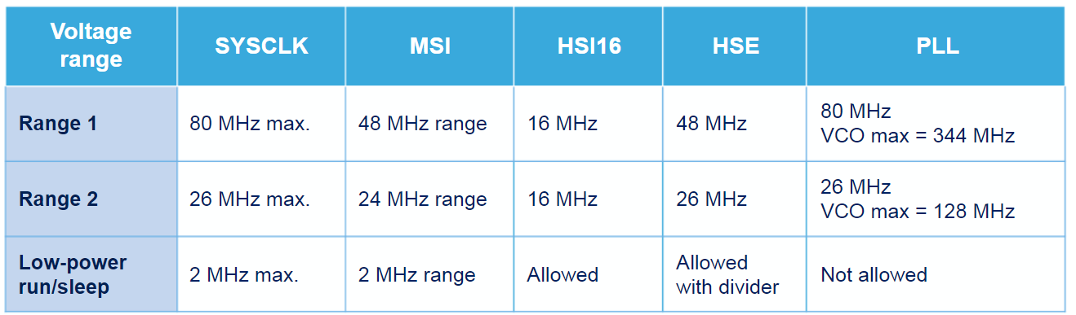
System clock
SYSCLK, AHB, APB1 and APB2 is max. frequency 80MHz

Slide 16
PLL Clocks

Slide 17
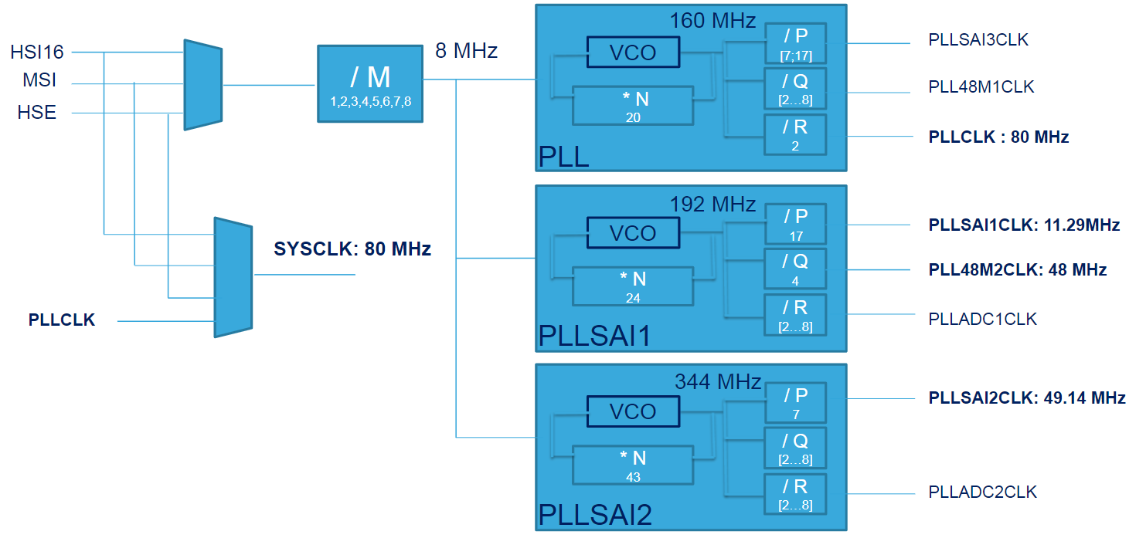
PLL Clocks

Slide 18
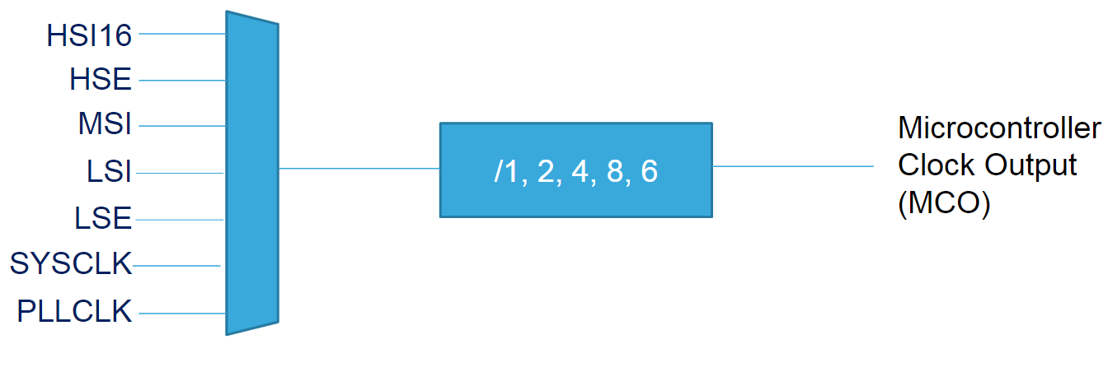
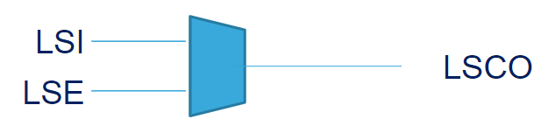
Clock Out
LSCO available in modes:
Stop 1
Stop 2
Standby
Shutdown

Slide 19
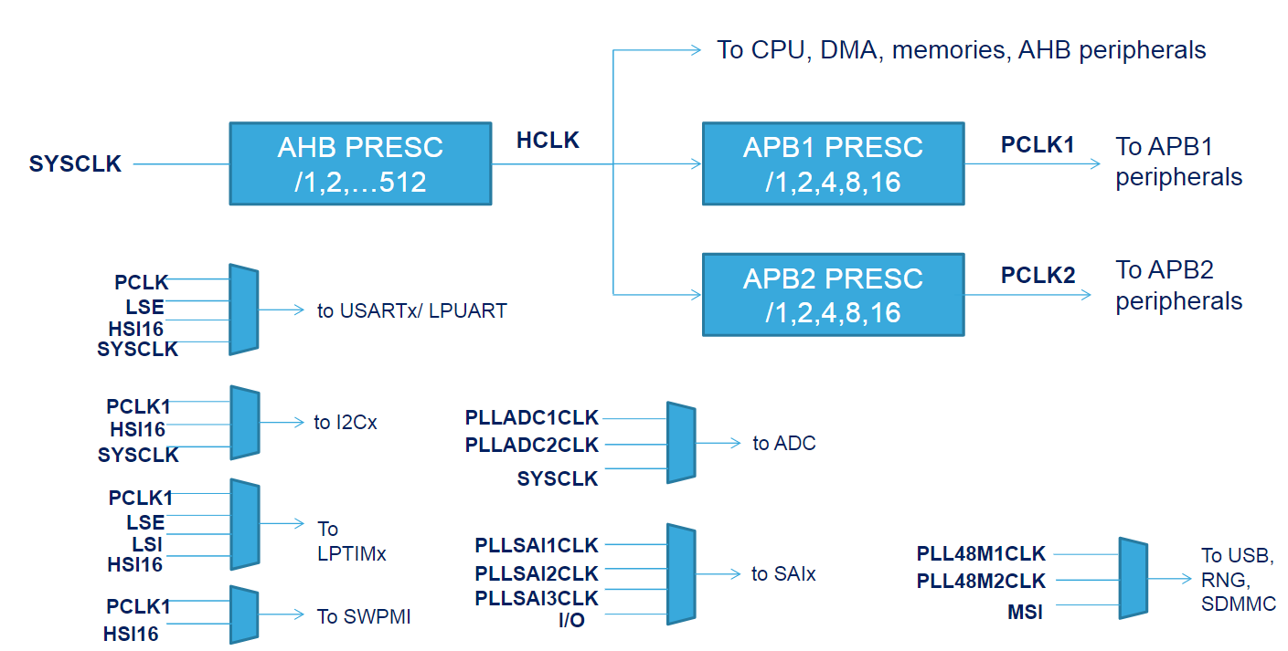
Clock tree

Slide 20
Clock Gating Configuration
Peripheral clock enable registers
  Clock is disable by default except for Flash
    No read and write support
SRAM1 and SRAM2 do not have enable bit
  Always enable in Run and LP Run modes

Slide 21
Cortex-M4 NVIC and EXTI

Slide 22
Nested Vectored Interrupt Controller (NVIC)
Low latency interrupt management
  Fast response to interrupt requests
    Most peripherals have dedicated interrupt
16 programmable priority levels
  Dynamic reprioritization
  Dynamic relocation of interrupt vector table
    Ensure are setup for enable interrupts
Interrupt become pending even if disable

Slide 23
Exception Entry and Return
Preemption and interrupt nesting
Late-arriving
S
IRQ 2
RS
S
IRQ 1
IRQ 1
RS
main
main
S
IRQ 1
IRQ 2
RS
main
main

Slide 24
Exception Entry and Return
Tail-Chaining
S
IRQ 1
IRQ 2
RS
main
main

Slide 25
Extended Interrupts and Event Controller -(EXTI)
Manges external and internal events
  Configurable line
  Direct line
Generates wakeup request processor
  STOP mode
  External communication or request

Slide 26
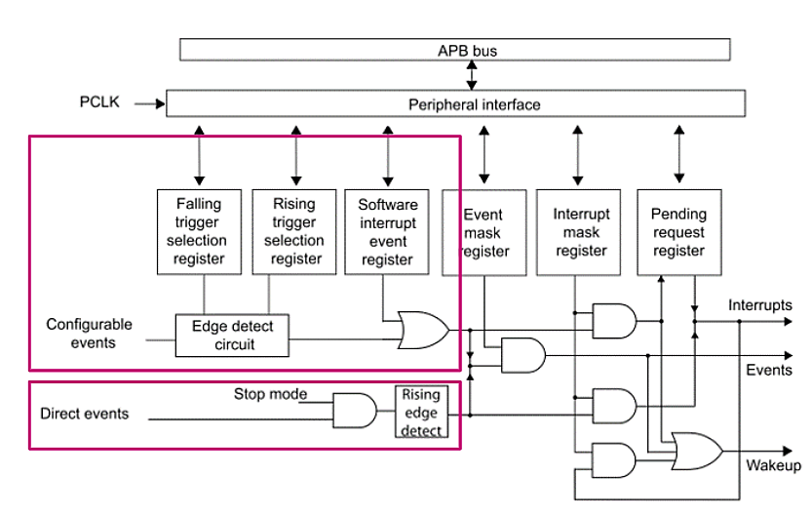
EXTI Architecture
GPIO
PVD
RTC
PVM
COMP
LCD
Communication Peripherals

Slide 27
Q&A

