Slide 1
Cortex-M4 Direct Memory Access (DMA) Lecture 3 - Part 1
EN3544 Embedded System
By: Ghalib Janjua

Slide 2
Contents
Direct Memory Access
Reference
Q&A

Slide 3
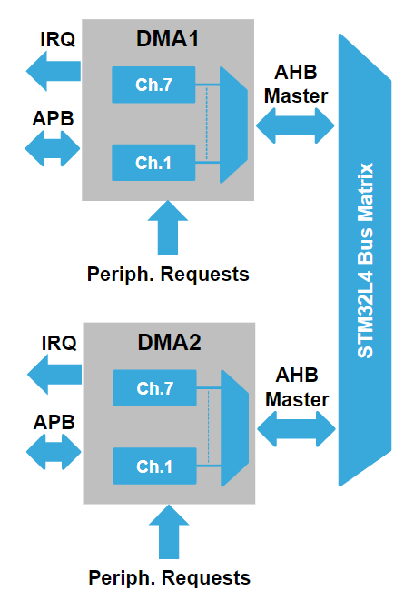
DMA
Transfer data without loading CPU
Peripherals to Peripherals
Memory to Memory
Memory to Peripheral
Peripheral to Memory
Fully configurable to manage
Hardware priorities
Software priorities

Slide 4
DMA
14 independent configurable channels
Hardware request or software trigger
Programmable priorities through software
Hardware priority higher in case of software priority equality
Flexible independent Configuration
Source and destination data sizes 8/16/32-bit
Maximum data transfer size 65535
Source and destination Address
Increment of source and destination pointer

Slide 5
DMA
Interrupt flags
Half transfer
Transfer complete
Transfer error
Global flags
Faulty channel automatically disables
Circular mode
Handle continuous data flow
Automatically reload
Data transfer size
Source and destination address

Slide 6
DMA Data Transfer
Memory to memory mode
No request
Data transfer starts as channel gets enable
Peripheral to Peripheral, Memory to peripheral & Peripheral to memory
Transfer occur at each hardware request
On completion request is acknowledged

Slide 8
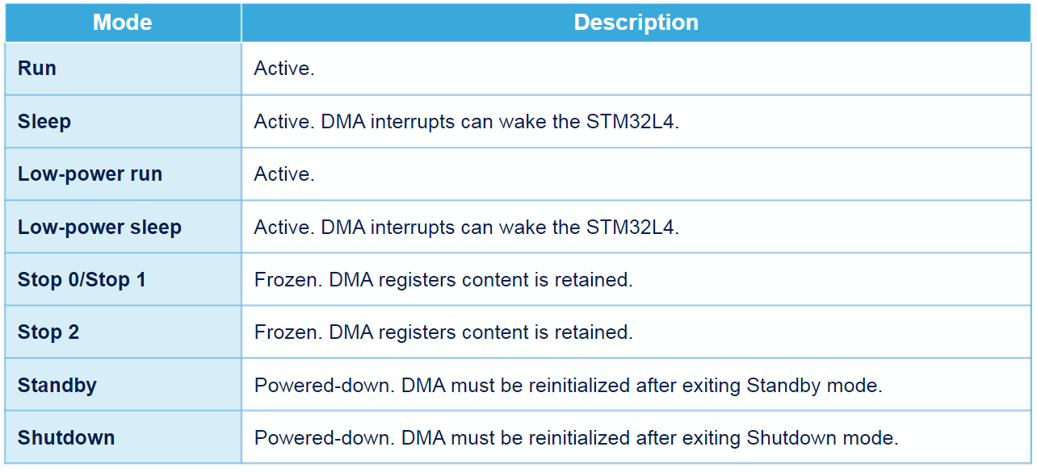
Low Power Mode Behaviour

Slide 9
Q&A

Slide 10
Cortex-M4 Power Management Lecture 3 – Part 2
EN3544 Embedded System
By: Ghalib Janjua

Slide 11
Contents
FlexPowerController
Power Supplies
Power Modes
Reference
Q&A

Slide 12
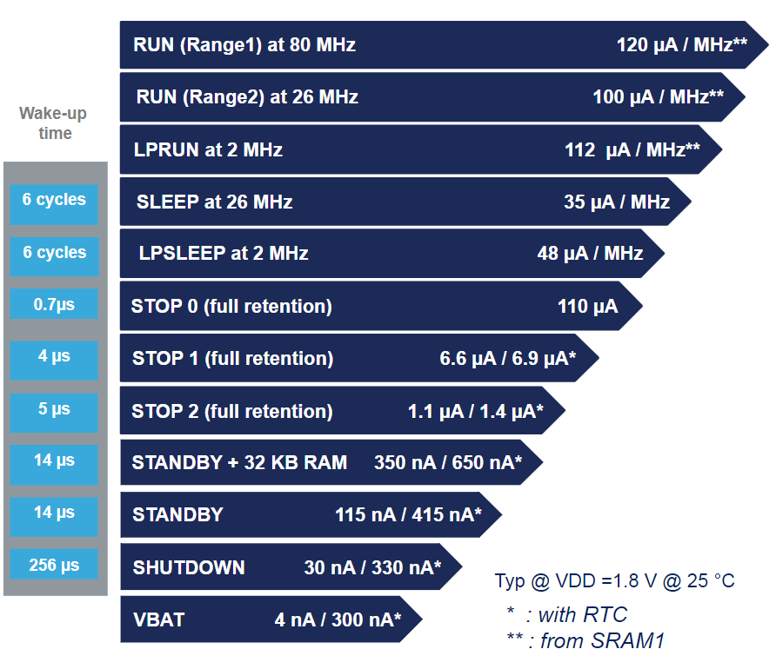
FlexPowerControl

Slide 13
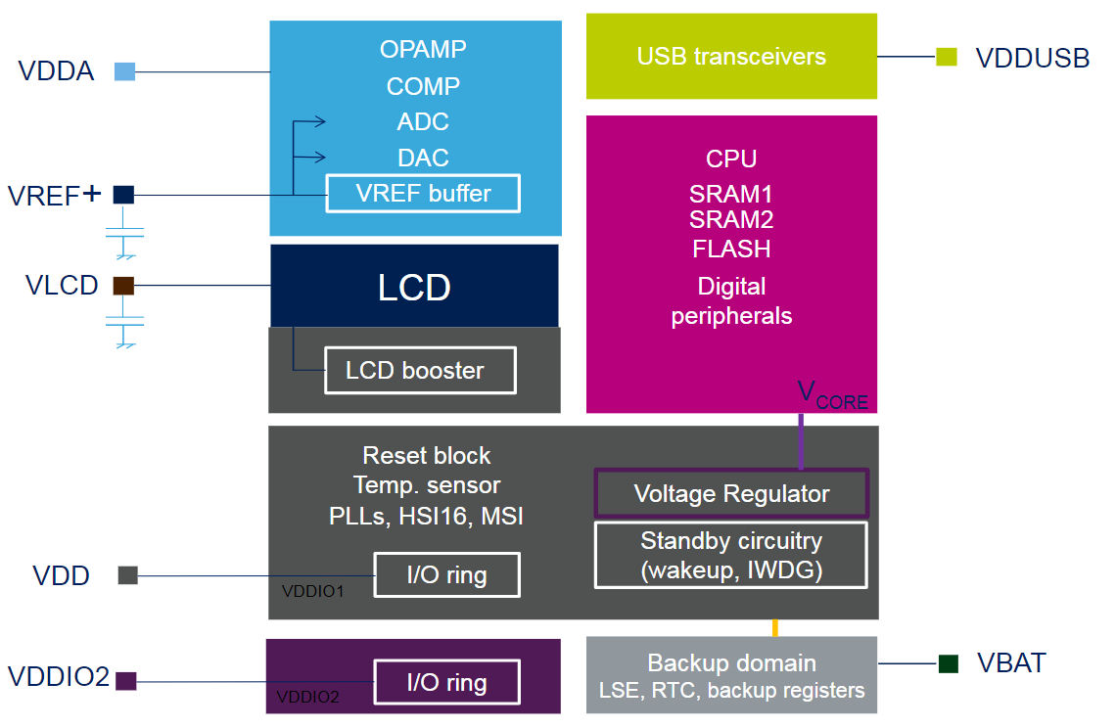
Power Supplies

Slide 14
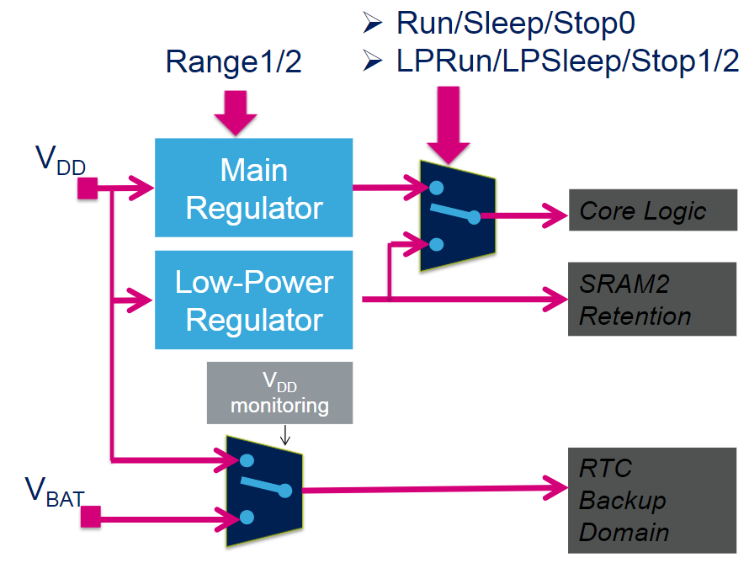
Voltage Regulator

Slide 15
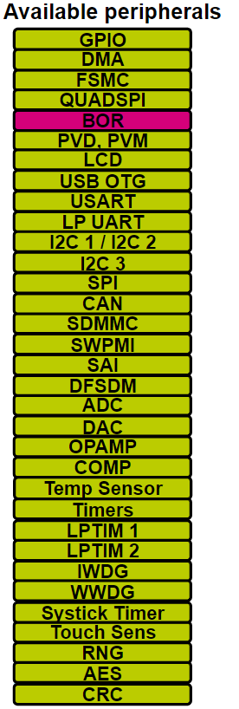
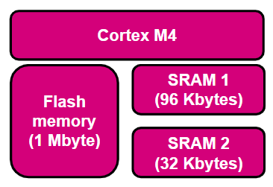
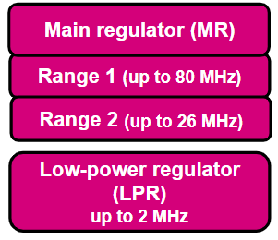
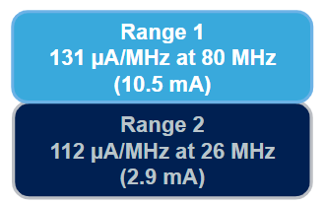
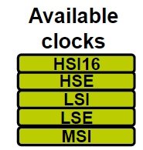
Run Mode: Range 1

Slide 16
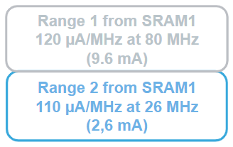
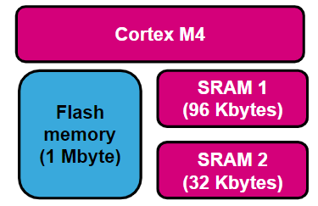
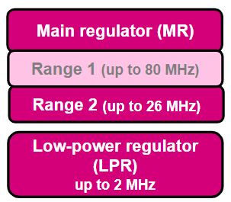
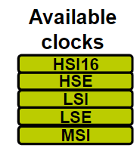
Run Mode: Range 2

Slide 17
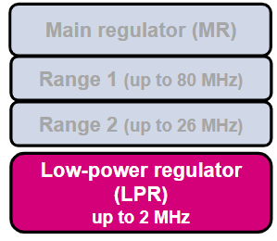
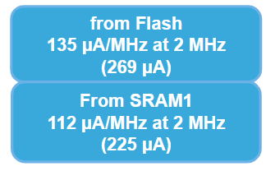
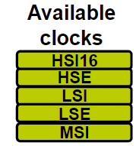
Low Power Run Mode

Slide 18
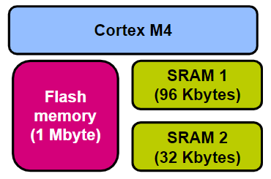
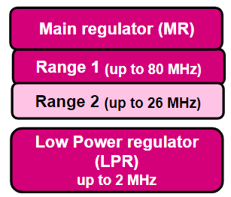
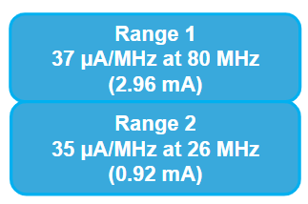
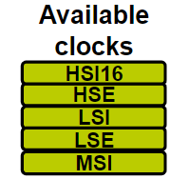
Sleep Mode: Range 1 & Range 2

Slide 19
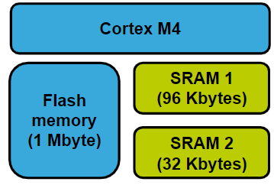
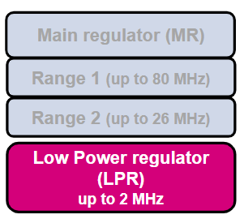
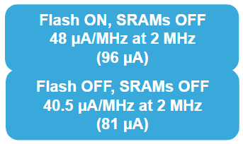
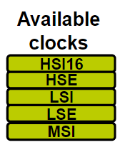
Low Power Sleep Mode

Slide 20
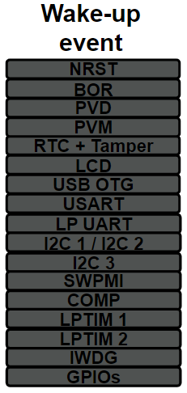
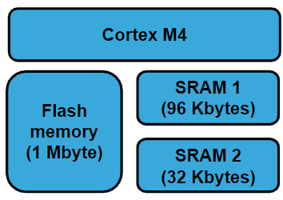
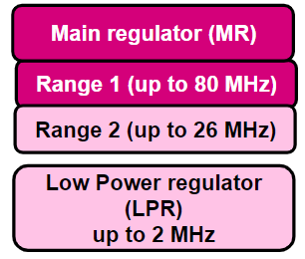
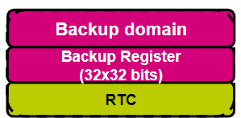
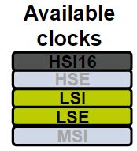
Stop 0 Mode

Slide 21
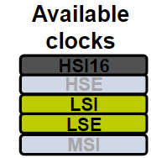
Stop 1 Mode

Slide 22
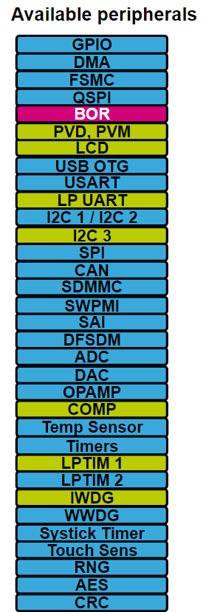
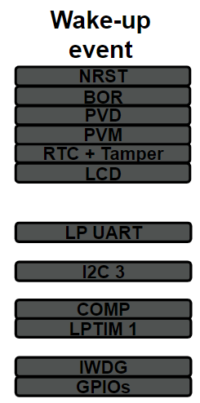
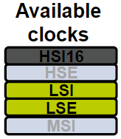
Stop 2 Mode

Slide 23
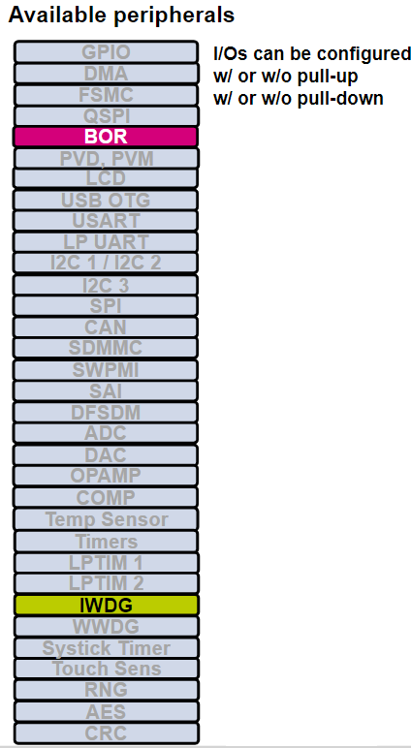
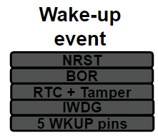
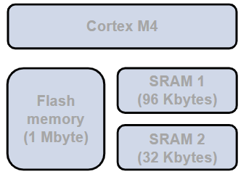
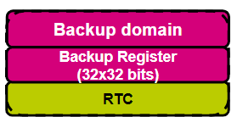
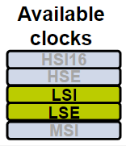
Standby Mode

Slide 24
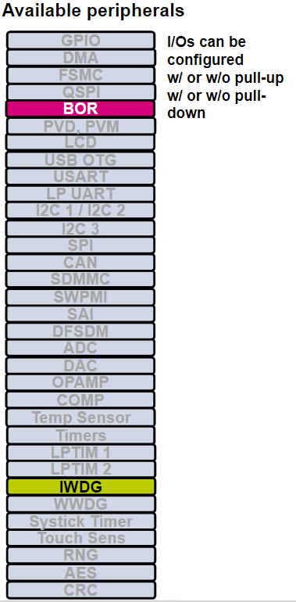
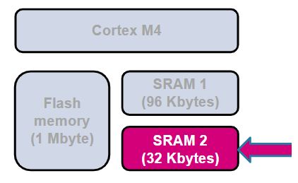
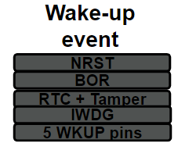
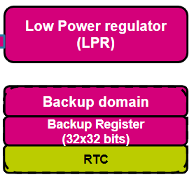
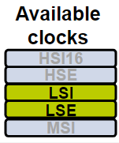
Standby Mode with SRAM2

Slide 25
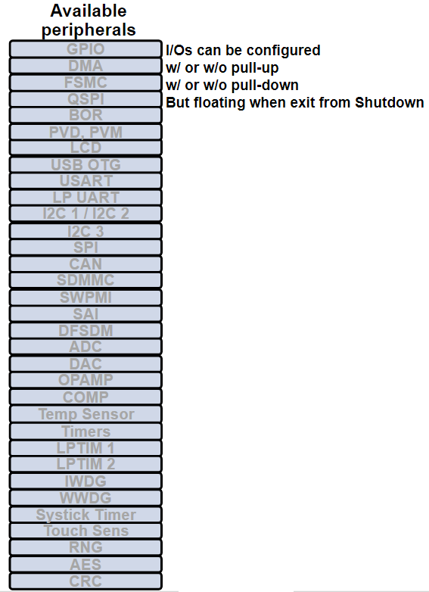
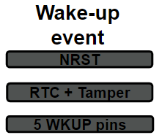
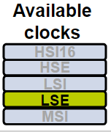
Shutdown Mode

Slide 26
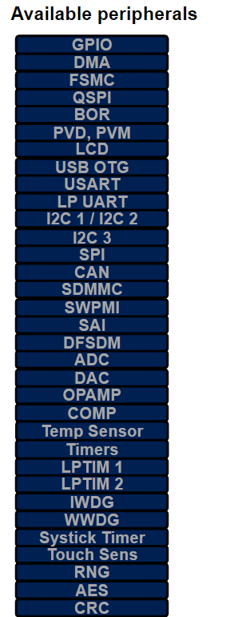
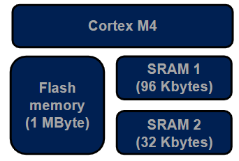
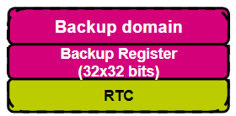
VBAT Mode

Slide 27
Power Mode Transition

Slide 28
Summary Power Modes

Slide 29
Using Low Power Run Mode
HAL_library
Register Info
HAL_PWREx_EnableLowPowerRunMode()
HAL_PWREx_DisableLowPowerRunMode()

Slide 30
Q&A

