Slide 1
Cortex-M4 Analog Peripherals Lecture 4
EN3544 Embedded System
By: Ghalib Janjua

Slide 2
Contents
Analog to Digital Converter (ADC)
Reference
Digital to Analog Converter (DAC)
Reference
Comparator (COMP) - Optional
Reference
Operational Amplifier (OPAMP) - Optional
Reference
Q&A

Slide 3
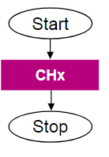
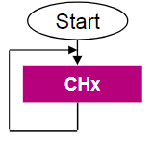
Analog to Digital Converter - ADC
Number of ADC = 3
16-24 input through GPIO (Single or differential ended)
Three WDG timer per ADC
12bit resolution, 16bit with oversampling
5.33 Msample/s (12bit) when f_{ADC_CLK}=80MHz
210uA per 1Msample/s
Mode
Single, Continuous, Scan, Discontinuous/injected
Data
DMA request generation
Interrupt request

Slide 4
ADC – Advance feature
Interleave mode can support up to 10 MSamples/s
Auto calibration to reduce offset
Deep power down mode
When not in use the internal power supply is disconnected
Auto-delayed Conversion
Make ADC to wait until last data is read before starting new conversion
Sampling time in Cycles
2.5, 6.5, 12.5, 24.5, 47.5, 92.5, 247.5, 640.5
Clock sources – HCLK or independent clock

Slide 5
ADC - Interrupts

Slide 6
ADC - Power Modes

Slide 7
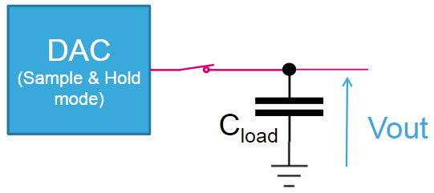
Digital to Analog Converter - DAC
2 DAC module
Can be Buffered output
Synchronised output
8bit or 12bit resolution
Right & left aligned
DMA – Interrupt event: Underrun and request
Tigger
Timer OR External I/O OR Software
Sample & Hold mode
Duty cycle
Noise generator and Triangular wave generator

Slide 8
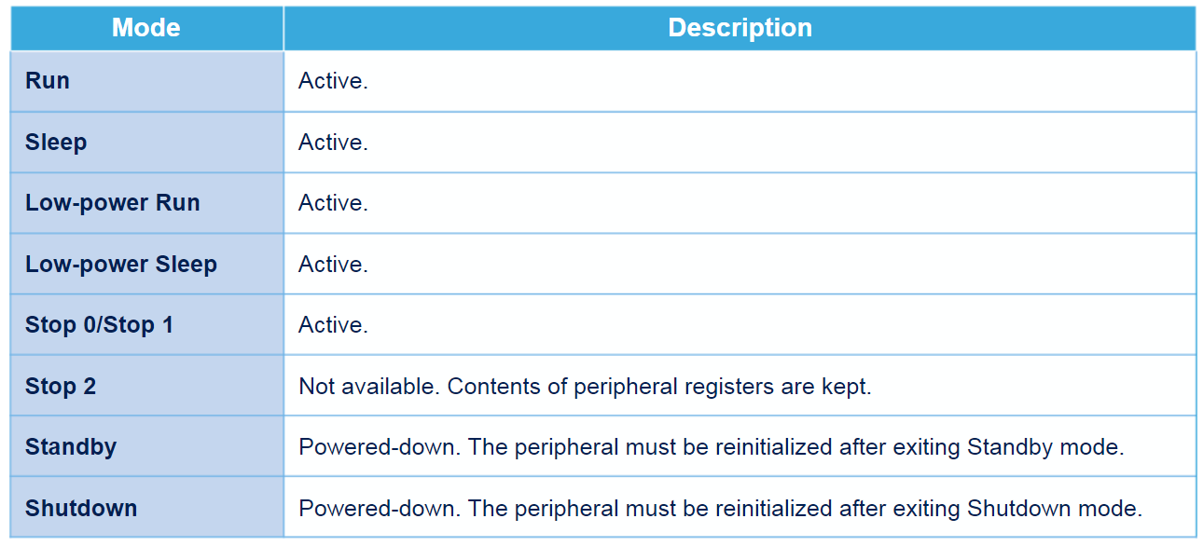
DAC

Slide 9
Comparator - COMP
Ultra low power comparator
Two comparator with binary output
Independent and Combine for window operation
Continuously monitor voltage (Speed vs Power consumption)
Can be connected to I/Os using alternate function
Can be redirected to various internal peripherals
Wakeup from sleep, stop and low power sleep
Can generate timer break signal
Can generate EXTI interrupt

Slide 10
COMP

Slide 11
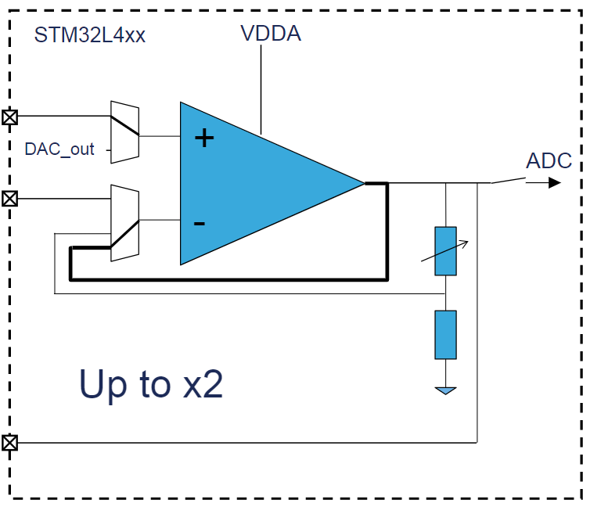
Operational Amplifier - OPAMP
Rail to rail output OPAMP with low offset voltage
Inverting
Non-inverting
Low/High pass filter
Operation mode
Normal mode (120uA)
Lower mode (45uA)
On chip mode
Standalone mode
Programable gain amplifier
Voltage follower

Slide 12
OPAMP

Slide 13
Q&A

