Slide 1
Cortex-M4 Communication Peripherals Lecture 5
EN3544 Embedded System

Slide 2
Contents
Universal Synchronous/asynchronous receive transmit (USART)
Reference
Q&A

Slide 3
USART
UART
SPI master (Serial Peripheral Interface)
Smartcard
IrDA SIR (Infrared Data Association)
LIN (Local Interconnect Network)
Modbus

Slide 4
UART
UART stands for universal asynchronous receiver / transmitter
defines a protocol, or set of rules, for exchanging serial data between two devices
Communication in UART can be
simplex (data is sent in one direction only)
half-duplex (each side speaks but only one at a time)
full-duplex (both sides can transmit simultaneously)

Slide 5
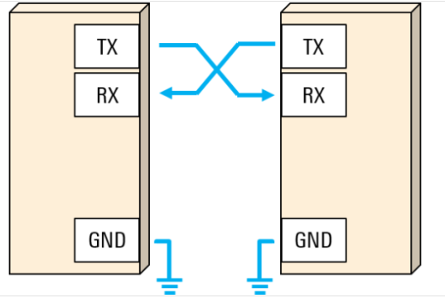
UART
Data in UART is transmitted in the form of frames.

Slide 6
Example
If we want to send the capital letter “S” in 7-bit ASCII, the bit sequence is 1 0 1 0 0 1 1. We first reverse the order of the bits to put them in least significant bit order, that is 1 1 0 0 1 0 1, before sending them out. After the last data bit is sent, the stop bit is used to end the frame and the line returns to the idle state.
7-bit ASCII ‘S’ (0x52) = 1 0 1 0 0 1 1
LSB order = 1 1 0 0 1 0 1

Slide 7
Parity bit
A UART frame can also contain an optional parity bit that can be used for error detection.
This bit is inserted between the end of the data bits and the stop bit.
The value of the parity bit depends on the type of parity being used (even or odd)
In even parity, this bit is set such that the total number of 1s in the frame will be even.
In odd parity, this bit is set such that the total number of 1s in the frame will be odd.

Slide 8
UART
7, 8 and 9 bits data size
Even, odd and no parity
0.5, 1, 1.5 and 2 stop bits
Programmable data order with MSB and LSB first
Programmable baud rate generator
Independent of PCLK
Auto baud rate detection
Hardware flow control
RS232 and RS485
Half duplex and full duplex

Slide 9
Contd..
Wakeup from stop 1
RXNE interrupt
Software event: Start bit, address match and any receive data
Receiver timeout feature
Configurable oversampling of 8 or 16 bits

Slide 10
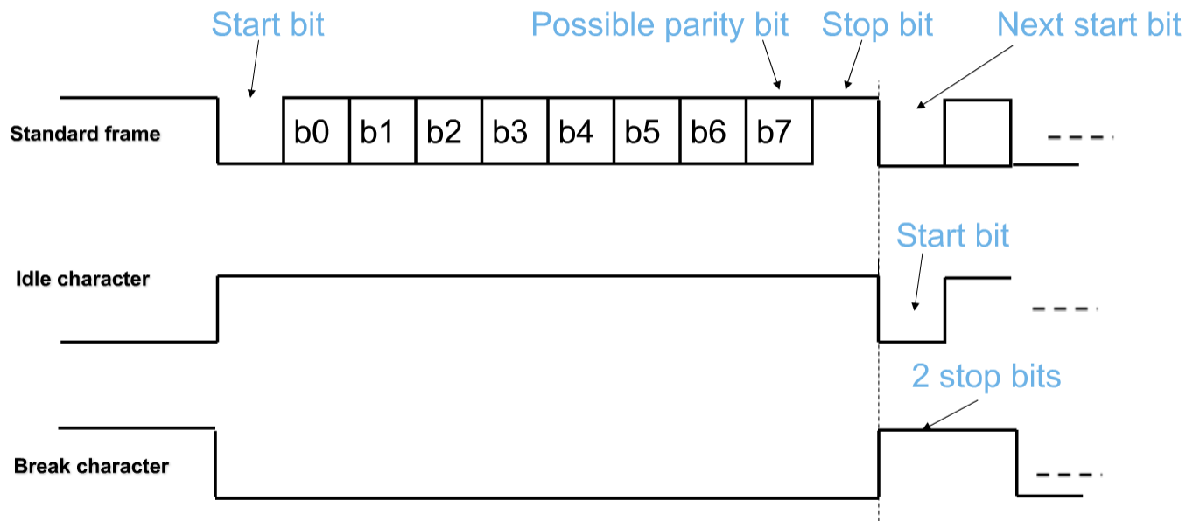
Data format

Slide 11
Interrupts

Slide 12
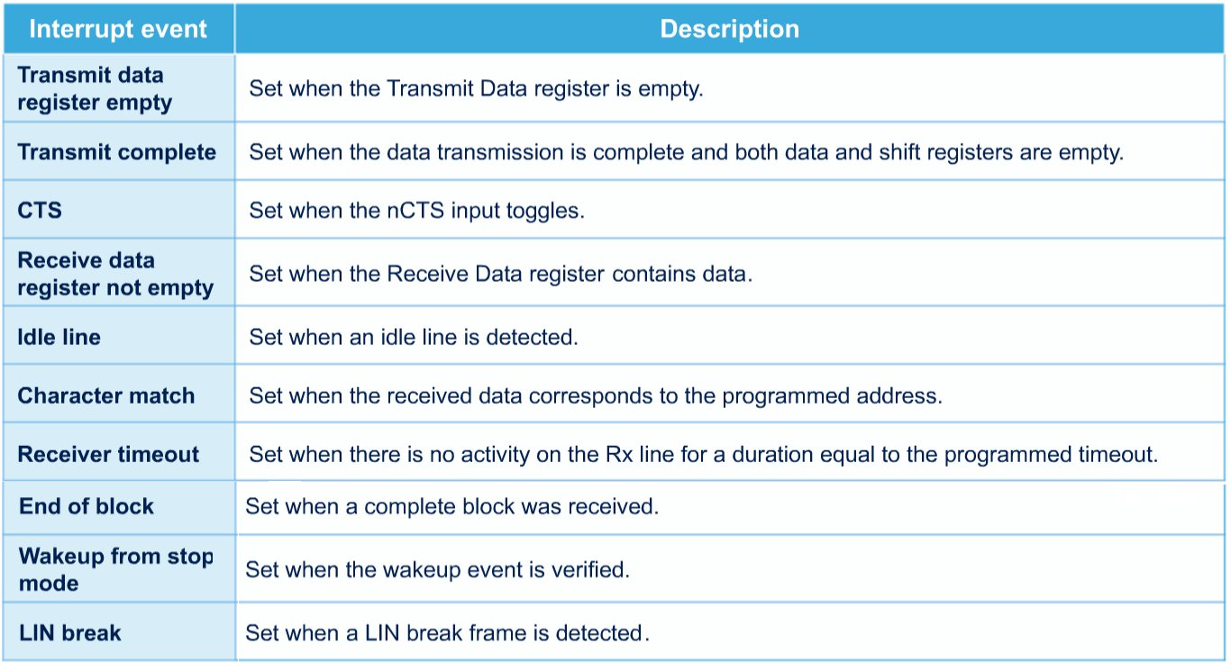

Slide 13
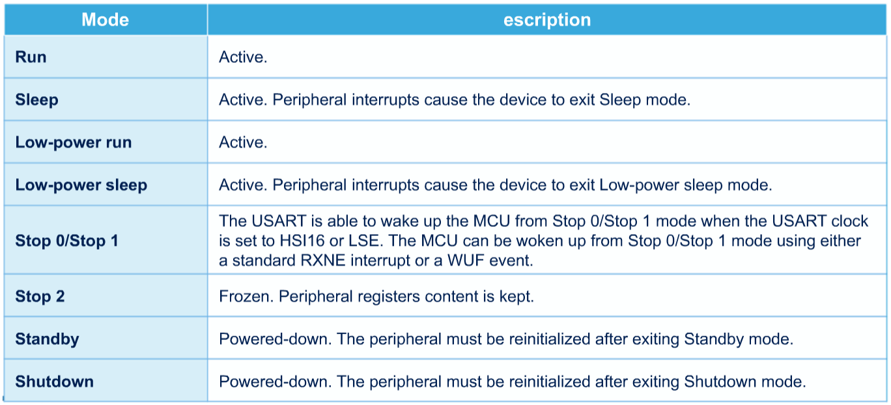
Low power modes

Slide 14
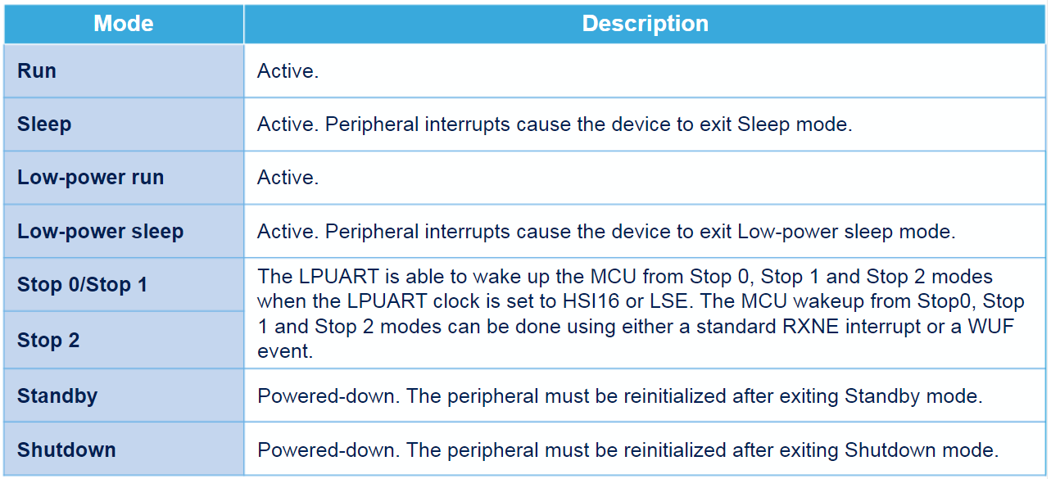
LPUART – Low power mode

Slide 15
Q&A

