Slide 1
Cortex-M4 Timers and PWM Lecture 6
EN3544 Embedded System

Slide 2
Contents
General Purpose Timers (GPTIM)
Reference
Application note
PWM
Q&A
Notes:
Handle timing related events, generate waveform and measure timing characteristic of input signal.

Slide 3
Timer
A timer (sometimes referred to as a counter) is a special piece of hardware inside many microcontrollers.
Their function is simple: they count (up or down, depending on the configuration--we'll assume up for now).
For example, an 8-bit timer will count from 0 to 255. Most timers will “roll over” once they reach their max value.

Slide 4
Common hardware functions with timers
Output compare (OC): toggle a pin when a timer reaches a certain value
Input capture (IC): measure the number of counts of a timer between events on a pin
Pulse width modulation (PWM): toggle a pin when a timer reaches a certain value and on rollover. By adjusting the on versus off time (duty cycle), you can effectively control the amount of electrical power going to another device.

Slide 5
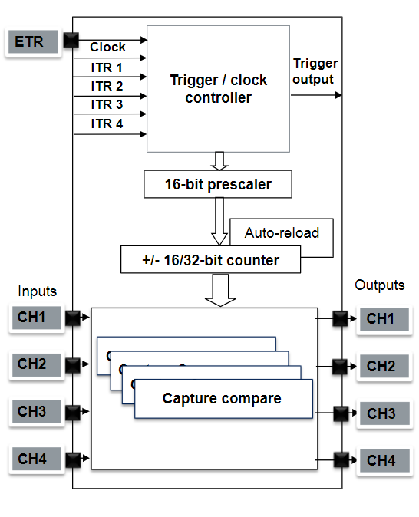
Timer feature
Time critical operation and unloading CPU
Software tasks
Time base, timeout and trigger
Hardware tasks
Waveform, measure signal timing and react to event
Interconnection of timer
Monitoring/trigger
Merging of timers
Application
Motor control and Digital power conversion

Slide 6
Contd…
Architecture
Number of inputs/outputs (1 to 9)
Resolution 16 or 32 bit
PWM, DMA, synchronization, up/down courting
Independent configuration
Capture
PWM
Default clock derived from APB domain and/or external clocks
Auto-reload and 16-bit pre-scaler
Update event
Interrupt or DMA

Slide 7
Prescaler
How fast do timers run? Well, that depends on how fast you tell them to run.
All timers require a clock of some sort.
Most will be connected to the microcontroller’s main CPU clock (others, like real time clocks, have their own clock sources).
A timer will tick (increment by one) each time it receives a clock pulse.

Slide 8
Prescalar (Example)
For a default main clock (HCLK) of 80 MHz, We could have a timer tick at 80 MHz, but that might be too fast for many of our applications.
A 16-bit timer can count to 65,535 before rolling over, which means we can measure events no longer than about 819 microseconds! (1/80M x 65535 = 819 us)
If we wish to measure longer events, we need to use a prescaler, which is a piece of hardware that divides the clock source.

Slide 9
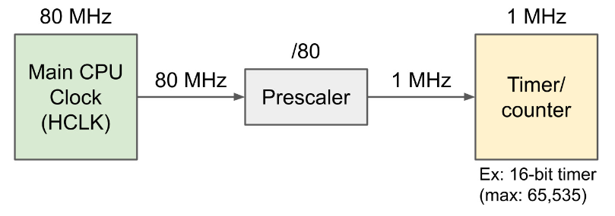
Prescalar (Example)
A prescaler of 80 would turn an 80 MHz clock into a 1 MHz clock.
Timer would tick once every 1 microsecond(1/1M = 1us)
A 16-bit timer, be able to time events up to a maximum of about 65.5 milliseconds (65535/1M = 65.5 ms )

Slide 10
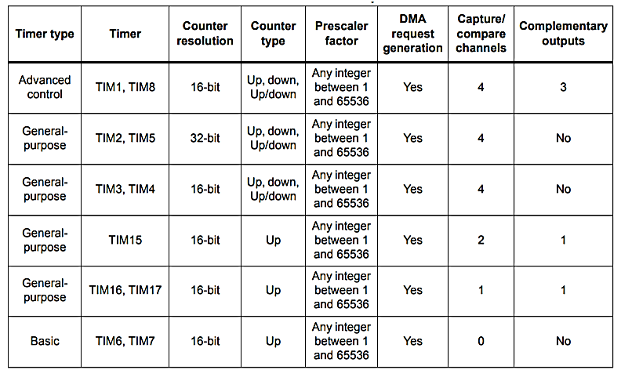

Slide 11
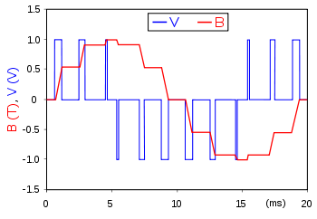
Pulse Width Modulation (PWM
PWM is a method to reduce the average power delivered by signal
PWM in an idealized inductor driven by a ■ voltage source modulated as a series of pulses, resulting in a ■ sine-like current in the inductor.

Slide 12
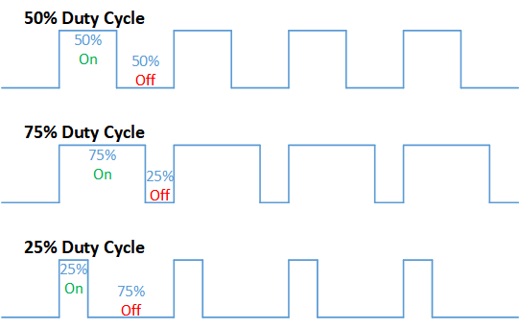
Pulse Width Modulation (PWM)
Parameters
Frequency
Duty cycle
Application
Servo motor control
Telecommunication
Voltage regulation
Figure : PWM

Slide 13
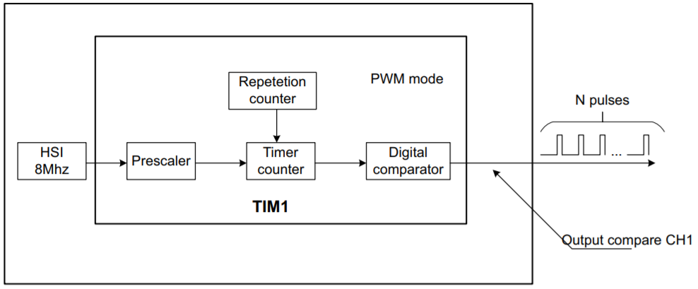
Counting period: PWM

Slide 14
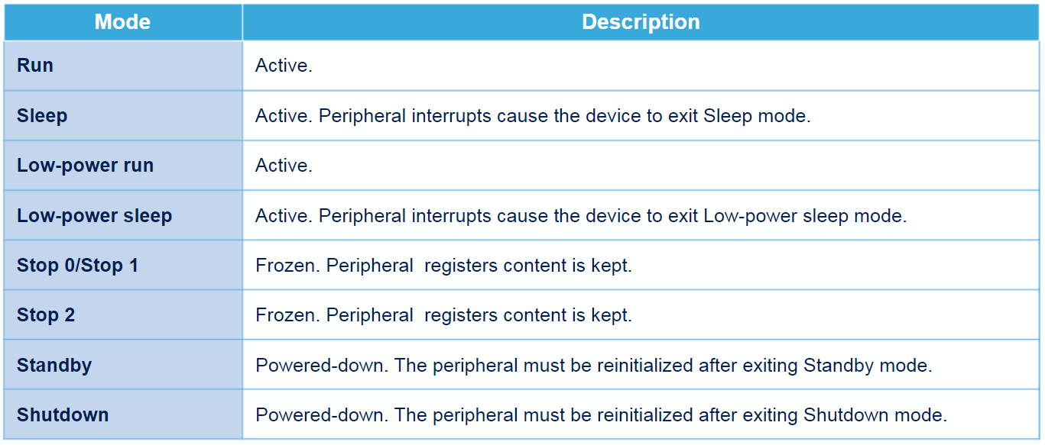
Low Power Modes

Slide 15
Q&A

