Slide 1
HDMI Input Peripheral

Slide 2
Learning Outcomes
At the end of this module, you will be able to:
Identify the function of miscellaneous HDMI signals including DDC, CEC, and HPD.
Outline the operation of an example implementation of an AXI4-Stream HDMI input peripheral.

Slide 3
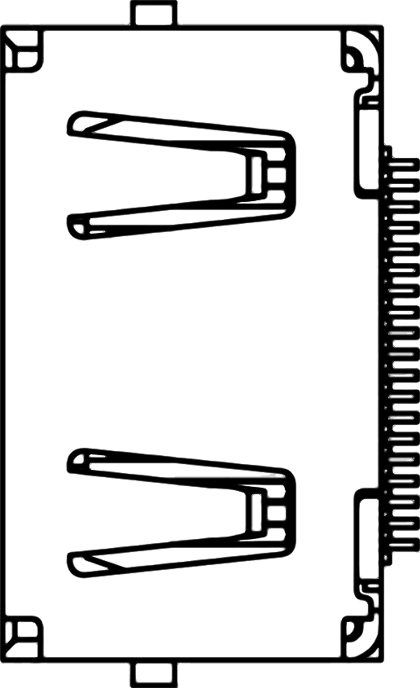
HDMI Interface
HDMI port on some development boards can be configured as either input or output, controlled by a HDMI_OUT_EN signal (for example).
TMDS Channel 0
hdmi_d_p0 / hdmi_d_n0
TMDS Channel 1
hdmi_d_p1 / hdmi_d_n1
TMDS Channel 2
hdmi_d_p2 / hdmi_d_n2
TMDS Clock
hdmi_clk_p / hdmi_clk_n
DDC
hdmi_scl / hdmi_sda
CEC
hdmi_cec
HPD
hdmi_hpd
hdmi_out_en
FPGA
Notes:
Some FPGA development boards have an HDMI port that can be configured as either input or output. Depending on whether it is configured as an input or as an output port, the direction of some signals differ between Source and Sink.
For a ZYBO Zynq development board, these signals are:
HPD (Hot Plug Detect): This signals the presence of a Sink to a Source. It is an input signal when Zynq is a Source and an output signal when it is a Sink.
5V0 (Auxiliary signal for Sink): This is an output signal when Zynq is a Source and an input signal when it is a Sink.
HDMI has three physically separate communication channels: DDC, TMDS and the optional CEC.
The CEC (Consumer Electronics Control) function is bidirectional by definition (it is used for remote control purposes).
When operating as Sink, the DDC (Display Data Chanel) function is required to be implemented so that a connected Source can read out important characteristics of the device. It is a communication channel based on the I2C bus specification.
TMDS (Transition-minimized differential signaling) interleaves video, audio and auxiliary data using three different packet types. It is used to send 10-bit characters that are encoded using 8b/10b encoding. It is supported on Zynq by the I/O buffers on the programmable logic side. 50 ohm external parallel termination resistors are provided on the ZYBO board.

Slide 4
HDMI Signals: Display Data Channel (DDC)
Used by the HDMI source device to read the E-EDID data from the HDMI sink device.
Used to learn what audio/video formats it can take.
Based on the I²C bus specification.
Usually implemented by an I²C EEPROM at address 0x50.
Implemented on FPGA in our Lab.
Notes:
HDMI specifically requires the device to implement the Enhanced Display Data Channel (E-DDC). This channel is used by the HDMI source device to read the E-DID data from the HDMI sink device to learn what audio/video formats it can take. It enables, for instance, a modern PC to identify what kinds of monitors are connected to the HDMI port.
The DDC function must comply with the I2C protocol (100kHz max clock rate). It can be implemented by emulating an I2C-capable EEPROM, for instance by using an embedded I2C peripheral or by implementing it on the FPGA programmable logic. The Source shall use I2C commands to read information from a Sink’s E-EDID with a subordinate address.

Slide 5
HDMI Signals: Consumer Electronics Control (CEC)
Designed to allow the command and control of up-to 15 CEC-enabled devices connected through HDMI by using only one of their remote controls.
One-wire bidirectional serial bus based on the CENELEC standard AV.link protocol.
Implementation is optional.
Notes:
Consumer Electronics Control (CEC) is an HDMI feature designed to allow the user to command and control up to 15 CEC-enabled devices connected through HDMI by using only one of their remote controls.
For example it allows for controlling a television set, a DVD player and a set-top box using only the remote control of the TV.
CEC is a one-wire bidirectional serial bus that is based on the AV.link protocol*. CEC implementation is optional in a product, but CEC writing is mandatory.
(*) AV.link is a protocol to carry control information between audio-visual devices connected via the SCART. It is standardized as CENELC EN 50157-1.

Slide 6
HDMI Signals: Hot Plug Detect (HPD)
Weak pulled-up to a positive voltage on sink devices.
Pulled-down to ground on source devices.
Allow sink devices to detect a plug action of sources
Notes:
As mentioned previously, the HPD signal is used to communicate the presence of a Sink to a Source. This makes the HDMI hot-pluggable. The HPD is transmitted over pin 19 of the connector.
It is pulled-up to a positive voltage on sink devices, and pulled-down to ground on source devices. However, a source may use a high voltage level HPD signal to initiate the reading of E-EDID data, and an HDMI Sink can indicate any change to the contents of the E-EDID by driving a low voltage on the pin. In either case, the HPD pin may be asserted only when the +5V power line from the Source is detected.

Slide 7
AXI4-Stream HDMI Input Peripheral
Deserializing TMDS channels to 10-bit parallel data.
10b/8b decoding to 8-bit video data and VSYNC/HSYNC.
Transmitting video data and VSYNC/HSYNC to AXI-Stream clock domain using a FIFO.
Generating TLAST and TUSER of AXI-Stream interface.
DDC implementation.
VS / HS
10bits
B
1:10
10b/8b
TLAST/ TUSER
Logic
TMDS Channels
10bits
G
1:10
10b/8b
AXI4- Stream
10bits
R
1:10
10b/8b
RGB 24bit
Deserializer
TMDS Decoder
FIFO
DDC
Notes:
This figure summarizes the processing of HDMI signals to obtain an RGB signal to be transmitted through an AXI4-Stream bus.
It consists of four input channels, three for TMDS and one for the DDC. Each input TNDS channel receives 8b/10b encoded signals that are first deserialized and then decoded to 8-bit video signals and Vsync/Hsync signals. These signals are then added to a FIFO for being transmitted over the AXI4-stream bus; Vsync/Hsync are used to produce TLAST/TUSER signals, while the three color channels are packed into 24-bit color data frames.
A DDC block is also implemented.

Slide 8
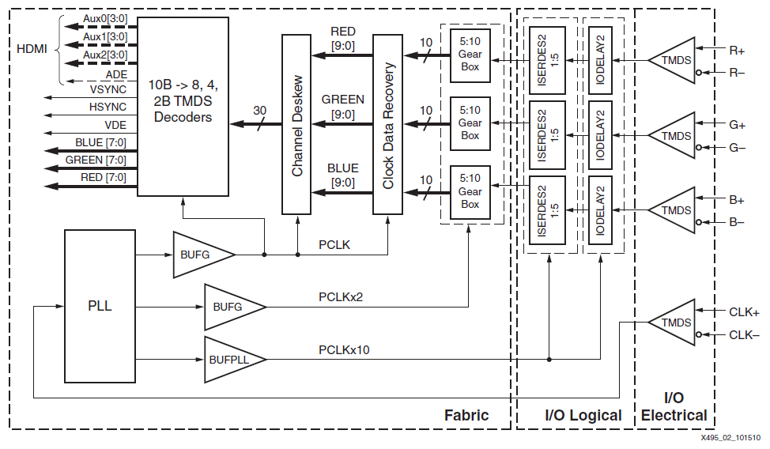
TMDS Deserialization and Decoding in Xilinx FPGA
Figure source: Xilinx XAPP495 (v1.0), 2010
Notes:
This figure shows the deserialization and decoding stage of the HDMI receiver design by Xilinx, to be implemented in Spartan-6 FPGAs.
The receiver needs to recover the bit sampling clock, by using the pixel clock coming in from the source or transmitter. Then, the bit clock is applied to recover the serial data stream before decoding it. This process is known as the Clock and Data Recovery.
The second step is performed by a channel deskew circuit which removes skews among the three data channels.
The last step is a 10-bit symbol decoding into one of three formats:
8-bit video pixel data (DVI or HDMI decoder)
4-bit auxiliary data (e.g. audio frames)
2-bit control data (e.g. HSYNC/VSYNC)
The bit sampling clock is recovered through a PLL that uses the pixel clock as a reference. This is necessary, because the clock phase must be adjusted for each data lane individually to correctly sample the incoming serial bit. To achieve this, the clock rising edge has to be aligned to the middle sampling window of each data lane.
You can find a detailed description in Xilinx XAPP495 (v1.0), 2010.

Slide 9
Utilization of FIFO
Clock domain crossing from HDMI pixel clock to AXI-Stream clock.
Buffering pixels when AXI-Stream is busy.
Pixel n+1
Pixel n
…
Pixel 3
Pixel 2
Pixel 1
HDMI
FIFO
AXI-Stream
Pixel
Clock
AXIS
Clock
AXIS
Ready
Notes:
As we did when implementing the AXI4-Stream VGA interface, we will use a FIFO to accommodate the data sampling rates in a clock domain crossing. The sender (HDMI block) operates at a lower rate than the receiver (the AXI4-Stream bus), so the FIFO will be used for buffering pixels when the AXI4-stream is busy.

Slide 10
TVALID / TUSER / TLAST Logic
TVALID is asserted when FIFO is not empty.
TUSER is asserted when the first pixel of each frame.
Set when vertical blanking.
Reset when negative clock edge after the first pixel.
TLAST is asserted at the last pixel of each line.
Use a counter to count pixels of each line.
Set TLAST at negative clock edge before the last pixel.
Notes:
Manager signals for the AXI4-stream protocol will be generated from information provided by both the FIFO status logic, and from the control data generated in the TMDS decoder.
TVALID will be asserted when the FIFO is not empty.
TUSER will be used to transmit information about the starting point of each frame. TUSER will be asserted thus with the first pixel of each frame by resetting it with the negative clock edge after the first pixel.
TLAST, which is used to indicate the boundary of each packet, will be asserted at the last pixel of each line by setting it at the negative clock edge before the last pixel.

