Slide 1
Interrupts and Low Power Features
Notes:
In this module we will cover extensively microcontroller interrupts and exceptions handling, often with a view to how these enable low power operation.

Slide 2
Syllabus
This module will cover the following
What are interrupts and why they should be used
Entering and exiting exception handlers
Microcontroller interrupts
Timing analysis
Program design with interrupts
Sharing data safely between interrupt service routines and other threads
Notes:
This module will begin with a general introduction into interrupts and their handling, then look into how interrupts are dealt with in the Arm architecture. Afterwards, general program design with interrupts will be discussed.

Slide 3
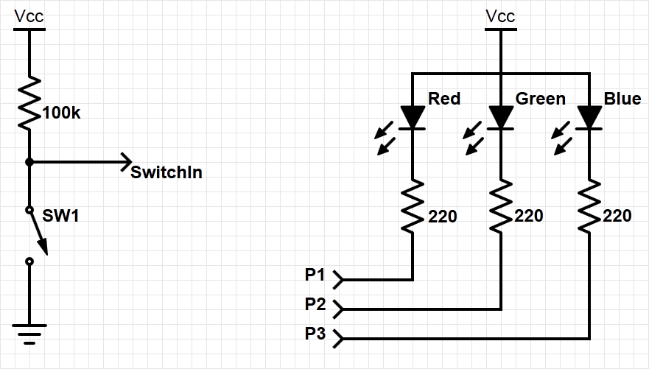
What is an interrupt?
A simple practical example
Objective: Change the color of an RGB LED attached to a microcontroller, every time a switch is pressed
Hardware requirement: Connect external switch to GPIO pin.
Logic solution: Software periodically checking if button pressed; OR notify the microcontroller of the event via hardware.
Notes:
To understand the concept of interrupt, let’s consider the following simple example: using a switch, we want to change the color of an RGB LED when the switch is pressed. To do this, we connect an external switch to a GPIO pin of the microcontroller. In order to prevent the GPIO pin from being “open,” we will use a pull up resistor (which can be internal). To implement the color changing logic we could write a code that periodically checks if the button was pressed, but this might not be very efficient. Alternatively we may prefer more efficient hardware functionality that notifies the microcontroller of button-press events. This is called an interrupt and in what follows we will discuss this concept in depth, sometimes returning to this simple example.

Slide 4
Detecting when the switch is pressed
Polling
Slow: User needs to check if the switch was pressed
Wasteful of CPU time: The faster the response needed, the more often user needs to poll
Not scalable: Difficult to build a multi-activity system that can respond quickly; system response time depends on all other processing it has to do
Interrupts
Fast: Hardware-based mechanism
Efficient: Code runs only when necessary
Scalable:
ISR response time doesn’t depend on most other processing
Code modules can be developed independently
Notes:
Polling is the method by which the microcontroller continuously checks the status of a flag. This software-based approach is slow, inefficient, and does not scale well. Specifically, the more GPIO or other events have to be polled, the more time is consumed. Hence, there is a natural limit to the number of GPIOs that can be supervised at a given processor speed.
In contrast, an interrupt-based routine only runs relevant code when it is called/initiated by the interrupt service routine (ISR). This routine directly executes the addressed code, sometimes without any CPU interaction. Therefore the solution is very scalable, because it is independent of the number of monitored events, and their supervision does not consume CPU time.

Slide 5
Interrupt (or exception) processing sequence
Main code is running in a loop; when an interrupt trigger occurs:
The microcontroller performs certain hard-wired processing.
The processor executes the ISR, including a return-from-interrupt instruction at the end.
Then the processor resumes running the main code.
Hard-wired
response activities
Interrupt routine
Main code
Time
Notes:
The term “interrupt” is self-explanatory: according to its priority, it interrupts (nearly) everything in order to trigger the execution of a specific code. While each interrupt’s configuration determines what is actually interrupted, if the interrupt is active, then the main program code will be stopped.
After stopping the main code, some hard-wired routines, such as saving data in registers, are performed, before the interrupt routine is launched.
All steps will be reversed after the interrupt routine is finished, and the regular program execution continues.

Slide 6
Interrupts in a nutshell
Hardware-triggered
Prompted by a signal from a peripheral or external device
Asynchronous: Can happen anywhere in the program (unless the interrupt is disabled)
“On-demand” software execution: Interrupt Service Routine runs in response to an interrupt
Fundamental mechanism of microcontrollers
Efficient event-based processing rather than polling
Ensures quick response to events, regardless of the program state, complexity, location
Allows many multi-threaded embedded systems to be responsive without an operating system (specifically, without a task scheduler)

Slide 7
Program requirements and design
The example of changing LED color
MAIN
RGB LED
SW
ISR
Count
(performs initialization, then updates LED based on count)
MAIN
Global Variable
ISR
When the switch, SW, is pressed, ISR increments the count variable.
Main code lights the LED according to the count value in binary (Blue: 4, Green: 2, Red: 1).
Main code toggles the debug line each time it executes.
ISR raises its debug line (and lowers the main’s debug line) whenever executed.
Notes:
Going back to our initial example, let’s examine how to program the LED color switching logic using interrupts.
The program can be divided into three key components: the main code, the ISR, and a global variable. The main code performs the initialization, lights the RGB LED according to the value of the global variable, and toggles the debug line for every loop iteration.
The ISR is triggered only when the switch is pressed and is incrementing the global variable. The ISR also sets the debug line each time it is executed.

Slide 8
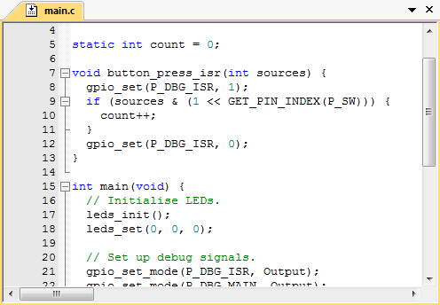
Example exception handler
How the processor responds to a (button press) event
An exception is any condition that needs to halt normal execution of the main instructions loop
This includes core resets, failures, and interrupts.
Notes:
Note the different code blocks are highlighted with the same colors that we used previously to identify the different components (i.e., global variables, main code, ISR)
The functional code of incrementing the counter (yellow: definition and initialization line) is located in the interrupt service routine (orange). This is activated by an interrupt on the pin to which the switch is connected. Here, a counter is incremented and the RGB LED is controlled according to the counter’s value.

Slide 9
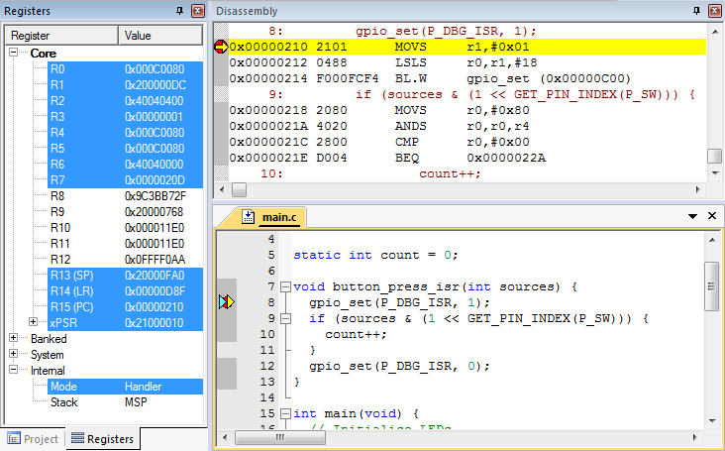
Detailed processor view
Using a debugger
Possible to inspect the registers’ contents, stack, source code, disassembled object code
Note: The compiler may generate code for function entry
Breakpoint placed on first line in the source code on the handler function
Notes:
We can use the debugger to observe the exception handling steps in detail. It is advantageous to follow the next steps within an integrated development environment (IDE) that is extended with the disassembly and register sections, so that every step of the exception handling can be observed inside the register. To see all the steps, the developer must set a breakpoint on the first line of the exception handler (here: line 8).

Slide 10
Entering exception handlers
Processor hardwired exception processing
Finish current instruction (except for lengthy instructions)
Push context (Return Address, xPSR, LR(R14), R12, R3, R2, R1, R0 registers) onto current stack (MSP or PSP)
Switch to handler/privileged mode, use MSP
Load PC with the address of interrupt handler
Load LR with EXC_RETURN code
Load Interrupt Program Status Register (IPSR) with exception number
Execute code of interrupt handler (usually 16 cycles from the exception request to execution of first instruction in handler)
Notes:
The Arm architecture is a family of advanced reduced instruction set computing (RISC)-based architecture for processors. This is globally known for the power efficiency provided and therefore widely considered close to an industry standard. As such, the Arm architecture is used in a broad range of mobile and IoT devices.
Arm Holdings, which is the company that designs Arm-based processors, does not manufacture processors. Instead it licenses its design to semiconductor partners that fabricate and sell to customers complete products that build on Arm IP, their own IP, and possibly third-party IP.
Arm also develop other types of IP and provides rich development tools and manuals.

Slide 11
Exception handling
1. Finish current instruction
Most instructions are short and finish quickly.
Some instructions may take many cycles to execute.
Load Multiple (LDM), Store Multiple (STM), Push, Pop, MULS (32 cycles for some processor core implementations)
This will delay interrupt response significantly.
If one of these is executing when the interrupt is requested, the processor:
abandons the instruction
responds to the interrupt
executes the ISR
returns from the interrupt
restarts the abandoned instruction
Notes:
Exception handling occurs when there is a pending exception with sufficient priority, and either the processor is in Thread mode, or the new exception is of higher priority than the exception currently being handled, in which case the new exception pre-empts the original exception. If the current executing instruction takes many cycles to execute, then the instruction is abandoned and is restarted after the ISR execution.
MULS = multiply instruction

Slide 12
Exception handling
2. Push Context onto Current Stack
 |  | <previous> | SP points here before interrupt
 | SP + 0x1C | xPSR
 | SP + 0x18 | PC
Decreasing | SP + 0x14 | LR
memory | SP + 0x10 | R12
address | SP + 0x0C | R3
 | SP + 0x08 | R2
 | SP + 0x04 | R1
 | SP + 0x00 | R0 | SP points here upon entering ISR
Two SPs: main (MSP), process (PSP)
Which one is active depends on the operating mode, CONTROL register bit 1.
Stack grows toward smaller addresses.

Slide 13
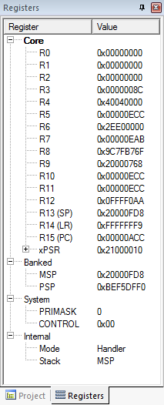
Context saved on stack
SP value is reduced since the registers have been
pushed onto the stack.
Saved R0
Saved R1
Saved R2
Saved R3
Saved R12
Saved LR
Saved PC
Saved xPSR
Notes:
The memory snapshot shows the registers saved on the stack. Each word in the stack now holds the value of each one of the registers that are pushed onto the stack (stack frame).

Slide 14
Exception handling
3. Switch to handler/privileged mode
Handler mode uses Main SP
Triggering exc. handler
Update IPSR with exc. number
Reset
Thread
Mode MSP or PSP
Exception Processing
Completed
Starting Exception Processing
Exception number 0x10 (interrupt number + 0x10)
Mode changed to Handler;
was already using MSP.
Handler Mode
MSP

Slide 15
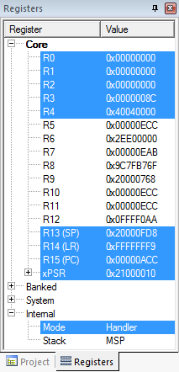
Exception handling
4. Load PC with the address of the exception handler
Memory Address | Value
0x0000_0000 | Initial Stack Pointer
0x0000_0004 | Reset
0x0000_0008 | NMI_IRQHandler
… | -
- | IRQ0_Handler
- | IRQ1_Handler
… | -
Reset: | -
 | -
… | -
NMI_IRQHandler: | -
… | -
IRQ0_Handler: | -
 | -
… | -
IRQ1_Handler: | -
 | -
 | -
PC has been loaded with the start address of the handler
Which program counter is selected from the vector table depends on which exception is used.
Notes:
When an exception is triggered, the program counter is loaded with the corresponding exception handler code, according to the exception handler type that can be found on the vector table.
In our example (right), the program counter is loaded with the address of the first instruction of the exception handler code.

Slide 16
Examining the vector table with debugger
Exception Number | IRQ Number | Vector | Offset
- | - | Initial SP | 0x00
1 | - | Reset | 0x04
2 | -14 | NMI | 0x08
3 | -13 | HardFault | 0x0C
4 | - | Reserved | 0x10
5 | - |  | -
6 | - |  | -
7 | - |  | -
8 | - |  | -
9 | - |  | -
10 | - |  | -
11 | -5 | SVCall | 0x2C
12 | - | Reserved | -
13 | - |  | -
14 | -2 | PendSV | 0x38
15 | -1 | SysTick | 0x3C
16 | 0 | IRQ0 | 0x40
17 | 1 | IRQ1 | 0x44
18 | 2 | IRQ2 | 0x48
. | - | . | -
16+n | n | IRQn | 0x40+4n
Why is the vector odd?
LSB of the address indicates that the handler uses Thumb code.
Notes:
The vector table contains the reset value of the stack pointer, and the start addresses, also called exception vectors, for all exception handlers. The least-significant bit of each vector must be 1, indicating that the exception handler is Thumb code. The Cortex-M4 processor only supports execution of instructions in Thumb state.

Slide 17
Exception handling
5. Load LR with EXC_RETURN code
Updated LR with EXC_RETURN Code
EXC_RETURN | Return Mode | Return Stack | Description
0xFFFF_FFF1 | 0 (Handler) | 0 (MSP) | Return to exception handler
0xFFFF_FFF9 | 1 (Thread) | 0 (MSP) | Return to thread with MSP
0xFFFF_FFFD | 1 (Thread) | 1 (PSP) | Return to thread with PSP
EXC_RETURN value generated by processor to inform on how to return
Which SP to restore registers from: MSP (0) or PSP (1)?
Previous value of SPSEL
Which mode to return to: Handler (0) or Thread (1)?
Another handler may have been running when this exception was raised

Slide 18
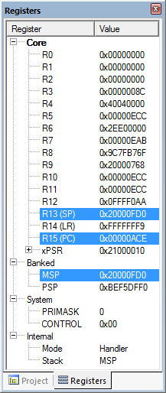
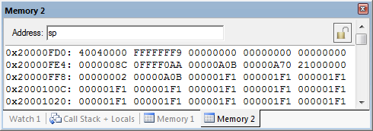
Exception handling
6. Start executing the exception handler
Exception handler starts running, unless preempted by a higher-priority exception.
Exception handler may save additional registers on stack.
e.g., if the handler may call a subroutine, LR and R4 must be saved.
Saved R4
Saved LR
Saved R0
Saved R1
Saved R2
SP value reduced
since registers have been pushed onto stack.
Saved R3
Saved R12
Saved LR
Saved PC
Saved xPSR
Notes:
Next, the exception code starts executing. If nested interrupts are allowed, this can be stopped by another, higher priority interrupt. Otherwise, nested interrupts may also be prohibited. In that case, only high priority exceptions, such as a reset or watchdog event, may interrupt this code.
Below you can see an additional code has been executed, and registers values have been pushed to the stack.

Slide 19
Exiting an exception handler
Execute instruction triggering the exception return processing
Select the return stack, restore context from that stack
Resume the execution of code at the restored address
Notes:
Exception return occurs when the processor is in Handler mode and loads the EXC_RETURN value into the PC, in order to restore the context and resume execution of the main code.

Slide 20
Exiting an exception handler
1. Execute the instruction for exception return
No “return from interrupt” instruction
Use regular instruction instead
BX LR - Branch to address in LR by loading PC with LR contents
POP …, PC - Pop address from stack into PC
… with a special value EXC_RETURN loaded into the PC to trigger exception handling processing
BX LR used if EXC_RETURN is still in LR
If EXC_RETURN has been saved on stack, then use POP.

Slide 21
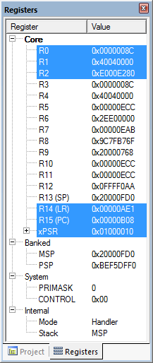
Exiting an exception handler
Content popped from stack
R4: 0x4040_0000
PC: 0xFFFF_FFF9
Saved R4
Saved LR
Saved R0
Saved R1
Saved R2
Saved R3
Saved R12
Saved LR
Saved PC
Saved xPSR

Slide 22
Exiting an exception handler
2. Select stack, restore the context
Check EXC_RETURN (bit 2) to determine from which SP to pop the context
Pop the registers from that stack
EXC_RETURN | Return Stack | Description
0xFFFF_FFF1 | 0 (MSP) | Return to the exception handler with MSP
0xFFFF_FFF9 | 0 (MSP) | Return to the thread with MSP
0xFFFF_FFFD | 1 (PSP) | Return to the thread with PSP
 |  | <previous> | SP points here after the handling
 | SP + 0x1C | xPSR
 | SP + 0x18 | PC
Decreasing | SP + 0x14 | LR
memory | SP + 0x10 | R12
address | SP + 0x0C | R3
 | SP + 0x08 | R2
 | SP + 0x04 | R1
 | SP + 0x00 | R0 | SP points here during the handling
Notes:
If the return mode is set to “handler,” the controller may execute another interrupt; otherwise it returns to the normal program execution.
Returning to the normal thread mode, the next step is to determine from which stack (MSP or PSP) the data should be restored. This decision is mainly made to prevent the main program from running out of stack space. As seen previously, the stack is defined by the second bit of the EXC_RETURN: if 0 then the information is in the MSP; if 1 then it is in the PSP.

Slide 23
Exiting an exception handler
Example
PC = 0xFFFF_FFF9, so return to thread mode with the main stack pointer
Pop exception stack frame from the stack back into the registers
Saved R0
Saved R1
Saved R2
Saved R3
Saved R12
Saved LR
Saved PC
Saved xPSR

Slide 24
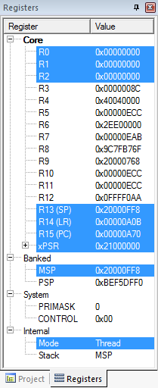
Exiting an exception handler
3. Resume executing the previous main thread code
Exception handling registers have been restored: R0, R1, R2, R3, R12, LR, PC, xPSR
SP is back to the previous value
Back in the thread mode
Next instruction to execute is at 0x0000_0A70

Slide 25
Microcontroller interrupts
Types of interrupts
Hardware interrupts
Asynchronous: Not related to what code the processor is currently executing
Examples: Interrupt is asserted, character is received on the serial port, or ADC finishes conversion
Exceptions, faults, software interrupts
Synchronous: The result of specific instructions executing
Examples: Undefined instructions, overflow occurs for a given instruction
We can enable and disable (mask) most interrupts as needed (maskable), others are non-maskable.
Interrupt service routine (ISR)
Subroutine which processor is forced to execute to respond to a specific event
After ISR completes, the MCU goes back to the previously executing code
Notes:
There are different types of interrupts: primarily “regular” and “exceptional” interrupts.
Regular interrupts are based on asynchronous external events; for example, they are created by ADC conversions, or data received at serial ports. Exceptions usually occur synchronously that means they are the result of undesirable behavior of executed instructions. Because they happen at the same time as the code, they are called “synchronous.”
Most interrupts can be masked; that is, they can be disabled. The term “masked” comes from the bit mask that is defined to filter unneeded or unwanted interrupts. Not all interrupts are however maskable; for example, the watchdog interrupt cannot be masked. In this case, they are called non-maskable interrupt (NMI).
The code that an interrupt forces to execute is called interrupt service routine (ISR).

Slide 26
Nested Vectored Interrupt Controller (NVIC)
Manages and prioritizes external interrupts
Interrupts are a type of exceptions (exception 16 through 16+N)
Modes
Thread Mode: entered on reset
Handler Mode: entered on executing an exception
Privilege level
Stack pointers
Main Stack Pointer, MSP
Process Stack Pointer, PSP
Exception states: Inactive, Pending, Active, A & P
Port Module
Arm Cortex Core
Next Module
NVIC
Another Module
Notes:
The Nested Vectored Interrupt Controller (NVIC) provides configurable low-latency interrupt handling abilities to the processor, and controls power management.
The NVIC also provides the vector table as a set of real vectors (addresses).
In addition, the NVIC saves and automatically restores a set of the CPU registers (R0-R3, R12, PC, PSR, and LR), performs quick entry to the next pending interrupt without a complete pop/push sequence, and serves a complete set of 255 (240 external) interrupts.

Slide 27
NVIC registers and state
Enable: allows interrupt to be recognized
Accessed through two registers (set bits for interrupts) – set enable with NVIC_ISER, clear enable with NVIC_ICER
CMSIS Interface: NVIC_EnableIRQ(IRQnum), NVIC_DisableIRQ(IRQnum)
Pending: interrupt has been requested but is not yet serviced
CMSIS: NVIC_SetPendingIRQ(IRQnum), NVIC_ClearPendingIRQ(IRQnum)
Notes:
The external interrupts are managed and prioritized by the NVIC. A “nested interrupt” is an interrupt routine call within another active interrupt. This second interrupt is called “nested.”
There are two possible states: the “enable state” that means that interrupts are recognized, and the “pending state” that means that an interrupt has been requested and detected but is not serviced yet.
CMSIS is the Cortex Microcontroller Software Interface Standard, a vendor independent interface for debugging that also provides commands for controlling the NVIC.

Slide 28
Core exception mask register
Similar to the “Global interrupt disable” bit in other MCUs
PRIMASK: Exception mask register (CPU core)
Bit 0: PM flag
Set to 1 to prevent activation of all exceptions with configurable priority
Clear to 0 to allow activation of all exception
Access using CPS, MSR, and MRS instructions
Use to prevent data race conditions with code needing atomicity
CMSIS-CORE API
void __enable_irq() – clears PM flag
void __disable_irq() – sets PM flag
uint32_t __get_PRIMASK() – returns value of PRIMASK
void __set_PRIMASK(uint32_t x) – sets PRIMASK to x
Notes:
Priority Mask Register: When set, the PRIMASK register prevents activation of all exceptions with configurable priority. This eliminates the problem of so-called data races. A data race occurs when two independent threads may access the same data.
The CMSIS-Core API provides dedicated commands to manipulate the PRIMASK and the PM flag.

Slide 29
Prioritization
Exceptions are prioritized, to order the responses to simultaneous requests
Smaller number == higher priority
Special cases
Priorities of some exceptions are fixed.
Reset: -3, highest priority
NMI: -2
Hard Fault: -1
Priorities of other (peripheral) exceptions are adjustable.
Value is stored in the interrupt priority register (IPR0-7).
0x00; 0x40; 0x80; 0xC0
Simultaneous exception requests?
Lowest exception type number serviced first.
New exception requested while a handler is executing?
New priority > current priority?
New exception handler preempts current exception handler.
New priority ≤ current priority?
New exception held in pending state.
Current handler continues execution.
Previous priority level restored.
New exception handled if priority level allows.
Notes:
The priority of nearly simultaneous interrupts is important. Here, a priority can be defined. The reset has the highest priority (-3) and the external exceptions are adjustable to higher priorities. The values are stored in the interrupt priority register.
When multiple exceptions are valid at the same time (i.e., more than one exception occurs during the execution of an instruction), they are handled by the core (after completing the execution of the current instruction), according to their priority.

Slide 30
Timing analysis
High-level view of behavior
Switch was pressed for about 0.21s.
ISR runs in response to the falling edge of the switch signal.
Main seems to be running continuously (signal toggles between 1 and 0).
Notes:
Next, we will explore the timing behavior of the example used in this module (the switched LED).
The timing analysis is made with the help of a logic analyzer. In our experiment, we can see that the switch is pressed for 0.21s, and the ISR is triggered in response to the falling edge of the signal switch. The DBG_MAIN signal is the debug signal that toggles on every loop iteration of the main code. Here, the interrupts do not seem to be working, since the DMG_MAIN signal is continuous.

Slide 31
Interrupt response latency
Latency == time delay
Why do we care?
This is the overhead that increases as the interrupt rate rises
This delays the response to external events that may or may not be acceptable for the application, such as sampling an analog waveform.
How long does it take?
Finish executing the current instruction or abandon it
Push various registers onto the stack, fetch vector
C_{IntResponseOvhd}: Overhead for responding to each interrupt
If we have external memory with wait states, this takes longer.
Notes:
A very important aspect of interrupts is “latency.” Latency is defined as the time delay between when interrupts are triggered and when the interrupt service routine begins to execute. In some applications, latency is critical; for example, when an analog waveform is sampled.
There are several side-effects that can affect latency that have to be taken into consideration. For example, latency is affected if the current executing instruction is finished or abandoned.

Slide 32
Maximum interrupt rate
The microcontroller can only handle so many interrupts per second.
F_{Max_Int}: Maximum interrupt frequency
F_{CPU}: CPU clock frequency
C_{ISR}: Number of cycles ISR takes to execute
C_{Overhead}: Number of cycles of overhead for saving state, vectoring, restoring state, etc.
F_{Max_Int} = F_{CPU} / (C_{ISR} + C_{Overhead})
Note that the model applies only when there is one interrupt in the system.
When processor is responding to interrupts, it does not execute other code.
U_{Int}: Utilization (fraction of processor time) consumed by interrupt processing
U_{Int} = 100% * F_{int} * (C_{ISR} + C_{Overhead}) / F_{CPU}
CPU looks like it’s running the other code with CPU clock speed of (1 - U_{Int}) * F_{CPU.}
Notes:
The maximum interrupt frequency equals the CPU clock frequency, divided by the sum of the interrupt service routine, plus the interrupt overhead cycles.
Note that the higher the interrupt frequency, the less the time there is for the CPU to execute other code.

Slide 33
Program design with interrupts
How much work to do in ISR?
Trade-off: Faster response for ISR code will delay completion of other code
In a system with multiple ISRs with short deadlines, perform critical work in ISR and buffer partial results for later processing
Should ISRs re-enable interrupts?
How to communicate between ISR and other threads?
Data buffering
Data integrity and race conditions
Volatile data: Can be updated outside of the program’s immediate control
Non-atomic shared data: Can be interrupted partway through read or write; is vulnerable to race conditions
Notes:
When designing a program with interrupts, it is necessary to take several design decisions from a timing perspective, related to the interrupt implementation.
First, we must consider the amount of work that will be assigned to an interrupt, and deal with the time to be spent in between ISR and other code. If multiple ISRs, it is better to assign them to perform only critical work, and to buffer the rest for later processing.
Another important question is whether ISRs should be in charge of re-enabling interrupts. Since having an ISR running for a long duration with all interrupts disabled is not desirable, it might be preferable for a long-running ISR to re-enable interrupts. On the other hand, if an ISR is fast and efficient, then there is no need for such action.
One way to communicate between ISR and other code is software data buffering that is generally used as a communication interface. One must always keep data integrity and race conditions in mind.

Slide 34
Volatile data
Compilers assume that variables in memory do not change spontaneously and optimize based on that assumption
Do not reload a variable from memory if the current function hasn’t changed it.
Read variable from memory into the register (faster access)
Write back to memory at the end of the procedure, or before a procedure call, or when the compiler runs out of free registers
This optimization can fail
Example: Reading from input port, polling for key press
While (SW_0); will read from SW_0 once and reuse that value
Will generate an infinite loop triggered by SW_0 being true
Variables for which it fails
Memory-mapped peripheral register: register changes on its own
Global variables modified by an ISR: ISR changes the variable
Global variables in a multithreaded application: another thread or ISR changes the variable
Notes:
To optimize code generation and improve runtime, the compiler makes some assumptions about code behavior. One key assumption is that all data behave in an atomic manner. Because changes from outside are not expected, some variables may be loaded into the registers (performance improvements) and register values written back to memory at the end of the procedure, or when there is a need.
This optimization can fail, however. For example, the application is reading from an input port, polling for key press, and the switch state is represented by the variable SW_0. If SW_0 is changed by an interrupt routine, this change will not be recognized, as this variable will not update within the while loop.
Other situations that might prompt failure are explicitly listed above.

Slide 35
The volatile directive
Compiler must be instructed which variables may change outside of its control
Use volatile keyword to force the compiler to reload this variable from memory before every use volatile unsigned int num_ints;
Pointer to a volatile int volatile int * var; // or int volatile * var;
Each time a variable is read in C language, (e.g., from status register) it will result in an assembly language LDR instruction.
Notes:
The indicator for potential external changes is the compiler keyword “volatile.”
Volatile data is data that may be changed in other parts of the software.
If a variable is declared using volatile, e.g. volatile int a, then a compiler will reload the variable before every use. However, one should be careful with the use of this declaration, because volatile may slow down the code, especially a very efficient, atomic code.

Slide 36
Non-atomic shared data
void GetDateTime(DateTimeType * DT){
DT->day = current_time.day;
DT->hour = current_time.hour;
DT->minute = current_time.minute;
DT->second = current_time.second;
}
We want to keep track of the current time and date
Use 1Hz interrupt from the timer
System:
current_time structure tracks time and days since some reference event
current_time’s fields are updated by periodic 1Hz timer ISR
void DateTimeISR(void){
current_time.second++;
if (current_time.second > 59){
current_time.second = 0;
current_time.minute++;
if (current_time.minute > 59) {
current_time.minute = 0;
current_time.hour++;
if (current_time.hour > 23) {
current_time.hour = 0;
current_time.day++;
… etc.
}
Notes:
A good example is a clock application: A routine is called at 1Hz by an interrupt, increasing the seconds counter by 1. The timer interrupt not only performs the atomic operation of increasing the counter, but also checks the correct assignment to minutes, hours, and days. Additionally, a routine defines GetDateTime, copying the data to a DateTimeType pointer.
Now, if there is poor timing between the interrupt and function call, an inconsistent situation (“data race condition”) may occur, as explained next.

Slide 37
Definitions
Race condition
Anomalous behavior due to unexpected critical dependence on the relative timing of events. Result of the example code depends on the relative timing of the read and write operations.
Critical section
A section of the code that creates a possible race condition. The code section can only be executed by one process at a time. Some synchronization mechanism is required at the entry and exit of the critical section to ensure exclusive use.

Slide 38
Data race conditions
Example: Checking the time
Problem: An interrupt at the wrong time will lead to a half-updated data in DT.
Failure Case
current_time is {10, 23, 59, 59} (10th day, 23:59:59)
Task code calls GetDateTime() that copies the current_time fields to DT: day = 10, hour = 23
A timer interrupt occurs that updates current_time to {11, 0, 0, 0}.
GetDateTime() resumes executing, copying the remaining current_time fields to DT: minute = 0, second = 0
DT now has a time stamp of {10, 23, 0, 0}.
The system thinks the time just jumped backwards one hour!
Fundamental problem: “race condition”
Preemption enables ISR to interrupt other code and possibly overwrite data
Must ensure atomic (indivisible) access to the object
Native atomic object size depends on the processor’s instruction set and word size
32 bits for Arm
Notes:
The problem arises when an interrupt is triggered during the execution of the GetDateTime function, while it is updating DT. The interrupt service routine changed the current time that as a result has to update the rest of the DT members with the new values. Consequently, the DT beginning of data is older than the end, and therefore they are inconsistent. This faulty update of the DT variable is a “race condition.”
This problem is not simple to solve. Usually, it is a good idea to turn off the interrupts at the beginning of GetDateTime(), using the PRIMASK PM-flag, and turn it on again later. However, this may lead to missing an interrupt event and a 1-second-count, and the consequence is an incorrect time.

Slide 39
Data race conditions
A closer look
Protect any data object that both
Requires multiple instructions to read or write (non-atomic access), and
Is potentially written by an ISR
How many tasks/ISRs can write to the data object?
If one, then we have one-way communication
Must ensure the data is not overwritten partway through being read
Writer and reader do not interrupt each other
If more than one, we
Must ensure the data is not overwritten partway through being read
Writer and reader do not interrupt each other.
Must ensure the data is not overwritten partway through being written
Writers do not interrupt each other.
Notes:
The data that has to be protected is that which is potentially changed by an ISR, and requires multiple instructions to read or write (non-atomic access).
There are many boundary conditions to be met. For instance, if only an ISR/task writes to a data object, then we must ensure that data is not overwritten partway through being read. Consequently, the writer and reader should not interrupt each other. Additionally, in the case of multiple ISRs that can write to data object, we have to ensure that writers do not interrupt each other as well.

Slide 40
Data race conditions
Solution: Briefly disable preemption
Prevent preemption within critical section
If an ISR can write to the shared data object, need to disable interrupts
save the current interrupt masking state in variable m
disable interrupts
Restore previous state afterwards (interrupts may have already been disabled for another reason)
Use CMSIS-CORE to save, control, and restore the interrupt masking state
Avoid disabling interrupts. Disabling delays response to all other processing requests.
Use as few instructions as possible, to make the time as short as possible.
void GetDateTime(DateTimeType * DT){
uint32_t m;
m = __get_PRIMASK();
__disable_irq();
DT->day = current_time.day;
DT->hour = current_time.hour;
DT->minute = current_time.minute;
DT->second = current_time.second;
__set_PRIMASK(m);
}
Notes:
One solution is to briefly disable preemption, in order to prevent any interruption during critical section execution. If we know that an ISR (or more) can write to the shared data object, we need then to disable interrupts. This can be achieved with the help of CMSIS-CORE by saving the current PRIMASK state into a temporary variable, disabling interrupts, executing the critical code section and, finally, restoring the PRIMASK register status.
In general, you should avoid disabling interrupts, since this may affect other processing requests. If you need to disable interrupts, try to do it for as few instructions as possible, in order to make the time of the interrupt as short as possible.

Slide 41
Coming next
Module | Contents
Introduction to the Mbed Platform | Mbed Overview Mbed OS Mbed SW/HW Development Kit CMSIS
IoT Connectivity, Part I | Introduction to Bluetooth Bluetooth Low Energy ZigBee
IoT Connectivity, Part II | WLAN and LPWAN IEEE 802.11 LoRaWAN NB-IoT
Notes:
In the following modules, we will introduce the Mbed Platform and study a range of connectivity solutions for IoT.

