Slide 1
Introduction to the Mbed Platform and CMSIS
Notes:
In this module we will study the Mbed Platform and Cortex Microcontroller Software Interface Standard (CMSIS) that enables rapid IoT development.

Slide 2
Syllabus
This module will cover the following
Mbed Overview
Mbed OS
Mbed Software Development Kit (SDK)
Mbed Hardware Development Kit (HDK)
Cortex Microcontroller Software Interface Standard (CMSIS)
Notes:
We will start with an overview of Mbed, and then look at the platform’s role in the realm of IoT. We will overview software libraries and discuss the features of Mbed OS. We will discuss the software and hardware development kit available in Mbed, and finish by investigating CMSIS.

Slide 3
Introduction to Mbed
What is Mbed?
A platform used for the easy prototyping and development of applications and systems based on Arm Cortex-M-based microcontrollers, typically used in the world of IoT
The Mbed platform provides:
Open software libraries
Open hardware designs
Open online tools for professional rapid prototyping of products based on Arm-based microcontrollers
The Mbed platform includes:
Mbed Operating System (Mbed OS) – Libraries, RTOS core, HAL, API, and more
A microcontroller Hardware Development Kit (HDK) and supported development boards
Integrated Development Environment (IDE), including an online compiler and online developer collaboration tools
Notes:
The Mbed platform provides a full set of resources necessary and useful for developers of Arm Cortex-M-based systems, particularly IoT. It is an online environment, supported by a broad community and microcontroller companies, offering:
Mbed OS (currently version 5)
Driver libraries (libs)
Hardware development kits (HDK) with sample layouts
A complete Integrated Development Environment (IDE) with compiler and collaboration tools

Slide 4
Mbed OS
Overview
Cortex-M RTOS Kernel
Open-source operating system for platforms using Arm microcontrollers (IoT)
Offers a variety of features to enable the development of IoT connected systems
Layer of abstraction interprets application code for hardware to understand
Developers can focus on programming portable applications
An Mbed OS application can be run on any Mbed-compatible platform
Development Tools
Portable Drivers
Mbed OS
Management Services
Integrated Security
IoT Connectivity
Notes:
Mbed OS is specifically designed for devices involved in the Internet of Things (IoT).
Provides a layer of abstraction that interprets the application code in way the hardware can understand.
This enables the developer to focus on programming applications that can run on a range of devices.

Slide 5
Mbed OS
Cortex-M RTOS kernel
Mbed has an RTOS core
Supports deterministic, multi-threaded, real-time software execution
RTOS primitives are available to allow drivers and applications to rely on threads, semaphores, mutexes, and other RTOS features
Cortex-M RTOS Kernel
Notes:
Mbed OS runs a real-time core (RTOS) that enables to develop applications with deterministic real-time behavior that can execute multiple tasks in parallel (multi-threading). This is made possible by abstract data types called semaphores that manage access to shared resources, and synchronization mechanisms such as locks (mutexes) that resolve concurrency problems.

Slide 6
Mbed OS
Security
Two security-focused building blocks:
Arm Mbed TLS
Secure Partition Manager (SPM)
Mbed TLS is a protocol for securing communication channels between devices and servers or gateways
The SPM is responsible for:
Isolating software within partitions
Managing the execution of software within partitions
Providing Inter-Process Communication (IPC) between partitions
Integrated Security
Notes:
Mbed provides two security-focused embedded building blocks: Mbed Transport Layer Security (TLS) and Secure Partition Manager (SPM).
Mbed TLS provides an intuitive API that makes it easy for developers to include cryptographic and SSL/TLS capabilities in their (embedded) products, facilitating this functionality with a minimal coding footprint.
The secure partition manager (SPM) is semantically similar to a hypervisor managing a virtual machine. During boot, the SPM allocates resources requested by a Secure Partition, performs architectural and system setup required by the Secure Partition, and implements a standard interface that is used for initializing a Secure Partition. During runtime, it implements standard interfaces that a Secure Partition can use to fulfill service requests, and respectively the non-secure world can use to access the services exported by a Secure Partition.

Slide 7
Mbed OS
IoT Connectivity
Mbed OS supports a number of connectivity protocols
Paired with Pelion Device Management to provide full support for a range of communication options
Such technologies include:
Bluetooth Low Energy (BLE)
Wi-Fi
Narrowband-IoT (NB-IoT)
6LoWPAN
Thread
Ethernet
IoT Connectivity
Notes:
Connectivity is the basic requirement of all Internet of Things (IoT) devices. Mbed OS implements diverse connectivity technology protocols, offering full support for multiple communication options. This includes BLE, NB-IoT, and 6LoWPAN, which we will discuss in detail in the next modules.

Slide 8
Mbed OS
Development tools
Arm Mbed Online Compiler
Circumvents need for dedicated desktop setup
Allows writing code from scratch or import existing projects
Arm Mbed CLI
Python-based command line tool, specifically for Mbed OS 5
Compiler versions supported: Arm compiler, GNU Arm Embedded, IAR Embedded workbench
Arm Mbed Studio
Desktop IDE for quick development, debug and deployment cycle
All can fetch the Mbed OS source code from GitHub/mbed.com, along with dependencies, and compile code for a target board
Development Tools
Notes:
The Arm Mbed OS ecosystem includes many tools designed to work with Mbed OS and projects that use Mbed OS throughout the development process. Specifically, projects can be created, imported, and built using Arm Mbed Studio, Arm Mbed CLI, and the Arm Mbed Online Compiler. The platform supports multiple compiling toolchains and IDEs for debugging.

Slide 9
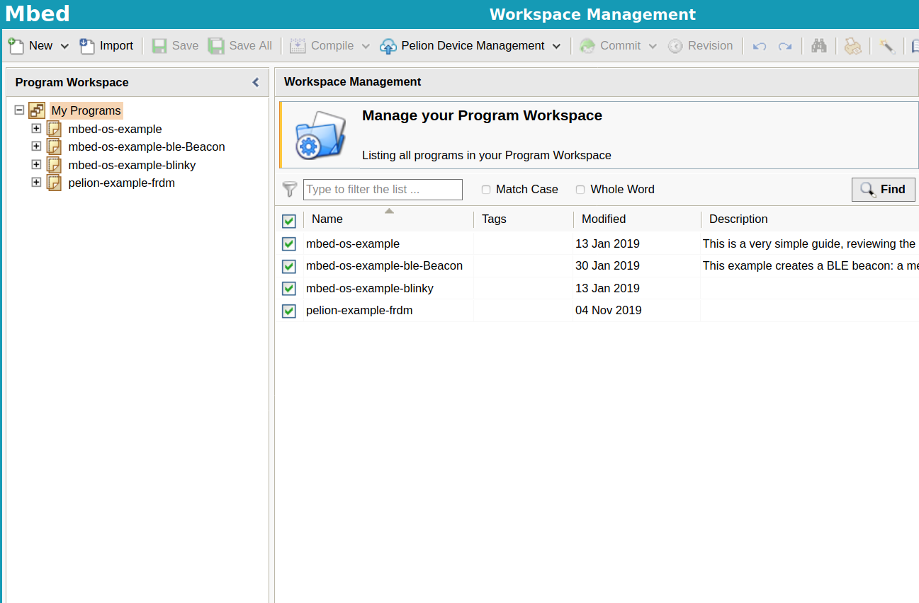
Mbed Online Compiler
Lightweight online C/C++ IDE
Enables quick program writing, compilation, and execution on a microcontroller
No prior-installation or set-up required to work with Mbed
Includes full code editor, version control, and library management

Slide 10
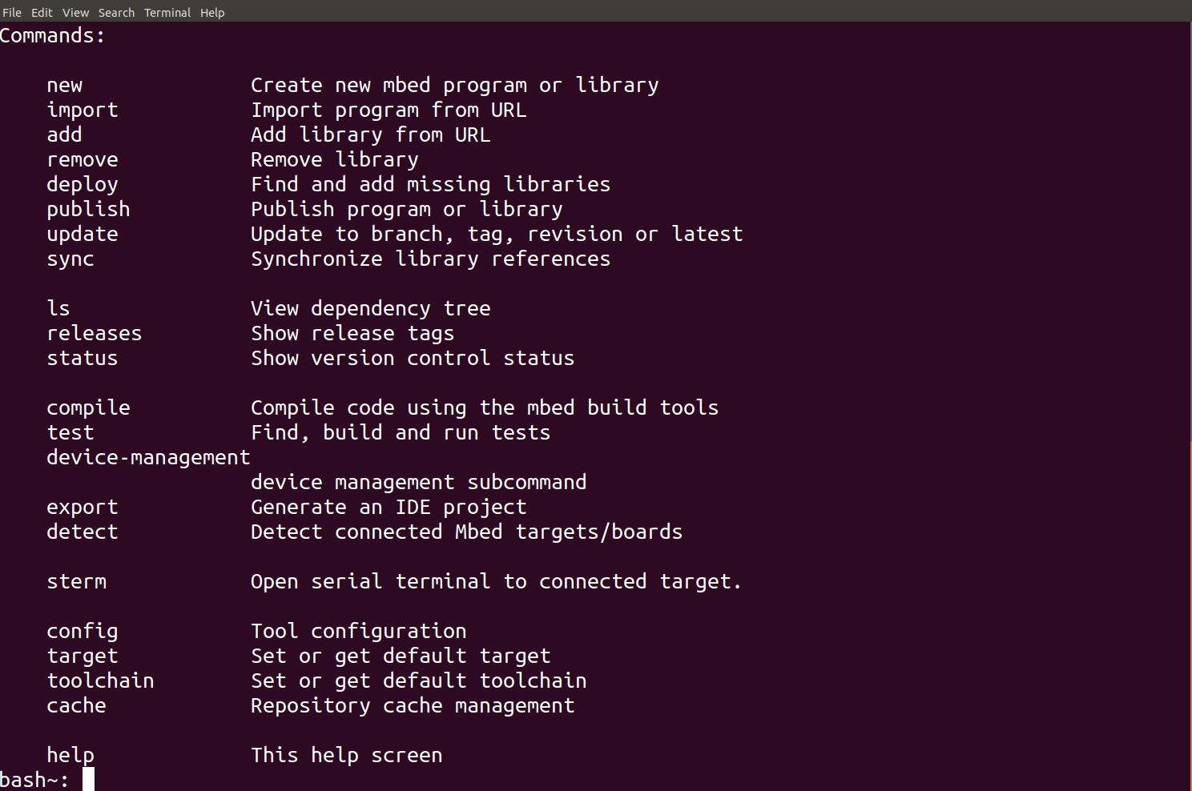
Mbed CLI
Command-line tool packaged as “mbed-cli” and based on Python
Solves dependency management and code publishing
Support for remotely hosted repositories
Git and Mercurial-based version control
Use of the Arm Mbed OS build system

Slide 11
Mbed Studio
Integrated development environment (IDE) for Mbed OS 5 applications
Includes everything required to create, compile, and debug Mbed programs
Automatically detects connected Mbed-enabled boards
Quick development for specific targets
Flashes code directly to connected platform
Provides debug session for debugging and profiling the target board

Slide 12
Mbed Software Development Kit (SDK)
C/C++ microcontroller software platform, licensed under Apache 2.0 license
Mbed SDK includes:
Official C/C++ software libraries
Start-up code, peripheral drivers, networking, RTOS, and runtime environment
Community-developed libraries and code
Cookbook of hundreds of reusable peripheral and module libraries built on top of the SDK
Software tools, such as build tools, test, and debug scripts
Enables rapid prototyping of embedded applications
Notes:
Provides hardware abstraction to be intuitive and concise, yet powerful enough to build complex projects.
Well tested start-up code, C runtime, libraries, and peripheral APIs that allows rapid project development. This is further supported by a large collection of community-developed code and libraries.

Slide 13
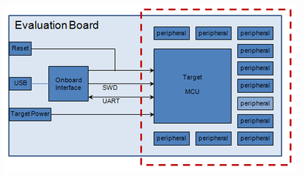
Mbed Hardware Development Kit (HDK)
Collection of designs to help develop custom hardware
Working with boards based on the Mbed HDK allows using Mbed ecosystem and associated technologies, including Mbed OS and DAPLink
The HDK offers:
Eagle schematics and board files
PDF schematics and board copies
CAM Job GERBERS for manufacture (including pick/place and drill)
Bill of Materials (BOM)
A repository of content and projects
Easy-to-use USB and debugging support
Example
Microcontroller sub-system used to build an evaluation board
Notes:
The Mbed Hardware Development Kit (HDK) consists of different hardware design resources that assist in the development of custom hardware. It further allows using Mbed OS and DAPLink in the design process. Arm Mbed DAPLink is an open-source software project that enables programming and debugging application software running on Arm Cortex CPU.

Slide 14
DAPLink
Open-source project implementing embedded firmware required for a Cortex debug probe
Human Interface Device (HID)
Provides a channel over which CMSIS-DAP protocols can run
Enables tools such as Keil MDK, IAR Workbench, and pyOCD
USB drag and drop programming
The DAPLink debug probes appear as USB disks on host computers
Binary and hex files can be copied to the USB disk that are then programmed into the memory of the target system
USB serial port
DAPLink probe also provides a USB serial port
Port will appear on a Windows PC as a COM port or in Linux as a /dev/tty interface
Notes:
The DAPLink debug probe is connected to the host computer via USB. The features provided include a Human Interface Device (HID), USB drag & drop programming, and a serial communications port.
The HID supports the CMSIS-DAP protocol that provides a standardized way to access the Cortex Debug Access Port (DAP) of an Arm Cortex microcontroller via USB. CMSIS-DAP is generally implemented as an on-board interface chip, providing direct USB connection from a development board to a debugger running on a host computer on one side, and over Joint Test Action Group (JTAG) or Serial Wire Debug (SWD) to the target device to access the Cortex DAP on the other. Multiple tools that can be used use CMSIS-DAP, including pyOCD that is an open source Python package for programming and debugging Arm Cortex-M microcontrollers.

Slide 15
Testing with Mbed
The Mbed platform offers several tools that support testing of Mbed code​
Greentea​
Automated testing tool for Arm Mbed OS development​
Pair with “UNITY” and “utest” frameworks​
https://os.mbed.com/docs/mbed-os/v5.15/tools/greentea-testing-applications.html​
Icetea​
Automated testing tool for Arm Mbed OS development​
Typically used for local development and automation in a continuous integration environment​
https://os.mbed.com/docs/mbed-os/v5.15/tools/icetea-testing-applications.html​
Notes:
A number of tools are available in the Mbed platform for the purpose of code testing. The process of flashing firmware to boards, running the tests, and generating reports is automated by the test system.

Slide 16
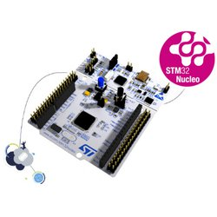
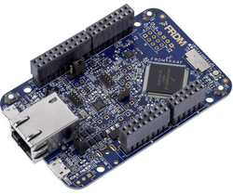
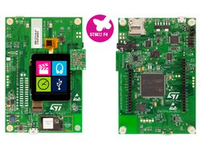
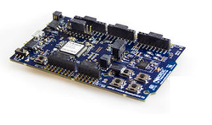
Mbed enabled platforms
The Arm® Mbed Enabled™ program outlines a set of functionality and requirements that must be met in order to become “Mbed Enabled.” This can cover development boards, modules, components, and interfaces
This benefits developers, as they are assured that the platforms they choose to work with can perform certain functions/provide certain performance.
It is also beneficial to vendors, as it gives their products more exposure when certified that can increase their popularity with developers in the Mbed ecosystem.
Some example boards include:
NUCLEO-F401RE
NXP FRDM-K64F
DISCO-F413ZH
Nordic nRF52-DK

Slide 17
High-level vs. low-level programming
High-level
Advantages:
Higher productivity (less development time)
Portability across devices
Code is easier to read and maintain
Allows code reuse
Rapid prototyping of applications
Disadvantages:
Less optimized code
Additional translation time from source to machine code
Another level of abstraction to deal with
Low-level
Advantages:
More optimized code and higher memory efficiency
Less translation time from source to machine code
Direct interaction with hardware
Disadvantages:
Less portability from one device to another
Code is more difficult to read, reuse, and maintain
Low productivity
Notes:
High-level programming brings some level of abstraction that hides some of the details of the target platform from the developer. This often includes automatic memory management that allows the developer to focus strictly on implementing the desired functionality.
Low-level programming typically involves coding with a limited instruction set that maps closely to the processor instructions. A compiler may not be not required to convert the code into machine language.

Slide 18
High-level vs. low-level programming
Low-level example: Blinking LED by manipulating MCU registers
A GPIO peripheral can be directly accessed by writing/reading specific memory addresses:
Assign a pointer to the address of each register
Registers can be read/written using the pointer
Notes:
This code is the closest approach to assembly level: everything is coded with addresses and pointers.
(the first line, including the mbed.h, should be disregarded, as it is only used for readability)
The code encapsulates the necessary port initialization, so it can focus on the LED-blinking function as the main routine.
On line 7, pin 18 is coded in a variable, by left-shifting a 1 eighteen times. Hence, bit 18 of mask_pin18 is set.
Lines 9 and 10 define the addresses to which ports (in this case, port 1) can be set and reset.
On lines 13 and 16, pin 18 at port 1 is toggled by setting and resetting it, respectively.
The code is short and efficient but is nearly unreadable if the purpose of the addresses in lines 9 and 10 is unknown, and if the names of the variables were not suggestive.

Slide 19
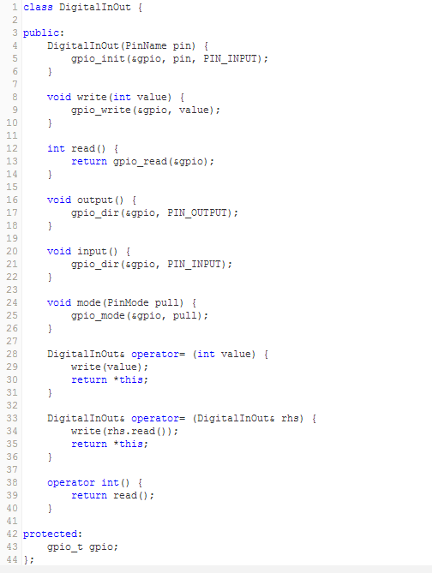
High-level vs. low-level programming
High-level example: Blinking LED using Mbed API
Mbed provides a user-friendly object-oriented API (C++ based)
More friendly functions
Defines basic operators to provide intuitive casting to primitive types and assignments
A digital I/O class is defined, as shown in the code snippet on the right that we can use to implement the LED blinking example.
Notes:
The easiest way to program an Arm-based Cortex-M controller is using the Mbed API.
The code snippet above shows the full C++ based abstraction, including operator functions that will be used to achieve the same LED blinking functionality.

Slide 20
High-level vs. low-level programming
High-level example: Blinking LED using Mbed API
With the support of the Mbed API, the same example can be programmed in a much simpler and more intuitive way:
Deep knowledge of C++ is not necessary to use the Mbed API. However, there are many C++ tutorials and books that can prove helpful.
... using Mbed API
code...
Notes:
In this example, the code is written using the Mbed API. The declaration of led1 already constructs and assigns it to LED1 as part of the evaluation board, with the correct ports and addresses. The assignment of 1 and 0, on lines 7 and 10 respectively, lets the code toggle the LED on and off, by writing these values to the port (= address).
Here, the use of addresses is completely invisible.

Slide 21
Cortex Microcontroller Software Interface Standard (CMSIS)
Vendor-independent hardware abstraction layer for the Cortex-M processor series
Provides a standardized software interface (library functions) that helps control the processor more easily, e.g., configuring the Nested Vectored Interrupt Controller (NVIC)
Improves software portability across different Cortex-M processors and Cortex-M based microcontrollers
Low-level programming
Higher-level CMSIS programming
Configure Cortex-M by directly accessing
registers in internal memory space, e.g.,
*(unsigned int*) NVIC_INT_ENABLE = 0x01;
Configure Cortex-M processors
by using CMSIS libraries, e.g.,
NVIC_EnableIRQ(Timer_IRQn);
API
Arm CMSIS-Core
Arm Cortex-M
Processor
Cortex-M0
Cortex-M
Cortex-M3
Cortex-M4

Slide 22
What is standardized by CMSIS?
Functions to access, e.g., NVIC, System Control Block (SCB), and System Tick timer
Enables an interrupt or exception: NVIC_EnableIRQ (IRQn_Type IRQn)
Sets pending status of interrupt: void NVIC_SetPendingIRQ (IRQn_Type IRQn)
Access to special registers, e.g.,
Read PRIMASK register: uint32_t __get_PRIMASK (void)
Set CONTROL register: void __set_CONTROL (uint32_t value)
Functions to access special instructions, e.g.,
REV: uint32_t __REV(uint32_t int value)
NOP: void __NOP(void)
Names of system initialization functions, e.g.,
System initialization: void SystemInit (void)

Slide 23
Benefits of CMSIS
Easier to port application code from one Cortex-M based microcontroller to another Cortex-M based microcontroller
Easier to reuse the same code between different Cortex-M based microcontrollers
Better compatibility when integrating third-party software components, since all third-party components, such as applications, embedded OS, middleware, etc., can share the same standard CMSIS interface
Better code density and smaller memory footprint, since the code in CMSIS has been optimized and tested

Slide 24
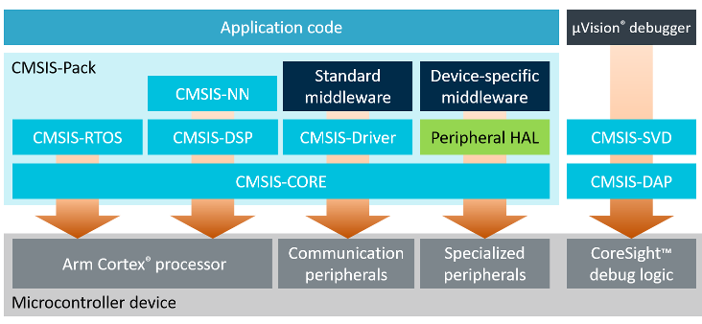
CMSIS components
The CMSIS consists of the following components:
CMSIS-CORE – implements basic run-time system for a Cortex-M device
CMSIS-RTOS – API that enables consistent software layers with middleware and library components
CMSIS-DSP library – rich collection of DSP optimized for various Cortex-M processor cores
CMSIS-SVD files – enable detailed views of device peripherals with current register state
CMSIS-DAP – standardized interface to the CoreSight Debug Access Port (DAP)
CMSIS-NN – collection of neural network kernels
Notes:
The CORE component offers a standardized API for the Cortex-M processor core and peripherals. Includes intrinsic functions for Cortex-M4/M7/M33/M35P SIMD instructions.
RTOS provides a common API for real-time operating systems along with a reference implementation based on the RTX real-time operating system. It enables software components that can work across multiple RTOS systems.
The DSP library collection has over 60 functions for various data types: fixed-point (fractional q7, q15, q31) and single precision floating-point (32-bit)
CMSIS-NN is a collection of efficient neural network kernels developed to maximize the performance and minimize the memory footprint on Cortex-M processor cores.
DAP is a firmware for a debug unit that interfaces to the CoreSight Debug Access Port. Arm CoreSight technology is a set of tools that can be used to debug and trace software that runs on Arm-based SoCs.

Slide 25
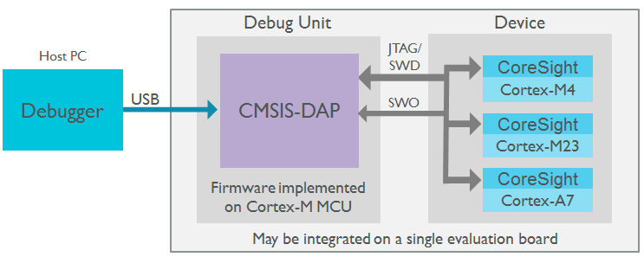
CMSIS-DAP
Interface firmware for the debug unit that connects the debug port to USB
Debugger can connect via USB to debug unit & device
Debug unit connected to target via JTAG/SW
CoreSight Debug and Trace Unit on CPU
Multi-core debugging
Notes:
Debuggers on host PC can connect via USB to the debug unit and to the device running the application software. The debug unit is connected to the target device via 5-pin JTAG or 2-pin Serial Wire Debug (SWD). The debug unit may be integrated on an evaluation board. Arm-Cortex processors then provide the CoreSight Debug and Trace Unit. DAP also supports multi-core debugging.

Slide 26
Coming next
Module | Contents
IoT Connectivity, Part I | Introduction to Bluetooth Bluetooth Low Energy ZigBee
IoT Connectivity, Part II | WLAN and LPWAN IEEE 802.11 LoRaWAN NB-IoT
The Cloud | Virtual Machines and Containers Protocols Big Data Processing The Arm Pelion Platform
Notes:
In the following modules, we will study a range of connectivity solutions for IoT and discuss cloud computing features that enable IoT.

