Slide 1
RTOS and RTX

Slide 2
Content of this Module
We cover the following topics in this module
Why RTOS
Compare with Super loop
RTX
CMSIS
Notes:
inputs and environment conditions.

Slide 3
Real-Time Operating Systems
Real-time operating systems (RTOS) are designed to meet harsh timing constraints
Hard real-time – critical tasks which have to be completed on time
Soft real-time – may continue finishing the task even missing the deadline
Industrial applications: robots, aircraft control …
Key design requirements:
Predictability and determinism
Speed – fast enough while keeping high predictability and determinism
Responsive to user control
Fail-safety
Advanced scheduling and memory allocation
Notes:
Real-time operating systems make sure that the tasks meet the timing requirements, i.e. finish execution before the dead line. The task can be hard real time – where the tasks need to finish before the deadline always. Example is an engine fuel to air ratio control is a hard real time task. The task can be a soft real time where the task may miss the deadline once in a while. Example is an automotive speed display on the dashboard. Examples can be found in robots, aircraft control etc. The real time system design requirements are determinism, speed to meet the deadlines, accuracy, fail safe operation, respond to various inputs and environment conditions.

Slide 4
Why RTOS on embedded systems?
Although it is possible to implement everything in a huge sequential loop…
Uses lengthy interrupt service routine (ISR)
Needs to keep synchronization between ISRs
Poor predictability (nested ISRs) and extensibility
Change of the ISR or the Super-Loop ripple through the entire system
RTOS: all computation requests are encapsulated into tasks and scheduled on demand
Better program flow and event response
Multitasking
Concise ISRs thus deterministic
Better communication
Better resource management
Easier to develop applications
Notes:
One can assign one interrupt for each task and whenever there is an interrupt, execute the task with the interrupt service routine (ISR). The interrupt can be generated at periodic intervals or due to an external or internal condition.
If the system has too many interrupts, then predictably, problems can occur due to nested interrupt etc. may appear.
RTOS eliminates the above problem and provides a better program flow, better event response, provides good multitasking, predictable task scheduling, meet the dead lines of all the tasks and many more advantages.

Slide 5
A case in point
GPS based Speed Camera Alarm and Moving Map
Sounds alarm when approaching a speed camera
Display’s vehicle position on LCD
Also logs driver’s position information
Hardware: GPS, user switches, speaker, LCD, flash memory
Tasks:
Dec: Decode GPS sentence to find current vehicle position.
Check: Check to see if approaching any speed camera locations. Takes longer as the number of cameras increases.
Rec: Record position to flash memory. Takes a long time if erasing a block.
Sw: Read user input switches.
LCD: Update LCD with map.
How to implement in a super loop?
Run tasks in the same order every time?
Allow preemption?
Dec
Check
Rec
Sw
LCD
Time
Notes:
Example: An example real-time system is a speed camera alarm system which uses GPS information of the current location of the vehicle which is moving at a high speed and a map with camera locations around the current location of the vehicle.
The tasks for achieving this are:
Decode the GPS information to find the current location of the vehicle
Check the locations of the camera around the current vehicle location
Record: Log driver’s position in the flash
Read user’s input settings or switches
Sound an alarm if the vehicle is approaching a speed camera
All the above tasks can be in a super-loop in the same order or with interrupt service routine.

Slide 6
Super-loop
Dec
Check
Rec
Sw
LCD
Dec
Simple but…
Always run the same schedule, regardless of changing conditions and relative importance of tasks.
All tasks run at the same rate. Changing rates requires adding extra calls to the function.
Maximum delay is the sum of all task run times. Polling/execution rate is equal to 1/maximum delay.
What if we receive GPS position right after Rec starts running?
Delays
Have to wait for Rec, Sw, LCD before we start decoding position with Dec.
Have to wait for Rec, Sw, LCD, Dec, Check before we know if we are approaching a speed camera!
while (1){
Dec();
Check();
Rec();
Sw();
LCD();
}
Notes:
A super-loop may execute each task in the same order and it can not respond to changing conditions in the input, recording time etc.

Slide 7
RTX
Royalty-free, deterministic, open source RTOS
High-Speed real-time operation with low interrupt latency
Flexible Scheduling: round-robin, pre-emptive, and collaborative
Small footprint for resource constrained systems
Compatible with Arm cores (from Arm7, Arm9 to Cortex-M processors) and software tools (Keil MDK-Arm)
Support for multithreading and thread-safe operation
Kernel aware debug support in Keil MDK-Arm
Dialog-based setup using µVision Configuration Wizard
Notes:
RTX is a real time operating system from Keil company. The Keil RTX is a royalty-free, deterministic real-time operating system designed for Arm and Cortex-M devices. It allows you to create programs that simultaneously perform multiple functions and helps to create applications which are better structured and more easily maintained.

Slide 8
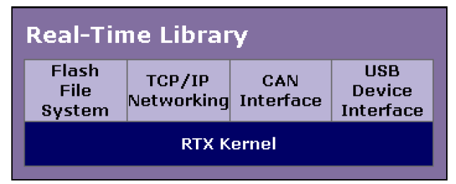
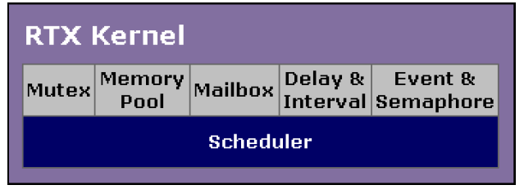
RTX Structure
Keil Real-Time Library (RTL)
RTX Kernel
Flash file system
Networking
CAN interface
USB device interface
RTX Kernel
Scheduler is the core of the RTX kernel
Supports for mutex, memory pool, mailbox, timing functions, events and semaphores
Notes:
The Keil real-time library is on top of the RTX kernel and contains libraries for flash file system, TCP/IP, CAN interface, USB interface etc.
The RTX kernel helps in scheduling tasks, it supports mutex, memory pool, mail box, timing functions and event/semaphores.

Slide 9
RTX Files
Add RTX to your project
Set RTX Kernel as OS
Include <RTL.h>
Add RTX_Conf_CM.c file (RTX_Conf_CM.c file will also include RTX_lib.c)
RTL.h – defines the basic types and kernel APIs
RTX_Conf_CM.c – configures the RTX and support for the configuration wizard
RTX_lib.c – the kernel system configuration, providing an in-code control of the kernel
Source code of the RTX kernel is precompiled and linked by Keil MDK-Arm
Notes:
RTX can be included in the project created using Keil MDK-Arm development environment.

Slide 10
RTL.h
Type defines
Supports Cortex-M architecture, with the following features:
Task management
Event flag management
Semaphore management
Mailbox management
Mutex management
Time management
User Timer management
System functions
Fixed memory block management functions
Notes:
RTL.h defines and supports the Cortex M CPUs with features like: Task management, time management, semaphore management etc. More features are listed on the slide.

Slide 11
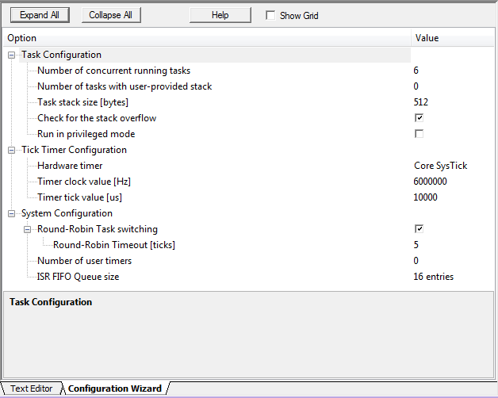
RTX_Conf_CM.c
“<h> <o> <i> <q>” are the annotations for Keil configuration wizard
Configuration wizard provides an easy-to-use GUI (see picture on the right)
Can also change the configuration by directly modifying the file
More about the Keil configuration wizard: http://www.keil.com/support/man/docs/uv4/uv4_ut_configwizard.htm
Notes:
RTX_Conf_CM.C is a configuration wizard with an easy to use graphical user interface as shown in the slide.

Slide 12
Source code of RTX
By default C:\Keil_v5\Arm\RL\RTX\SRC\CM (Keil uVision 5)
Or through the project file RTX_Lib_CM located in C:\Keil_v5\Arm\RL\RTX
Notes:
A typical “Project” folder is shown with RT kernel and config files.

Slide 13
CMSIS and CMSIS-RTOS
Arm Cortex Microcontroller Software Interface Standard (CMSIS)
Vendor-independent hardware abstraction layer
Used for Cortex-M processor series
Specifies debugger interfaces
The CMSIS-RTOS API
Generic RTOS interface for Cortex-M processor-based devices
Standardized API for software components that require RTOS functionality, gives serious benefits to the users and the software industry
Notes:
Arm Cortex Microcontroller Software Interface Standard (CMSIS) provides board independent hardware abstraction layer. The supported boards are Cortex M processor boards.
The CMSIS-RTOS API– provides generic RTOS interfaces.

Slide 14
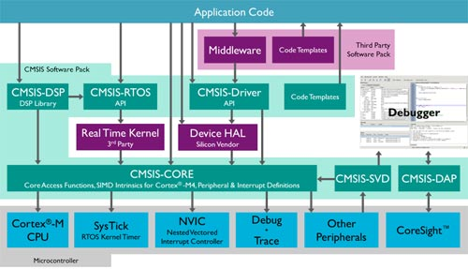
CMSIS and CMSIS-RTOS
Notes:
A pictorial representation of CMSIS and CMSIS-RTOS on the Cortex M CPU is shown in the slide.

Slide 15
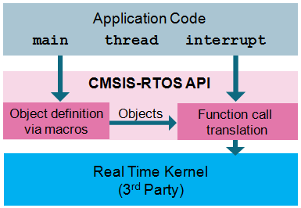
CMSIS-RTOS and RTX
CMSIS-RTOS API – an abstracted layer on top of RTX kernel or other 3rd party RTOS kernels
Application programs can be easily ported to other 3rd party RTOS kernels (such as FreeRTOS)
In this set of teaching materials, we will focus on the RTX kernel rather than the CMSIS-RTOS API
Same concept
More low-level details
RTX or other 3rd RTOS kernel
Notes:
CMSIS-RTOS API is an abstracted layer on top of RTX kernel or other 3rd party RTOS kernels
Application programs can be easily ported to other 3rd party RTOS kernels (such as FreeRTOS)
In this set of teaching materials, we will focus on the RTX kernel rather than the CMSIS-RTOS API.

Slide 16
To setup RTX
In the main function
os_sys_init(first_task);
That’s it!

