Slide 1
RTX Task and Time Management

Slide 2
Content of this Module
Tasks in RTX, Task States, Creation and Deletion
Advanced Real Time Task Scheduling
Periodic Task scheduling
Earliest Dead Line First
Rate Monotonic
System performance and Assumptions
Prioritized Scheduling
Priority Inversion
Priority Inheritance
Dead Lock
Priority Ceiling
Priority Scheme in RTX, Options
Simple Time Management API
RTX control functions
Notes:
In this module we will look at RTX Scheduling and Advanced Scheduling algorithms like EDF, RM.

Slide 3
Tasks in RTX
Task is the term used to refer to a process in RTX
C function with keyword __task preceding the function return type
Some basic API functions:
OS_TID
os_tsk_create(task, priority);
os_tsk_create_user(task, priority, &stack, sizeof(stack));
os_tsk_create_ex(task, priority, parameter);
os_sys_init(task);
os_tsk_delete(taskID);
os_tsk_delete_self();
Notes:
Task is the term used to refer to a process in RTX.
There are many API (application programming interface) functions:
Oos_tsk_create(task, priority); - Creates a task with a particular priority.
os_tsk_delete(taskID); - Deletes a task.
Some more tasks are listed in the slide.

Slide 4
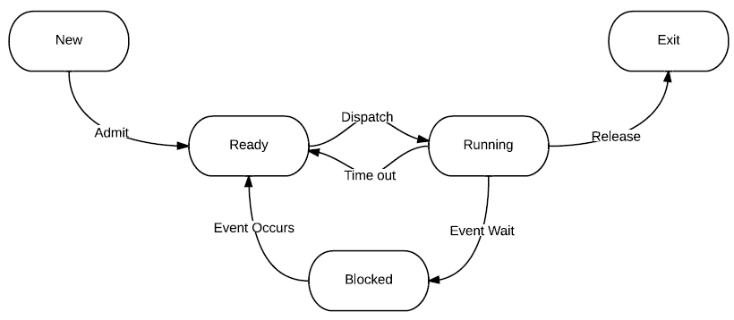
Task State
P_TCB->state
rt_TypeDef.h
#define INACTIVE 0; - Related function: os_tsk_delete()
#define READY 1; - Related function: os_tsk_create()
#define RUNNING 2; - Related function: os_tsk_self() – only one running task, this returns its TID
#define WAIT_DLY 3; - Related function: os_dly_wait() – blocked for a certain time
#define WAIT_ITV 4; - Related function: os_itv_set() and os_itv_wait() – repeat the task periodically
#define WAIT_OR 5; - Related function: os_evt_wait_or() – wait for or-event
#define WAIT_AND 6; - Related function: os_evt_wait_and() – wait for and-event
#define WAIT_SEM 7; - Related function: os_sem_wait() – wait for sempahore
#define WAIT_MBX 8; - Related function: os_mbx_wait() – wait for mailbox message
#define WAIT_MUT 9; - Related function: os_mut_wait() – wait for mutex
rt_Task.h
Blocked
Notes:
Task states like Ready, Running, Blocked etc. can be defined by statements like:
#define READY 1;

Slide 5
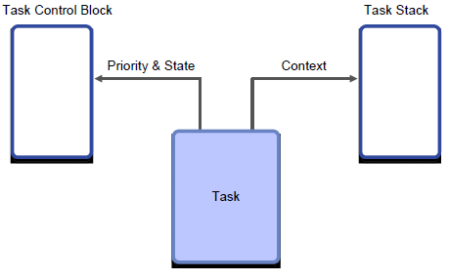
Task Creation and Deletion
Related functions
Task creation:
OS_TID - taskID;
__task void some_task() {…}
taskID = os_tsk_create (some_task, priority);
taskID = os_tsk_create_user_ex(some_task,priority,&stack,sizeof(stack),parameter)
Task deletion:
os_tsk_delete (some_task);
Priority
U8 member in the TCB in rt_TypeDef.h
Larger number = higher priority
‘0’ for an ideal task, ‘1’ for a round-robin task
User Stack (_user)
You can set the default size in the configuration wizard
Notes:
Task creation can assign priority and define user stack size. Tasks also have the feature to be deleted if needed.

Slide 6
Task Creation and Deletion
Parameters (_ex)
RTX allows you to have multiple instances of the same task
Passing parameters to a task at creation, for example, to specify GPIO pins
taskID = os_tsk_create_ex(led_on_off, 0, led1)
taskID = os_tsk_create_ex(led_on_off, 0, led2)
Tasks can be created and deleted by tasks
Tasks can delete other tasks and themselves
os_tsk_delete(some_task);
Tasks can create other tasks (but cannot create themselves)
The first task is created by:
os_sys_init(first_task);
The first task is commonly used for
Initialization of hardware
Creation of all other tasks
Then deletes itself
Notes:
At task creation, RTX allows you to have multiple instances of the same task, passing parameters to a task at creation, for example, to specify GPIO pins.
Tasks can be created and deleted by other tasks.
The first task is commonly used for
Initialization of hardware
Creation of all other tasks
Then deletes itself

Slide 7
Advanced Real-time Scheduling
Recall the aperiodic real-time scheduling policies introduced previously
EDD, EDF and LL
Same priority
No inter-task dependency
Aperiodic
Before introducing the RTX scheduler, we will discuss two more real-time scheduling scenarios
Periodic
Prioritized
Notes:
Real time scheduling can be used for aperiodic tasks or periodic tasks.
EDD, EDF, and LL are some algorithms commonly used for aperiodic scheduling. Here, all the tasks are aperiodic and have the same priority and no inter-task dependency.
In the next few slides we will learn about periodic and prioritized tasks and their scheduling algorithms.

Slide 8
Periodic Task Model
P1
P1
P1
P1
P2
P2
P2
P3
P3
0 1 2 3 4 5 6 7 8 9 10 11 12
Time
Describes real-time computational requirements
Constant process execution time C_{i}
Tasks are periodic with period T_{i}
Release time
Task is released every T_{i} time units and is ready to run
Deadline D_{i} .
Might be related to period T_{i} making analysis easier
Can also be earlier than the end of a period!
Task | Exec. Time C_{i} | Period T_{i} | Deadline D_{i}
P1 | 1 | 4 | 4
P2 | 2 | 6 | 6
P3 | 3 | 12 | 12
Notes:
For every periodic task, the following parameters are specified: Execution time, period, dead line, and release time.
In the above figure, task P1 takes 1 unit to execute, the period is 4 units, and the deadline is 4. Release time can be within the period.
Some assumption is: The deadline and period are the same. The interval between two occurrences of task 1 may be more than period interval (4 units), but task 1 appears in every periodic interval (within every units period).
The release time of a task should be such that the task can be executed before the dead line. Example, task 1 has a dead line of 8, the execution time is 1 unit and it can not be released at time 7.5 unit. It can be released at any time between 4 and 8.

Slide 9
Periodic Scheduling
Goals
Meet all task deadlines!
Not always schedulable to meet all deadlines!
Maximize processor utilization (U)
The fraction of time CPU performs useful work
Limit scheduling overhead
Limit context switching overhead
Which ready task to run?
Based only on task importance?
Would starve consistently low priority task unnecessarily
Some common approaches
Earliest deadline first (EDF)
Rate monotonic (RM)
Deadline monotonic (DM) (D_{i}≤T_{i})
Notes:
In periodic scheduling our goals are to meet all the task deadlines and maximize processor utilization. The utilization of a processor is the sum of (execution time of task/period of task) for all tasks. The expression is given in the slide and we will see it again in the next slide.
The scheduler needs to decide which task to run next. It can be based on the importance or priority of the task without starving any low priority task.
Some common algorithms are :
Earliest deadline first (EDF)
Rate monotonic (RM)
Deadline monotonic (DM) (D_{i}≤T_{i}), i.e. dead line is less than or equal to period

Slide 10
Earliest Deadline First
Run the job with the earliest deadline first
Utilization-based schedulability test depends on deadline constraints
Di = Ti : Schedulable if utilization ≤ 100%
Di > Ti : Schedulable if utilization ≤ 100%
Di < Ti : Have to use a more complicated test
Hard to implement such dynamic policy
Run-time scheduler has to keep track of all deadlines, which also depends on tasks’ release time
Sorting by deadline, time complexity: O(n)
Periodic tasks only? Will repeat every hyper-period, the least common multiple of all task periods
Notes:
Earliest Deadline First (EDF) runs the task with the earliest deadline first. It is a dynamic approach and decided during the running of tasks.

Slide 11
Rate Monotonic
Shortest period first, preemptive
Optimal for workload where deadline = the end of period, i.e., D_{i}=T_{i} .
Assume D_{i}=T_{i} , the utilization bound for RM: U_{max} is*
U_{max} approaches ln2 (around 0.693) as n approaches positive infinity.
If U<U_{max} , 100% schedulable, otherwise, maybe schedulable. An example:
A modified approach: harmonic RM – task period can be evenly divide every longer task period for example, periods of 10, 20, 40, 80… Bound is 100%
Task | Execution Time C | Period T | RM Dispatch
P1 | 1 | 8 | First
P2 | 1 | 9 | Second
P3 | 9 | 12 | Third
*Originally proved by CL Liu and JW Layland in 1973. "Scheduling algorithms for multiprogramming in a hard-real-time environment."
Notes:
In this example, although the utilization is below 100%, P3 will miss the deadline in the second period!
But total utilization is equal to the sum (execution time/period). In this example: Total utilization = ( 1/8) + (1/9) + (9/12) = 0.986. Utilization value is not below 0.7796 the U max for 3 tasks. Hence these 3 tasks are not RM schedulable.
Deadline monotonic includes RM, dispatch the task with least time from release to deadline.

Slide 12
System Performance During Transient Overload
RM, DM – Each task has fixed priority. So?
This priority determines that tasks will be scheduled consistently
Task A will always preempt task B if needed
Task B will be forced to miss its deadline to help task A meet its deadline
EDF – Each task has varying priority. So?
This priority depends upon when the task’s deadline is, and hence when the task becomes ready to run (release time)
Task B may have higher priority than A depending on release times
To determine whether task A or B will miss its deadline we need to know their release times
Can theoretically harness up to 100% of the CPU performance
Notes:
RM and DM (Rate Monotonic and Dead Line Monotonic) are static priority algorithms. Tasks are given priority depending on some criteria (in RM: the task with shortest period has the highest priority).
The total utilization of the processor under RM is limited for large number of tasks to 69%.
EDF – The Earliest Deadline First algorithm is a dynamic priority algorithm. Task’s priorities change when approaching the deadline. The total utilization of the processor for this scheme can be up-to 100%.

Slide 13
Our Assumptions
Tasks are periodic with period Τ_{i}
Extension 1: Support aperiodic tasks by setting Τ_{i} = min(Τ_{Interarrival i})
Single CPU
OK for some systems, but not all
C_{ContextSwitch} = 0
Scheduler speed. EDF requires ordered list of ready tasks.
Task state information needs to be swapped
Constant process execution time C_{i}
What if the worst-case time is much slower than average?
Then need a processor fast enough to handle the worst case
Most of the time the processor will be wasting resources
No data dependencies between tasks
Not all tasks are ready to run simultaneously
Some tasks block on other tasks
Notes:
Some of the assumptions for RM and EDF algorithms are:
Tasks are periodic
Single CPU is available
Context switching time is zero
The task execution time is known and it is fixed value. In reality, the execution time may vary between minimum and worst case value. If we assume the execution time is the Worst case time and assign the tasks as per RM,
(if RM schedulable), all the tasks will meet the deadline. But, when the execution time is average or minimum, the processor will have more free time.
We assume also that the tasks are independent of each other. Results of one task are not needed for another task. (if this is the case, both the tasks can be made as one big single task and scheduling can be done).

Slide 14
Prioritized Scheduling
taskID = os_tsk_create(some_task, priority);
Prioritized Scheduling means that task with higher priority should be dispatched and can preempt lower priority tasks
The problem is dependency. For instance, can a task in its critical section be preempted?
If no, any problem?
If yes, any problem?
The point of prioritized scheduling is based on the emergency level of the task, instead of whether it’s in a critical section. But you have to pay extra attention to critical sections as otherwise they may cause conflict between tasks.
Priority inversion
Notes:
Tasks may have a priority. A high priority task will pre-empt the low priority task. But if a low priority task is in a critical section, it may not be pre-empted. This can cause special handling.

Slide 15
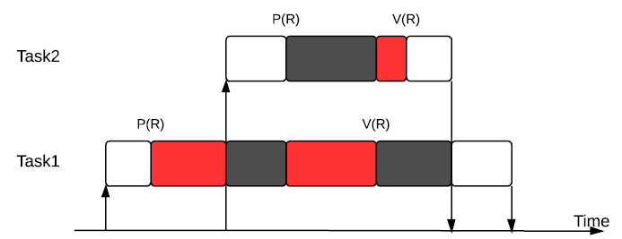
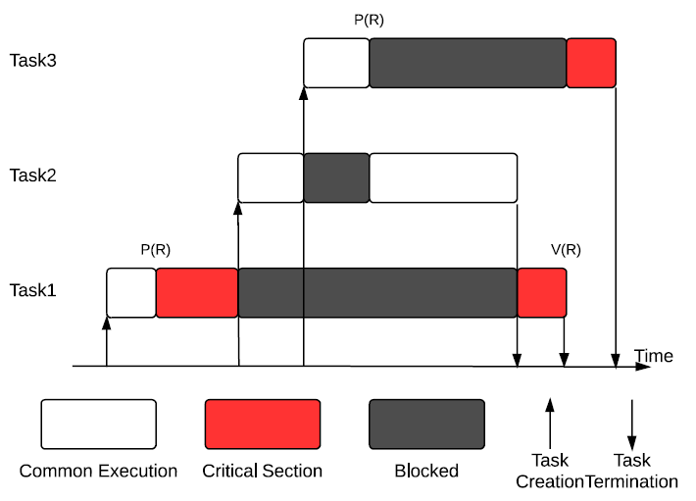
Preemptive Critical Section
Priority(T_{N})>Priority(T_{M}),if N>M
Seems okay?
But what if a higher priority task would like to enter the same critical section? P(R) blocks task 2 if task 1 has the mutex (recall the requirements for mutex). Still acceptable as contaminating CS may cause even worse disaster, better avoid that and let task 1 finish first.
Blocking time seems to be bounded by the maximum length of critical section of lower priority tasks. But no. See the second example.
Priority inversion: even though task 2 is not requesting R, it blocks task 3!
Notes:
Examples here apply mutex to guarantee exclusive access to a critical section.
A low priority task can block a high priority task if it is executing a critical section. This is called Priority Inversion.

Slide 16
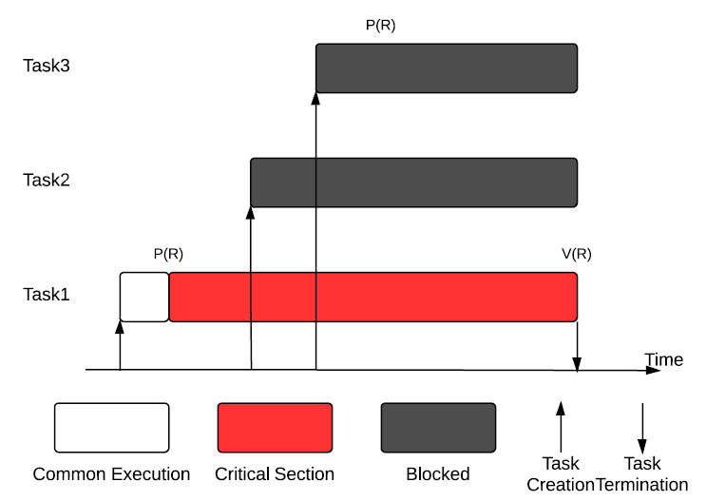
Non-Preemptive Critical Section
Plausible? Can solve previous problem. But…
Task 3 and 2 are on fire!
Notes:
When a task is in a critical section, it can not be pre-empted. In the slide, task 3 and task 2 are blocked since task 1 is executing in the critical section.

Slide 17
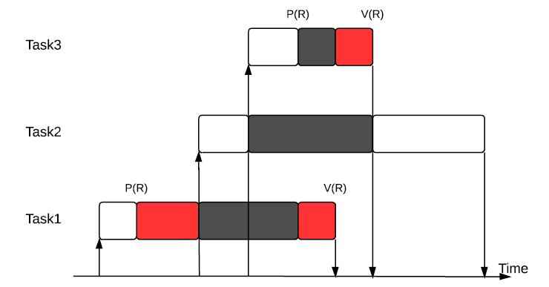
Priority Inheritance
Applied in many RTOS including RTX.
Blocking time is now bounded by the maximum (sum) length of critical section of lower priority tasks.
The idea is to elevate the priority of low priority task (if it blocks high priority task) to the highest priority of tasks blocked by it.
And resume its original priority when it exits the critical section.
Task 1 inherents task 3’s priority
Notes:
In many RTOS including RTX, the priority of low priority task (if it blocks high priority task) is increased to the highest priority of tasks blocked by it.
It then resumes its original priority when it exits the critical section. This is called Priority Inheritance.

Slide 18
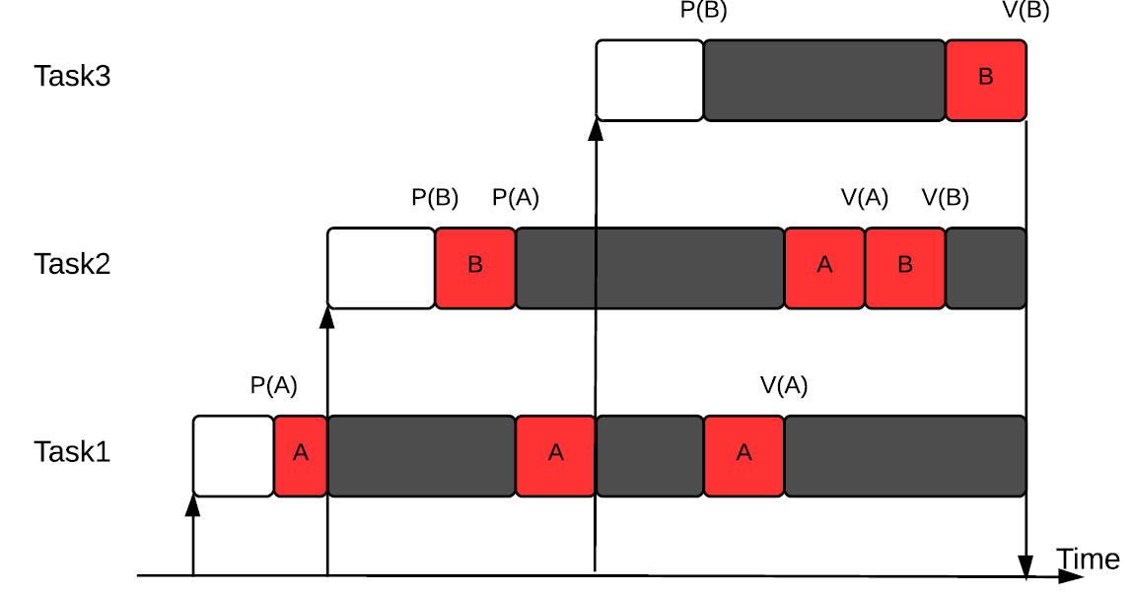
Priority Inheritance
If same priority, then FIFO
Another example:
Task 2 blocked by task 1, hence Priority(T₁) = Priority(T₂)
Then, task 3 is blocked by task 1, hence Priority(T1) = Priority(T₃), also Priority(T₁)=Priority(T₂)=Priority(T₃) as task 2 is blocked by task 1. So Task 1 continues(FIFO)
After task 1 releases A, its priority will be resumed. Task 2 continues.
Similarly, after task 2 releases B, its priority will be downgraded and task 3 continues.
Notes:
In the above figure, task 1 has a lower priority. Task 3 has the highest priority. But, if task 1 grabs the critical resource “A”, and if task 2 needs A, then it is blocked though it has higher priority. Since this happened, as per the priority inheritance principle, task 1 gets the priority of task 2. At present you can think that task 1 and 2 are in FIFO (because they both have the same priority. Since task 1 entered the FIFO queue, it will continue).
After task 1 releases A, its priority comes down to original value.

Slide 19
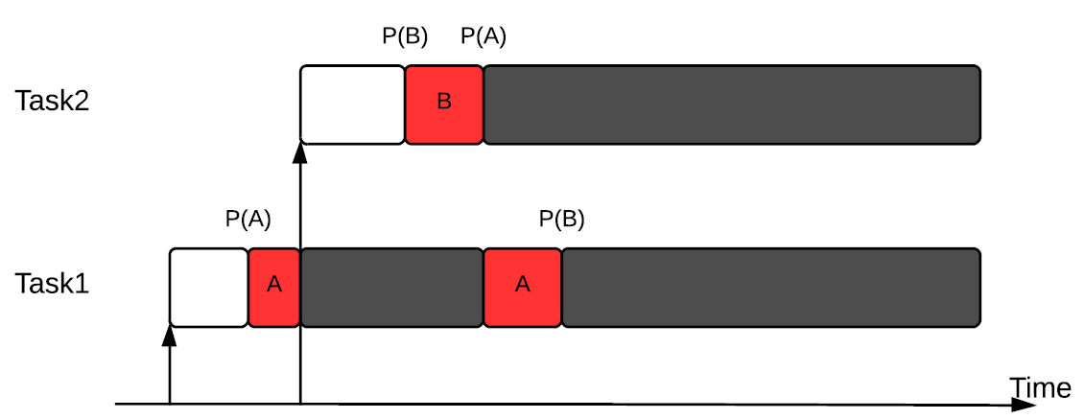
Deadlock Caused by Priority Inheritance
Unfortunately, priority inheritance is not perfect. Consider the following example:
Recall Coffman conditions for deadlock. Deadlock here!
Notes:
If there are two critical shared resources, priority inheritance will not solve the problem, it will lead to a dead-lock problem.
Task 1 has critical resource A and task 2 has critical resource B. Next, task 1 needs B and task 2 needs A. This is where dead-lock occurs.

Slide 20
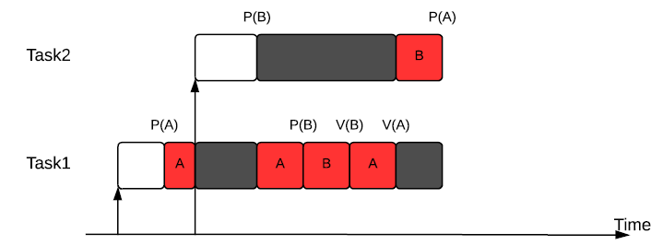
Priority Ceiling
Improvement on priority inheritance. But not implemented in the RTX.
Define the priority ceiling for a resource: PC(R) are the highest priority processes that may request mutual exclusive access to R
Priority ceiling accepts requests to enter any critical section only if task A’s priority is larger than PC (all resources accessed by tasks other than A). This solves deadlocks by preventing circular wait conditions
If task A is blocked due to this, then the priority of task B which is blocking task A, will be elevated to A’s priority (if A is the highest) as the usual priority inheritance protocol.
Another improvement is that it reduces the blocking time to at most the length of one critical section of a low priority task.
Notes:
When task 2 requests B, it is rejected as task 1 is accessing A and PC(A) is max(T1,T2)=T2 and task 2 does not have a priority larger than its own priority. So task 1 continues (with priority of t2 as task 2 is blocked by it) and can request B as other tasks are not accessing any critical section (no priority ceiling). After task 1 releases A and B, its priority resumes and task 2 can carry on as all priority ceilings are removed.
Here each resource is assigned a priority ceiling, which is a priority equal to the highest priority of any task which may request the resource.
This solves the deadlock and prevents circular wait. It is a dynamic priority scheduling technique, but this is not implemented in RTX.

Slide 21
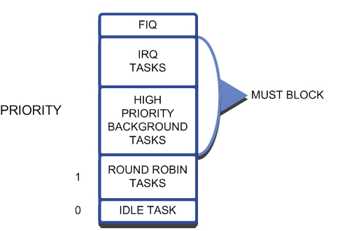
Task Priority Scheme in RTX
RTX supports priority scheduling and applies priority inheritance policy with mutex.
Possible to alter the priority of a task after creation.
OS_RESULT os_tsk_prio(taskID, priority);
OS_RESULT os_tsk_prio_self(priority);
Higher number, higher priority, from 0 to 255
A FIFO queue for each priority
Fast interrupt has the highest priority (handled by CM core instead of RTX)
Then interrupts
Then tasks with a priority larger than 1. RTX will not preempt tasks with priority larger than 1 so they must be self-blocking!
Tasks in queue 0 will be put into queue 1 when there are no tasks running
Notes:
The RTX mutex will be introduced in the next module.
RTX supports priority scheduling and applies priority inheritance policy with mutexes.
Possible to alter the priority of a task after creation.
Higher number, higher priority, from 0 to 255
A FIFO queue for each priority
The figure in the slide shows the priority. From priority low to high: Idle task, Round Robin Tasks, High Priority background task, IRQ (interrupt request tasks),

Slide 22
RTX Scheduling Options
Pre-emptive scheduling
Each task has a different priority and will run until it is pre-empted or has reached a blocking OS call.
Round-Robin scheduling
Each task has the same priority and will run for a fixed period, or time slice, or until it has reached a blocking OS call.
Quantum is determined by the RTX_Conf_CM.c file: Round-Robin Timeout [ticks] × Timer tick value. For example, by default, the time quantum is 10000µs ×5 = 50000µs=50ms.
If quantum expired, state will be changed to READY.
Co-operative multi-tasking
Each task has the same priority and the Round-Robin is disabled. Each task will run until it reached a blocking OS call or uses the os_tsk_pass() call.
The default scheduling option for RTX is Round-Robin Pre-emptive. Prioritized RR.
RTX does not provide aperiodic or periodic deadline scheduling.
Notes:
Taking deadlines into consideration is always a challenge for operating system design.
RTX scheduling options:
Pre-emptive scheduling with a different priority for each task. Sometimes the OS can pre-empt a task.
Round robin scheduling: All tasks have the same priority. Each task will run for a short fixed period of time. This quantum can be fixed by RTX Conf CM.c command. A round robin queue is maintained to make sure all the tasks get to execute.
Co-operative Multi-tasking: here all tasks have the same priority. No round robin queue. Each task will run till there is a blocking OS call.
RTX allows only Round-Robin Pre-emptive ( or Prioritized Round Robin) scheduling.
RTX does not provide aperiodic or periodic deadline scheduling.

Slide 23
Simple Time Management APIs
Besides the scheduling options, RTX can also manage time through the following APIs:
Get current time
U32 os_time_get (void);
Returns current OS time measured in ticks
Simple delay
void os_dly_wait (unsigned short delay_time)
Turn the state of calling task into WAIT_DLY
Actual delay time = delay_time × timer tick value
After the delay time, turn the state of the task back to READY
Make sure you have the correct timer clock value
Periodic task execution
Set the interval within the task by calling void os_itv_set (unsigned short interval_time) first
Actual delay time = interval_time × timer tick value
Then change the to WAIT_ITV by calling void os_itv_wait (void) inside the task
Notes:
RTX provides time management as: Get current time, simple delay and periodic task execution. The operating system decides the task execution periods based on the interval time set.

Slide 24
Simple Time Management APIs
Cooperate function
void os_tsk_pass ();
Task calling this function will voluntarily give up its current possession of CPU and allow next ready task with same priority to run.
No task switch if the next ready task has a lower priority than the calling task.
User timer function
Set the number of available user timer first.
Set a single shot timer by calling OS_ID os_tmr_create (unsigned short tcnt, unsigned short info)
Actual countdown time = tcnt × timer tick value
After it reaches zero, RTX runs the callback function void os_tmr_call (U16 info). The prototype function can be found in RTX_Conf_CM.c
Info is the parameter passed to the callback function
Notes:
Also possible to assign an ID to a timer and kill specific a timer.
RTX supports cooperate function and user time function.
Task calling a cooperate function will voluntarily give up its current possession of the CPU and allow the next ready task with same priority to run.
In the user timer function, the time is first set, when it reaches zero, the next task is called.

Slide 25
Other RTX Control Functions
Scheduler lock – stops task switching, though ISRs can still execute
If you want your code to run as a contiguous block, (critical section for example), it is a good idea to temporally stop the scheduler.
void os_tsk_lock();
Disables kernel timer interrupts, stopping task switching
void os_tsk_unlock();
Enables kernel timer interrupts, allowing task switching
Power management - used in low power RTX
Used with os_dly_wait or os_tmr_create. Hibernate the CPU until next activity.
U32 os_suspend();
Calculates for how many ticks the system can sleep
Locks task scheduler
Use this in idle_task to determine when to set wake-up timer before sleeping (wfi instruction)
void os_resume(U32 sleep_time);
Updates system timer with sleep duration (number of ticks)
Unlocks task scheduler, allowing normal scheduling
Use this in idle_task to resume
Notes:
RTX has two control functions: Scheduler Lock and Power Management.
Scheduler lock prevents tasks switching (though, Interrupts can be allowed).
Power management is used to make the CPU hibernate or sleep for a fixed time.

Slide 26
Next
Lab
Sharing data in RTX

