Slide 1
Sharing Data in RTX

Slide 2
Previous
RTX Task and Time Management
Notes:
In the previous module we learnt about RTX tasks and time management.

Slide 3
Inter-Task Communication
Inter-task communication primitives are of crucial importance to OS design
Several mechanisms or primitives are provided by RTX
Events
Mutex
Semaphore
Mailbox
The first three provide synchronization
The last one provides data communication
We will have a close look at each one of them one by one.
Notes:
Inter-task communication mechanisms in RTX are:
Events
Mutex
Semaphore
Mailbox
Events, mutex and semaphore provide synchronization of tasks.
Mailbox provides data communication between tasks.

Slide 4
Events
An effective alternative to busy-waiting
Trigger task A when event X happens (event flag set by other tasks)
Each task has 16 private event flags, corresponding information is stored in the task’s TCB
Ask the task to wait for events and its state will turn to WAIT_AND or WAIT_OR, depending on the version of the event wait call.
Once the required event flags are set, the task will be put back to the READY state and wait for the scheduler to dispatch it
Flags can also be cleared by other tasks
Notes:
Instead of busy waiting for a flag, “Events” can be used by tasks to signal to other tasks.
Each task has 16 private event flags (stored in TCB register).
Wait for events can be a WAIT_AND or WAIT_OR event.
Once the required event flags are set, the task will be put back to the READY state and wait for the scheduler to dispatch it.
Flags can also be cleared by other tasks.

Slide 5
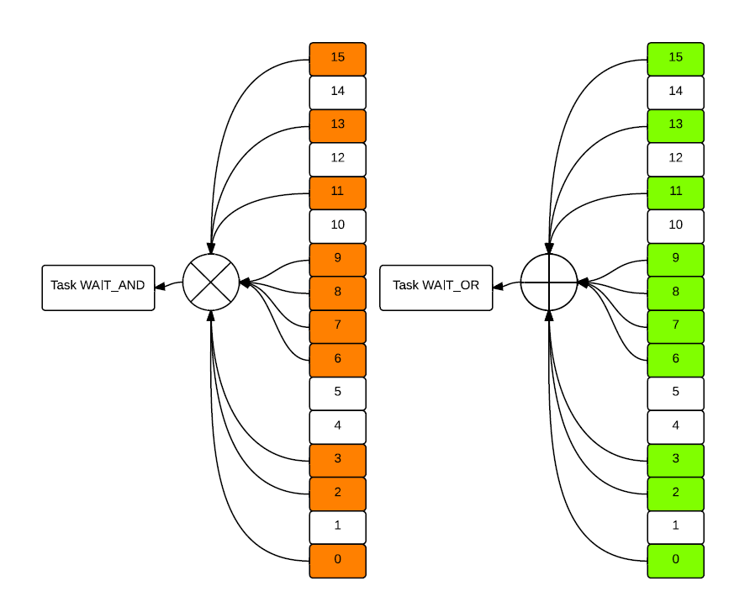
And & Or Events
Self-explanatory function definitions
OS_RESULT os_evt_wait_and (U16 wait_flags, U16 timeout );
OS_RESULT os_evt_wait_or (U16 wait_flags, U16 timeout );
Task will only monitor the flags specified by wait_flags
Using the os_evt_wait_and function, all monitored flags must be set to trigger the task
Using the os_evt_wait_or function, setting any monitored flag will trigger the task
You can set timeout as well, task will be put back to READY after timeout period even if flags are not set
As usual, based on timer tick value
0xFFFF means infinite timeout
Notes:
WAIT_AND :
Tasks which are waiting for all the set events to occur are in the WAIT_AND state. When all event flags are set, the task is switched to the READY state. The os_evt_wait_and() function is used to place a task in the WAIT_AND state.
WAIT_OR
Tasks which are waiting for at least one event flag are in the WAIT_OR State. When the event occurs, the task is switched to the READY state. The os_evt_wait_or() function is used to place a task in the WAIT_OR state.
READY:
Tasks which are ready to run are in the READY state. Once the running task has completed processing, RTX selects the next ready task with the highest priority and starts it.
A timeout setting can make the task to READY state after the time out. See an example in the next slide.

Slide 6
After Event
Set the event flags by calling os_evt_set(0xABCD, taskID); in another task.
If event is triggered,
Specified flags will be cleared if set
evt_wait returns the OS_RESULT
OS_R_EVT, if the specified flags have been set
OS_R_TMO, timeout
For or event, you may need to know which exact flags have been set, do the following right after the evt_wait_or:
which_flag = os_evt_get();
Then take according steps based on the bit pattern of which_flag
Clear flags by calling os_evt_clear(0xABCD, taskID); in another task before it triggers the blocked task.
Notes:
The os_evt_set function sets the event flags for the task identified by the function argument. The function only sets the event flags whose corresponding bit is set to 1 in the event_flags argument.
Here is another example event call
#include <rtl.h>
__task void task1 (void)
{
OS_RESULT result;
result = os_evt_wait_and (0x0003, 500);
if (result == OS_R_TMO)
{ printf("Event wait timeout.\n"); }
else { printf("Event received.\n"); }
.. }
If event is triggered,
Specified flags will be cleared if set
evt_wait returns the OS_RESULT
OS_R_EVT, if the specified flags have been set
OS_R_TMO, timeout
For or event, you may need to know which exact flags have been set, do the following right after the evt_wait_or:
which_flag = os_evt_get();
Then take according steps based on the bit pattern of which_flag
Clear flags by calling os_evt_clear(0xABCD, taskID); in another task before it triggers the blocked task.

Slide 7
Interrupt and Event
As mentioned before, interrupts will “interrupt” the OS if they are not handled properly.
systick is also a form of interrupt, older architectures will disable interrupts while interrupted - less of an issue for Cortex-M.
Rule of thumb:
Use interrupt to set event flags
Then do the lengthy job in a task!
void isr_evt_set (U16 event_flags, OS_TID task_id);
Of course, do not forget the IRQ routine stuff (clear interrupt bits for example)
Notes:
ARM7/9 does not have good support for nested interrupts, but the Cortex-M does. Even so, it is still a better practice to write short ISR.
Interrupts will interrupt the OS if they are not handled properly.
The processor has a 24-bit system timer, SysTick, that counts down from the reload value to zero, reloads, then it wraps to the value in the SYST_RVR register on the next clock edge, then counts down on subsequent clocks.
Rule of thumb:
Use interrupt to set event flags
Then do the lengthy job in a task!
void isr_evt_set (U16 event_flags, OS_TID task_id);
Of course, do not forget the IRQ routine stuff (clear interrupt bits for example)

Slide 8
Mutex
A mutex, in many ways, is a binary semaphore.
Two major purposes in RTX:
Synchronize tasks
Protect shared variables or resources
RTX mutex has the priority inheritance scheme built in but has no priority ceiling protocol, so be really careful if your task involves more than one mutex.
Remember to release the mutex after use. RTX will not release the mutex on task deletion – other tasks will never be able to acquire it again!
An alternative way: use the lock and unlock functions.
Task acquired a mutex can still be interrupted and blocked
Whereas a locked task will not be preempted by the OS (more control over everything)
But in most cases, mutex is what you want.
Notes:
A mutex can be considered a binary semaphore and is used for the synchronization of tasks and for protection of shared variables or resources.
In RTX, a mutex has the priority inheritance but not priority ceiling property.
Since RTX will not release the mutex bit, it should be cleared after the use or end of the task by the program.
One can also use Lock and Unlock functions.

Slide 9
Mutex Routines
Three related functions and one type only
Declare a mutex object first: OS_MUT mutexID;
Then initialize the mutex through os_mut_init (mutexID);
Grab the mutex through os_mut_wait (mutexID, timeout );
timeout, yes, its usage is identical to that in evt_wait
Return values:
OS_R_MUT: has to wait and task is put to WAIT_MUT state and will be put back to READY if the mutex is later on released
OS_R_TMO: timeout
OS_R_OK: has the mutex and task can continue
After the critical section, release the mutex through os_mut_release (mutexID);
What if the task does not have the mutex?
Mutex is not semaphore!
Notes:
os_mut_release (mutexID); will return OS_R_NOK as an error code and will not change the state of the mutex if the task is not the owner of the mutex.
Declare a mutex object first: OS_MUT mutexID;
Then initialize the mutex through: os_mut_init (mutexID);
Grab the mutex through: os_mut_wait (mutexID, timeout );
After the critical section, release the mutex through: os_mut_release (mutexID);
An example is given below
#include <rtl.h>
OS_MUT mutex1;
void f1 (void) {
os_mut_wait (&mutex1, 0xffff);
..
/* Critical region 1 */
..
/* f2() will not block the task. */
f2 ();
os_mut_release (&mutex1);
}
void f2 (void) {
os_mut_wait (&mutex1, 0xffff); ..
/* Critical region 2 */
..
os_mut_release (&mutex1);
}
__task void task1 (void) {
..
os_mut_init (&mutex1);
f1 ();
..
}
__task void task2 (void) {
..
f2 ();
..
}

Slide 10
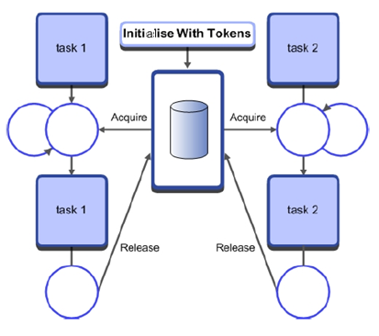
Semaphore
Recall that a semaphore is a container of a number of tokens.
Acquire a token first, then access a resource.
To finish with the resource, return the token.
Also used to synchronize tasks or protect variables and resources.
Very sophisticated and comprehensive ways of using semaphores.
Unlike mutex, you may destroy a task with unreleased tokens (depends on how you use your semaphore).
Simple routine APIs, but frequently misused!
Notes:
A semaphore is a variable/container of a number of tokens and counting semaphores have a value more than 1 (tokens). Semaphores are used to allocate a resource. Acquire a token from a semaphore to access a resource and then return the token after use of the resource.
Semaphores can be used for both mutually exclusive use of a resource and for the synchronization of tasks. Options for making the task which takes a DELETE_SAFE are provided by the mutex, which means the task deletion is not possible when holding the mutex. Whereas you may destroy a task with unreleased tokens.

Slide 11
Semaphore Routines
Very similar to the mutex. Again, three related functions and one type only.
Declare a semaphore container first: OS_SEM semID;
Then initialize the semaphore through os_sem_init (semID, unsigned token_count);
token_count, the initial number of tokens
Grab a token through os_sem_wait (semID, timeout);
timeout, as expected, just like mut_wait and evt_wait.
Return values:
OS_R_SEM: has to wait until a semaphore is available, task is put to WAIT_SEM state and will be put back to READY if some task sends a semaphore.
OS_R_TMO: timeout
OS_R_OK: has the token and task can continue
Return/create a token in the semaphore container through os_sem_send (semID);
Can a task return(create) a token even if it has no token?
Semaphore is not a mutex!
Its counterpart for ISR : isr_sem_send(semID);
Notes:
A task can initialize the semaphore through os_sem_init (semID, unsigned token_count);
A task can grab a token through os_sem_wait (semID, timeout);
Return values:
OS_R_SEM: has to wait until a semaphore is available, task is put to WAIT_SEM state and will be put back to READY if some task sends a semaphore.
OS_R_TMO: timeout
OS_R_OK: has the token and task can continue
Return/create a token in the semaphore container through os_sem_send (semID);
os_sem_wait (semaphore1, 0xffff); // equivalent to acquire.
os_sem_send (semaphore1); // equivalent to release.

Slide 12
Mutexes vs. Semaphore
Semaphore
Used for signaling from tasks or ISRs to waiting tasks
Can be initialized to 0, meaning “The event hasn’t happened yet”
Mutex
Used to ensure mutually exclusive access to a shared object
Is a binary semaphore with priority inheritance and some other changes
Is initialized to 1, meaning “The object isn’t being used now”
Common pitfall
Semaphore handles several copies of equivalent resources whereas mutex handles one?
Semaphore does not keep track of the order of access – effectively treating all resources identically! If your multiple copies of equivalent resources are not identical,
Access and release order matters
Use multiple mutexes instead of semaphores!
Notes:
Further discussion by Michael Barr at http://www.barrgroup.com/Embedded-Systems/How-To/RTOS-Mutex-Semaphore
Semaphores can count to more than 1. i.e. they can be used to share multiple common identical resources. A mutex is binary and it can be taken and released; they also give serial mutually exclusive access to a resource.
Multiple mutexes can be used to give access to multiple different type resources. Counting semaphores can only work on multiple identical resources.

Slide 13
Mailboxes and Messages in RTX
Pass the Data
Sharing bigger chunks of information between tasks
A mailbox is a queue of user-defined length
Each queue element (message) is four bytes long, can be used in two ways
Can hold the data itself (up to 32 bits)
Can hold a pointer to larger objects
When passing larger objects, need to dynamically allocate memory per object, free when done processing
Pass a Pointer to the Data
Notes:
So the user has to both declare the mailbox and allocate memory for the data.
The mailbox allows sharing data between tasks. It is a queue of user-defined length.
When passing larger objects, need to dynamically allocate memory per object, free when done processing

Slide 14
Creating Mailboxes
Create mailbox
os_mbx_declare(mailbox_name, mail_slots)
Declares an array (mailbox_name) of 32-bit unsigned ints
One element per message (mail_slots)
Four extra elements for mailbox management
Initialize the mailbox
os_mbx_init(&mailbox_name, sizeof(mailbox_name))
Takes pointer to mailbox and size in bytes
In RTL.h:
#define os_mbx_declare(name,cnt) U32 name [4 + cnt]
Notes:
The os_mbx_declare macro defines a mailbox object. The argument name is the name of the mailbox object. The argument cnt (or mail slot) is the number of messages that can be entered into the mailbox object. The os_mbx_declare macro is part of RL-RTX.
Example:
#include <rtl.h> /* Declare a mailbox for 20 messages. */
os_mbx_declare (mailbox1, 20);
__task void task1 (void)
{
..
os_mbx_init (&mailbox1, sizeof(mailbox1));
..
}
The os_mbx_init function initializes the mailbox object identified by the function argument.
The argument mbx_size specifies the size of the mailbox, in bytes. However, the number of message entries in the mailbox is defined by the os_mbx_declare macro.
The os_mbx_init function is in the RL-RTX library. The prototype i

Slide 15
Sending Messages
Prepare message if passing a pointer to the data
May need to allocate memory (if object doesn’t exist)
Send the message
os_mbx_send(&mailbox, msg_ptr, timeout)
Send message pointed to by msg_ptr
What if mailbox is full?
os_mbx_send will block (task will sleep) until space becomes available
timeout again
Return code: OS_R_OK and OS_R_TMO
isr_mbx_send(&mailbox, msg_ptr)
ISRs use this version
Use isr_mbx_check() to find number of free message entries in mailbox
If mailbox is full, the message is discarded and os_error() function is called, placing system in infinite loop by default
Notes:
To send messages, you send the pointer to the data, to the task.
os_mbx_send(&mailbox, msg_ptr, timeout) -- This function puts the pointer to a message, message_ptr, in the mailbox, if the mailbox is not already full.
The isr_mbx_send function puts the pointer to the message message_ptr in the mailbox if the mailbox is not already full. The isr_mbx_send function does not cause the current task to sleep even if there is no space in the mailbox to put the message.

Slide 16
Receiving Messages
os_mbx_wait(&mailbox, &msg_ptr, timeout)
Provides a pointer to the next message in the specified mailbox
Must free the message’s memory after using it
Will block if the mailbox has no message
timeout again
Return code:
OS_R_MBX: has to wait to get message
OS_R_OK
OS_R_TMO
isr_mbx_receive(&mailbox, &msg_ptr)
Provides a pointer to next message
Return value indicates result
OS_R_MBX: message was in mailbox and was read
OS_R_OK
Notes:
The os_mbx_wait function gets a pointer to a message from the mailbox if the mailbox is not empty. The function puts the message pointer from the mailbox into the location pointed by the message argument.
OS_R_MBX The task has waited until a message was put in the mailbox.
OS_R_TMO The timeout specified by timeout has expired before a message was available in the mailbox.
OS_R_OK A message was available in the mailbox, and the task continues without waiting.

Slide 17
Dynamic Memory Allocation
It doesn’t fit anywhere!
Here!
Single pool handling all size requests
Pool for 32-byte requests
Pool for 16-byte requests
Allocating and freeing different sizes of memory can cause fragmentation, so free space is distributed in fragments which are too small to use
Solution is to create a separate memory pool for each size of data to be allocated
Notes:
Allocating and freeing different sizes of memory can cause fragmentation, so free space is distributed in fragments which are too small to use.
The solution is to create a separate memory pool for each size of data to be allocated. i.e. For 32 byte requests keep a pool of memory. For 16 byte requests keep a pool of memory.

Slide 18
RTX Dynamic Memory Allocation
RTX has powerful fixed memory block memory allocation routines - box
“box” = memory pool of fixed-size blocks
Thread safe and re-entrant
Functions
_declare_box(box_name, block_size, block_count) allocates memory statically (declares an array called box_name)
_init_box(box_name, box_size, block_size) initializes the box
_alloc_box(box_name) returns a pointer to a memory block, or NULL on failure
_calloc_box(box_name) returns a pointer to a memory block (initialized to 0), or NULL on failure
_free_box(box_name, block) frees up the block in that pool
Better to use these for fixed size messages
Variable length memory allocation (malloc() and free() from stdlib.h) functions are not re-entrant! Use lock and unlock to disable context switch!
Notes:
RTX has fixed memory block allocation routines called BOX.
The _declare_box8 macro declares an array of bytes that can be used as a memory pool for allocation of fixed blocks with 8-byte alignment.
_init_box initializes the box
_alloc_box – The _alloc_box function allocates a block of memory from the memory pool that begins at the address box_name.
The _calloc_box function allocates a block of memory from the memory pool that begins at the address box_name and initializes the entire memory block to 0.
The _init_box function initializes a fixed block size memory pool. When the memory pool is initialized, the RTX kernel handles memory requests by allocating a block of memory from the memory pool.

Slide 19
A Working Example
os_mbx_declare (MsgBox, 16); /* Declare an RTX mailbox */
U32 mpool[16*(2*sizeof(U32))/4 + 3]; /* Reserve a memory for 16 messages */
__task void rec_task (void);
__task void send_task (void) {
/* This task will send a message. */
U32 *mptr;
os_tsk_create (rec_task, 0);
os_mbx_init (MsgBox, sizeof(MsgBox));
mptr = _alloc_box (mpool); /* Allocate a memory for the message */
mptr[0] = 0x3215fedc; /* Set the message content. */
mptr[1] = 0x00000015;
os_mbx_send (MsgBox, mptr, 0xffff); /* Send a message to a 'MsgBox' */
os_tsk_delete_self ();
}
__task void rec_task (void) {
/* This task will receive a message. */
U32 *rptr, rec_val[2];
os_mbx_wait (MsgBox, (void**)&rptr, 0xffff); /* Wait for the message to arrive. */
rec_val[0] = rptr[0]; /* Store the content to 'rec_val' */
rec_val[1] = rptr[1];
_free_box (mpool, rptr); /* Release the memory block */
os_tsk_delete_self ();
}
int main (void) {
_init_box (mpool, sizeof(mpool), sizeof(U32));
os_sys_init(send_task);
}
Notes:
Modified from RL-ARM User’s Guide.
An example is shown in the slide.

Slide 20
Sharing Data Safely
Preemption and interrupt could contaminate data:
One writer and at least one reader scenario
Data overwritten partway through being read - Writer and reader might interrupt each other
More than one writer, at least one reader scenario
Data overwritten partway through being read - Writer and reader might interrupt each other
Data overwritten partway through being written - Writers interrupt each other
Is the read/write operation indivisible/atomic?
Yes, then problem solved – but what if not?
Race condition
Anomalous behaviour due to unexpected critical dependence on the relative timing of events
Depends on the relative timing of the read and write operations
Critical section
A section of code which creates a possible race condition
Any access to a shared data structure is a critical section of code
Some synchronization mechanism is required at the entry and exit of the critical section to ensure exclusive use
Notes:
When data is shared by tasks, we need to make sure that they are not overwritten and corrupted.
If we allow pre-emption and interruption of tasks, then the overwriting of shared data can happen.
Race condition – one task changing the variable in a wrong sequence can corrupt the data.
Any access to shared data can be considered as a critical section of code.

Slide 21
Data Race Bug: Timestamp Data Structure
System
TimerVal structure tracks time and days since some reference event
TimerVal’s fields are updated by periodic timer ISR
Problem
An interrupt at the wrong time will lead to wrong data in DT
Failure Example
TimerVal is {10, 23, 59, 59}
Task code calls GetDateTime(), which starts copying the TimerVal fields to DT: day = 00, hour = 23
A timer interrupt occurs, which updates TimerVal to {11, 0, 0, 0}
GetDateTime() resumes executing, copying the remaining TimerVal fields to DT: minute = 0, second = 0
DT now has a time stamp of {10, 23, 0, 0}.
The system thinks time just jumped backwards one hour!
void GetDateTime(DateTimeType * DT){
DT->day = TimerVal.day;
DT->hour = TimerVal.hour;
DT->minute = TimerVal.minute;
DT->second = TimerVal.second;
}
Notes:
Data race can lead to wrong data. This can also be due to time stamp error.

Slide 22
Atomicity, ARM ISA and Shared Memory
ARM is a Load/Store architecture – variables can only be modified in registers, not in memory
Any memory-resident variable must be accessed with at least three instructions: load, modify, store.
This creates a critical section from the load instruction to the store instruction (inclusive)
It’s not just multi-element data structures – ANYTHING in memory (even bytes or words) is vulnerable
Tasks communicating with shared memory are vulnerable to race conditions
Any variables used in shared memory communication must be protected
Notes:
ARM is a load/store architecture – variables can only be modified in registers, not in memory.
Any memory-resident variable must be accessed with at least three instructions: load, modify, store.
Tasks communicating with shared memory are vulnerable to race conditions.
Any variables used in shared memory communication must be protected.

Slide 23
Reentrancy and Data Sharing
A naive implementation itoa() function
Converts an integer to a text string (char array)
Space for only one string is allocated, so itoa() is non-reentrant.
Not ensuring mutually exclusive global resource use makes the function non-reentrant
Various fixes possible
Could change itoa() so that the calling function must allocate space for string
Could change itoa() to store the buffer locally
Could protect the array with a semaphore to ensure mutual exclusion
Could prevent task switching (and maybe even interrupts) in critical sections for global data
itoa() is called by multiple tasks and is representative of application library code (math libraries, error handlers, I/O drivers)
Observation: sometimes data sharing problems are hidden in non-reentrant shared functions
Write re-entrant code
Code which can have multiple simultaneous, interleaved, or nested execution instances which will not interfere with each other
This is important for multi-threaded code, recursive functions, and interrupt handling
If each instance has its own data, the code is reentrant (e.g. using own stack frame and restoring all relevant processor state)
Notes:
The itoa () function converts integer to a text string.
Space for only one string is allocated, so itoa() is non-reentrant.
There are many solutions to make it reentrant.

Slide 24
General Solutions Based on RTX
Use the primitives introduced to avoid data race
Single Writer
Buffer data so reader and writer don’t access the same copy
Do-it-yourself buffering
Mailbox and message!
Multiple writers
Make sure only one writer accesses the shared variable
Use Mutex
Or disable preemption/interrupt ( Disable Cortex-M interrupt or lock/unlock RTX)
Also double check your tasks, better to make them re-entrant unless you have good reasons not to
Notes:
A mailbox has certain disadvantages: handling the memory allocation is trivial; cannot deal with multiple readers easily.
There are solutions based on RTX.
Make the tasks re-entrant

Slide 25
Next
Lab
Performance Evaluation and OS-Aware Debugging

