Slide 1
Introduction to the Mbed Platform and CMSIS

Slide 2
Module Syllabus
Mbed Overview
Mbed and the Internet of Things
Overview of Software Libraries
Mbed OS
Mbed Software Development Kit
Mbed Hardware Development Kit (HDK)
Cortex Microcontroller Software Interface Standard (CMSIS)

Slide 3
Introduction to Mbed
What is Mbed?
A platform used for the easy prototyping and development of applications and systems based on Arm Cortex-M-based microcontrollers, typically for use in the world of the Internet of Things (IoT)
The Mbed platform provides:
Open software libraries
Open hardware designs
Open online tools for professional rapid prototyping of products based on Arm-based microcontrollers
The Mbed platform includes:
Mbed Operating System (Mbed OS)
Libraries, RTOS core, HAL, API, and more
A microcontroller Hardware Development Kit (HDK) and supported development boards
Integrated Development Environment (IDE), including an online compiler and online developer collaboration tools
Notes:
The Mbed platform provides a full set of resources necessary and useful for developers of Arm Cortex-M-based systems. It is an online system, supported by a broad community and microcontroller companies, offering:
Mbed OS 5
Driver libraries (libs)
Hardware development kits (HDK) with sample layouts
A complete IDE with compiler and collaboration tools

Slide 4
Mbed OS
Mbed OS
Cortex-M RTOS Kernel
Portable Drivers
Integrated Security
IoT Connectivity
Management Services
Development Tools

Slide 5
Mbed OS - Overview
An open-source operating system for platforms using Arm microcontrollers, specifically designed for devices involved in the Internet of Things (IoT)
Offers a variety of features to enable the development of IoT connected systems
Provides a layer of abstraction that interprets the application code in way the hardware can understand
This enables the developer to focus on programming applications that can run on a range of devices
An Mbed OS application can be run on any Mbed-compatible platform
Mbed OS
Cortex-M RTOS Kernel
Portable Drivers
Integrated Security
IoT Connectivity
Management Services
Development Tools

Slide 6
Mbed OS – Cortex-M RTOS Kernel
Mbed has an RTOS core
Supports deterministic, multithreaded, real-time software execution
RTOS primitives are available to allow drivers and applications to rely on threads, semaphores, mutexes and other RTOS features
Cortex-M RTOS Kernel

Slide 7
Mbed OS - Security
Mbed provides two security-focused embedded building blocks:
Arm Mbed TLS
Secure Partition Manager (SPM)
Mbed TLS is a protocol for securing communication channels between devices and servers or gateways
The secure partition manager is responsible for:
Isolating software within partitions
Managing the execution of software within partitions
Providing Inter-Process Communication (IPC) between partitions
Integrated Security

Slide 8
Mbed OS - Connectivity
Mbed OS supports a number of connectivity protocols
Paired with Pelion Device Management to provide full support for a range of communication options
Such technologies include:
NarrowBand-IoT (NB-IoT):
Bluetooth Low Energy (BLE)
6LoWPAN
Thread
IoT Connectivity

Slide 9
Mbed Software Development Kit
Mbed Software Development Kit (SDK) includes:
Software libraries
Official C/C++ software libraries
Start-up code, peripheral drivers, networking, RTOS and runtime environment
Community-developed libraries and codes
Cookbook of hundreds of reusable peripheral and module libraries have been built on top of the SDK, which can be used to build your projects faster
Software tools, such as build tools, test and debug scripts
Enables rapid prototyping of embedded applications
Notes:
It is a rich toolbox that supports developers by providing guides and code segments for already solved problems.
Many of these software tools, such as BTLE-stacks or start-up codes, are continuously maintained by the community for faster code development.

Slide 10
Mbed HDK
The Mbed Hardware Development Kit (HDK) consists of different hardware design resource that assist in the development of custom hardware
Allows utilisation of the Arm Mbed ecosystem and associated technologies such as Mbed OS and DAPLink
Working with boards based on the Mbed HDK allows for an efficient start to working with the Mbed platform
The HDK offers:
Eagle schematics and board files
PDF schematics and board copies
CAM Job GERBERS for manufacture (including pick/place and drill)
Bill of Materials (BOM)
A repository of content and projects
Source: https://os.mbed.com/docs/mbed-os/v5.9/reference/arm-mbed-hdk.html

Slide 11
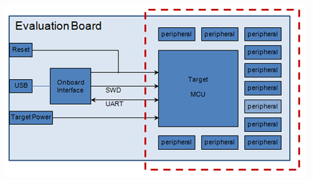
Benefits of the Mbed HDK
Quick design short-cut
Using ready-made schematics
Easy-to-use USB and debugging support
Compatible with Mbed OS
An example of how a microcontroller sub-system might be used to build an evaluation board

Slide 12
DAPLink
Open Source project that implements the embedded firmware required for a Cortex debug probe
Complemented by numerous reference designs that enable creation of DAPLink debug probe hardware
The DAPLink debug probe is connected to the host computer via USB and connects to the target system through a standard Cortex debug connecter
Features – provided via USB connection:
HID interface
Provides a channel over which CMSIS-DAP protocols can run
Enables tools such as Keil MDK, IAR Workbench, and pyOCD
USB drag and drop programming
The DAPLink debug probes appear as a USB disk on the host computer
Binary and hex files can be copied to the USB disk which are then programmed into the memory of the target system
USB serial port
DAPLink probe also provides a USB serial port
Port will appear on a Windows as a COM port or Linux as a /dev/tty interface

Slide 13
Development Tools
There are multiple ways for developers to program with Mbed. These consist of:
Mbed Studio
Mbed Online Compiler
Mbed CLI

Slide 14
Mbed Studio
Integrated development environment (IDE) for Mbed OS 5 applications
Includes everything required to create, compile and debug Mbed programs
Automatically detects connected Mbed enabled boards
Quick development for specific targets
Flashes code directly to connected platform
Provides debug session for debugging and profiling the target board

Slide 15
Mbed Online Compiler
A lightweight online C/C++ IDE that enables quick writing of programs, compilation, and running on a microcontroller
No prior-installation or set-up required to work with Mbed
Includes full code editor, version control, and library management

Slide 16
Mbed CLI
Arm Mbed CLI is a command-line tool packaged as ‘mbed-cli’ and based on Python.
Enables Git and Mercurial-based version control, along with dependency management, code publishing, support for remotely hosted repositories, and use of the Arm Mbed OS build system.
Reference: https://os.mbed.com/docs/mbed-os/v5.14/tools/developing-mbed-cli.html

Slide 17
Testing with Mbed
The Mbed platform offers a number of tools that support testing of your Mbed code
Greentea
Automated testing tool for Arm Mbed OS development
Pair with 'UNITY' and 'utest' frameworks
https://os.mbed.com/docs/mbed-os/v5.15/tools/greentea-testing-applications.html
Icetea
Automated testing tool for Arm Mbed OS development
Typically used for local development and automation in a continuous integration environment
https://os.mbed.com/docs/mbed-os/v5.15/tools/icetea-testing-applications.html
Process of flashing boards, running the tests, and generating reports is automated by the test system
Notes:
https://os.mbed.com/docs/mbed-os/v5.14/tools/testing.html

Slide 18
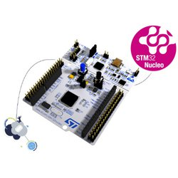
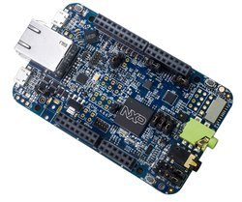
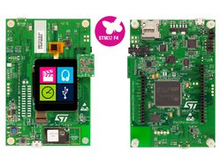
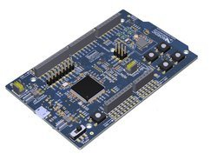
Mbed Enabled Platforms
The Arm® Mbed Enabled™ program outlines a set of functionality and requirements that must be met in order to become “Mbed Enabled”. This can cover development boards, modules, components, and interfaces
This benefits developers as they are assured that the platforms they choose to work with can perform certain functions/provide certain performance
It is also beneficial to the vendors as it allows their products more exposure when certified, and enables their product to become more familiar with developers in the Mbed eco-system
Some example boards include:
NUCLEO-F401RE
DISCO-F413ZH
DISCO-F413ZH
Nordic nRF51-DK

Slide 19
High-level vs. Low-level Programming
High-level
Advantages:
Higher productivity (less development time)
Portability across devices
Resulting code that is easier code to read and maintain
Allows reuse of code
Rapid prototyping of applications
Disadvantages:
Less optimized code
Additional translation time for source to machine code
Another level of abstraction to deal with
Low-level
Advantages:
More optimized code and memory efficient
Less translation time for source to machine code
Directly talk to hardware
Disadvantages:
Less portability from one device to another
Resulting code is more difficult for others to read, reuse, and maintain
Low productivity

Slide 20
Comparison: High-level vs Low-level
MCU register layer
Blinky example by poking registers
Mbed API
Blinky example using Mbed API functions
High-level
Control GPIO using Mbed API
GPIO Registers
Low-level

Slide 21
MCU Register Example
As shown in previous modules, the GPIO peripheral can be directly accessed by writing/reading specific memory addresses:
Assign a pointer to the address of each register
Registers can be read/ written to using the pointer
Directly access MCU registers
Notes:
This code is the closest approach to assembly level: everything is coded with addresses and pointers. The first line, including the mbed.h, should be disregarded as it is only used for this example’s readability. This code encapsulates the necessary port initialization, so it can focus on the blinky-function as the main routine.
In line 7, pin 18 is coded in a variable, by left-shifting a 1 eighteen times. So the bit 18 of mask_pin18 is set.
Lines 9 and 10 define the addresses to which ports (in this case, port 1) can be set and reset.
In lines 13 and 16, the pin 18 at port 1 is toggled by setting and resetting it respectively.
The code is short and efficient, but is nearly unreadable if the purpose of the addresses in lines 9 and 10 is not known, and if the names of the variables are not self-speaking.

Slide 22
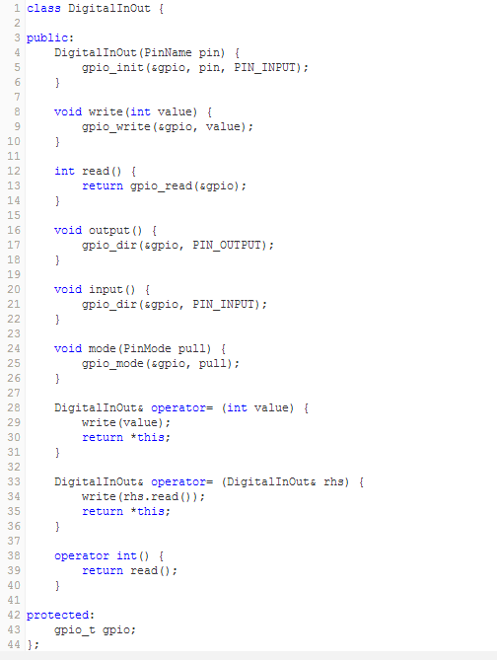
Mbed API Example
The Mbed API provides the actual user-friendly object-oriented API to the final user
More friendly functions/APIs
Object oriented API (using C++)
Top-level API used by the majority of the programs developed on the mbed platform
Defines basic operators to provide intuitive casting to primitive types and assignments
A digital IO class is defined as shown in the code clip.
Notes:
The easiest and most understandable way to program an Arm-based Cortex-M controller is to use the mbed API.
This slide shows an example of its code implementation. It shows the full C++ based abstraction, including operator functions as used in the example on the next slide.

Slide 23
Mbed API Example
With the support of the Mbed API, the same blinky example can be programmed in a much simpler and more intuitive way:
... using Mbed API
code...
Note that the Mbed API is programmed using the object-oriented language C++, which originated from C language with object-oriented features such as classes.
Deep knowledge of C++ is not necessary to use the Mbed API. However, many tutorials and books can help you learn C++ if you wish.
Notes:
In this example, code is written using the Mbed API. The declaration of led1 already constructs and assigns it to LED1 as part of the evaluation board, with the correct ports and addresses. The assignment of 1 and 0, in lines 7 and 10 respectively, lets it toggle on and off by writing the according values to the port (= address).
In this code, the use of addresses is completely encapsulated and invisible.

Slide 24
Cortex Microcontroller Software Interface Standard (CMSIS)
CMSIS: Cortex Microcontroller Software Interface Standard
A vendor-independent hardware abstraction layer for the Cortex-M processor series
Provides a standardized software interface, such as library functions, which help control the processor more easily, e.g. configuring the Nested Vectored Interrupt Controller (NVIC)
Improves software portability across different Cortex-M processors and Cortex-M based microcontrollers
low level programming
higher-level CMSIS programming
Configure Cortex-M by directly accessing
registers in its internal memory space
e.g. *(unsigned int*) NVIC_INT_ENABLE = 0x01;
Configure Cortex-M processors
by using CMSIS libraries
e.g. NVIC_EnableIRQ(Timer_IRQn);
API
Arm CMSIS-Core
Arm Cortex-M
Processor
Cortex-M0
Cortex-M
Cortex-M3
Cortex-M4

Slide 25
What is Standardized by CMSIS?
Functions to access, e.g., NVIC, System Control Block (SCB) and System Tick timer
Enables an interrupt or exception: NVIC_EnableIRQ (IRQn_Type IRQn)
Sets pending status of interrupt: void NVIC_SetPendingIRQ (IRQn_Type IRQn)
Access to special registers e.g.
Read PRIMASK register: uint32_t __get_PRIMASK (void)
Set CONTROL register: void __set_CONTROL (uint32_t value)
Functions to access special instructions e.g.
REV: uint32_t __REV(uint32_t int value)
NOP: void __NOP(void)
Names of system initialization functions e.g.
System initialization: void SystemInit (void)

Slide 26
Benefits of CMSIS
Easier to port application code from one Cortex-M based microcontroller to another Cortex-M based microcontroller
Easier to reuse the same code between different Cortex-M based microcontrollers
Better compatibility when integrating third-party software components, since all third-party components such as applications, embedded OS, middleware etc., can share the same standard CMSIS interface
Better code density and smaller memory footprint, since the codes in CMSIS have been optimized and tested

Slide 27
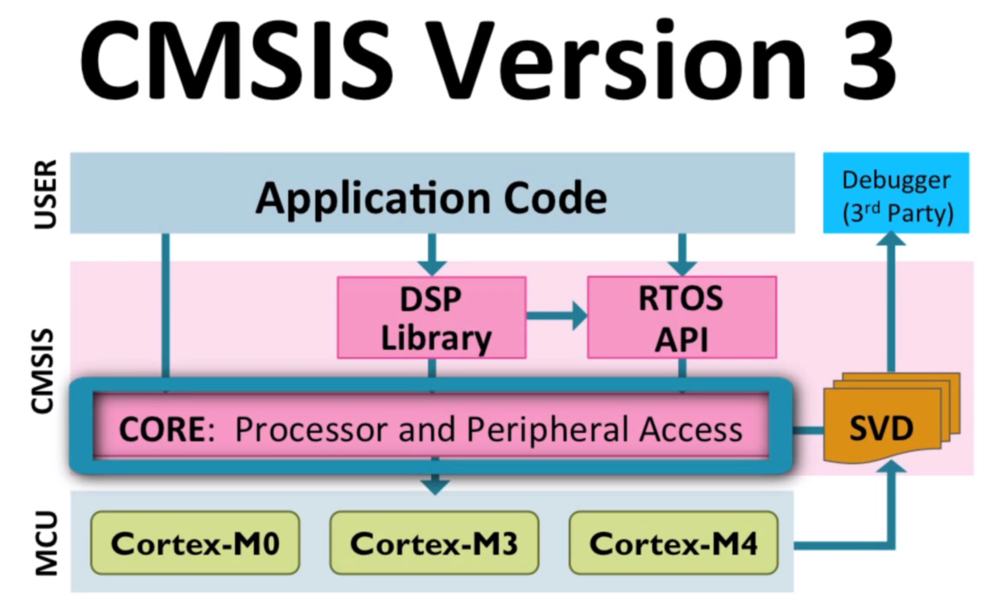
CMSIS Components
The CMSIS consists of the following components:
CMSIS-CORE
CMSIS-DSP, CMSIS-RTOS API and CMSIS-SVD
In this module, we will focus on using CMSIS-CORE

Slide 28
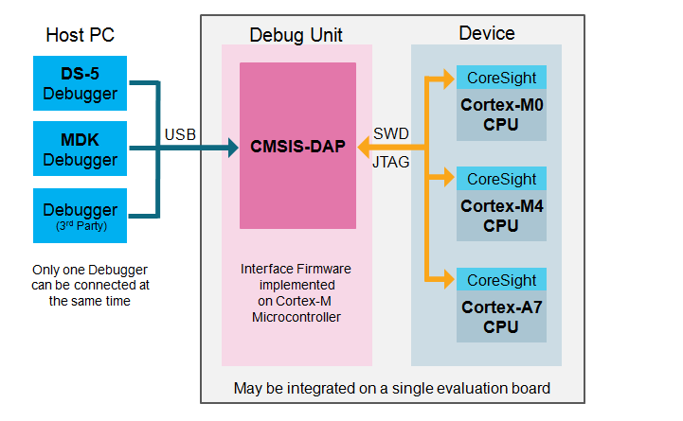
CMSIS-DAP
CMSIS-DAP is an interface firmware for the debug unit that connects the debug port to USB
Debuggers can connect via USB to the debug unit and to the device running the application software
The debug unit is connected to the target device via JTAG or SW
The Arm-Cortex processors then provide the CoreSight Debug and Trace Unit
Arm Development Studio Debugger

Slide 29
CMSIS Functions: Access NVIC
CMSIS Function | Description
void NVIC_EnableIRQ (IRQn_Type IRQn) | Enables an interrupt or exception.
void NVIC_DisableIRQ (IRQn_Type IRQn) | Disables an interrupt or exception.
void NVIC_SetPendingIRQ (IRQn_Type IRQn) | Sets the pending status of interrupt or exception to 1.
void NVIC_ClearPendingIRQ (IRQn_Type IRQn) | Clears the pending status of interrupt or exception to 0.
uint32_t NVIC_GetPendingIRQ (IRQn_Type IRQn) | Reads the pending status of interrupt or exception. This function returns non-zero value if the pending status is set to 1.
void NVIC_SetPriority (IRQn_Type IRQn, uint32_t priority) | Sets the priority of an interrupt or exception with configurable priority level to 1.
uint32_t NVIC_GetPriority (IRQn_Type IRQn) | Reads the priority of an interrupt or exception with configurable priority level. This function return the current priority level.

Slide 30
CMSIS Functions: Access Special Registers
Special Register | Access | CMSIS Function
PRIMASK | Read | uint32_t __get_PRIMASK (void)
 | Write | void __set_PRIMASK (uint32_t value)
CONTROL | Read | uint32_t __get_CONTROL (void)
 | Write | void __set_CONTROL (uint32_t value)
MSP | Read | uint32_t __get_MSP (void)
 | Write | void __set_MSP (uint32_t TopOfMainStack)
PSP | Read | uint32_t __get_PSP (void)
 | Write | void __set_PSP (uint32_t TopOfProcStack)

Slide 31
CMSIS Functions: Execute Special Instructions
Instruction | CMSIS Intrinsic Function
CPSIE i | void __enable_irq(void)
CPSID i | void __disable_irq(void)
ISB | void __ISB(void)
DSB | void __DSB(void)
DMB | void __DMB(void)
NOP | void __NOP(void)
REV | uint32_t __REV(uint32_t int value)
REV16 | uint32_t __REV16(uint32_t int value)
REVSH | uint32_t __REVSH(uint32_t int value)
SEV | void __SEV(void)
WFE | void __WFE(void)
WFI | void __WFI(void)

Slide 32
CMSIS Functions: Access System
CMSIS Function | Description
void NVIC_SystemReset(void) | Initiate a system reset request
uint32_t SysTick_Config(uint32_t ticks) | Initialize and start the SysTick counter and its interrupt
void SystemInit (void) | Initialize the system
void SystemCoreClockUpdate(void) | Update the SystemCoreClock variable

