Slide 1
Digital Input and Output (IO)
Notes:
Digital inputs and outputs are the basis for an interaction between peripheral components and the microcontroller system. In contrast to analog inputs and outputs (which are mostly used for reading sensors or generating waveforms), digital inputs and outputs (I/Os) can only provide two states: on and off (0 or 1).
This state needs to be translated into an application-specific voltage, signaling the state. The most common voltage for microcontroller applications is the unipolar 0 and 5 V. For bus communication, this voltage may need to be adapted to the bus-specific voltage such as -5...+5 V for the USB bus or -15...+15 V for the RS 232 bus.
This lecture deals with the handling of digital inputs and outputs.

Slide 2
Module Syllabus
Digital input and output (IO)
Voltages and logic values
General-purpose IO (GPIO) controller
Using pointers to access GPIO
Define data structure for peripherals
Mbed API Digital I/O
DigitalIn/DigitalOut
BusIn/BusOut
Digital IO examples
Using LED
Using 7-segment display
Using infrared emitter/detector
Notes:
In this module, the student will learn about:
The link between physical voltages and logic values
How to set up the controller for accessing and using so-called general-purpose input/output (GPIO) pins
This module ends with some examples for the application of GPIOs.

Slide 3
Voltages and Logic Values
In digital devices, logical values : ‘ 1’ or ‘0’, are represented as electrical voltages
Different devices may use different voltages to represent a logic value
For example, the external pins of the Nucleo F401RE platform use 3.3 volts for logic ‘1’, and 0 volts for logic ‘0 ’
Different logic can, however, have different meanings in different contexts depending on the interpretation we give to different voltage levels
Logic | Voltage | Boolean | Circuit | Switch
‘1’ | 3.3V | True | Closed | On
‘0’ | 0V | False | Open | Off
Notes:
0 and 1 represent the logical state of a voltage switched OFF or ON. These states are not necessarily connected to a dedicated voltage, but could be a unipolar range from 0...+3.3V, or any arbitrary different voltage such as 0...+5V for common microcontroller applications, or 0 (0.7V) to 12V for a LIN Bus, or bipolar levels from -15V...+15V for RS232 or -5V...+5V for USB.
With general-purpose I/O-pins (GPIO), a microcontroller usually provides voltages at the dedicated levels 0 and its maximum positive power supply +Vcc. Until recently, +Vcc (the HIGH voltage) was 5V; however, today’s ultra-low power processors have reduced this voltage to as low as 1.8V. This means that it may be necessary to shift the levels produced by the processor with an additional IC (a level converter) to reach the required levels.
Generally, active components such as LEDs or motors can also be driven directly with GPIOs. But as the ports generally provide quite a low current (usually 10mA) and low total power (1.8V x 10mA = 18mW), the approach of directly driven components is good for testing purposes but not very common in real-life application. In real-life applications, GPIOs control ‘switches,” such as transistors, to disable or enable the power supply for other components.
The most important thing is to remember that GPIOs can only provide two voltage levels. If more than two are required, an analog input or output, or the trick of a pulse width modulation (PWM), must be used.

Slide 4
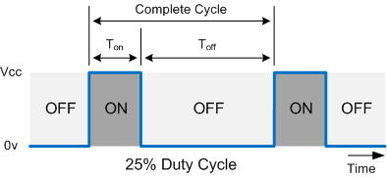
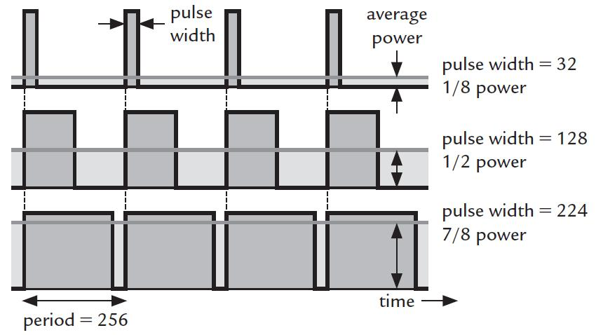
Example: Pulse Width Modulation (PWM)
Generating analog-like signal digitally by modulation of power:
Digital signals can only turn signals on and off -> generate 2 values
Using pulse width modulation, analog-like signals can be generated, varying the average electrical power over time
Change ratio between on and off times within one periodic cycle
Duty-cycle: t_{on} / (t_{on} + t_{off})
= t_{on} / t_{cycle}
Application
Control of voltage-sensitive components such as LEDs or servos
https://students.cs.byu.edu/~clement/cs224/labs/L06a-morse/images/PWM_duty_cycle.jpg
Notes:
Although digital signals can only generate amplitudes 0 and 1, it is possible to create an analog-like output, with a pulse width modulation (PWM). A PWM periodically repeats an on-off pattern. Within the on-off pattern, the ratio between the on-time vs. the total time of a period may change. This ratio is called the ‘duty-cycle’ and reflects the portion of energy transmitted during one whole periodic cycle.
While the amplitude can only be changed between 0 and 1, the duty-cycle may be changed in a much higher resolution, depending on the selected clock frequency. The transported energy, i.e., the most relevant physical quantity, is proportional to the duty-cycle.
This digital-to-analog conversion is mainly used when:
There is no amplitude modulated analog signal available
The system is sensitive to changes in the supply voltage such as LEDs or servos, but must be modulated

Slide 5
GPIO Design
Each physical pin is connected to a multiplexer
Allows each pin to perform several functions
Optimizes functionality for small packages
Each port is connected to microcontroller via peripheral bridge
Additional settings are required to make virtual pins on physical pins (pin pad) available
Signal multiplexer and other pin options can be configured in the pin control register (PCR).
GPIO pins split into groups, called ports
Each port has 32 virtual pins [31:0] assigned
To reduce power consumption, clocks are turned off for particular areas
Default setting: clock is disabled
To use a peripheral or a resource, clock has to be enabled for each item individually
physical pin management
Pin Control
Register (PCR)
...
IRQ
GPIO Ports
MUX
Pin Pad
Clk
Tmr
...
clock
Notes:
The following sections will explain how GPIOs work and should be set up. In order to do this, it is necessary to understand the general concept behind GPIOs as illustrated in the slide.
Because physical pins are ‘valuable’ in most processors, physical pins are assigned dynamically to different functions such as timer, clock, ADC, or GPIO. This means that GPIOs are handled and managed virtually and need to be assigned separately to a physical pin. The multiplexer between the virtual and the physical pins is managed by a pin control register (PCR).
Every GPIO pin (virtually or physically) represents a 0 or 1 state; therefore, it is a bit. To save memory, GPIOs are grouped in ports according to the register size of the controller. If the controller arranges the registers into groups of 32 bits, the GPIOs are combined into ports of 32 pins.
In order to save energy, the clock is disabled, by default, in particular areas such as the GPIO resource block. Therefore, it needs to be enabled individually.

Slide 6
GPIO Design
Normally, the external pins are not directly accessible, but accessed via a peripheral called general-purpose input/output (GPIO).
Used for general purpose, no special usage defined
Widely used for most applications
The direction of input/output is controlled by the direction register
GPIO Controller
Bus Interface
Registers
Data Output Register
Set Output Register
MUX
Output Buffer
Clear Output Register
Toggle Output Register
Pin Pad
Direction Register
Inv
Input Buffer
Input Register
Notes:
For data management, three types of registers are required:
1. GPIO control registers setting the general GPIO configuration such as direction management
2. Data control registers managing and manipulating the data sent to the GPIO
3. Data registers containing sent or received data
All GPIOs are controlled with the GPIO controller, which is connected via an internal bus interface. Because the GPIO may be used bi-directionally (half duplex), it is necessary to set its mode to input or output with the direction register.
If the GPIO pin is configured for output, the data output register can be written with a new value in which the set output register is masked with a 1.
If the GPIO pin is configured for input, it should be pulled up (to Vcc) or pulled down (to GND) with a pull-up or pull-down resistor. This prevents a free-floating gate with an undefined electrical potential, in case the source for the input pin is turned off.
With a pull-x-resistor, the input pin is automatically pulled to the x-potential. Such resistors can be applied by external wiring, though many processors also offer this as an internally wired feature. Note that this feature needs to be considered carefully because it always draws energy either from the source or via the pull-x-transistors.

Slide 7
Methods for Programming Digital GPIO
We will look at two ways of programming digital GPIO:
Low-Level: GPIO Registers
Slower to write
More understanding of underlying functionality
High-Level: Mbed API
Quicker to write
Less understanding of underlying functionality

Slide 8
GPIO Registers
For example, in the Nucleo F401RE MCU, there are eight GPIO peripherals named from PORTA-PORTH, and each of them has 10 registers, which include:
Port Mode Register (MODER) - configure the I/O direction mode (input/output/alternate/analog)
Output Type Register (TYPER) – configure the output type of the I/O port (push-pull/open-drain)
Output Speed Register (OSPEEDR) – configure the I/O output speed (2/25/50/100 MHz)
Pull-Up/Pull-Down Register (PUPDR) – configure the I/O pull-up or pull-down (no pull-up, pull-down/pull-up/pull-down)
Input Data Register (IDR) – contain the input value of the corresponding I/O port
Output Data Register (ODR) – can be read and written by software (ODR bits can be individually set and reset by writing to the BSRR)
Bit Set/Reset Register (BSRR) – can be used for atomic bit set/reset
Configuration Lock Register (LCKR) – used to lock the configuration of the port bits when a correct write sequence is applied to bit 16
Alternate Function Low Register (AFRL) – configure alternate function I/Os
Alternate Function High Register (AFRH) – configure alternate function I/Os

Slide 9
Using Pointer to Access GPIO
Normally, you can use a pointer to directly access a GPIO peripheral in either C or assembly. For example in C, to light an LED on PB_10:
This solution is fine for simple applications. However, if multiple instantiations of the same type of peripheral are available at the same time, we will need to define registers for each peripheral, which makes code maintenance difficult
On the other hand, since each register is defined as a separate pointer, each register access requires a 32-bit address constant. As a result, the program image will consume a larger memory space.
#define RCC_AHB1ENR (*((volatile unsigned long *) 0x40023830))
#define GPIOB_MODER (*((volatile unsigned long *) 0x40020400))
#define GPIOB_PUPDR (*((volatile unsigned long *) 0x40020408))
#define GPIOB_OSPEEDR (*((volatile unsigned long *) 0x4002040C))
#define GPIOB_ODR (*((volatile unsigned long *) 0x40020414))
RCC_AHB1ENR |= 0x02;
GPIOB_MODER |= 0x00100000;
GPIOB_PUPDR |= 0x00200000;
GPIOB_OSPEEDR |= 0x00200000;
GPIOB_ODR |= 0x0400;

Slide 10
Define a Data Structure for Peripherals
To further simplify the code and reduce its length, we can:
Define the peripheral register set as a data structure,
Define the peripheral as a memory pointer to this data structure:
For example:
typedef struct {
volatile unsigned int MODER;
volatile unsigned int OTYPER;
volatile unsigned int OSPEEDR;
volatile unsigned int PUPDR;
volatile unsigned int IDR;
volatile unsigned int ODR;
volatile unsigned int BSRRL;
volatile unsigned int BSRRH;
volatile unsigned int LCKR;
volatile unsigned int AFR[2];
} GPIO_TypeDef;

Slide 11
Define a Data Structure for Peripherals
Then, to turn on an LED on PB_10:
#define GPIOB_BASE 0x40020400
#define GPIOB ((GPIO_TypeDef *) GPIOB_BASE )
RCC -> AHB1ENR |= 0x02;
GPIOB -> MODER |= 0x00100000;
GPIOB -> PUPDR |= 0x00200000;
GPIOB -> OSPEED |= 0x00200000;
GPIOB -> ODR |= 0x0400;

Slide 12
Define a Data Structure for Peripherals
With such arrangement:
The same register data structure for the peripheral can be shared between multiple instantiations
Hence code maintenance is easier
The requirement for immediate data storage is reduced
Compiled code is smaller, giving better code density
With further modification, the functions developed for one peripheral can be shared between multiple instantiations by passing the base pointer to the function, for example:
#define GPIOA ((GPIO_TypeDef *) GPIOA_BASE )
#define GPIOB ((GPIO_TypeDef *) GPIOB_BASE )
#define GPIOC ((GPIO_TypeDef *) GPIOC_BASE )
void GPIO_init (GPIO_TypeDef *GPIO_pointer) {
GPIOB -> MODER |= 0x00100000;
GPIOA -> MODER |= 0x00010000;
}

Slide 13
Mbed API – Digital I/O
The Mbed API provides a number of drivers that provide access to general purpose microcontroller hardware
For digital I/O the key APIs are:
DigitalIn
DigitalOut
BusIn
BusOut
We will take a look at some examples and see how they compare to the low-level equivalent

Slide 14
DigitalIn/DigitalOut
The DigitalIn interface is used to read the value of a digital input pin
The logic level is either 1 or 0
The DigitalOut interface is used to configure and control a digital output pin by setting the pin to a logic level of 0 or 1.
Any number of Arm Mbed pins can be used as a DigitalIn or DigitalOut, for example:
There is also the DigitalInOut interface, which is a bidirectional digital pin, we can use this interface to read the value of a digital pin when set as an input(), as well as write the value when set as an output().
DigitalIn mybutton (Input Pin);
DigitalOut Led_out(Output Pin);
int main() {
if (mybutton)
Led_out = 1;
}

Slide 15
DigitalIn Class Reference
Function Name | Description
DigitalIn(PinName pin) | Create a DigitalIn connected to the specified pin.
DigitalIn(PinName pin, PinMode mode) | Create a DigitalIn connected to the specified pin.
int read () | Read the input, represented as 0 or 1 (int).
void mode (PinMode pull) | Set the input mode.
int is_connected () | Return the output setting, represented as 0 or 1 (int).
operator int () | An operator shorthand for read().

Slide 16
DigitalOut Class Reference
Function Name | Description
DigitalOut(PinName pin) | Create a DigitalOut connected to the specified pin.
DigitalOut(PinName pin, int value) | Create a DigitalOut connected to the specified pin.
void write () | Set the output, specified as 0 or 1 (int).
int read () | Return the output setting, represented as 0 or 1 (int).
int is_connected () | Return the output setting, represented as 0 or 1 (int).
DigitalOut & operator= (int value) | A shorthand for write().
DigitalOut & operator= (DigitalOut &rhs) | A shorthand for write() using the assignment operator which copies the state from the DigitalOut argument.
operator int () | An operator shorthand for read().

Slide 17
BusIn/BusOut
The BusIn API allows you to combine a number of DigitalIn pins to read them at once
Useful for checking multiple inputs together as a single interface instead of individual pins
The BusOut API allows you to combine a number of DigitalOut pins to write to them at once
Useful for writing to multiple pins together as a single interface instead of individual pins.
Any number of Arm Mbed pins can be used as a BusIn or BusOut, for example:
#include "mbed.h"
BusOut myleds(LED1, LED2, LED3, LED4);
int main() {
while(1) {
for(int i=0; i<16; i++) {
myleds = i;
wait(0.25);
}
}
}
https://os.mbed.com/docs/mbed-os/v5.15/apis/busout.html

Slide 18
BusIn Class Reference
Function Name | Description
BusIn (PinName p0, PinName p1=NC … PinName p15=NC) | Create a BusIn, connected to the specified pins.
BusIn (PinName pins[16]) | Create a BusIn, connected to the specified pins.
int read () | Read the value of the input bus.
void mode (PinMode pull) | Set the input pin mode.
int mask () | Binary mask of bus pins connected to actual pins (not NC pins). If bus pin is in NC state make corresponding bit will be cleared (set to 0), else bit will be set to 1.
operator int () | A shorthand for read().
DigitalIn& operator[] (int index) | Access to a particular bit in random-iterator fashion.

Slide 19
BusOut Class Reference
Function Name | Description
BusOut (PinName p0, PinName p1=NC … PinName p15=NC) | Create a BusOut, connected to the specified pins.
BusOut (PinName pins[16]) | Create a BusOut, connected to the specified pins.
void write (int value) | Write the value to the output bus.
int read () | Read the value currently output on the bus.
void mode (PinMode pull) | Set the input pin mode.
int mask () | Binary mask of bus pins connected to actual pins (not NC pins). If bus pin is in NC state make corresponding bit will be cleared (set to 0), else bit will be set to 1.
BusOut & operator= (int v) | A shorthand for write().
operator int () | A shorthand for read().
DigitalIn& operator[] (int index) | Access to a particular bit in random-iterator fashion.

Slide 20
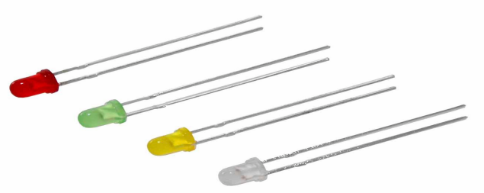
Digital IO Example: LEDs
Light-emitting Diode (LED)
Emits light when switched on
Is the simplest way to indicate the status of logic
Is also widely used in applications such as automotive lighting, general lighting, traffic signals etc
Digital Output
Vcc 3.3V
I_{D}
I_{D}
R
R
LED
LED
Digital Output
GND
Digital output sources current to LED
Digital output sinks current from LED
Notes:
Important note: Never connect an LED directly to a voltage source without calculating the maximum current.
The maximum current for a standard LED is about 10mA, and the power drop of an LED depends on its color.
For a red LED, we expect a voltage drop of about 2V at the LED. Connecting this LED to a GPIO of 5V output voltage means that the remaining 3V difference is driving the full output current through the LED, trying to increase the voltage drop at the LED to 5V. But because an LED has physically defined voltage drop, this can’t happen, which means that the LED will be destroyed by the current.
Therefore, a ‘protection resistor’ has to be series-connected with the resistor. The size of the resistor can easily be calculated by looking at the difference between the driving voltage and the “color”-voltage. This difference must not exceed the maximum current calculated by R = U / I = (5V-2V) / 10 mA = 0.3 * 10^3 Ohm = 300 Ohm.

Slide 21
Digital IO Example: 7-Segment Display
Use 7 segments and a dot to display numerals or letters
Widely used in digital electronic devices, such as digital clocks and electronic meters
Simple to controller, easy to debug
Different values can be represented by different combinations of 8-bit segments (including dot). For example:
Display | 0 | 1 | 2 | 3 | 4
8-bit value | 00111111 | 00000110 | 01011011 | 01001111 | 01100110
Display | 5 | 6 | 7 | 8 | 9
8-bit value | 01101101 | 01111101 | 00000111 | 01111111 | 01101111
Notes:
With GPIOs, a 7-segment display can be directly driven. By defining 7 bit-values, each driving a separate pin at a GPIO, numbers can be directly displayed without encoding and decoding BCD converters.

Slide 22
Digital IO Example: Infrared Emitter/Detector
Infrared emitter (LED)
A light-emitting diode that emits invisible infrared (IR) when conducting e.g. when connected to digital output:
‘1’: IR emitted (or brightness above a threshold)
‘0’: no IR emitted (or brightness below a threshold)
Infrared detector (photodiode)
Converts light into either current or voltage e.g. when connected to digital input:
‘1’: IR received (or brightness above a threshold)
‘0’: no IR received (or brightness below a threshold)
Vcc 3.3V
Digital Output
R
R
Infrared emitter
Infrared detector
Digital Input
GND
Notes:
In this example, the same method is applied as before, but one GPIO is defined as input, the other one as output.
Please note: An output GPIO should always have the internal pull-up and pull-down resistor activated, in order to protect the inputs against undefined input states if no source is connected.
This is because an output is, by definition, a low impedance (= low resistance) element. If a power-producing element is connected to a GPIO pin by mistake, then the full energy current will flow into the chip, without a protective high impedance resistor to reduce the flow. This might destroy the pin driver, if not the whole chip.

Slide 23
Resources
Cortex-M4 Technical Reference Manual: https://developer.arm.com/docs/100166/0001
Cortex-M4 Devices Generic User Guide: https://developer.arm.com/docs/dui0553/b
STM32 Nucleo-F401RE: https://www.st.com/en/evaluation-tools/nucleo-f401re.html

