Slide 1
Analog Input and Output

Slide 2
Module Syllabus
Analog input and output overview
Analog input
Digital-to-analog converter
Analog output
Analog-to-digital converter
ADC range
Resolution and quantization
Sampling frequency
Input/output analog signals using Mbed
Mbed analog input
Mbed analog output

Slide 3
Overview of Analog Input and Output
Most signals in the real world are analog signals
Processors are digital devices. To interface with analog signals, these have to be converted into digital signals and vice versa
Analog-to-Digital Converter (ADC):
Converts the amplitude of physical analog signals to discrete digital numbers
Involves signal sampling and quantization
Digital-to-Analog Converter (DAC):
An inverse operation of ADC
Converts digital data into analog signals, such as current, voltage, or electric charge
For example, a DAC could be used to drive an earphone or speaker amplifier so that sound (analog air pressure waves) can be produced.
Notes:
To be readable by a processor, an analog real-world-signal needs to be converted into a digital signal. This means that a sensor’s first step is to convert the physical signal into an electrical one.
After sampling with a sample-and-hold-stage (time-discretization), the signal it is converted, via an analog-to-digital-converter (ADC), into time- and value-discrete digital samples.
In the inverse operation, a digital-to-analog-converter converts the samples into real-world analog type values. The values can only be analog because the sampling and quantization is a real loss of information which cannot be recovered or substituted.

Slide 4
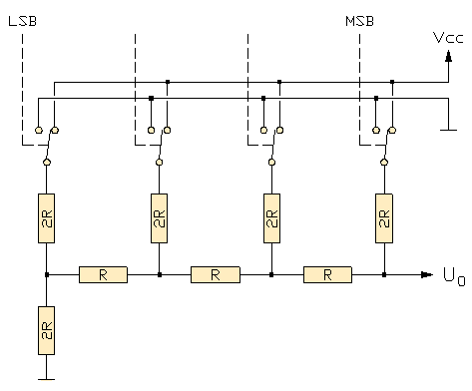
Digital-to-Analog Converter
Digital-to-Analog Converter (DAC):
Input: discrete finite-precision number (usually in binary)
Output: continually varying physical signals, such as voltage or pressure
The following picture gives an 8-bit DAC example:
Reference Voltage: V_{r}
Bit0
+
Bit1
8-bit DAC
+
Bit2
Analog Voltage
Output: V_{o}
Digital Input D
Bit3
Bit4
Bit5
-
Bit6
Bit7
Control Signals
source: http://www.vias.org/mikroelektronik/da_converter.html
Notes:
A DAC transmits the digital input values to a resistor network, in which the input voltage of the according bits is binary weighted. This is usually done with a R-2R-resistor network. The output voltage is the analog equivalent to the digital input number, weighted with the reference voltage.

Slide 5
Digital-to-Analog Converter
The relationship between a DAC’s input and its output is:
Vo: Output voltage
Vr: Value of the reference voltage
D: Value of the input binary word
n: the number of bits in the word
Maximum output:
Vr is never reached in this case since:

Slide 6
Digital-to-Analog Converter
For example, to generate a triangular wave:
Input: 3-bit binary data
Output: analog voltage ranging from 0 to 7/8 V_{r}
Output
voltage
7 V_{r} / 2³
6 V_{r} / 2³
5 V_{r} / 2³
4 V_{r} / 2³
3 V_{r} / 2³
2 V_{r} / 2³
1 V_{r} / 2³
0 V_{r} / 2³
Binary input
Notes:
This means that the output of a 3-bit value (0...7) triangular waveform behind a DAC is the curve shown in the figure.

Slide 7
Analog-Digital-Conversion-System
An ADC-System usually consists of three stages:
Multiplexer: reduces the number of required ADC components at the expense of conversion speed
Sample-and-hold: keeps the analog signal during the conversion constant. Time discretization!
ADC: converts the analog into digital signal
Reference Voltage Vr
Input Channels
Input Voltage Vi
8-bit ADC
Bit0
Analog input 1
Bit1
Analog input 2
Sample-
and-
hold
Bit2
Bit3
Digital
Output D
Analog input 3
Bit4
Bit5
Analog input 4
Bit6
Multiplexer
Bit7
Control signals
Notes:
There are usually three steps in an analog-to-digital conversion:
First, select the input line to be converted (multiplexer). Because an ADC-stage consumes the chip area and is complex to build, due to its need for precision, the number of ADCs must be kept to a minimum. An upstream multiplexer switches the analog line to the respective multiplexer and makes it available for a conversion.
Next, the sample-and-hold is usually a switched capacitor, which is loaded with the actual voltage of the analog signal and keeps it constant during the conversion time.
Finally, the ADC converts the analog signal into a digital signal.

Slide 8
Analog-to-Digital Converter
Analog-to-Digital Converter (ADC):
Input: time-discrete due to the prior S+H-stage physical signals
Output: discrete numbers that are proportional to the analog input amplitude
The following picture gives an example of an 8-bit ADC:
Reference Voltage V_{r}
Input Voltage Vi
8-bit ADC
Bit0
Bit1
Bit2
Bit3
Digital
Output D
Bit4
Bit5
Bit6
Bit7
Control Signals
Notes:
The main task of an ADC is to create the digital values of an analog input voltage. The signal is already time-discrete as a result of the previous S+H-stage.
Different types of converters are available as shown on the next slide.

Slide 9
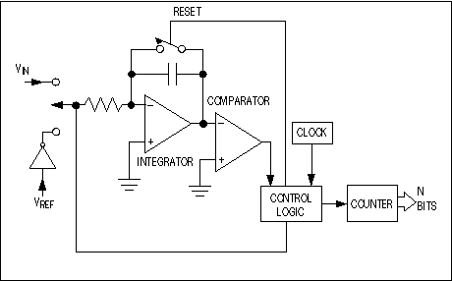
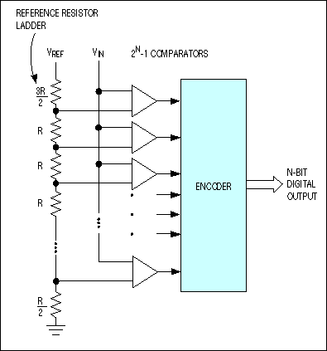
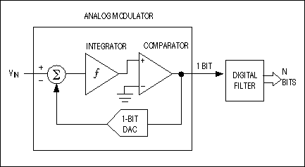
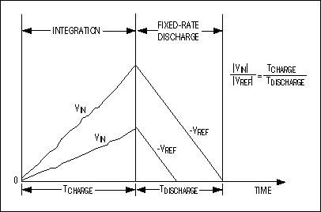
ADC Types
There are 3 common types for ADC:
Flash converters, comparing the input voltage with different reference voltage levels
Slope converters, converting the voltage into a charge capacitor and measuring the time for charging and discharging
Feedback converters, trying to generate a signal proportional to the input voltage. The internal proportionality-coefficient represents the digital word.
feedback converter
here: delta-sigma
flash converter
slope converter
source: http://www.skillbank.co.uk/SignalConversion/adc.htm
Notes:
All the different types of ADC have advantages and disadvantages:
The flash converter is very fast but needs as many comparators as digital values to be represented; for example, an 8-bit converter needs 256 comparators.
The slope converter is quite fast and easy to set up, but it needs to be very stable during and between different measurements. Additionally, a very stable and fast clock has to be designed, as the resolution of the clock defines the resolution.
A feedback converter (such as delta-sigma, successive approximation, etc.) is often the best trade-off. The analysis of different feedback converters’ precision and resolution is beyond the scope of this module.

Slide 10
ADC Range
ADCs have minimum and maximum permissible input values, which determine the range of an ADC.
The range and the resolution of the ADC are linked to the reference voltage and the physical principle of the ADC.
Flash converter and feedback converter:
Slope converter:
V_{i}: input voltage; V_{ref}: reference voltage; n: digital resolution in bit; t_{charge}: charging time; t_{clock}: reference clock

Slide 11
ADC Resolution and Quantization
The resolution of the ADC refers to the number of discrete data that can be produced over the range of the analog values.
Resolution determines the minimum magnitude of the quantization and the quantization error.
Can be expressed in bits, e.g., an 8-bit ADC has a resolution of 256 values.
Can also be expressed in volts: the minimum change in the digital output is called the Least Significant Bit (LSB) voltage, e.g., an 8-bit ADC with a range of 10V has a resolution of 10/256V.
Resolution also determines the maximum possible average Signal to Noise Ratio (SNR).
Notes:
The resolution (= quantization step) depends on a physical principle of an ADC, which is the reference voltage.
Because the resolution represents discrete values, there is a so-called ‘resolution error’. This is the difference between a minimum resolution step and the real value:
error = V_input – digital Value * V_reference/2^n
The error can be reduced with a higher resolution, but a countermeasure against the resolution is noise. Because no conversion principle is perfectly stable, the output value for the same input voltage may differ slightly between single conversions. This is the resolution noise. The higher the resolution, the higher the noise.

Slide 12
Quantization Error
Quantization error is the noise introduced by quantization in an ideal ADC.
Rounding error between the actual analog input and the digitized value
Digital output
Sampling instance
111
110
101
100
Quantization
error
011
010
Actual input
001
000
Input voltage

Slide 13
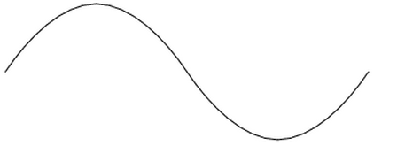
ADC Sampling Frequency
In ADC, the sampling rate refers to the rate of collecting new values
The analog signal is continuous in time
Digital data are is discrete
The sampling rate has to be high enough to reproduce the original signal
According to the Shannon-Nyquist sampling theorem, the sampling frequency must be at least double that of the highest frequency in the incoming signal.
For example, the accepted standard range of audible frequencies is in the range of 20 to 20,000 Hz, approximately, so standard audio CDs are sampled and played at 44.1kHz.
Reduced sampling frequency will result in signal aliasing effect as shown below:
Notes:
The sampling rate is a combination of the total system’s time constants. It must be slow enough for the S+H and the multiplexer to follow, and fast enough for the S+H not to lose its values. You can see that there is always a trade-off among all system components.
The Shannon theorem can be explained in the frequency domain. Sampling leads to repeating spectra with the frequency distance of the sampling frequency. They need double the bandwidth compared to the ‘useful signal’ in the frequency domain, because they are represented by their positive AND negative values. This means that they need double the distance between the repeating spectra, in order to avoid overlapping of parts of the repeating spectra.
Therefore, as previously noted, this distance between the repeating spectra is defined by the sampling rate, so the sampling rate has to be at least double the signal bandwidth. In practice, this should be between factor 5 and 10, because sampling is not ideal on infinitely steep slopes.
The effect of overlapping spectra is called ‘aliasing’. Anti-aliasing filters cut the signal above the maximum Shannon-frequency to avoid aliasing; however, the signal above the Shannon frequency is lost.

Slide 14
Input Analog Signal Using Mbed
The Mbed API provides libraries for both ADC and DAC.
For example, the following functions are provided to input an analog signal:
Function Name | Description
AnalogIn (PinName pin) | Create an AnalogIn connected to the specified pin
float read () | Read the input voltage, represented as a float in the range [0.0, 1.0]
unsigned short read_u16 () | Read the input voltage, represented as an unsigned short in the range [0x0, 0xFFFF]
operator float () | An operator shorthand for read()
Notes:
Before using a GPIO for input and output, the following should be taken into consideration:
Not all ports are similarly suitable for digital AND analog IO, so be sure to select the correct ports.
Ports must be initialized and configured before being used as input OR output.

Slide 15
Example of Analog Input
The following code gives an example of using analog input functions:
#include "mbed.h"
AnalogIn ain(Analog Input Pin);
DigitalOut led(Output Pin);
int main() {
while (1){
if(ain > 0.3) {
led = 1;
} else {
led = 0;
}
}
}
Notes:
In the first two lines of the code above
an analog input port
a digital output port
are configured and initialized.
If the analog input rises above a given voltage (here: 0.3V), line 3 of main, an LED, is turned on. Otherwise, it is turned off, as per line 6 of main.

Slide 16
Output Analog Signal Using Mbed
Mbed API functions for analog output
Function Name | Description
AnalogOut (PinName pin) | Create an AnalogOut connected to the specified pin.
void write (float value) | Set the output voltage, specified as a percentage (float)
void write_u16 (unsigned short value) | Set the output voltage, represented as an unsigned short in the range [0x0, 0xFFFF]
float read () | Return the current output voltage setting, measured as a percentage (float)
AnalogOut operator= (float percent) | An operator shorthand for write()
AnalogOut operator float () | An operator shorthand for read()

Slide 17
Example of Analog Output
The following code gives an example of using analog output functions:
#include "mbed.h"
AnalogOut signal(Analog Output Pin);
int main() {
while(1) {
for(float i=0.0; i<1.0; i+=0.1) {
signal = i;
wait(0.0001);
}
}
}
Notes:
This program outputs a 10-step ramp (for loop) with f = 1kHz (10kHz for 1 step with 10 steps for the ramp = 1kHz total signal frequency).
The output port is again initialized in the second line of the program.

Slide 18
Resources
Mbed: https://www.mbed.com/en/
Official Mbed GitHub Repository: https://github.com/ARMmbed/mbed-os
Mbed OS 5: https://os.mbed.com/docs/mbed-os/v5.14/introduction/index.html

