Slide 1
AMBA 3 AHB-Lite Bus Architecture
Intro to System-on-Chip Design Course

Slide 2
Learning Objectives
At the end of this lecture, you should be able to:
Define the main elements of a Bus.
Outline the steps used to access a peripheral in typical bus operation.
Identify the AMBA Bus families and their respective supported bus protocols.
Describe the functions of the Address Decoder in the AHB-Lite system.
Describe the principles of operation of the AHB-Lite bus in terms of type of transfer and transfer phases.

Slide 3
Module Syllabus
Basic Principles of Buses
Main Features of Arm AMBA Bus Families
AMBA 3 AHB-Lite Bus
Hardware Architecture
Operation Principles

Slide 4
Building a System on a Chip
Software high-level
application development
Application Design (e.g., Game)
Application Programming Interface (API)
Software low-level drivers & libraries programming
Arm CMSIS-Core
Peripheral Drivers
Arm Cortex-M0
Processor
Timer
Peripheral
GPIO
Peripheral
7-segment
Peripheral
Hardware design
AHB
Memory
VGA
Peripheral
UART
Peripheral
Notes:
One of the most important aspects of a system on a chip (SoC) is not only which components or blocks it houses, but also how they interconnect.
So far, we have studied the hardware architecture of the Cortex-M0, its instructions set, and its main power-saving features. This module will focus on learning the basic principles of the Arm AHB bus. A bus is a very important part of the SoC design, as it allows the processor to communicate with other parts of the system, such as memory blocks, peripherals, and application-specific logic.

Slide 5
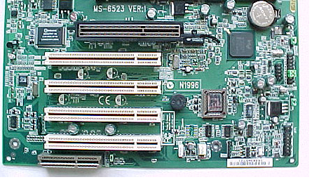
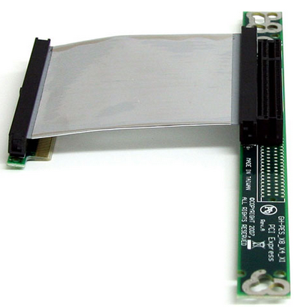
What Is a Bus?
Traditionally, a bus is a communication system that allows data to be transferred between different components in a system.
Hardware and software infrastructure are involved:
Hardware infrastructure includes physical implementation, such as cables or wires; e.g., the PCI uses a PCI cable to connect components inside a desktop.
Software infrastructure includes the bus protocol, e.g., the PCI bus protocol.
PCI socket on a motherboard
PCI bus cable
Notes:
A basic building block of most on-chip communication architectures in SoC designs is the single shared bus.
The simplest bus design consists of a set of shared, parallel wires to which various components are connected, where only one component on the bus can have control of the shared wires at any given time to perform data transfers. Such a simple bus design limits the parallelism and achievable performance in the system, which makes it unsuitable for most SoC applications. Therefore, more advanced solutions are usually employed in such systems. One of these is the AMBA bus, which we will discuss today.
The bus design specification includes both hardware and software infrastructures. The hardware infrastructure includes the physical implementation, such as cables or wires. For example, the PCI uses a PCI cable to connect components inside a desktop. Software infrastructure includes the bus protocol, e.g., PCI bus protocol.

Slide 6
Bus Terminology
Manager
Subordinate 1
Address
Decoder
Subordinate 2
Multiplexor
Select
Subordinate 3
Subordinate
Multiplexor
Notes:
In this diagram, we can see an example of a bus design. There are some terms that are typically used in the specifications of on-chip buses, and it is important to be familiar with the terminology used.
A “manager” (or initiator) refers to the IP component that initiates a read or write data transfer (e.g., processor or DSP).
A “subordinate” (or target) refers to the IP component that does not initiate transfers and only responds to incoming transfer requests (e.g., memory block).
A “decoder” refers to a logic block that decodes the destination address of a data transfer initiated by a manager and selects the appropriate subordinate to receive the data.
A multiplexor is used to multiplex the read data bus and response signals from the subordinates to the manager. The decoder provides control for the multiplexor.

Slide 7
Bus Operation in General
A bus typically consists of three types of signal lines:
The data bus is used to exchange data information.
The address bus is used to select one of the peripherals (or one register of a peripheral).
Control signals are used to synchronize and identify transactions, such as ready, write/read, and transfer mode signals.
System on Chip
Manager
(microprocessor)
32-bit Address bus
32-bit Data bus
Subordinate 1
Subordinate 2
Subordinate 3
Subordinate 4
Subordinate 5
Subordinate 6

Slide 8
A Typical Bus Operation Example
The following steps illustrate a typical operation to access a peripheral
Processor
Peripheral
The manager (e.g., a processor) selects one peripheral (or one register) by giving the address to the address bus. At the same time, it sets control signals, such as read or write and transfer size.
Address bus
Select a peripheral
Control bus
Read operation, transfer size at the same time

Slide 9
A Typical Bus Operation Example
The following steps illustrate a typical operation to access a peripheral
Processor
Peripheral
The manager (e.g., a processor) selects one peripheral (or one register) by giving the address to the address bus. At the same time, it sets control signals, such as read or write and transfer size.
The manager waits for the subordinate (e.g., peripheral) to respond.
Address bus
Select a peripheral
Control bus
Read operation, transfer size at the same time

Slide 10
A Typical Bus Operation Example
The following steps illustrate a typical operation to access a peripheral
Processor
Peripheral
The manager (e.g., a processor) selects one peripheral (or one register) by giving the address to the address bus. At the same time, it sets control signals, such as read or write and transfer size.
The manager waits for the subordinate (e.g., peripheral) to respond.
Once the subordinate is ready, it sends back the requested data to the processor. At the same time, it sets the ready signal on the control bus.
Address bus
Select a peripheral
Control bus
Read operation, transfer size at the same time
Data bus
Send data back to processor
Control bus
Set ready signal at the same time

Slide 11
A Typical Bus Operation Example
The following steps illustrate a typical operation to access a peripheral
The manager (e.g., a processor) selects one peripheral (or one register) by giving the address to the address bus. At the same time, it sets control signals, such as read or write and transfer size.
The manager waits for the subordinate (e.g., peripheral) to respond.
Once the subordinate is ready, it sends back the requested data to the processor. At the same time, it sets the ready signal on the control bus.
Finally, the manager reads the transmitted data and starts another communication cycle.
Address bus
Select a peripheral
Control bus
Read operation, transfer size at the same time
Data bus
Send data back to processor
Control bus
Set ready signal at the same time
Processor reads the data and starts the next operation
Address bus
Select a peripheral

Slide 12
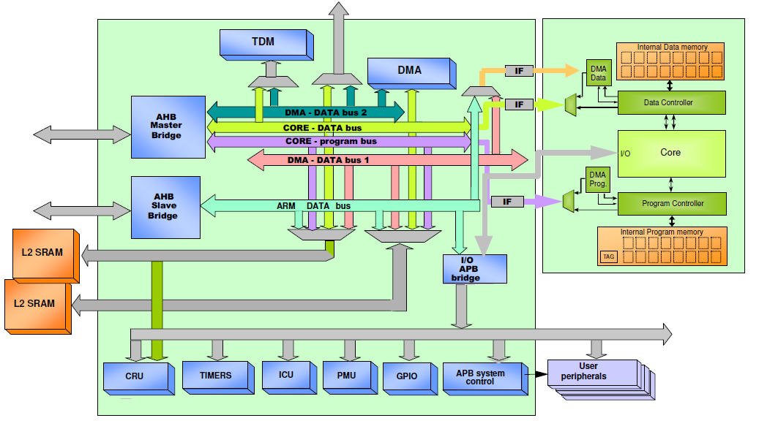
Communication Architecture Standards
Why do we need communication standards?
Modular design approach
Allows design reuse
Facilitates IP integration into an SoC design
Picture source: http://www.ecs.soton.ac.uk/ (SoC Advance design Technique)
Notes:
Modern SoCs need to handle incompatible IP interfaces. Assembling heterogeneous IPs for SoC design can take months. Interface and communication standards define a specific data transfer protocol and decide the number and functionality of pins at IP interfaces, which makes it easy to connect diverse IPs quickly.
So, in summary, communication standards can encourage modular system design and IP reuse, make the design of IP cores independent of the system design, and facilitate the integration of IP cores from different vendors.

Slide 13
Arm AMBA System Bus
AMBA: Advanced microcontroller bus architecture
AMBA protocol is an open standard on-chip interconnect specification.
Provides the interface standard that enables IP reuse
Facilitates right-first-time development of multiprocessor designs with large numbers of controllers and peripherals
Widely used in modern portable mobile devices, such as tablets and smartphones

Slide 14
Arm AMBA Bus Families
AMBA family | Bus protocol
AMBA 5 | CHI
AMBA 4 | ACE, ACE-Lite
 | AXI4, AXI4-Lite, AXI4-Stream
AMBA 3 | AXI
 | AHB (AHB-Lite)
 | APB
 | ATB
AMBA 2 | AHB, APB
AMBA 1 | ASB, APB
Notes:
There are five families of AMBA specifications (AMBA 1, 2, 3, 4, and 5), which are developed to meet different requirements.
AMBA 1 defines two buses: advanced system bus (ASB) and advanced peripheral bus (APB).
AMBA 2 introduces the AHB (advanced high-performance bus) and the APB (advanced peripheral bus). The AHB was intended to be the main system bus in microcontroller usage, and the APB was developed for peripherals connection and designed to take up a minimal area.
AMBA 3 defines four buses (AXI, AHB, APB, and ATB). AMBA 3 AHB and APB specifications have the same usage as in the previous version. AMBA 3 AXI was developed to support high data throughput. AMBA 3 ATP facilitates moving trace data around the chip.
AMBA 4 adds another five bus protocols as shown in this table. AXI4 is an update to AXI3 to enhance the performance and utilization of the interconnect when used by multiple managers. ACE (AXI coherency extensions) is widely used on the latest Arm Cortex-A processors including Cortex-A7 and Cortex-A15.
In this course, we will be using the AMBA 3 AHB-Lite interface to build our SoC.

Slide 15
AMBA 3 AHB-Lite Bus
AHB
High-performance synthesizable designs
Supports multiple bus managers
Provides high-bandwidth operation
AHB-Lite:
A subset of AHB
Simplifies the design of AHB bus, e.g., typically with a single manager
Notes:
The AHB is a high-performance synthesizable design, which supports multiple bus managers and provides high-bandwidth operation. AHB supports connections of on-chip and off-chip memory blocks. AHB-Lite is a subset of the AHB specifications, designed for single manager systems with simple peripherals.

Slide 16
AHB-Lite Bus Block Diagram
Manager
CONTROL
HWDATA [31:0]
Subordinate 1
HADDR [31:0]
Address
Decoder
HSEL_1
HSEL_2
Subordinate 2
HSEL_3
Multiplexor
Select
Subordinate 3
HRDATA_3 [31:0]
HRDATA
[31:0]
RESPONSE_3
Subordinate
Multiplexor
HRDATA_2 [31:0]
RESPONSE
RESPONSE_2
HRDATA_1 [31:0]
RESPONSE_1
Notes:
This diagram shows a single manager AHB-Lite system design with one AHB-Lite manager and three AHB-Lite subordinates. The decoder block is controlled by the manager that specifies which subordinate must be selected. The multiplexor block is controlled by the decoder that chooses which subordinate output data must be connected to the manager.
The most common AHB-Lite subordinates are internal memory devices, external memory interfaces, and high-bandwidth peripherals.

Slide 17
AHB-Lite Manager Interface
The AHB-Lite manager provides address and control information to initiate read and write operations.
The manager also receives the response from the subordinate, including data and ready and response signal.
Manager
HWRITE
Transfer response
HREADY
HSIZE [1:0]
HRESP
HBURST [2:0]
CONTROL signals
Global signals
HPROT [3:0]
HRESETn
HTRANS [1:0]
HCLK
HMASTLOCK
HADDR [31:0]
Address
Data
HRDATA [31:0]
Data
HWDATA [31:0]
Notes:
The manager block generates three types of output signals: address, data, and control signals, which include the following: HWRITE (the transfer direction); HSIZE (the size of the transfer); and HTRANS (transfer type), which can be IDLE, BUSY, NONSEQUENTIAL, or SEQUENTIAL.
There are other signals. More detailed information on these can be found in the AHB-Lite reference manual.
There are three types of input signals that can be received by the manager block. These are data signals; transfer response signals from the decoder, which indicates that the previous transfer is complete; and global signals, which include the clock and the reset signals.

Slide 18
AHB-Lite Subordinate Interface
An AHB-Lite subordinate responds to transfer initiated by the manager in the system.
The signal HSELx is the output from the address decoder, which is used to select one subordinate at a time.
Select signal
HSELx
Subordinate x
HWRITE
HSIZE [1:0]
CONTROL signals
HBURST [2:0]
HREADYOUT
Transfer response
HPROT [3:0]
HRESP
HTRANS [1:0]
HMASTLOCK
HREADY
HRDATA [31:0]
Data
Address
HADDR [31:0]
Data
HWDATA [31:0]
Global signals
HRESETn
HCLK
Notes:
The subordinate block receives five types of input signals:
Address
Data
Global signals (e.g., clock and reset)
Select signal
Other control signals from the manager
There are two types of output signals generated by the subordinate: data and transfer response signals. The latter includes HREADYOUT and HRESP. Both signals are intended for the manager block and carry information about the status of the transfer.

Slide 19
Address Decoder
Selects one of the subordinates depending on the current address bus
Also informs the subordinate multiplexor
Address
Decoder
Multiplexor select
HSEL_1
HADDR [31:0]
HSEL_2
HSEL_3
Notes:
The address decoder selects one of the subordinates depending on the current address bus available on its HADDR inputs. The logic value of HSELx signal is calculated by decoding the address bus using combinatorial logic.
The address decoder also informs the subordinate multiplexor using the multiplexor select output signal.

Slide 20
Subordinate Multiplexor
Subordinate multiplexor
Inputs the response signals (HRDATA, HREADY, and HRESP) from all the subordinates, and outputs one of them depending on the selecting signal from the address decoder.
Address
Decoder
Multiplexor Select
HRDATA_1
RESPONSE_3
HREADY
HSEL_1
HRDATA_2
Subordinate
Multiplexor
HRESP
HADDR [31:0]
RESPONSE_2
HSEL_2
HRDATA
[31:0]
HRDATA_3
HSEL_3
RESPONSE_1
Notes:
The inputs of this block are the response signals (HRDATA, HREADY, and HRESP) from all the subordinates. This block chooses the response signals from one subordinate to send to the manager. This choice is controlled by a selecting signal from the address decoder.

Slide 21
Hardware Implementation
Due to the pipelined operation, some signals have to be deliberately delayed:
The selecting signals from the decoder to the multiplexor are delayed for one clock cycle.
The HREADY signal is delayed for one clock cycle before it is fed back to the multiplexor.
The detailed implementation can be referred from the code that is provided in the EDK.
Flip-flop
Multiplexor Select
HRDATA_1
Address
Decoder
RESPONSE_3
HREADY
HSEL_1
HRDATA_2
Subordinate
Multiplexor
HRESP
HADDR [31:0]
RESPONSE_2
HSEL_2
HRDATA
[31:0]
HRDATA_3
HSEL_3
RESPONSE_1
Flip-flop

Slide 22
AHB-Lite Operation Principles
AHB-Lite supports three types of transfers:
Single
Incrementing bursts that do not wrap at address boundaries
Wrapping bursts that wrap at particular address boundaries
Notes:
The manager starts a transfer by driving the address and control signals. These signals provide information about the address, direction, and width of the transfer, and indicate if the transfer forms part of a burst. Transfers can be single, incrementing bursts that do not wrap at address boundaries, and wrapping bursts that wrap at particular address boundaries.

Slide 23
AHB-Lite Operation Principles
An AHB-Lite transfer consists of two phases:
The address phase, which lasts for a single HCLK cycle unless it is extended by the previous bus transfer.
The data phase might require several HCLK cycles. The HREADY signal is used to control the number of clock cycles required to complete the transfer.

Slide 24
AHB-Lite Bus Timing
This module focuses on the basic bus operation, so we assume the following:
No BURST transaction: HBURST[2:0] is always 3’b000.
Never generates locked transactions: HMASTLOCK is always 1’b0.
All transactions issued are non-sequential transfer: HTRANS[1:0] is either 2’b00 (IDLE) or 2’b10 (non-sequential).
Notes:
More advanced bus transaction can be found in the AMBA 3 AHB-Lite Protocol Specification.

Slide 25
Basic Read Transfer
Simple read transfer with no wait states
HCLK
CONTROL
Control 0
Control 1
Control 2
Control 3
HADDR [31:0]
Address 0
Address 1
Address 2
Address 3
HRDATA [31:0]
Read Data 0
Read Data 1
Read Data 2
HWRITE
HREADY
Notes:
We start with a basic read transfer.

Slide 26
Basic Read Transfer
Simple read transfer with no wait states
The address phase: The manager drives the address and control signals onto the bus after the rising edge of HCLK.
HCLK
CONTROL
Control 0
Control 1
Control 2
Control 3
HADDR [31:0]
Address 0
Address 1
Address 2
Address 3
HRDATA [31:0]
Read Data 0
Read Data 1
Read Data 2
HWRITE
HREADY
Notes:
The address phase: The manager drives the address and control signals onto the bus after the rising edge of HCLK, and clears HWRITE to zero.

Slide 27
Basic Read Transfer
Simple read transfer with no wait states
The address phase: The manager drives the address and control signals onto the bus after the rising edge of HCLK.
The data phase: The subordinate samples the address and control information and make data available at HRDATA before driving the appropriate HREADY response.
HCLK
CONTROL
Control 0
Control 1
Control 2
Control 3
HADDR [31:0]
Address 0
Address 1
Address 2
Address 3
HRDATA [31:0]
Read Data 0
Read Data 1
Read Data 2
HWRITE
HREADY
Notes:
This response is sampled by the manager on the third rising edge of HCLK. This simple example demonstrates how the address and data phases of the transfer occur during different clock cycles. The address phase of any transfer occurs during the data phase of the previous transfer. This overlapping of address and data is fundamental to the pipelined nature of the bus and enables high-performance operation while still providing adequate time for a subordinate to provide the response to a transfer.

Slide 28
Basic Write Transfer
Simple write transfer with no wait states
The address phase: The manager drives the address and control signals onto the bus after the rising edge of HCLK and sets HWRITE to one.
HCLK
CONTROL
Control 0
Control 1
Control 2
Control 3
HADDR [31:0]
Address 0
Address 1
Address 2
Address 3
HRDATA [31:0]
Write Data 0
Write Data 1
Write Data 2
HWRITE
HREADY
Notes:
n/a

Slide 29
Basic Write Transfer
Simple write transfer with no wait states
The address phase: The manager drives the address and control signals onto the bus after the rising edge of HCLK and sets HWRITE to one.
The data phase: The subordinate samples the address and control information and make data available at HRDATA before driving the appropriate HREADY response.
HCLK
CONTROL
Control 0
Control 1
Control 2
Control 3
HADDR [31:0]
Address 0
Address 1
Address 2
Address 3
HRDATA [31:0]
Write Data 0
Write Data 1
Write Data 2
HWRITE
HREADY
Notes:
n/a

Slide 30
Read Transfer with Wait State
Address phase (first clock cycle)
Give address and control signals; set HWRITE to one.
Data phase (multiple clock cycles)
The subordinate holds HREADY to zero f it is not ready to provide data; manager delays its next transaction.
When the subordinate is ready, it will set HREADY to one and at the same time it will provide data. The manager will then continue its next transaction.
HCLK
CONTROL
Control 0
HADDR [31:0]
Address 0
HRDATA [31:0]
Data 0
HWRITE
HREADY
Notes:
This is a more complicated transfer type.

Slide 31
Write Transfer with Wait State
Address phase (first clock cycle)
Give address and control signals; clear HWRITE to zero.
Data phase (multiple clock cycles)
The manager gives its data at HWDATA. The subordinate holds HREADY to zero if it is not ready to receive the data; the manager delays its next transaction.
When the subordinate is ready, it will receive the data and set HREADY to one. The manager will then continue its next transaction.
HCLK
CONTROL
Control 0
HADDR [31:0]
Address 0
HWDATA [31:0]
Data 0
HWRITE
HREADY
Notes:
n/a

