Slide 1
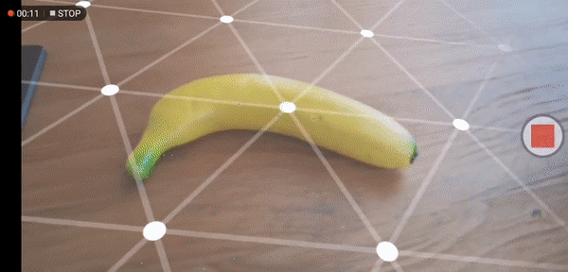
Augmented Reality (AR)
Augmented reality uses an overlay onto the real world
Digital components blend with the human perception
Pokemon GO is a clear example of augmented reality
Notes:
So the previous content looked primarily at virtual reality, but what about augmented reality (AR)?
In contrast to immersing people in a completely simulated world, what augmented reality does, is place an overlay onto reality, in other words, digital world components blend with the human perception of the real world.
This could go as far as blending with our sight, hearing, smell, and touch senses.
Back in 2016, a large number of people were experimenting and experiencing the merging of digital assets with our real world as a result of the release of Pokemon Go.

Slide 2
Augmented Reality - History
Myron Krueger developed “Videoplace”
“Videoplace” allowed people to interact with silhouettes of other users
In the 90s, KARMA, the first paper about an AR system, was released
An AR version of Quake came at the end of the millennium
Pokemon Go became a global trend in 2016, which incorporated an AR system
Boeing uses AR glasses HoloLens 2 to guide technicians to wire complex avionic parts
Many Industries are trying to ride on the upcoming wave of AR
Notes:
Like VR, AR concepts are not new, back in the 70s, Myron Krueger established an artificial laboratory called the “Videoplace” and developed his idea that consisted of interacting with the silhouettes of other users in an artificial environment.
It was not until 90s that we saw a plenty of interesting developments like KARMA, which was the first paper on AR system prototype, followed by an AR Quake game at the star of the millennium.
Then, we saw how Boeing used AR glasses, the HoloLense 2, to guide technicians to wire complex avionic parts.
In 2016, people all over the world were trying to capture Pokémon on the streets via the Pokemon Go app, which utilized AR.
And it seems like many industries will benefit from the development of augmented reality in the upcoming years.

Slide 3
Augmented Reality (continued)
In order for the virtual objects to seamlessly blend into the real world, it is important to know where the camera is and the direction it is pointing.
We can do this with Visual-Inertial Simultaneous Location and Mapping (SLAM).
In order for AR systems to integrate realistic augmentations within the real world, we need a certain type of software and algorithms, and this is where SLAM or simultaneous location and mapping comes in.
SLAM is a series of complex computations and algorithms that uses sensors to construct maps and structures in unknown environments so that we can keep track of the agent’s position.
An agent can be anything that makes a decision such as a person, a robot, or software.
Notes:
In order for AR systems to integrate realistic augmentations within the real world, we need a certain type of software and algorithms, and this is where SLAM or simultaneous location and mapping comes in.
SLAM is a series of complex computations and algorithms that uses sensors to construct maps and structures in unknown environments so that we can keep track of the agent’s position.
An agent can be anything that makes a decision such as a person, a robot, or software.

Slide 4
Simultaneous Localization and Mapping (SLAM)
SLAM is a series of complex computations and algorithms that uses sensors to construct maps and structures in unknown environments
It comes from an old robotic problem on how to estimate the position of a robot equipped with on-board sensors
Popular algorithms to tackle this problem are particle filter, Extended Kalman Filter (EKF), Covariance intersection, and Graph SLAM
More in this link -> https://en.wikipedia.org/wiki/Simultaneous_localization_and_mapping
Notes:
SLAM is a series of complex computations and algorithms that uses sensors to construct maps and structures in unknown environments.
It comes from an old robotic problem on how to estimate the position of a robot equipped with on board sensors.
Popular algorithms to tackle this problem are particle filter, extended Kalman filter, Covariance intersection, and Graph SLAM.

Slide 5
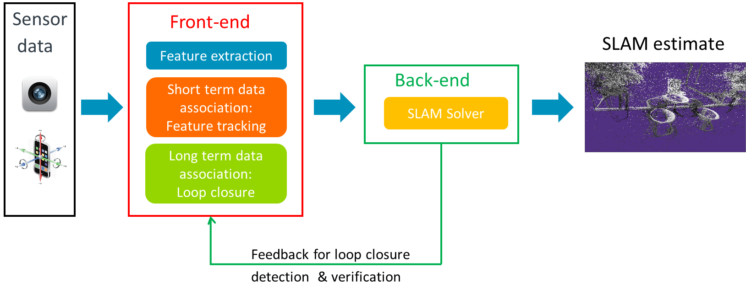
Visual-Inertial SLAM pipeline
Cameras, accelerometers, gyroscope, etc. Anything that can be used to get information about the environment.
Notes:
A basic pipeline of SLAM look like this:
In the first module, we have the sensor data. In this module, we try to collect all the raw data around our environment through the usage of the hardware integrated in our agents. Note that an agent can be anything that makes a decision such as a person, a robot, or software. For instance, in a mobile phone, we will use cameras, gyroscope, and accelerometers.

Slide 6
Visual-Inertial SLAM pipeline
Extract the relevant features from the sensor data, like pixel location of distinguishable points in the environment
Notes:
It is common to have a module, the front-end, that extracts relevant features from the sensor data. For instance, in vision-based SLAM, the front-end extracts the pixel location of distinguishable points in the environment. The front-end is also in charge of associating each measurement to a specific landmark (3D point) in the environment: this is the so-called data association.

Slide 7
Visual-Inertial SLAM pipeline
Feeds back information to the front-end to support loop closure detection and validation
Notes:
The back-end usually feeds back information to the front-end, for example, to support loop closure detection and validation. When we say loop closure, we mean that the agent is capable of knowing it has returned to a previously visited area.

Slide 8
Visual-Inertial SLAM pipeline
A nearly 3D reconstruction of the environment
Notes:
By the end of the pipeline, we hope to end with a nearly 3D construction of the environment or the SLAM estimation that can help us to figure out where our agent is and where it is looking.

Slide 9
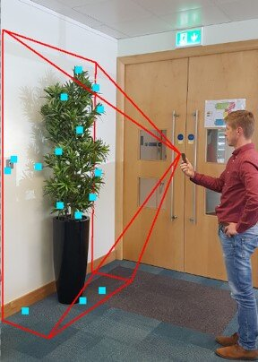
SLAM in smartphones
SLAM can run in high-end smartphones thanks to their cameras and Inertial Measurement Units (IMUs)
A smartphone will collect information from the IMU sensors and video feed
SLAM combines the readings from the IMUs and the video feed to achieve a higher localization accuracy than each separate input
The camera feed will detect 2D Features points
Notes:
SLAM can run in high-end smartphones using their cameras and Inertial Measurements units or (IMUs)
If you look at the picture on the right, the smartphone is building information about the environment through gathering data from IMU sensors and video feed from the monocular camera.
Although IMUs provide information about the actual movements of the smartphone, their readings are not accurate enough. SLAM combines the readings from the IMUs and the video feed to achieve a higher localization accuracy than each separate input.
The camera feed works by detecting “2D features points” within the current frame and then it attempts to correlate them with the points found in the previous frame.
Based on these relative points and the IMU reading, an algorithm can work out the 3D and orientation of the device with an accuracy to the centimeter range.

Slide 10
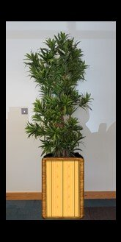
Sparse SLAM
Visual-Intertial SLAM provides the 3D position of the 2D feature points, also known as a point cloud
When the point cloud contains less than a ~2000-3000 points, we use the term “Sparse SLAM”
You can extract planes from sparse point cloud (Google ARCore, Appel ARKit)
We can anchor virtual objects to detected planes and render them properly on top of the real world
Point cloud
Notes:
The SLAM algorithm pipeline also provides the 3D position of the 2D feature points that the system has been tracking, which is also known as a “point cloud.”
You can also get sparse point cloud, which then can be used to extract the planes from the environment. This set of point cloud is also known as SPARSE SLAM. With them and the camera pose (position and orientation), we can render virtual objects properly on the top of the real world as they were.
For example, you can see in this photo how we were able to insert our gold luggage in front of the plant.

Slide 11
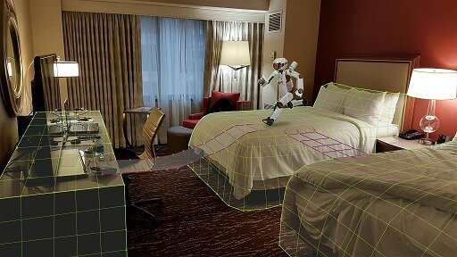
A dense reconstruction of the environment
Mixed reality (MR) games/experiences need to interact with the environment
MR apps should have knowledge of the environment topology
If you want to implement advanced AR, where virtual objects interact with the real objects
Like project shadows, collisions, etc., you need a dense reconstruction of the environment
Notes:
Before continuing, let’s talk about what we mean by a dense reconstruction of the environment.
Mixed reality games/experiences need to interact with the environment.
MR apps should have knowledge of the environment topology, if you want to implement advanced AR, where virtual objects interact with the real objects.
Like project shadows, collisions, etc., you need to extract a dense reconstruction of your environment.
For instance,
https://community.arm.com/developer/tools-software/graphics/b/blog/posts/the-rise-of-depth-on-mobile
Look at the picture of the hotel room on the right, assume that it is an AR game. You want to exploit the real-world geometry and you want to add a bridge between the left bed and the desk, and also between the two beds. You do this so that the character can move around the room and interact with the scene. How can you do this if you don’t have any information of the geometry of the main objects in the scene? If you could achieve some information and figure out that there are three main geometry blocks formed by the two beds and a desk, then you could add assets related with these objects; bridges between them, for example, to allow the character moving around.

Slide 12
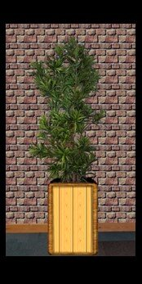
Dense SLAM
Uses dedicated hardware, such as depth sensors
You can produce (obtain) lot more points in the point cloud in comparison to Sparse SLAM
This will result in a better representation of your environment, and thus you will be able to achieve virtual-to-real interactions or modify the real world with virtual objects.
Notes:
Sparse SLAM might not give you a full representation of your environment, but if you are willing to use dedicated hardware like depth sensors , you can achieve the detection of more point clouds. As a result, we get a dense reconstruction of our environment, and we can modify the real-world environment against the virtual one.
For instance, you can see how the wall behind the plant has changed by a virtual wall made of bricks. In this case, we called this Dense SLAM.
Please don’t be tricked by the graph on the left side. Normally, in Sparse SLAM, you will see less than 1000 point clouds, whereas in Dense, you might encounter more than a million of point clouds.

Slide 13
Mobile Depth Cameras
Depth cameras are a crucial component in SLAM.
They produce depth images where each pixel shows the distance from the camera to the point in the environment. The color encodes the depth.
Some of the techniques used to calculate the depth of a scene are:
Stereo Triangulation
Passive Stereo
Active Stereo
Structured light
Time of Flight (ToF)
Notes:
Depth cameras are a crucial component in SLAM
They produce depth images where each pixel shows the distance from the camera to the point in the environment. The color encodes the depth.
Some of the techniques used to calculate the depth map of a scene are:
Stereo Triangulation (Passive Stereo and Active Stereo)
Structured light
Time of Flight (ToF)
To give you an example, please look at how the picture on the right shows a depth map (left) produced by a depth sensor. The colors in the depth image encode depth values from the nearest to most distant points. The corresponding RGB image is on the right.

Slide 14
Stereo Triangulation
The depth is calculated using a stereo or multiple camera setup
Passive Stereo
Calculate the depth in the same way as our binocular vision.
If we know the distance between two cameras or baseline that are looking at point C, we can use linear algebra to calculate the distance to this point.
$$\frac{b}{\sin\left(\text{β}\right)}=\frac{c}{sin\left(\text{Θ} \right)}$$
b $=\frac{c\sin\left(\text{β}\right)}{sin\left(\text{Θ} \right)}$ = $\frac{c\sin\left(\text{β}\right)}{sin\left(\text{α}\text{ + }\text{β} \right)}$
b = $\frac{depth}{sin\left(\text{α} \right)}$ = $\frac{c\sin\left(\text{β}\right)}{sin\left(\text{α}\text{ + }\text{β} \right)}$
$depth$ = $\frac{c\sin\left(\text{β}\right)sin\left(\text{α} \right)}{sin\left(\text{α}\text{ + }\text{β} \right)}$
A
α
Θ = α + β
b
Baseline = c
depth
Θ
C
a
B
β
Notes:
In Stereo Triangulation, the depth is calculated using a stereo or multiple camera setup. There are two types of stereo triangulation:
Passive Stereo: calculates the depth in the same way as our binocular vision.
For instance, let’s say you have two cameras A and B, and both of them are looking at point C. If we already know the distance between the two cameras, also known as the “baseline,” we can use linear algebra to calculate the depth of this object. For instance, here we are using law of sines to calculate the depth from the duck to the camera’s baseline.

Slide 15
Stereo Triangulation
Active Stereo
Uses the same principle, but the system uses an IR projector that projects a random pattern.
Provide additional source of texture that adds details to surfaces (useful in textureless environments) and additional light source in poor lighting conditions.
A
α
Θ = α + β
b
Projector
Baseline = c
depth
C
Θ
a
B
β
Notes:
Active Stereo: Uses the same principle, but the system uses an IR projector that projects a random pattern.
Provide additional source of texture that adds details to surfaces (useful in textureless environments) and additional light source in poor lighting conditions.

Slide 16
Passive/Active Stereo – Depth Calculation
In order to calculate the depth, we can use the following formula:
$$\frac{b}{\sin\left(\text{β}\right)}=\frac{c}{sin\left(\text{Θ} \right)}$$
b $=\frac{c\sin\left(\text{β}\right)}{sin\left(\text{Θ} \right)}$ = $\frac{c\sin\left(\text{β}\right)}{sin\left(\text{α}\text{ + }\text{β} \right)}$
b = $\frac{depth}{sin\left(\text{α} \right)}$ = $\frac{c\sin\left(\text{β}\right)}{sin\left(\text{α}\text{ + }\text{β} \right)}$
$depth$ = $\frac{c\sin\left(\text{β}\right)sin\left(\text{α} \right)}{sin\left(\text{α}\text{ + }\text{β} \right)}$
A
α
Θ = α + β
b
Baseline = c
depth
Θ
C
a
B
β

Slide 17
Structured light
This system is formed by a camera and a projector.
The projector illuminates the scene with a specific designed light pattern.
The depth of an object is calculated from the deformation of the projected light pattern on the objects
A
α
Θ = α + β
b
Baseline = c
depth
C
Θ
a
Projector
β
Notes:
The system is formed with a camera and projector; in this case, the projector illumines the scene with specific designed light pattern.

Slide 18
Time of Flight
The system uses a projector of ultra-short IR pulse light and a detector.
The laser shoots a light into an object, whereas the detector detects bouncing light to estimate the time of flight.
This system is similar to a radar.
Laser
$$d=\frac{ct}{2}$$
$where "c" is equal to the speed of light$,
“$t" is equal to the total time of flight, and$
$$"d" is equal to the distance from the system to the object$$
depth = d
Receptor
Notes:
The system uses a projector of ultra-short IR pulse light and a detector. The laser shoots a light into an object, whereas the detector detects bouncing light to estimate the time of flight. This is very similar to a radar system.

Slide 19
Neural Networks for Depth Prediction
Neural Networks are used to generate depth maps from 2D images
Neural Networks are trained with RGB-depth data to learn producing depth from monocular RGB images
This is a hot topic, which is evolving very fast
Notes:
Neural Networks are used to generate depth maps from 2D images
Neural Networks are trained with RGB-depth data to learn producing depth from monocular RGB images
This is a hot topic, which is evolving very fast

Slide 20
AR deployment Google ARCORE and Apple ARKIT
Thanks to Google and Apple; it is easier to implement AR applications
Google ARCore and Apple ARKit are both frameworks for building Augment Reality
ARCore is designed to be used on high-end Android devices
ARKit is designed to be used on high-end iOS devices
With Unity AR Foundation, you can use both frameworks in your apps and games
ARKit works with any device running iOS11
ARCore works with a specific set of devices that you will find in the following page
https://developers.google.com/ar/discover/supported-devices
Notes:
Thanks to Google and Apple; it is easier to implement AR applications
Google ARCore and Apple ARKit are both frameworks for building Augment Reality
ARCore is designed to be used on high-end Android devices
ARKit is designed to be used on high-end iOS devices
With Unity AR Foundation, you can use both frameworks in your apps and games
ARKit works with any device running iOS11
ARCore works with a specific set of devices that you will find in the following page

Slide 21
The Future of AR
A boom for AR and VR is expected to come in this decade
Many industries will benefit from AR such as
Healthcare
E-commerce
Navigation
Education
Notes:
It’s predicted that the boom of AR will come in this decade because of supportive technologies such as AR glasses and 5G.
Because of this, many of industries are and will benefit from AR such as:
Healthcare.
In this case, AR is expected to enhance human performance during surgery, helping medicine students to grasp faster and better concepts of the human body and to provide guidance during diagnostic and therapeutic interventions.

Slide 22
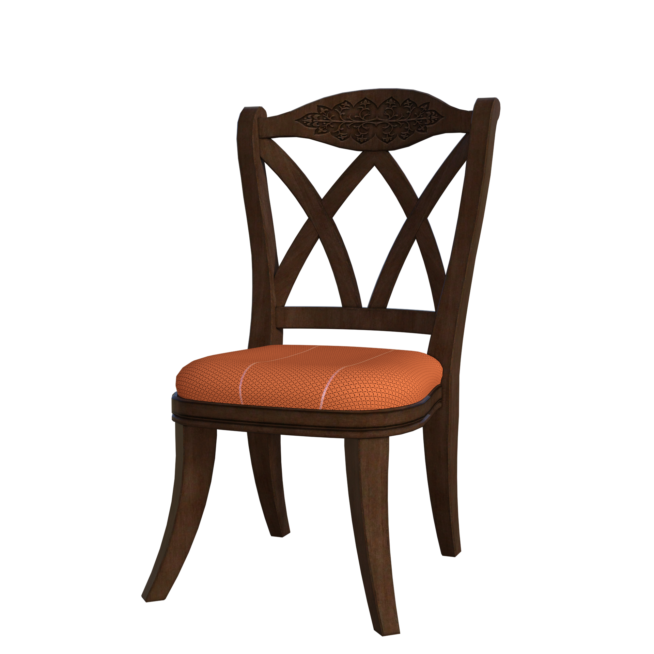
The Future of AR
A boom for AR and VR is expected to come in this decade
Many industries will benefit from AR such as
Healthcare
E-commerce
Navigation
Education
Notes:
E-commerce: in this case, AR is expected to enhance the preview of a product for consumer; you could imagine trying millions of cloths from your home, or experiment how your new furniture will look like at home.

Slide 23
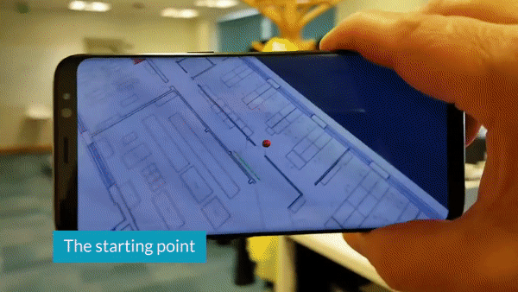
The Future of AR
A boom for AR and VR is expected to come in this decade
Many industries will benefit from AR such as
Healthcare
E-commerce
Navigation
Education
Notes:
Navigation: in this case, AR will provide a map overlay to improve users ability to navigate areas.

Slide 24
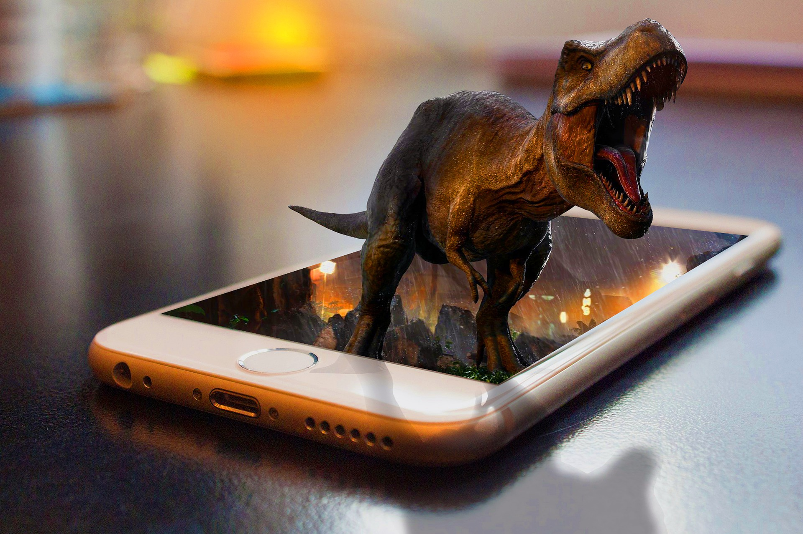
The Future of AR
A boom for AR and VR is expected to come in this decade
Many industries will benefit from AR such as
Healthcare
E-commerce
Navigation
Education
Notes:
Education: in this case, AR will make the material more immersive. For instance, you can picture students looking at their book images that could become alive through the use of their mobile phones.

Slide 25
The Future of AR
A boom for AR and VR is expected to come in this decade
Many industries will benefit from AR such as
Healthcare
E-commerce
Navigation
Education
Military
Arts & Music
Video games
Manufacturing
Gaming
Broadcasting
Tourism
Archaeology
Architecture
Social Interaction
Many more …
Notes:
There is no denial that many industries will benefit from AR

Slide 26
The Future of AR: AR Cloud
AR Cloud technology is not matured
AR Cloud could mirror the real world and provide 1:1 scale experience
It will allow us to “paint the world with data”
https://medium.com/openarcloud
ARM
ASSETS
AR CLOUD
ASSETS
ARM
Notes:
To end this lecture:
We would like to talk about AR Cloud, which is possibly one of the most interesting things in the future.
You might have already heard about this term, but the technology is not completely matured.
An AR Cloud is one ambitious project that will reformat the way that we control information.
AR Cloud aims to mirror the whole world, so when people use AR devices, this technology can provide precise position and orientation relative to the physical world so that cameras of the devices will match 1:1 scale representation of the world stored in the cloud.
In addition, having this system stored in the cloud will give the possibility of interaction between multiple users.
This will give a new concept to paint the world with data.
For instance, let’s say that you want to add a path to your company; you could go into the world stored in the AR Cloud, upload your assets in certain coordinates, and now any costumer using an AR device will be able to interact with your digital assets.
This ambitious project has already been discussed in The Open AR Cloud (OARC) association as a
decentralized AR Cloud; if you would like to read more, follow this link

