Slide 1
Inclusive Language Commitment
Arm is committed to making the language we use inclusive, meaningful, and respectful. Our goal is to remove and replace non-inclusive language from our vocabulary to reflect our values and represent our global ecosystem.
Arm is working actively with our partners, standards bodies, and the wider ecosystem to adopt a consistent approach to the use of inclusive language and to eradicate and replace offensive terms. We recognise that this will take time. This course contains references to non-inclusive language; it will be updated with newer terms as those terms are agreed and ratified with the wider community.
Contact us at education@arm.com with questions or comments about this course. You can also report non-inclusive and offensive terminology usage in Arm content at terms@arm.com.

Slide 2
Introduction to Robotic Systems
Notes:
Hello and welcome to this course titled Introduction to Robotic Systems.

Slide 3
Module Syllabus
Review of definitions:
What is Robotics?
Why Robotics?
What is Mechatronics
Robots
Example of Robotic Systems
Introduction to robotic systems
Typical models and components
Autonomous car: A complex robotic system
Notes:
This module introduces the basic theories and preliminary methods of robotic systems development.
This module starts with the definitions of both robotics and mechatronics.
The basic concepts of robotic systems and the design process are then introduced by examining an autonomous car from a robotic system-level perspective.

Slide 4
Review of Definitions
What is Robotics
Implementation and use of robots
Employ engineering and computer science disciplines in its implementation.
Computing system uses inputs from environment sensors to provide control for robot.
Robotics
An autonomous mechatronic system
Mechatronics
Notes:
Robotics is a subset of mechatronics, with some level of autonomy. Autonomy is achieved by the system’s ability to sense its environment and provide computing and control for the robot while integrating mechanical and electrical, and computer science disciplines in its implementation.

Slide 5
Review of Definitions
Why Robotic Systems
Deployed in:
Dangerous task.
Task requiring high precision, fast computation.
Task requiring continuous monitoring.
Robotics
An autonomous mechatronic system
Mechatronics
Notes:
Robotic systems can be employed for tasks in dangerous, unknown, or hostile environment; for example, robots deployed in outer space. Robotic systems can also be deployed for task requiring high precision, fast computation, and task requiring continuous monitoring. Typical examples are systems deployed in monitoring and control of nuclear facilities. Here, the robots operate with some level of autonomy.

Slide 6
Review of Definitions
What is Mechatronics?
Electrical Engineering
Mechanical Engineering
Control Theory
Computer Science
Information Engineering
“systems showing a combination of mechanical and electrical engineering disciplines for the development of industrial automation”
Robotics
An autonomous mechatronic system
Mechatronics
Notes:
At this point, it is proper to give a brief definition of mechatronics, a superset of robotics. The term “mechatronics” was first conceived to describe the combination of mechanical and electrical engineering disciplines for the development of industrial automation systems. Today, mechatronics also encompasses other disciplines, such as control theory and computer science. Mechatronic systems range from quite simple ones, such as a blender or a toaster, to more advanced systems that can be found in, for example, industrial robotics. In our daily lives, we are surrounded by mechatronic systems!

Slide 7
Review of Definitions
Robotics
Mechatronics
Notes:
However, the boundary is not always clear, and the definitions are often blurred.

Slide 8
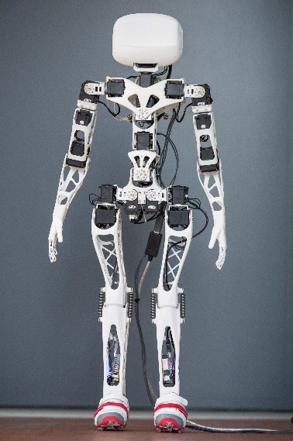
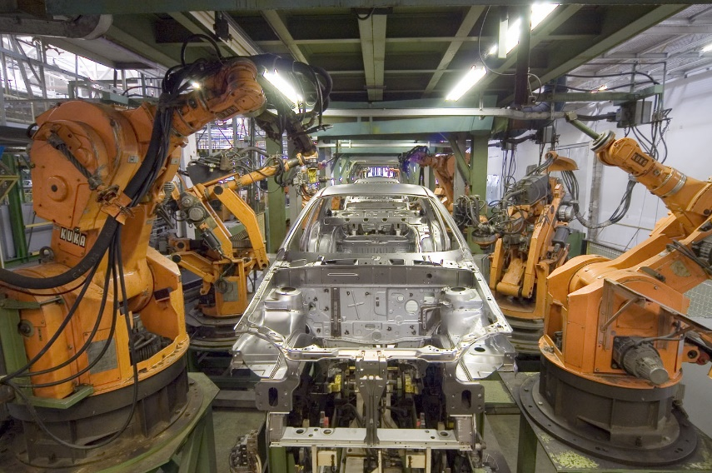
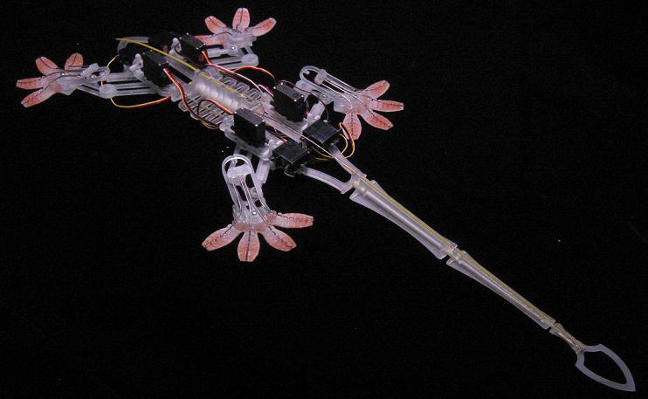
Review of Definitions
Robot
Term invented in 1920 by Karol and Josef Čapek
Used to describe autonomous mechatronic machines
“…capable of carrying out a complex series of actions automatically”
Wikipedia
Notes:
The term “robotics” was initially described by Czech writer Karel Capek in his 1920 play “Rossum’s Universal Robot.”
Isaac Asimov first used the term in print in 1941 with his work of fiction. Asimov’s introduced three laws of robotics, which are:
-A robot may not injure a human being or, through inaction, allow a human being to come to harm.
-A robot must obey orders given to it by human beings except where such orders would conflict with the First Law.
-A robot must protect its own existence as long as such protection does not conflict with the First or Second Law. They are still considered to be highly relevant today.
Robotics deals with the development of autonomous mechatronic machines. It can be defined as a system that is capable of carrying out a complex series of actions automatically.
In contrast to mechatronic systems, robots are usually assumed to have a higher level of autonomy than mechatronic systems. All robotic systems are mechatronic systems, but not all mechatronic systems are robotic systems.
Robots can come in a wide variety of form factors ranging from humanoid, industrial, to even bio-inspired soft robot.
They are traditionally considered to be a system that can sense, think, act, and communicate, and it will include some level of mechanics, sensing, control, intelligence, or autonomy.

Slide 9
Review of Definitions
Examples of robotic systems:
Industrial robotics, e.g., robotic arm
Radio-controlled aerial drones
Modern cars (self-driving)
Robotic Exoskeletons
Humanoid Robots
Disaster recovery robots
Notes:
Many robotic systems surround us in our daily lives.
Some of these, for example, an aerial drone, depend on the exact implementation and level of autonomy.
We are now going to consider the main systems in robotic systems and how these interface together.

Slide 10
Introduction to Robotic Systems Design
The Environment
e.g., field, kitchen, factory
Material properties
Terrain
Morphology
Notes:
Every robotic system is situated in an environment and interacts with it in some way.
The environment both defines the problem and also imposes conditions or constraints on the robotic system. For example, the morphology, materials, or terrain could provide constrains on the design whilst also determining the goal of the system, which is to cause impact or interaction with the environment in some manner.
To understand how systems interact with the environment to achieve this end goal by somehow changing its state, we can use the sense-perceive-act model.

Slide 11
Introduction to Robotic Systems Design
The Environment
e.g., field, kitchen, factory
Material properties
Terrain
Morphology
Sense
Perceive
Act
Notes:
A set of sensors estimates the state of the system, in order to determine how to make the required modification and perform some kind of understanding of the environment.
To understand the sensor input and determine what action to take, an algorithm performs some perception, based on the input from the sensors. The algorithm often runs on an embedded system; that is, it often resides in a microcontroller or a microprocessor.
To achieve some output or change in the environment, some sort of action must then be performed.
The perception algorithm determines how to affect the environment through a set of actuators. These actuators receive the signals from the microcontroller and alter the physical state of the environment in some way.
If the loop happens once, i.e., all actuation occurs based on the system, it is said to be under open loop control: there is no feedback. If the system iterates this control loop many times and uses feedback from the output of the mechatronic system, the system is said to be under closed loop control.

Slide 12
Introduction to Robotic Systems Design
The Environment
e.g., field, kitchen, factory
Material properties
Terrain
Morphology
Sense
Perceive
Act
Imaging
Object detection
Accelerometer
Determine position
Determine location of obstacles
Actuator motors to avoid obstacles/move forward
Notes:
We can use this model in the context of a self-driving car.
For example, a simple car (two motors) wants to move forward to obstacles.
We have sensors to understand the environment, understanding both the robot itself (its speed/position) and also the environment (e.g., where obstacles are).
Using the sensory information, we perform some perception, determining the position from the sensor data and the location of obstacles in the environment.
From this, the system can determine how to act and, in this example, how to actuate the motors to move forward, avoiding obstacles.
The action could lead to changes in the environment, so the loop begins again. We have a closed loop system.
The sense-perceive-act framework is a useful method for understanding and designing robotic systems.
We will now look in a little more detail into these different subsystems.

Slide 13
Autonomous Car: A Complex Robotic System
Lidar sensor
Line/track sensors
Steering (remain on track)
Velocity control (maintain a set speed)
Velocity sensor
Notes:
The car contains sensors to orient itself within its environment. A car (whether it is autonomous or not) will use two primary sets of information to control its motion:
First, it needs to know its velocity.
Second, it needs to know positional information (where it is in relation to the track).
Velocity sensing can be implemented in several ways, and it is usually performed by measuring the rotational velocity of the wheels, i.e., how quickly the wheels are turning. This can be done through optical means, using magnetic sensing, as well as back EMF (electromotive force).
Where the car is in relation to the track can be measured optically. One way to do this is to use a line camera. Also a Lidar sensor can be used to detect obstacles and determine the car’s position in its environment.

Slide 14
Autonomous Car: A Complex Robotic System
Microcontroller board
Microcontroller board
Notes:
The control algorithm resides on the microcontroller. The sensor inputs are registered using the analog and/or digital input ports on the microcontroller. Sometimes, the input signals from the sensors are weak and have to be amplified before interfacing with the microcontroller. Operational amplifiers provide an easy and robust way to do this.
Now, we have all sensed information, and various algorithms run on the sensor data during the perception phase. Perception phase includes object detection like algorithms for environment understanding, planning algorithms to decide what is the next step for movement, and various control algorithms on creating actuation outputs based on the sensor input data, which is then sent to actuation phase.

Slide 15
Autonomous Car: A Complex Robotic System
Velocity (motors)
Steering (servos)
Motors
Servo
Motors
Notes:
The microcontroller uses two types of actuators to interact with its environment: 1) motors and 2) servos. Servos control the angle of the front wheels, which in turn control which way the car is traveling.
In general, it is desirable for the autonomous car to be traveling at a set velocity. The algorithm/microcontroller will adjust the amount of power supplied to the motors in order to control for a set (desired) velocity. The desired velocity will be the set point of the control algorithm. For example, it may be desirable for the car to slow down as it traverses curves. The weak output power of a microcontroller output port is not enough to deliver the required electrical power for the motors to turn. Consequently, an output amplifier is needed. Such an amplifier is commonly known as a motor controller. A servo can be used to control the angle of the front wheels and control the direction of travel for the car. The servo can be controlled directly using the output of the microcontroller, as it contains its own amplifier and control circuitry.

Slide 16
Autonomous Car: A Complex Robotic System
Power supply
Power supply
Notes:
In addition to the components described previously, the robotic system must contain a power supply that enables seamless operation of all the components, such as the microcontroller, electronics, sensors, and actuators. A central component of the car system is the battery, which stores the energy necessary for the system to operate while on the track. The battery depletes over time, and the voltage will not be stable (it will vary) with the flow of current. So we may need to design power conditioning to ensure stable (uninterruptable) operation of the system. The power supply may contain a DC/DC converter to ensure stable power supply despite the falling battery voltage.

