Slide 1
Power Supply for Autonomous Cars
Notes:
Hello and welcome.
In this video, we will look at the power supply technique used in mechatronic systems, especially, for autonomous cars.

Slide 2
Module Outline
Overview of Power Supply for Autonomous Cars
Power Supply I: Linear Voltage Regulators
Power Supply II: DC/DC Converter
Complete Power Supply Solution
Notes:
We will go through some key components in power supplies such as regulators and DC converters.

Slide 3
Overview: Power Supply for Autonomous Cars
Different power needs for various sub-systems
On-board power supply needed to:
Drive the motors (large currents)
Drive the servo (moderate currents)
Power the MCU (low currents, voltage stability)
Power the sensors (low currents, voltage stability
Battery is the main reservoir of on-board power
Many battery types
Most common types for electric vehicles are lithium-ion batteries (high energy density, moderate cost, large discharge/charge cycle life)
http://www.wirelessmadness.com/
Notes:
The power supply is an essential component of an autonomous car, because it ensures the seamless operation of all the components while the car is driving on the track; i.e., it is disconnected from any external power supply. It needs to supply the power to all the different sub-components of the system. Some of the components have different requirements. For example, a lot of power (high current) might need to be supplied to the motors to provide fast acceleration. On the other hand, the microcontroller is concerned with voltage stability rather than the ability to dissipate large amounts of power. The power supply may need to be designed separately to meet these different requirements.
A battery is usually the main supplier of power for on-board power. There are many types of battery, but the most frequently used for autonomous vehicle applications is the lithium-ion (Li-ion) battery, due to its relatively moderate cost, high-energy density, and long life.

Slide 4
Overview: Power Supply for Autonomous Cars
Battery
Motor
Servo
power supply
MCU
power supply
Sensor
power supply
R_{b}
M
V_{b,ini}
+
-
MCU
Sensors
Servo
Schematic of the required power supply for the sub-systems
Notes:
The subsystems of the autonomous car can be represented by the following schematic. The battery provides power to the motors (remember, on the car kit chassis, there are two motors), the servo, the microcontroller (and digital electronics), and the sensors (and perhaps additional analog electronics). Additional power modules can be added if needed.

Slide 5
Overview: Power Supply for Autonomous Cars
Battery
7.2 V
Motor
Servo
power supply
MCU
power supply
Sensor
power supply
R_{b}
M
5 V
5 V
5 V
7.2 V
+
-
MCU
Sensors
Servo
Schematic of the required power supply for the sub-systems
Notes:
Let’s consider a 7.2V Li-ion battery that will be the power reservoir for the autonomous car power supply. Let us assume that all the electronics require 5V DC, and so does the servo. Since motors are less sensitive to voltage changes, they can be connected straight to the battery without the need of power conditioning (smoothing and regulating). Ignoring for now the voltage drop across the resistor, the battery will output approximately 7.2V, while the servo, MCU, and sensor electronics require 5V. Consequently, the principal job of the servo, MCU, and sensor power supplies is to reduce the battery voltage to a stable 5V DC. This can be achieved in a simple way using a linear regulator.

Slide 6
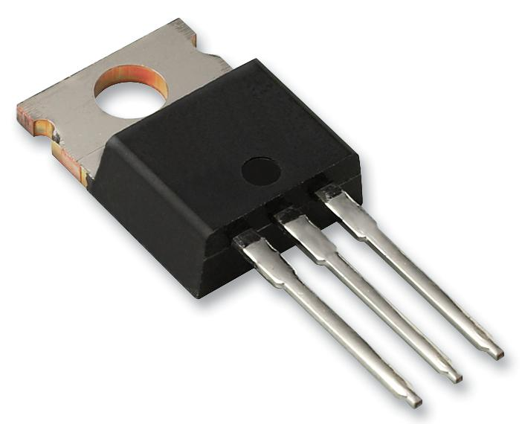
Power Supply 1: Linear Voltage Regulator
Reduces the supply voltage to a stable set value
Output voltage less than input voltage
A variable (controlled) resistor
Key parameters
Output voltage (e.g. 5V)
Input voltage range
Output current
Dropout
e.g. LM2940CT-5.0/NOPB
5V output
0V to 26V input
1A max output
500mV dropout
+
Linear voltage regulator
+
Input voltage
Output voltage
_{(e.g. 5V)}
-
-
Notes:
A linear regulator is essentially a variable load, which provides stable output voltage by providing enough voltage drop from the input voltage to a prescribed value. It is simple and reliable, and provides a fixed output. Parameters to watch out for when selecting a linear regulator are a) output voltage: this has to match what we want/need as output of the power supply; b) input voltage range: this describes what input voltage range is tolerated by the device, usually some maximum voltage; c) maximum amperage rating: i.e., how much current the unit can supply; and d) dropout: this is the minimum voltage drop that is taken up by the control circuit in the device before the device starts operating. We usually look for a low dropout regulator. At high current and high voltage drop across the regulator, the device will dissipate significant power, e.g., 5V output, 20V input at 1A, the device will dissipate 15W, so a heat sink is needed.

Slide 7
Review: Power Supply for Autonomous Cars
Battery
Servo
power supply
MCU
power supply
Sensor
power supply
0.1Ω
M
7.2 V
+
24 A
2 A
-
MCU
Sensors
Servo
Schematic of the required power supply for the sub-systems
Notes:
However, a linear regulator might not be enough to maintain a stable power supply. Consider the car is starting from stall, and the motors draw 12A each, so a total current draw of 24A. In addition, the servo may be actuating, and the current draw of the servo is, e.g., 2A, for a total current draw (discounting the electronics) of 26A. Lets consider a 7.2V Li-Ion battery with internal resistance of 0.1Ω (this resistance may seem high, but could be representative of a battery that has been discharged somewhat).

Slide 8
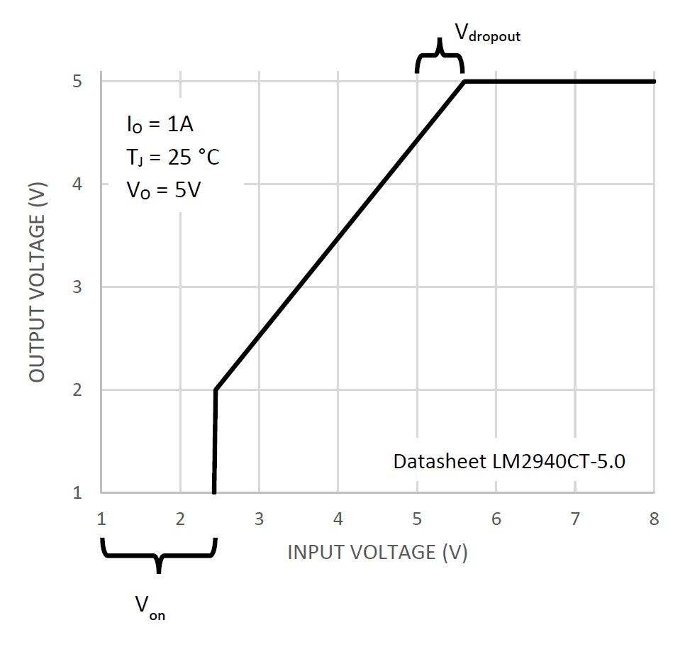
Power Supply 1: Linear Voltage Regulator
Datasheet LM2940CT-5.0
Notes:
The output voltage of the linear regulator can be illustrated by the following relationship between input and output voltage. The linear regulator turns on at a specific on voltage, V_on. The output voltage then increases linearly with the input voltage as long as the input voltage is below the designated output voltage of the regulator. When the input voltage exceeds the desired output voltage, the output voltage does not increase any more. Note that the output voltage always trails the input voltage by 0.5V (in the case of the LM2940). This is the dropout voltage, V_{dropout}. In all cases, the input voltage > designated output voltage + V_{dropout} for the regulator to function properly.

Slide 9
Review: Power Supply for Autonomous Cars
Battery
Servo
power supply
MCU
power supply
Sensor
power supply
2.6 V
26 A
M
7.2 V
+
-
MCU
Sensors
Servo
Schematic of the required power supply for the sub-systems
Notes:
The resulting voltage drop over R_{b} will be 2.6V, resulting in a remaining output battery voltage of 4.6V. To illustrate the problem, let us assume that some of the electronics, and perhaps the MCU require a 5V power supply. The linear regulator connected to the MCU/electronics will no longer be able to supply 5V, and the voltage will rather drop down to 4.6 – 0.5V = 4.1V (assuming a 0.5V dropout ). Consequently, an additional component for the power supply must be created.

Slide 10
Power Supply II: DC/DC Converter
Must elevate the voltage to provide a stable power supply (say 5V)
This can be done using switching power supplies
Switching power supply:
Uses capacitors or inductors to store energy
Switches between a charge and discharge cycle
During the discharge cycle the energy is added or subtracted from the input voltage
Boost converter adds the stored voltage to boost supply voltage
Buck converters subtract the stored voltage to decrease the supply voltage
In this module we will look at a boost converter
Notes:
Depending on the functionalities, we will want to either decrease or increase the voltage level relative to the input voltage. This can be done with switching power supplies. A switching power supply uses capacitors and inductors to store energy and switches to charge or discharge to reallocate the energy. During the discharge cycle, the energy is added or subtracted from the input voltage. A boost converter boosts the supply voltage while a buck converter decreases the supply voltage. Now, we will take a closer look at the boost converter.

Slide 11
Power Supply II: Boost Converter
Used to boost the input voltage
Uses a storage inductor as the storage element for the boost stage
L
D
-
+
+
V_{L}
V_{i}
+
i_{L}
V_{o}
-
Sw
C
R_{L}
-
Notes:
The boost converter uses an inductor (L) as the storage element. The boosted voltage is stored in an output capacitor (C) before it is delivered to the load R_{L}. A diode (D) ensures that the supply output capacitor only discharges through the load. The boost converter consists of two cycles: 1) the charge stage and 2) the step-up stage.

Slide 12
Power Supply II: Boost Converter: 1 Charge Stage
L
D
-
+
+
V_{L}
V_{i}
+
V_{o}
-
i_{L}
Sw
C
R_{L}
-
The switch is closed
The inductor starts storing magnetic energy by conserving current passing through
Voltage across an inductor:
Notes:
In the charge stage, the switch is closed, and the inductor is being charged with magnetic energy. The voltage across the inductor is set to input voltage V_{i}. The current through the inductor increases, as the magnetic energy is building up. Assuming that the time the switch is on is << than tau (L/R), the current is increasing at a rate of di_L/dt, which can be calculated as V_{i}/L.

Slide 13
Power Supply II: Boost Converter: 2 Step-up Stage
L
D
-
+
+
V_{L}
V_{i}
+
V_{o}
-
i_{L}
Sw
C
R_{L}
-
The switch opens
Inductor ‘attempts’ to maintain current and thus throws a large inversed voltage to maintain current i_{L}
The current i_{L} passes through diode D and charges up capacitor C
Notes:
The switch is opened to start the step-up stage. As the switch is opened, the inductor attempts to maintain the current flowing through it by changing its voltage. A rapid negative change in current, due to the opening of the switch, will result in a large negative voltage across the inductor (negative according to the V_{L} definition).

Slide 14
Power Supply II: Boost Converter: 2 Step-up Stage
L
D
-
+
+
V_{L}
V_{i}
+
V_{o}
-
i_{L}
Sw
C
R_{L}
-
V_{L}
-
+
V_{i}
+
-
The switch opens
Inductor “attempts” to maintain current and thus throws large inversed voltage to maintain current i_{L}
The current i_{L} passes through diode D and charges up capacitor C
Notes:
The voltage V_{L} adds to Vi. The added voltage is larger than V_{i}, even larger than V_{C}, because that is the only way the inductor can maintain the current across L. Consequently, charge is transferred to the capacitor C, at a higher voltage than V_{i}.

Slide 15
Power Supply II: Boost Converter: 2 Step-up Stage
L
D
-
+
+
V_{L}
V_{i}
+
V_{o}
-
i_{L}
Sw
C
R_{L}
-
The step-up current (slope) through the inductor is now:
Inductor is discharging
Notes:
The slope of the current through the inductor is now (V_{i} – V_{o})/L, assuming that V_{o} does not significantly change over a cycle. This is a fair assumption due to a large storage capacitor at the output.

Slide 16
Power Supply II: Boost Converter: Charge Step Revisited
The inductor is charging up. After t₁ we open the switch (Sw → OFF).
Sw
ON
V_{i}
V_{L}
slope = V_{i}/L
i_{L}
t₁
Notes:
This diagram shows the voltage and current across the inductor L as a function of switch position. The switch is closed at t = 0, and remains closed for t₁.

Slide 17
Power Supply II: Boost Converter: Step-Up Step Revisited
Sw
ON
OFF
The inductor is charging up. After t₁ we open the switch (Sw → OFF).
V_{L}
The inductor is now discharging and transferring charge to capacitor C for the duration of t₂.
V_{i} - V_{o}
slope = V_{i}/L
slope = (V_{i} – V_{o})/L
i_{L}
t₁
t₂
Notes:
As the switch is closed, the current over the inductor is being reduced, and the energy is being transferred to the output storage capacitor. The voltage over the inductor is now V_{i}-V_{o}, and the current change is (V_{i} – V_{o})/L. Note that V_{o} is larger than V_{o}, and so the change is negative (the capacitor is discharging).

Slide 18
Power Supply II: Boost Converter: Step-Up Step Revisited
Sw
ON
OFF
The inductor is charging up. After t₁ we open the switch (Sw → OFF).
V_{L}
The inductor is now discharging and transferring charge to capacitor C for the duration of t₂.
V_{i} - V_{o}
slope = V_{i}/L
slope = (V_{i} – V_{o})/L
At steady state:
i_{L}
t₁
t₂
Notes:
By making the energy analysis, i.e., analyzing the energy transferred from the inductor at each stage, and realizing that the energy charged and discharged in each cycle must be equal, we can calculate the voltage at the output to be inversely proportional with the duty cycle of the discharge step, i.e., t₂/ (t₂+t₁).

Slide 19
Power Supply II: Boost Converter: LT1370
Solid state solution switching regulator
Low (minimum) supply voltage 2.7 V
Maximum 6A output current
Typical application:
12V boost converter
Use low ESR capacitors
Datasheet, LT1370, Linear Technology
Notes:
The solid-state switching regulator LT1370 is a convenient DC-DC converter that can boost voltage starting with voltage as low as 2.7V. The typical configuration is to boost up voltage to 12V, which is presented on the datasheet. It is important to use low ESR (equivalent serial resistance) capacitors. However, the datasheet recommends using tantalum capacitors, except for input and output resistors, which should be electrolythic. Remember to rate the maximum voltage of the electrolythic capacitors to at least 2 times the output/input voltage to avoid spikes. Consult the datasheet about the recommended minimum path between the diode D1 and output capacitors.

Slide 20
Power Supply for Autonomous Cars: Entire System
Two-component stable power-supply:
Boost converter to ensure input voltage to linear regulator is always > 5V + V_{dropout}
e.g. 12V
Linear regulator to provide stable output supply voltage
V_{o,DC-DC} → V_{in,reg}+V_{dropout}
V_{out,reg}
V_{bat} → V_{in,DC-DC}
DC-DC
boost converter
Linear voltage regulator
R_{bat}
V_{out}
V_{bat,ini}
+
-
Notes:
Consequently, combining a DC-DC boost converter with a linear regulator allows for the creation of a stable power supply, that will operate down to the on-voltage for the DC-DC converter. Care has to be taken to ensure that the regulators and converters can supply enough power to the various components. Care must also be taken to ensure that the output voltage of the DC-DC boost converter reaches higher than the output voltage of the linear regulator + its dropout voltage. In the case of the LM2940CT, that is 5.5 V; however, in general, it is better to go higher.

Slide 21
Power Supply for Autonomous Cars: Entire System
Two-component stable power-supply:
Boost converter to ensure input voltage to linear regulator is always > 5V + V_{dropout}
e.g. 12V
Linear regulator to provide stable 5V supply
7.2V
12V
5V
DC-DC
boost converter
Linear voltage regulator
R_{bat}
V_{out}
V_{bat,ini}
+
-
Notes:
A good (albeit not the most efficient) solution is to use the typical configuration of the boost converter, boost the voltage to 12V, and then reduce it down to 5V through the linear regulator.

Slide 22
Power Supply for Autonomous Cars: Entire System
Redundancy:
Reliability through redundancy: you can probably disconnect the DC-DC converter without problems
Can avoid high current conditions in SW
7.2V
7.2V
5V
DC-DC
boost converter
Linear voltage regulator
R_{bat}
V_{out}
V_{bat,ini}
+
-
Notes:
Another benefit of this modular approach is that it is possible to bypass the DC-DC boost converter, perhaps through a set of built-in switches or jumping wire points, and thus leaving the possibility of running the system on battery power without boosting. DC-DC converters are tricky, and can burn up if there is an issue with the feedback loop. A system using a linear regulator is in general simpler. Furthermore, software can be written to avoid the high current conditions, such as longer acceleration due to lower PWM at the start, or not turning when accelerating at the start (during stall or close to stall).

Slide 23
Power Supply for Autonomous Cars: Entire System
Finishing it up:
Fuse (battery protection)
Emergency stop switch
switch
fuse
DC-DC
boost converter
Linear voltage regulator
R_{bat}
V_{out}
V_{bat,ini}
+
-
Notes:
Two additional components are needed to complete a stable power supply:
The circuit breaker, which protects the system against excessive currents. The circuit breaker should be located as close to the battery terminals as possible, and will limit excessive power dissipation in the battery in case of a short-circuit in the system. This will protect the battery from rapid overheating and potential fire.
Also, a disconnect switch, which allows for disconnecting power to all the components, avoiding a run-away condition, as well as provides the ability to stop the car if necessary on the track

Slide 24
Power Supply for Autonomous Cars: Entire System
bypass switch
Finishing it up:
Disconnect the DC-DC converter
switch
fuse
DC-DC
boost converter
Linear voltage regulator
R_{bat}
V_{out}
V_{bat,ini}
+
-
Notes:
It is also possible to provide a switch that bypasses the DC-DC converter from the system. This increases the reliability of the system, in case the converter fails.

Slide 25
Power Supply for Autonomous Cars: Entire System
bypass switch
Finishing it up:
Disconnect the DC-DC converter
switch
fuse
DC-DC
boost converter
Linear voltage regulator
R_{bat}
V_{out}
V_{bat,ini}
+
-
Notes:
Here, the bypass is on.

Slide 26
Power Supply for Autonomous Cars: Entire System
bypass switch
Finishing it up:
Disconnect the DC-DC converter
switch
fuse
DC-DC
boost converter
Linear voltage regulator
R_{bat}
V_{out}
V_{bat,ini}
+
-
Notes:
And here, the bypass is off.

Slide 27
Summary: Power Supply for Autonomous Cars
A reliable supply is necessary to provide different voltage or current to car sub-systems
Output battery voltage can vary as a function of current
Can cause problems at stall, turning
Linear voltage regulator can provide a stable output voltage
As long as V_{in}> V_{out}+V_{dropout}
A switching (DC-DC) converter can both reduce and increase the voltage to desired level
A DC-DC boost converter, together with one or more linear voltage regulators, can provide a stable supply voltage
Notes:
Now, let’s summarize what we have learnt in this module.
Power supply needs to provide stable voltage and current for different components in a mechatronic system. A battery’s output voltage varies as a function of current and this can stall the motors. Linear voltage regulators are widely used to provide a stable voltage. DC-DC converters, on the other hand, can scale the voltage input, either reducing or increasing it. A voltage regulator, combined with the DC-DC converter, can provide a stable supply voltage for the mechatronic system.

