Slide 1
DC Motors and Motor Controllers
Notes:
Hello and welcome! In this video, we will look at the DC motors and motor controllers.

Slide 2
Module Syllabus
DC motors
FET review
Motor controllers
Notes:
We will begin with the basics of DC motors. We will then move on to field effect transistors and their application in motor controllers.

Slide 3
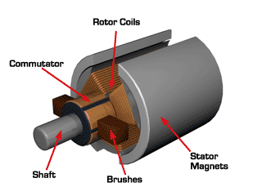
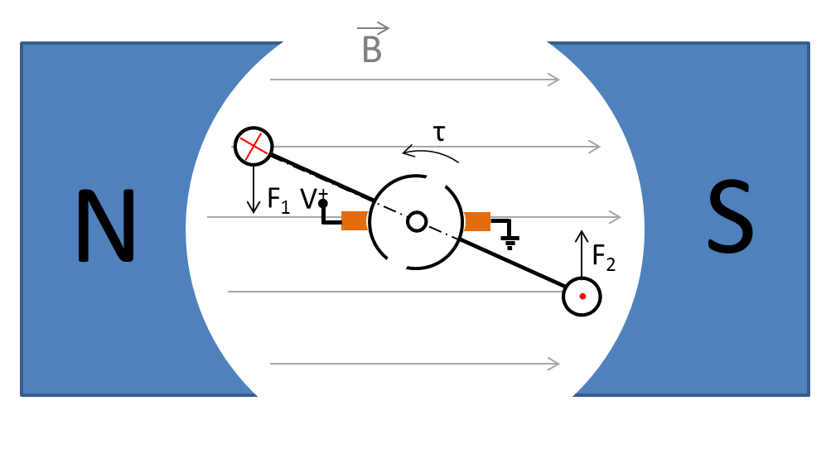
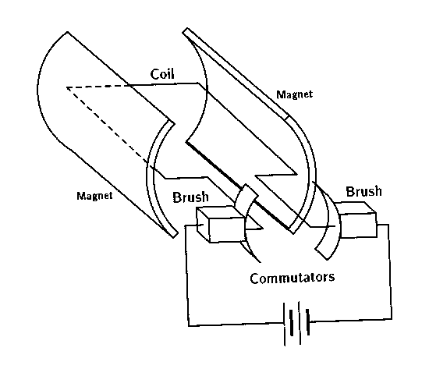
DC Motors
Used to provide a torque to a shaft, capable of spinning the shaft to some velocity under the application of a DC current.
r1
http://www.electrical4u.com/permanent-magnet-dc-motor-or-pmdc-motor/
http://mechatronics.mech.northwestern.edu/design_ref/actuators/motor_theory.html
Notes:
A DC motor is used to provide a torque to a shaft that will be connected to the wheel base of an autonomous car. The basic DC motor consists of a pair of fixed permanent magnets called the stator, a set of rotating coils connected to the shaft, and a commutator. The commutator is a mechanical device that ensures that the coils rotate from one side of the magnet to the other. The direction of the current is reversed so that the provided torque always acts in the same direction.
F = Force, i = current, l = the vector of the coil wire cutting the field, and B = the magnetic field between the magnets (also called the magnetic flux density) from N to S.

Slide 4
DC Motors
Used to provide a torque to a shaft, capable of spinning the shaft to some velocity under the application of a DC current
r1
commutator
http://www.electrical4u.com/permanent-magnet-dc-motor-or-pmdc-motor/
http://mechatronics.mech.northwestern.edu/design_ref/actuators/motor_theory.html
Notes:
Note the position of the commutator in the schematic on the right.

Slide 5
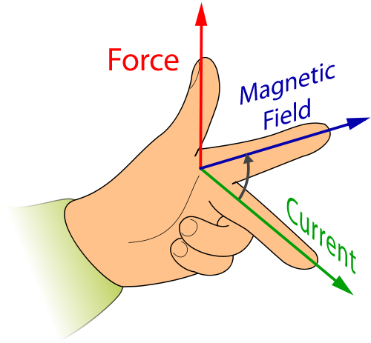
Lorentz Law
Fleming's left-hand rule for motors
Left index finger is pointing in the direction of the magnetic field vector
Left middle finger points in the direction of the current vector
Left thumb indicates the direction of the force
http://www.bigshotcamera.com/fun/buildables/motor#01
Notes:
The force on the coil wire in the winding (assuming perpendicular direction to the field) can be found by using a variety of methods. The easiest is Fleming’s left-hand rule. Aligning the index finger of the left hand with the magnetic field, and the middle finger with the current vector (from + to -) gives us the direction of the force, along the thumb.

Slide 6
DC Motors: Commutator
B
A
τ
N
S
V⁺
F₁
B
F₂
Notes:
As the current is flowing into the wire cross-section A, and out of cross-section B, the torque Tau rotates counterclockwise.

Slide 7
DC Motors: Commutator
F₂
B
B
N
τ
S
A
F₁
Notes:
Keeping the same polarity (i.e., keeping the current flowing in the same direction, from cross-section A to B) will cause the torque to reverse, as the coil rotates past θ = π/2 line (blue-striped line).

Slide 8
DC Motors: Commutator
B
F₂
B
τ
N
S
V⁺
F₁
A
Notes:
However, the commutator reverses the polarity, so that the current flows into node B and out of node A. The torque always points in the correct direction.

Slide 9
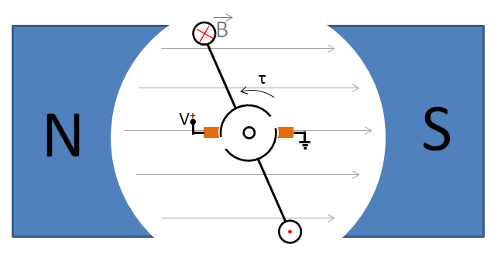
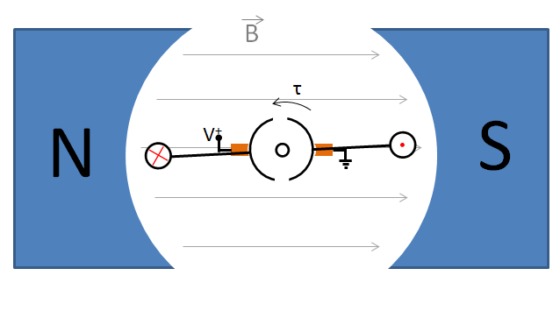
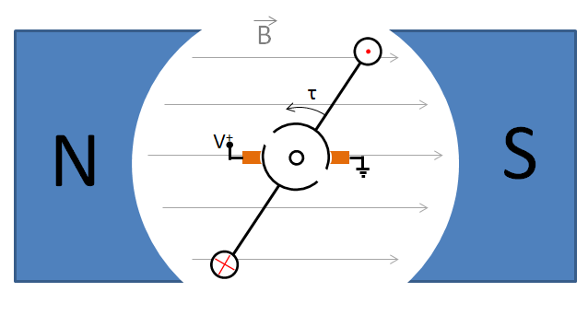
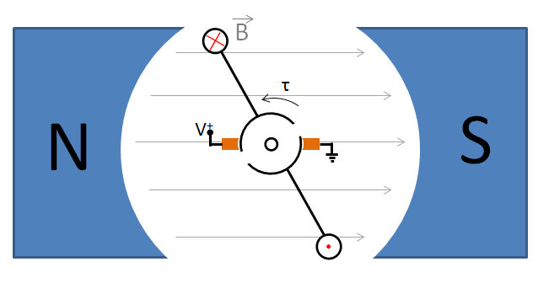
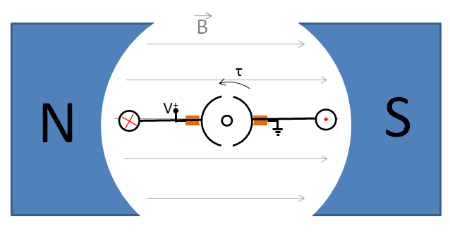
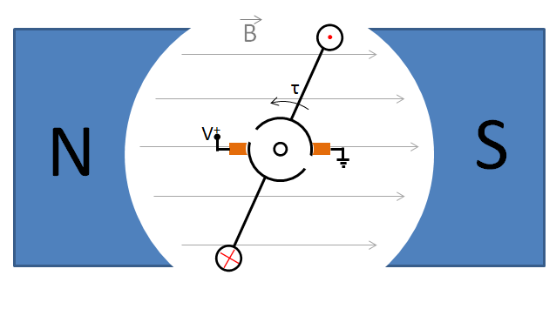
DC Motors: Torque Ripple
B
E
Recall:
τ_{max}
τ
torque ripple
A
F
π/2
θ
0
C
D
3π/2
A
B
C
D
E
F
Notes:
However, the magnitude of the torque depends on the angle between the r-vector and the F-vector. It is highest when the coil is close to position B, and lowest when it is close to position A, when the entire force F is projected along vector r. Consequently, the torque varies from τ_max to 0. This variation is called torque ripple. Torque ripple is to be avoided, because it may provide vibrations and uneven force through the system. Torque ripple is large (bad) in a two-segment commutator.

Slide 10
DC Motors: Torque Ripple
4-segment commutator:
B
N
S
F₁
V⁺
F₂
Notes:
A four-segment commutator dramatically reduces the torque ripple.

Slide 11
DC Motors: Torque Ripple
4-segment commutator:
B
F₂
N
S
V⁺
F₁
Notes:
As the rotor turns, only the coil that causes force nearly perpendicular to the arm radius is energized.

Slide 12
DC Motors: Torque Ripple
4-segment commutator:
B
N
S
V⁺
F₄
F₃
Notes:
As the rotor turns, only the coil that causes force nearly perpendicular to the arm radius is energized.

Slide 13
DC Motors: Torque Ripple
4-segment commutator:
τ
τ_{max}
torque ripple
τ_{min}
θ
0
π/2
π
Now, greatly reduced torque ripple
Notes:
This chart shows that the four-segment commutator helps to dramatically reduce the torque ripple.

Slide 14
Motor: Electrical Equivalent Circuit
+
V_{m}
V_{m}
-
Symbol:
+
M
-
i_{m}
DC motor can be represented as an electrical element in a circuit diagram:
V_{m} is the across element voltage (motor voltage)
i_{m} is the through element current (motor current)
Notes:
The DC motor has two terminals to which we’ll connect a power supply. When power is supplied to the DC motor, it causes the shaft to rotate. In rotational motion, power is the product of torque tau and angular velocity omega. The input to the motor is current and voltage, applied through the motor electrical terminals. The voltage across the motor is called motor voltage, or V_{m}, while the current through the motor is called motor current, or i_{m}. The electrical symbol for the motor is shown on the right.

Slide 15
Motor: Electrical Equivalent Circuit
V_{m}
+
-
Symbol:
M
R_{m}
L_{m}
+
i_{m}
V_{m}
i_{m}
+
e
-
-
Assumes at steady state,
An equivalent circuit can be constructed to model the operation of the motor from an electrical perspective
Notes:
An equivalent circuit can be constructed, which models the operation of the motor from an electrical perspective, i.e., the relationship between the motor current and the motor voltage. The insides of a motor consist of a winded wire (coil), which has some internal resistance, called winding resistance of the motor, R_{m}. The wire is also an inductor, with some motor inductance L_{m}; however, the motor inductance only comes into play when the current changes abruptly. We will revisit this when it comes to snubbing.
However, a DC motor is also a generator, because as the shaft turns, the winding moves through a magnetic field (B), generating a reverse potential across the windings, which counteracts some of the applied voltage V_{m}, and reduces the motor current i_{m}. This voltage is called back EMF (electromotive force), V_{emf}. V_{emf} is equal to some constant k_{e} times the angular velocity of the shaft omega (which corresponds to how fast the coil wires move through the magnetic field). In steady state, or when the current does not change too fast, the V_{m} is equal to the sum of the voltage drop across the winding resistance and V_{emf}. Note that V_{emf} limits how fast the shaft will spin; e.g., if the shaft increases its angular velocity, eventually all applied voltage V_{m} will be negated by V_{emf}. In other words, a DC motor is self-limiting in angular velocity.

Slide 16
Electromotive Force in a Wire Moving Through B-field
Electrons in a wire moving through a magnetic field B at a velocity v will be pushed towards one end, while the holes will be pushed to the other end, causing a net potential V_{emf}
http://web.mit.edu/8.02t/www/materials/StudyGuide/guide10.pdf
Notes:
EMF (voltage) across the wire moving in a magnetic field is generated because the electrons in the wire are moved away (separated) from holes due to wire motion through the field. This separation generates a potential, and thus current, in the circuit.

Slide 17
Motor: Electrical Equivalent Circuit
switch
switch
+
M
motor
V_{b}
V_{m}
-
-
+
battery
The DC motor connected to the battery, with a switch in between
Notes:
We analyze the motor performance by connecting the DC motor to a battery via a switch. The battery has some voltage V_{b}, while the motor will have a voltage V_{m} across its terminals.

Slide 18
Motor: Electrical Equivalent Circuit
R_{b}
R_{m}
+
+
i_{m}
+
V_{b,ini}
+
V_{b}
V_{m}
e
-
-
-
-
battery
motor
Combined equivalent circuit diagram for the simple battery-motor system
Notes:
We can now analyze the system performance by looking at the combined equivalent circuit diagram of the battery-motor system. To model the performance accurately, we need to include internal battery resistance, R_{b}, which limits how much current a battery can provide. Battery resistance is in general very small, but not negligible at moderate to high currents. Open-circuit battery voltage, also called the nominal battery voltage, is referred to as V_{b,ini}.

Slide 19
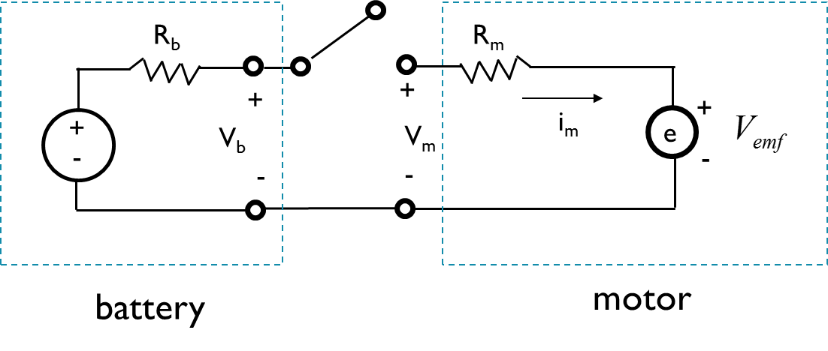
Motor: Electrical Equivalent Circuit Analysis
switch
OFF
Motor at rest
i_{m}
Motor current zero
V_{m}
Motor voltage zero
V_{b}
Nominal (open circuit) battery voltage V_{b}
Notes:
Initially, the switch is in the off position, and the motor is at rest (angular velocity of the shaft, omega is zero). Since the switch is open, the motor current is at zero. The motor voltage is also at zero (no zero motor current, and no V_{emf}). No current is flowing through the internal resistor of the battery, R_{b}, so the battery voltage is equal to the nominal, open circuit battery voltage V_{b,ini.}

Slide 20
Motor: Electrical Equivalent Circuit Analysis
switch
OFF
ON
Motor spinning up
is increasing.
stall current, i_{max}
Motor current initially sharply increases, but then starts dropping due to V_{emf}
i_{m}
Motor voltage jumps up, and slowly keeps increasing due to buildup of V_{emf}
V_{m}
Sharp increase in i_{m} causes voltage drop across R_{b}, and drop in V_{b}. As i_{m} is reduced, V_{b} increases
V_{b}
Notes:
As the switch is thrown, the motor spins out. Initially, the motor current jumps up, and is equal to V_{b_ini} / (R_{b}+R_{m}). Initially, omega is at rest, and so is V_{emf}. At this point, the motor current i_{m} is the highest (and so is the torque). The motor current with the shaft at rest is called a stall current. As the shaft spins up, the motor current is reduced due to a buildup of V_{emf}.
Motor voltage initially increases rapidly, as the motor is connected to the battery, V_{m} = V_{b} = V_{b_ini} – i__{m}*R_{b}.
The motor voltage increases as the V_{emf} increases and adds to V_{m}. V_{b} initially drops, as i_{m} increases sharply, and some voltage is lost across R_{b}.
As i_{m} is reduced due to V_{emf}, V_{b} increases slowly.
Note that this diagram does not include the voltage spikes due to changes in i_{m} and interaction with L_{m},
which for this purpose can be ignored, since they are operating at a much faster timescale.

Slide 21
Motor: Electrical Equivalent Circuit Analysis
switch
OFF
ON
OFF
Motor spinning down is increasing.
i_{m}
Motor current drops to zero
Motor voltage drops down to the value provided by only V_{emf}
V_{m}
V_{b}
V_{b} goes up to V_{b,ini}, as no voltage drop over R_{b}
Notes:
As the switch is opened, the motor current is interrupted. Depending on loss and friction in the system, the motor now starts to spin down. Motor voltage is reduced; however, the motor is now working as a generator, and the only contribution is the back EMF, i.e., V_emf. V_b is increased to V_b,ini, since there is no more drop across the internal resistance R_b. Note that this diagram does not include the voltage spikes due to changes in i_m and interaction with L_m, which for this purpose can be ignored, because they are operating at a much faster timescale.

Slide 22
Motor: Inductive Kickback
switch
switch
+
M
motor
V_{b}
I_{ind}
-
V_{m}
-
+
battery
Current through the motor interrupted: inductive kickback
Reversed-biased snubber diodes short the resulting voltage spike
Notes:
An inductor will resist attempts to change the current flowing through it. (Recall that voltage across an inductor, v(t) = L di/dt.) Consequently, when we disconnect the supply current through the motor by opening the switch, the inductor (which is the motor winding) will create a large voltage spike in the opposite polarity. Such large spikes may be detrimental to connected electronics. A snubber (or flyback) diode is often used to short the resulting voltage spike.

Slide 23
Summary: DC Motors
DC Motors provide actuation for many mechatronic systems such as electric cars
A commutator ensures that the torque spins the shaft in one direction for a certain polarity
Back EMF generates a voltage across the winding, limiting the motor current as a function of the angular velocity of the shaft (and winding)
Some important implications of back EMF:
It will limit the ultimate angular velocity of the shaft (if it didn’t, all unloaded DC motors would likely disintegrate: ω → ∞)
Can be used for velocity sensing
Highest motor current at stall (ω = 0). Motor controllers must be designed to handle stall currents
Snubber diodes help to remove voltage spikes due to switching current through the winding
Notes:
Let’s summarize what we have learnt so far.
DC motors provide actuation for many mechatronic systems. A commutator inside a DC motor ensures that the torque spins the shaft in one direction for a certain polarity. Back EMF generates a voltage across the winding, which limits the ultimate angular velocity of the shaft. Lastly, snubber diodes can help to remove voltage spikes due to switching current through the winding.

Slide 24
Motor Controllers
MCU
switch
FET
+
M
+
M
V_{b}
V_{m}
V_{b}
V_{m}
-
-
A motor controller is an amplifier which converts weak signals from the microcontroller GPIO ports to high current that drive the motor
Solid-state using Power FET technology (e.g. NDP7060L)
Fast switching time
Large currents
Notes:
Next, let’s look at the motor controllers. The goal of a motor controller is to be able to replace the manual switch with a solid-state switch that can be controlled by a microcontroller unit (MCU). Different motor controllers have different topologies, the simplest ones consisting of just one single transistor. The most commonly used transistors are field effect transistors (FETs). We call them power FETs because they can handle (i.e., control) substantial power throughput.

Slide 25
Field Effect Transistor: A Review
gate
drain
source
Can be n-channel or p-channel
Most common is n-channel
Fabricated on a doped silicon substrate
Has four terminals: Source, Drain, Gate, and Body
If not specified, body is assumed connected to Source
gate oxide
n+
n+
p-type
gate
body
source
drain
Cross-section of an n-type (n-channel) FET
body
Symbol
Notes:
A bit about the FET before we continue. We will focus on a type of FET called Metal Oxide Semiconductor Field Effect Transistor (MOSFET)
Various semiconductors can be used to construct an FET, however silicon is mostly used. An FET consists of a silicon channel whose conductance can be controlled by an electric field. An FET has four teminals which are Source, Drain, Gate and Body. In FET specifications, the body may not be specified. In this case one can assume that it is connected to the source. The drain and source are both doped as n-type type wells on a p-type substrate. The gate is seperated from the drain and the source by an oxide layer.
The electric field to control the current from source to drain is applied to the gate. When enough voltage is applied to the gate, an inversion layer of n-channel is formed between the source and the drain, this is n- channel which enhances as the gate voltage increases.

Slide 26
Field Effect Transistor: A Review
V_{dd}
gate
drain
FET Operation (n-channel)
Source/body is usually connected to ground
Drain is connected to V_{dd}
Initially source and drain isolated through a dual PN junction
source
n+
n+
p-type
body
GND
Notes:
The source/body is usually connected to the ground. The drain is connected to V_{dd.} Initially, the source and drain are isolated through a dual PN junction.

Slide 27
Field Effect Transistor: A Review
V_{dd}
gate
drain
source
FET Operation (n-channel)
To switch the transistor on, gate is connected to positive voltage
Accumulation of positive charges on the gate electrode attracts negative charges just underneath the gate, in the channel region
V⁺
⁺⁺⁺⁺⁺⁺⁺⁺⁺⁺⁺⁺⁺
⁻ ⁻ ⁻ ⁻ ⁻ ⁻ ⁻ ⁻ ⁻ ⁻ ⁻ ⁻ ⁻
n+
n+
p-type
body
GND
Notes:
To switch the transistor on, the gate is connected to positive voltage. Accumulation of positive charges on the gate electrode attracts negative charges just underneath the gate, in the channel region.

Slide 28
Field Effect Transistor: A Review
V_{dd}
gate
drain
source
FET Operation (n-channel)
When the density of negative charges in the channel reaches a certain threshold, the channel becomes conductive
Above gate threshold voltage
Initially, channel acts like a resistor, FET operates in the linear region
V⁺
⁺⁺⁺⁺⁺⁺⁺⁺⁺⁺⁺⁺⁺
⁻ ⁻ ⁻ ⁻ ⁻ ⁻ ⁻ ⁻ ⁻ ⁻ ⁻ ⁻ ⁻
n+
n+
p-type
body
GND
Notes:
When the density of negative charges in the channel reaches a certain threshold, the channel becomes conductive.
Initially, the channel acts like a resistor as the FET operates in the so-called linear region.

Slide 29
Field Effect Transistor: A Review
V_{dd}
gate
drain
source
FET Operation (n-channel)
As drain to source voltage (V_{ds}) increases, the channel gets pinched off at the drain, limiting the drain to source current (Id)
FET is now operating in the saturation region
V⁺
⁺⁺⁺⁺⁺⁺⁺⁺⁺⁺⁺⁺⁺
⁻ ⁻ ⁻ ⁻ ⁻ ⁻ ⁻ ⁻ ⁻
n+
n+
p-type
body
GND
Notes:
As drain to source voltage V_{ds} increases, the channel gets pinched off at the drain, limiting the drain to source current (Id). The FET is now operating in the saturation region.

Slide 30
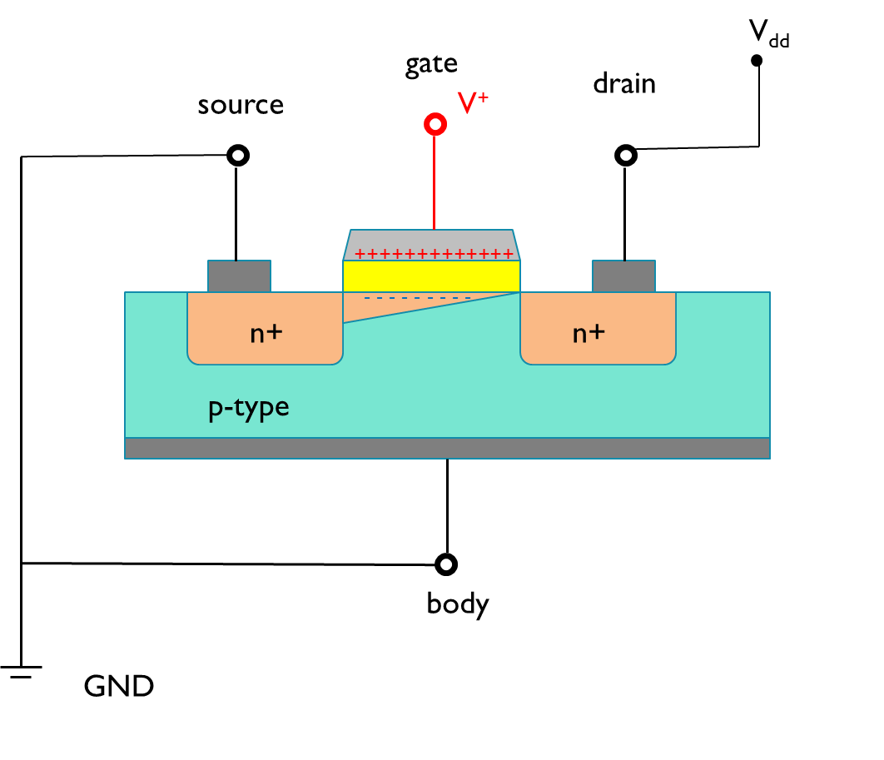
Field Effect Transistor: A Review
Linear region
Saturation region
V_{GS} = 3.5 V
V_{GS} = 3.0 V
V_{GS} = 2.5 V
I/V characteristics for a NDP7060L Power FET
Datasheet NDP7060L
Notes:
The operational characteristics of an FET can be described using a V/I curve. The drain to source current (I_{D}) can be seen as a function of drain to source voltage (V_{ds}) for a set gate voltage V_{gs}. In the linear region, I_{D} increases linearly with V_{ds}, and the FET operates in the linear region. Once V_{gs} gets large, the channel is pinched at the drain, and does not allow more electrons to flow through it. At that point, I_{D} does not increase any more with V_{gs}, and the FET operates in the saturation region.

Slide 31
Summary: Field Effect Transistors
Power FETs are used as solid state switches in a motor controller
In an n-channel FET, positive charges on the gate form a n-type channel between the source and the drain
Once on, a FET operates in either linear or saturated region
Notes:
We have just looked at the basics of field effect transistors. The FETs are often used as solid-state switches in a motor controller. In an n-channel FET, positive charges on the gate form an n-type channel between the source and the drain. Once switched on, the FET operates in either the linear or saturated region.

Slide 32
Motor Controllers: FETS as Switches
Switch is now replaced with a FET
Single FET motor controller
Only turn in one direction
Motor and battery resistance in series
Analyze for maximum (i.e. stall) current
M
V_{bat}
+
-
MCU
single transistor controller
Notes:
Replacing the switch by an FET allows better control by an MCU. Different motor controllers have different topologies, the simplest ones consisting of just one single transistor . With a single FET, the controller can only cause the motor to turn in one direction.

Slide 33
Motor Controllers: FETS as Switches
motor
battery
Modify electric diagram for stall (ω = 0)
No back EMF
No inductive component
Load-line analysis
R_{b}
R_{m}
V_{b,ini}
+
-
MCU
single transistor controller
Notes:
This is the equivalent circuit when the motor is at stall.

Slide 34
Motor Controllers: FETS as Switches
motor
battery
e.g. assume
V_{b,ini} = 5V, R_{m} = 0.4Ω, R_{b} = 0.1Ω
V_{gs} provided by the MCU
R_{b}
R_{m}
V_{b,ini}
+
-
MCU
4
5
single transistor controller
I/V characteristics for a NDP7060L Power FET
Datasheet NDP7060L
Notes:
This slide shows the load line analysis for the FET, using the I-V characteristics of the NDP7060L power FET as an example.

Slide 35
Motor Controllers: FETS as Switches
motor
battery
e.g. assume
V_{b,ini} = 5V, R_{m} = 0.4Ω, R_{b} = 0.1Ω
V_{gs} provided by the MCU
R_{b}
R_{m}
V_{b,ini}
+
-
OFF
MCU
4
5
single transistor controller
I/V characteristics for a NDP7060L Power FET
Datasheet NDP7060L
Notes:
The first point on the load line is when the transistor is in the OFF state. The FET is equivalent to an open switch, and the voltage drop across the FET (from source to drain) is equivalent to V_{b,ini}.; in this case, 5V.

Slide 36
Motor Controllers: FETS as Switches
motor
battery
e.g. assume
V_{b,ini} = 5V, R_{m} = 0.06Ω, R_{b} = 0.01Ω
V_{gs} provided by the MCU
R_{b}
R_{m}
V_{b,ini}
+
-
ON
MCU
4
5
single transistor controller
I/V characteristics for a NDP7060L Power FET
Datasheet NDP7060L
Notes:
The second point on the load line is when the transistor is completely ON. We assume the on resistance of the FET is negligible in comparison, and the maximum current that will flow through the FET will be 71A. We can now draw the load line (green) along which the V_{ds}/I_{D} point will lie, as a function of V_{gs}. Under the assumption above, we can use the load line to measure the power dissipation across the FET.

Slide 37
Motor Controllers: FETS as Switches
motor
battery
e.g. assume
V_{b,ini} = 5V, R_{m} = 0.06Ω, R_{b} = 0.01Ω
V_{gs} provided by the MCU
R_{b}
R_{m}
V_{b,ini}
+
-
ON
V_{gs} = 3.3V
MCU
4
5
single transistor controller
I/V characteristics for a NDP7060L Power FET
Datasheet NDP7060L
Notes:
The load line illustrates a problem with directly connecting the GPIO to the gate of the FET. If you assume that the GPIO can deliver 3.3V output, then the resulting point on the load line corresponds to approximately 0.77V_{ds} and 52A I_{D}. The rectangle under the load line, covered by the 0.77V V_{ds} and 52A I_{D} is 40W. This is quite high power.

Slide 38
Motor Controllers: FETS as Switches
motor
battery
e.g. assume
V_{b,ini} = 5 V, R_{m} = 0.06Ω, R_{b} = 0.01Ω
V_{gs} provided by the MCU
R_{b}
R_{m}
V_{b,ini}
+
-
ON
MCU
V_{gs} = 2.6 V
4
5
single transistor controller
I/V characteristics for a NDP7060L Power FET
Datasheet NDP7060L
Notes:
Furthermore, drain may not be at ground, e.g., in H-bridge topologies that we will observe later in this module. If the drain of the FET is elevated by 0.7V above ground, then the V_{gs} would now be at 2.6V, Id would be approximately 35A, and the power dissipation in FET would be at 61W.

Slide 39
Motor Controllers: the need for FET drivers
To reduce the power dissipation in ON state, V_{gs} must be as high as possible (up to gate voltage breakdown)
V_{gs} may be above V_{dd}
3.3 V output from GPIO not high enough
Solution: FET Drivers
Solid-state circuits that elevate ON output voltage to a higher ON level.
In some cases much higher than V_{dd}
E.g. MC 33883 elevated the gate voltage enough to ensure the MOS FET is in the ON state, while protecting the gate from over voltage.
Datasheet 33883
Notes:
However, the higher the Vgs, the higher on the load line we get in the ON state, and thus less power dissipation in the FET. Remember, we ideally want the FET to be completely ON. In fact, the Vgs can go above Vdd to provide the required gate voltage and alleviate the concern when the source is not at ground. In a motor controller, this is often handled by a circuit called an FET driver. MC 33883 elevated the gate voltage enough to ensure the MOS FET is in the ON state, while protecting the gate from over voltage.

Slide 40
Motor Controllers: FETS as Switches
motor
battery
e.g. assume
V_{b,ini} = 5 V, R_{m} = 0.06Ω, R_{b} = 0.01Ω
V_{gs} provided by the MCU
R_{b}
R_{m}
V_{gs} = 14.3 V
+
V_{b,ini}
-
ON
FET driver
MCU
4
5
single transistor controller
I/V characteristics for a NDP7060L Power FET
Datasheet NDP7060L
Notes:
This slide shows the ON state of the transistor after the signal is transferred through an FET driver like MAX621. The V_{gs} is now at 14.3V, and V_{ds} is 0.3V (est.), I_{D} is 60A (est.), and the dissipated power is only 18W. The FET drivers work with capacitive charge pumps, and are ideal when motors are run by pulse-width modulation (PWM).

Slide 41
Summary: Motor Controllers
Motor controllers are used to control the actuation of a motor using one or more FETs
Load-line analysis is used to determine the power dissipated in a FET in a motor controller
To lower the dissipated power in a FET, V_{gs} needs to be as high as possible.
A FET driver is used to elevate V_{gs} above V_{dd,} ensuring proper switching
Notes:
This brings us to the end of this video.
In this part of the video, we looked at how FETs can be used to control motors. We’ve also discussed the load-line analysis for calculating the power dissipation in an FET. We also showed that to lower the dissipated power in an FET, V_{gs} needs to be as high as possible. Lastly, an FET driver can be added to lift V_{gs} above V_{dd} to ensure proper switching.

