Slide 1
Optical Sensing in Robotics
Notes:
Hello and welcome! In this video, we will look at optical sensing techniques in robotics.

Slide 2
Module Syllabus
Sensor: An Introduction
Review: Operational Amplifiers
Optical Encoders
Velocity control
Optical Line Camera
Line following (steering)
Notes:
We will start by introducing the basics of sensors, followed by a revisit of operational amplifiers. Then, we will discuss the principles of optical encoders and line cameras, as well as their applications in robotics.

Slide 3
Sensors - An Introduction
Obtains the information about the environment
Provides transduction between the physical (mechanical) and electrical domains
Transduction: Conversion of energy between energy domains
Physical
Electrical
Sensor
Sensor
electronics
Environment
Microcontroller
Notes:
Sensors are tasked with obtaining information about the environment (the physical system surrounding the autonomous car) and the input of a microcontroller. Sensors provide transduction between the physical and (most often) electrical domains. Transduction implies conversion of energy between energy domains, and sensors are usually transducers that convert energy from the mechanical (physical) domain to the electrical domain.
In a typical sensing system, the environment (e.g., change in the temperature) influences the sensor in some way. The sensor converts that influence (e.g., change in resistance) into some form of electrical signal. That change is now in the electrical domain, but the signal is often too weak for the microcontroller to interpret directly. Sensor electronics allows interface with the microcontroller, often by using operational amplifiers to amplify the signal to levels required for microcontroller input. The microcontroller reads the conditioned input signal through its analog or digital input ports, and uses that information in its control loop.

Slide 4
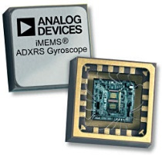
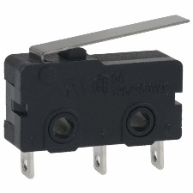
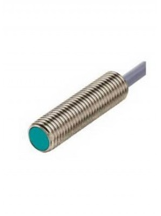
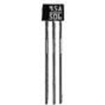
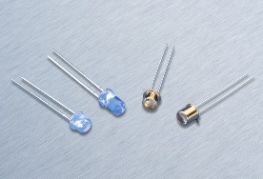
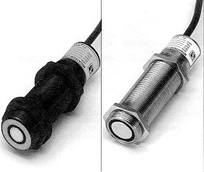
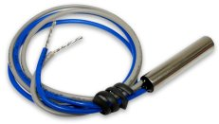
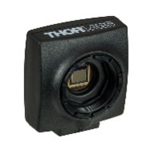
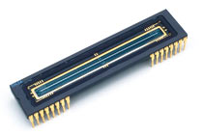
Sensors – An Introduction
Relevant types of sensor:
Inertial
Magnetic
Ultrasonic
Temperature
Mechanical
http://www.analog.com
http://www.indiantradebird.com/custom-sensors-technologies-micro-switches?cpid=ODM5OSw3LDEsNA==
https://www.powell.com/item/Honeywell-Sensing-and-Control-V7-1C17D8-207-GSorAZ/266539?gclid=CObXpbCEnM4CFQ6EaQodaasNKg
http://www.honeywell.com/
http://www.wolfautomation.com
Optical
Photodiodes / phototransistors
Encoders
Cameras
http://www.instronics.com
http://www.tempsensing.com
https://www.thorlabs.com
https://www.teledynedalsa.com
Notes:
A variety of sensors can be used for a mechatronic system like the autonomous car. Mechanical switches are often used in robotics to sense a physical location of an end effector, or a linear actuator. Switches can also be used to detect when a robot, for example, enters a docking location. The limitation of switches is that they require physical contact, i.e., are subject to wear. Non-contact (proximity) sensors are much better at detecting the position and/or orientation without the wear associated with making physical contact. Optical sensors, such as those composed of a pair of emitter and receiver photodiodes, can be used to detect the physical location or rotation of a wheel or the car itself. A class of such sensors, optical encoders, use corrugated or colored discs to detect the position of a shaft, and can be used to gauge the velocity of an electric DC motor. We will examine the encoders later in this module.
Arrays of optical sensors, with focusing optics, can be used to obtain a visual representation of the environment, and form a camera system. A normal camera has a 2D pixel array; however, 1D pixel arrays called linear cameras can be used to simplify the image recognition, and to provide control in areas such as autonomous cars. We will examine linear cameras later in this module.
Other types of sensors can also be used. Inertial sensors can be used to measure acceleration and deceleration. Although acceleration can be integrated to provide velocity information, this is often inaccurate and subject to drift. Magnetic sensors can be used as proximity sensors to magnetic or metallic structures, and can be used in lieu of optical sensors for velocity/proximity detection. Ultrasound sensors are also useful for mapping and proximity detection, especially since they can provide ranging information to obstacles. Finally, a suite of other environmental sensors can be used. A good example is temperature sensors, which can detect changes in temperature such as overheating of battery or robot components. Some of the above sensors include the on-board electronics such that their signal can be directly integrated with an MCU, but for some, signal conditioning has to be developed as well.

Slide 5
Review – Operational Amplifiers
Operational Amplifiers (OpAmps) are commonly used to amplify (precondition) sensing signal for input to a microcontrollers
OpAmps are analyzed as ideal
+V_{sup}
i+
Ideal OP-Amp:
High input impedance (i+ ≈ 0, i- ≈ 0)
Low output impedance
Infinite gain (A is very large)
+V
+
$$V_{out}=A(V^{+}−V^{−})$$
i-
V_{out}
-V
-
-V_{sup}
Notes:
A commonly used circuit for amplifying the sensor input (which is usually something that is needed) is an operational amplifier (OpAmp). An OpAmp has two power supply inputs (V_{sup}+ and V_{sup}), as well as two inputs (+ and -). The output, V_{out} is equal to the difference between V+ and V-, multiplied by some gain A. An OpAmp is usually analyzed assuming it’s an ideal circuit, in which case A is infinite. Other assumptions of ideality include infinite input impedance (no current flows into + and -, and the OpAmp can supply infinite output current).

Slide 6
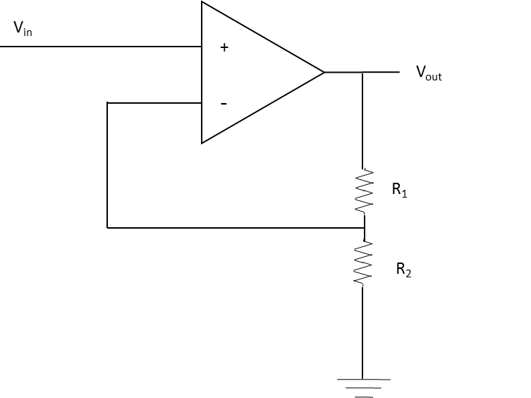
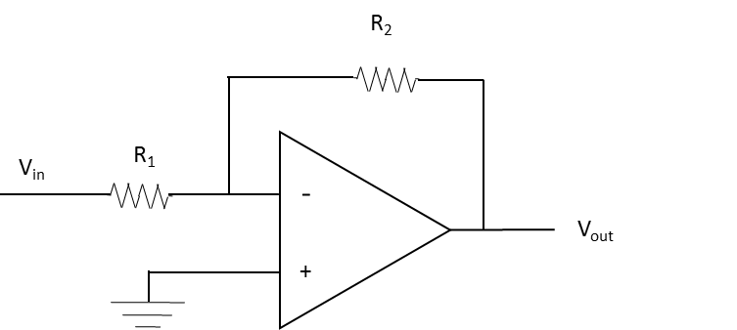
Review – Operational Amplifiers
Two main configurations:
Inverting amplifier
Non-inverting amplifier
Notes:
The OpAmp can be configured to operate in one of two modes, non-inverting or inverting. We will analyze both in the next slides. In general, although the gain of the OpAmp is assumed infinite, infinite gain is not very useful. So, in a practical amplifier circuit, the gain is set to a fixed value using a feedback circuit.

Slide 7
Review – Operational Amplifiers
Non-inverting OpAmp
V_{in}
+
V_{out}
-
$$V_{out}=\frac{R_{1}+R_{2}}{R_{2}}V_{in}$$
R₁
R₂
Notes:
The non-inverting configuration amplifies the signal V_{in}, coming to the positive input of the OpAmp (+) using a combination of resistors to set the effective gain of the amplifier circuit to (R₁+R₂)/R₂. Note that the gain can only be larger than 1. The operation of the feedback circuit can be understood like this: OpAmp will try to make V+ ~ V-. The feedback circuit, which is a voltage divider, is set such that V+ ~ V- when V_{out} = V_{in} (R₁+R₂)/R₂.

Slide 8
Review – Operational Amplifiers
Inverting OpAmp
R₂
V_{in}
R₁
-
$$V_{out}=−\frac{R_{2}}{R_{1}}V_{in}$$
V_{out}
+
Notes:
The inverting amplifier has + input connected to the ground. The feedback composed of R1 and R2 is designed such that "V minus" is going to be equal to ground for some value of V out. You can check that this is the case when V out is equals to the sum of "minus R2 over R1" times V in, that is the gain is "minus R2 over R1.

Slide 9
Review – Operational Amplifiers
Inverting OpAmp as charge integrator
C
V_{in}
R₁
-
$$V_{out}\left(t^{′}\right)=− \int_{0}^{t^{′}}{\frac{V_{in}\left(t\right)}{RC}dt}+V_{out}(0)$$
V_{out}
+
Notes:
The inverting amplifier can be used as charge integrator. Note that as the capacitor is being charged up, V^{out} needs to reduce its voltage such that V- is at GND level. Hence, as the voltage across the capacitor C increases as a function of the capacitor adding charge, V^{out} is reduced to compensate, by the integration of V_{in}(t)/RC.

Slide 10
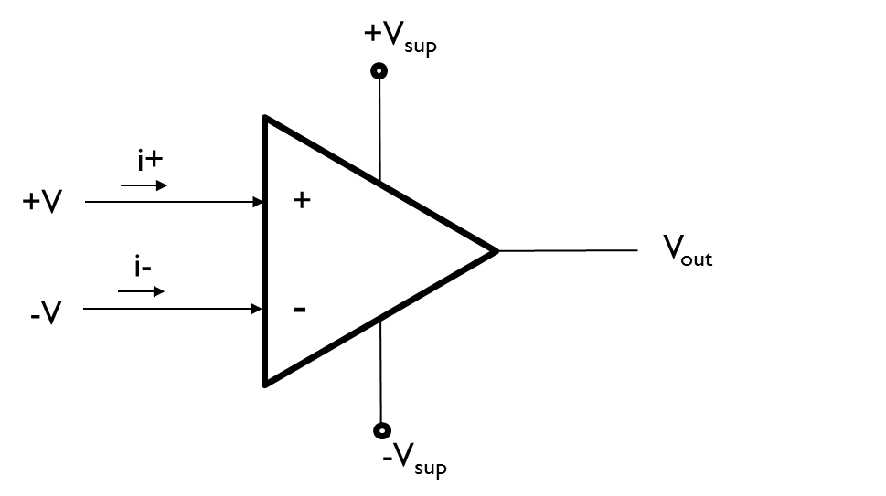
Review – Operational Amplifiers
Single supply inverting OpAmp
Need to create a virtual ground at ½ V_{dd}
V_{dd}
V_{dd}
+
V_{out}
R₁
-
R₂
C
Notes:
Even though OpAmps in general require a dual supply, it is possible to develop an OpAmp that runs on a single supply, which is more representative of what we have onboard an autonomous car. This is achieved by connecting the positive power supply (V_{dd}) to +V, _{sup} the ground to –V, _{sup}, and creating a virtual ground at ½ V_{dd} with which to reference the signal coming into the OpAmp. The virtual ground is created using two resistors R₁ and R₂, since it has to be at ½ V_{dd}, R₁ = R₂ (between 10K and 100K ohm). In addition, an RF ground provides grounding for the RF signal.

Slide 11
Summary: Sensors and Operational Amplifiers
Sensors provide information about the state of the environment to the microcontroller
Operational Amplifiers (OpAmps) are often used to amplify the sensing signal
OpAmps come in two flavors:
Non-inverting
Inverting
Gain of a non-inverting amplifier is always > 1
A virtual ground can be used if an amplifier is used as single supply
Notes:
So far, we’ve looked at sensors in general. We also revisited the different configurations of OpAmps, both inverting and non-inverting. The gain of non-inverting amplifiers is always greater than 1.

Slide 12
Optical Rotary Encoders and Velocity Sensing
Velocity sensing is necessary for a car to reach a set velocity
Recall
To reach the desired velocity, the car has to accelerate, i.e. increase i_{m}
Once desired velocity is reached the car has to coast, reducing i_{m} to counteract friction and drag
I_{m} must be larger to maintain same velocity if traversing an incline
Velocity = distance / time
Assuming a no-slip condition:
Resulting velocity:
Notes:
Now, let’s move on to a new topic: velocity sensing.
For obvious reasons, it is often desired to measure a vehicle’s true velocity. As we have discussed in previous modules, the torque tau is proportional to the motor current i_m. If we can measure the velocity accurately, we know when to increase or decrease the motor current to reach a desired velocity.
The velocity can be directly translated to the rotation speed of the wheel, which is equal to the angular velocity times the radius of the wheel.

Slide 13
Optical Rotary Encoders and Velocity Sensing
Optical rotary encoders:
Non-contact way to measure rotation/angular velocity
Can be purchased enclosed, or can be built onto the car wheel base
Basics of operations:
Photodiode
output
LED
0
π/4
π/2
3π/4
θ
Photodiode
Notes:
An optical rotary encoder can be used to measure the relative rotation, and velocity, of a wheel of an autonomous car. Assuming no-slip conditions, the rotation of the wheel should correspond to the displacement and velocity of the car. The rotary encoder can be purchased already enclosed, with a shaft sticking out; however, a lot of times, it is easier to build an encoder onto the side of the wheel. What is needed is a colored wheel (as illustrated), illuminated by a focused LED, and a photodiode measuring the refection of the surface. Care has to be taken to avoid illumination from daylight, so IR illumination and a photodiode are always preferred. Sometimes, combo illumination driver and detector units, such as the HAMAMATSU S6809, can be used for this. As the wheel rotates, the detected illumination pattern is shown to the right. Each pulse (P) on the photodiode corresponds to pi/2 rotation of the wheel.

Slide 14
Optical Rotary Encoders and Velocity Sensing
Photodiode
output
LED
0
π/4
π/2
3π/4
θ
Photodiode
Two ways to measure velocity:
Count number of transitions (edges) within a fixed amount of time
Measure time between two transitions, i.e. the width of pulse or valley
Depends on the number of transitions vs. sampling rate
Notes:
There two ways to measure the velocity using an optical encoder. One is counting the number of transitions within a fixed amount of time. The other is to measure the time between the transitions. We will explain these two methods in more detail now.

Slide 15
Optical Rotary Encoders and Velocity Sensing
Count number of edges in a fixed amount of time:
Photodiode
output
where is sampling time, n is the number of transitions, and is the angle between transitions, in this case π/4.
0
π/4
π/2
3π/4
θ
Error:
Notes:
The velocity can be measured by counting the number of transitions from an optical encoder (n) per a fixed unit of time (t_{s}). This can be achieved by continuously incrementing a counter on each transition, and after a certain time, looking at the counter value. Input can be continuously sampled, and transitions recorded (n is incremented if input_t-1 is not equal to input_{t}), and a timer or timed interrupt is used to keep track of the time.
Maximum error can occur if the counter has been sampled or started just before a transition occurs.

Slide 16
Optical Rotary Encoders and Velocity Sensing
Measure time between transitions:
Photodiode
output
where is the time of first transition, is the time of second transition is the angle between transitions, in this case π/4.
0
π/4
π/2
3π/4
θ
Error:
where is the sampling interval.
Notes:
Measuring the time between the transitions allows for estimation of velocity by dividing the angular distance * r by the difference in time between the two transitions. To record the times of both transitions, one can sample the input, and look for transitions from low to high. Alternatively, an interrupt can be set up on the transition. If sampling of input is used, then the resulting error is a function of the sampling interval; worst case, the input was just sampled as the transition occurred.

Slide 17
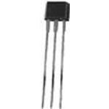
Velocity Sensing – Alternative Approaches
Optical encoder is just one way to measure velocity
Other approaches include:
Back EMF from the motors
Other types of proximity sensors to mark a revolution of the wheel
Good example is Hall-effect sensors
Hall effect sensors e.g. SS41
Honeywell
Magnet
Output
0
π/2
π
3π/2
θ
Notes:
There are alternative ways to measure the velocity of the autonomous car. One such approach is to measure the generated voltage (back EMF) from the motor, which is proportional to the velocity. It is also possible to use other types of proximity sensors to mark the revolution of the wheel. One common sensor is the Hall effect, which measures the nearby magnetic field. Placing a magnet on the wheel and placing the Hall effect sensor nearby generates a pulse as the wheel is rotating. The angle between the pulses can be explored experimentally.

Slide 18
Summary: Optical Rotary Encoders and Velocity Sensing
Non-contact way of measuring rotation, can be integrated on the wheel
Assuming no-slip conditions, wheel rotation corresponds to distance traveled
An optical rotary encoder wheel can be used to measure rotation
Two approaches:
Measure time between transitions
Count number of transitions within a time interval
Which approach to choose depends on: velocity, sampling time, allowable error
Other approaches, such as sensing back EMF or hall effect (magnetic) sensing can be used to estimate the velocity
Notes:
In summary, optical rotary encoders provide a non-contact way of measuring rotation and it often can be integrated on the wheel easily. Depending on the sampling rate and margin for error, two approaches can be used: i.e., measuring the time between transitions or counting the number of transitions within a fixed time interval. Other approaches, such as sensing back EMF or Hall effect sensors, can be used to estimate the velocity.

Slide 19
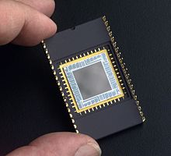
Optical Line Camera and Line Following
A vision system is a key component in any autonomously driving car
Optical camera projects an image onto a surface composed of light sensitive pixels
Charge Coupled Device (CCD) image sensor:
An array of light sensitive pixels fabricated on a silicon chip, used to detect projected images
2D array an essential component in many digital cameras
Sophisticated image reconstruction algorithms are usually needed
Line or edge following can be constructed using a 1D CCD array, and a simplified algorithm
wikipedia
wikipedia
Notes:
A vision system is usually a key component of any autonomous driving car. As a camera or sets of cameras are usually used to identify markers on the street, ensure that the car is well centered on the roadway, and avoid obstacles. The digital camera is converting an image, projected onto a light sensitive surface composed of pixels, into electrical signals. A device that is often used as such a light-sensitive surface is a charge-coupled device (CCD) image sensor, where incoming light causes capacitors in pixels to be charged up, and then the charges are coupled out. A 2D array of CCD sensors are key components in many digital cameras. Correspondingly, the extracted image usually has the form of a matrix. For a vision system, a sophisticated feature extraction algorithm is often needed to extract the relevant features, such as road markers. However, a much simpler algorithm can be implemented to perform line-following, or edge detection, using a line (1D) CCD array. In this array, the image is projected onto a line of pixels. A high-contrast line going through the field of view of the camera can be detected using a simple algorithm.

Slide 20
Optical Line Camera and Line Following
Line camera contains
1D CCD array (line)
Lens to focus the image across the CCD array
Within the image plane
Image still projected on a plane
Only one line of image detected
lens
Pixel values
focal plane
line CCD sensor
image plane
Notes:
The line camera will still project the image through a lens on the image plane, just like a regular camera; however, the CCD sensor will only detect (capture) the signal from one line of the image. The line will be represented by analog values, with the high values representing light pixels and low values representing dark pixels. Just like a regular camera, the image has to be made sharp by adjusting the focal plane of the line camera. However, the plane only has to focus on the image that is projected over the line sensor. An in-focus line means a less blurry line. How well the line is detected depends on the focus, and the orientation of the camera. Both should be adjusted for optimal results.

Slide 21
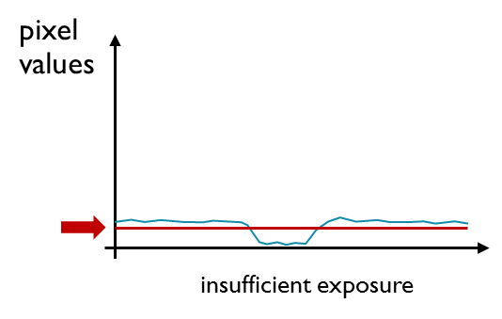
Optical Line Camera and Line Following
Detecting line center
Thresholding an effective method
NOTE: need to adjust the level of thresholding as well as the exposure level
Pixels (image elements) as array of 1’s and 0’s
Simple algorithms to detect line locations
Pixel counting
pixel values
threshold value
{1,1,1,1,1,1,0,0,0,0,0,1,1,1,1,1,1}
good exposure
line width
distance to center
Notes:
An easy way to detect the line is to simply threshold the pixels values, assigning a digital array of 1s and 0s to values above and below the threshold value, respectively. Note that the input from the line camera depends on the exposure, and that the thresholding should be adjusted based on the exposure. Signal noise will likely be present, and the lighting conditions may vary. It is strongly recommended that periodic scaling of the exposure time is done such that the signal always remains within a reasonable range of the ADC scale. The location of the center line can then be detected by counting the pixels, detecting the line (1 to 0 transition), measuring the width of the line (counting until next 0 to 1 transition), and diving the number of line pixels in half. Several measurements should be used to average the input signal.

Slide 22
Optical Line Camera and Line Following
Recommended line camera: TAOS TSL1401CL
128 x 1 linear optical sensor array
3 – 5 V V_{dd} power supply
Datasheet TSLI401CL
Notes:
A recommended sensor that is supported in this module is based on the TAOS TSL1401CL sensor by Texas Instruments. It’s a 128-pixel line camera. The sensor is controlled by two digital inputs (CLK and SI) and the pixels are read serially through the AO output pin. The AO signal is rail-to-rail based on the supply voltage V_{dd}, and hence can be compatible with the ADC input of the microcontroller.

Slide 23
Optical Line Camera and Line Following
Sensor functionality:
The pixels are serially read
SI marks the start of the readout sequence
Each clock pulse marks the transition to a new pixel, accessible through AO
During reading, pixels are in parallel exposed
Exposure time (integration time):
Datasheet TSLI401CL
Notes:
The sensor exposes the pixels in parallel; however, the readout is done serially, enabling easy interfacing to an ADC of a microcontroller. The voltage out on the analog output (that should be read by an ADC of the microcontroller) is proportional to R_{e}, the device responsivity for a given wavelength of light given in V/(μJ/cm2). E_{e} is the incident irradiance in μW/cm2, t_{int}, integration time in seconds, plus a small offset V_drk, the analog output voltage for dark condition. The output of each pixel is clocked using the clock (CLK) pulse, and the SI marks the start of the sequence. The exposure (integration) time t_{int} is equivalent to the 129 cycles it takes to read out the entire pixel array, minus the eighteen cycles that the sensor uses to zero out the pixels before the next sequence, multiplied by the clock period t_{clk}, plus the time after the 129 cycles to the initiation of a new SI pulse (t_{tqt}).

Slide 24
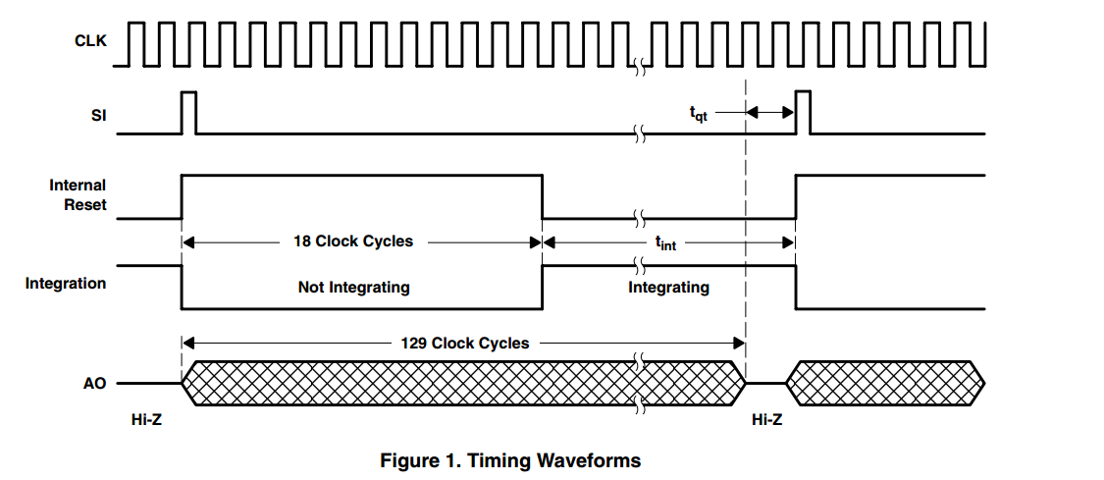
Optical Line Camera and Line Following
Datasheet TSLI401CL
Notes:
The clocking of the sensor can be further visualized by the following signal sequence.

Slide 25
Optical Line Camera and Line Following
Datasheet TSLI401CL
Notes:
The reset cycle is initiated by the SI pulse. First, the charge is transferred to the storage capacitor via S2.

Slide 26
Optical Line Camera and Line Following
Datasheet TSLI401CL
Notes:
After charge transfer, the storage capacitor is placed in high-impedance mode (disconnected), and the integrating capacitor is shorted to zero out the charge.

Slide 27
Optical Line Camera and Line Following
Datasheet TSLI401CL
Notes:
As the clock clocks through the 128 clocking cycles, the storage capacitors are connected one by one to the output, to read out the pixels, and then back to the high-impedance state. This can happen during the reset cycle or the integration cycle, but will happen only during the first 129 clock cycles. After that, all the storage capacitors are in high-impedance state.

Slide 28
Optical Line Camera and Line Following
Datasheet TSLI401CL
Notes:
After the eighteen cycles, the integrating capacitor is un-shorted, and keeps integrating the input signal.

Slide 29
Exposure Adjustment
Recap sensor functionality:
Note exposure time is proportional to t_{int}
Can adjust exposure by adjusting the integration time!
Lower CLK frequency (readout) in low-light conditions
Higher CLK frequency (readout) in high-light conditions
Potential problem
Slow down control loop
CLK exceeds the ADC frequency
Solution:
Two cycles, 1) exposure and 2) readout.
Fast sequence – expose only, ignore readout on AO
Slow sequence – readout only, read stored data in cycle 1)
5 KHz < f_{clock} < 8 MHz
Notes:
The speed at which the system is clocking through the pixels works like an electronic shutter, determining the exposure time. This is important, because the lighting conditions might vary. The integration time, t_{int}, determines how long the pixels are charging up the integration capacitors. Varying the CLK frequency allows us to shorten or prolong the integration time. Sufficient integration time can be determined online by examining the values (contract) between the black and light portions of the image (black line and white sides). This can be done online, as part of the control loop, to guard against changing lighting conditions. However, changing CLK might impact the control loop, as it will take a longer or shorter time to read through the 128 pixels. Furthermore, the frequency of CLK might be too high for the ADC (analog to digital converter) to read the signal. To get around that limitation, it is possible to split the exposure/readout loop into two separate cycles. The algorithm can first clock through the 129 CLK cycles required to limit the t_{int} beyond what can be done by waiting for the ADC. Once the 129 CLK cycles have been completed, the exposed pixel values are all stored in their storage capacitors. Now, a second slow cycle clocks through 129 CLK cycles, this time reading the AO values. The pixel values exposed (and overexposed) during this second cycle are discarded.

Slide 30
Exposure Adjustment
pixel values
pixel values
pixel values
saturation
underexposed
(not enough dynamic range)
good exposure
overexposed
(not enough dynamic range)
Exposure should be adjusted to maximize dynamic range
Can be done online during line following
Can be done during the control loop
Notes:
When using the line camera, it’s important to calibrate the exposure to maximize dynamic range. The figure on the left shows a situation of under exposure whereas the figure on the right shows a situation of overexposure. Both would cause low sensitivity and increase error.

Slide 31
Summary: Optical Line Camera and Line Following
A 2D light-sensitive pixel array is used in cameras for image capture
A 1D pixel array (line) can be used for line detection – line camera
Can be used for optical line following
Focus sensor on the line
Thresholding can be used to determine the center of the line
Line camera provided with the kit uses TAOS TSL1401CL sensor
128 pixels
Variable integration (exposure) time
Sequential (serial) output via AO, controlled through CLK and SI
Exposure can be varied to accommodate changes in lighting conditions
Changing the CLK frequency
Can be done dynamically to account for changes in light conditions
Notes:
We’ve now looked briefly at the various light-sensing technologies. While a 2D pixel array is good for image capture, a 1D pixel array is effective for line detection. We’ve also looked at the working principles of the TAOS TSL1401CL sensor. In order to get the best results out of these sensors, it’s important to tune the exposure level so that the dynamic range is maximized.

