Slide 1
Robot Operating System
Notes:
Hello and welcome to the Mechatronics and Robotics Online Course. In this video, we will look at robot operating systems.

Slide 2
Module Syllabus
Overview
Why robot operating system (ROS)
Characteristics of ROS
ROS packages
Client libraries
Catkin build system
Concepts
Graph Resource Names
Controller
Node
Topic
Service
Useful commands
Notes:
We will start with an overview of ROS, followed by some key concepts such as node, topic, and service. At the end, we will look at some useful commands in ROS.

Slide 3
Overview
What is ROS?
ROS is an open-source meta-operating system (or so-called “framework”) for robotic systems.
What’s included in ROS?
Hardware abstraction, low-level device drivers, package management, concurrency and communication, tools and libraries, etc.
Objective
To support code reuse in robotics research and development
License
BSD and Apache 2.0
Notes:
ROS is a meta-operating system that performs scheduling, loading, monitoring, and error handling using a virtualization layer between application software and computing hardware.
ROS runs on top of a conventional operating system, for example, Linux. ROS provides libraries that perform these functions.
The objective of ROS is simply to maximize the code reuse in robotics application development.
ROS is open-sourced under the terms of BSD and Apache 2.0

Slide 4
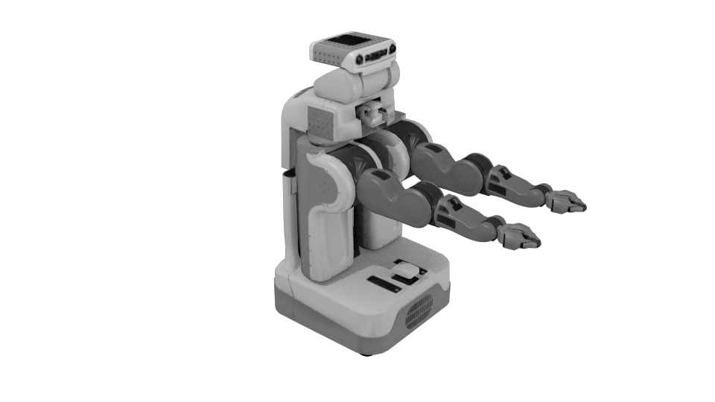
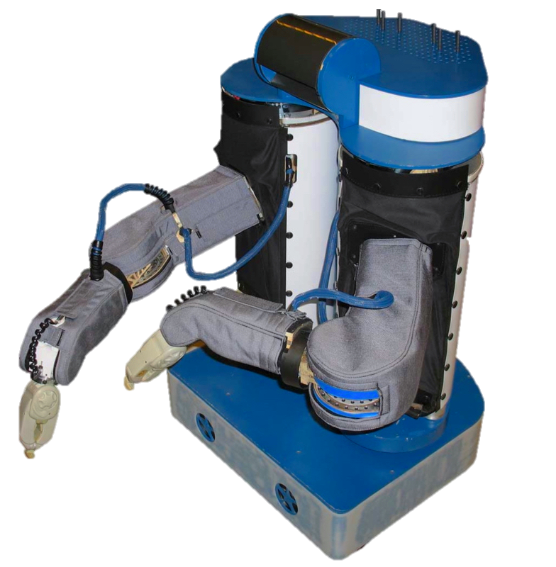
A Brief History of ROS
Predecessor: Switchyard: a robot software framework developed to support the Stanford AI Robot (STAIR)
Willow Garage continued to develop ROS from 2007 and launched ROS1.0 in 2010.
ROS was handed over to former Open Source Robotics (OSRF), now Open Robotics, in 2013
PR2
Source: https://www.openrobots.org/morse/doc/1.2/user/robots/pr2.html
PR1
Source: https://spectrum.ieee.org/automaton/robotics/robotics-software/wizards-of-ros-willow-garage-and-the-making-of-the-robot-operating-system
Notes:
The early work of ROS was inspired from the Switchyard robotic software framework developed as part of the STAIR project at Stanford University. Willow Garage launched ROS1.0 in 2010. The early versions of ROS were prototyped on PR1 and PR2 robots. Later in 2013, ROS were handed over to Open Robotics.

Slide 5
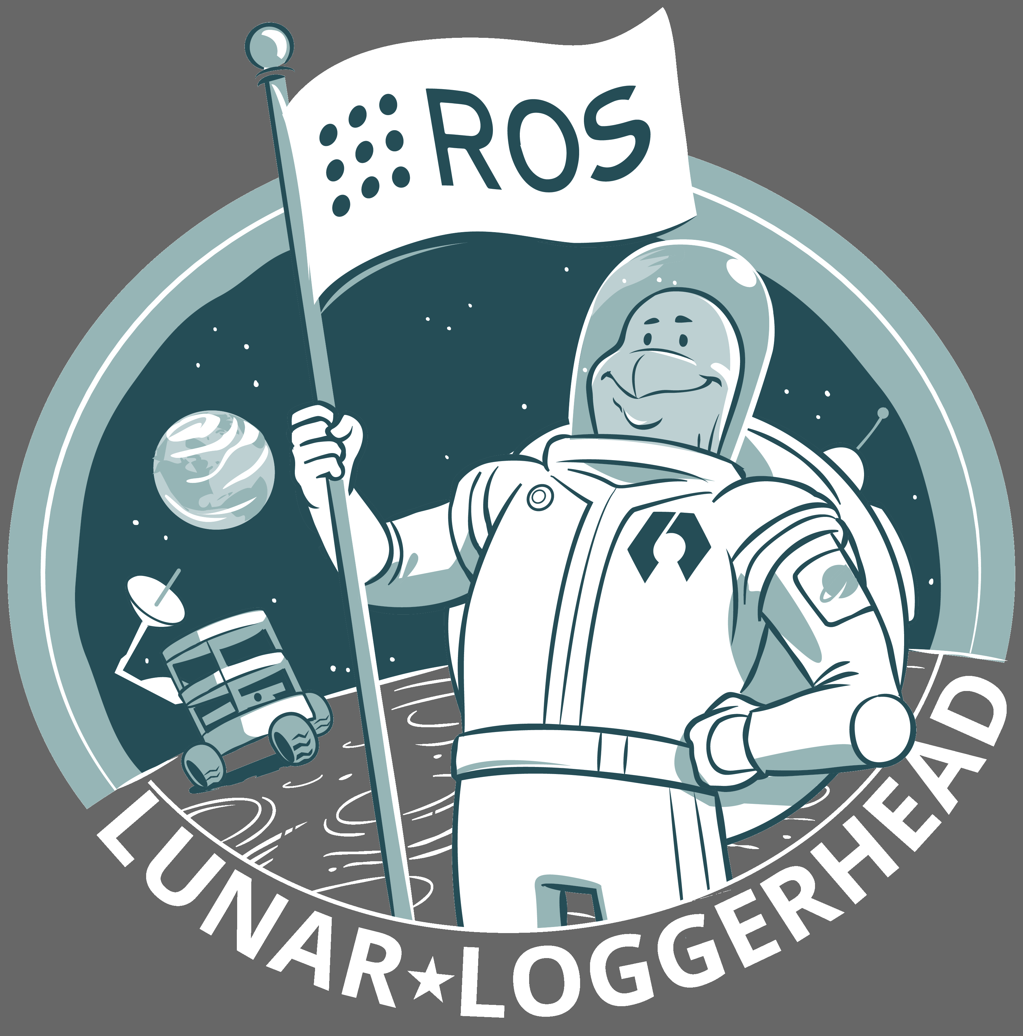
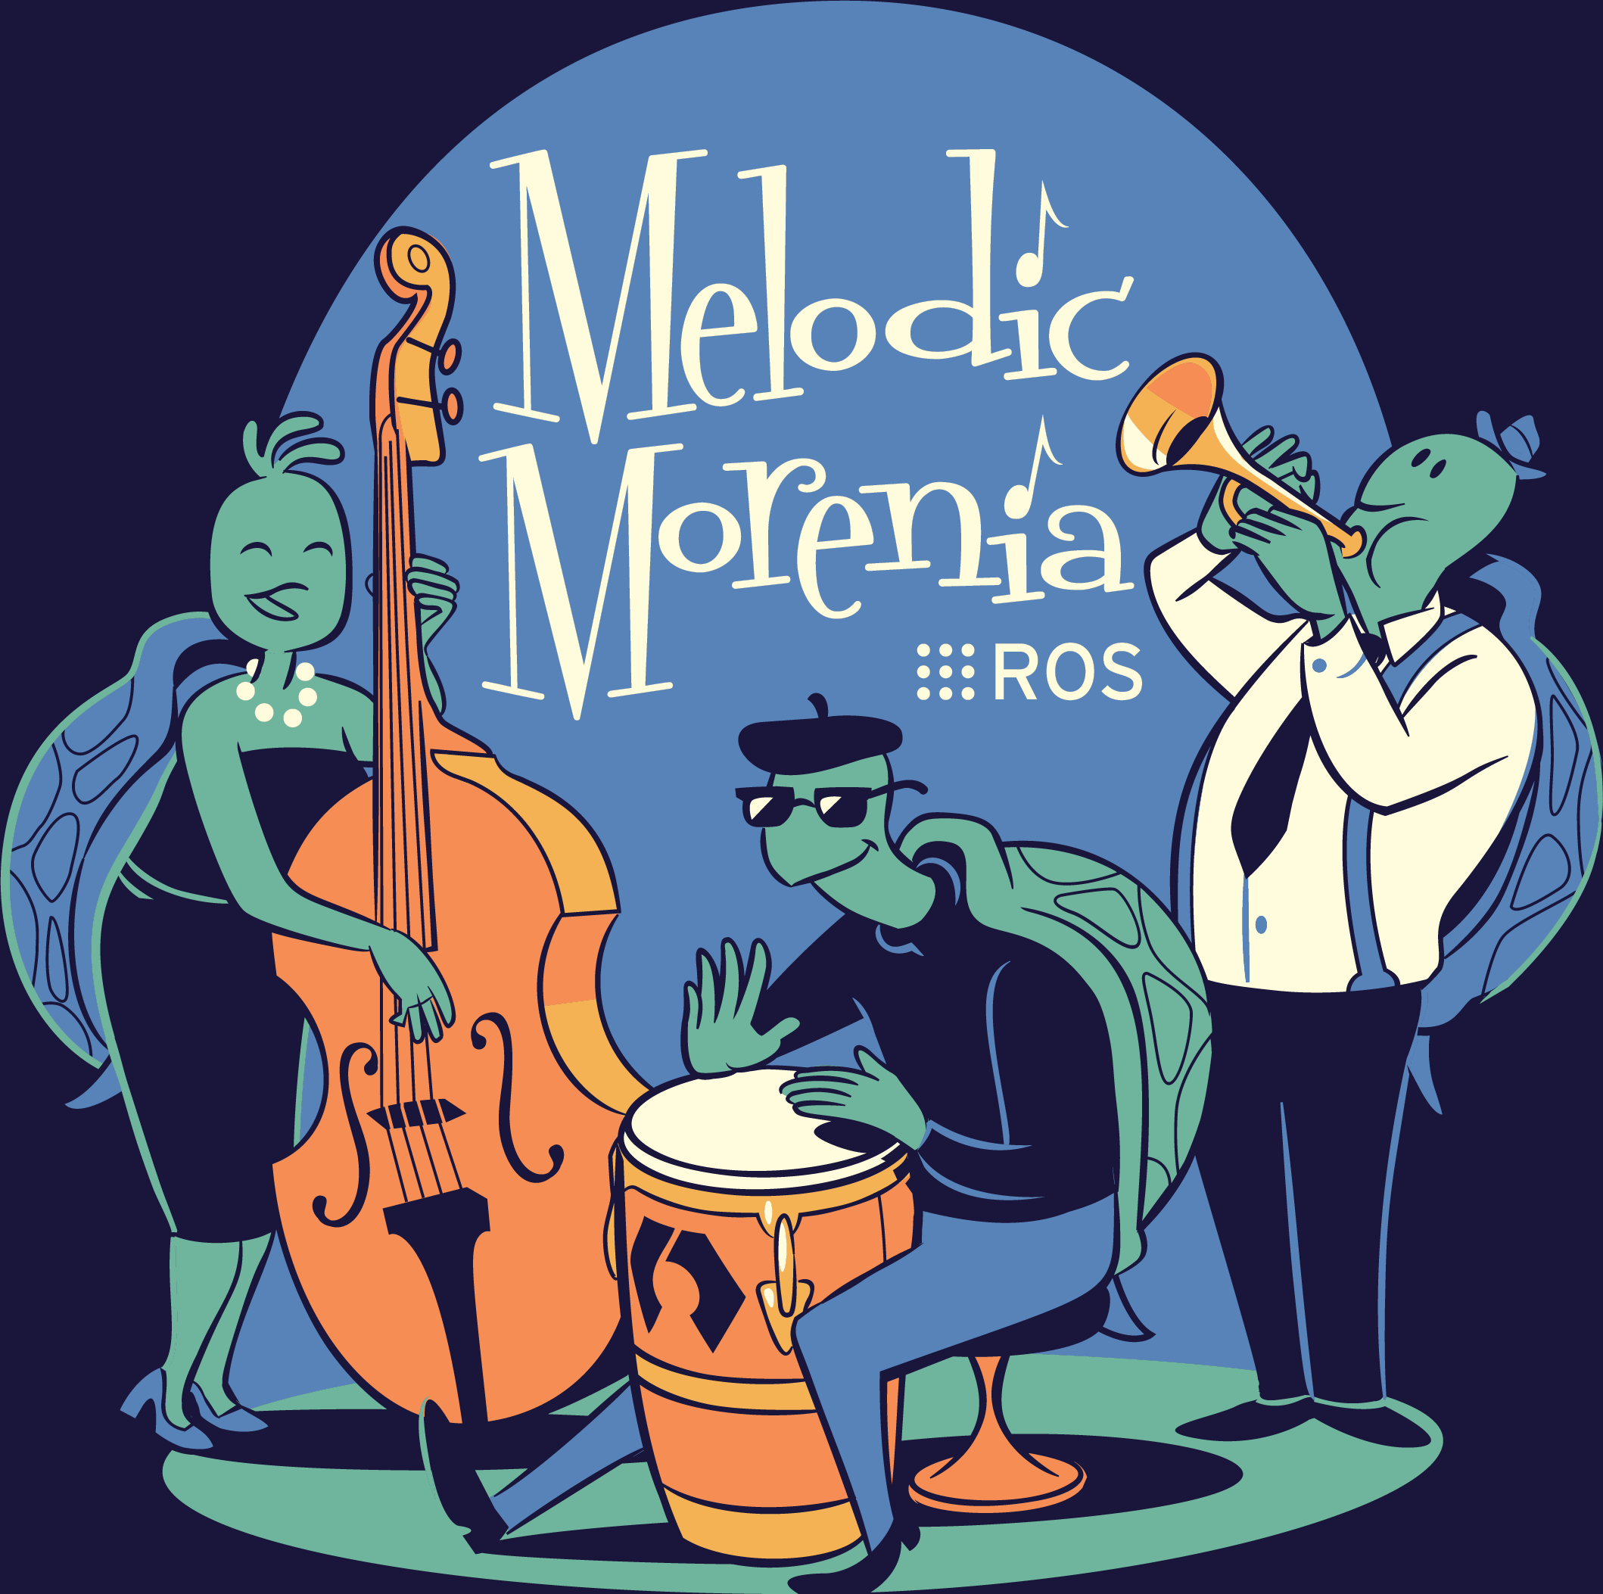
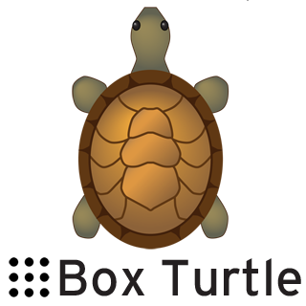
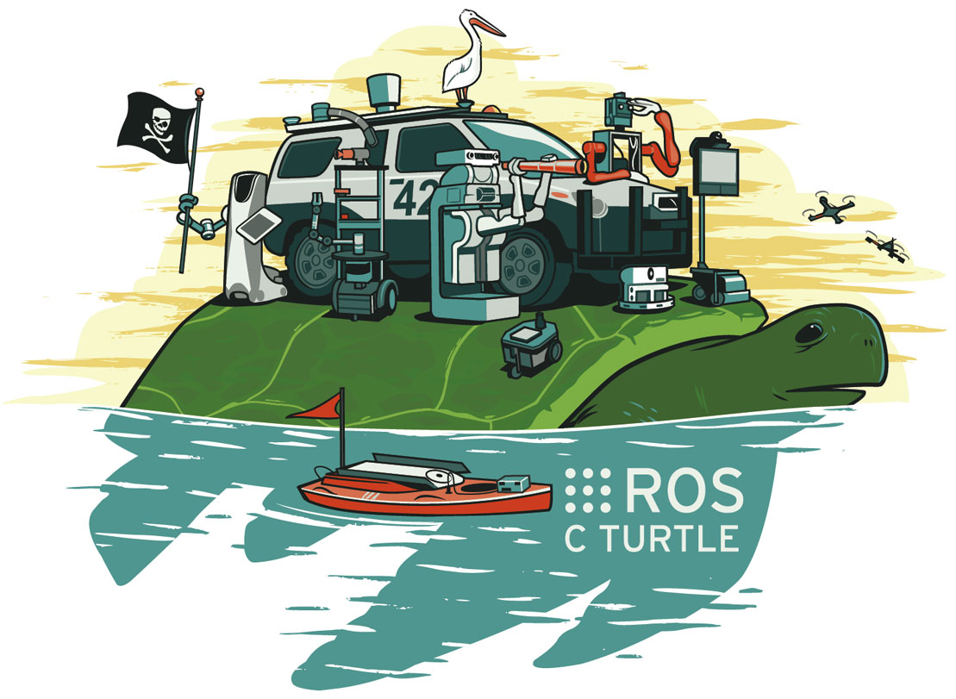
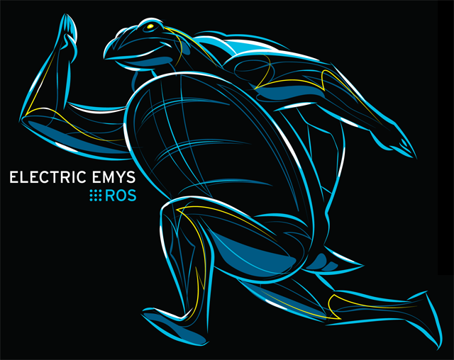
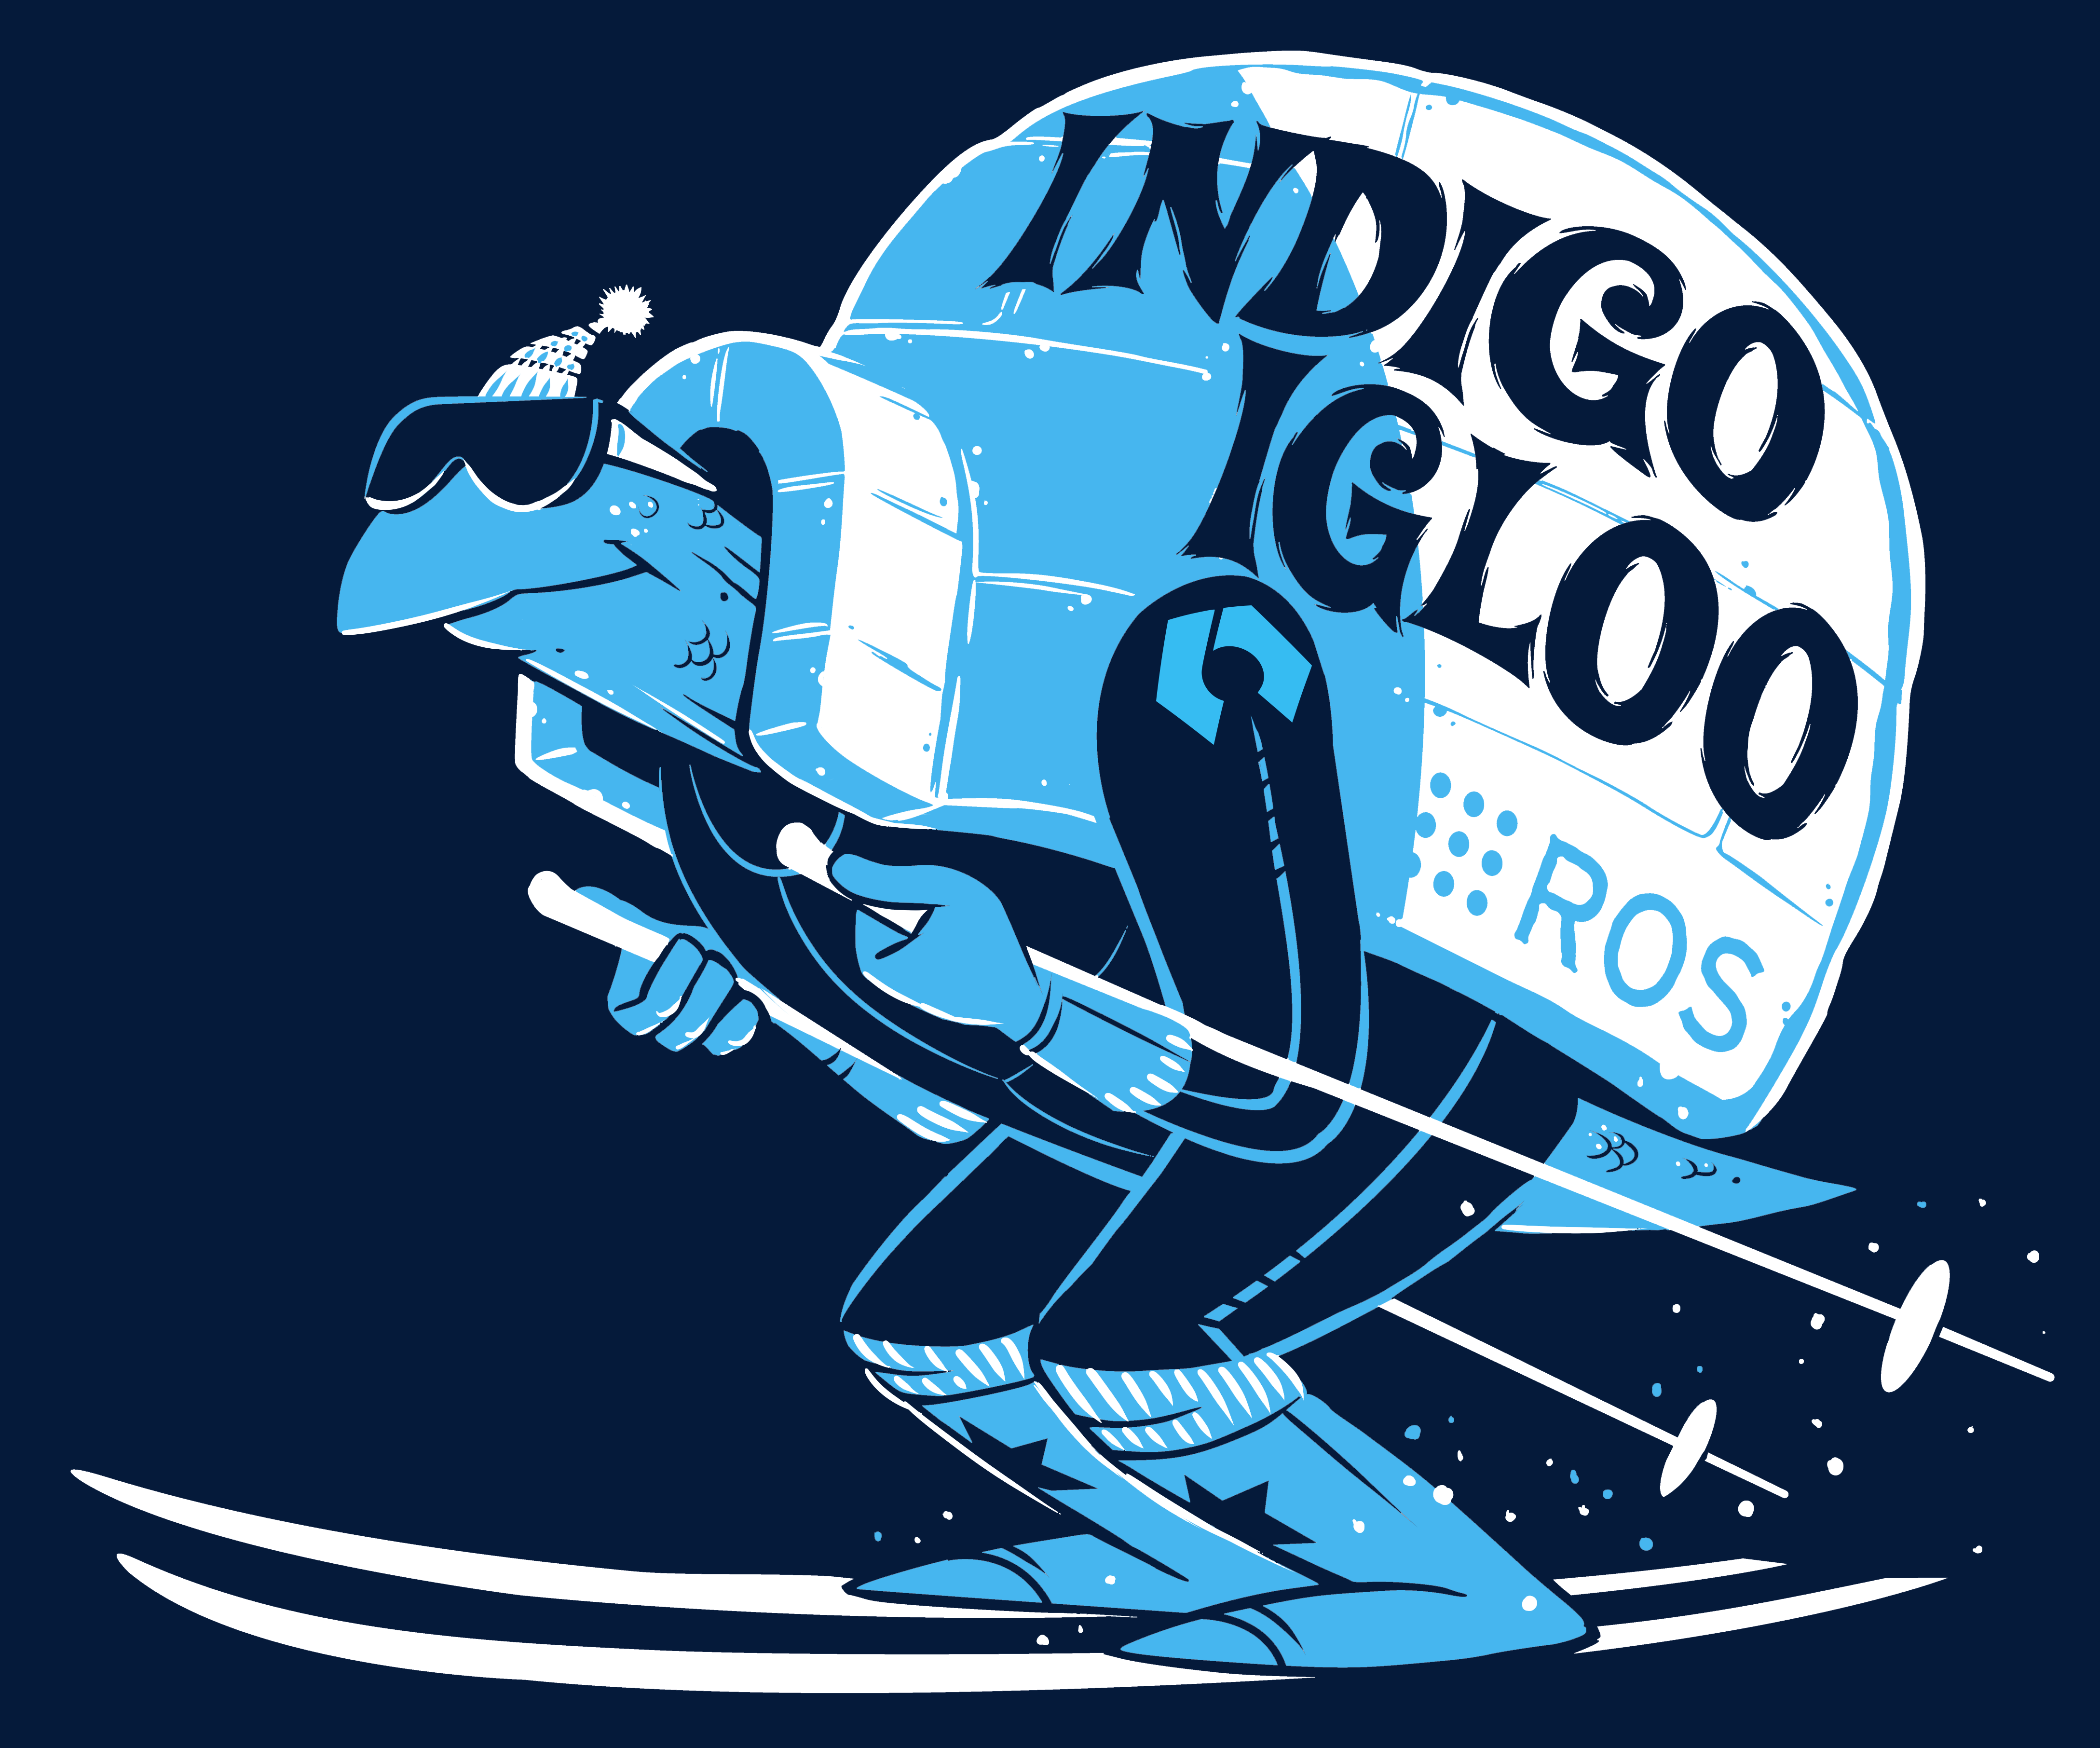
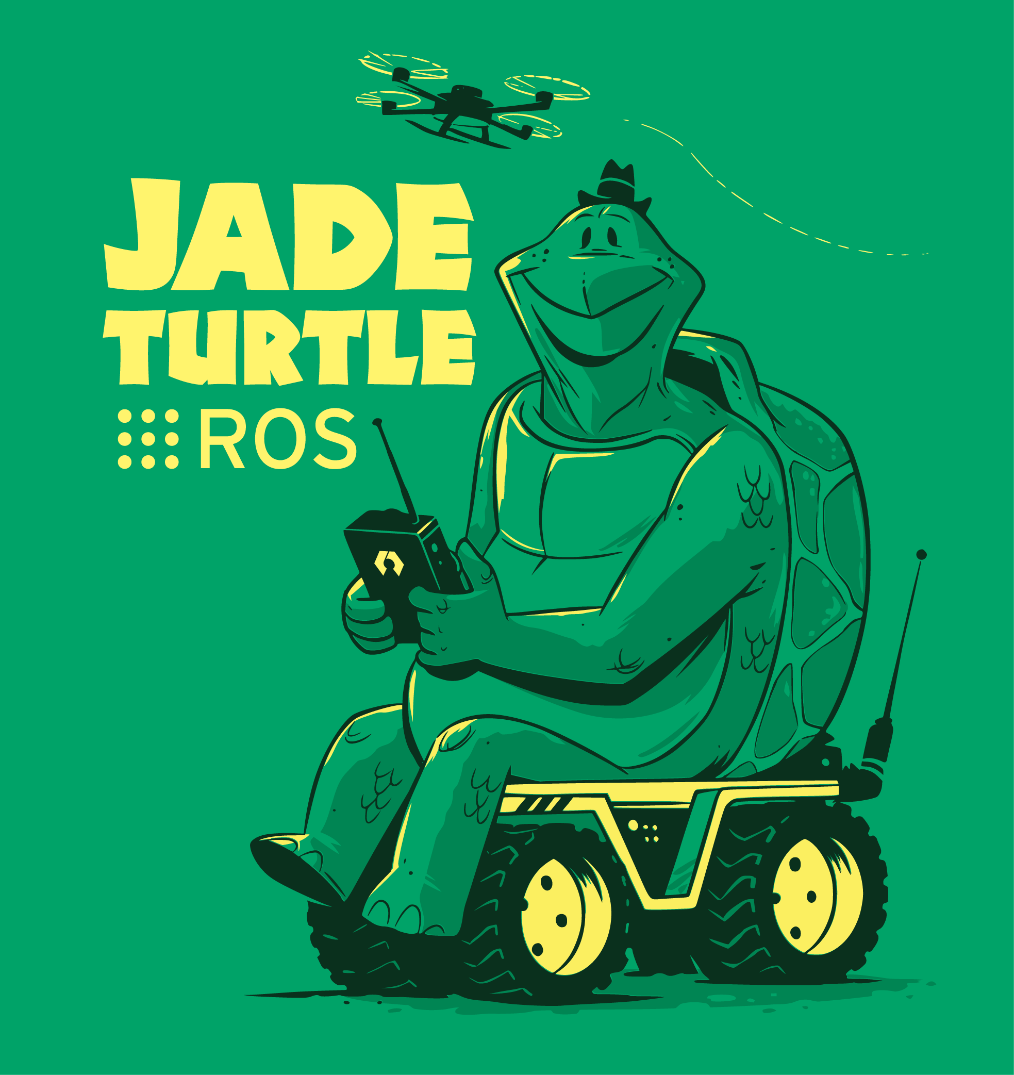
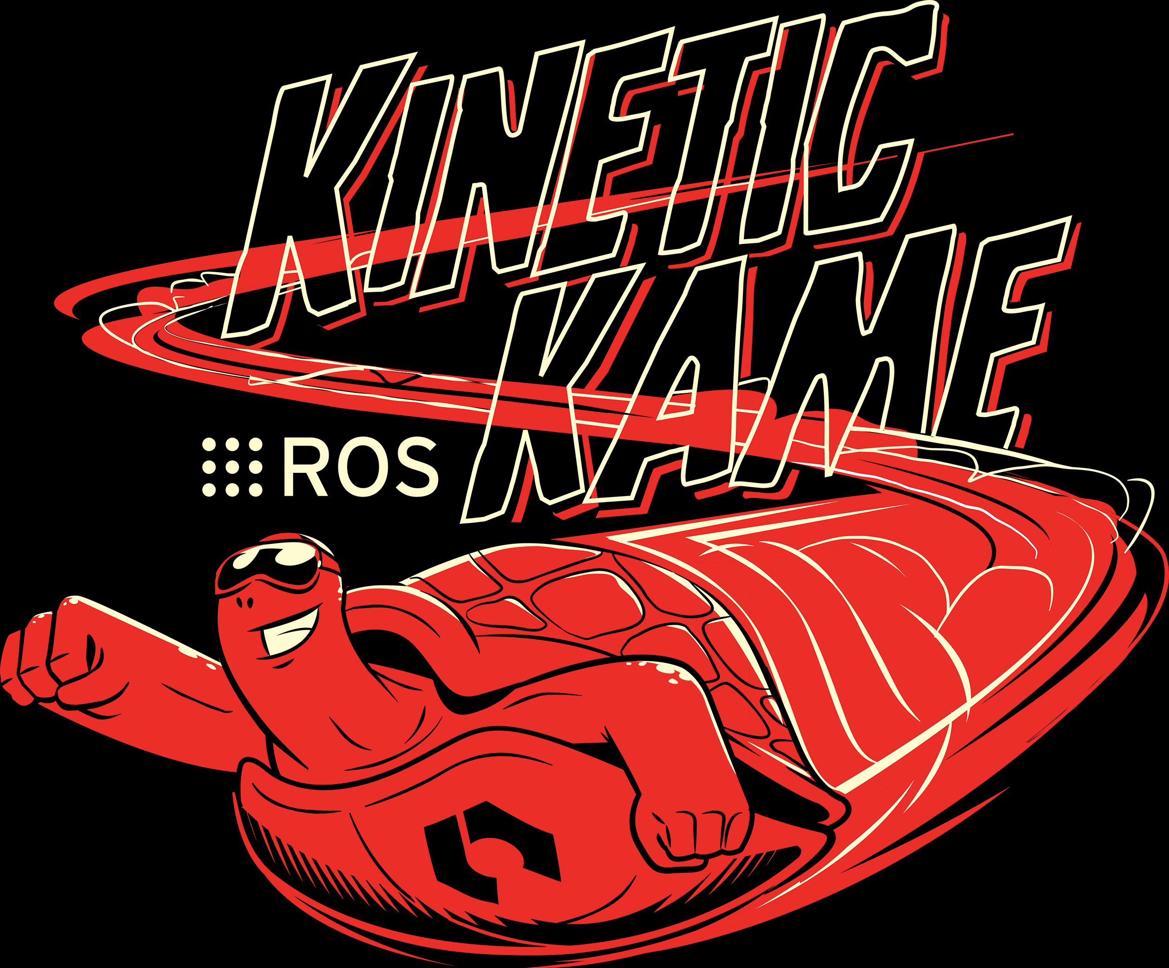
ROS Versions
ROS distributions (versions) are launched in alphabetic order.
Current version: Melodic Morenia
2007 | 2010.01 | 2010.03 | 2010.08 | 2011.03 | 2011.08 | 2012.04 | 2012.12 | 2013.09 | 2014.07 | 2015.03 | 2016.05 | 2017.05 | 2018.05
Switchyard | ROS 1.0 | Box Turtle | C Turtle | Diamondback | Electric Emys | Fuerte Turtle | Groovy Galapagos | Hydro Medusa | Indigo Igloo | Jade Turtle | Kinetic Kame | Lunar Loggerhead | Melodic Morenia
 | Currently supported version
Notes:
Here are some of the release rules of ROS:
There should be a new ROS release each May.
Release on even-numbered years is an LTS release ( 5-year support).
Release on even-numbered years is a normal release ( 2-year support).
As a result, each ROS release is supported on exactly one Ubuntu LTS release.
ROS uses the symbol of a turtle, which stemmed from the educational programming language Logo developed back in the 1960s.

Slide 6
Why ROS?
As robotic systems continue to grow, software development for a robot has become very complex.
A full stack starts from low-level hardware drivers all the way up to perceptions and artificial intelligence.
Code reusability has soon become an issue since software developed for different frameworks, which are designed for different purposes, can hardly be reused.
Notes:
A robot is a complex system. Imagine to design a new robot from scratch, the software stack needs to include the low-level hardware drivers all the way up to computer visions and artificial intelligence algorithms.
The lack of a common platform makes it difficult to reuse what has already been done from other projects. This is why a unified platform like ROS is urgently needed for everyone to develop robotics projects.

Slide 7
Characteristics of ROS
The architecture was initially developed at Stanford and Willow Garage to address large-scale service robots and since has become generic.
Peer-to-peer topology: multiple processes run by several hosts are connected concurrently at runtime; onboard and offboard computers are networked so that heavy computations (e.g., computer vision and speech recognition) can be done remotely.
Multilanguage support: the ROS messaging system is developed to support various programming languages including C++ and Python. Cross-language development is the norm.
Modularized tools: microkernel design
Easy code extraction: ROS encourages drivers and algorithms to be developed in standalone libraries without dependencies on ROS. This allows for better code reuse from ROS to other opensource projects and vice versa.
Notes:
ROS is one of many so-called robotics software frameworks. But several attributes make it stand out.
First, ROS was designed for large robotic systems from the very beginning. Second, different components of the robot work in a distributed network and employ a messaging mechanism to achieve communication within the network.
Next, ROS supports multi-language development, mainly C++ and Python. The ROS modules are packaged so that each of them can be easily extracted and reused for other ROS or non-ROS projects. One of the core advantages of ROS is the support for collaborative development, which means developers can all update their own packages at their own schedule.

Slide 8
ROS Packages
ROS applications (including ROS itself) are organized into “packages”. This is to support collaborative development.
At a minimum, an ROS package requires a directory with an XML file describing itself and its dependencies.
A typical ROS package will contain source files, executable files and other supporting files.
Formation of a large eco-system
>2700 packages for ROS Indigo
>2300 packages for ROS Kinetic
Notes:
Like the smartphone industry, development of robotics also requires joint force from software and hardware developers. Although a large ecosystem is yet to form, ROS seems to have already attracted a lot of attention, as more and more packages are developed in ROS for hardware and software. A skeleton ROS package only requires a directory with an XML file describing itself and its dependencies. A typical ROS package will contain source files, executable files, and other supporting files. As of the end of 2018, more than 2000 packages have been developed for ROS Indigo and Kinetic.

Slide 9
Components of ROS
Notes:
This figure shows an overview of some of the most important components of ROS.
At the bottom is a hardware layer that interfaces with hardware components such as sensors, motors, and controllers.
The communication layer is in charge of data transmission and reception.
The robotics application layer consists of key service applications based on the robotics application framework.
On the top is the client layer, which supports multiple development languages.
ROS also come with simulation tools such as Gazebo and software development tools such as Rviz and rqt.
Many software components in ROS are borrowed and reused from other open-source projects. For example, drivers, navigation, and simulator from the Player Project; vision from OpenCV, and planning from OpenRAVE.

Slide 10
Client Libraries
Although ROS nodes can be developed in many languages, the main focus is to provide robust support on two:
roscpp: C++ client library, optimized for performance
rospy: Python client library, object-oriented, prioritizes development time over runtime performance
Other libraries:
roslisp
roscs
Rosjava
Rosgo
rosR
…
Notes:
ROS offers client libraries for many programming languages. Although the major focus is to support C++ and Python, libraries for lisp, c#, java, GO, and R are also available.

Slide 11
Catkin Build System
ROS uses catkin as its build system.
Catkin is based on Cmake (cross platform make).
The build environment is described in the “CMakeLists.txt” file in each package’s folder.
Catkin is in favor of rosbuild in that it makes it easy to manage packages and solve dependencies.
Notes:
Catkin is the dedicated Cmake-based build system for ROS. Cmake stands for “cross platform make”; therefore, ROS can be built on multiple platforms. A “CMakeList.txt” file is needed to describe the build environment. Catkin replaces Rosbuild since ROS Groovy.

Slide 12
Graph Resource Names
“Graph Resource Names provide a hierarchical naming structure that is used for all resources in the ROS computation graph, e.g., nodes, parameters, topics, and services.”
Each resource belongs to a namespace. Resources can create resources within their own namespace. They can also access resources under other namespaces.
Global names:
Start with “/”, are fully resolved, and shouldn’t be used too often to improve code portability
E.g., /turtle1/color_sensor
Relative
Relative names are resolved by attaching the relative name to the current default namespace.
E.g., cmd_vel in namespace /turtle1 is resolved as /turtle1/cmd_vel.
Private
Start with “~”. Private names do not specify their namespace fully. Instead, they use their node’s name as a namespace. Often used for setting parameters
E.g., ~robot1/motor1_vel in /mySystem/node1 is resolved as /mySystem/node1/robot1/motor1_vel
Notes:
In ROS, concepts such as nodes, parameters, and topics are called resources. They combine to form a so-called graph, which is a graphical representation of message communications in ROS and is useful when visualizing this distributed network of robotic systems.
Resources need to have names and all belong to a namespace. The naming hierarchy can be understood as follows:
Global names start with a “/” (forward slash). As they are global, they should be unique to avoid conflicts. One should avoid using global names too often, as this will reduce code reusability.
Relative names can be resolved by attaching them to the current namespace. For instance, cmd_vel in namespace /turtle1 is equivalent to the global name /turtle1/cmd_vel.
Lastly, names that start with a “~” (tilde) are private. Their namespace follows that of the node’s.

Slide 13
Controller
The controller manages 1) node-to-node connection information and 2) message communication between nodes.
The controller provides a name server for each node to look up names.
The target nodes can register their own information or request other nodes’ information by accessing the controller.
XMLRPC is used as the protocol between controller and nodes.
Controller
Node information
Node information
Node 1
Node 2
Connection information
Notes:
When a name is created, it’s recorded to the controller.
A controller is essentially a name server that registers the information about all the nodes and their connections along with all message communication among them.
The nodes can register their own information or request other nodes’ information by accessing the controller.
XML-Remote Procedure Call, or XMLRPC is used as the communication protocol between a controller and a target. Since XMLRPC is lightweight and does not maintain connectivity, it’s suitable for a large-scale robotic system. XMLRPC is widely supported by various programming languages.

Slide 14
Node
Node is an executable program that performs computation in ROS.
/LaserScan
Laser Distance Sensor
SLAM
Node 2
Node 3
/odometry
/LaserScan
Wheel Motor
Control
Navigation Stack
Node 1
Node 4…N
/cmd_vel
Notes:
A node can be thought of as the minimum unit of an executable program in ROS. Each node runs some task. A typical ROS usually consists of many nodes that are running in parallel at runtime across multiple hosts. For example, as shown in this graph, the system consists of multiple processes. Each is represented by a node or a group of nodes. Node 1 controls motor speed and it gets the velocity value from the navigation stack, which is a group of nodes. Node 2 gets the data from the laser distance sensor and broadcasts it as a LaserScan message. The SLAM node subscribes to the LaserScan and odometry messages to map the environment and locate the robot. Finally, the navigation node gets the mapping information from the SLAM node and odometry from the motor sensor and calculates the route and sends the velocity command back to the motor controller.

Slide 15
Message
Messages are simple data structures that pass information between different nodes.
Strictly typed data type
Supports standard primitive types, e.g., integer, float, Boolean
Can be made of other messages
Supports arrays
Notes:
A message is a data structure that is used to pass information between different nodes.
ROS message can contain most of the major data types such as integer, float, or Boolean. Messages can also be nested to contain other messages or message arrays.

Slide 16
Message: Built-in Types
Primitive Type | Serialization | C++ | Python2 | Python3
bool | unsigned 8-bit int | uint8_t | bool
int8 | signed 8-bit int | int8_t | int
uint8 | unsigned 8-bit int | uint8_t | int
int16 | signed 16-bit int | int16_t | int
uint16 | unsigned 16-bit int | uint16_t | int
int32 | signed 32-bit int | int32_t | int
uint32 | unsigned 32-bit int | uint32_t | int
int64 | signed 64-bit int | int64_t | long | int
uint64 | unsigned 64-bit int | uint64_t | long | int
float32 | 32-bit IEEE float | float | float
float64 | 64-bit IEEE float | double | float
string | ascii string (4) | std::string | str | bytes
time | secs/nsecs unsigned 32-bit ints | ros::Time | rospy.Time
duration | secs/nsecs signed 32-bit ints | ros::Duration | rospy.Duration
Notes:
This table shows the built-in data types for messages. And their corresponding C++ and Python data types are given.

Slide 17
“std_msgs”: ROS Standard Message Package
Bool
Byte
ByteMultiArray
Char
ColorRGBA
Duration
Empty
Float32
Float32MultiArray
Float64
Float64MultiArray
Header
Int16
Int16MultiArray
Int32
Int32MultiArray
Int64
Int64MultiArray
Int8
Int8MultiArray
MultiArrayDimension
MultiArrayLayout
String
Time
UInt16
UInt16MultiArray
UInt32
UInt32MultiArray
UInt64
UInt64MultiArray
UInt8
UInt8MultiArray
Notes:
ROS also provides a “std_msgs” (standard messages) package for the common message types. These are essentially wrappers for the primitive messages with the addition of some special message types such as color and empty message.
The header type is useful when setting frame IDs for libraries such as tf for coordinate transformation.

Slide 18
“msg” File
Format:
An example message file:
Fieldtype1 fieldname1
Fieldtype2 fieldname2
Example.msg
time stamp
uint32 data
Notes:
Now, let’s look at the general format of a message file. It simply consists of a field type and a field name. For instance, reading from a sensor can be passed in a message with the time stamp and the 32-bit data field.

Slide 19
Topic
Topic is a mechanism of passing messages between nodes in ROS
A node can publish a message to a given topic.
A topic can be subscribed by multiple nodes.
Multiple nodes can publish to a single topic.
A single node can publish and subscribe to multiple topics.
Unidirectional, asynchronous, continuous
Publisher A
Topic A
Subscriber A
Publisher B
Topic B
Subscriber B
Notes:
Now let’s introduce a very important concept in ROS: topic.
Multiple nodes can publish messages to a given topic. These nodes are called publishers.
A topic can also be subscribed by multiple nodes, which are called “subscribers”. A single node can also subscribe to several topics.
Communication using topics is unidirectional and continuous. It is also asynchronous.

Slide 20
Topic
/LaserScan
Laser Distance Sensor
SLAM
Node 2
Node 3
/odometry
/LaserScan
Wheel Motor
Control
Navigation Stack
Node 1
Node 4…N
/cmd_vel
Notes:
For example, in our previous illustration of the node structure, Node 1 is a publisher that publishes data to the odometry topic. It’s also a subscriber of the cmd_vel topic, as it receives motor velocity data from other nodes.

Slide 21
Service
Service is requested by a client and responded to by a server.
Synchronous
Bidirectional
One to one
A certain service can only be advertised by one node.
Request
Client
Server
Response
Notes:
Similar to the topic, a service is another mechanism used to exchange messages. But a service is synchronous, bidirectional, and one to one.
A node that requests a service is called a client. The node that delivers the service is called a server.

Slide 22
“srv” File
Composed of both request message and response message
example.srv
int64 a
int64 b
---
Int64 sum
Request
Response
Notes:
Let’s take a look at a simple service message file. The request and the response are separated by a delimiter. The client node can use this service message to request a summation of two integer numbers.

Slide 23
Useful Commands
Command | Description | Example
roscore | Launch the controller and parameter server | roscore
roscd [PACKAGE_NAME] | Navigate to the directory of an ROS package | roscd turtlesim
rosrun [PACKAGE_NAME] [NODE_NAME] | Execute one or more nodes | rosrun turtlesim turtlesim_node
roslaunch [PACKAGE_NAME] [LAUNCH_FILE_NAME] | Execute multiple nodes in a specified package | roslaunch hls_lfcd_lds_driver hlds_laser.launch
rostopic [OPTION][TOPIC_NAME] | Topic-related commands, e.g., list all the topics (list), show the content of a message in real time (echo), show the information of a topic (info) | rostopic list rostopic echo /turtle1/pose rostopic info /turtle1/pose
rospack [OPTION][PACKAGE_NAME] | Package-related commands, e.g., show the package location (find), list a package’s dependencies (depends), list all other packages that depend on a specific package (depends-on), re-index the package folder | rospack find turtlesim rospack depends turtlesim rospack depends-on turtlesim rospack profile
catkin_create_pkg [PACKAGE_NAME] [DEPENDENCY_PACKAGE1] [DEPENDENCY_PACKAGE 2] ... | Create an empty package | catkin_create_pkg my_pacakge rospy std_msgs
catkin_make [option] | Build a package or packages in catkin build system | catkin_make --pkg my_package
Notes:
Finally, let’s look at some useful commands in ROS. The roscore command launches the controller and parameter server. The rosrun command can be used to run one or more nodes. The roslaunch command can be used when launching multiple nodes in a specified package, which are usually listed in a launch file. Rostopic commands are used for operations on topics. For example, “rostopic list“ lists all the topics in the current system, and “rostopic echo” shows the content of the message for a specific topic. The rospack command offers operations on the ROS packages. For instance, “rospack find” helps locate a package.
The catkin_create_pkg command creates an empty template package for users to fill the information and add necessary files. Finally, the “Catkin_make” command is used to build one or all packages.

Slide 24
Summary
ROS is an open-source meta-operating system for robotic systems.
Peer-to-peer, multilingual, modularized
A node represents the minimum unit of executable program in ROS.
Nodes pass information to each other using messages.
Common messaging methods include topic and service.
The controller manages the node-to-node connection information and message communication between nodes.
Notes:
Now, let’s summarize what we have learnt so far.
ROS is an open-source meta-operating system for robotic systems. It is becoming popular because it is peer-to-peer, multilingual, and modularized.
A node in ROS represents the minimum unit of executable program in ROS. Nodes pass information to each other using messages. Common messaging methods include topic and service.
The manages the node-to-node connection information and message communication between nodes. controller

