Slide 1
Simultaneous Localisation and Mapping (SLAM)
Notes:
Hello and welcome! In this video, we will look at Simultaneous Localisation and Mapping operation, otherwise known as SLAM in robotic systems.

Slide 2
Module Syllabus
Overview
Uncertainties in robotics
Probabilistic robotics
Mapping
Navigation
Notes:
We will go through the uncertainties in robotics, which brought up the topic of probabilistic robotics with some fundamental algorithms. Finally, we will look at some techniques used in mapping and navigation.
We will first present an overview of the problem that SLAM operation tries to address.

Slide 3
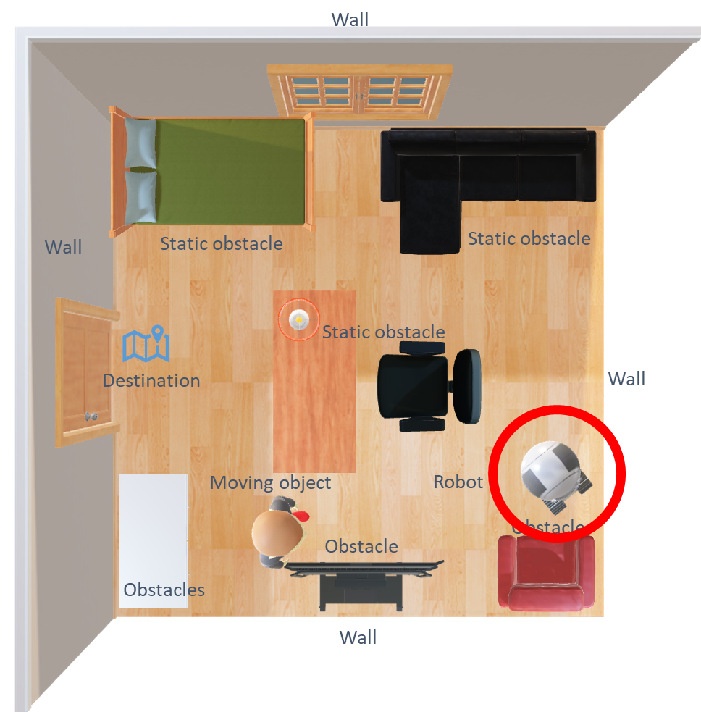
Overview
Problem:
how can a robot navigate itself in a strange environment?
Notes:
A central problem to solve in autonomous robotics is the ability to navigate in unfamiliar environment. That is, regardless of its position, the robot will be able to navigate to a specified destination.
The robot must become familiar with its environment to be able to navigate it. In addition, the robot must determine its position in the environment and its pose.

Slide 4
Overview
Problem:
how can a robot navigate itself in a strange environment?
Step 1:
Mapping
Step2:
Localization
Navigation
Notes:
The task can be broken down into the following steps: mapping, localization, and navigation.

Slide 5
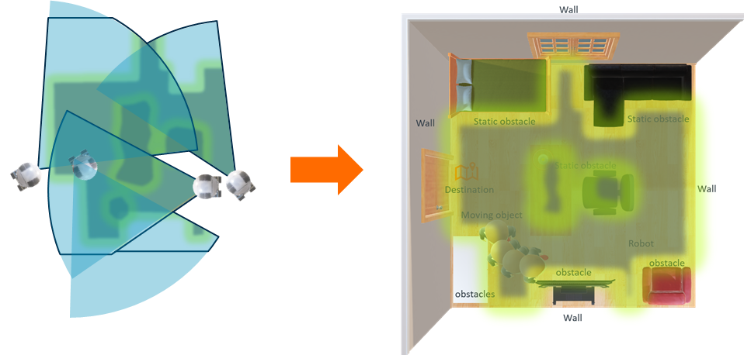
Step 1: Mapping
Mapping is the process by which the robot model its environment.
The robot senses its environment in order to map it
Laser sensors (e.g., LDS, LRF, LiDAR),
Vision sensors (e.g., various cameras)
Depth sensors (e.g., RealSense, Kinect, Xtion)
Ultrasonic sensors, Infrared sensors
The robot must be able to estimate its position w.r.t its environment during mapping.
Notes:
The robot needs a map of the environment to be able to navigate it conveniently. A map can be saved beforehand in the memory or can be constructed on the fly.
By using various types of sensors, a robot can model its environment which can later be used to aid navigation. The mapping process can either be done autonomously or under the control of someone remotely. In both cases, the robot moves around and scans the area to form a complete map.

Slide 6
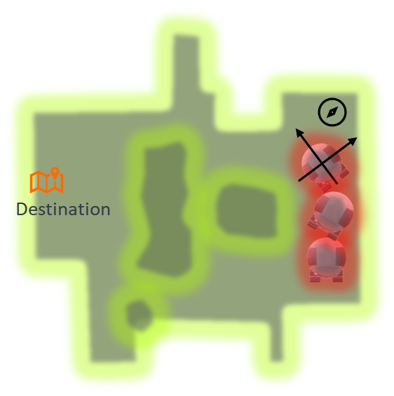
Step 2: Localization
Localization is the process of estimating the robots position in its environment
The location and orientation of a robot are called “pose”.
Without a GPS signal, the robot can still estimate its “pose” using “dead reckoning” based on its past location, wheel speed, sensor readings, and time elapsed.
Accurate positioning can be achieved using statistical methods such as a particle filter.
Localization
Notes:
Once a map has been obtained, the robot will need to locate itself on the map. The robot needs to know not only its own current location, but also its orientation, which is essential when used to estimate its next location.
The location and orientation combined is often called the “pose” of a robot. In more complex robotic systems, the state of each joint and sensor are also recorded to estimate a robot’s pose more accurately.
As GPS tends not to work well inside the building, the robot uses various sensors to best estimate its pose. This is a continuous process, as the robot keeps calculating its new position based on the integration of any movement in the elapsed time to its last location in the map. The method is known as “dead reckoning”. Of course, sensors or motor encoders can have errors. Thus, robust localization requires advanced techniques such as a particle filter.

Slide 7
Simultaneous Localization and Mapping (SLAM)
Which comes first?
estimate of the robots “pose” or mapping its environment?
SLAM:
Robot simultaneously tracks its position and while mapping an unknown/known environment.
Estimate of the robots “pose” and mapping its environment are mutually dependent.
SLAM algorithms include
Particle filter, Extended Kalman filter, Graph SLAM, etc
These slam algorithms help the robot estimate its position within the map during navigation.
Notes:
The robot needs a map to localise itself and a robot cannot acquire a map of its environment without a good estimate of its location. Therefore the question of which comes first localisation or mapping makes SLAM operation complex.
Both mapping and localisation operations are mutually dependent and SLAM aims to simultaneously perform both operations.
There are different algorithms aimed at addressing the SLAM problem such as extended Kalman filter-based algorithms, Particle Filter, GraphSLAM, etc. These algorithms aid the robot to calculate the “belief” that a robot has about the environment states, including its own state. More on SLAM algorithms when we discuss Approximations of Bayes Filter

Slide 8
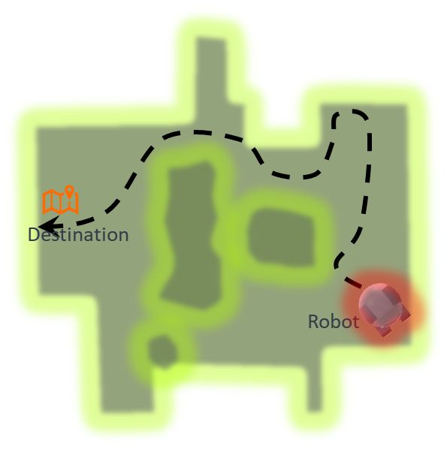
Step 3: Navigation
Finally, the robot needs to plan the route given all the information acquired from the above methods.
Path search and planning algorithms (e.g., A*, potential field, particle filter, and RRT)
Navigation
Notes:
After the robot accurately locates itself in the map, planning and search algorithms can be applied to find the best route to avoid all the obstacles to reach the destination.

Slide 9
Uncertainty in Robotics
Uncertainty
Notes:
Now that we have briefly looked at the navigation problem, let’s pause for a bit and look at the general robotic system from the high level. This will help us understand an important method to deal with complex robotic systems.
Let’s first introduce the concept of uncertainty.
From a robotic arm in a factory’s assembly line, to a disaster recovery robot or a self-driving car on the road, robotic systems are built to deal with different levels of uncertainty. This uncertainty can come from different sources. We outlined five major sources of uncertainty here.

Slide 10
Uncertainty in Robotics
Environment
Uncertainty
Notes:
First, the environment surrounding the robot can be highly dynamic, for example, a room where its content is being moved around from time to time or a street occupied by different shops, pedestrians, or cars.

Slide 11
Uncertainty in Robotics
Sensor
Environment
Uncertainty
Notes:
Second, the sensors on the robot, governed by laws of physics, can only detect what they can detect. For example, a camera cannot see through a wall, and all sensors’ data comes with error and noise, which affect the perception of the robot.

Slide 12
Uncertainty in Robotics
Sensor
Environment
Uncertainty
Model
Notes:
Third, the model can generate uncertainties. Since all models are abstractions of the real world, they are intrinsically inaccurate, for example, the motion model of a robot.

Slide 13
Uncertainty in Robotics
Sensor
Environment
Computation
Uncertainty
Model
Notes:
Next, computation generates delays. In order to achieve sound real-time response, algorithms usually sacrifice accuracies and take approximations.

Slide 14
Uncertainty in Robotics
Sensor
Environment
Computation
Uncertainty
Model
Robot
Notes:
Lastly, the robot itself is also a source of uncertainty. The motors and actuators have wear and tear and can become less accurate over time.
As you can see now, a robot can actually never be 100% sure about its own state (for example, its location) or the surrounding environment (for example, the map) because of the aforementioned uncertainties. Fortunately, we can represent uncertainties mathematically using probability, and this is brings us to our next topic.

Slide 15
Probabilistic Robotics
Explicitly represent uncertainties in forms of probability distribution over a whole space of hypotheses
Think about a localization problem: a robot is randomly placed at a location. How would the robot quickly locate itself and navigate, given that the global map is stored in the robot’s memory?
Prior Belief
Notes:
Probabilistic robotics is a way of dealing with uncertainties and unpredictability in robotic systems with the help of probability. A robot’s state is no longer a single estimation, but rather, a distribution of all possibilities. Let’s take a brief look at how this works. As illustrated in this figure, a robot is placed in a main tunnel. Assuming a map has previously been saved, the robot needs to locate itself. Since the robot has no clue where it is at the moment, it’s fair for it to assume a uniform probability across the whole landscape since the robot can be anywhere in the map. We also describe this probability of location as the “belief”.

Slide 16
Probabilistic Robotics
Explicitly represent uncertainties in forms of probability distribution over a whole space of hypotheses
Think about a localization problem: a robot is randomly placed at a location. How would the robot quickly locate itself and navigate, given that the global map is stored in the robot’s memory?
Current Belief
Notes:
As the robot moves along the main tunnel, the sensors detect the entrance to another tunnel. According to this observation and comparing it to the pre-stored map data, the robot adjusts its current belief so that it’s more probable to be located near the entrances to one of the three tunnels. Up to now, the robot cannot distinguish between different tunnels. Note, there’s still a non-zero probability everywhere else. This is because there’s a chance that the sensor is malfunctioning and the robot is actually not near a tunnel entrance.

Slide 17
Probabilistic Robotics
Explicitly represent uncertainties in forms of probability distribution over a whole space of hypotheses
Think about a localization problem: a robot is randomly placed at a location. How would the robot quickly locate itself and navigate, given that the global map is stored in the robot’s memory?
Prior Belief
Observation
Notes:
As the robot continuous to move, its “belief” propagates along. But the belief is smoothed out gradually to account for any motoring error. As the robot passes a second tunnel entrance, the observation model suggests the robot could again be near one of the three tunnels. The robot multiplies this observation with its previous belief to update the current belief (i.e., a new estimation of its location).

Slide 18
Probabilistic Robotics
Explicitly represent uncertainties in forms of probability distribution over a whole space of hypotheses
Think about a localization problem: a robot is randomly placed at a location. How would the robot quickly locate itself and navigate, given that the global map is stored in the robot’s memory?
Current Belief
Notes:
As illustrated in this chart, the robot is pretty confident that it’s near the second tunnel entrance, since the probability there is the highest.

Slide 19
Probabilistic Robotics
Explicitly represent uncertainties in forms of probability distribution over a whole space of hypotheses
Think about a localization problem: a robot is randomly placed at a location. How would the robot quickly locate itself and navigate, given that the global map is stored in the robot’s memory?
Belief
Notes:
Now, you have seen how a robot can locate itself using probabilities.

Slide 20
Bayes Filter
A Bayes filter is a general algorithm to calculate the “belief” that a robot has about the environment states (including its own state).
For example, it can be used to predict the robot’s position by calculating the probability distribution of all possible positions based on the previous position, latest motor instructions, and sensor readings.
Approximations of a Bayes filter are used for computational efficiency and practicality.
Notes:
A Bayes filter is a general algorithm to calculate the “belief” that a robot has about the environment states (including its own state).
For example, it can be used to predict the robot’s position by calculating the probability distribution of all possible positions based on the previous position, latest motor instructions, and sensor readings.
Approximations of a Bayes filter are used for computational efficiency and practicality.

Slide 21
Bayes Filter Algorithm
Definitions
$$bel\left(x_{t}\right)=p(x_{t}|z_{1:t},u_{1:t})$$
$$\overline{bel}\left(x_{t}\right)=p(x_{t}|z_{1:t−1},u_{1:t})$$
symbol | definition
$$x_{t}$$ | State at time $t$
$$z_{t}$$ | Measurement
$$u_{t}$$ | Control
$$\overline{bel}(x_{t})$$ | Prediction
$$bel\left(x_{t−1}\right)$$ | Prior
$${p(x_{t}|u_{t},x}_{t−1})$$ | Motion model
$$bel\left(x_{t}\right)$$ | Belief
$$η$$ | Normalization constant
Notes:
Before we reveal the Bayes filter algorithm, let’s first define some parameters. x_t is the state variable (for example, it can be a location on the map, or the state that a door is open or closed). Z_t is the measurement, for instance, the sensor readings. U_t is the control on the motors and actuators.
Our primary goal is to calculate the belief at time t. Denoted “bel(x_t)”, the belief is defined as a conditional probability of state x_t given all the past controls and measurements. For example, this could be the probability of the robot being at location x given its wheels have rotated for 30 s and the camera captured a landmark 15 cm away. This is also called the posterior probability. Similarly, /bel (“bel” bar) is defined as the belief before the latest measurement; therefore, it’s interpreted as the prediction. Bel(xt-1) would be the prior probability, as this is the knowledge that the robot possesses before any control and measurement data. We can describe the movement model of a robot as the conditional probability of getting x_t given the control u_t and the past state x_t-1. Finally, eta is a normalization constant that makes sure the probability density sums up to 1.

Slide 22
Bayes Filter Algorithm
Pseudo code:
Bayes_filter($bel\left(x_{t−1}\right),u_{t},z_{t}):$
for all $x_{t}$:
{
$\overline{bel}(x_{t})=\int{p(x_{t}|u_{t},}x_{t−1})bel\left(x_{t−1}\right)dx$
$bel\left(x_{t}\right)=ηp\left(z_{t} | x_{t}\right)\overline{bel}\left(x_{t}\right)$
}
return $bel\left(x_{t}\right)$
Notes:
This slide shows the pseudo code of the Bayes filter algorithm on how to calculate the belief. Note that the Bayes filter is recursive; therefore, it takes the previous belief, the control, and measurement as its input. Then, for all possible outcomes of state variable x_t, the prediction is obtained by convolving the movement model with the previous belief distribution. This is Line 4 in the pseudo code. In the next step, the robot updates its belief by incorporating the measurement with the prediction.

Slide 23
Approximations of Bayes Filter
Algorithms:
Kalman filter
Particle filter
Rao-Blackwellized Particle Filter (RBPF)
For instance, particle filter:
1
2
3
4
5
Initialization
Prediction
Update
Pose estimation
Resampling
Notes:
The Bayes filter algorithm, in general, can be used to calculate posterior probabilities. As mentioned before, approximations of a Bayes filter are used for computational efficiency and practicality for applications such as pose estimation, motion modeling and mapping. Such methods include Kalman filter, particle filter, and Adaptive Monte Carlo Localization. Kalman filters and particle filters are popular algorithms for simultaneous localization and mapping, or SLAM. This diagram illustrates the particle filter for pose estimation. Instead of covering the entire distribution, samples are used. These samples are called particles. A weight is assigned to each particle to reflect the probability. At the initialization stage, since the robot’s pose is not known, a number of particles are random generated with the same weight. At the prediction stage, the particles are moved according to the robot’s motion model as well as the odometry data. In the update stage, the weight of each particle is updated after the sensor measurement, since some of the particles are more probable than the others. An estimation of the pose can be made at this stage. The resampling step is important, as less weighted particles are removed and new particles are generated around the more weighted particles. Steps 2 to 5 are repeated to continuously track the robot. The particle filter is widely used in Monte Carlo Localization.

Slide 24
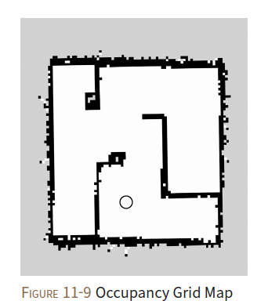
Map
2D occupancy grid map (OGM)
Occupancy probability occ = (255-color)/255. Value 0→not occupied, 1→occupied
The occupancy probability is then converted to an integer between 0 and 100. “-1” means unknown area.
Area is represented as a greyscale value (0-255).
White: free to move
Black: occupied and cannot move
Grey: unknown area
Saved in a .pgm file (map details) and .yaml (map information)
Notes:
Now, let’s take a closer look at the map itself. Shown in the figure is a two-dimensional OGM. This greyscale map reflects the posterior probabilities calculated by the robot, in other words, the environment perceived by the robot. From the greyscale values, the occupancy probabilities can be derived. Ranging from 0 to 1, the larger the occupancy probability, the more likely a space is occupied. The occupancy map is saved in a .pgm file and a .yaml file. The .pgm file contains the map data itself while the .yaml file contains other information about the map, such as resolution, threshold, and origin.

Slide 25
Navigation
Cell value
Occupied area
255
Costmap
Global
Local
Collision area
253-254
Free area
Areas with high collision probability
128-252
Greyscale costmap
Area with low collision probability
1~127
0
Distance from the robot
Green: laser sensor data
Notes:
From the OGM, the robot can calculate a costmap, which evaluates which areas are free for the robot to move. The global costmap sets up a path plan for the robot to move on the static map. The local costmap is used for planning the path to avoid obstacles near the robot.

Slide 26
Route Planning
Trajectory planner
Dynamic window approach (DWA)
Velocity (translational and rotational) search space
Objective function
Notes:
Trajectory planner and DWA are both route planner algorithms. The DWA operates in velocity space. It can select a velocity that quickly navigates the robot to a destination while avoiding obstacles.

Slide 27
Summary
An autonomous robot often needs to break the navigation problem into three tasks: 1) mapping, 2) localization, and 3) navigation.
Since uncertainties can arise from internal/external sources, probabilities are introduced to describe the robot’s inner belief of its environment.
The Bayes filter algorithm is an iterative method to calculate the posterior probabilities.
Approximations of a Bayes filter such as particle filter and Kalman filter are used to solve specific problems in robotics including pose estimation and localization.
Notes:
In summary, in this module, we looked at how a robot can solve the problem of navigating in its environment.
An autonomous robot often needs to break the navigation problem into three tasks: mapping, localization, and navigation.
Since uncertainties can arise from internal/external sources, probabilities are introduced to represent the robot’s inner belief of the environment.
The Bayes filter algorithm can be used to calculate the posterior probabilities.
Approximations of a Bayes filter such as particle filter and Kalman filter are used to solve different problems in robotics such as pose estimation and localization while mapping the environment.

